Slide 1

Hochschule München University of Applied Sciences
Master Thesis Defense
Computational Engineering (M.Sc.)
Heykel Khadhraoui
Fakultät für Maschinenbau Fahrzeugtechnik Flugzeugtechnik
Design and Implementation of a Real-Time Cartesian Impedance Controller for a 7-DOF Collaborative Robot
Contact-induced alignment of a grinding tool with a plane surface
Supervisors: Prof. Norbert Nitzsche · Prof. Ruth Otto
2026

Slide 2
Presentation roadmap
From the contact problem to the measured controller behaviour
1
Motivation and research question
Central question: how can contact-induced rotation be shaped without sacrificing compliant surface contact?
Why angular mismatch at contact needs compliant rotation
2
Controller and CoC formulation
Directional impedance, point shift, torque assembly, null space
3
Implementation and experiments
1 kHz real-time controller, contact sequence, 69 trials
4
Experimental results
Stiffness, CoC direction, commanded wrench, null-space terms
5
Conclusion and next step
Adaptive temporary CoC, then return to TCP
Design and Implementation of a Real-Time Cartesian Impedance Controller
2
Master Thesis - Heykel Khadhraoui

Slide 3
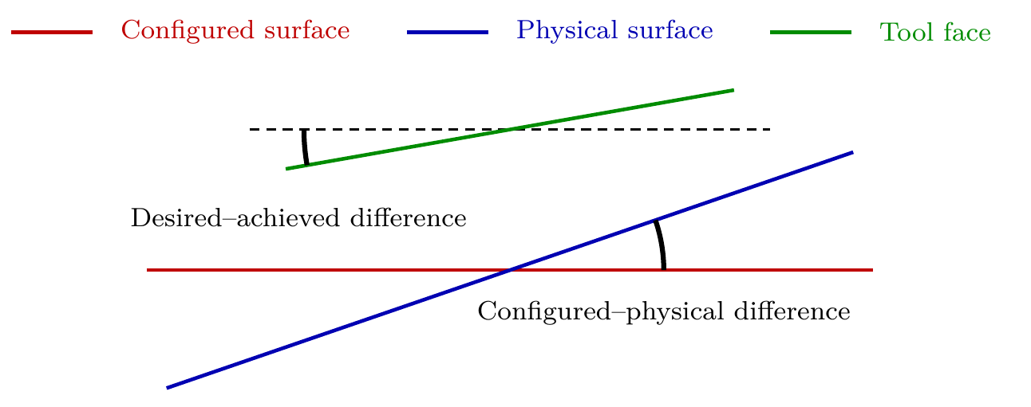
Motivation
Surface entry can contain both reference error and achieved-pose error
Contact problem
• Configured and physical surface normals can differ because of placement and calibration tolerances.
• The achieved tool orientation can differ from the desired orientation before contact.
• Edge- or corner-first contact generates moments; a rigid pose controller opposes the corrective rotation.
• Finite rotational compliance allows the contact interaction to rotate the end effector towards alignment.
Desired behaviour
• Keep the commanded normal press and tangential position retention.
• Allow passive rotation about surface tangents during Contact Establishment.
• Use the virtual CoC only to bias the rotational direction when needed.
The measured quantity is the end-effector rotation generated during Contact Establishment.
Design and Implementation of a Real-Time Cartesian Impedance Controller
3
Master Thesis - Heykel Khadhraoui

Slide 4
Research question and thesis contributions
The experiments isolate stiffness and compliance-centre effects
How do directional Cartesian stiffness and a virtual CoC affect contact-induced tool rotation — and can one fixed non-zero CoC remain useful for both offset directions?
Controller contribution
Experimental contribution
• Real-time Cartesian impedance controller on the Franka Emika Panda.
• Surface-relative translational and rotational stiffness/damping.
• Software-defined virtual centre of compliance displaced from the TCP.
• Projected null-space damping and singular-value conditioning.
• Rotational stiffness, tangential translational stiffness, and CoC position varied in contact.
• Positive and negative initial angular offsets compared about t₁.
• Separate pose-hold experiment isolates the two null-space terms.
• 69 total trials: 57 surface-contact + 12 pose-hold.
Main measured response: γₜ₁ — signed end-effector rotation relative to the held contact-entry orientation.
Design and Implementation of a Real-Time Cartesian Impedance Controller
4
Master Thesis - Heykel Khadhraoui

Slide 5
Controller concept
One torque command combines the Cartesian task, secondary null-space terms, and model compensation
Surface-relative impedance
Virtual CoC
Null-space objective
Directional K and D define compliant pressing, tangential retention, and rotational freedom.
A point shift couples translation and rotation and adds a controllable moment contribution.
Projected damping reduces redundant motion; conditioning improves the sampled Jacobian configuration.
The same 1 ms callback evaluates the active Cartesian reference, the CoC transformation (when enabled), the null-space torque, and the final torque command.
1 kHz
7 DOF
6×7
1
nominal FCI control rate
Panda manipulator
geometric Jacobian
redundant direction at full rank
Design and Implementation of a Real-Time Cartesian Impedance Controller
5
Master Thesis - Heykel Khadhraoui

Slide 6
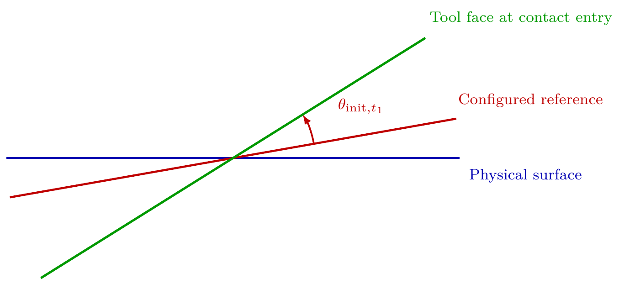
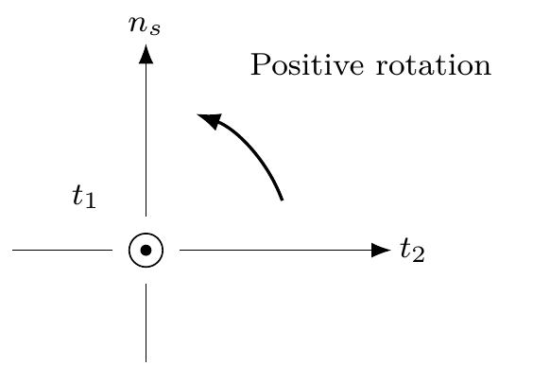


Surface frame and response metric
All contact comparisons are resolved relative to the configured surface frame
Entry condition
Signed achieved angular offset about t₁ at contact entry.
Contact response
γ is the relative rotation from the measured end orientation back to the held entry orientation.
Alignment convention: γₜ₁ and θ_init,t₁ have the same sign when contact rotates the end effector towards the configured surface-parallel orientation.
Design and Implementation of a Real-Time Cartesian Impedance Controller
6
Master Thesis - Heykel Khadhraoui

Slide 7



Cartesian impedance and complete torque command
Directional compliance is defined in the surface frame and mapped to joint torque
Cartesian wrench
Joint torque command
Contact Establishment directional design
• High tangential translational stiffness Kₚ,t₁ and Kₚ,t₂ retains the tool position along the plane.
• Lower normal stiffness Kₚ,n provides compliant pressing.
• Low rotational stiffness about t₁ and t₂ permits contact-induced alignment; higher stiffness about n_s keeps in-plane orientation.
The contact trajectory holds the measured entry orientation as R_d, so any later end-effector rotation becomes the measured contact response.
Design and Implementation of a Real-Time Cartesian Impedance Controller
7
Master Thesis - Heykel Khadhraoui

Slide 8
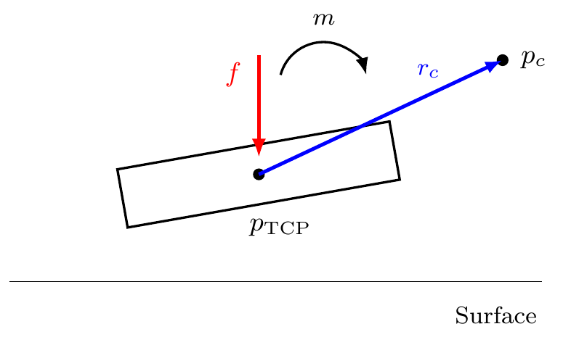

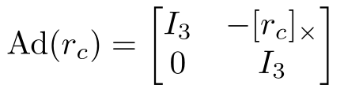


Virtual centre of compliance
The point shift changes where the impedance is defined and introduces translation–rotation coupling
Point shift
Shifted stiffness
Off-diagonal blocks couple translation and rotation.
Complete commanded TCP moment
At r_c = 0, the coupling term vanishes. Finite rotational compliance remains active, but no extra CoC-induced moment favours either rotational direction.
Design and Implementation of a Real-Time Cartesian Impedance Controller
8
Master Thesis - Heykel Khadhraoui

Slide 9
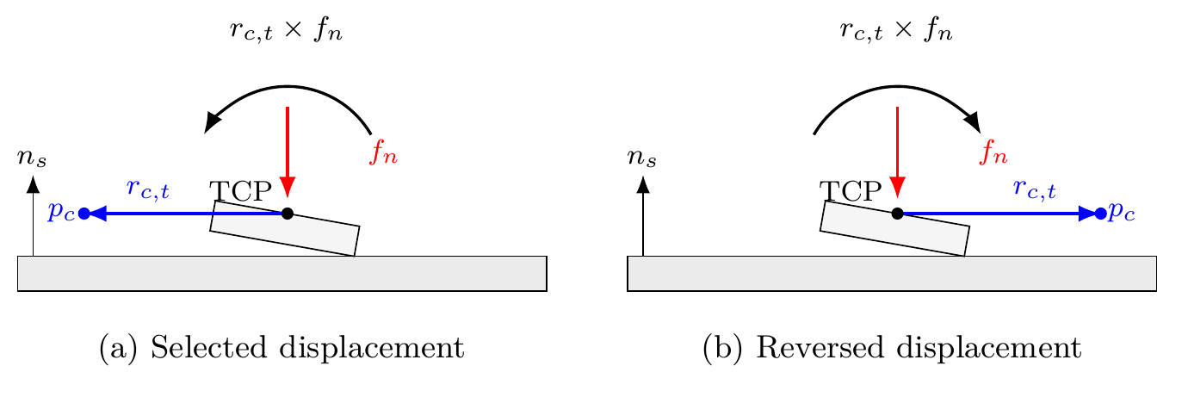

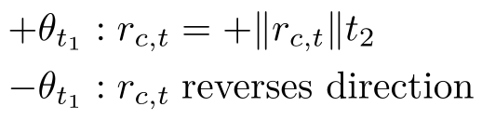
Why the CoC direction matters
A tangential lever turns the commanded normal press into a directional moment
Direction rule
During pressing, F_n < 0. The selected r_c,t makes r_c,t × f_n oppose the angular-offset direction.
Reversing the initial angular offset reverses the useful CoC displacement. Therefore one fixed non-zero tangential CoC cannot assist both directions equally.
TCP-centred CoC: r_c = 0 → no directional bias.
Design and Implementation of a Real-Time Cartesian Impedance Controller
9
Master Thesis - Heykel Khadhraoui

Slide 10
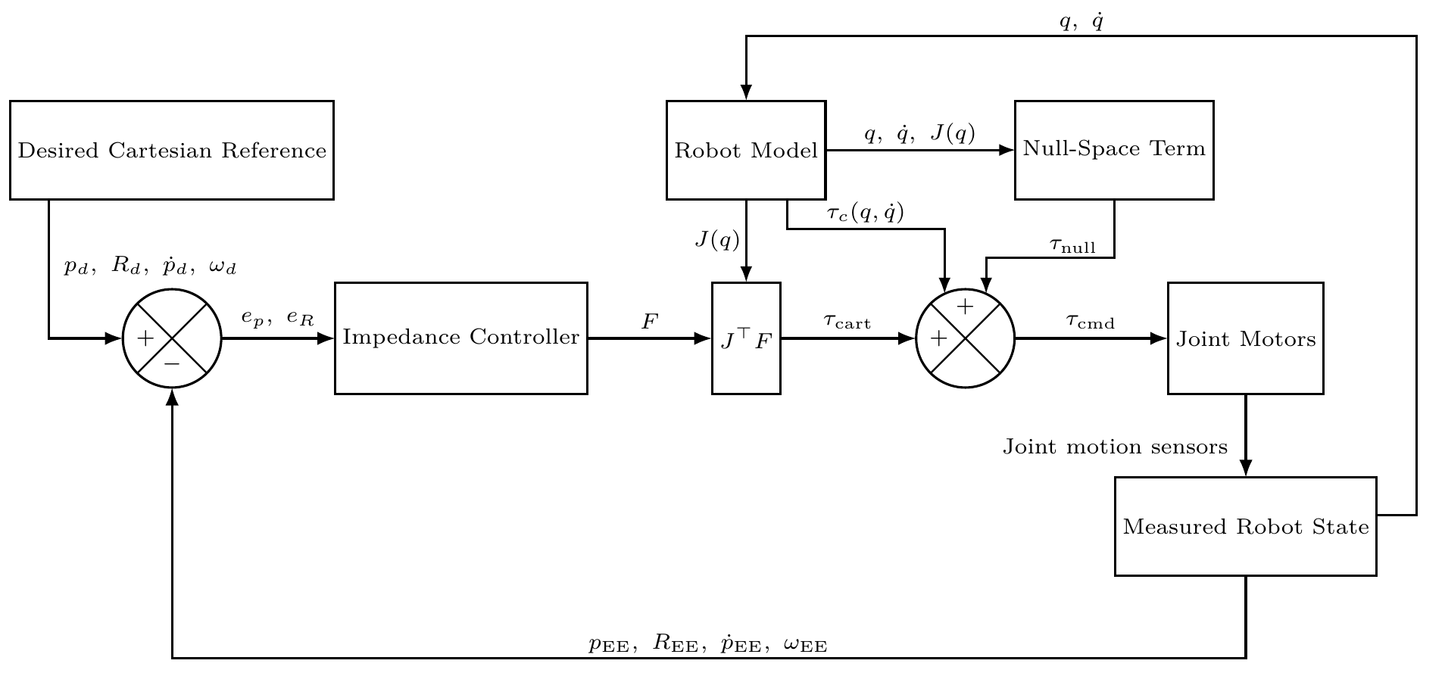
Real-time controller architecture
The torque callback operates only on preallocated state and robot/model data
Implementation choices
• C++14 with libfranka 0.7.1 and Eigen 3.3.7.
• Ubuntu 20.04.3, PREEMPT_RT kernel 5.9.1-rt20.
• Nominal 1 ms callback; terminal input handled by a separate keyboard thread.
• File output is deferred until torque control stops.
• Each session reloads and validates the parameter set.
Gravity compensation is handled by the FCI; the application adds the model Coriolis/centrifugal term τ_c.
Design and Implementation of a Real-Time Cartesian Impedance Controller
10
Master Thesis - Heykel Khadhraoui

Slide 11
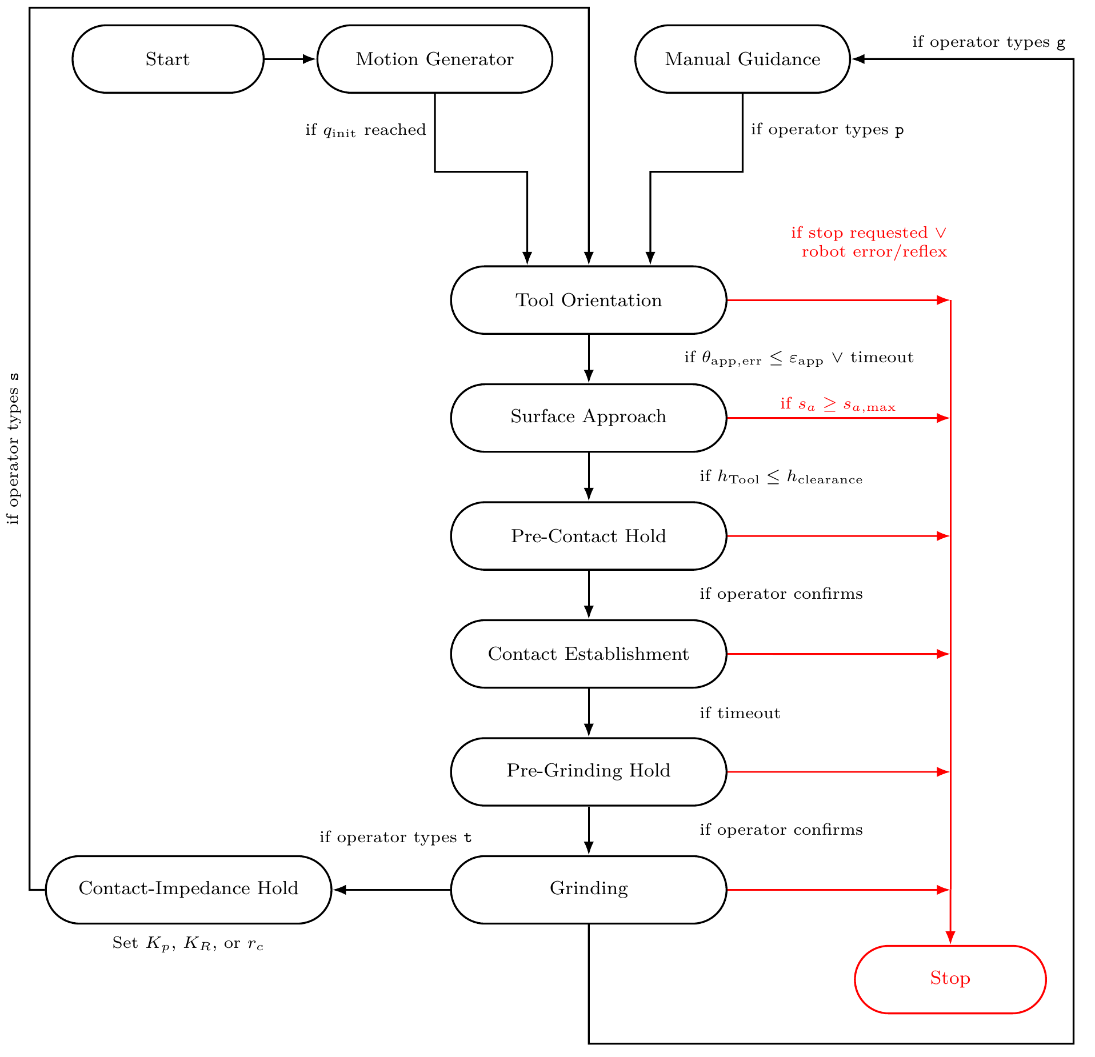
Surface-contact sequence
The experiment separates orientation, approach, contact establishment, hold, and grinding
Measured phase
• Tool Orientation: establish the commanded pre-contact direction.
• Surface Approach: descend until the minimum rectangular-tool clearance reaches 20 mm.
• Contact Establishment: move the selected tool point toward the surface for up to 5 s while holding the captured entry orientation.
• Pre-Grinding Hold: preserve the final contact reference until operator confirmation.
• Grinding: retain the normal press and superimpose tangential motion; not part of the quantitative evaluation.
All reported contact-response values come from Contact Establishment.
Design and Implementation of a Real-Time Cartesian Impedance Controller
11
Master Thesis - Heykel Khadhraoui

Slide 12
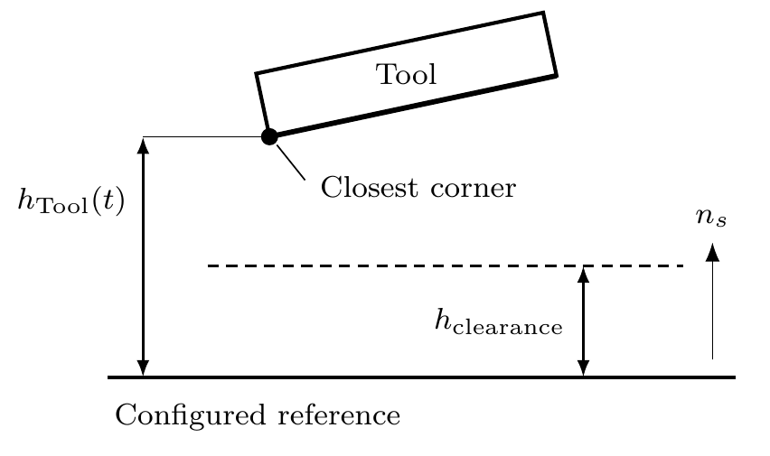
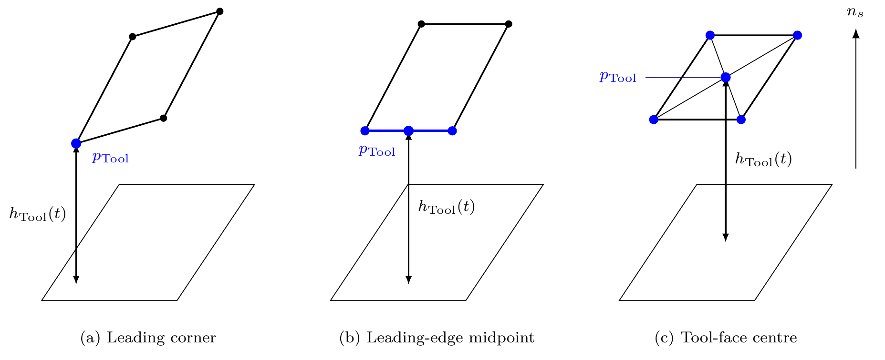
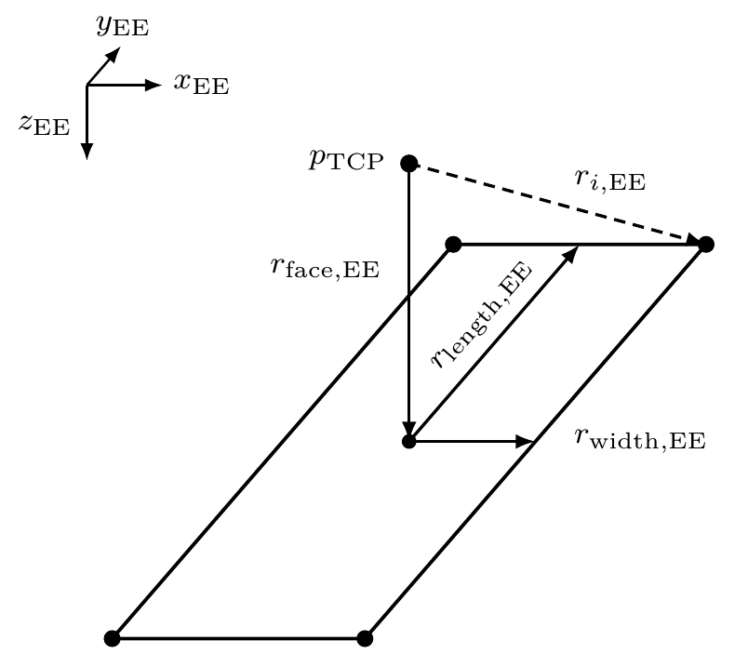
Tool geometry, clearance, and contact entry
The controller uses the rectangular face geometry to decide when approach ends
Geometry used in the experiments
Tool face: 40 × 120 mm · centre: +20 mm along Z_EE · custom gripper fingers
Contact begins from the selected leading face feature while the controller still regulates the TCP.
The minimum clearance of the complete rectangular face determines the transition from Surface Approach to Contact Establishment.
Design and Implementation of a Real-Time Cartesian Impedance Controller
12
Master Thesis - Heykel Khadhraoui

Slide 13
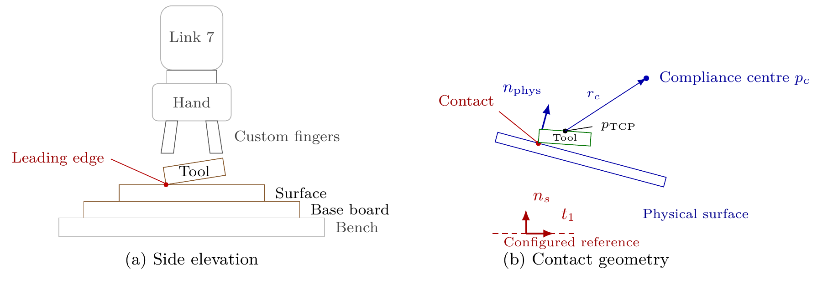
Experimental system
Franka Panda, rectangular tool, planar plate, and a real-time control computer
Hardware and contact
• Franka Emika Panda, 7 DOF, torque-controlled through the FCI.
• Rectangular grinding tool clamped by the Franka Hand with custom pads/fingers.
• Plane plate mounted on a raised base board; dry contact in every trial.
• Control and logging at the nominal 1 kHz rate.
40×120
20
tool face [mm]
tool-centre offset [mm]
Communication_test passed the libfranka mean command-success criterion ≥ 0.90.
Design and Implementation of a Real-Time Cartesian Impedance Controller
13
Master Thesis - Heykel Khadhraoui

Slide 14
Surface-reference and tool-normal calibration
The controller reference and the physical tool normal were established independently
Surface reference
• Complete tool face seated on the plane once.
• −Z_EE transformed to base coordinates defines the outward configured surface normal n_s.
• Configured normal corresponds to −1.585° about base x and +0.988° about base y.
Tool normal
• Tool face seated on the plane at three yaw orientations.
• A unit vector in end-effector coordinates was fitted to make its base-frame direction as constant as possible.
• Calibrated tool normal differs from nominal +Z_EE by ≈1.56°.
θ_init,t₁ is calculated from the measured entry orientation and these calibrated directions; the physical tool–surface angle was not measured directly.
Design and Implementation of a Real-Time Cartesian Impedance Controller
14
Master Thesis - Heykel Khadhraoui

Slide 15
Contact-test configuration
All comparisons change one parameter while the remaining contact sequence and geometry stay fixed
Orientation / approach
Contact Establishment
Repetitions / logging
• Orientation + approach gains: Kₚ = 150 N/m in all directions; Kᴿ = [180, 180, 90] N·m/rad.
• Damping factor ζ = 1.9.
• Approach speed 0.1 m/s; clearance = 20 mm.
• Baseline contact gains: Kₚ = [2000, 2000, 350] N/m and Kᴿ = [5, 5, 50] N·m/rad.
• Damping factor ζ = 1.0, inertia-scaled by direction.
• Press speed 0.08 m/s; independent 5 s timeout.
• Each parameter setting repeated 3 times.
• 57 surface-contact trials + 12 pose-hold trials = 69 total.
• Runtime signals stored in a preallocated in-memory ring buffer and written to CSV after torque control.
During Cases A–D the surface-contact null-space configuration stayed fixed: d_null = 2 N·m·s/rad and k_σ = 1 N·m.
3×
19
69
repetitions per setting
contact parameter settings
reported trials
Design and Implementation of a Real-Time Cartesian Impedance Controller
15
Master Thesis - Heykel Khadhraoui

Slide 16
Main surface-contact experimental matrix
Cases A–D separate the baseline, stiffness effects, and tangential CoC position
Case
Variable
Achieved initial condition
Tested values
Trials
A
CoC at TCP
φ₀=0.74°; +9.31°; −9.41° about t₁
r_c = 0
9
B
Rotational stiffness
+9.31° to +9.32° about t₁
K_R,t₁ = 15, 50 N·m/rad (+ 5 N·m/rad baseline)
6
C
Tangential translational stiffness
+9.24° to +9.31° about t₁
K_p,t₂ = 300, 800 N/m (+ 2000 N/m baseline)
6
D
Tangential CoC position
+9.32° and −9.36° about t₁
r_c,t₂ = −40, −20, −10, +10, +20, +40 mm (+ 0 mm baseline)
36
The r_c,t₂ = 0 reference in Cases B–D reuses the corresponding Case-A TCP-centred measurement.
Design and Implementation of a Real-Time Cartesian Impedance Controller
16
Master Thesis - Heykel Khadhraoui

Slide 17
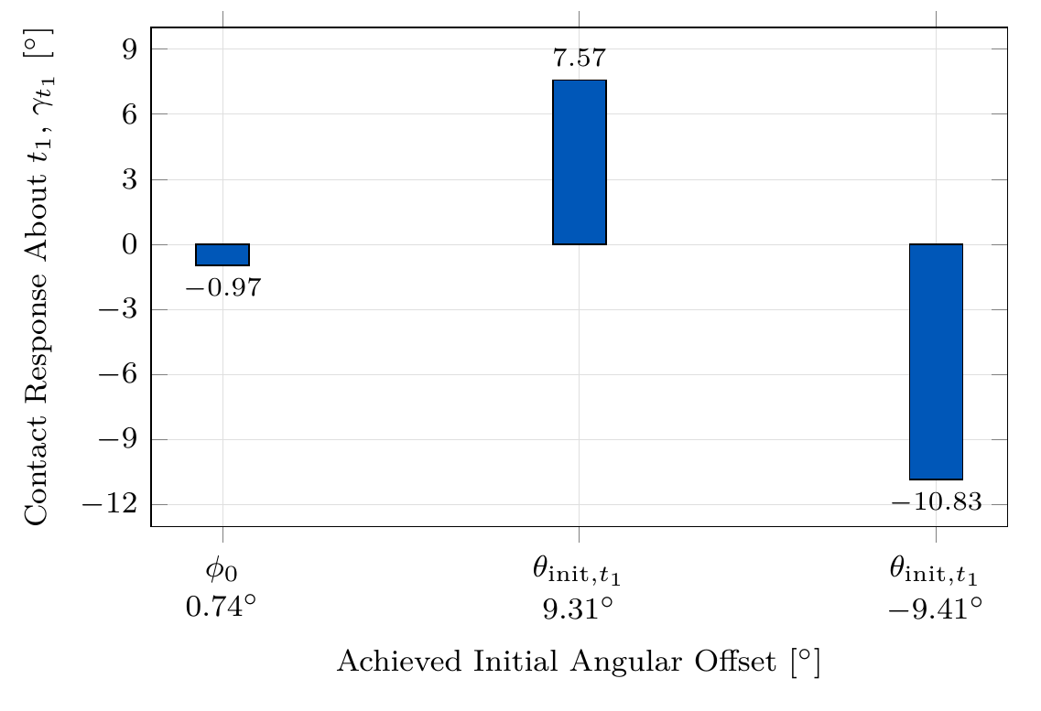
Results I — TCP-centred baseline
Case A: with r_c = 0, contact-induced rotation occurs towards the configured surface for both tested directions
+7.57°
−10.83°
response at +9.31° initial offset
response at −9.41° initial offset
81.3%
115.1%
|response| / |initial|, positive
|response| / |initial|, negative
Interpretation
• At the TCP, r_c × f = 0: there is no additional CoC moment selecting a rotational direction.
• The finite rotational compliance still permits contact-induced rotation in both directions.
• This makes the TCP-centred condition a suitable direction-independent final configuration after alignment.
TCP-centred CoC = direction-independent baseline.
Design and Implementation of a Real-Time Cartesian Impedance Controller
17
Master Thesis - Heykel Khadhraoui

Slide 18
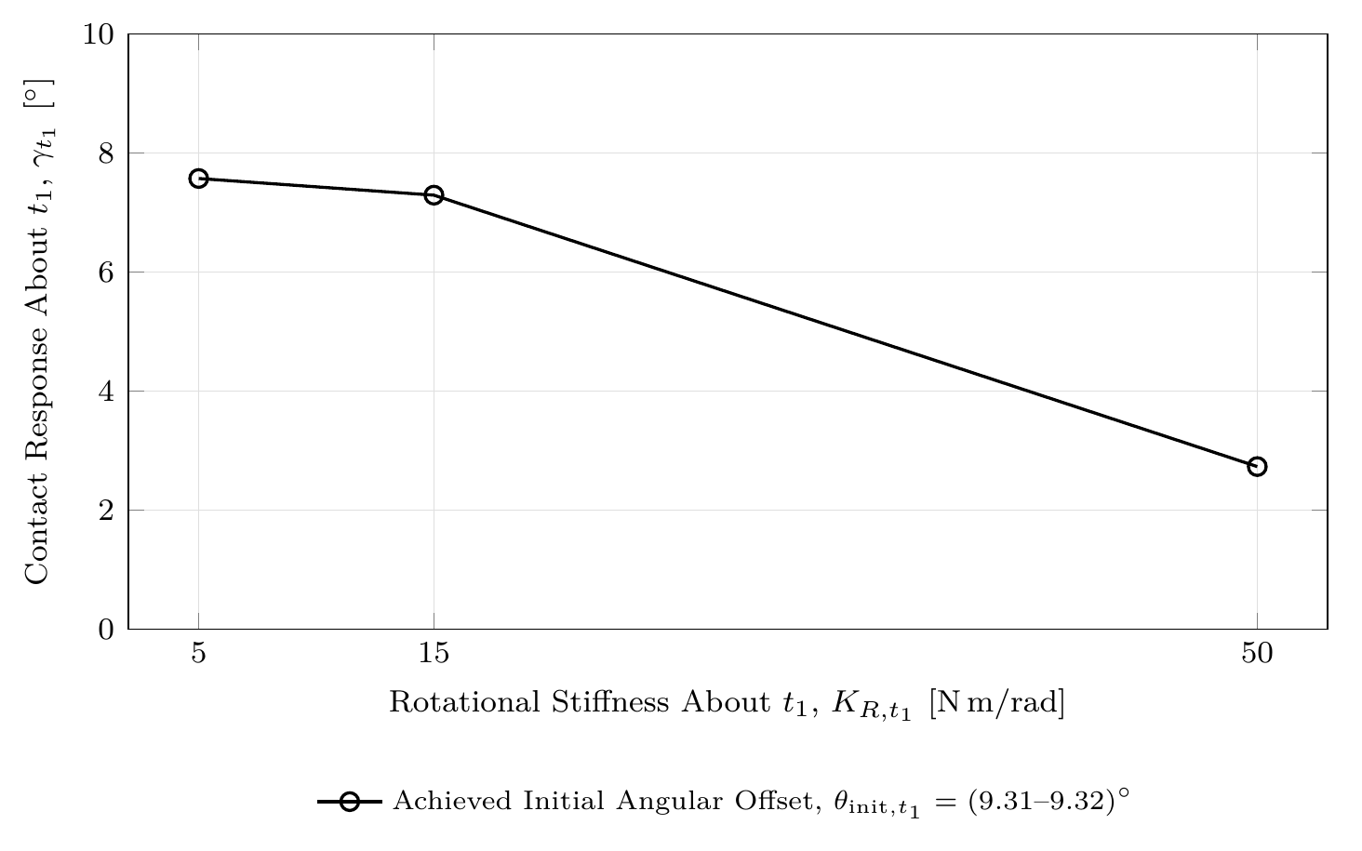
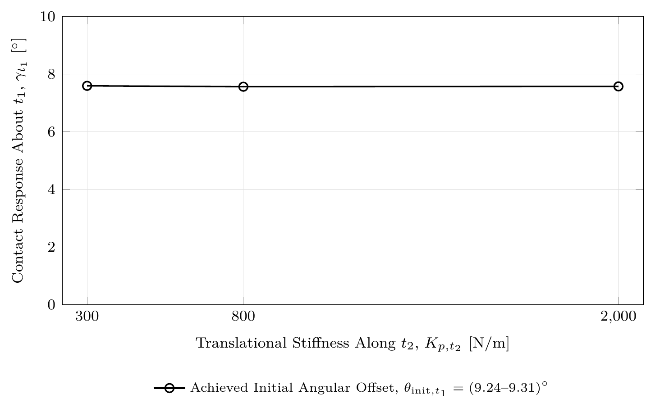
Results II — stiffness effects
Rotational stiffness controls the alignment response much more strongly than tangential translational stiffness
Case B — K_R,t₁
−63.9%
Case C — K_p,t₂
0.4%
5 → 50 N·m/rad
response reduction: 7.57° → 2.73°
300 → 2000 N/m
response span: 7.56°–7.59°
Takeaway: the alignment response is far more sensitive to rotational stiffness about the response axis than to the tested cross-axis translational stiffness.
Design and Implementation of a Real-Time Cartesian Impedance Controller
18
Master Thesis - Heykel Khadhraoui

Slide 19
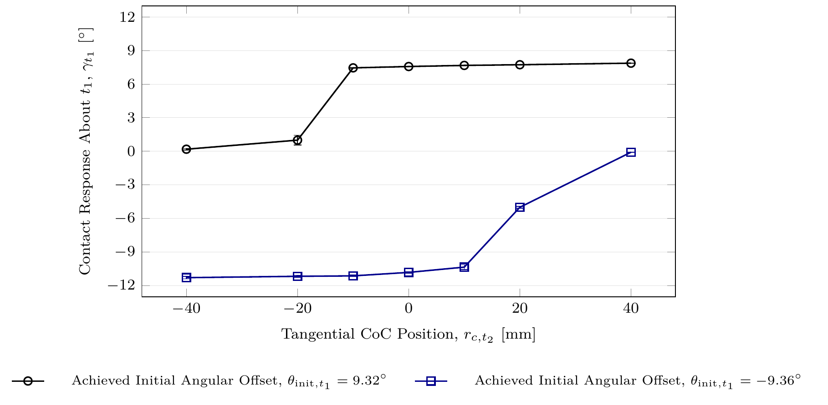
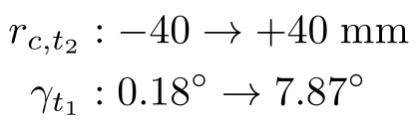
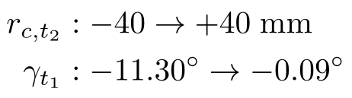
Results III — tangential CoC position
Case D: the displaced CoC selects a preferred rotational direction
Positive initial offset (+9.32°)
Negative initial offset (−9.36°)
Same lever direction, opposite effect: useful for one sign and strongly opposing for the other.
Selecting the CoC direction according to the initial offset increased the final response by ≈4%. Selecting the opposite direction reduced the response by ≈98–99%.
Design and Implementation of a Real-Time Cartesian Impedance Controller
19
Master Thesis - Heykel Khadhraoui

Slide 20
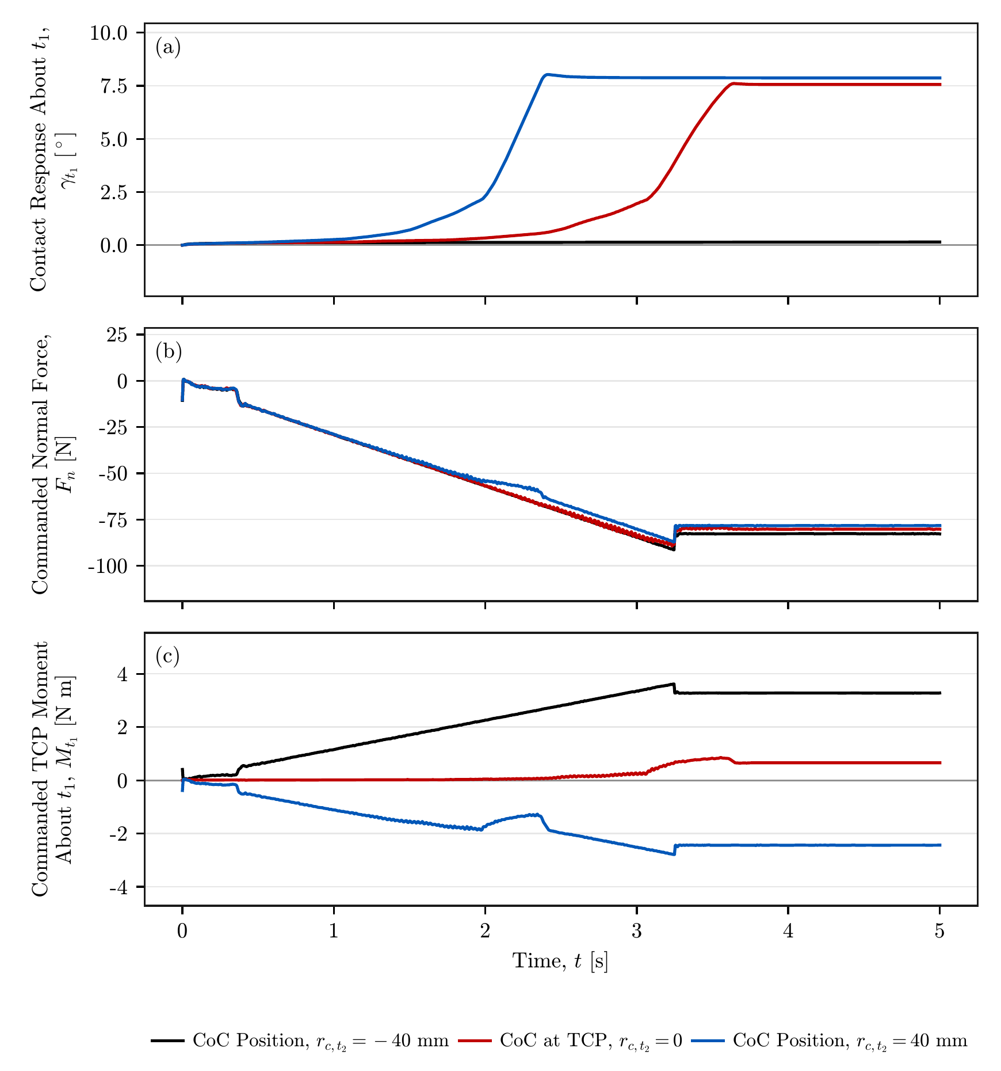
Results IV — mechanism behind the CoC effect
The normal press stays similar, while the commanded TCP moment changes strongly and reverses sign
Positive-offset condition
• Compared r_c,t₂ = −40, 0, +40 mm at mean θ_init,t₁ = 9.32°.
• Commanded normal force settles in a narrow range: about −77 to −82 N.
• Commanded TCP moment settles at ≈ +3.28, +0.66, and −2.44 N·m.
• The moment reverses direction between the two displaced CoCs, while the normal force changes only slightly.
2.3 s
3.6 s
≈ steady response, +40 mm
≈ steady response, TCP
The displaced CoC mainly changes the rotational moment generated by the commanded press — not the press magnitude itself.
Design and Implementation of a Real-Time Cartesian Impedance Controller
20
Master Thesis - Heykel Khadhraoui

Slide 21






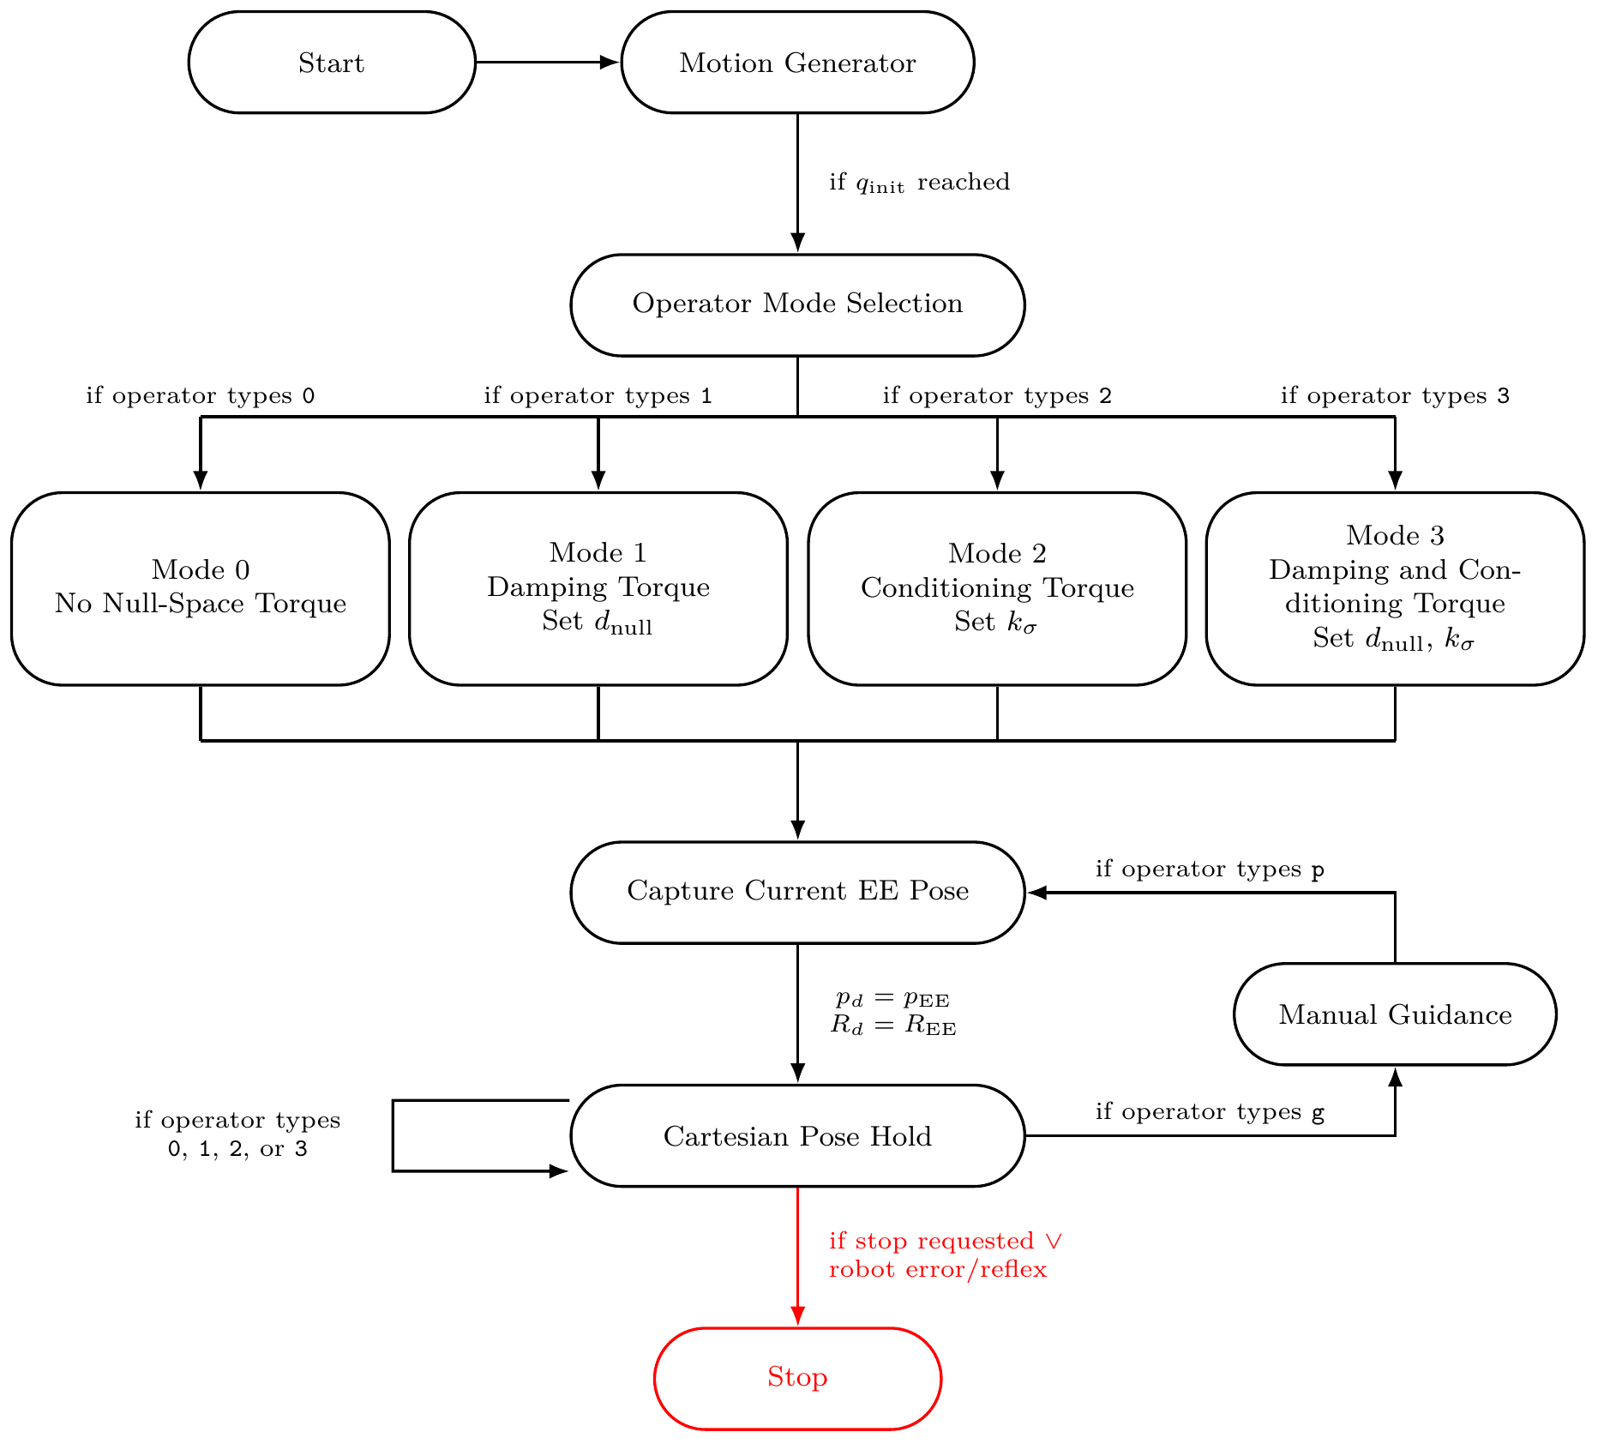
Secondary null-space controller
The 7-DOF Panda has one redundant direction at full Jacobian rank
SVD and projector
Projected damping
Singular-value conditioning
Dissipates redundant joint motion already present.
Drives the configuration toward the sampled neighbour with the larger σ_min.
Design and Implementation of a Real-Time Cartesian Impedance Controller
21
Master Thesis - Heykel Khadhraoui

Slide 22
Null-space pose-hold experiment
The two secondary terms are evaluated separately under one repeatable virtual disturbance
Four settings × 3 trials
Held Cartesian pose
Virtual disturbance
• Mode 0: τ_null = 0.
• Mode 1: projected damping, d_null = 2 N·m·s/rad.
• Mode 2: conditioning only, k_σ = 1.5 N·m.
• Mode 2: conditioning only, k_σ = 2.0 N·m.
• K_p,hold = 2000 N/m.
• K_R,hold = 50 N·m/rad.
• D_p,hold = 50 N·s/m.
• D_R,hold = 8 N·m·s/rad.
• Acceptance: max ||e_p|| < 2 mm during disturbance.
• 20 N virtual point force on link 3 at r_p = [0, 0, 0.2]ᵀ m.
• Force direction aligned with the selected link-point motion produced by the initial structural null direction.
• Equivalent torque bounded by 3 N·m.
settling / conditioning active
smooth ramp up
20 N
ramp down
post-disturbance observation
0 s
5 s
7 s
8 s
9 s
end
Evaluation metrics: cumulative projected null-space motion E_N, net displacement Δη, Δσ_min, and Cartesian position retention.
Design and Implementation of a Real-Time Cartesian Impedance Controller
22
Master Thesis - Heykel Khadhraoui

Slide 23
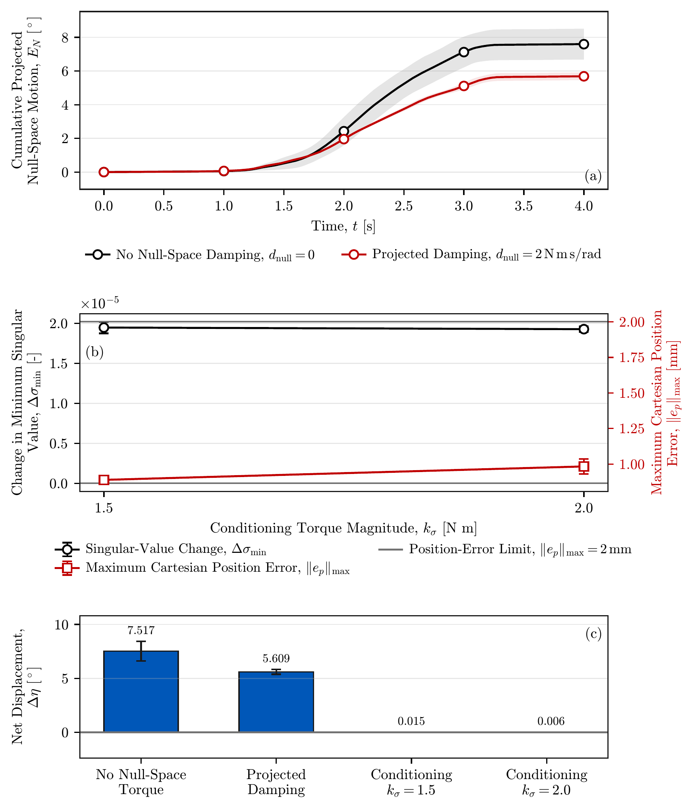


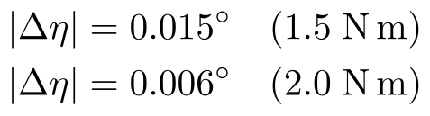
Results V — null-space pose hold
Projected damping reduces redundant motion; conditioning nearly removes the final net displacement
Projected damping
≈25% less redundant motion.
Singular-value conditioning
Net-displacement reduction: 99.8% and 99.9% relative to inactive.
2.0 N·m leaves slightly less final displacement but produces much more back-and-forth motion: E_N = 1.619° vs 0.283°.
Design and Implementation of a Real-Time Cartesian Impedance Controller
23
Master Thesis - Heykel Khadhraoui

Slide 24
Main experimental findings
What the measurements establish within the investigated task and parameter ranges
1
TCP-centred CoC is direction-independent
Contact-induced rotation occurred towards the configured surface for both tested initial directions.
2
Rotational stiffness is the dominant stiffness variable
5 → 50 N·m/rad reduced the response by 63.9%; K_p,t₂ variation changed it by only 0.4%.
3
A displaced CoC is direction-selective
Matched direction slightly increased/faster response; the opposite direction reduced the response by ≈98–99%.
4
The mechanism is the commanded moment
Normal force stayed similar while M_t₁ changed strongly and reversed sign with CoC direction.
5
Null-space terms have distinct roles
Projected damping reduces motion; singular-value conditioning actively changes the redundant configuration.
Complete CoC setting = magnitude + direction + coordinate frame.
Design and Implementation of a Real-Time Cartesian Impedance Controller
24
Master Thesis - Heykel Khadhraoui

Slide 25
Limitations
The quantitative conclusions are intentionally scoped to the tested geometry and measurements
Surface-contact scope
Measurement scope
• One Panda configuration, rectangular tool and mounting arrangement, configured surface reference, and Contact Establishment trajectory.
• Main repeatable comparison was rotation about t₁; t₂ measurements were more variable.
• Each trial used one fixed CoC displacement during Contact Establishment; adaptive switching was not tested.
• Grinding motion was implemented but not included in the quantitative contact-response evaluation.
• Physical tool–surface angle and instantaneous pressure/contact centre were not measured directly.
• θ_init,t₁ and γₜ₁ therefore describe end-effector orientation relative to the configured surface reference.
• Tool mount had about ±2° unloaded angular play about y_EE, approximately aligned with t₂ in the flat configuration.
Null-space scope
Interpret the reported percentages as measured effects within the investigated task and parameter ranges.
Projected damping and singular-value conditioning were tested separately in pose hold under one virtual disturbance direction and one robot configuration.
Design and Implementation of a Real-Time Cartesian Impedance Controller
25
Master Thesis - Heykel Khadhraoui

Slide 26
Future work — adaptive temporary CoC
The results suggest a simple state-dependent compliance-centre strategy
1
2
3
4
Start at TCP
Estimate offset direction
Apply temporary tangential CoC
Return to TCP after alignment
No directional bias before the initial offset is known.
Use the achieved tool orientation relative to the configured surface.
Select r_c,t perpendicular to the offset so r_c × f_n supports the required rotation.
Remove the directional preference and retain bidirectional compliant rotation.
Additional work: direct physical tool–surface angle measurement, stiffer tool mount, t₂ and arbitrary tangent-plane rotations, combined null-space terms under physical disturbances.
Proposed logic: TCP CoC → estimate deviation → selected lever → return to TCP
Design and Implementation of a Real-Time Cartesian Impedance Controller
26
Master Thesis - Heykel Khadhraoui

Slide 27
Conclusion
Final answer to the contact-alignment question
A fixed non-zero tangential CoC is not direction-independent.
The TCP-centred CoC is direction-independent and remains the robust final configuration.
The displaced CoC changes the commanded moment generated by the normal press. That moment can support or oppose contact-induced alignment depending on the displacement direction.
63.9%
≈4%
98–99%
99.8–99.9%
response reduction from rotational stiffness sweep
final-response gain with matched CoC direction
response suppression with opposite CoC direction
net-displacement reduction from conditioning
Thank you
Questions
Design and Implementation of a Real-Time Cartesian Impedance Controller
27
Master Thesis - Heykel Khadhraoui

Slide 28
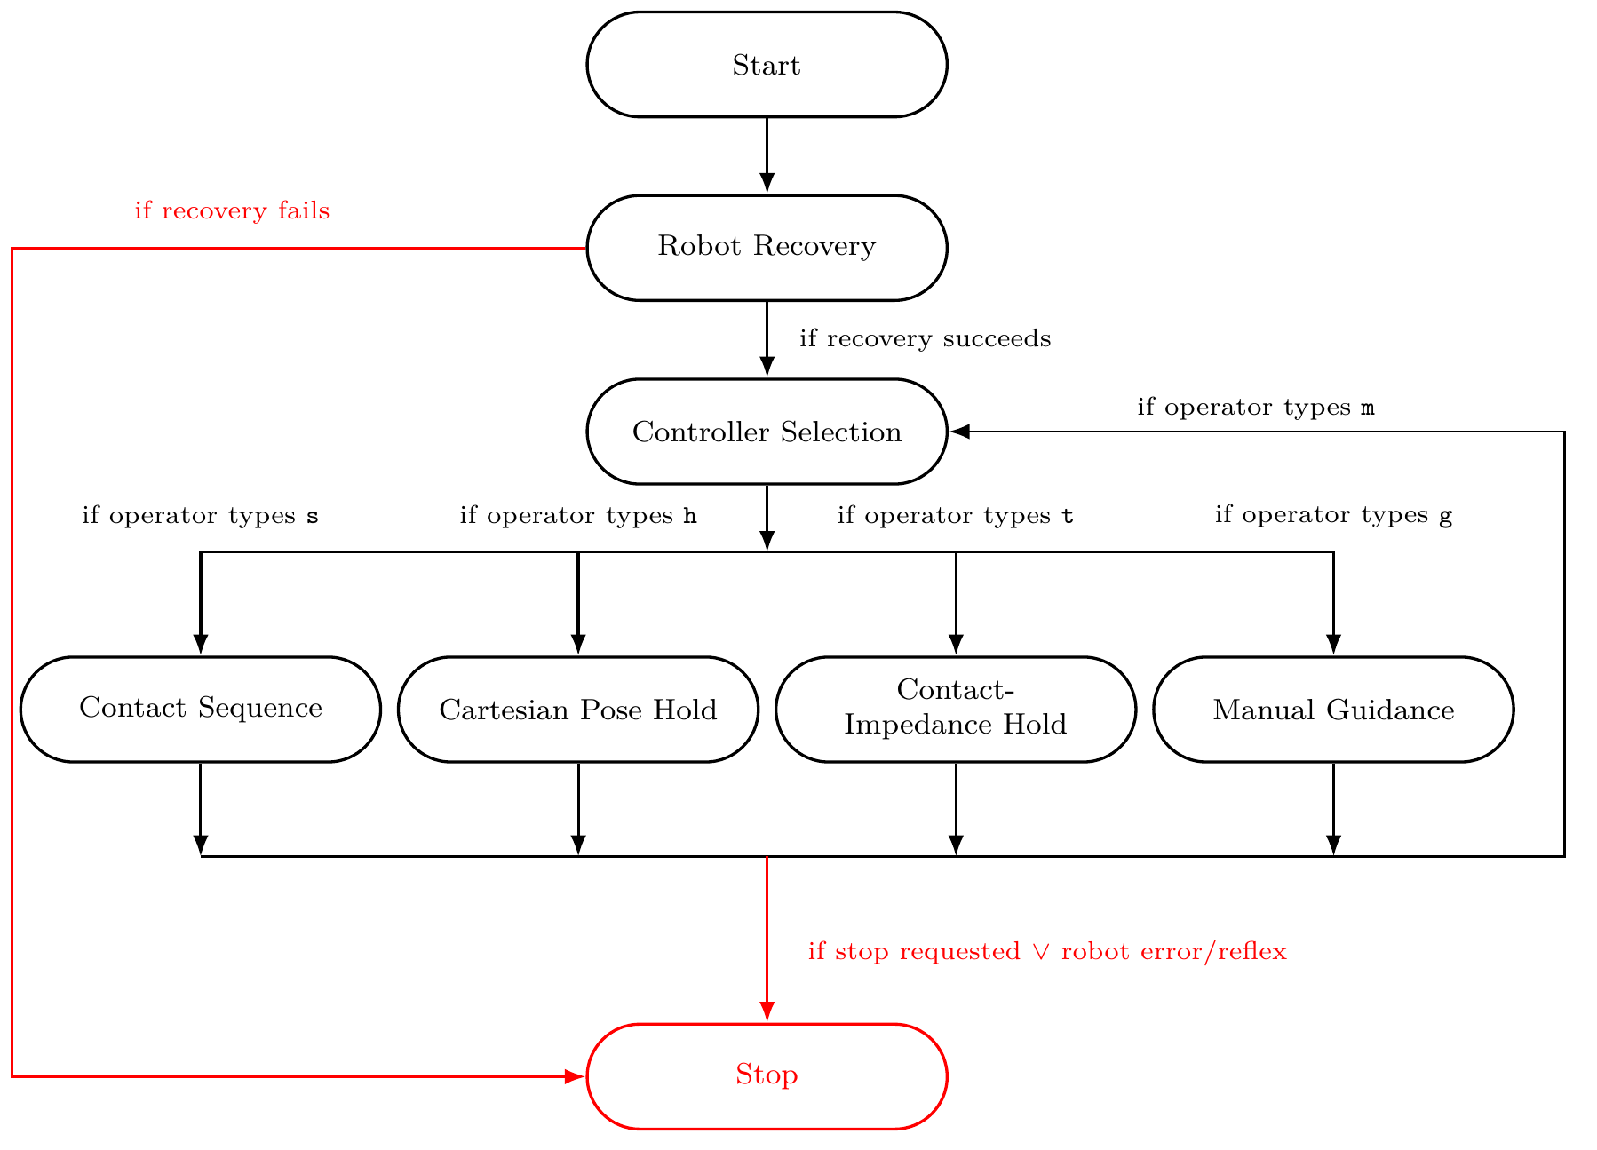
Backup — complete controller state flow
BACKUP
Program-level operating modes and common stop paths
Design and Implementation of a Real-Time Cartesian Impedance Controller
28
Master Thesis - Heykel Khadhraoui

Slide 29
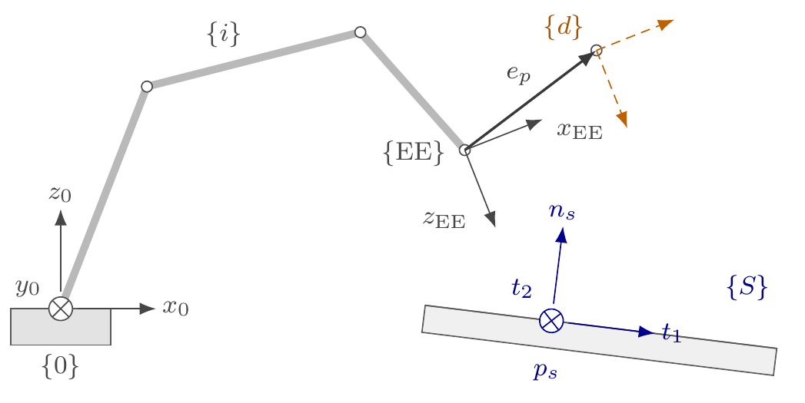
Backup — reference frames
BACKUP
Base, end-effector, TCP/tool, and configured surface frames
Frame roles
• Base frame {0}: global expression of pose, Jacobian, forces, and moments.
• End-effector frame {EE}: measured robot state and calibrated tool geometry.
• TCP: coincident with the end-effector origin in the controller formulation.
• Surface frame {S} = [t₁, t₂, n_s]: principal compliance directions and evaluation axes.
The CoC shift changes the reference point; the surface-frame rotation changes the principal impedance directions.
Design and Implementation of a Real-Time Cartesian Impedance Controller
29
Master Thesis - Heykel Khadhraoui

Slide 30
Backup — main gains and trajectory timing
BACKUP
Controller settings held constant unless explicitly varied by the experiment
Common state gains
State
K_p [t₁,t₂,n_s] N/m
K_R [t₁,t₂,n_s] N·m/rad
ζ
Orientation / approach
150,150,150
180,180,90
1.9
Contact Establishment
2000,2000,350
5,5,50
1.0
Key trajectory / transition parameters
Minimum orientation time
1.0 s
Orientation timeout / max rate
5.0 s / 20°/s
Approach speed
0.1 m/s
Tool clearance
0.020 m
Contact minimum / timeout
2.0 s / 5.0 s
Press speed
0.080 m/s
Virtual press endpoint
0.240 m
Pre-contact hold
disabled
Pre-grinding hold
enabled
Design and Implementation of a Real-Time Cartesian Impedance Controller
30
Master Thesis - Heykel Khadhraoui

Slide 31
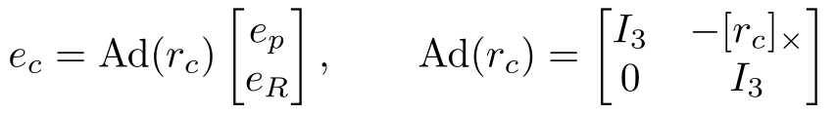

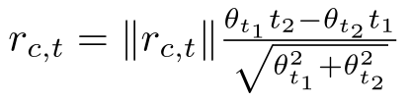
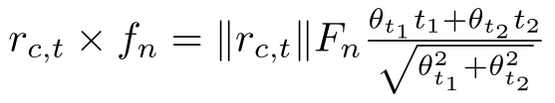
Backup — CoC transformation equations
BACKUP
Analytical point-shift formulation used in the controller
For a tangential displacement and normal press:
Design and Implementation of a Real-Time Cartesian Impedance Controller
31
Master Thesis - Heykel Khadhraoui

Slide 32

Backup — null-space equations
BACKUP
Projected damping and sampled singular-value conditioning
Design and Implementation of a Real-Time Cartesian Impedance Controller
32
Master Thesis - Heykel Khadhraoui

Slide 33
Backup — software and robot-side safety
BACKUP
Reproducibility and command-handling configuration
Software
Robot-side thresholds
Real-time handling
• Ubuntu 20.04.3
• PREEMPT_RT kernel 5.9.1-rt20
• g++ 9.3, C++14, -O2
• Eigen 3.3.7
• libfranka 0.7.1
• Joint-torque collision thresholds: 140 N·m for all joints.
• Cartesian force thresholds: 240 N.
• Cartesian moment thresholds: 240 N·m.
• Robot errors/reflexes terminate the active control state.
• Control callback uses prepared in-memory data only.
• Keyboard input is transferred through atomic variables from a separate thread.
• Torque-control / communication exceptions end the session.
• Data are written to file only after torque control stops.
The FCI performs gravity and motor-friction compensation for external joint-torque mode; the controller adds τ_c(q,q̇).
Design and Implementation of a Real-Time Cartesian Impedance Controller
33
Master Thesis - Heykel Khadhraoui

Slide 34
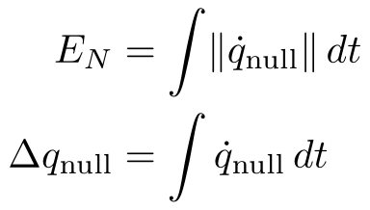
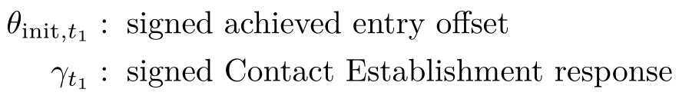
Backup — data recording and evaluation metrics
BACKUP
Signals are logged at the control rate and reduced to task-specific comparison quantities
Logged each cycle
Contact metrics
Null-space metrics
• Measured robot state and Cartesian pose/velocity.
• Active position/orientation reference.
• Pose errors and commanded Cartesian wrench.
• Controller state and null-space configuration.
• Returned joint-torque command.
Each setting: mean ± sample standard deviation over 3 repetitions.
Also: net scalar displacement Δη, Δσ_min, and max Cartesian position error.
Cartesian position-retention criterion during the null-space disturbance: max ||e_p|| < 2 mm.
Design and Implementation of a Real-Time Cartesian Impedance Controller
34
Master Thesis - Heykel Khadhraoui

Slide 35
Backup — numerical result summary
BACKUP
Key values for rapid discussion during questions
Comparison
Reference / low
Changed / high
Measured effect
Case A, + offset
θ_init=+9.31°
γ=+7.57°
81.3% of initial magnitude
Case A, − offset
θ_init=−9.41°
γ=−10.83°
115.1% of initial magnitude
Rotational stiffness
K_R,t₁=5 → γ=7.57°
K_R,t₁=50 → γ=2.73°
63.9% reduction
Translational stiffness
K_p,t₂=300 → γ≈7.56°
K_p,t₂=2000 → γ≈7.57°
0.03° span = 0.4%
CoC, + offset
r_c,t₂=−40 → 0.18°
r_c,t₂=+40 → 7.87°
direction-selective
CoC, − offset
r_c,t₂=−40 → −11.30°
r_c,t₂=+40 → −0.09°
direction-selective
Projected damping
E_N=7.596°
E_N=5.687°
≈25% less cumulative motion
Conditioning 1.5 / 2.0
|Δη|=0.015°
|Δη|=0.006°
99.8–99.9% net reduction
Design and Implementation of a Real-Time Cartesian Impedance Controller
35
Master Thesis - Heykel Khadhraoui

Slide 36
Backup — implemented grinding continuation
BACKUP
Grinding is part of the controller sequence but outside the quantitative evaluation
After Pre-Grinding Hold, the Grinding state retains the normal pressing reference established during Contact Establishment and superimposes a smooth tangential motion.
Normal press
Tangential motion
CoC at TCP
Reference established during Contact Establishment is retained.
A smooth along-surface trajectory is superimposed.
The implemented Grinding state defines the impedance at the TCP.
The thesis evaluates Contact Establishment, not grinding performance. This separation prevents the later tangential motion from confounding the alignment-response comparison.
Design and Implementation of a Real-Time Cartesian Impedance Controller
36
Master Thesis - Heykel Khadhraoui

