Slide 1

Hochschule München University of Applied Sciences
Master Thesis Defense
Computational Engineering (M.Sc.)
Heykel Khadhraoui
Fakultät für Maschinenbau Fahrzeugtechnik Flugzeugtechnik
Design and Implementation of a Real-Time Cartesian Impedance Controller for a 7-DOF Collaborative Robot
Contact-induced alignment of a grinding tool with a plane surface
Supervisors: Prof. Norbert Nitzsche · Prof. Ruth Otto
2026

Slide 2
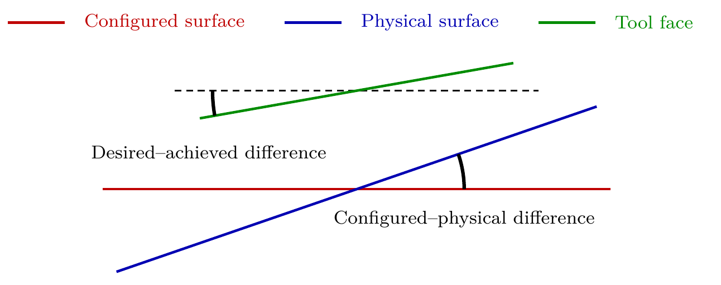
Motivation and research question
Contact begins with an angular mismatch between tool and surface
Problem
Edge- or corner-first contact can create a moment while a rigid pose controller resists the corrective rotation.
Question
How do directional Cartesian stiffness and a virtual centre of compliance shape the contact-induced rotation?
Goal: press against the surface while allowing the tool to rotate towards alignment.
Design and Implementation of a Real-Time Cartesian Impedance Controller
2
Master Thesis - Heykel Khadhraoui

Slide 3
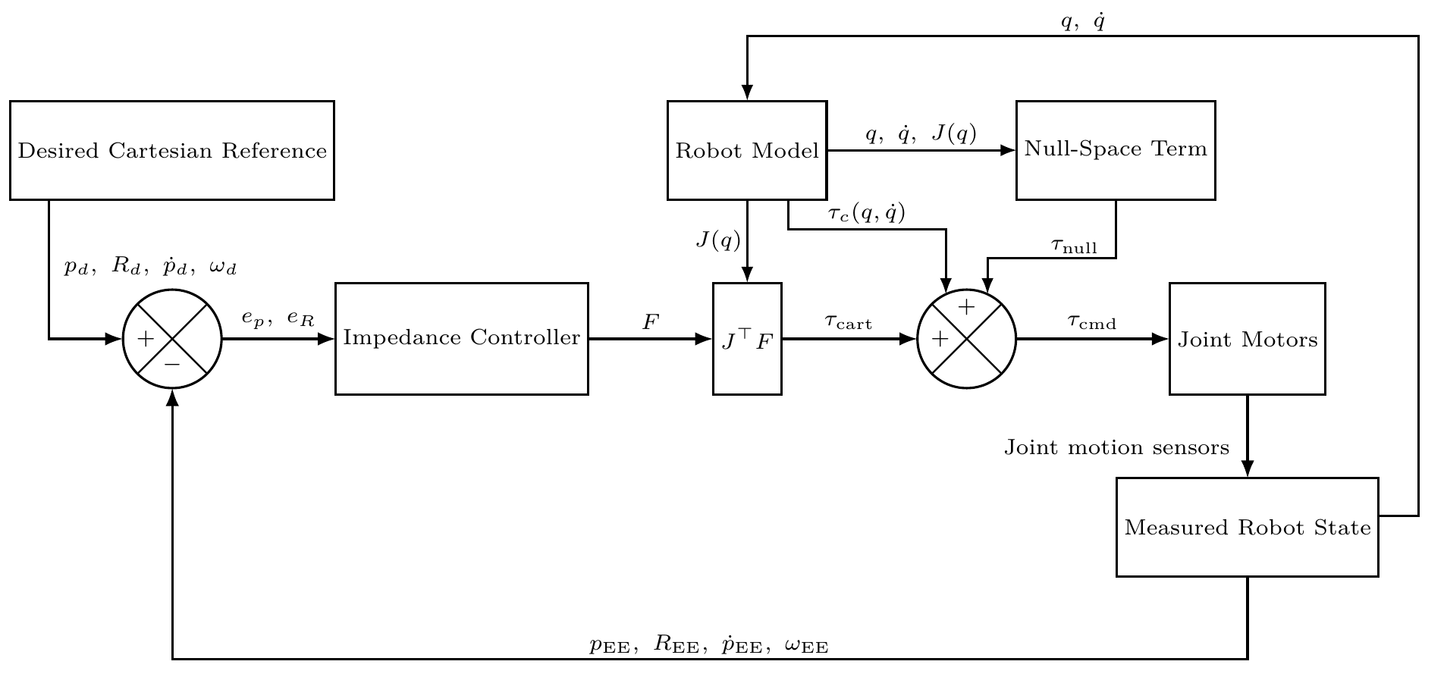

Real-time Cartesian impedance controller
One torque command combines the Cartesian task and the secondary null-space terms
Three design elements
• Directional stiffness and damping in the surface frame.
• Shiftable virtual centre of compliance.
• Projected null-space damping / conditioning.
1 kHz
7 DOF
nominal torque callback
Franka Panda
Design and Implementation of a Real-Time Cartesian Impedance Controller
3
Master Thesis - Heykel Khadhraoui

Slide 4
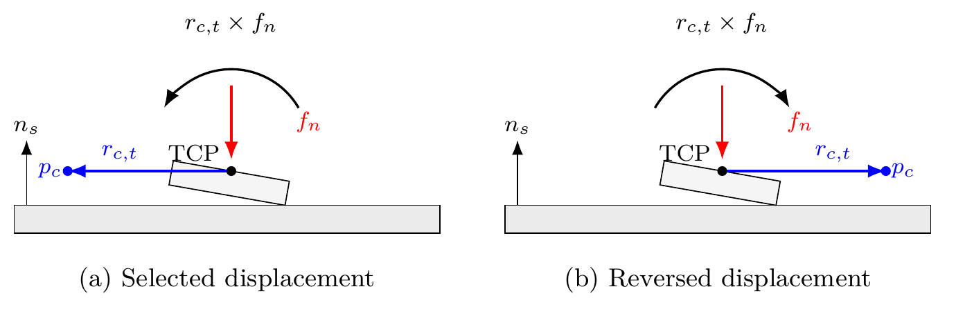



Virtual centre of compliance
The normal press can generate an additional corrective moment
• TCP-centred: no directional CoC moment.
• Tangential displacement: the normal press creates a moment about a surface tangent.
• Reversing the displacement reverses that moment.
The useful CoC direction therefore depends on the direction of the initial angular offset.
Design and Implementation of a Real-Time Cartesian Impedance Controller
4
Master Thesis - Heykel Khadhraoui

Slide 5
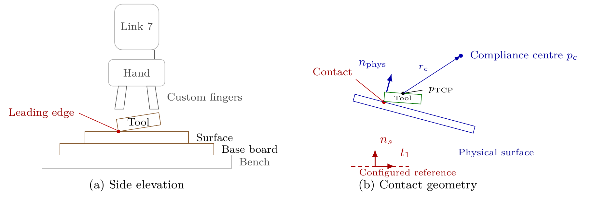
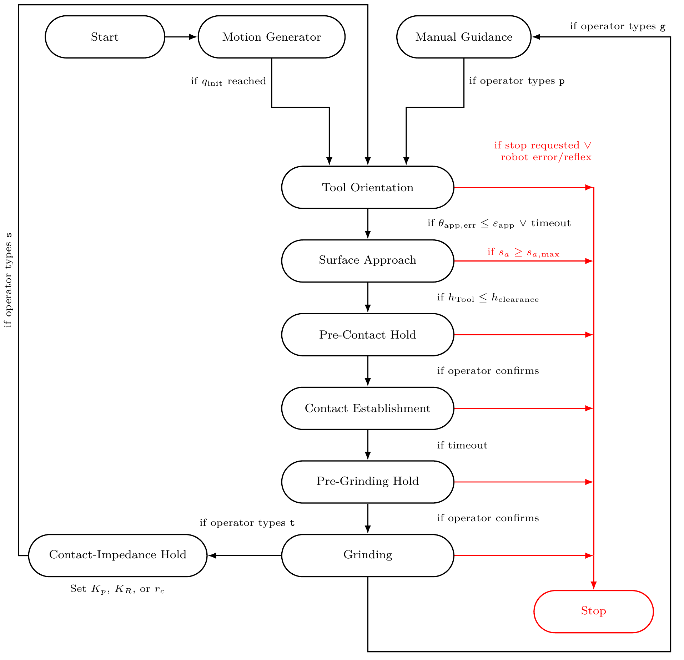
Experimental setup and contact sequence
The quantitative evaluation focuses on Contact Establishment
Contact Establishment
The tool approaches to a 20 mm geometric clearance and then presses toward the plane while the entry orientation is held.
Measured response: end-effector rotation during this phase.
All surface-contact comparisons use the same geometry and phase sequence.
Design and Implementation of a Real-Time Cartesian Impedance Controller
5
Master Thesis - Heykel Khadhraoui

Slide 6

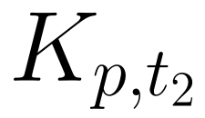
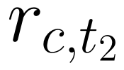
Experimental plan
Cases A–D isolate baseline, stiffness effects, and compliance-centre position
A
B
C
D
TCP-centred baseline
Rotational stiffness
Tangential stiffness
Tangential CoC position
initial offset direction
3×
57
12
repetitions / setting
surface-contact trials
pose-hold trials
69 reported trials in total.
Design and Implementation of a Real-Time Cartesian Impedance Controller
6
Master Thesis - Heykel Khadhraoui

Slide 7
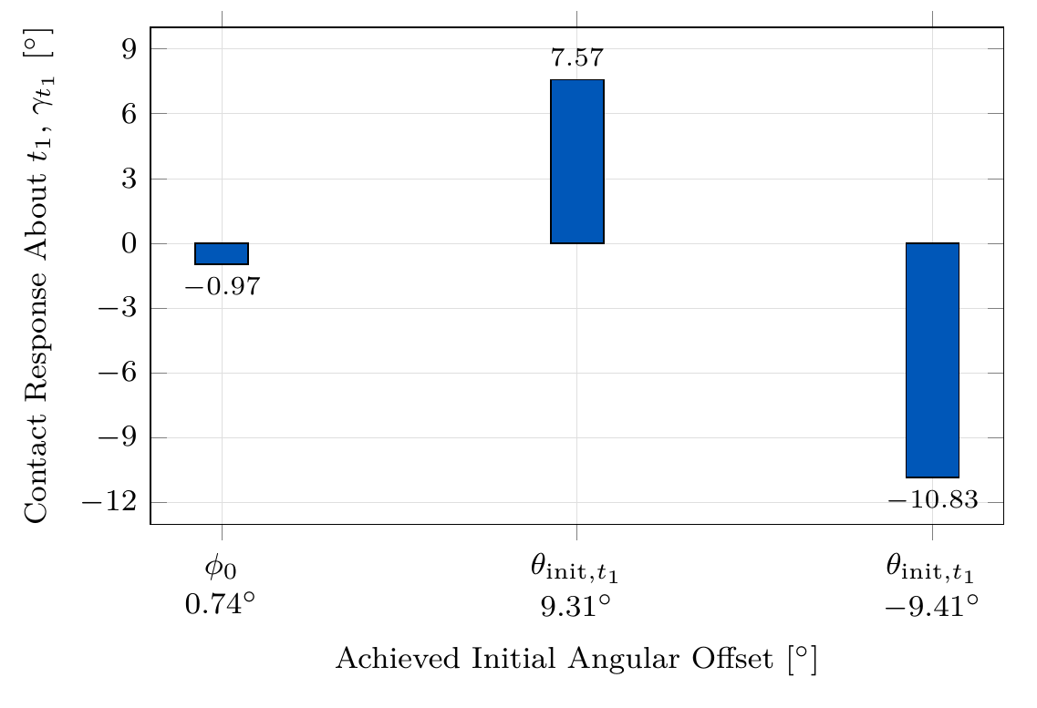
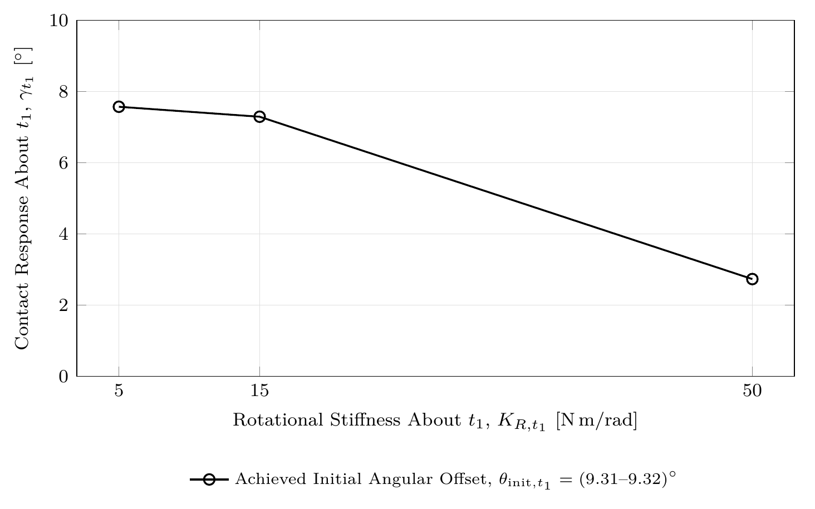
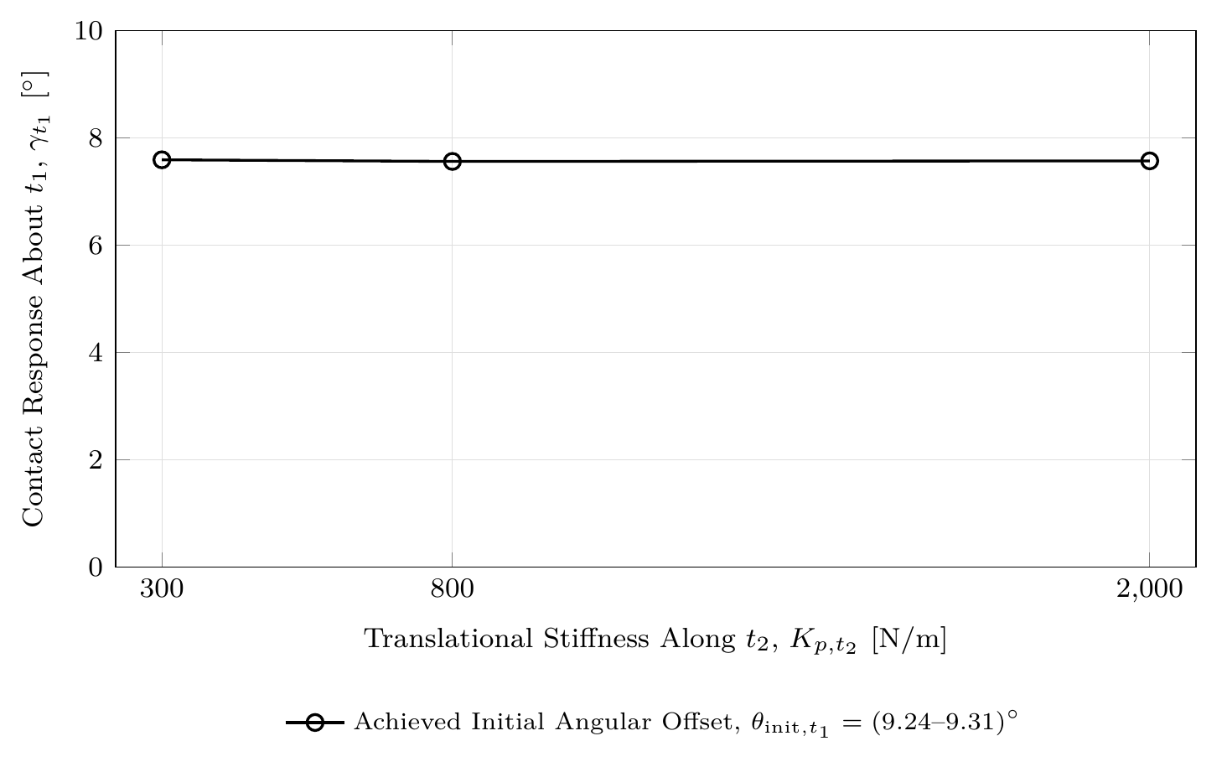


Results — baseline and stiffness
Rotational stiffness changes the alignment response much more than tangential translational stiffness
TCP centred
−63.9%
0.4%
The contact response is much more sensitive to rotational stiffness about the response axis.
response with higher rotational stiffness
response span from tangential-stiffness sweep
Design and Implementation of a Real-Time Cartesian Impedance Controller
7
Master Thesis - Heykel Khadhraoui

Slide 8
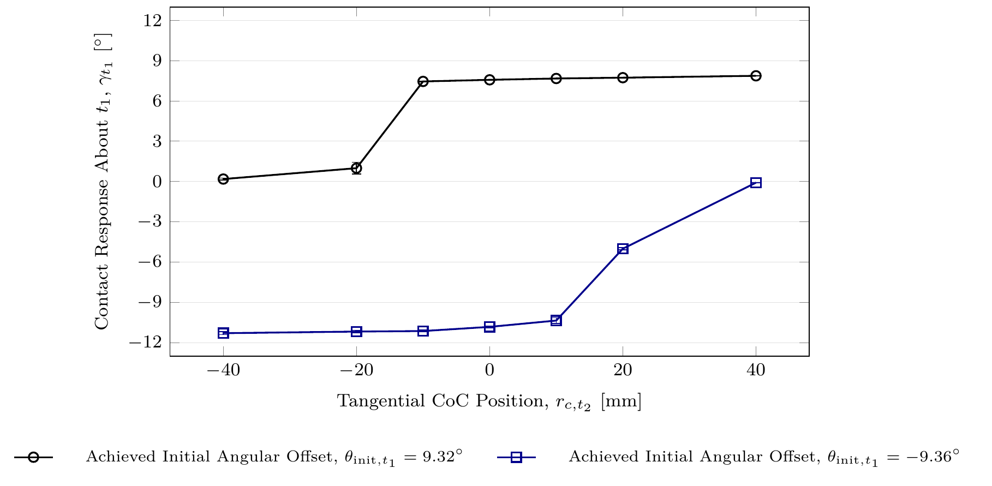

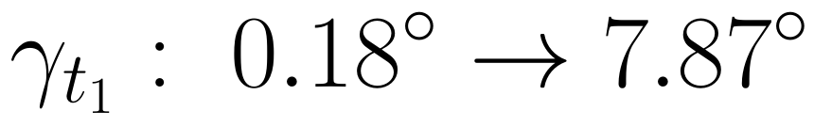

Results — tangential CoC position
The same lever direction assists one initial offset and opposes the other
Positive initial offset
Negative initial offset
Opposite CoC direction reduced the response by ≈98–99%.
Direction matters more than simply increasing stiffness.
Design and Implementation of a Real-Time Cartesian Impedance Controller
8
Master Thesis - Heykel Khadhraoui

Slide 9
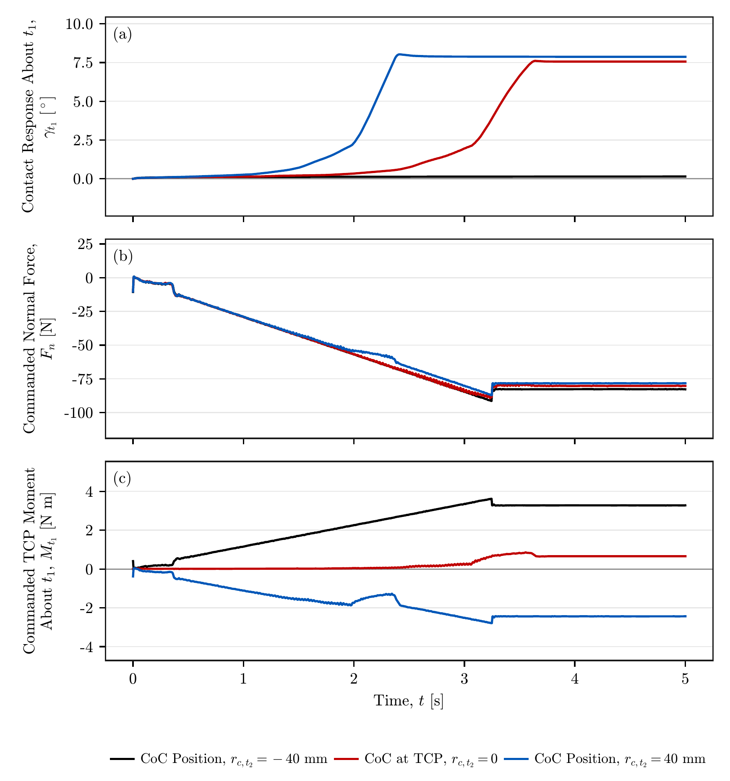


Why the CoC changes the response
The normal force stays similar while the commanded moment changes strongly
Positive-offset comparison
steady normal force
TCP moment across ±40 mm CoC
The displaced CoC mainly changes the rotational moment generated by the press, not the press magnitude.
Design and Implementation of a Real-Time Cartesian Impedance Controller
9
Master Thesis - Heykel Khadhraoui

Slide 10
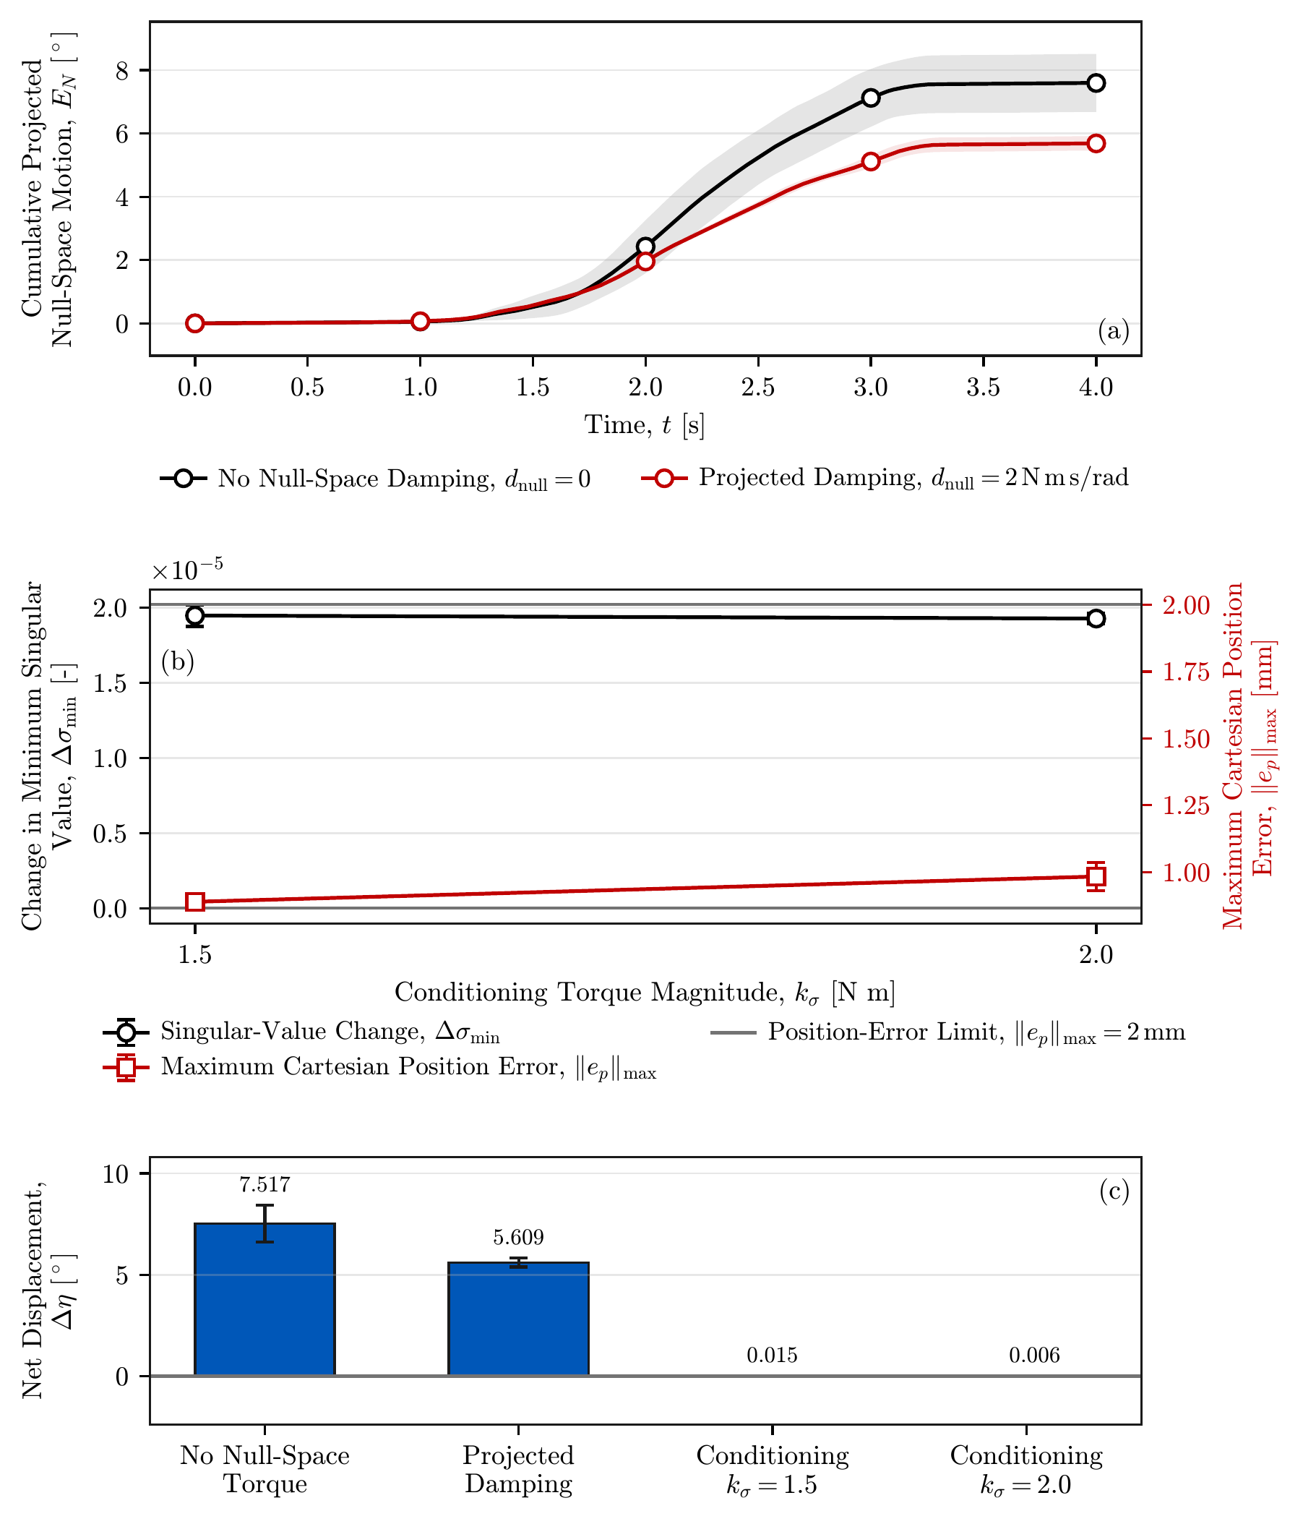

Secondary null-space result
The Cartesian pose is held while redundant joint motion is shaped separately
Projected damping
≈25%
less cumulative null-space motion
Conditioning
final net displacement at 1.5 / 2.0 N·m
Cartesian position stayed below the 2 mm acceptance limit.
Design and Implementation of a Real-Time Cartesian Impedance Controller
10
Master Thesis - Heykel Khadhraoui

Slide 11
Main findings
Three results answer the contact-alignment question
Rotational compliance enables contact-induced alignment.
Higher rotational stiffness strongly reduces the response.
1
A displaced CoC is direction-selective.
Its lever can assist or oppose the required rotation.
2
The TCP-centred CoC is direction-independent.
It removes the additional directional moment after alignment.
3
Practical strategy: use a temporary direction-selected CoC, then return the CoC to the TCP.
Design and Implementation of a Real-Time Cartesian Impedance Controller
11
Master Thesis - Heykel Khadhraoui

Slide 12
Limitations
The quantitative results are scoped to the tested hardware and geometry
Measurement
Experimental scope
Tool mount
Physical tool–surface angle and contact centre were not measured directly.
One robot configuration, tool, surface reference, and contact trajectory.
About ±2° unloaded play can make the physical tool motion differ from the measured EE rotation.
The reported percentages describe the investigated parameter ranges, not a universal robot/tool optimum.
Design and Implementation of a Real-Time Cartesian Impedance Controller
12
Master Thesis - Heykel Khadhraoui

Slide 13
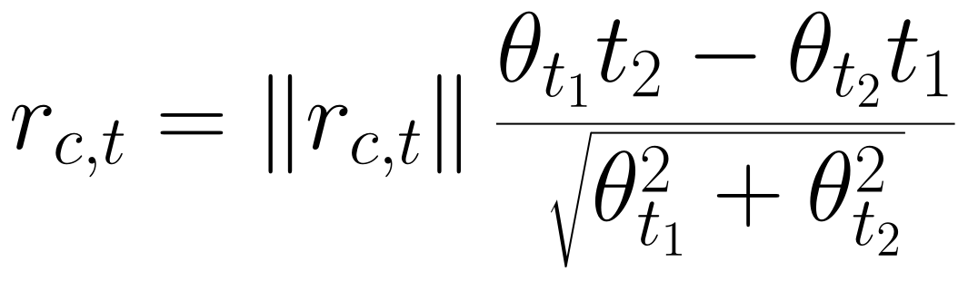

Future work
Adaptive temporary CoC based on the measured initial offset
1
2
3
4
Start at TCP
Estimate offset
Apply selected lever
Return to TCP
• Direct tool-angle / force–torque measurement.
• More directions in the surface tangent plane.
• Combined null-space terms under physical disturbances.
Design and Implementation of a Real-Time Cartesian Impedance Controller
13
Master Thesis - Heykel Khadhraoui

Slide 14
Conclusion
Final answer to the contact-alignment question
A real-time Cartesian impedance controller was implemented and tested on the Franka Panda.
Rotational stiffness controls how freely contact can rotate the tool.
The virtual CoC controls which rotational direction the press favours.
Best practical interpretation: temporary selected lever → TCP-centred compliant contact.
Thank you
Questions
Design and Implementation of a Real-Time Cartesian Impedance Controller
14
Master Thesis - Heykel Khadhraoui

Slide 15
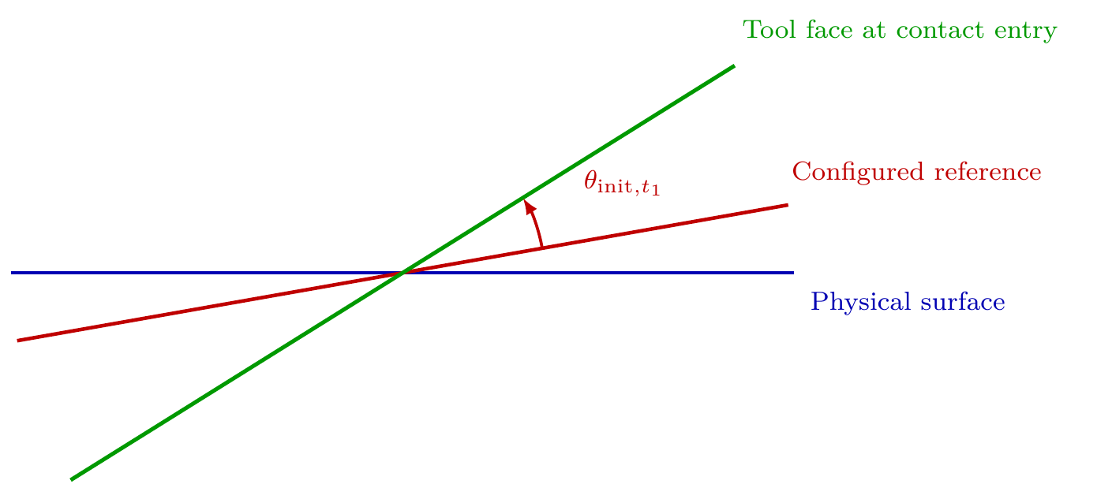

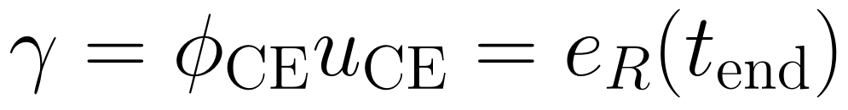
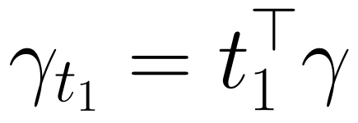
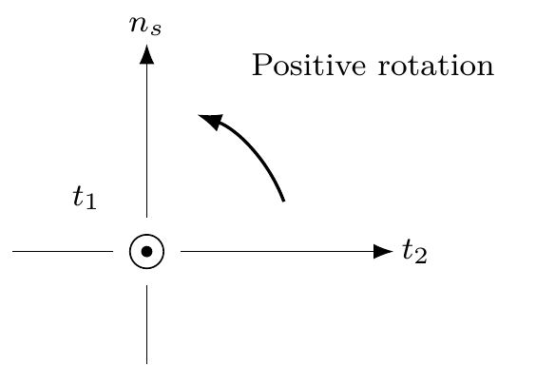


Backup — surface frame and response metric
BACKUP
Signed quantities used for the contact comparison
The measured response and the initial angular offset have the same sign when the rotation is toward the configured surface-parallel orientation.
Design and Implementation of a Real-Time Cartesian Impedance Controller
15
Master Thesis - Heykel Khadhraoui

Slide 16
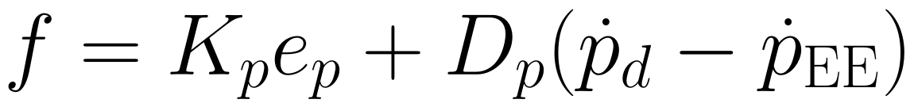


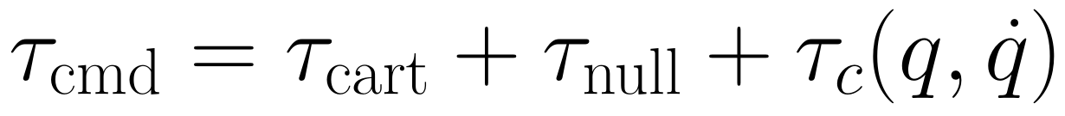



Backup — Cartesian impedance equations
BACKUP
Surface-relative translational and rotational impedance
During Contact Establishment the entry orientation is held as the reference; the later end-effector rotation is therefore the measured contact response.
Design and Implementation of a Real-Time Cartesian Impedance Controller
16
Master Thesis - Heykel Khadhraoui

Slide 17

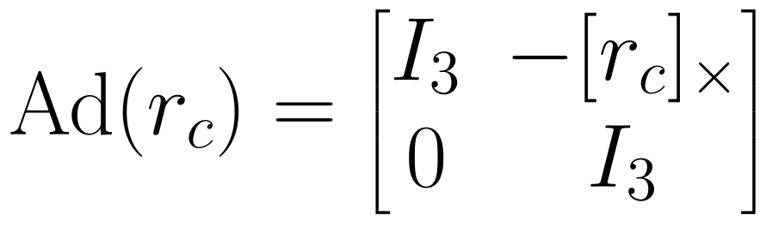



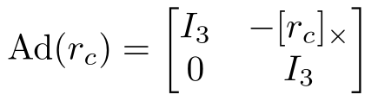



Backup — CoC transformation
BACKUP
Point-shift formulation used by the controller
Design and Implementation of a Real-Time Cartesian Impedance Controller
17
Master Thesis - Heykel Khadhraoui

Slide 18
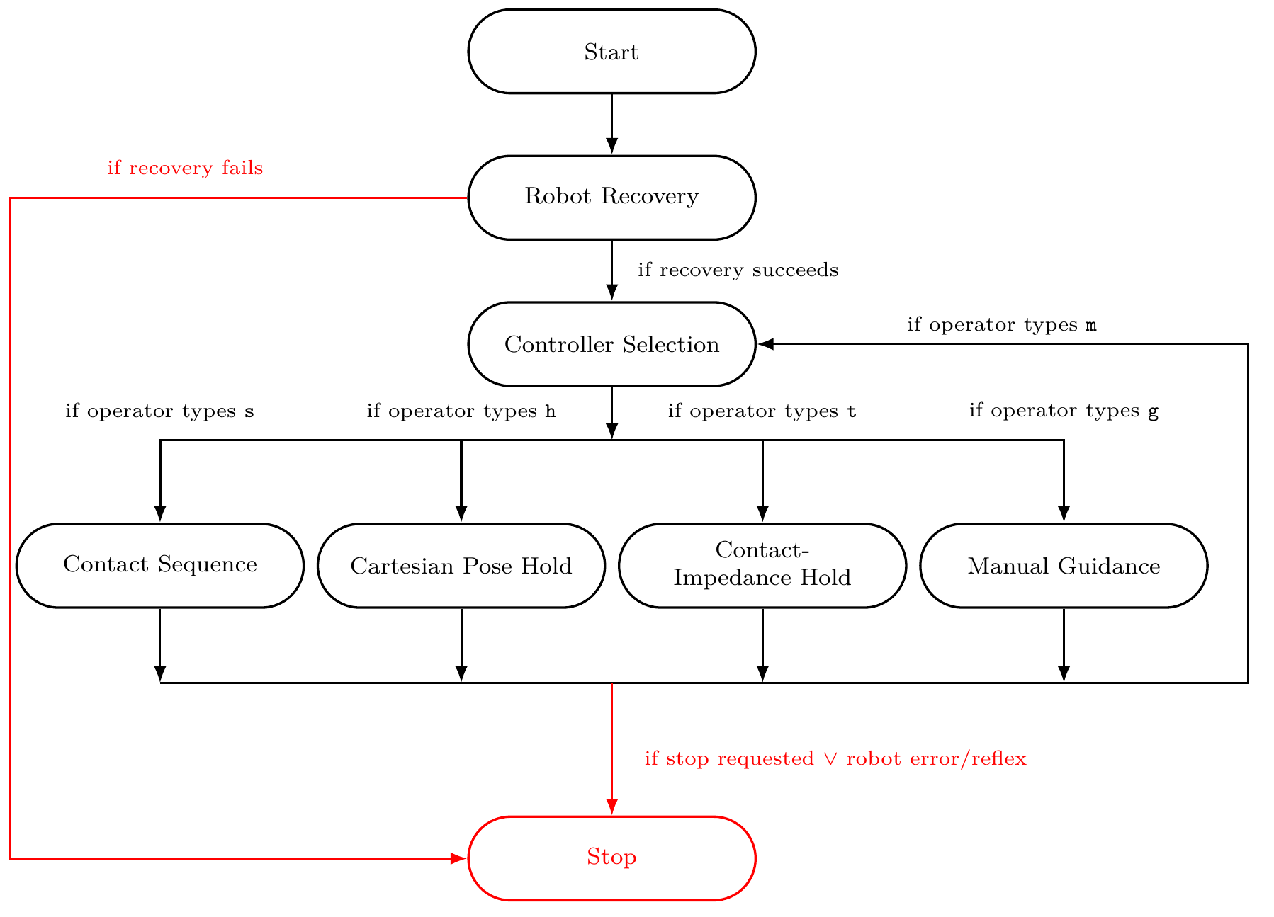
Backup — complete controller state flow
BACKUP
Program-level operating modes and common stop paths
Design and Implementation of a Real-Time Cartesian Impedance Controller
18
Master Thesis - Heykel Khadhraoui

Slide 19
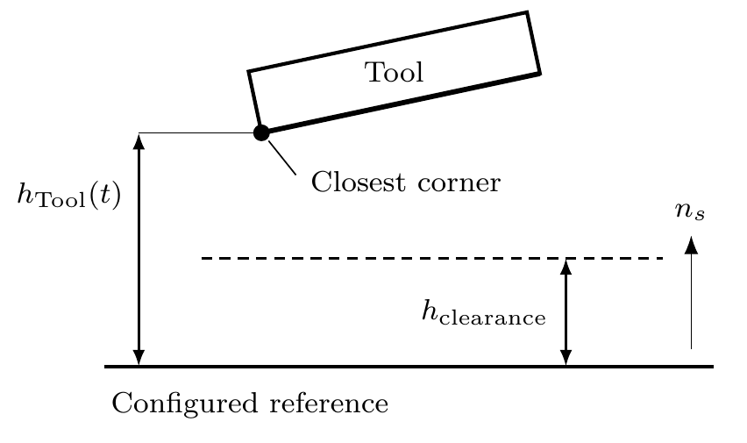
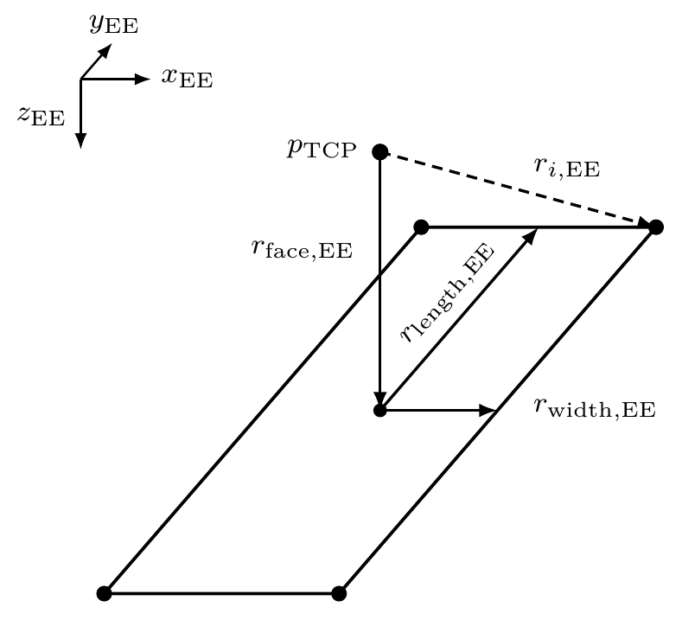
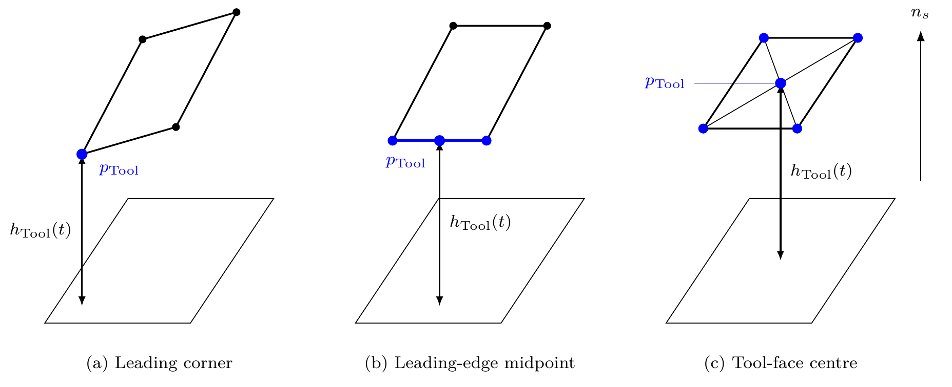
Backup — tool geometry and calibration
BACKUP
Clearance, leading feature, and configured surface reference
• Tool face: 40 × 120 mm; tool-centre offset: 20 mm.
• Approach ends when the minimum face clearance reaches 20 mm.
• The surface and tool-normal calibrations define the orientation metrics.
Design and Implementation of a Real-Time Cartesian Impedance Controller
19
Master Thesis - Heykel Khadhraoui

Slide 20
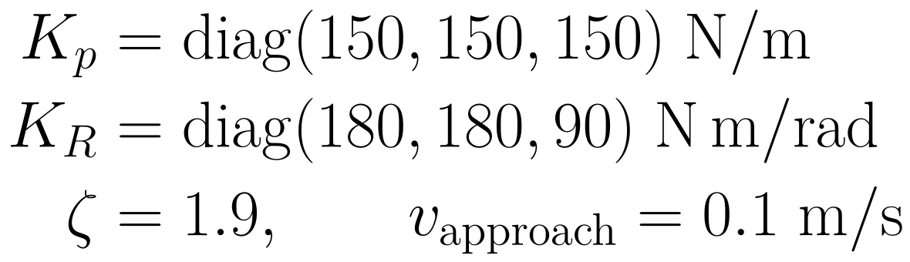
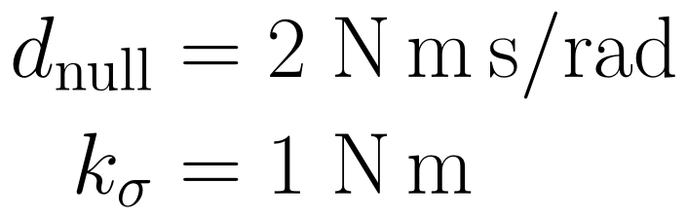
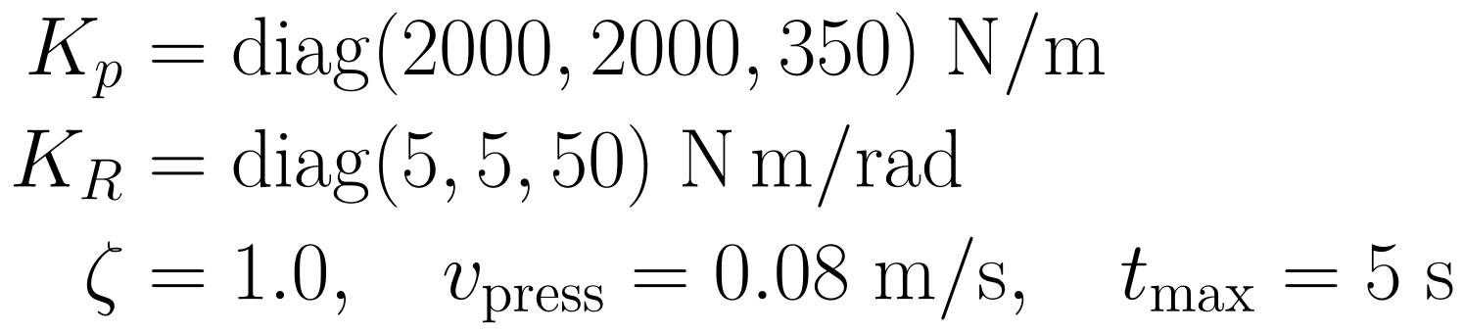
Backup — main gains and timings
BACKUP
Values held constant unless explicitly varied
Orientation / approach
Contact Establishment
Surface-contact null space
Each parameter setting was repeated three times.
Design and Implementation of a Real-Time Cartesian Impedance Controller
20
Master Thesis - Heykel Khadhraoui

Slide 21
Backup — surface-contact experimental matrix
BACKUP
Cases A–D and tested values
Case
Variable
Tested values
Trials
A
TCP-centred baseline
9
B
Rotational stiffness
6
C
Tangential translational stiffness
6
D
Tangential CoC position
36
Design and Implementation of a Real-Time Cartesian Impedance Controller
21
Master Thesis - Heykel Khadhraoui

Slide 22
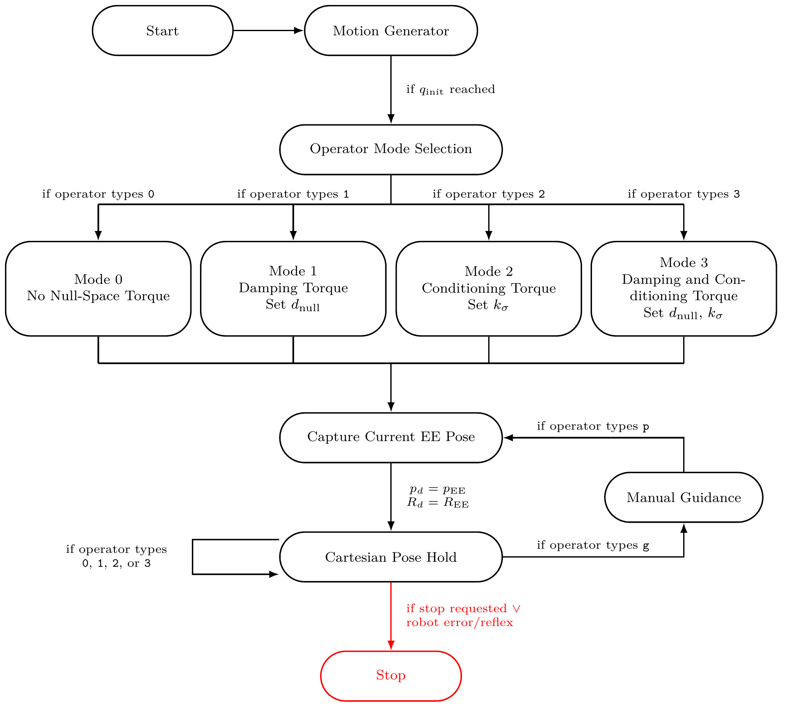

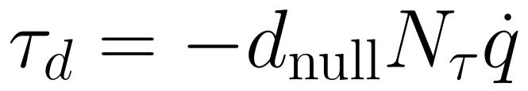




Backup — null-space controller and pose-hold test
BACKUP
Projected damping and singular-value conditioning
• 4 settings × 3 trials.
• 20 N virtual disturbance on link 3.
• Cartesian acceptance limit: 2 mm maximum position error.
Design and Implementation of a Real-Time Cartesian Impedance Controller
22
Master Thesis - Heykel Khadhraoui

Slide 23
Backup — software, safety, and logging
BACKUP
Implementation details for reproducibility
Software
Real-time handling
Robot-side monitoring
• Ubuntu 20.04.3 + PREEMPT_RT
• C++14 / Eigen 3.3.7
• libfranka 0.7.1
• Preallocated callback data
• Keyboard input on separate thread
• CSV write after torque control
• Robot errors/reflexes terminate control
• Collision thresholds remain robot-side
• Gravity compensation handled by FCI
Signals are logged at the nominal 1 kHz controller rate.
Design and Implementation of a Real-Time Cartesian Impedance Controller
23
Master Thesis - Heykel Khadhraoui

Slide 24

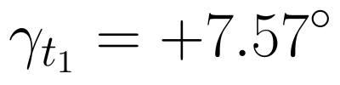

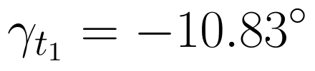












Backup — numerical result summary
BACKUP
Key values for questions
Comparison
Reference / low
Changed / high
Measured effect
Case A, + offset
81.3% of initial magnitude
Case A, − offset
115.1% of initial magnitude
Rotational stiffness
63.9% reduction
Translational stiffness
0.4% span
CoC, + offset
direction-selective
CoC, − offset
direction-selective
Projected damping
≈25% less cumulative motion
Conditioning 1.5 / 2.0
very small final displacement
Design and Implementation of a Real-Time Cartesian Impedance Controller
24
Master Thesis - Heykel Khadhraoui

