Slide 1

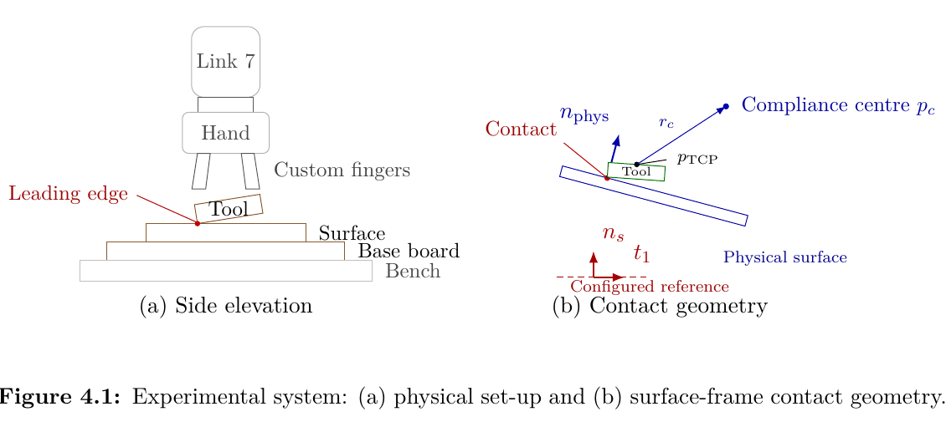
Design and Implementation of a Real-Time
Cartesian Impedance Controller for a
7-DOF Collaborative Robot
Contact-induced tool-surface alignment with a virtual centre of compliance
Heykel Khadhraoui
Master Thesis Defense · Computational Engineering (M.Sc.)
Supervisors: Prof. Norbert Nitzsche · Prof. Ruth Otto
Robot, tool and surface-contact geometry
Hochschule München · Faculty of Mechanical, Automotive and Aeronautical Engineering

Slide 2

Presentation overview
From the contact problem to the measured controller behaviour
1
Motivation and objective
Main question
2
Controller and CoC theory
How do stiffness and virtual CoC position influence passive tool-surface alignment during Contact Establishment?
3
Implementation and experiments
4
Results and interpretation
5
Conclusion and outlook
Master Thesis Defense · Heykel Khadhraoui
1

Slide 3
Motivation
Angular mismatch at contact entry can create edge-first loading
Surface placement, calibration and tool mounting introduce small orientation differences before contact.
A tilted rectangular face can first contact along an edge or corner, producing concentrated contact loads.
Rigid position control resists the corrective rotation. Finite rotational compliance allows contact interaction to rotate the tool towards the surface.
The aim is to keep the normal pressing action while allowing passive contact-induced alignment.
Experimental tool and surface geometry used in the thesis.
Master Thesis Defense · Heykel Khadhraoui
2

Slide 4
Thesis objective and contributions
What was implemented and what was measured
Controller contribution
Experimental contribution
Real-time Cartesian impedance controller for the Franka Emika Panda.
Directional translational and rotational stiffness and damping defined relative to the surface.
Software-defined virtual centre of compliance displaced from the TCP.
Projected null-space damping and singular-value conditioning.
Main contact study: Cases A–D.
Case A: TCP-centred baseline.
Case B: rotational stiffness.
Case C: translational stiffness along the surface.
Case D: signed tangential CoC position.
Separate Cartesian pose-hold study for the null-space controller.
Master Thesis Defense · Heykel Khadhraoui
3

Slide 5
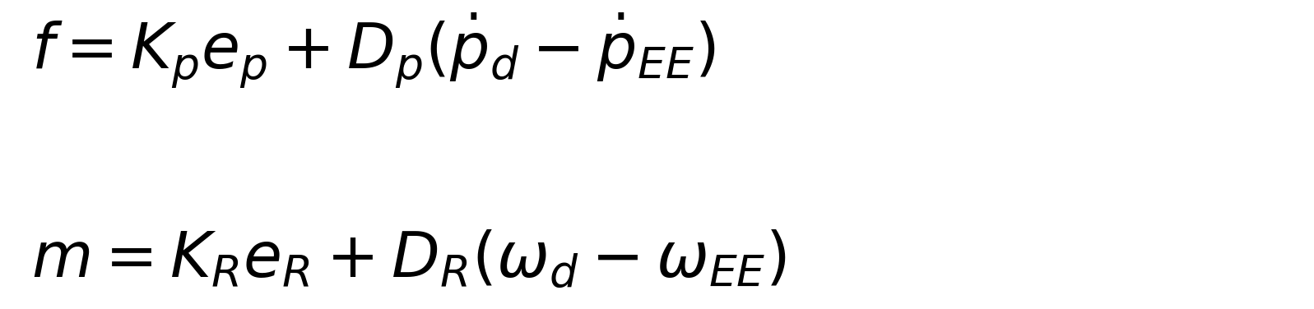

Cartesian impedance controller
The controller regulates position and orientation directly in Cartesian space
Impedance wrench
Joint-torque command
Jᵀ maps the commanded Cartesian wrench to joint torque.
τnull is an additive secondary torque projected into the kinematic null space.
τc supplies the Coriolis/centrifugal model term required by the robot interface.
The surface frame provides the physically relevant directions: t₁, t₂ and nₛ. Stiffness and damping are assigned separately along/about these directions.
Master Thesis Defense · Heykel Khadhraoui
4

Slide 6
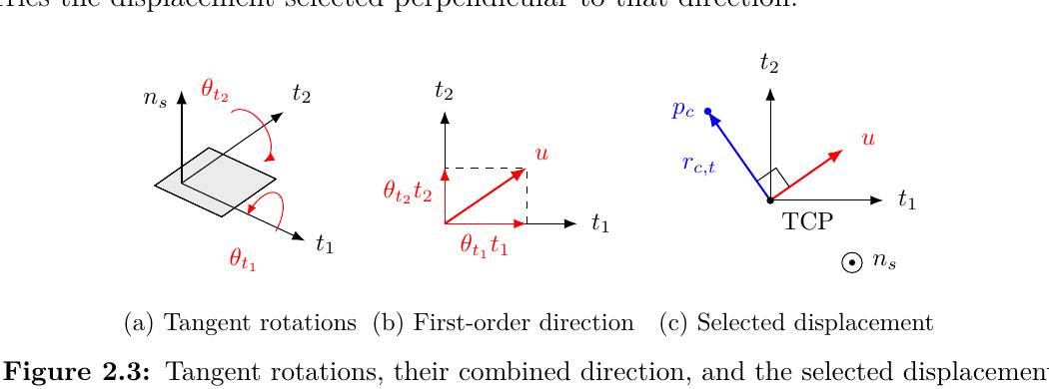

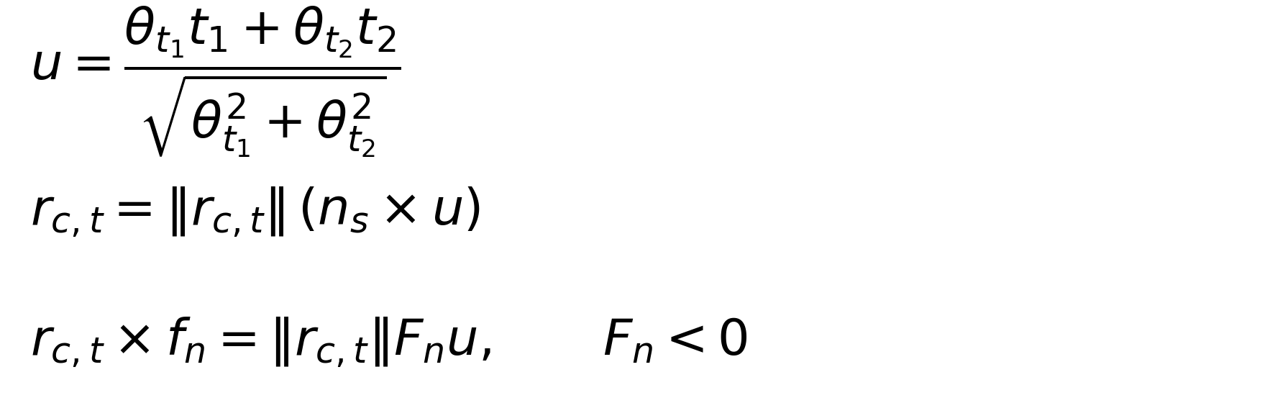
Virtual centre of compliance
A displaced reference couples normal pressing to a selectable rotational moment
Interpretation
Small-angle tilt direction and the selected tangential CoC displacement.
The CoC magnitude sets the lever length, while its tangential direction sets the sign and axis of the additional TCP moment generated by the press.
Master Thesis Defense · Heykel Khadhraoui
5

Slide 7
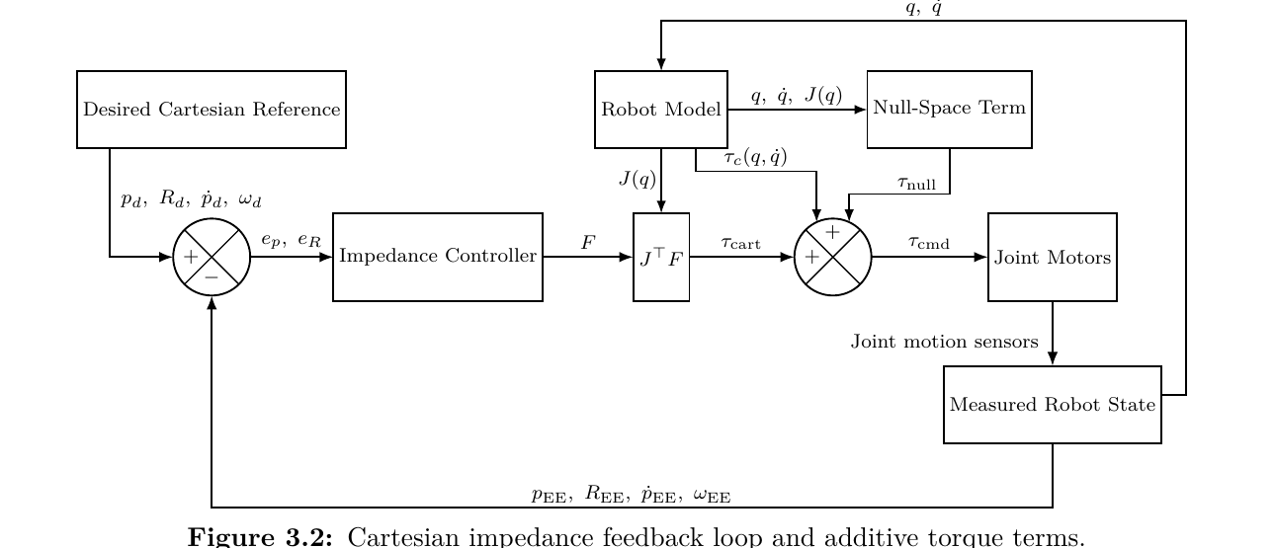
Real-time implementation
One 1 kHz callback evaluates the reference, impedance wrench and torque command
The active state provides the desired Cartesian reference and the state-specific gains.
The measured robot state supplies pose, velocity, joint state and Jacobian information.
During Contact Establishment, the orientation reference is held at the entry orientation; the measured rotation is therefore contact-induced.
The same torque-level architecture is used for the contact study and the separate pose-hold study.
Cartesian impedance feedback loop and additive torque terms.
Master Thesis Defense · Heykel Khadhraoui
6

Slide 8
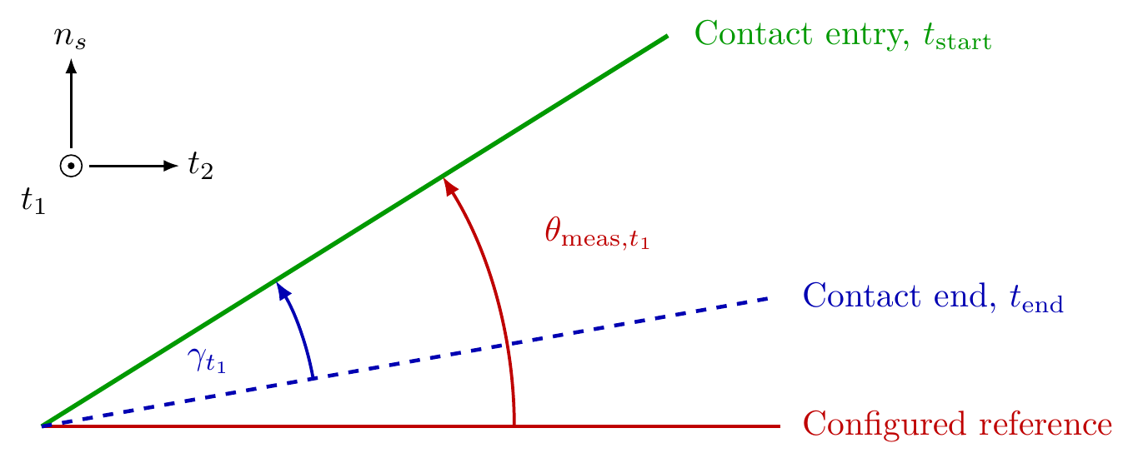
Contact sequence and experiment design
The measured response is generated during Contact Establishment
Tool
Orientation
Surface
Approach
Contact
Establishment
Pre-Grinding
Hold
Grinding
Main contact matrix
Case A — CoC at TCP; three measured entry offsets.
Case B — rotational stiffness about t₁.
Case C — tangential translational stiffness along t₂.
Case D — tangential CoC position for both angular-offset directions.
Three repetitions per parameter setting.
Measured entry offset: configured reference → contact entry.
Contact response: contact end → entry, opposite to the end-effector rotation during contact.
Master Thesis Defense · Heykel Khadhraoui
7

Slide 9
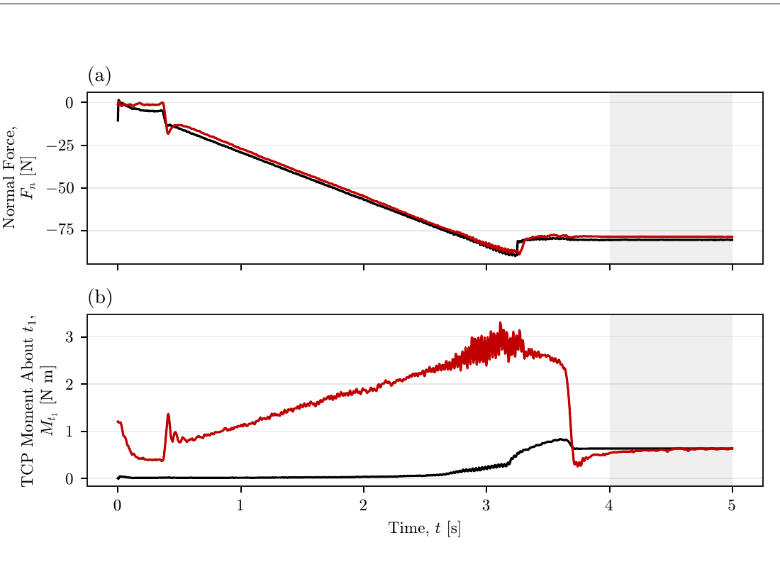
Controller wrench evaluation
Commanded and model-estimated interaction quantities agree closely in stationary contact
2.32%
4.87%
normal-force difference
moment difference
The comparison uses one TCP-centred positive-offset Contact Establishment trial.
Both commanded and model-estimated quantities are expressed at the TCP and resolved on the same surface axes.
The small stationary differences support using the robot’s model-estimated wrench as the measured interaction wrench available from the robot.
Master Thesis Defense · Heykel Khadhraoui
8

Slide 10
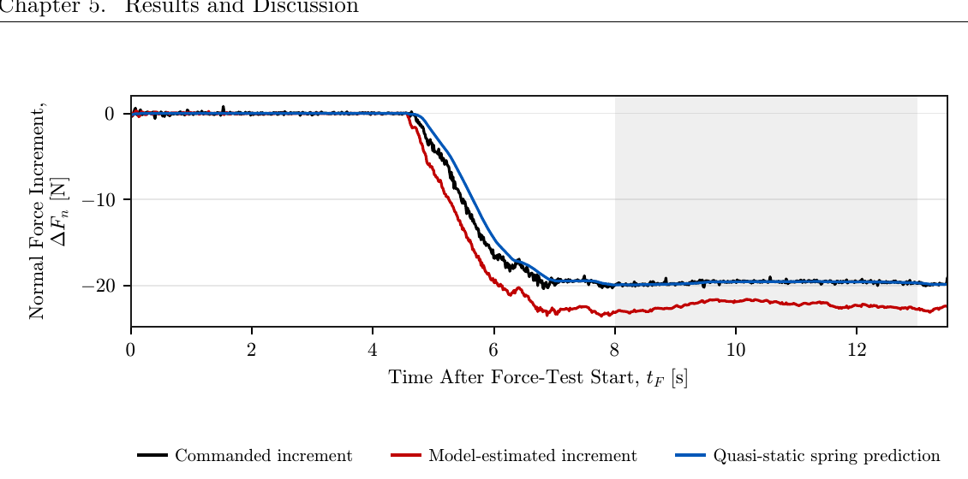
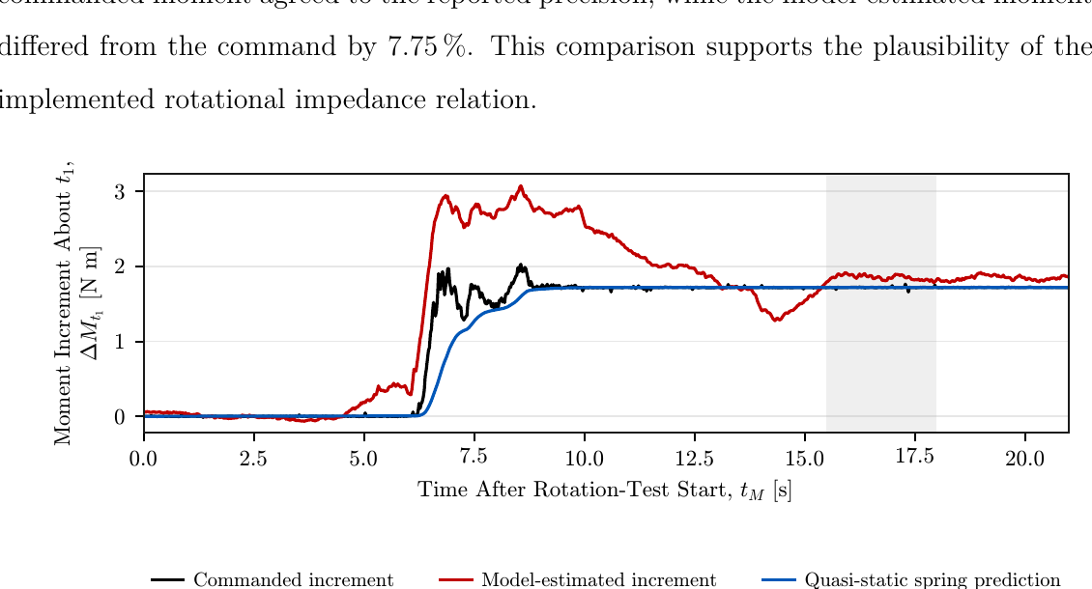
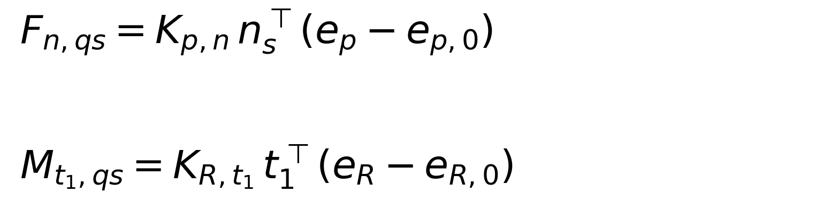
Quasi-static plausibility assessment
Separate translational and rotational perturbations check the implemented stiffness relations
Normal-force perturbation
Moment perturbation about t₁
Quasi-static prediction vs commanded: 0.05% for force and agreement to reported precision for moment. Model-estimated differences were 13.50% and 7.75%, respectively.
Master Thesis Defense · Heykel Khadhraoui
9

Slide 11
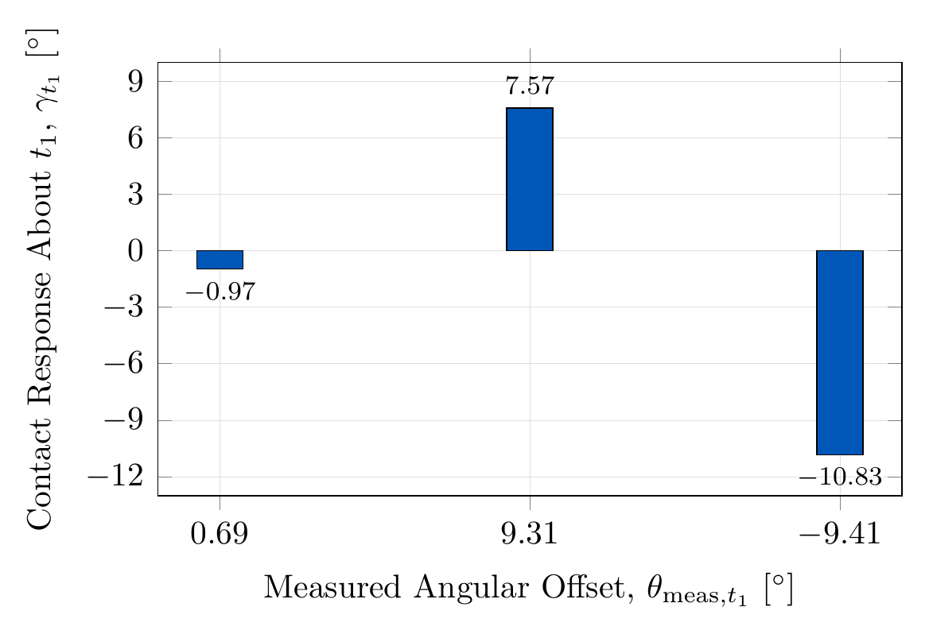
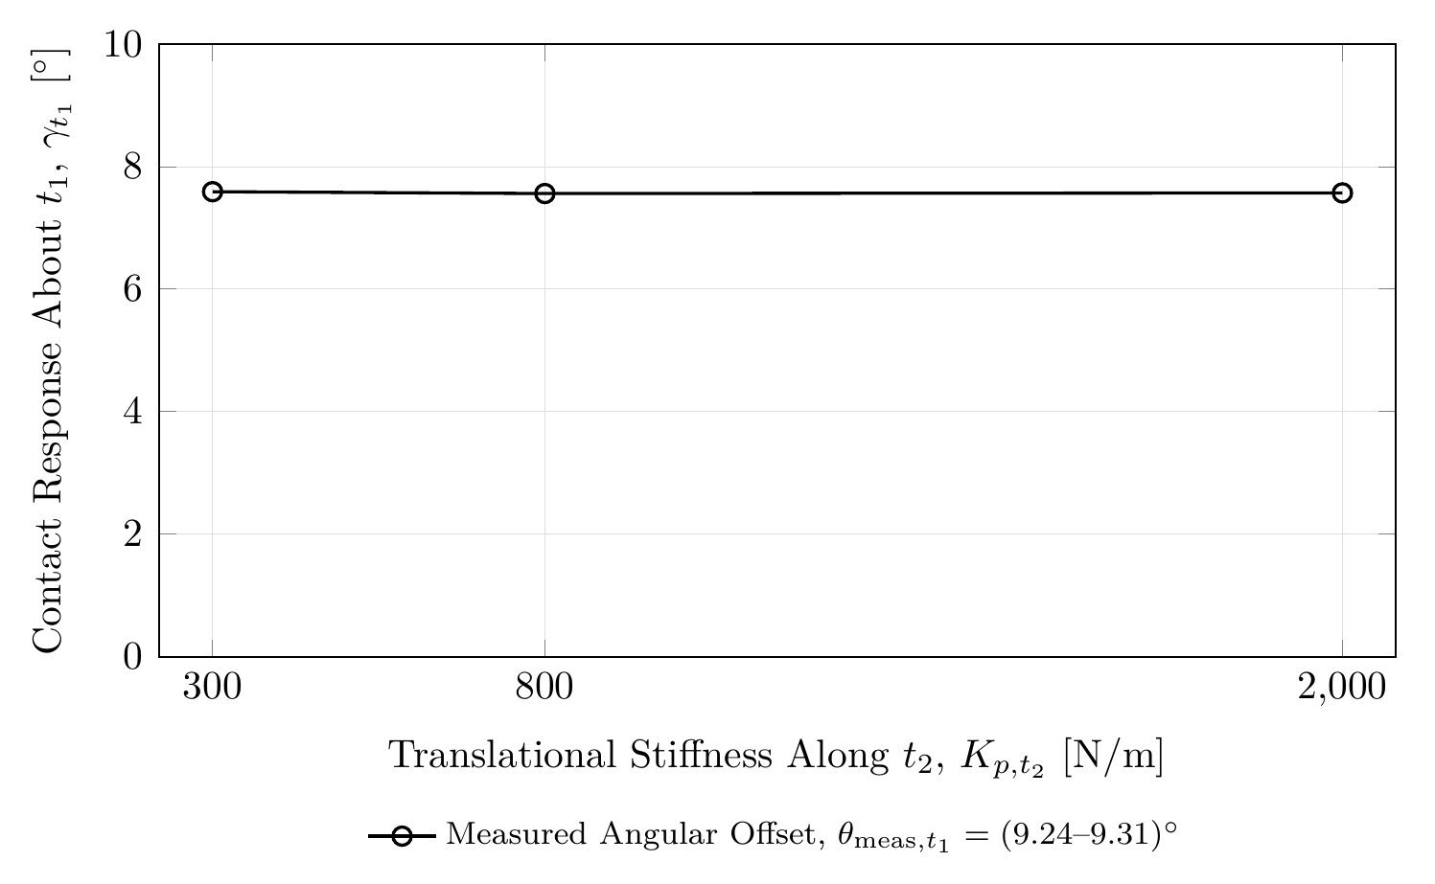
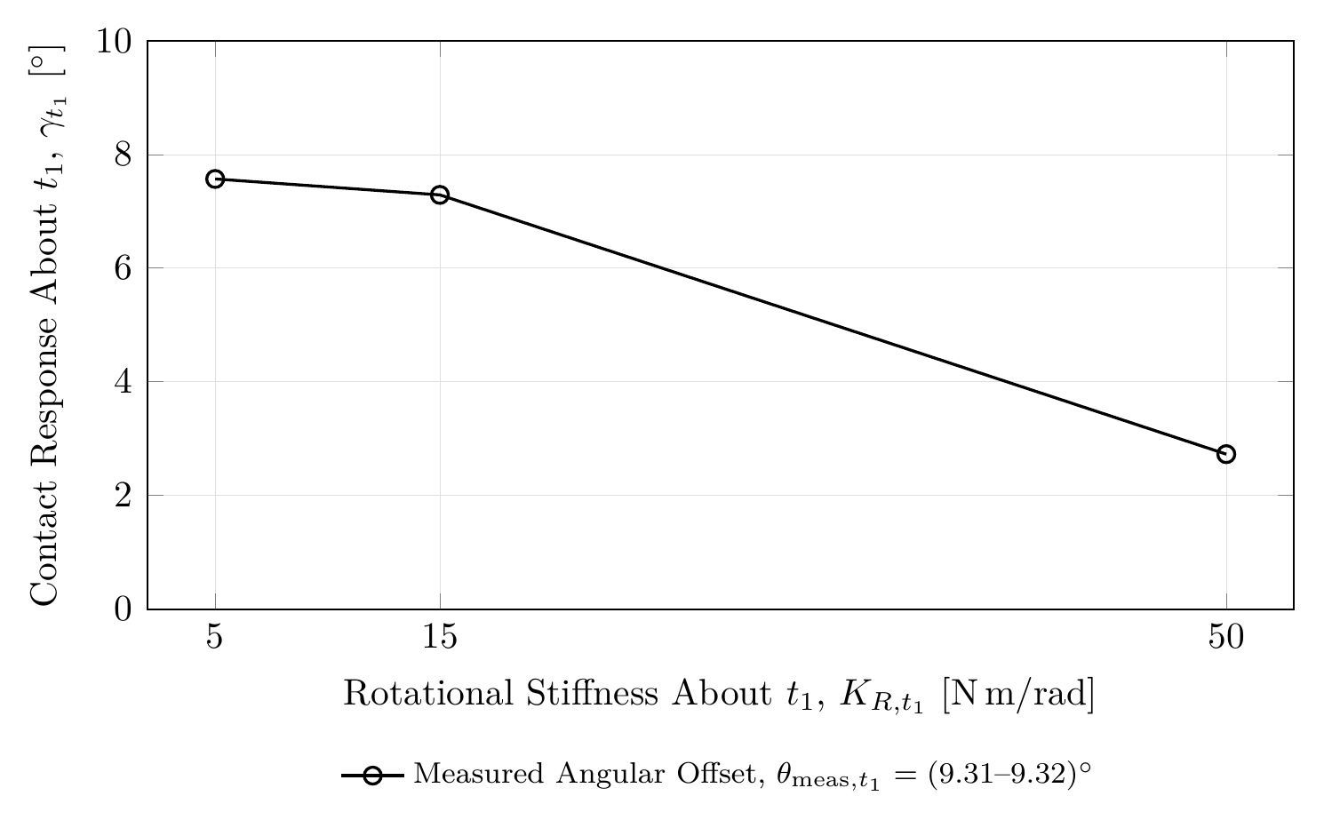
Main results I — baseline and stiffness
Cases A–C establish how strongly the response depends on the basic impedance settings
Case A — TCP baseline
Case B — rotational stiffness
Case C — translational stiffness
Case A: contact-induced rotation occurred towards the configured surface for both tested rotational directions.
Case B: increasing K_R,t₁ from 5 to 50 N m/rad reduced the response from 7.57° to 2.73° — a 63.9% reduction.
Case C: the tested K_p,t₂ variation changed the response by only 0.03°, equal to about 0.4% of the TCP-centred reference.
Master Thesis Defense · Heykel Khadhraoui
10

Slide 12
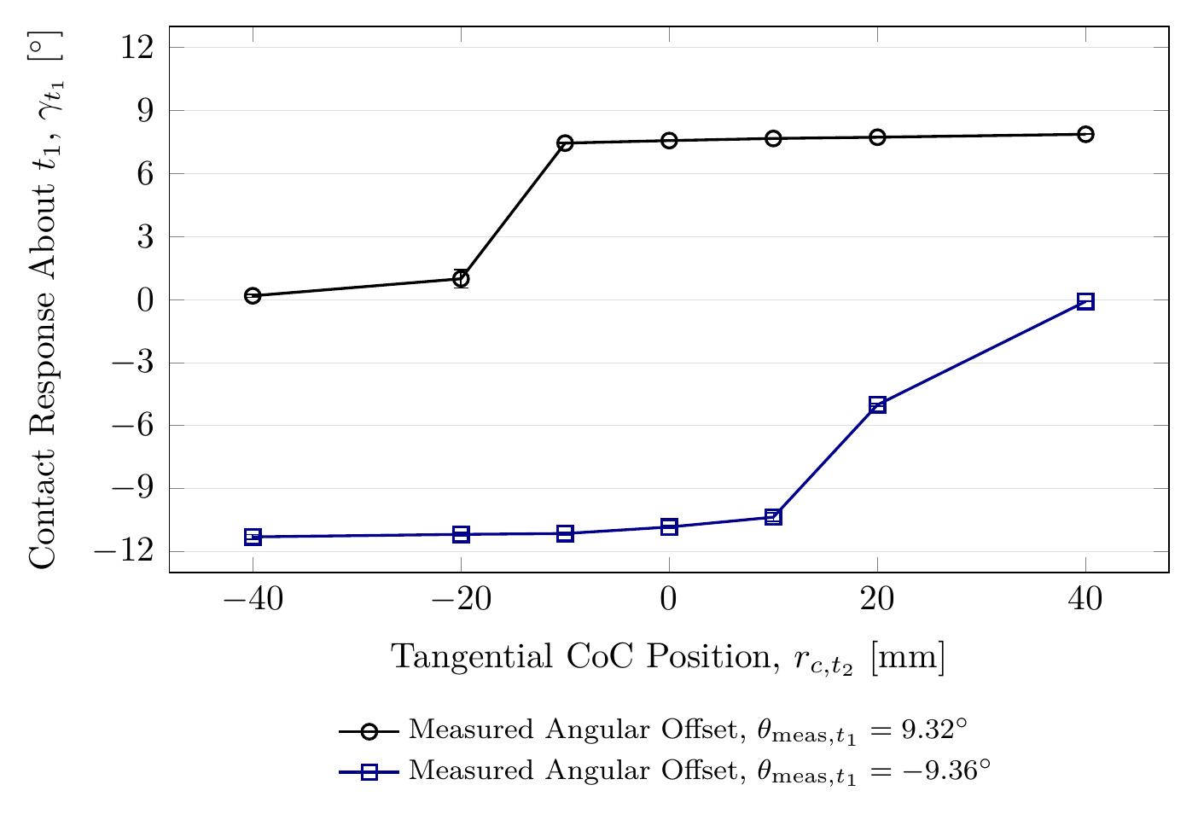
Main results II — tangential CoC position
The CoC displacement strongly changes the preferred rotational direction
Case D findings
For the positive offset, moving the CoC from −40 mm to +40 mm increased the measured response from 0.18° to 7.87°.
For the negative offset, the same CoC sweep changed the response from −11.30° to −0.09°.
A suitably selected displaced CoC increased the final response only slightly (~4%) but produced faster alignment.
The opposite displacement direction reduced the response by approximately 98–99%.
Main interpretation: the displaced CoC acts primarily as a selector of the preferred rotational direction.
Master Thesis Defense · Heykel Khadhraoui
11

Slide 13
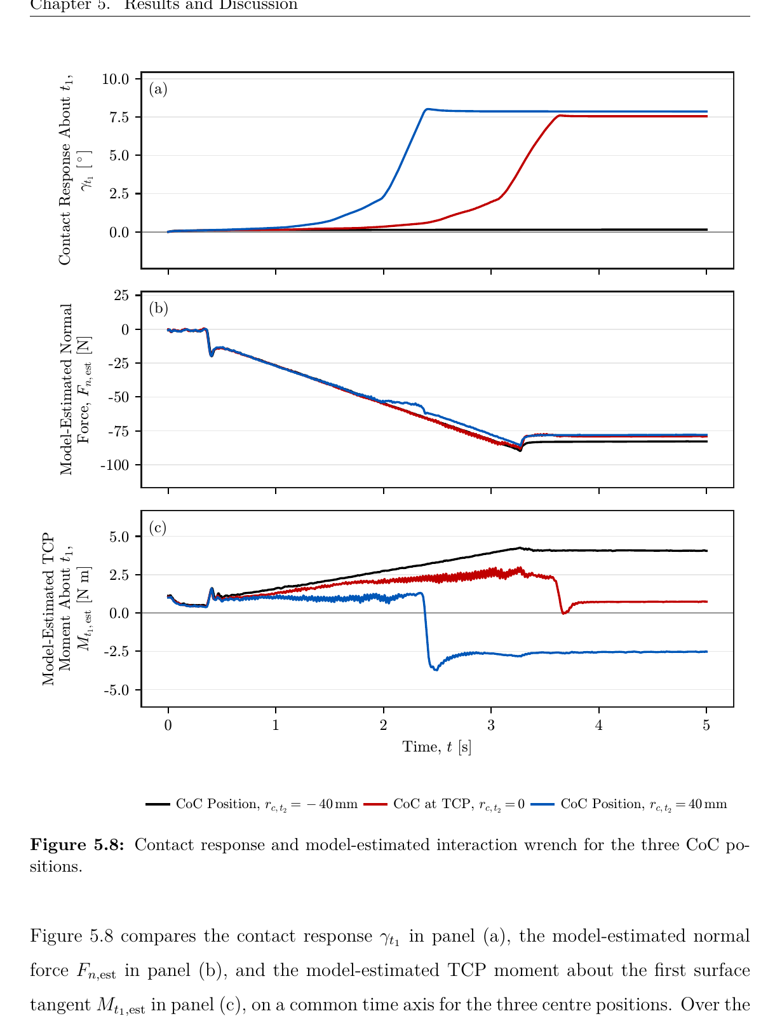
Main results III — mechanism behind the CoC effect
The estimated contact moment changes strongly while the normal force remains similar
Final stationary values
CoC position: −40 mm TCP +40 mm
Estimated Fₙ [N]
−82.9 −79.0 −78.0
Estimated Mₜ₁ [N m]
+4.07 +0.73 −2.54
The normal force changes little, whereas the TCP moment changes sign and magnitude. The measured rotational response follows this change.
Master Thesis Defense · Heykel Khadhraoui
12

Slide 14
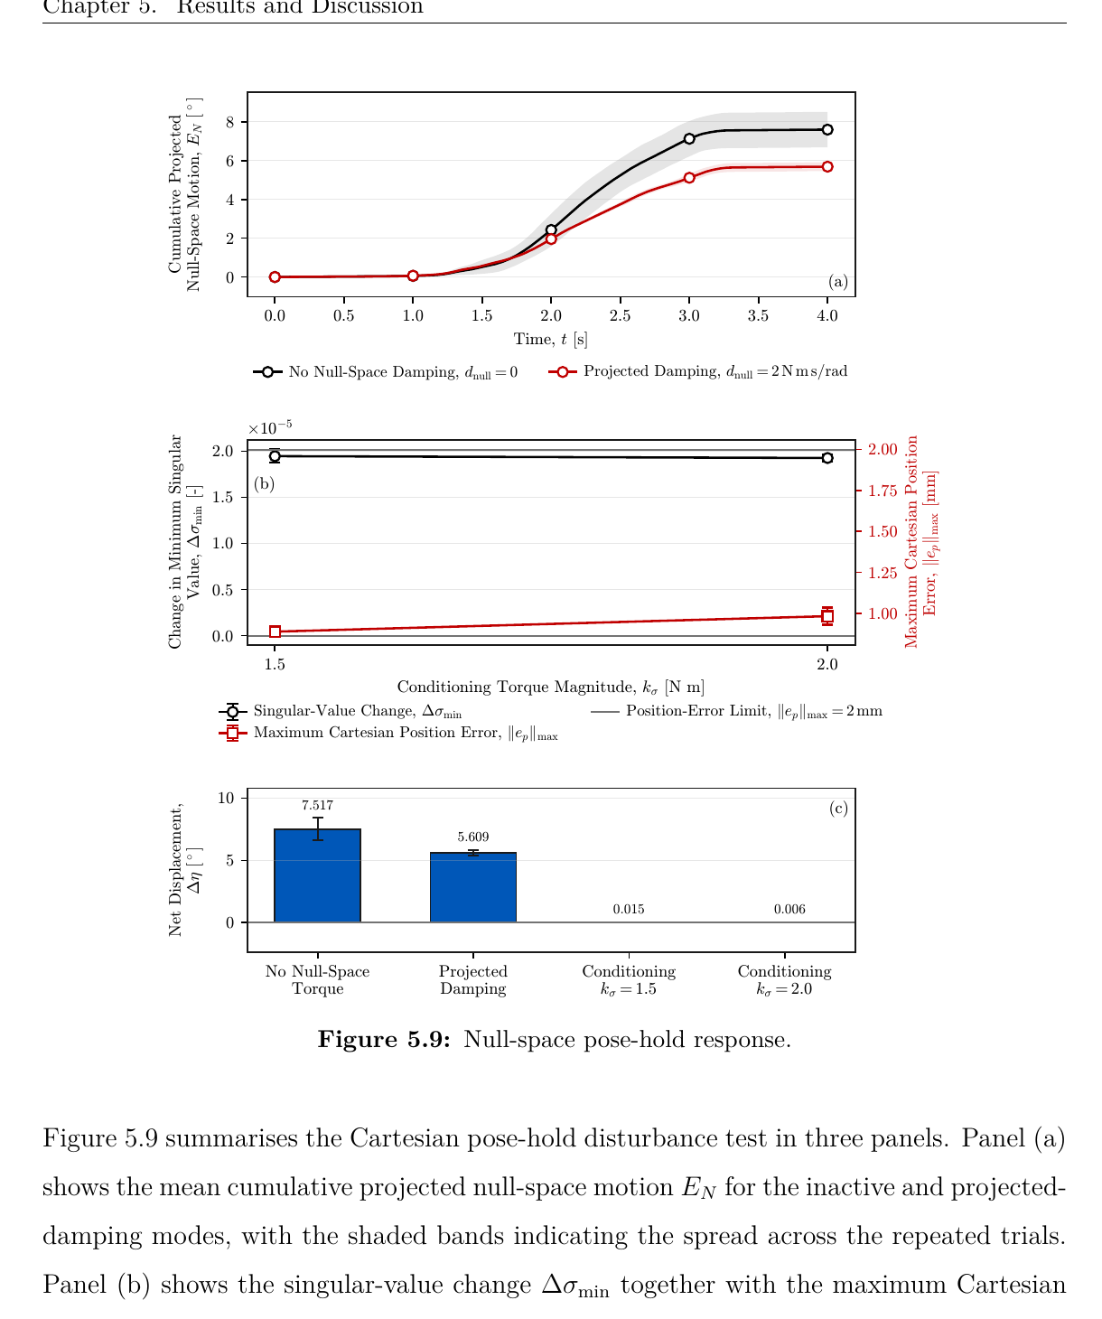

Secondary study — null-space pose hold
Projected damping and singular-value conditioning modify redundant joint motion while the Cartesian pose is held
Measured effects
Projected damping reduced cumulative projected null-space motion from 7.596° to 5.687° — about 25%.
Singular-value conditioning reduced the net displacement from 7.517° to 0.015° and 0.006° for the two tested torque magnitudes.
This corresponds to approximately 99.8–99.9% reduction in net displacement.
All tested conditioning cases remained below the 2 mm Cartesian position-error criterion.
The larger conditioning torque produced more cumulative back-and-forth motion despite a similar final region.
Master Thesis Defense · Heykel Khadhraoui
13

Slide 15
Main findings
What the experiments establish together
1
Rotational compliance enables passive contact-induced alignment.
2
Rotational stiffness has a strong effect; the tested translational stiffness variation has only a small effect.
3
The tangential CoC position strongly biases the rotational response through the additional TCP moment.
4
The TCP-centred CoC is direction-neutral and therefore a sensible final configuration after alignment.
5
Projected damping and singular-value conditioning provide complementary null-space behaviour.
Core takeaway: CoC placement is a directional control parameter, not only a scalar lever length.
Master Thesis Defense · Heykel Khadhraoui
14

Slide 16
Limitations and future work
Scope of the present conclusions and the next controller step
Limitations
Future work
One robot configuration, one rectangular tool, one configured surface and one Contact Establishment trajectory.
The physical tool-surface angle and instantaneous contact point were not measured directly.
The model-estimated wrench is not an independent force/torque-sensor measurement.
Tool-mount angular play can make the physical tool-face motion differ from the measured end-effector motion.
Grinding itself was implemented but not quantitatively evaluated in this study.
Measure the physical tool-surface angle and validate the interaction wrench with an external F/T sensor.
Evaluate a more rigid tool mount and additional surface/tool configurations.
Implement an adaptive CoC strategy: start at the TCP, estimate the angular offset, temporarily select the supporting tangential displacement, then return the CoC to the TCP after alignment.
Extend the evaluation to sustained grinding and automatic contact-quality measures.
Master Thesis Defense · Heykel Khadhraoui
15

Slide 17
Conclusion
A real-time virtual compliance reference can shape passive tool-surface alignment
The Cartesian impedance controller generated the required normal pressing action while allowing contact-induced rotation towards the configured surface.
The experiments show that the displaced virtual CoC mainly changes the rotational moment and therefore the preferred direction of the alignment response.
A supporting CoC direction can accelerate and slightly increase the response, while the opposite direction can almost suppress it.
This motivates an adaptive CoC strategy that uses a temporary direction-selected displacement and returns to the TCP after alignment.
Thank you
Questions?
Master Thesis Defense · Heykel Khadhraoui
16

