Slide 1
AI – BASED SALES FORECASTING
MEMBERS
Suyash Jadhav – BTECH/10779/23
Shubham Raj – BTECH/10820/23
Madhur Anand – BTECH/10650/23
Shrishti Mishra – BTECH/10612/23
Mihika Lakra – BTECH/10580/23

Slide 2
Problem Statement & Objectives
THE PROBLEM
OUR OBJECTIVE
Unpredictable sales fluctuations cause inventory imbalances — overstocking wastes capital, while understocking loses revenue.
Reactive supply chain management means businesses are always catching up, never ahead.
Traditional forecasting methods fail to capture complex seasonal patterns and market shifts.
Build an AI-driven time-series forecasting model using the Kaggle Superstore dataset.
Leverage Facebook Prophet to predict future daily sales with confidence intervals.
Enable proactive inventory decisions — move from reactive management to data-driven foresight.

Slide 3
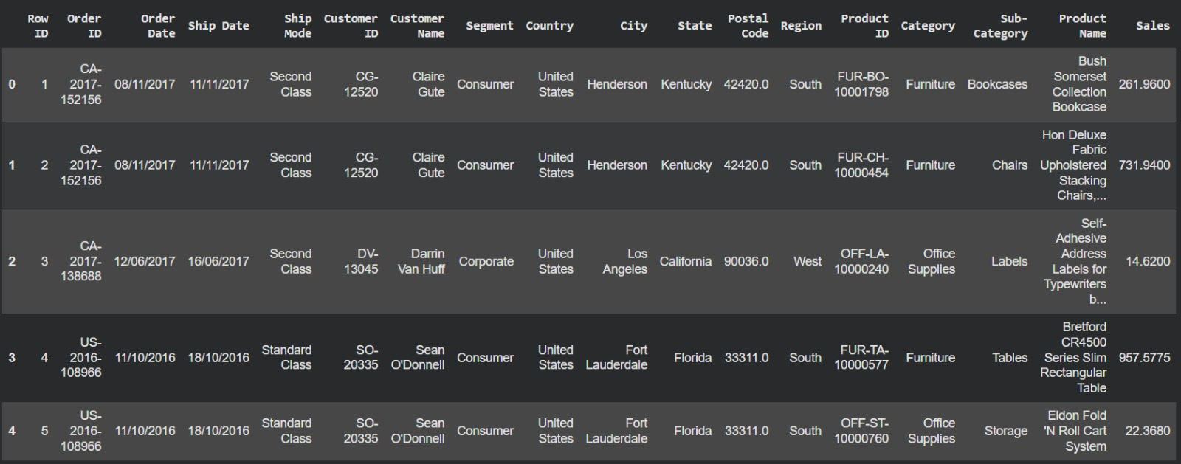
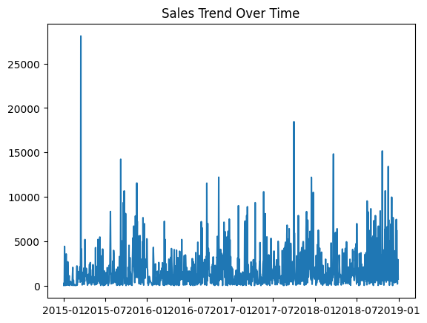
Dataset Overview & Exploratory Analysis
9,994 Orders
Total transactions in dataset
4 Regions
West, East, Central, South
3 Categories
Furniture, Tech, Office Supplies
4 Years Data
2015 – 2018 daily records

Slide 4
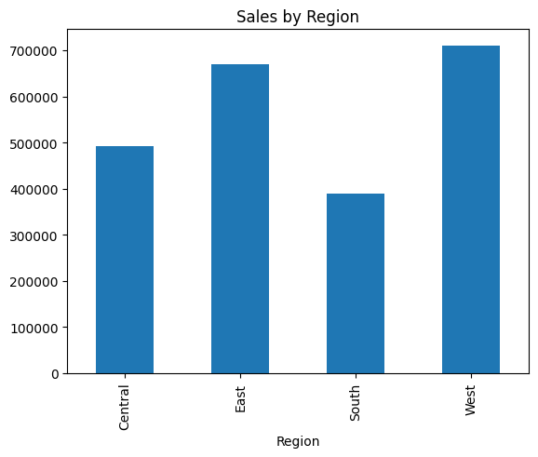
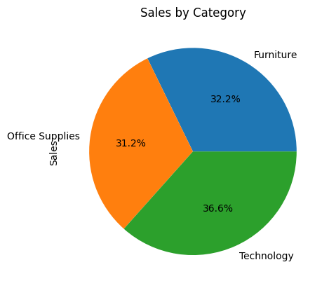
Sales Insights — EDA Results
West region leads with ~$710K in total sales
Technology is the top category at 36.6% of sales
Sales by Region
Sales by Category

Slide 5
Model Overview and Architecture
1
Algorithm
2
Model Governance and Tracking
Algorithm Used: Facebook Prophet (an open-source time-series forecasting library).
Purpose: Designed specifically for analyzing business time-series data with strong seasonal effects and missing data points.
Target Variable: Total Daily Sales Amount (y).
Time Feature: Order Date (ds), aggregated at the daily level.
Experiment Tracking: Fully integrated with MLflow to log all training runs, parameters, and evaluation metrics automatically.
Model Registry: The best model is registered within the Microsoft Fabric Model Registry under the name prophet_sales_forecaster.
Model Signature: MLflow automatically infers and logs the input/output schema (the model signature), ensuring that the batch scoring pipeline knows exactly what data types to pass in.

Slide 6
Predictive Modeling Features
1
Algorithm Configuration and Seasonality
2
Performance Evaluation and Validation
Captures Business Cycles: Explicitly uses yearly and weekly seasonality to detect macroeconomic trends and day-of-week patterns.
Multiplicative Scaling: Configured with "multiplicative" seasonality, ensuring that as overall sales volume grows, seasonal peak variations scale proportionally with it.
Optimized Trend Flexibility: Uses a change point_prior_scale of 0.05 to perfectly balance the model against underfitting (too stiff) and overfitting (too volatile).
Accuracy Tracking: Continuously monitors in-sample error metrics including MAE (dollar error), RMSE (stability), and MAPE (percentage error).
Rigorous Cross-Validation: Utilizes a time-series rolling window approach for out-of-sample testing (365-day initial training window, sliding forward by 90 days, evaluated on a 30-day hidden future period).

Slide 7
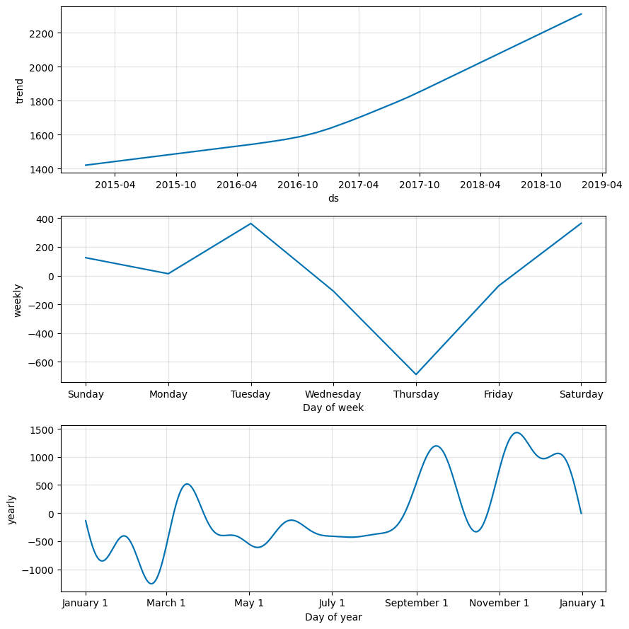
Model Architecture — Facebook Prophet
Input Data
ds = Date
y = Sales
Trend
Growth over
time
Seasonality
Weekly +
Yearly cycles
Noise
Random market
variation
Output
yhat, upper
lower bounds
Prophet Formula: y(t) = trend(t) + seasonality(t) + noise(t)

Slide 8
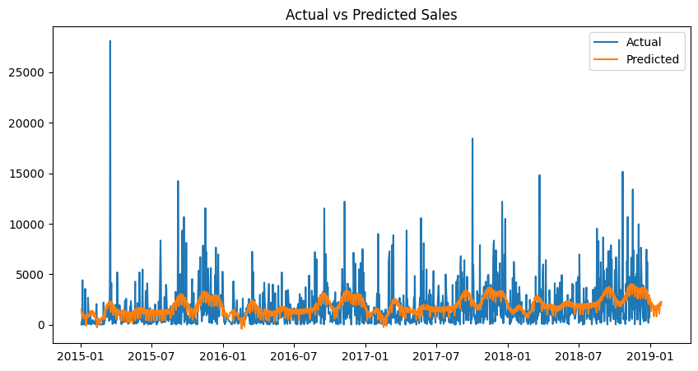
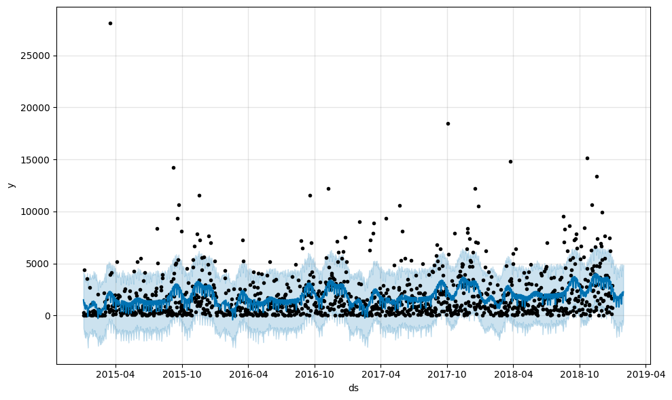
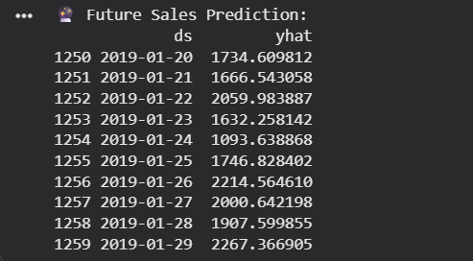
Forecast Results — Actual vs Predicted
Future Predictions (Jan 2019)
2019-01-20
$1,734.61
2019-01-21
$1,666.54
2019-01-22
$2,059.98
2019-01-23
$1,632.26
2019-01-24
$1,093.64
2019-01-25
$1,746.83
2019-01-26
$2,214.56
2019-01-27
$2,000.64
2019-01-28
$1,907.60
2019-01-29
$2,267.37

Slide 9
Results, Impact & Conclusion
1.
2.
3.
Sales Decline Detected
Sales Surge Predicted
Supply Chain Stability
Trigger targeted discounts & marketing campaigns to boost demand before shortfall occurs.
Proactively increase inventory ordering to meet demand without stockouts.
Precise forecasts prevent over-manufacturing, reduce waste and stabilize local distribution.
Prophet successfully captured historical sales nuances — transitioning retail strategy from reactive management to proactive, AI-driven foresight.

