Slide 1

Problem F – Verilog Simulation Optimization via Instruction Reduction
Introduction to IC Design Automation
Department of Computer Science and Engineering
Yuan Ze University
Team Name:
IndexO
Team Member’s Names:
張晉瑋
Team Member’s ID#’s:
1071524
Date: 04/13/2021

Slide 2
Outline
Problem Description
Algorithm to Solve the Problem
Data Structures
Experimental Results
Difficulties

Slide 3
Outline
Problem Description
Algorithm to Solve the Problem
Data Structures
Experimental Results
Difficulties

Slide 4
Background
Hardware simulation with CPU is basically a compiler topic.
Intermediate Representations (IR)
Minimizing instructions is beneficial to reduce runtime due to less code being executed and data locality
Verilog Simulation Optimization via Instruction Reduction

Slide 5
Problem Description
Convert a given Verilog design into an optimized Verilog design (source-to-source, .v-to-.v)
The objective is to minimize the total number of continuous assignments and vector bit/part-selects in the Verilog design

Slide 6
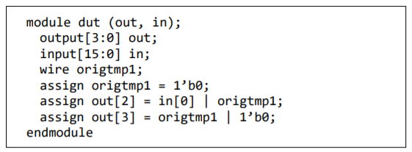

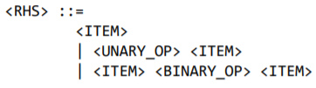
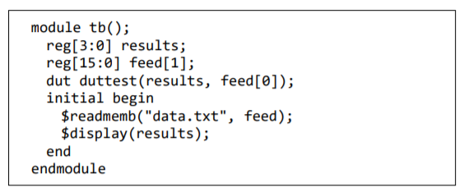
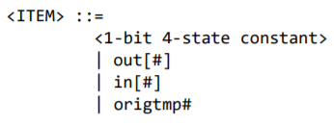

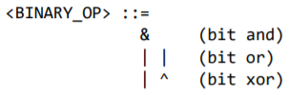
Input

Slide 7
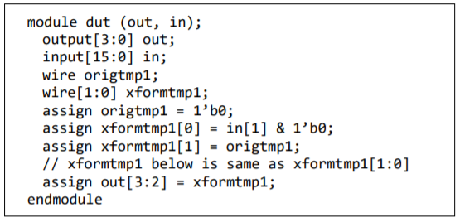



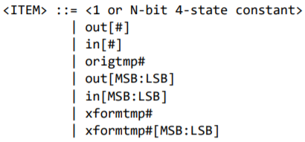
Output

Slide 8
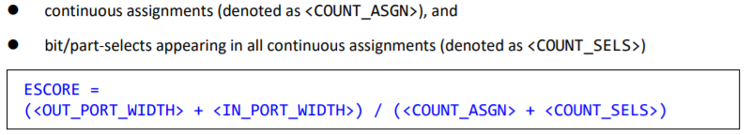
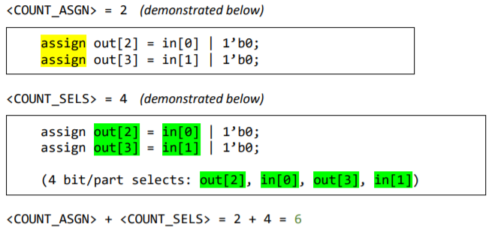


Evaluation

Slide 9
Outline
Problem Description
Algorithm to Solve the Problem
Data Structures
Experimental Results
Difficulties

Slide 10
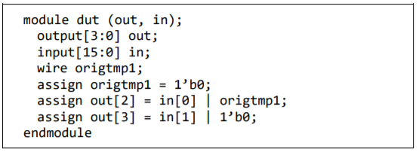
Example

Slide 11
Constant Case (1/3)
1’b1
wire
out
1’b1
out
1’b0
wire
out
1’b0
out

Slide 12
Constant Case (2/3)
1’b1
or
out
in
1’b1
out

Slide 13
Constant Case (3/3)
1’b0
or
out
in
in
out

Slide 14
Merge Case (1/2)
1’b0
or
out [3]
in[1]
1’b0
or
out
[4]
in[2]

Slide 15
Merge Case (2/2)
2’b0
or
out [3:4]
in
[1:2]
in
[1:2]
or
out [3:4]
by constant case

Slide 16
Outline
Problem Description
Algorithm to Solve the Problem
Data Structures
Experimental Results
Difficulties

Slide 17
Data Structures
State
std::vector<State> *edge
int type (start, end, bit, wire, …)
int MSB
int LSB
int value

Slide 18
Experimental Results
Show the results and your analysis if you have any. This can have as many pages as you wish.
Also show the runtime of your program
If you are still on coding, show 2 pages of code you have written here.

Slide 19
Difficulties
Describe the difficulties you encountered and how you overcome the difficulties if you have done so.

