Slide 1

Problem F – Verilog Simulation Optimization via Instruction Reduction
Introduction to IC Design Automation
Department of Computer Science and Engineering
Yuan Ze University
Team Name:
IndexO (cadb0061)
Team Member’s Names:
張晉瑋
Team Member’s ID#’s:
1071524
Date: 07/22/2021

Slide 2
Outline
Problem Description
Algorithm to Solve the Problem
Data Structures
Experimental Results
Difficulties

Slide 3
Outline
Problem Description
Algorithm to Solve the Problem
Data Structures
Experimental Results
Difficulties

Slide 4
Background
Hardware simulation with CPU is basically a compiler topic.
Intermediate Representations (IR)
Minimizing instructions is beneficial to reduce runtime due to less code being executed and data locality
Verilog Simulation Optimization via Instruction Reduction

Slide 5
Problem Description
Convert a given Verilog design into an optimized Verilog design (source-to-source, .v-to-.v)
The objective is to minimize the total number of continuous assignments and vector bit/part-selects in the Verilog design

Slide 6
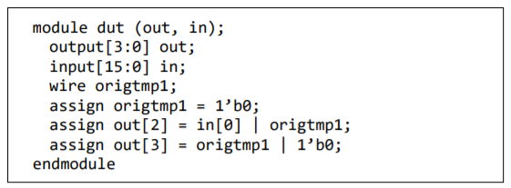

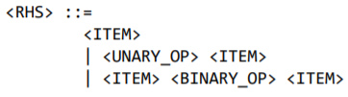
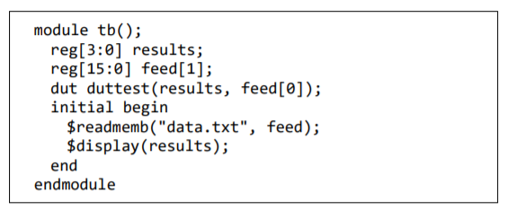
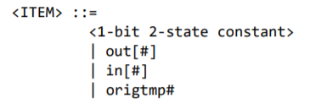

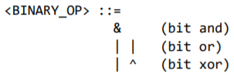
Input

Slide 7
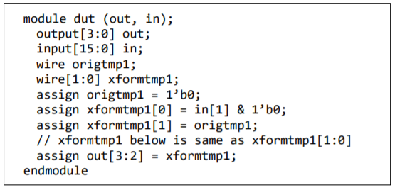



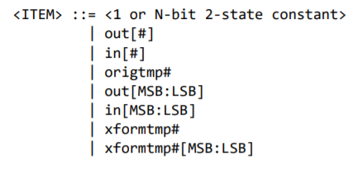
Output

Slide 8
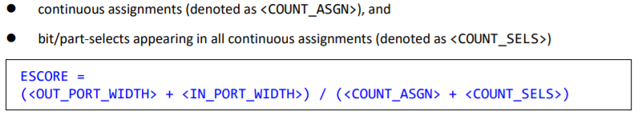
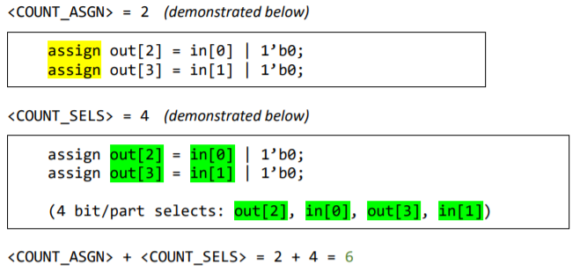


Evaluation

Slide 9
Outline
Problem Description
Algorithm to Solve the Problem
Circuit Graph
Post-order Reduction
Continuous Combination
Equivalence Combination
Data Structures
Experimental Results
Difficulties

Slide 10
Outline
Problem Description
Algorithm to Solve the Problem
Circuit Graph
Post-order Reduction
Continuous Combination
Equivalence Combination
Data Structures
Experimental Results
Difficulties

Slide 11








Circuit Graph
$$OUT$$
$$OUT$$
Objective
Represent a circuit
Definition
Directed Graph
Nodes are Components
OUT selects are begin nodes
BIT and IN selects are end nodes
WIRE, AND, OR, XOR, and NOT are internal nodes
begin
internal
$$OR$$
$$W$$
$$XOR$$
end
$$IN$$
$$BIT$$
$$IN$$

Slide 12
Outline
Problem Description
Algorithm to Solve the Problem
Circuit Graph
Post-order Reduction
Continuous Combination
Equivalence Combination
Data Structures
Experimental Results
Difficulties

Slide 13
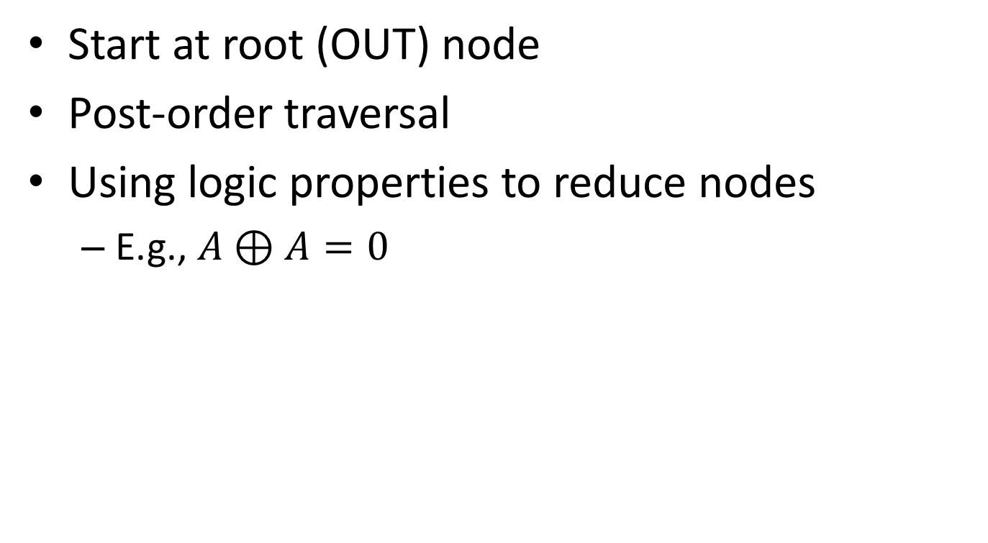
Post-order Reduction
Start at root (OUT) node
Post-order traversal
Using logic properties to reduce nodes
E.g., $A⊕A=0$
7
6
1
5
4
2
3

Slide 14







Example
$$OUT_{3}$$
$$OR$$
$$IN_{19}$$
$$W_{28}$$
$$XOR$$
wire origtmp28
assign out[3] = in[19] | origtmp28
assign origtmp28 = in[19] ^ in[19]
$$IN_{19}$$
$$IN_{19}$$

Slide 15
Example
$$OUT_{3}$$
$$OR$$
$$IN_{19}$$
$$W_{28}$$
$$XOR$$
wire origtmp28
assign out[3] = in[19] | origtmp28
assign origtmp28 = in[19] ^ in[19]
$$IN_{19}$$
$$IN_{19}$$

Slide 16

Example
$$OUT_{3}$$
$$OR$$
$$IN_{19}$$
$$W_{28}$$
$$BIT_{0}$$
wire origtmp28
assign out[3] = in[19] | origtmp28
assign origtmp28 = 1’b0

Slide 17

Example
$$OUT_{3}$$
$$OR$$
$$IN_{19}$$
$$BIT_{0}$$
assign out[3] = in[19] | 1’b0

Slide 18
Example
$$OUT_{3}$$
$$OR$$
$$IN_{19}$$
$$BIT_{0}$$
assign out[3] = in[19] | 1’b0

Slide 19

Example
$$OUT_{3}$$
$$IN_{19}$$
assign out[3] = in[19]

Slide 20
Example
$$OUT_{3}$$
$$IN_{19}$$
wire origtmp28
assign out[3] = in[19] | origtmp28
assign origtmp28 = in[19] ^ in[19]
assign out[3] = in[19]

Slide 21
Outline
Problem Description
Algorithm to Solve the Problem
Circuit Graph
Post-order Reduction
Continuous Combination
Equivalence Combination
Data Structures
Experimental Results
Difficulties

Slide 22








Example – 1
$$OUT_{3}$$
$$OUT_{4}$$
$$OUT_{5}$$
$$OUT_{3:5}$$
$$0$$
$$1$$
$$1$$
$$011$$

Slide 23







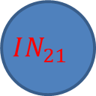




Example – 2
$$OUT_{3}$$
$$OUT_{4}$$
$$OUT_{3:4}$$
$$IN_{19}$$
$$IN_{20}$$
$$IN_{19:20}$$
$$OUT_{3}$$
$$OUT_{4}$$
$$OUT_{3:4}$$
$$IN_{19}$$
$$IN_{21}$$
$$IN_{19:21}$$

Slide 24










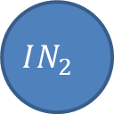

Example – 3
$$OUT_{3}$$
$$OUT_{4}$$
$$OUT_{3:4}$$
$$OR$$
$$OR$$
$$OR$$
$$IN_{2}$$
$$IN_{5}$$
$$IN_{3}$$
$$IN_{6}$$
$$IN_{2:3}$$
$$IN_{5:6}$$

Slide 25
Outline
Problem Description
Algorithm to Solve the Problem
Circuit Graph
Post-order Reduction
Continuous Combination
Equivalence Combination
Data Structures
Experimental Results
Difficulties

Slide 26



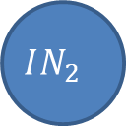





Example – 1
$$OUT_{3}$$
$$OUT_{4}$$
$$OUT_{3}$$
$$OUT_{4}$$
$$OR$$
$$OR$$
$$OR$$
$$IN_{2}$$
$$IN_{5}$$
$$IN_{2}$$
$$IN_{5}$$
$$IN_{2}$$
$$IN_{5}$$

Slide 27



















Example – 2
$$OUT_{3}$$
$$OUT_{4}$$
$$OUT_{3}$$
$$OUT_{4}$$
$$XOR$$
$$XOR$$
$${IN}_{8}$$
$$W_{1}$$
$${IN}_{8}$$
$$OR$$
$$W_{1}$$
$$IN_{2}$$
$$IN_{5}$$
$$OR$$
$$OR$$
$$IN_{2}$$
$$IN_{5}$$
$$IN_{2}$$
$$IN_{5}$$

Slide 28
Outline
Problem Description
Algorithm to Solve the Problem
Data Structures
Experimental Results
Difficulties

Slide 29
Data Structures
Struct Component
Data
int type // BIT, IN, OUT, WIRE, OR, AND, NOT, XOR
int msb
int lsb
int id
Component *left
Component *right
Component *parent

Slide 30
Outline
Problem Description
Algorithm to Solve the Problem
Data Structures
Experimental Results
Difficulties

Slide 31
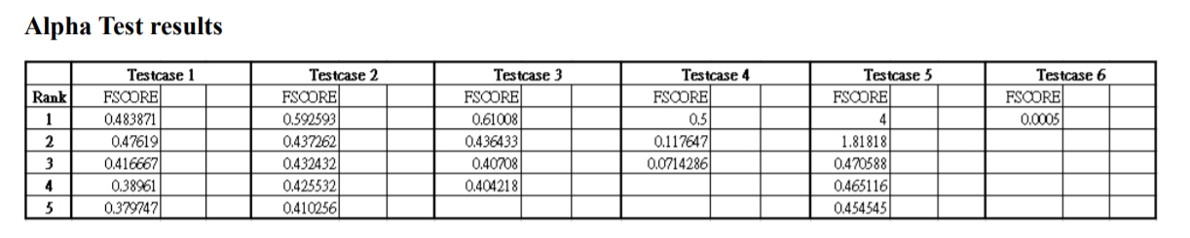
Alpha Test Evaluation
Date | Testcase1 | Testcase2 | Testcase3 | Testcase4 | Testcase5 | Testcase6
06/28 | 0.41667 | 0 | 0 | 0 | 1.81818 | 0.0005004

Slide 32
Improve After Alpha Test
Date | Testcase1 | Testcase2 | Testcase3 | Testcase4 | Testcase5 | Testcase6
07/22 | 0.5660377358 | 0.5970149254 | 0.6182795699 | 0.5000000000 | 4.0000000000 | 0.0009995002

Slide 33
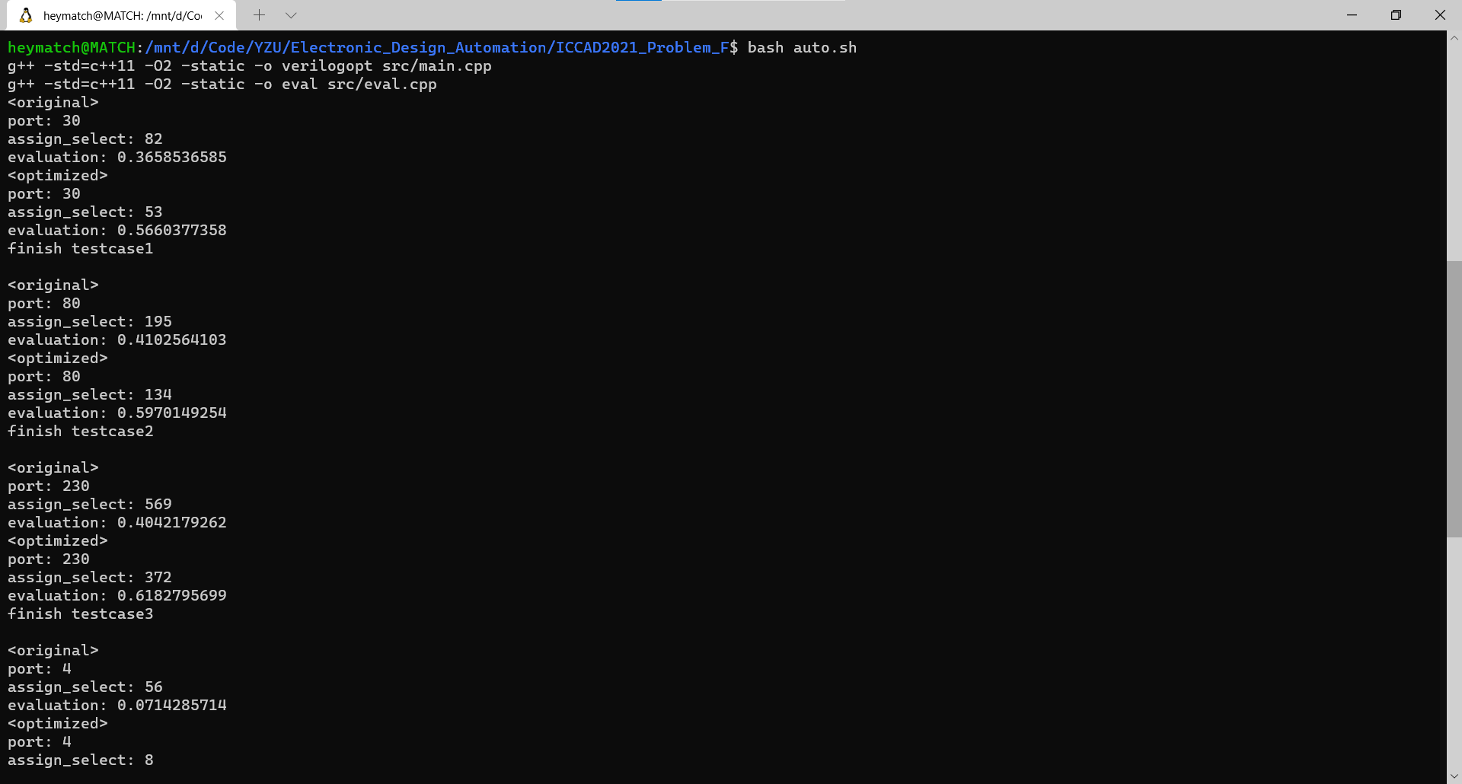
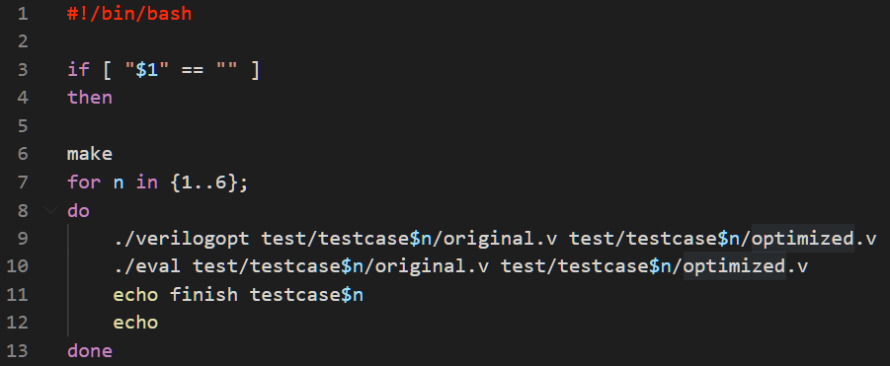
Runtime

Slide 34
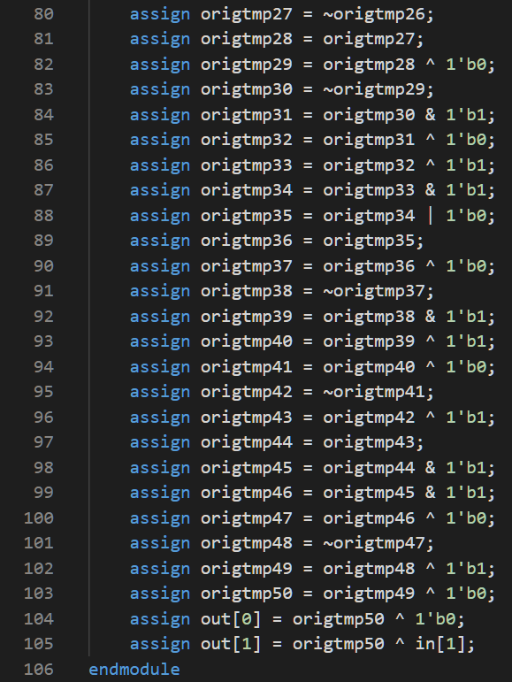
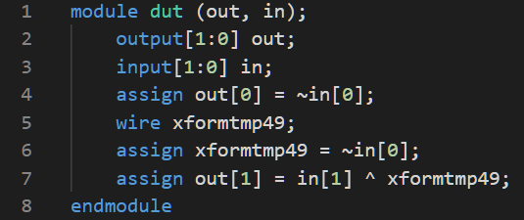
Result – Testcase4
original.v (106 lines)
optimized.v (8 lines)

Slide 35
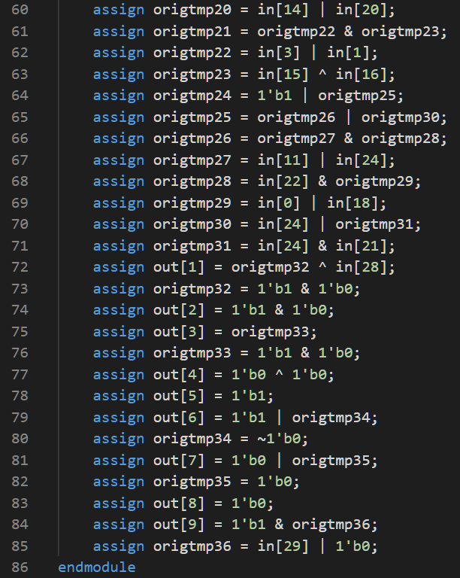
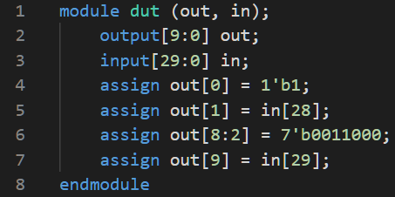
Result – Testcase5
original.v (86 lines)
optimized.v (8 lines)

Slide 36
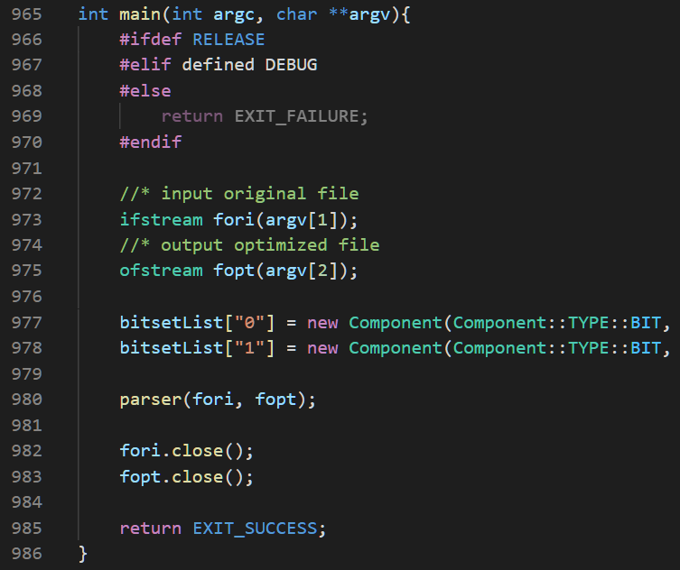
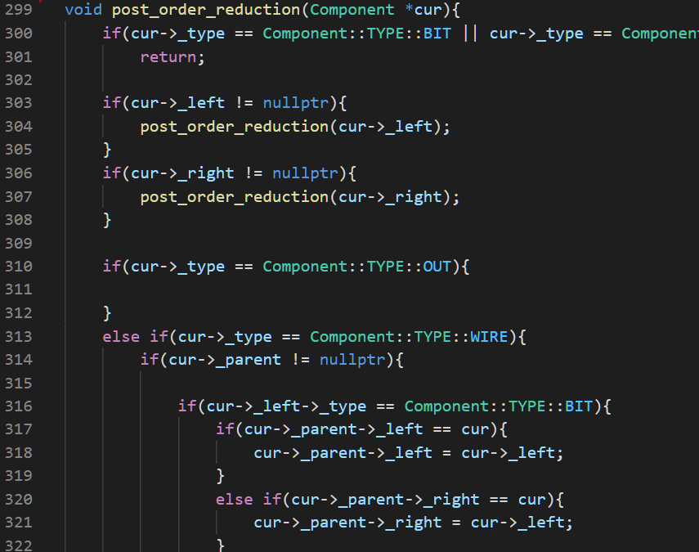
Code (986 Lines)

Slide 37
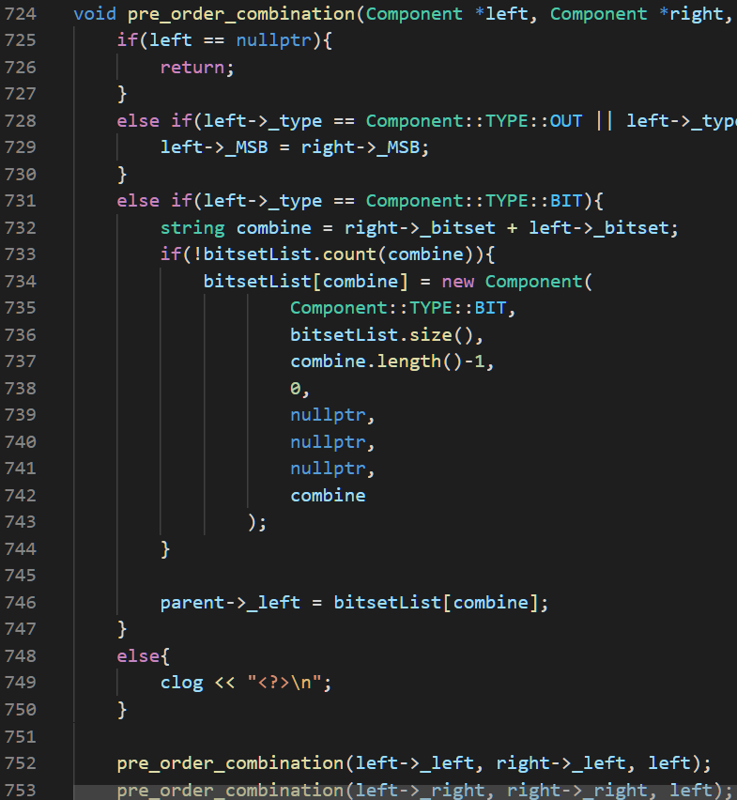
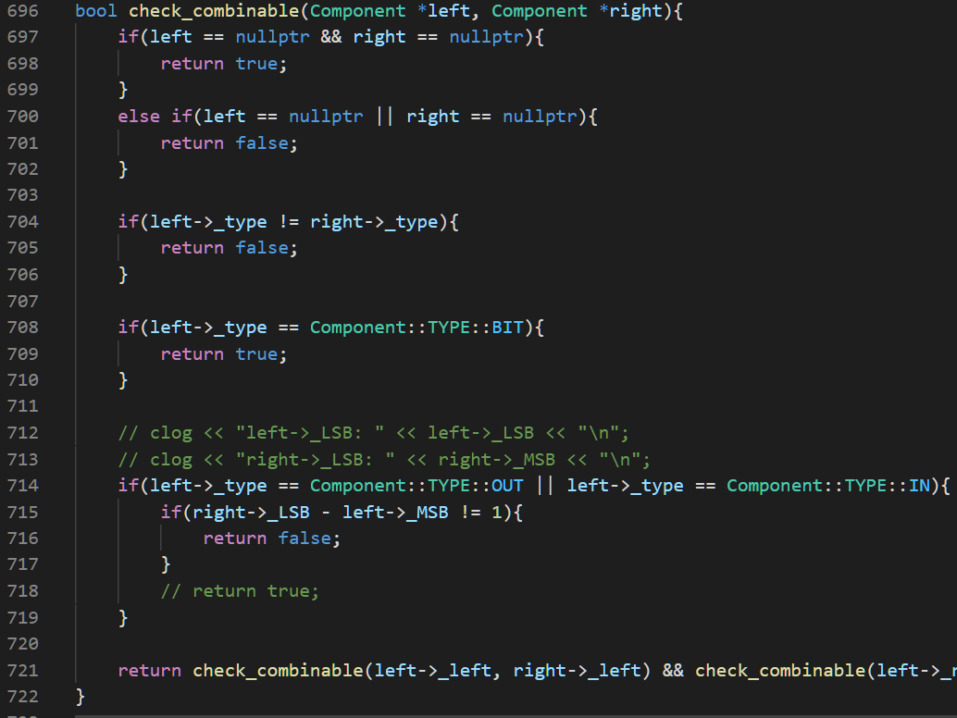
Code (986 Lines)

Slide 38
Outline
Problem Description
Algorithm to Solve the Problem
Data Structures
Experimental Results
Difficulties

Slide 39

Post-order Reduction: Not Obvious Cases
Some cases are not easy to know it can reduce
$\left(A⋅B\right)\left(A+C⋅D⊕E+…\right)=?$
$\left(A⋅B\right)\left(A+C⋅D⊕E+…\right)=(A⋅B)$

Slide 40
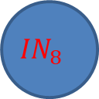



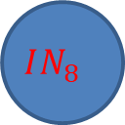









Equivalent?
$$OUT_{3}$$
$$OUT_{3}$$
$$XOR$$
$$XOR$$
$${IN}_{8}$$
$$W_{1}$$
$${IN}_{5}$$
$$W_{1}$$
$$XOR$$
$$XOR$$
$$IN_{2}$$
$$IN_{5}$$
$$IN_{2}$$
$$IN_{8}$$

