Slide 1

Problem F – Verilog Simulation Optimization via Instruction Reduction
Introduction to IC Design Automation
Department of Computer Science and Engineering
Yuan Ze University
Team Name:
IndexO (cadb0061)
Team Member’s Names:
張晉瑋
Team Member’s ID#’s:
1071524
Date: 06/08/2021

Slide 2
Outline
Problem Description
Algorithm to Solve the Problem
Data Structures
Experimental Results
Difficulties

Slide 3
Outline
Problem Description
Algorithm to Solve the Problem
Data Structures
Experimental Results
Difficulties

Slide 4
Background
Hardware simulation with CPU is basically a compiler topic.
Intermediate Representations (IR)
Minimizing instructions is beneficial to reduce runtime due to less code being executed and data locality
Verilog Simulation Optimization via Instruction Reduction

Slide 5
Problem Description
Convert a given Verilog design into an optimized Verilog design (source-to-source, .v-to-.v)
The objective is to minimize the total number of continuous assignments and vector bit/part-selects in the Verilog design

Slide 6
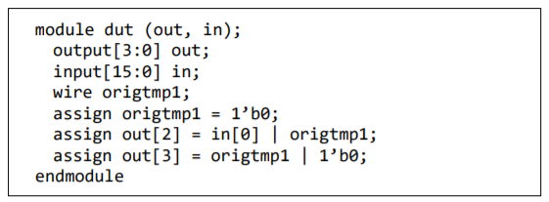

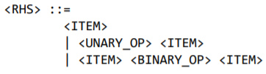
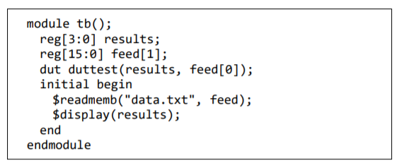
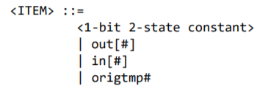

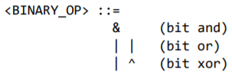
Input

Slide 7
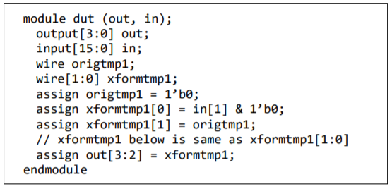



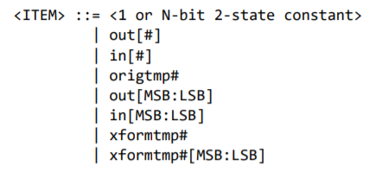
Output

Slide 8
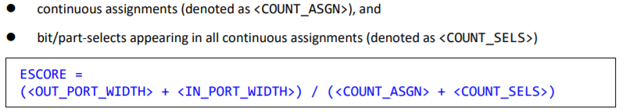
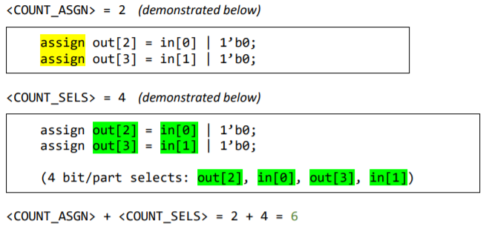


Evaluation

Slide 9
Outline
Problem Description
Algorithm to Solve the Problem
Data Structures
Experimental Results
Difficulties

Slide 10







Circuit Graph
$$OUT$$
Objective
Represent a circuit
Definition
Directed Acyclic Graph
OUT select is start node
BIT and IN selects are edge nodes
WIRE, AND, OR, XOR, and NOT are internal nodes
$$OR$$
$$IN$$
$$W$$
$$XOR$$
$$IN$$
$$BIT$$

Slide 11
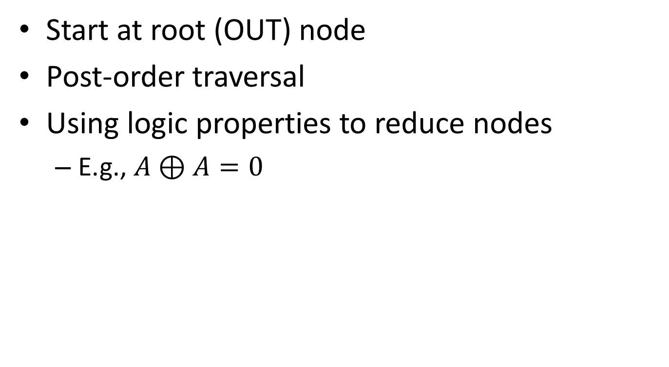
Post-order Reduction
Start at root (OUT) node
Post-order traversal
Using logic properties to reduce nodes
E.g., $A⊕A=0$
7
6
1
5
4
2
3

Slide 12







Example
$$OUT_{3}$$
$$OR$$
$$IN_{19}$$
$$W_{28}$$
$$XOR$$
wire origtmp28
assign out[3] = in[19] | origtmp28
assign origtmp28 = in[19] ^ in[19]
$$IN_{19}$$
$$IN_{19}$$

Slide 13
Example
$$OUT_{3}$$
$$OR$$
$$IN_{19}$$
$$W_{28}$$
$$XOR$$
wire origtmp28
assign out[3] = in[19] | origtmp28
assign origtmp28 = in[19] ^ in[19]
$$IN_{19}$$
$$IN_{19}$$

Slide 14

Example
$$OUT_{3}$$
$$OR$$
$$IN_{19}$$
$$W_{28}$$
$$BIT_{0}$$
wire origtmp28
assign out[3] = in[19] | origtmp28
assign origtmp28 = 1’b0

Slide 15

Example
$$OUT_{3}$$
$$OR$$
$$IN_{19}$$
$$BIT_{0}$$
assign out[3] = in[19] | 1’b0

Slide 16
Example
$$OUT_{3}$$
$$OR$$
$$IN_{19}$$
$$BIT_{0}$$
assign out[3] = in[19] | 1’b0

Slide 17

Example
$$OUT_{3}$$
$$IN_{19}$$
assign out[3] = in[19]

Slide 18
Example
$$OUT_{3}$$
$$IN_{19}$$
wire origtmp28
assign out[3] = in[19] | origtmp28
assign origtmp28 = in[19] ^ in[19]
assign out[3] = in[19]

Slide 19
Outline
Problem Description
Algorithm to Solve the Problem
Data Structures
Experimental Results
Difficulties

Slide 20
Data Structures
Struct Component
Data
int type // BIT, IN, OUT, WIRE, OR, AND, NOT, XOR
int msb
int lsb
int id
Component *left
Component *right
Component *parent
Method
post_order_reduction()
post_order_make_inst()

Slide 21
Outline
Problem Description
Algorithm to Solve the Problem
Data Structures
Experimental Results
Difficulties

Slide 22
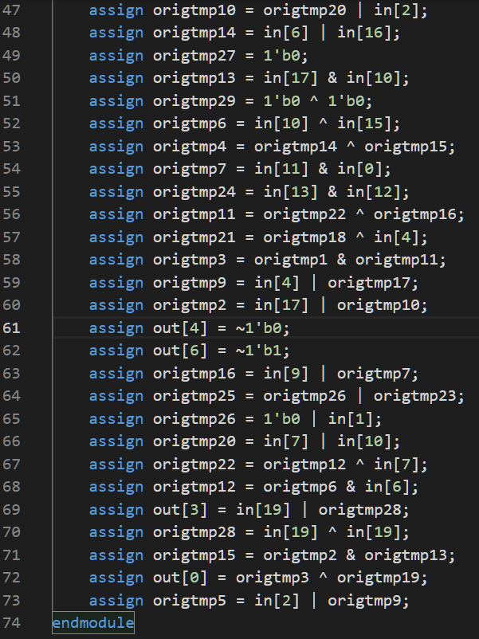
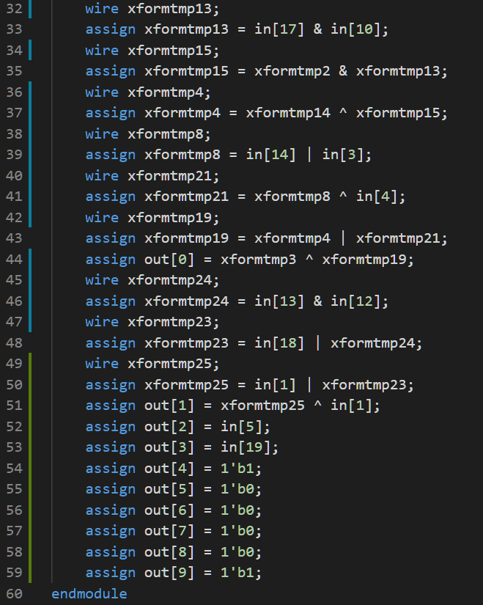
Result
original.v
optimized.v

Slide 23
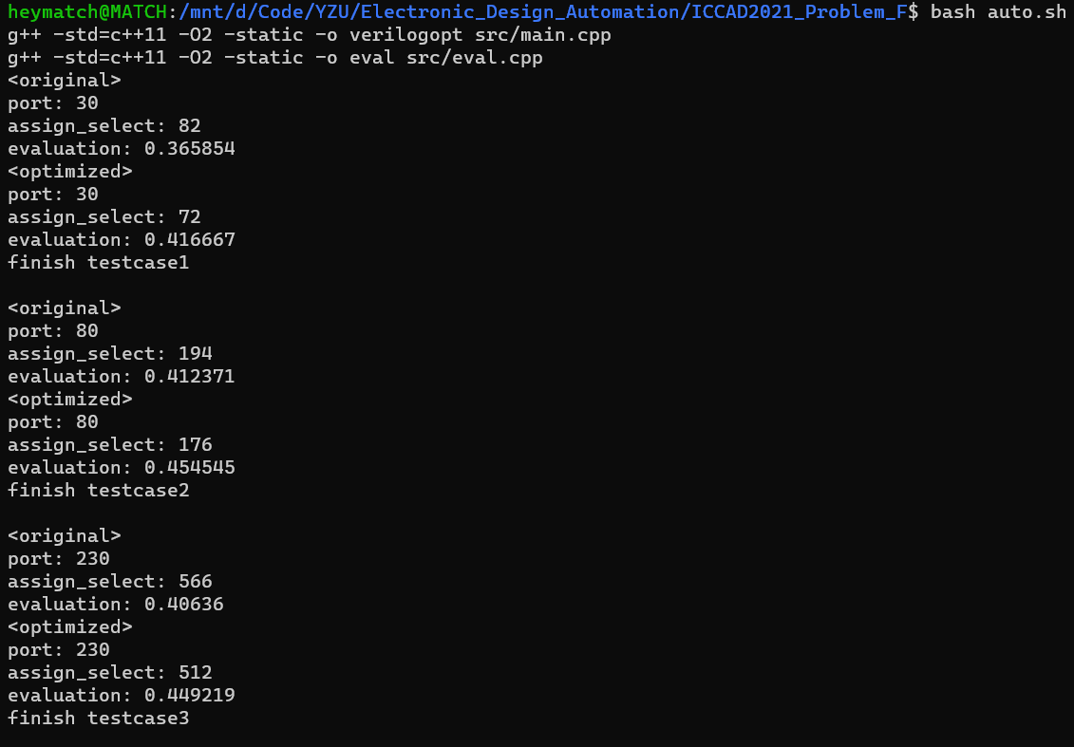
Evaluation

Slide 24
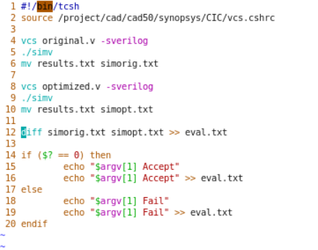
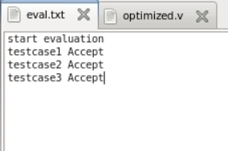
Verification (in TSRI Machine)

Slide 25
Outline
Problem Description
Algorithm to Solve the Problem
Data Structures
Experimental Results
Difficulties

Slide 26
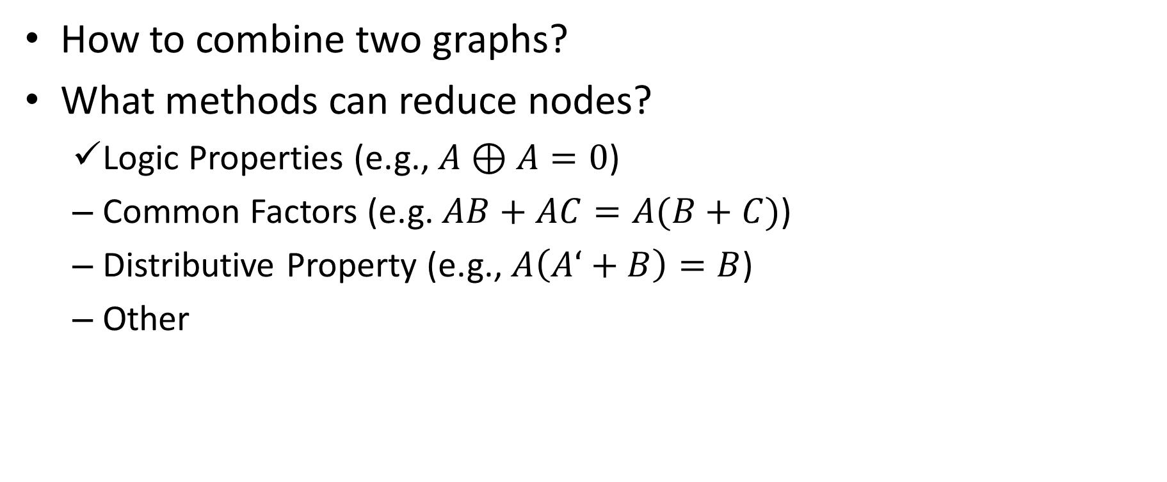
Difficulties
How to combine two graphs?
What methods can reduce nodes?
Logic Properties (e.g., $A⊕A=0$)
Common Factors (e.g. $AB+AC=A(B+C)$)
Distributive Property (e.g., $A\left(A‘+B\right)=B$)
Other

