Slide 1
Can IMU features predict PX4–GPS velocity residuals?
PHASE 1 · CLASSICAL ML BENCHMARK
ML-Assisted IMU Drift Reduction for GNSS-Denied UAV Navigation
Meghna Nair · Pranjal Shukla · Shreya Narayani
38,967
4
142
5
telemetry rows
PX4 flight logs
IMU-only features
predictors compared
Notes:
Phase 1 asks a narrow question: using only IMU-derived features, can classical ML predict the difference between the PX4 EKF2 velocity and the GPS velocity, well enough to correct PX4? Dataset: 38,967 rows from four PX4 logs recorded on 2026-09-08. 142 leakage-safe features. Two baselines plus Ridge, Random Forest and Histogram Gradient Boosting. Spoiler: on the held-out flight none of the models beats leaving PX4 uncorrected — the deck explains why.

Slide 2
What the models are asked to predict
PROBLEM FORMULATION
TARGET CONSTRUCTION (as recorded)
Scope, as stated in the repo
IMU
PX4 EKF2
dead_reckoning = 0 in all 38,967 rows
GPS fix 3D / DGPS throughout; 23–31 satellites
Dropping GPS inputs does not make the PX4 target GPS-independent
accel + gyro (raw)
→ v_PX4 (N, E, D)
Δv = v_PX4 − v_GPS
likely fused into EKF2
3 targets · m/s
GPS
→ v_GPS (N, E, D)
CORRECTION (evaluated offline on held-out log_54)
Correct claim
142 IMU-only features
Regressor
Δv̂
v_corr = v_PX4 − Δv̂
PX4–GPS velocity residual prediction using IMU-derived features — not validated GNSS-denied drift reduction.
Success criterion: corrected velocity closer to GPS than raw PX4 (i.e. beat zero correction).
Notes:
Targets are verified to equal px4_v minus gps_v per NED axis. Because EKF2 probably fused GPS while recording, the residual is between a GPS-aided estimator and GPS, not pure inertial drift. The repo (docs/target_definition.md) states this explicitly, and the deck keeps that framing. Correction convention: v_corrected = v_PX4 − predicted Δv. The baseline to beat is doing nothing.

Slide 3
Four flights, one session, split by whole flight
DATASET AUDIT
log_51 · Train
log_52 · Validation
log_53 · Train
log_54 · Test
150 s
200 s
250 s
300 s
350 s
400 s
450 s
10,277 rows · 70.4 s
8,657 rows · 64 s
11,727 rows · 82.2 s
8,306 rows · 57.6 s
Light notches = timestamp gaps > 50 ms (≈2.3 s each). Axis: PX4 timestamp column (s since boot); all logs dated 2026-09-08.
22,004 / 8,657 / 8,306
~200 Hz
0
≤ 2.2 × 10⁻¹⁶
40 gaps
train / val / test rows (56.5 / 22.2 / 21.3 %)
median row interval 5.0 ms; 31 native columns
missing, infinite or duplicate rows
max error: targets = v_PX4 − v_GPS, verified
> 50 ms, splitting the logs into 44 continuous segments
Notes:
Sources: results/eda/tables/log_summary.csv, quality_audit.csv, target_verification.csv, results/models/split_info.csv. All four logs come from one session (about 4.6 minutes of data in total). Each log contains roughly periodic ~2.3 s timestamp gaps; the feature pipeline splits on gaps > 50 ms, giving 44 continuous segments. Note: docs/eda_report.md §3.3–3.4 lists approximate per-log counts and 10–15 ms max gaps that do not match its own log_summary.csv; the values here come from the CSV.

Slide 4
Three guards against optimistic scores
LEAKAGE CONTROLS
1 Feature quarantine — 17 columns never used as inputs
3 Whole-flight splits, because neighbouring rows are near-copies
GPS velocity N/E/D
GPS speed
EPH, EPV
satellites, fix type
PX4 velocity x/y/z
5 validity flags
dead_reckoning
Only the 8 IMU channels (6 axes + 2 magnitudes) feed the pipeline.
2 Temporal isolation inside each flight
Rolling windows, lags, differences, jerk reset at every gap > 50 ms
Lags filled with past values only (causal)
Both rules covered by unit tests (14 tests pass)
log_51, longest continuous segment (1,363 rows)
2,802 distinct values per Δv target across 38,967 rows — GPS updates far slower than the ~200 Hz row rate, so random row splits would put near-identical rows in train and test.
Notes:
Quarantine list: src/utils.py LEAKY_COLUMNS (17 columns). Temporal isolation: src/feature_engineering.py; tests in tests/test_feature_engineering.py (gap segmentation, causal lags, jerk uses real dt). Chart: autocorrelation of the targets on the longest continuous segment of log_51, computed from data/imu_drift_feature_dataset.csv for this deck. Unique-value counts from results/eda/tables/quality_audit.csv. Split: train log_51 + log_53, validation log_52, test log_54.

Slide 5
From 8 IMU channels to 142 features, per segment
FEATURE ENGINEERING
8 IMU channels
Split at gaps
Rolling min / max / range
54
10, 50, 100 samples (≈50, 250, 500 ms) × 6 axes
accel x, y, z
gyro x, y, z
|a|, |ω|
a_z ≈ −9.78 m/s²: raw, gravity included
Δt > 50 ms
(≈10× median 5 ms)
44 continuous segments
all temporal features reset at each boundary
Rolling mean / std
48
10, 50, 100 samples × 8 channels
Lags
18
t−1, t−5, t−10 × 6 axes, causal fill
142
Raw channels
8
8 channels as-is
input features
First differences
8
8 channels
Jerk
3
da/dt with actual elapsed Δt (m/s³)
Cross-axis
3
accel & gyro XY angle (atan2), |a| / |ω|
Notes:
Source: src/feature_engineering.py. Counts: rolling mean/std 8 channels × 3 windows × 2 = 48; rolling min/max/range 6 axes × 3 windows × 3 = 54; lags 6 × 3 = 18; first differences 8; jerk 3; cross-axis 3; raw 8. Total 142, asserted by tests/test_feature_engineering.py. Windows are in samples, so durations assume the nominal 200 Hz cadence.

Slide 6
Two baselines, three classical regressors
MODELS & PROTOCOL
BASELINE
BASELINE
LINEAR
BAGGED TREES
BOOSTED TREES
Zero correction
Mean predictor
Ridge
Random Forest
Hist. Gradient Boosting
Δv̂ = 0 — leave PX4 untouched
Δv̂ = training-set mean
multi-output, L2
150 trees
one model per axis
RMSE = RMS of the true residual
per axis, from log_51 + log_53
α = 1000 via leave-one-log-out CV
largest value in grid 0.01–1000
max depth 16, min leaf 2
max_features √p
trained in 2.3 s
120 iters, depth 8
lr 0.08, L2 0.5, min leaf 20
trained in 3.0 s
EVALUATION PROTOCOL
StandardScaler fit on train logs
Fit on log_51 + log_53
Report on log_52 (val) and log_54 (test)
Correct: v_PX4 − Δv̂, compare to GPS
Metrics per axis (N, E, D): RMSE, MAE, R², bias = mean(pred − true). Headline RMSE = mean of the three per-axis RMSEs.
Notes:
Hyperparameters and training times from configs/*.json (single run, so timings are indicative). HistGradientBoosting is wrapped in MultiOutputRegressor, i.e. one booster per axis. Ridge alpha was chosen by leave-one-log-out CV over the two training logs; the CV curve decreases monotonically and the chosen alpha = 1000 is the largest value in the grid, so stronger regularisation was never tested. RF/GBM hyperparameters are fixed in the scripts; validation metrics are reported but not used for tuning.

Slide 7
No model beats leaving PX4 uncorrected
TEST FLIGHT LOG_54 · 8,306 ROWS
0.1472 m/s
Zero correction RMSE — the best result in the benchmark
+10.5 %
Best model (Random Forest) is 10.5 % worse than doing nothing
Model | MAE | R² | Bias
Zero correction | 0.1065 | -0.013 | 0.017
Random Forest | 0.1189 | -0.171 | 0.058
Gradient Boosting | 0.1252 | -0.255 | 0.064
Mean predictor | 0.1268 | -0.239 | 0.069
Ridge | 0.1319 | -0.387 | 0.070
Every R² is negative. Units m/s; bias = mean(pred − true), averaged over N, E, D.
Notes:
Source: results/models/metrics_table.csv and model_comparison_report.md. I re-ran the full pipeline (make data, train, benchmark) on a fresh clone: Ridge, Gradient Boosting and both baselines reproduce exactly; Random Forest reproduces to within 0.0003 m/s (0.1624 vs 0.1626), which does not change any ranking. The repo reports this honestly as a negative finding.

Slide 8
The vertical axis is where corrections fail
VELOCITY CORRECTION VS. RAW PX4
−17.8 to −28.4 %
Δv_D gets worse under every predictor
within 2.1 %
Random Forest on N and E: almost neutral, never better
Raw PX4 RMSE vs. GPS on log_54
Δv_N
Δv_E
Δv_D
0.101
0.102
0.239
m/s — the vertical residual is also the largest
Notes:
Source: results/models/correction_evaluation.csv (improvement_pct_N/E/D). corrected = px4 − predicted residual; RMSE against GPS. Ridge degrades even the horizontal axes by 13–15 %. The mean predictor is essentially neutral on N and E (train mean ≈ 0 there) but is the worst on D — a first hint that the problem is a vertical offset.

Slide 9
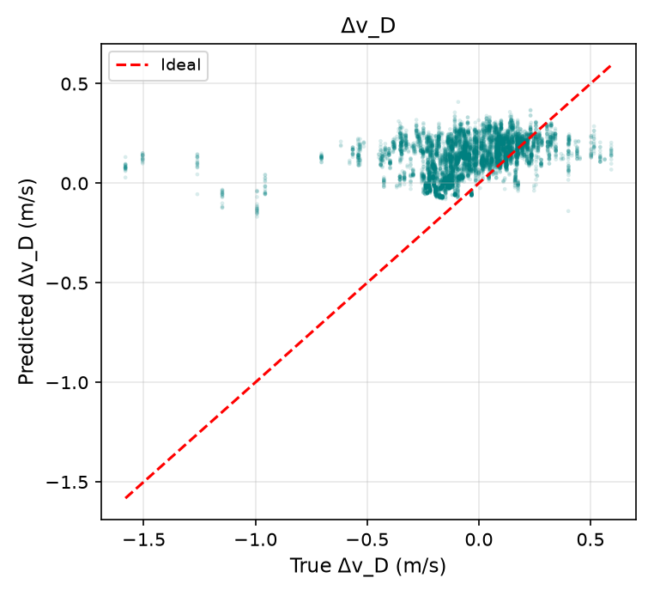
A vertical offset learned from log_51 does not transfer
DIAGNOSIS · AUDIT ANALYSIS OF REPO DATA
+0.18 to +0.19
test bias on Δv_D (m/s) for Ridge, RF and GBM; raw PX4: +0.044
39–43 %
of each model's Δv_D squared error is that constant offset
≈ 99 %
Random Forest, test log_54 — predictions sit above zero for most true values (results/plots/rf_scatter_test.png)
of RF importance sits in rolling-window stats (500 ms window: 55 %)
Training mean +0.153 vs. test mean −0.044 m/s → a 0.197 m/s shift.
Same pattern on validation log_52: Δv_D bias +0.24 to +0.26 for all three models.
Notes:
This slide is my audit analysis computed from repository files, not a claim from the original report. Per-flight means: data/imu_drift_feature_dataset.csv (also results/eda/tables/per_log_means.csv). Bias values: results/models/metrics_table.csv (bias_D) and val_metrics in configs/*.json. Offset share = bias_D² / RMSE_D² per model. Feature-importance grouping from results/models/rf_feature_importances.csv: 10/50/100-sample rolling stats carry 9.2 / 34.7 / 55.0 % of impurity importance; lags, raw, differences and jerk together ≈ 1.2 %. Interpretation: log_51 has a large positive vertical residual that is not explained by IMU features in other flights; with only two training flights the models absorb it as an offset. The 'aerodynamic downwash' explanation in docs/project_presentation.md is not tested anywhere in the repo, so it is not repeated here.

Slide 10
TAKEAWAYS
A clean, reproducible negative result — and a clear reason for it
What holds
What limits it
Next steps
Leakage-safe pipeline: 17 GPS/PX4 columns quarantined, per-segment features, whole-flight splits
14 unit tests pass; CI runs tests + split audit
Fresh re-run reproduces the benchmark (RF within 0.0003 m/s)
Target is GPS-aided EKF2 output, not pure inertial drift
4 logs, one session, ≈ 4.6 min in total
log_54 was inspected during development
Ridge α = 1000 sits at the edge of its search grid
Logs with GPS fusion disabled or real dead-reckoning segments (repo)
New independent recordings for a pristine test (repo)
More flights, then test per-flight offset handling on Δv_D (audit)
github.com/heymegzz/vio-drift-reduction
Notes:
Close on three points: the engineering is sound and reproducible; the scientific claim must stay narrow (residual prediction, not GNSS-denied drift reduction); and the failure is concentrated in a vertical offset driven by one training flight, which more and better-controlled flights can test. Items marked (repo) come from docs/target_definition.md and the README; items marked (audit) come from the analysis on the previous slide.

