Slide 1
Sprocket Central Pty Ltd
Data Analytics Slide-share
Mihir Pahwa

Slide 2
Objective outline
Marketing team looking to Increase sales
Target 1000 new customers that will bring highest value to business

Slide 3
Approach for Data analysis
Wealth segment sorted by age group
Profits sorted by industry
Max purchases by each industry
Number of cars owned by each state
Customer classification

Slide 4
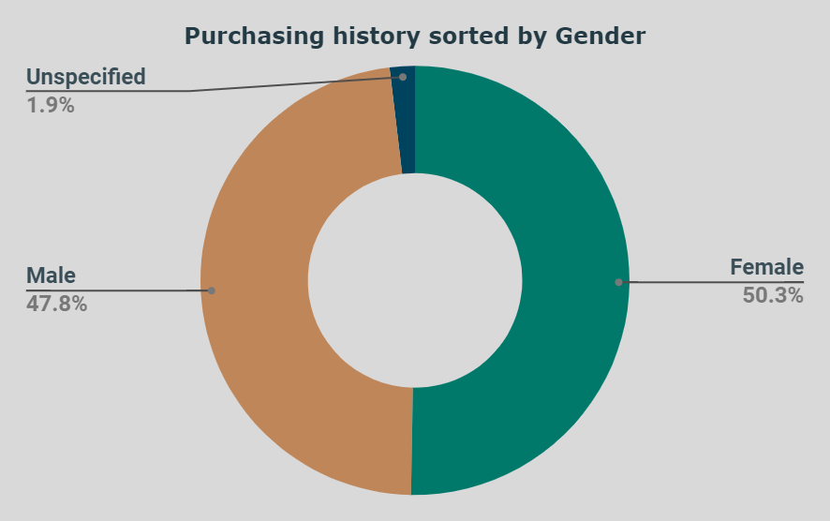
Male and female purchases are fairly equal
No significant difference observed

Slide 5
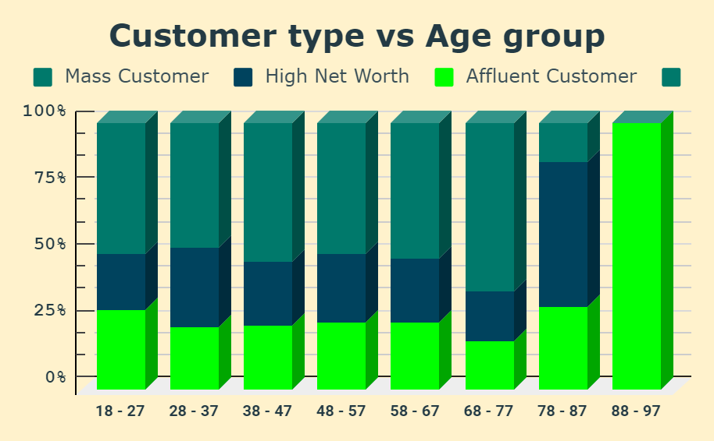
Wealth types -Mass customer -High Net worth -Affluent customer
Observations –
88-90 age group comprises of affluent customers .
68-77 age group comprises of 70% of mass customers .
78-87 age group has majority 55% of high net worth customers.

Slide 6
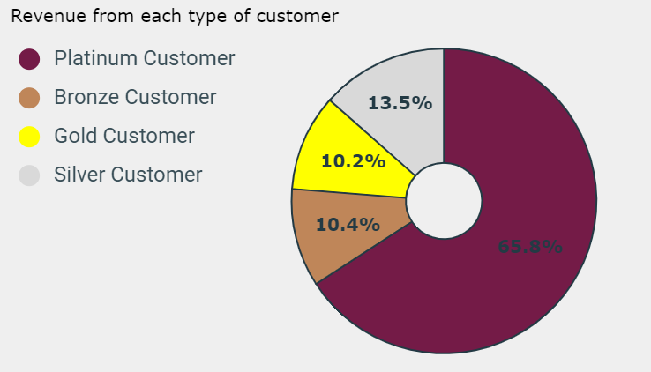
From RFM analysis
Platinum customers bring most revenue.

Slide 7
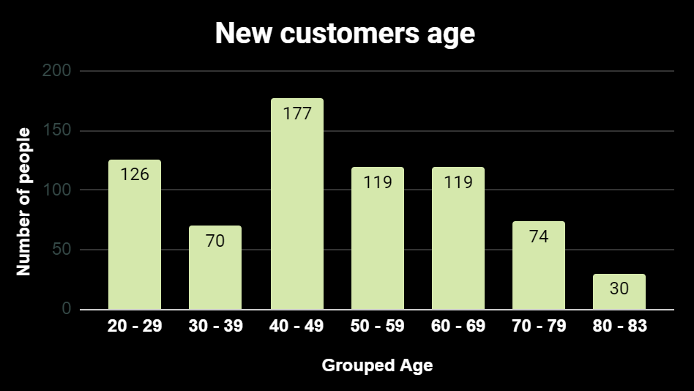
New customer Age demographic
Majority new customers in 40-49 age group

Slide 8
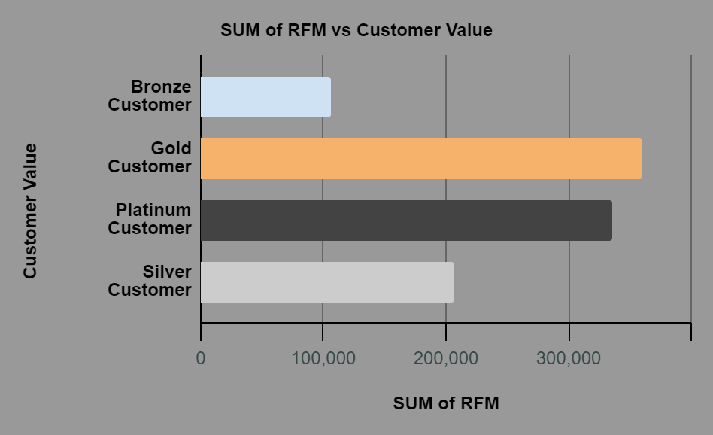
Sum of RFM value
Gold customer have highest sum of RFM value hence most valuable.

Slide 9
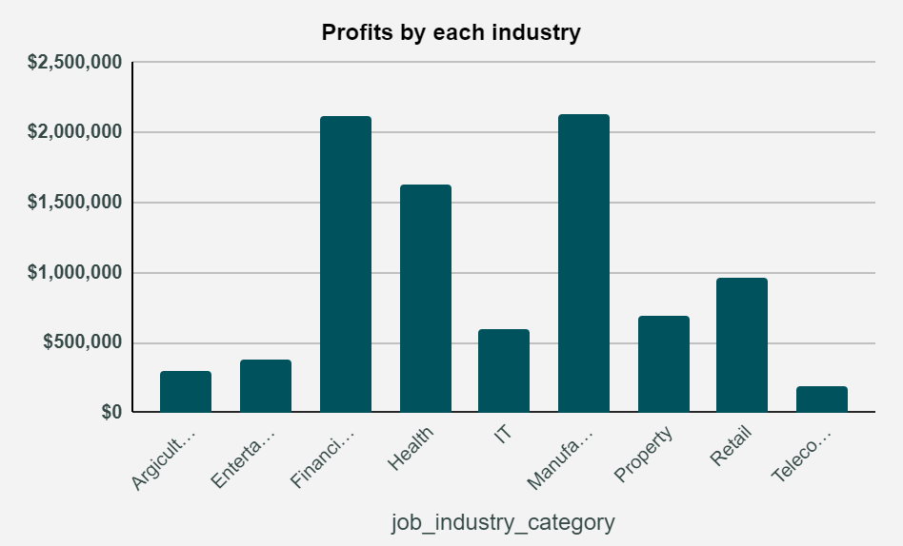
Profits by industry
People working in Financial services , Health and Manufacturing bring in most profits

Slide 10
Customer Classification Customers to target from new list for high profits-
1) People working in finance ,manufacturing, health
2) From above charts Age = 40 – 60
3) People who live in NSW and VIC

Slide 11
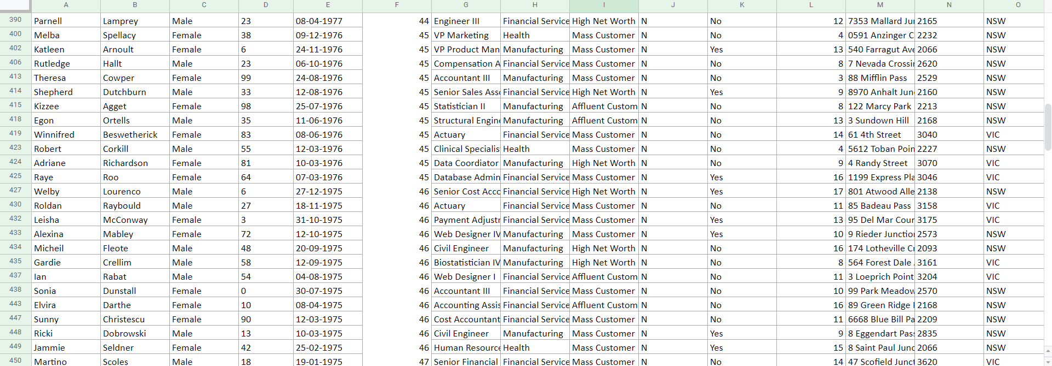
Sorted list of customers by above conditions gives us a list of 1000 customers that should be targeted.

