Slide 1
Semigroups and Groups

Slide 2
Semigroups and Groups
Binary Operations Revisited
Semigroups
Products and Quotients of Semigroups
Groups
Products and Quotients of Groups

Slide 3
Groups – 群

Slide 4
Groups
Definition
Abelian
Properties of groups
Finite groups
Subgroups

Slide 5
Group
A group (G,*) is a monoid, with identity e, that has the additional property that for every element a ∈ G there exists an element a' ∈ G, such that
    a*a' = a'*a = e .

Slide 6
group
A group (G, *) is a set together with a binary operation * on G such that, for any elements a, b, and c in G
  (a*b)*c = a*(b*c).
  a unique element e in G such that
    a*e = e*a
  an element a' ∈ G, called an inverse of a and written as a⁻¹, such that
    a*a' = a'*a = e or aa' = a'a = e or aa⁻¹ = a⁻¹a = e

Slide 7
Abelian – 阿贝尔群
A group G is said to be Abelian if ab = ba for all elements a and b in G.

Slide 8
Q, the set of all rational numbers under the operation of addition
Z⁺, under the operation of addition

Slide 9
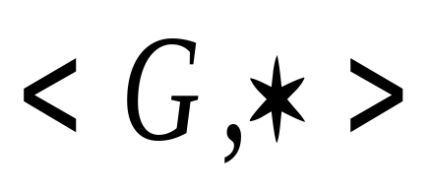



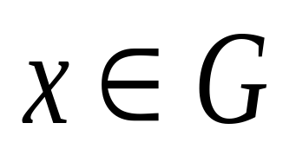

定义 设 是一代数系统,
是非空集合, 为 上二元
运算,若
1) 是封闭的
2) 是可结合的
3) 存在幺元
4) 对任一 ,存在它的逆元
则称 是一个群.

Slide 10


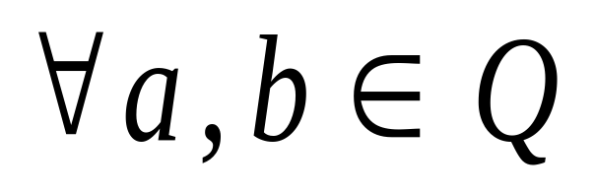
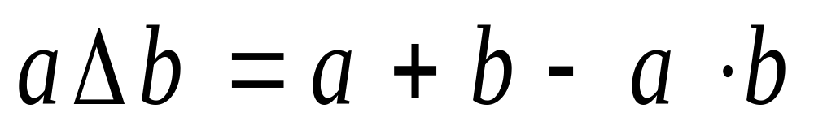
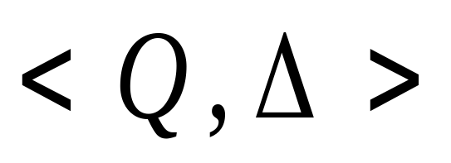
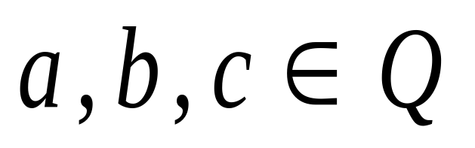
例 在 中, 为有理数
集. 对
试讨论 是否是群？是否有零元？
解: 对任意

Slide 11

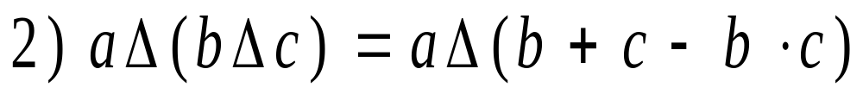
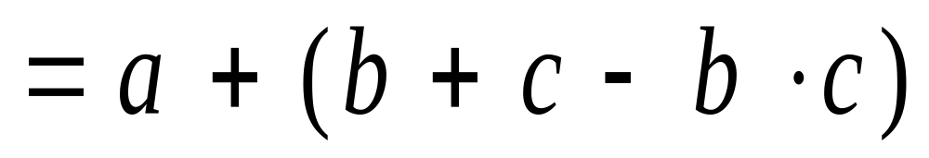
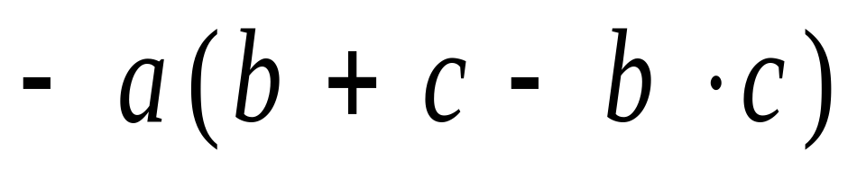
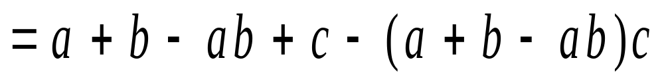
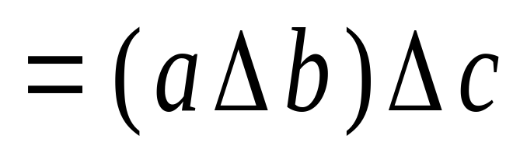
1) a+b-a*b Q

Slide 12


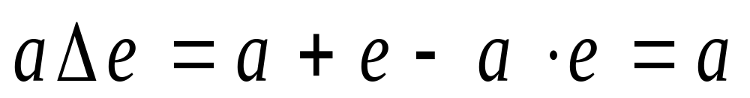
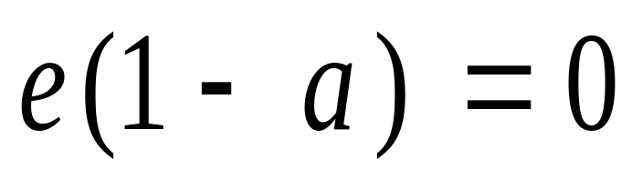
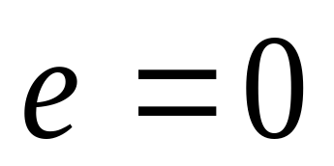
幺元

Slide 13
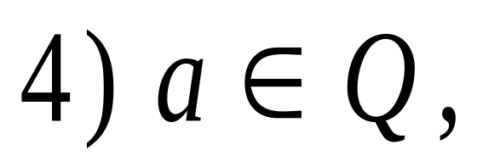
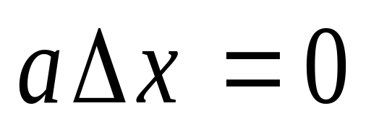
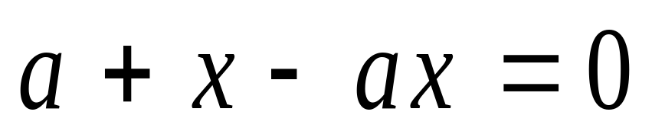
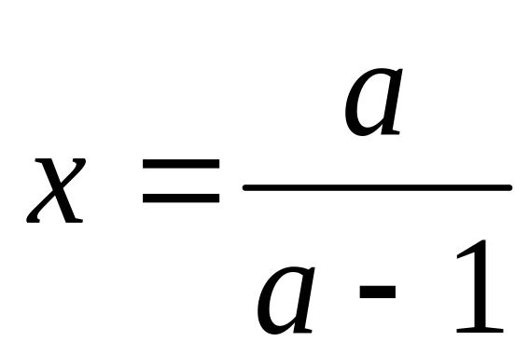
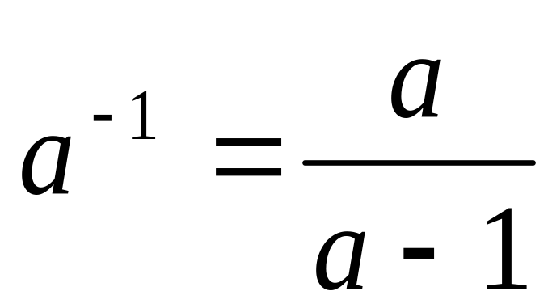
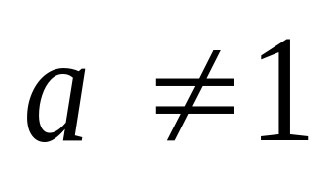
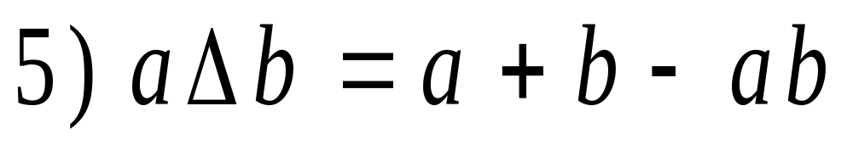
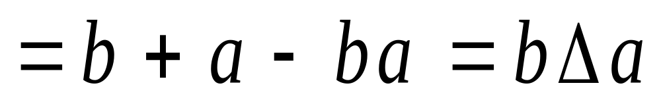
逆元
时

Slide 14


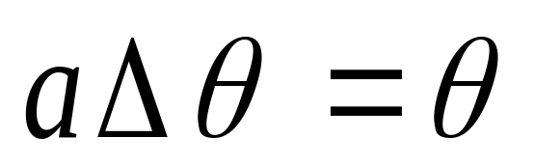
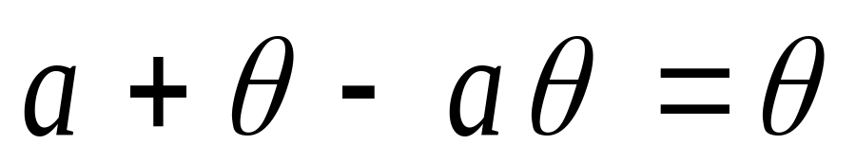
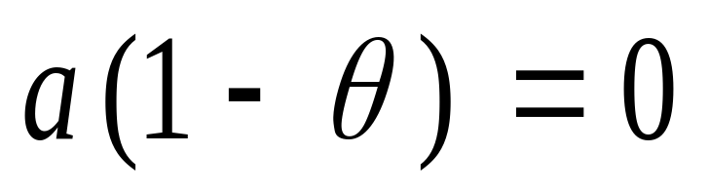
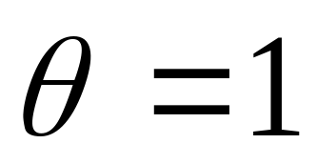
零元

Slide 15
Definition
A group (G, *) is a set together with a binary operation * on G such that, for any elements a, b, and c in G
  (a*b)*c = a*(b*c).
  a unique element e in G such that
    a*e = e*a
  an element a' ∈ G, called an inverse of a and written as a⁻¹, such that
    a*a' = a'*a = e or aa' = a'a = e or aa⁻¹ = a⁻¹a = e

Slide 16
Abelian – 阿贝尔群
A group G is said to be Abelian if ab = ba for all elements a and b in G.

Slide 17
Example 4
Let
  G be the set of all nonzero real numbers and
  a*b = ab/2.
Show
  (G, *) is an Abelian group.

Slide 18
Example 4 - Solution
* is a binary operation
  If a and b are elements of G,
  then ab/2 is a nonzero real number and
  hence is in G.
associativity
  (a*b)*c = (ab/2)*c = (ab)c/4
  a*(b*c) = a*(bc/2) = a(bc)/4= (ab)c/ 4.
  * is associative.

Slide 19
Example 4 - Solution
2 is the identity
  a*2 = (a)(2)/2 = a = (2)(a)/2 = 2*a.
a' = 4/a is an inverse of a
  a*a' = a*4/a = a(4/a)/2 = 2 = (4/a)(a)/2 = (4/a)*a = a' *a.
Abelian
  a*b = ab/2 = ba/2 = b*a
So, G is an Abelian group.

Slide 20
Theorem 1
Let G be a group. Each element a in G has only one inverse in G.
Proof
  Let
    a' and a" be inverses of a.
  Then
    a' = a'e = a'(aa") = (a'a)a" = ea" = a".

Slide 21
Theorem 2
Let
  G be a group and
  a, b, and c be elements of G.
Then
  left cancellation – 左消去律
    ab = ac implies that b = c
  right cancellation – 右消去律
    ba = ca implies that b = c

Slide 22
Theorem 2 - Proof
Left cancellation
  Suppose that ab = ac.
  a⁻¹(ab) = a⁻¹(ac)
  (a⁻¹a)b = (a⁻¹a)c by associativity
  eb = ec by the definition of an inverse
  b = c by definition of an identity.
Right cancellation
  The proof is similar to above.

Slide 23
Theorem 3
Let
  G be a group and
  a and b be elements of G.
Then
  (a⁻¹)⁻¹ = a.
  (ab)⁻¹ = b⁻¹a⁻¹

Slide 24
Theorem 3 - Proof
(a⁻¹)⁻¹ = a
  a⁻¹a = aa⁻¹ = e
  the inverse of an element is unique,
  So, (a⁻¹)⁻¹ = a
(ab)⁻¹ = b⁻¹a⁻¹
  (ab)(b^{-l}a⁻¹) = a(b(b^{-l}a⁻¹)) = a((bb^{-l}) a⁻¹) = a(ea⁻¹) = aa⁻¹ = e
  similarly, (b^{-l}a⁻¹)(ab) = e
  so (ab)⁻¹ = b⁻¹a⁻¹

Slide 25
Theorem 4
Let
  G be a group, and
  a and b be elements of G
Then
  The equation ax = b has a unique solution in G.
  The equation ya = b has a unique solution in G.
Proof is omitted

Slide 26
Finite group – 有限群
If G is a group that has a finite number of elements, G is said to be a finite group, and the order(阶) of G is the number of elements |G| in G.
A finite group can be represented in the form of the multiplication table.

Slide 27
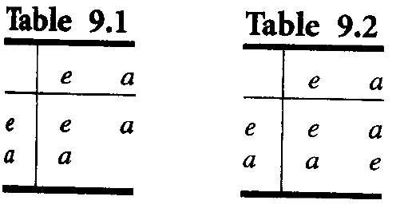
Group of order 1, 2
If G is a group of order 1, then
  G = {e}, and ee = e.
Let G = {e, a} be a group of order 2.
  The blank can be filled in by e or by a?

Slide 28
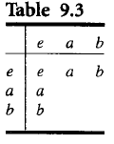
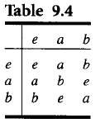
Nonisomorphic groups of order 3
Let G = {e, a, b} be a group of order 3.

Slide 29
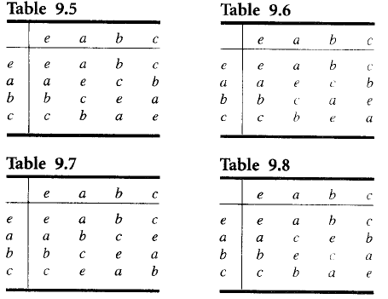
Groups of order 4
Let G = {e, a, b, c} be a group of order 4

Slide 30

Example 5
Let B = {0, l }, and let + be the operation defined on B as follows:
Then B is a group.

Slide 31
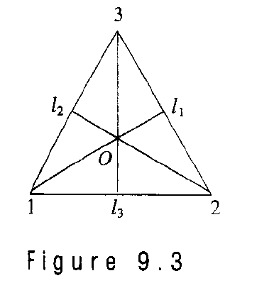
An important group
Given the equilateral triangle with vertices l, 2, and 3
Consider it’s symmetries.

Slide 32
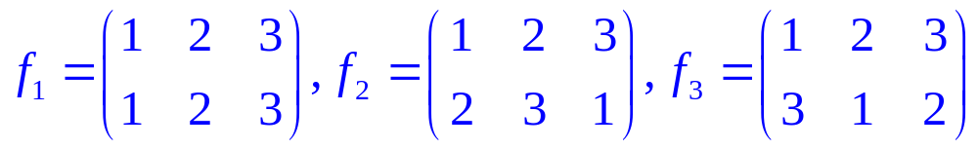
Symmetries of the triangle
There are counter-clockwise rotations f₂, f₃, f₁ of the triangle about O through 120º, 240º, 360º(or 0º) respectively.
f₁, f₂, f₃ can be written as the permutations.

Slide 33
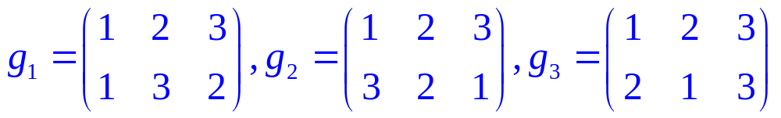
Symmetries of the triangle
Three additional symmetries of the triangle are g₁, g₂, and g₃, by reflecting about the lines l₁, l₂, and l₃, respectively.
Denote these reflections as the following permutations:

Slide 34
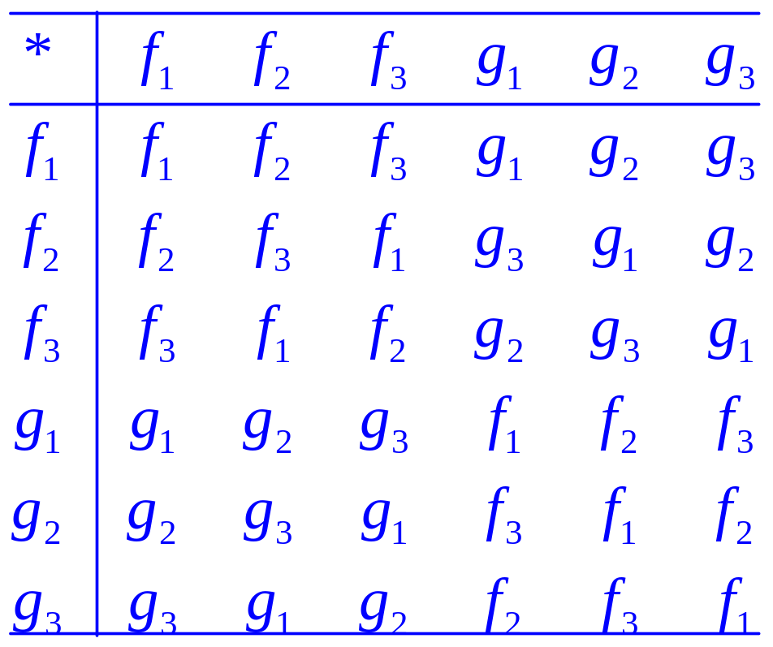
Group of symmetries of the triangle
Let S₃ = {f₁, f₂, f₃, g₁, g₂, g₃} and introduce the operation *, followed by, on the set S₃

Slide 35
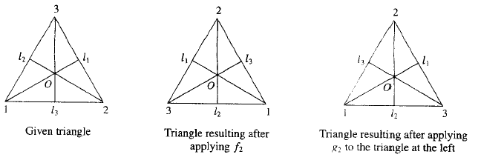
Compute f₂*g₂ geometrically

Slide 36
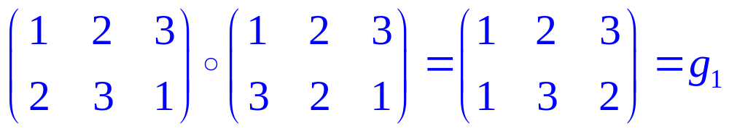
Compute f₂*g₂ algebraically
To compute f₂*g₂ algebraically, we compute f₂□g₂.
So f₂*g₂ = g_{l}.

Slide 37
Example 7
The set of all permutations of n elements is a group of order n! under the operation of composition.
This group is called the symmetric group on n letters (n次对称群) and is denoted by S_{n}.
由部分置换构成的群称为置换群(permutation group)。

Slide 38
Subgroup – 子群
Let H be a subset of a group G such that
  (a) The identity e of G belongs to H.
  (b) If a and b belong to H, then ab∈ H.
  (c) If a ∈ H, then a^{-l} ∈ H.
Then H is called a subgroup of G.

Slide 39
Examples
Let G be a group. Then G and H = {e} are subgroups of G, called the trivial subgroups (平凡子群) of G.
Consider S₃, the group of symmetries of the equilateral triangle. It is easy to verify that H = {f₁, f₂, f₃} is a subgroup of S_{3.}

Slide 40
Example 11
Let A_{n} be the set of all even permutations in the group S_{n}. It can be shown from the definition of even permutation that A_{n} is a subgroup of S_{n} called the alternating group on n letters. (n次变换群)

Slide 41
Example 12
Let
  G be a group and
  a∈G.
Define
  a^{n} as aa...a (n factors), for n ∈ Z⁺ and
  a⁰ as e.
  a^{-n} as a^{-l}a^{-l...} a^{-l} (n factors).
if n and m are any integers, then a^{n}a^{m} = a^{n+m}.
It is easy to show that
  H = (a^{i}|i ∈ Z} is a subgroup of G. (generated by a)

Slide 42
Theorem 5
Let
  (G, *) and (G', *') be two groups, and
  f: G→G' be a homomorphism from G to G'.
Then
  (a) If e is the identity in G and e' is the identity in G', then f(e) = e'.
  (b) If a ∈G, then f(a⁻¹) = (f(a))⁻¹.
  (c) If H is a subgroup of G, then f(H) = {f(h)|h ∈ H} is a subgroup of G'.

Slide 43
Proof - (a)
Let
  x = f(e)
Then
  x *' x = f(e)*'f(e) = f(e*e) = f(e) = x
  so x *' x = x Multiplying both sides by x^{-l} on the right
  x =x*'x* ' x^{-l} = x*'x^{-l} = e'
Thus f(e) = e'

Slide 44
Proof - (b)
Let
  a ∈ G
Then
  a * a⁻¹ = e
  so f(a*a⁻¹) = f(e) = e'
  f(a) *' f(a⁻¹) = e'
  Similarly, f(a⁻¹) *' f(a) = e'
Hence
  f(a⁻¹) =(f(a))⁻¹

Slide 45
Proof - (c)
This follows from Theorem 4 of Section 9.2 and parts (a) and (b).
  Q.E.D.

Slide 46
Note
Remember that an isomorphism preserves all properties defined in terms of the group operations.
Example 16
  The groups S₃ and Z₆ are both of order 6. However, S₃ is not Abelian and Z₆ is Abelian. Hence they are not isomorphic.

Slide 47
Example 17
The groups with multiplication Tables 9.6, 9.7, and 9.8 are isomorphic.
The group with multiplication Table 9.5 is called the Klein 4 group(克莱因四元素群) and it is denoted by V.
Tables 9.5 and 9.6 are not isomorphic groups?
  Observe that if x is any element in the group determined by Table 9.5, then x² = e

Slide 48
Cyclic group – 循环群
Recall the subgroup generated by a. Now Check Table 9.7
  a⁰ = e
  a¹ = a
  a² = b
  a³ = c
  So G = {a⁰, a¹, a², a³}
Such group is called cyclic group.

Slide 49
Homework
12,16 @348
26,32@349

Slide 50
Products and Quotients of Groups

Slide 51
Theorem 1
If
  G₁ and G₂ are groups,
then
  G = G₁×G₂
is a group with binary operation defined by
  (a_{l}, b_{l})(a₂, b₂) = (a₁a₂, b_{l}b₂).

Slide 52
Proof
By Theorem 1, Section 9.3, we have that G is a semigroup.
The existence of an identity and inverses is easy to verify.
  Q.E.D.

Slide 53
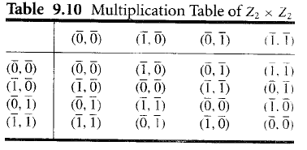
Example 1
Let G₁ and G₂ be the group Z₂. For simplicity of notation, we shall write the elements of Z₂ as 0 and l, respectively, instead of [0] and [l]. Then the multiplication table of G = G₁×G₂ is given in Table.

Slide 54
Example 1
Since G is a group of order 4, it must be isomorphic to V or to Z₄ , the only groups of order 4.
The function
  f: V→ Z₂ × Z₂ defined by
  f(e) = (0, 0), f(a) = (1, 0), f(b) = (0, 1), and f(c) = (1, 1)
is an isomorphism.

Slide 55
Note
If we repeat Example 1 with Z₂ and Z₃, we find that Z₂×Z₃≌ Z₆.
It can be shown, in general, that
  Z_{m}×Z_{n}≌ Z_{mn}
    if and only if
  GCD(m, n) = l.

Slide 56

Example 2
Let B ={0, l } be the group, where + is defined as above
Then B^{n} = B×B×...×B (n factors) is a group with operation ⊕ defined by
  (x₁, x₂,... x_{n}) ⊕ (y₁, y₂,... y_{n})
  = (x₁+y₁, x₂+y₂,.... x_{n}+y_{n} ).
The identity of B^{n} is (0, 0,..., 0), and every element is its own inverse.

Slide 57
Theorem 2
Let R be a congruence relation on the group (G, *).
Then the semigroup (G/R, ⊙) is a group, where the operation ⊙ is defined on G/R by
  [a]⊙[b] = [a*b]
Proof
  Since a group is a monoid, G/R is a monoid.
  Let [a] ∈ G/R.
  Then [a⁻¹] ∈ G/R, and
  [a] ⊙ [a⁻¹] = [a*a⁻¹] = [e].
  So [a]⁻¹ = [a⁻¹].
  Hence (G/R, ⊙) is a group.

Slide 58
Corollary 1
If R is a congruence relation on a group G, then the function
  f_{R}: G→G/R
given by
  f_{R}(a) = [a]
is a group homomorphism.

Slide 59
Corollary 2
If
  f: G→G' is a homomorphism from the group (G, *) onto the group (G', *'), and
  R is the relation defined on G by
    a R b if and only if f(a) = f(b), for a and b in G
Then
  R is a congruence relation.
  The function f: G/R →G', given by f([a]) = f(a) is an isomorphism from the group (G/R, ⊙) onto the group (G', *' ).

Slide 60
Definition
Let
  H be a subgroup of a group G
  a ∈G
The left coset(左陪集) of H in G determined by a is the set
  aH = {ah| h ∈ H}
The right coset (右陪集) of H in G determined by a is the set
  Ha = {ha | h ∈ H}
A subgroup H of G is normal(正规子群) if
  aH = Ha, for all a in G

Slide 61
Warning
If Ha = aH, it does not follow that, for h∈H and a ∈ G, ha = ah.
But ha = ah', where h' is some element in H.

Slide 62


Note
If H is a subgroup of G, we shall need in some applications to compute all the left cosets of H in G.
  First, suppose that a∈H. Then aH H, since H is a subgroup of G;
  Moreover, if h ∈ H, then h = ah', where h' = a⁻¹h ∈ H, so that H aH.
  Thus, if a ∈ H, then aH = H.

Slide 63
Example 3
Let
  G be the symmetric group S₃.
  The subset H = {f_{l}, g₂} is a subgroup of G.
Compute all the distinct left cosets of H in G.

Slide 64
Example 3
Solution
  If a ∈H, then aH = H. Thus
  f_{l} H = g₂H = H.
  f₂H = {f₂, g₁}
  f₃H = {f₃, g₃}
  g₁H = {g₁, f₂}= f₂H
  g₃H = {g₃, f₃}= f₃H
The distinct left cosets of H in G are
    H, f₂H, and f₃H.

Slide 65
Theorem 3
Let
  R be a congruence relation on a group G
  H = [e], the equivalence class containing the identity.
Then
  H is a normal subgroup of G
  [a] = aH = Ha, for each a∈G

Slide 66
Proof
Let
  a and b be any elements in G.
Then
  b ∈ [a] if and only if [b] = [a].
    R is an equivalence relation
  if and only if [e] = [a]⁻¹[b] = [a⁻¹b].
    G/R is a group
  if and only if H = [e] = [a⁻¹b].
  if and only if a⁻¹b ∈ H or b ∈ aH.
So [a] = aH for every a ∈ G.

Slide 67
Proof
Similarly,
  b ∈ [a] if and only if H = [e] = [b][a]⁻¹ = [ba⁻¹].
  [a] = Ha.
Thus [a] = aH = Ha, and H is normal.
  Q.E.D.

Slide 68
Note
Combining Theorem 3 with Corollary 1, we see that in this case the quotient group G/R consists of all the left cosets of N = [e]. The operation in G/R is given by
  (aN)(bN) = [a]⊙[b] = [ab] = abN
and the function f_{R}: G→G/R, defined by
  f_{R}(a) = aN
is a homomorphism from G onto G/R. For this reason, we will often write G/R as G/N.

Slide 69
Theorem 4
Let
  N be a normal subgroup of a group G
  R be the following relation on G
    a R b if and only if a⁻¹b ∈ N.
Then
  (a) R is a congruence relation on G.
  (b) N is the equivalence class [e] relative to R, where e is the identity of G.

Slide 70
Proof (a)
R is an equivalence relation
  Let a ∈ G.
    a R a, since a⁻¹a = e ∈ N,
    R is reflexive.
  Suppose that a R b
    a⁻¹b ∈ N.
    (a⁻¹b)⁻¹ = b⁻¹a ∈ N,
    b R a.
    R is symmetric.
  Suppose that a R b and b R c.
    a^{-l}b ∈ N and b⁻¹c ∈ N.
    (a^{-l}b)(b^{-l}c) = a^{-l}c ∈ N,
    a R c.
    R is transitive.

Slide 71
Proof (a)
R is a congruence relation on G.
  Suppose that a R b and c R d.
    Then a⁻¹b ∈ N and c⁻¹d ∈ N
  Since N is normal, Nd = dN
  since a^{-l}b ∈ N , then a⁻¹bd= dn for some n∈N.
  (ac)⁻¹bd = (c⁻¹a⁻¹)(bd) = c⁻¹ ( a⁻¹b)d = (c⁻¹d) n∈N
  so ac R bd.
  Hence R is a congruence relation on G.

Slide 72
Proof (b)
Suppose that x ∈ N.
  x⁻¹e= x⁻¹∈ N
  x R e
  x ∈ [e]
  N [e]
Conversely, if x ∈ [e],
  x R e
  x⁻¹e= x⁻¹∈ N
  x ∈ N
  [e] N
Hence N = [e].

Slide 73
Note
Following three are equivalent
  a congruence relation R on G
  a normal subgroup H of G
  a homomorphism from G to G/R or G'

Slide 74
Corollary 2
Let
  f be a homomorphism from a group (G, *) onto a group (G', *')
  the kernel(核) of f, ker(f), be defined by ker(f) = {a ∈G| f(a) = e'}.
Then
  ker(f) is a normal subgroup of G.
  The quotient group G/ker(f) is isomorphic to G'.

Slide 75
Example 6
Consider the homomorphism f from Z onto Z_{n} defined by f(m) = [r], where r is the remainder when m is divided by n. Find ker(f).
Solution
  An integer m in Z belongs to ker(f)
  if and only if f(m) = [0]
  if and only if m is a multiple of n
  Hence ker(f) = nZ.

Slide 76
Homework
4 @353
18, 30@354

Slide 77
Tips for proof
Direct proof
Substructure
Iso- and homomorphism

Slide 78
Key ideas for review
Binary operation
  Commutative, Associative
Semigroup, Monoid, Group
  Subsemigroup, Submonoid, Subgroup
Isomorphism, Homomorphism
  Congruence relation R on semigroup (S, *)
  Quotient semigroup S/R,
Order of group, S_{n} , Z_{n},置换群, 循环群
Left and right coset, Normal subgroup

Slide 79
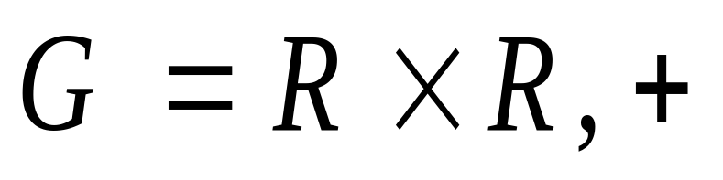
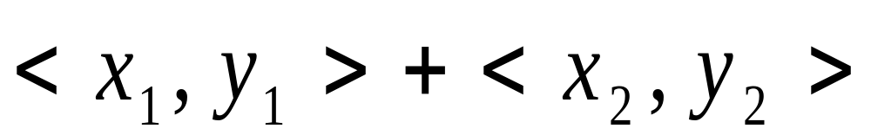

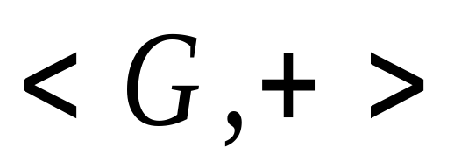
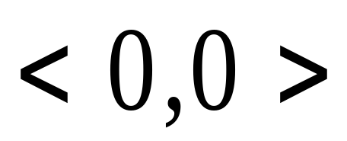
例
定义为
为有幺元
的阿贝尔群.

Slide 80
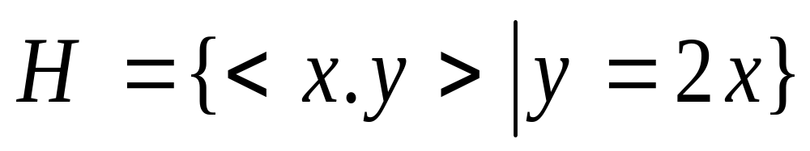
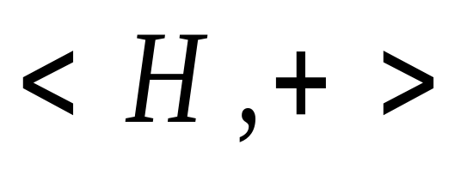
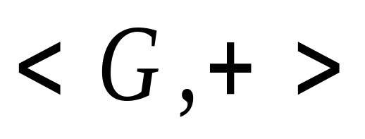
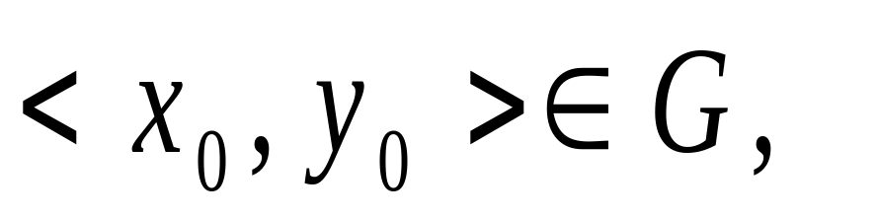
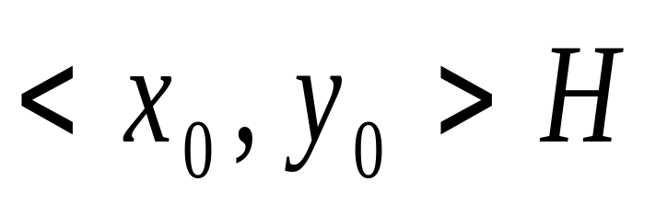

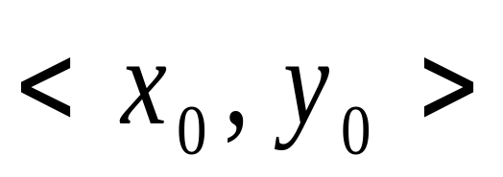
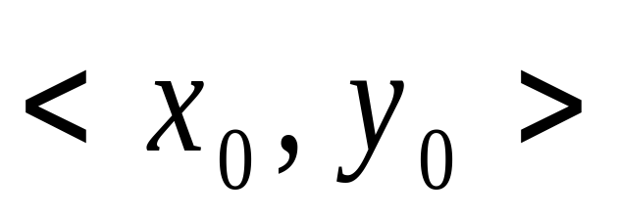

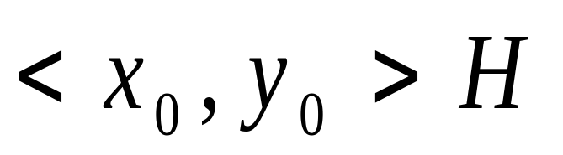
为
的子群.
对
关于
的左陪集.

Slide 81
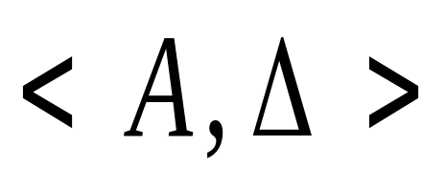

















Slide 82
Thanks for your attention!
Coming up next …
Groups and Coding

