Slide 1
Groups and Coding

Slide 2
Groups and Coding
Coding of Binary Information and Error Detection
Decoding and Error Correction

Slide 3
Coding of Binary Information and Error Detection
Encoding function
Hamming distance
Group Codes
Parity check matrix

Slide 4
Coding theory
In today’s modern world of communication, data items are constantly being transmitted from point to point. The basic problem in transmission of data is that of receiving the data as sent and not receiving a distorted piece of data.
Coding theory has developed techniques for introducing redundant information(引入冗余信息) in transmitted data that help in detecting, and sometimes in correcting, errors.

Slide 5
Unit of information
Message(消息) is a finite sequence of characters from a finite alphabet B = {0, l }
Word(字) is a sequence of m 0's and l 's.

Slide 6
Groups
The set B is a group under the binary operation + (mod 2 addition )
It follows that B^{m} = B × B × … × B (n factors) is a group under the operator ⊕ defined by
  (x₁, x₂,…, x_{m}) ⊕ (y₁, y₂ ,…, y_{m})
  = (x₁ + y₁, x₂ + y₂ , …, x_{m} + y_{m})
An element in B^{m} will be written as (b₁,b₂,..., b_{m}) or more simply as b₁b₂...b_{m}

Slide 7
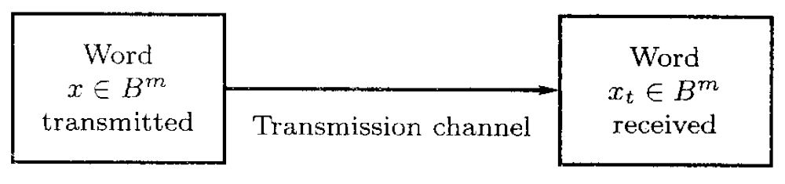
Transmission channel and Noise
An element x ∈ B^{m} is sent through the transmission channel and is received as an element x_{t} ∈ B^{m}.

Slide 8
Transmission channel and Noise
Noise(噪声) in the transmission channel may cause a 0 to be received as a l, or vice versa, lead x ≠ x_{t}
对
错
对
对
时

Slide 9
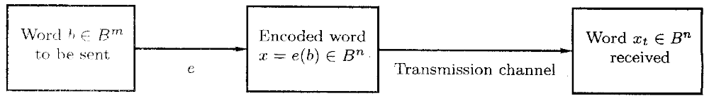
Encoding function - 编码函数
Choose: an integer n>m and a one-to-one function e: B^{m} → B^{n}
  e is called an (m, n) encoding function, representing every word in B^{m} as a word in B^{n}.
  If b ∈ B^{m}, then e(b) is called the code word(码字) representing b.

Slide 10
Encoding function
If the transmission channel is noiseless, then x_{t} = x for all x in B^{n}.
In this case x = e(b) is received for each b ∈ B^{m}, and since e is a known function, b may be identified.

Slide 11
Encoding function
In general, errors in transmission do occur.
We will say that the code word x = e(b) has been transmitted with k or fewer errors if x and x_{t} differ in at least 1 but no more than k positions.

Slide 12
Error detect – 差错检测
Let e: B^{m} → B^{n} be an (m, n) encoding function.
e detects k or fewer errors if whenever x = e(b) is transmitted with k or fewer errors, then x_{t} is not a code word (thus x_{t} could not be x and therefore could not have been correctly transmitted).
For b ∈ B^{n}, the number of l's in x is called the weight(权) of x and is denoted by |x|

Slide 13
Example 1
Find the weight of each of the following words in B⁵.
  x=01000 |x|=1
  x=11100 |x|=3
  x=00000 |x|=0
  x=11111 |x|=5

Slide 14
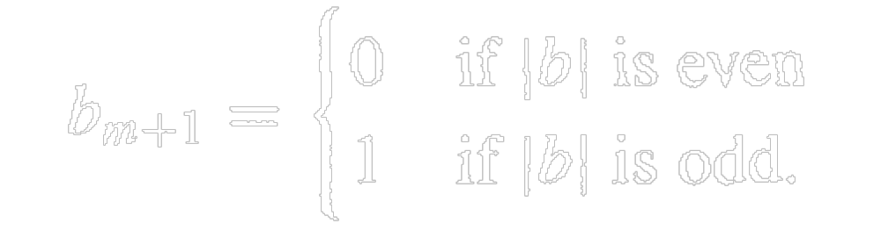
Example 2 parity check code –奇偶校验码
The following encoding function e: B^{m} → B^{m+1} is called the parity (m, m+1) check code: If b = b₁b₂…b_{m} ∈ B^{m}, define
e(b) = b₁b₂…b_{m} b_{m+1}
where

Slide 15
Example 2 parity check code
Let m = 3. Then
    e(000) = 0000
    e(001) = 0011
    e(010) = 0101
    e(011) = 0110
    e(100) = 1001
    e(101) = 1010
    e(110) = 1100
    e(111) = 1111
Suppose now that b = 111. Then x = e(b) = 1111

Slide 16
Example 3
Consider the (m, 3m) encoding function e: B^{m} → B^{3m}.
If b = b₁b₂…b_{m} ∈ B^{m}, define
e(b) = b₁b₂…b_{m}b₁b₂…b_{m}b₁b₂…b_{m}

Slide 17
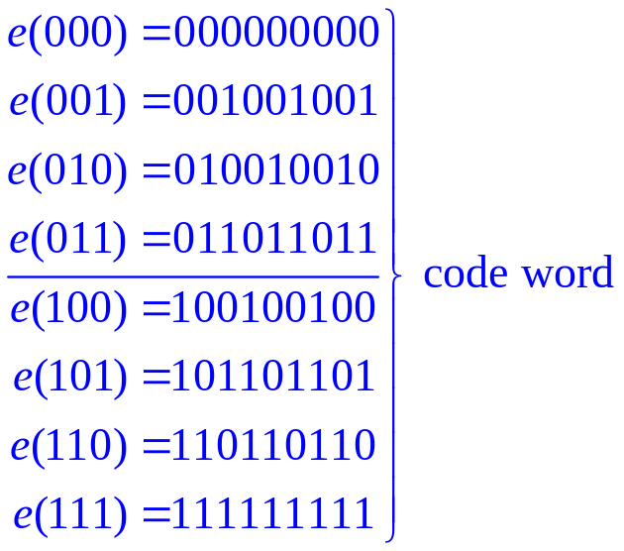
Example 3
Suppose now that b = 011
  Then e(011) = 011011011.
Assume now we receive the word 011111011. This is not a code word, so we have detected the error.

Slide 18
(00,10,01,11)
(00,11)
(1,0)
(1,1)
(0,0)
(0,1)

Slide 19
B^{m}(0,1)->B^{n}(000,111)
(0,0,1)
(1,0,1)
(0,1,1)
(1,1,1)
(0,0,0)
(1,0,0)
(0,1,0)
(1,1,0)

Slide 20
Hamming distance – 海明距离
Let x and y be words in B^{m}. The Hamming distance δ(x, y) between x and y is the weight, |x⊕y|, of x ⊕ y.
The distance between x = x₁x₂…x_{m} and y = y₁y₂…y_{m} is the number of various of i such that x_{i} ≠ y_{i}, that is, the number of positions in which x and y differ.
Using the weight of x ⊕ y is a convenient way to count the number of different positions.

Slide 21
Example 4
Find the distance between x and y:
  (a) x = 110110, y = 000101
  (b) x = 001100, y = 010110.
Solution
  (a) x ⊕ y = 110011, so | x ⊕ y | = 4
  (b) x ⊕ y = 011010, so | x ⊕ y | = 3

Slide 22
Theorem 1 properties of distance function
Let x, y, and z be elements of B^{m}. Then
  (a) δ(x, y) = δ(y, x)
  (b) δ(x, y)≥0
  (c) δ(x, y) = 0 if and only if x = y
  (d) δ(x, y)≤δ(x, z) + δ(z, y)
Proof of (d)
δ(x, y) = | x ⊕ y | = | x ⊕ 0 ⊕ y |
= | x ⊕ z ⊕ z ⊕ y |
≤| x ⊕ z |+| z ⊕ y |

Slide 23
Minimum distance
The minimum distance of an encoding function e: B^{m} → B^{n} is the minimum of the distances between all distinct pairs of code words; that is,
min{δ(e(x), e(y)) | x, y ∈ B^{m}}

Slide 24
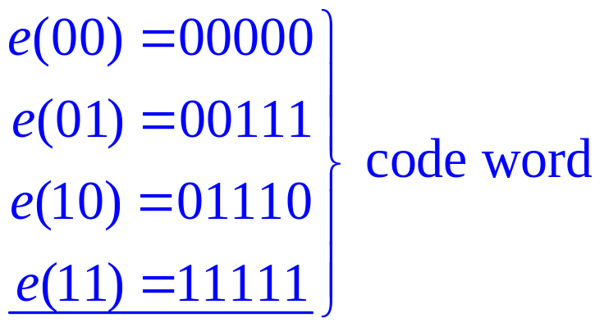
Example 5
Consider the following (2, 5) encoding function e:

Slide 25
Theorem 2
An (m, n) encoding function e: B^{m} → B^{n} can detect k or fewer errors
  if and only if
its minimum distance is at least k + l.

Slide 26
Proof
⇐ the minimum distance is at least k + 1
Let b ∈ B^{m} , and let x = e(b) ∈ B^{n} be the code word representing b.
  x is transmitted and is received as x_{t}. If x_{t} were a code word different from x, then δ(x, x_{t})≥ k+l, so x would be transmitted with k + l or more errors.
  Thus, if x is transmitted with k or fewer errors, then x_{t} cannot be a code word.
  This means that e can detect k or fewer errors.

Slide 27
Proof e can detect k or fewer errors ⇒
Suppose that the minimum distance between code words is r ≤ k
Let x and y be code words with δ (x, y) = r.
  If x = y, that is, if x is transmitted and is mistakenly received as y, then r≤k errors have been committed and have not been detected.
Thus it contradict with e can detect k or fewer errors.
  Q.E.D.

Slide 28
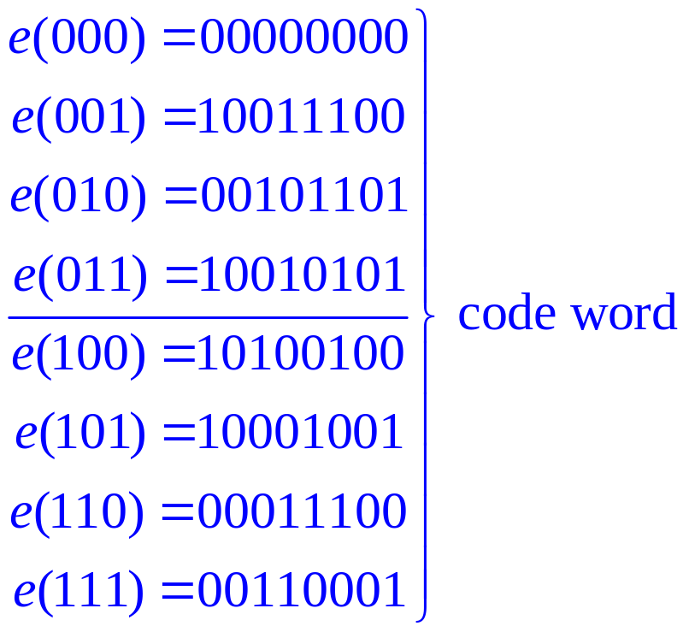
Example 6
How many errors will e detect?
Consider the (3, 8) encoding function e: B³ → B⁸ defined by

Slide 29
Group Codes – 群码
An (m, n) encoding function e: B^{m} → B^{n} is called a group code if
  e(B^{m}) = {e(b) | e(b) ∈ B^{n} } = Ran(e)
is a subgroup of B^{n}

Slide 30
Subgroups
Recall from the definition of subgroup give in Section 9.4 that N is a subgroup of B^{n} if
  (a) the identity of B^{n} is in N,
  (b) if x and y belong to N, then x ⊕ y ∈ N, and
  (c) if x is in N, then its inverse is in N.

Slide 31
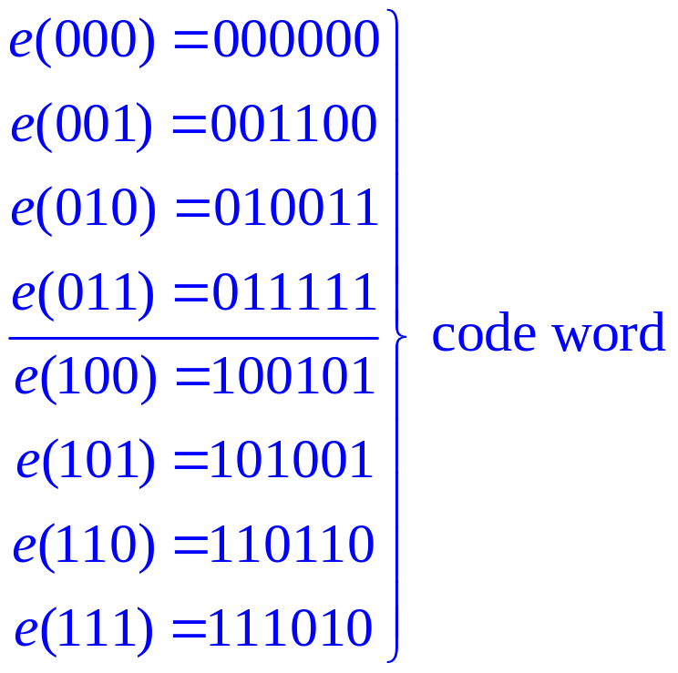
Example 7: is e a group code?
Consider the (3, 6) encoding function e: B³ → B⁶ defined by

Slide 32
Example 7: is e a group code?
We must show that the set of all code words
  N = {000000, 001100, 010011, 011111, 100101, 101001, 110110, 111010}
is a subgroup of B⁶.

Slide 33
Theorem 3
Let e: B^{m} → B^{n} be a group code. The minimum distance of e is the minimum weight of a nonzero code word.

Slide 34
Proof of Theorem 3
Let δ be the minimum distance of the group code, and suppose that δ = δ(x, y), where x and y are distinct code words.
Also, let η be the minimum weight of a nonzero code word and suppose that η = |z| for a code word z.

Slide 35
Proof of Theorem 3
Since e is a group code, x ⊕ y is a nonzero code word. Thus
  δ = δ(x, y) = |x ⊕ y| ≥ η.
On the other hand, since 0 and z are distinct code words,
  η = |z| = |z ⊕ 0 | = δ(z, 0) ≥ δ
Hence η = δ.
  Q.E.D.

Slide 36
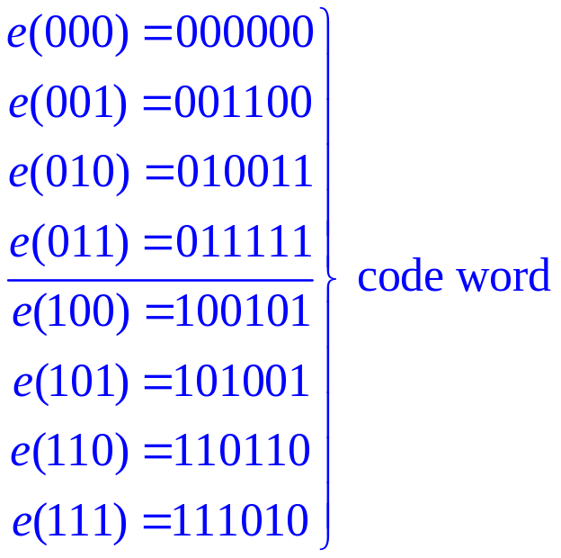
Example 8
The minimum distance of the group code in
is 2
To check this directly would require 28 different calculations.

Slide 37
Constructing
group code

Slide 38
A review on Boolean matrices
  mod-2 sum D ⊕ E
  mod-2 Boolean product D * E
Theorem 4
  Let D and E be m × p Boolean matrices, and let F be a p × n Boolean matrix. Then
    (D ⊕ E) * F = (D * F) ⊕ (E * F).
  That is, a distributive property holds for ⊕ and *.

Slide 39

Example 5
Let B = {0, l }, and let + be the operation defined on B as follows:
Then B is a group.

Slide 40
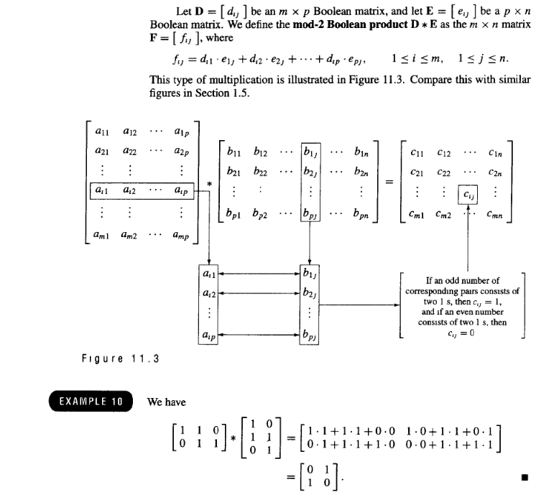

Slide 41
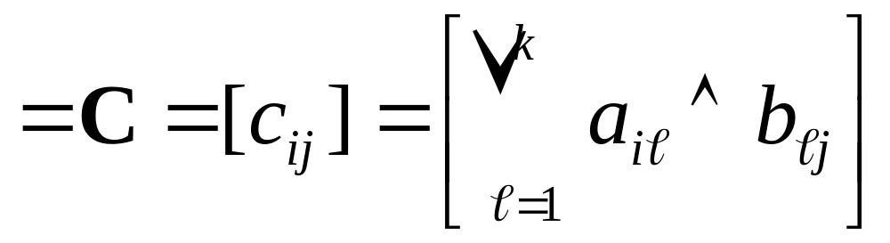
Boolean Products
Let A=[a_{ij}] be an m×k zero-one matrix,
& let B=[b_{ij}] be a k×n zero-one matrix,
The boolean product of A and B is like normal matrix ×, but using ∨ instead of + in the row-column “vector dot product”:
A⊙B

Slide 42
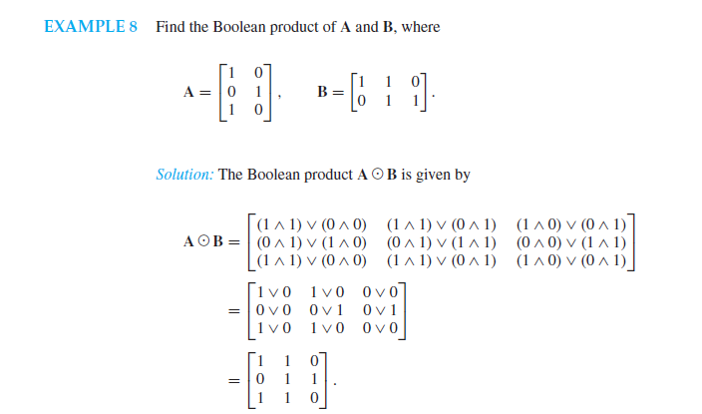

Slide 43
Notation
We shall now consider the element
  x = x₁x₂…x_{n} ∈ B^{n}
as the 1 × n matrix
  [x₁ x₂ … x_{n} ]

Slide 44
Theorem 5
Let m and n be nonnegative integers with m < n, r = n - m, and let H be an n × r Boolean matrix.
Then the function f_{H}: B^{n} → B^{r} defined by
  f_{H}(x) = x * H, x ∈ B^{n} ;
is a homomorphism from the group B^{n} to the group B^{r}.

Slide 45
Proof
If x and y are elements in B^{n}, then
f_{H}(x ⊕ y) = (x ⊕ y) * H
= (x * H) ⊕ (y * H) by Theorem 4
= f_{H}(x ) ⊕ f_{H}(y).
Hence f_{H} is a homomorphism from B^{n} to B^{r}
  Q.E.D.

Slide 46
Corollary 1
Let m, n, r, H, and f_{H} be as in Theorem 5. Then
  N = {x ∈ B^{n} | x * H = 0}
  is a normal subgroup of B^{n}.
Proof:
  N is the kernel of the homomorphism f_{H}, so it is a normal subgroup of B^{n}.

Slide 47
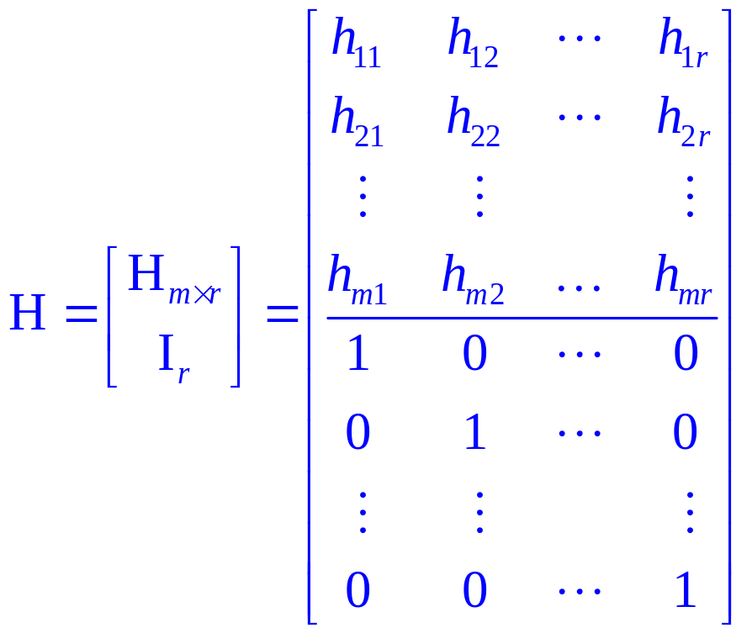
Parity check matrix –
一致性检验矩阵
Let m < n and r = n – m, the following n × r Boolean matrix is called a parity check matrix.

Slide 48
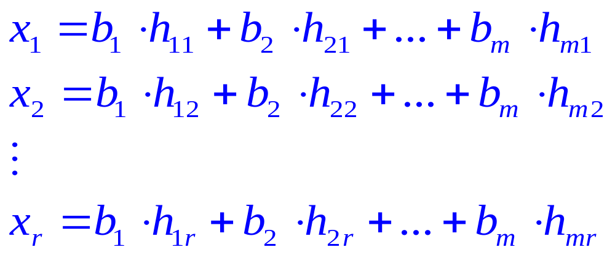
Encoding function
Define an encoding function e_{H}: B^{m} → B^{n}
  If b = b₁b₂…b_{m},
  let x = e_{H}(b) = b₁b₂…b_{m} x₁x₂…x_{r}, where
    (1)

Slide 49
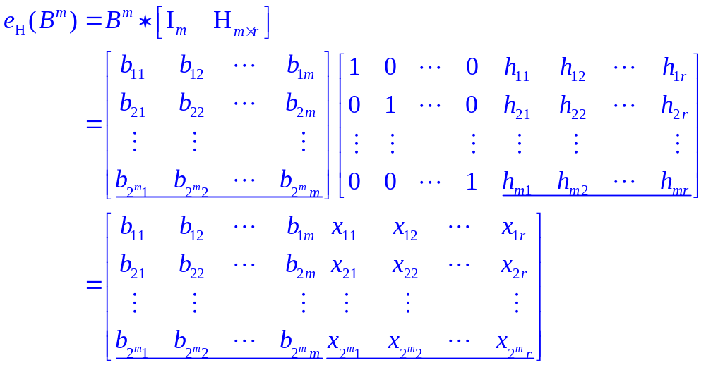
e_{H}: B^{m} → B^{n} in matrix format

Slide 50
Theorem 6
Let x = y₁y₂…y_{m}x₁… x_{r} ∈ B^{n}. Then
  x * H = 0
if and only if
  x = e_{H}(b) for some b ∈ B^{m}.

Slide 51
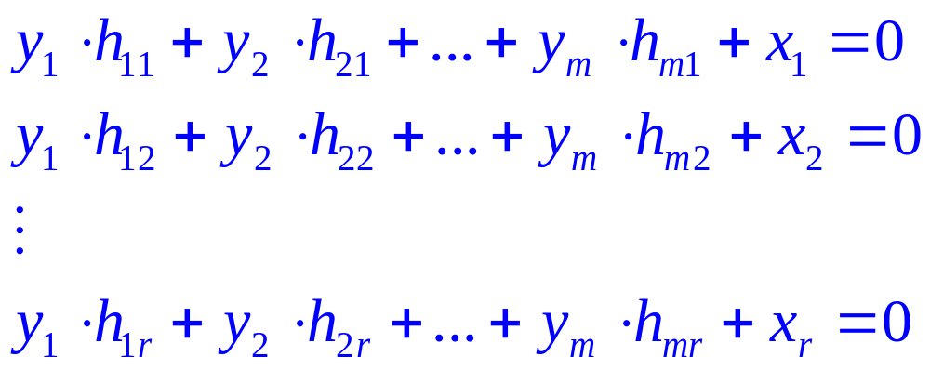
Proof: x * H = 0 ⇒ x = e_{H}(b) for some b ∈ B^{m}
Suppose that x * H = 0

Slide 52
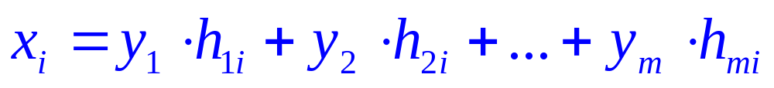
Proof: x * H = 0 ⇒ x = e_{H}(b) for some b ∈ B^{m}
Note that x_{i}+x_{i}=0. So add x_{i} to i^{th} row and get
Letting b₁ = y₁, b₂ = y₂,..., b_{m} = y_{m}, we see that x₁, x₂,..., x_{r} satisfy the equations in (l). Thus b = b₁b₂…b_{m} ∈ B^{m} and x = e_{H}(b)

Slide 53
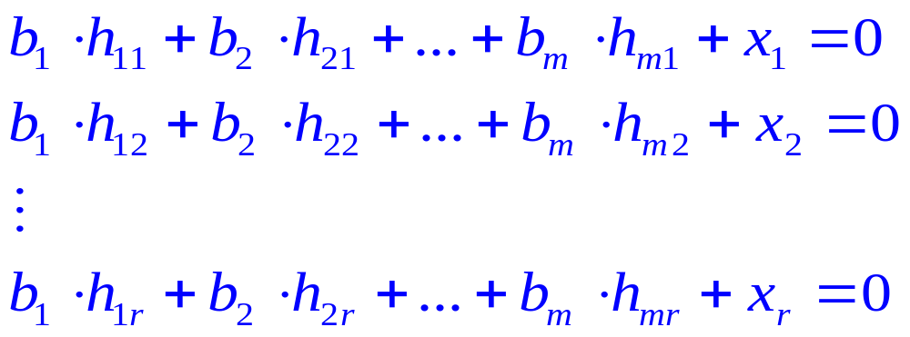
Proof: x * H = 0 ⇐ x = e_{H}(b) for some b ∈ B^{m}
Conversely if x = e_{H}(b), the equations in (l) can be rewritten by adding x_{i} to both sides of the i^{th} equation, i = l, 2,..., n, as
which shows x * H = 0
  Q.E.D.

Slide 54
Corollary 2
  e_{H}(B^{m} ) = {e_{H}(b) | b ∈ B^{m}} is a subgroup of B^{n}
Proof :
The result follows from the observation that
  e_{H}(B^{m} ) = ker(f_{H})
  and from Corollary l.
Thus e_{H} is a group code.

Slide 55
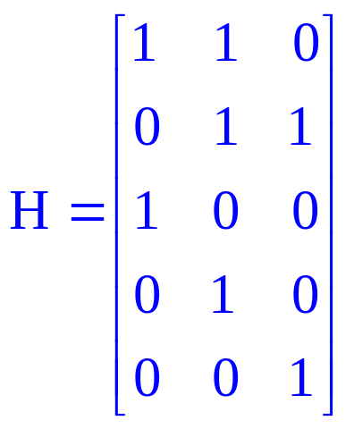
Example 11
Let m = 2, n = 5, and
Determine the group code e_{H}: B²→ B⁵.

Slide 56
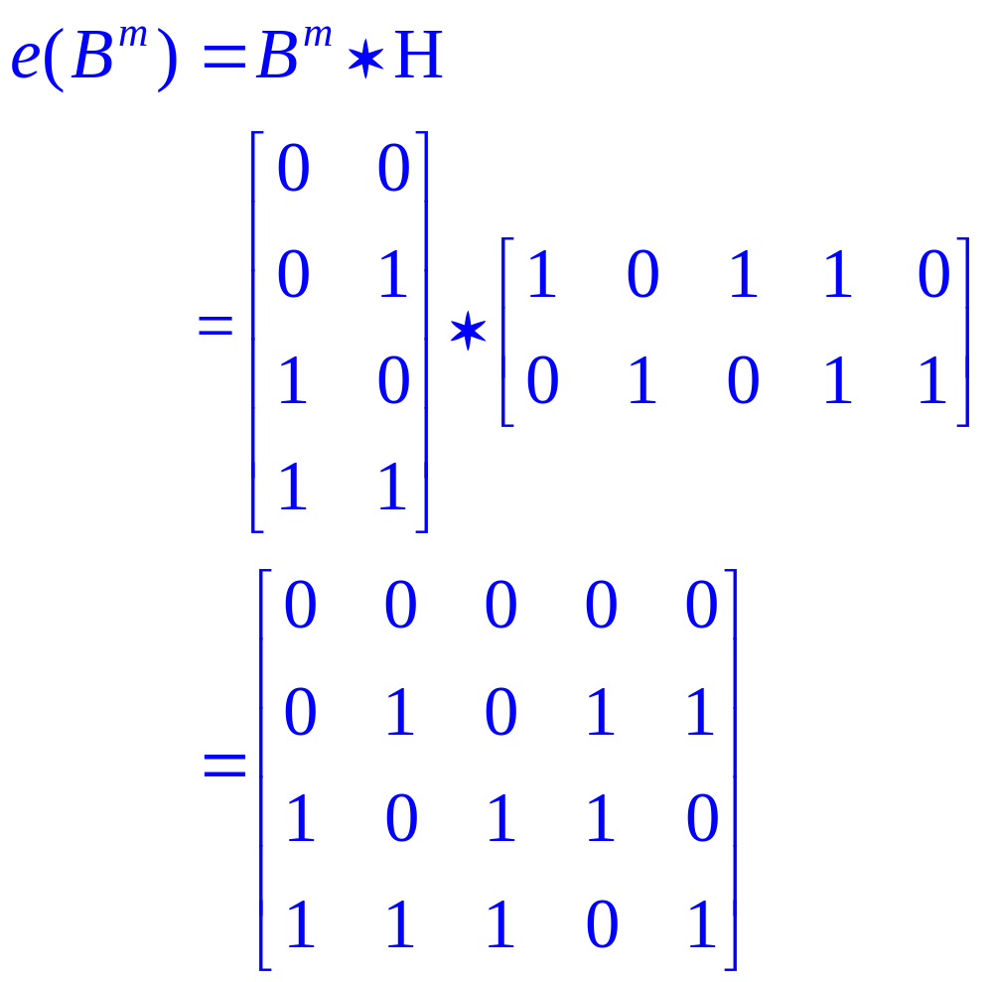
Solution 11

Slide 57
Homework
19,23,25,27 P412

Slide 58
Thanks for your attention!
Coming up next …
Decoding and Error Correction

Slide 59
Decoding and Error Correction
译码与纠错

Slide 60
f_{H} (x) =x*H
B^{n}
B^{r}
f_{R} (x) =[x] _{R}= x ⊕ N
xRy if only if x⁻¹ ⊕ y∈N
f_{H} (x)= f_{H} (y)
F (xN)= f_{H} (x) =x*H
B^{n}/N
{xN |x ∈ B^{n}}= {(x*H=y |y ∈ B^{r} )}
N={x=e(b),b ∈ B^{m}}= {(x*H=0) |x ∈ B^{n} }

Slide 61
Decoding Function – 译码函数
Consider an (m, n) encoding function e: B^{m} → B^{n}.
Once the encoded word x = e(b) ∈ B^{n}, for b ∈ B^{m}, is received as the word x_{t}, we are faced with the problem of identifying the word b that was the original message.

Slide 62
Decoding Function
Consider an (m, n) encoding function e: B^{m} → B^{n}.
An onto function d: B^{n} → B^{m} is called an (n, m) decoding function associated with e(与e关联的译码函数) if d(x_{t}) = b' ∈ B^{m} is such that when the transmission channel has no noise, then b' = b, that is,
  d o e = 1_{Bm}

Slide 63
Decoding Function
The decoding function d is required to be onto so that every received word can be decoded to give a word in B^{m}.
It decodes properly received words correctly, but the decoding of improperly received words may or may not be correct.

Slide 64
Example 1
Consider the parity check code that is defined in Example 2 of Section 11.1
Define the decoding function d: B^{m+1} → B^{m}.
  If y = y_{l}y₂…y_{m}y_{m+l} ∈ B^{m+1} , then d(y) = y_{l}y₂…y_{m}
Observe that if b = b_{l}b₂…b_{m}∈ B^{m}, then
  (d o e)(b) = d(e(b)) = b
  so d o e = 1_{Bm}
For a concrete example, let m = 4.
  Then d(10010) = 1001 and d(11001) = 1100

Slide 65
Decoding function
Let e be an (m, n) encoding function and let d be an (n, m) decoding function associated with e.
The pair (e, d) is said to correct k or fewer errors
  if whenever x = e(b) is transmitted correctly or with k or fewer errors and x_{t} is received, then d(x_{t}) = b. Thus x_{t} is decoded as the correct message b.

Slide 66

Example 2
Consider the (m, 3m) encoding function defined in Example 3 of Section 11.1. Define the decoding function d: B^{m}→ B^{3m}.
Let y = y₁y₂…y_{m}y_{m+1}… y_{2m}y_{2m+1}…y_{3m}, Then
  d(y) = z₁z₂…z_{m}
  where
  E.g. x_{t} = 011011111, then d(x_{t}) = 011

Slide 67

Maximum likelihood technique – 极大似然技术
Since B^{m} has 2^{m} elements, there are 2^{m} code words in B^{n}. List it as
  x⁽¹⁾, x⁽²⁾,..., x^{(2m)}
If the received word is x_{t}, we compute δ(x^{(i)},x_{t}) for 1 ≤i ≤ 2^{m}, and choose the first code word, say it is x^{(s)}, such that

Slide 68
Maximum likelihood decoding function
That is, x^{(s)} is a code word that is closest to x_{t} and the first in the list.
If x^{(s)} = e(b), we define the maximum likelihood decoding function d associated with e by
  d(x_{t}) = b

Slide 69
Theorem 1
Suppose that e is an (m, n) encoding function and d is a maximum likelihood decoding function associated with e. Then
  (e, d) can correct k or fewer errors
if and only if
  the minimum distance of e is at least 2k + l.

Slide 70
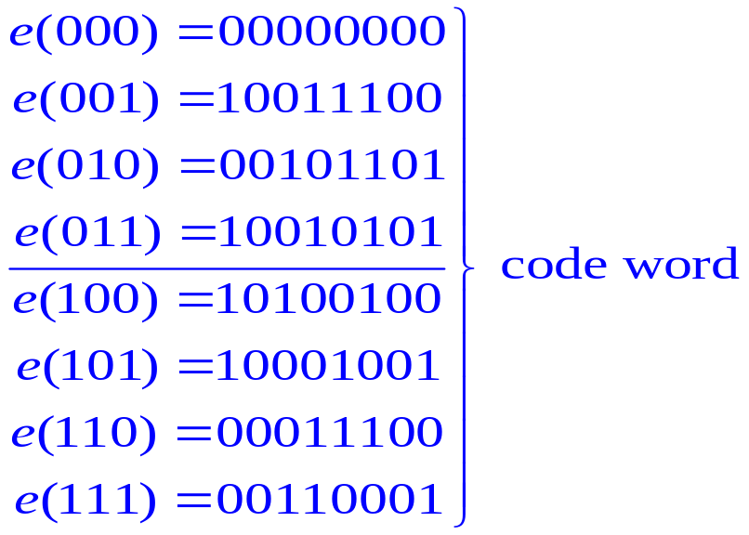
Example 3
How many errors can (e, d) correct?
The (3, 8) encoding function e: B³ → B⁸
and let d be an (8, 3) maximum likelihood decoding function associated with e.

Slide 71
Constructing
maximum likelihood decoding function associated with a given group code

Slide 72
Theorem 2
If K is a finite subgroup of a group G, then every left coset of K in G has exactly as many elements as K.

Slide 73
Proof
Let aK be a left coset of K in G, where a ∈ G. Consider the function f: K → aK defined by
  f(k) = ak, for k ∈ K.
We show that f is one to one and onto.
To show that f is one to one, we assume that
  f(k_{l}) = f(k₂), k_{l}, k₂ ∈ K.
  Then ak_{l} = ak₂
Left multiply a⁻¹, we have
  k_{l} = k₂

Slide 74
Proof
To show that f is onto, let b be an arbitrary element in aK. Then b = ak for some k ∈ K. We now have
  f(k) = ak = b
  so f is onto.
Since f is one to one and onto, K and aK have the same number of elements.
  Q.E.D

Slide 75
Group code word
Let e: B^{m} → B^{n} be an (m, n) encoding function that is a group code.
Thus the set N of code words in B^{n} is a subgroup of B^{n} whose order is 2^{m}, say
  N = {x⁽¹⁾, x⁽²⁾,..., x^{(2m)}}.

Slide 76
Coset leader – 陪集头
Suppose that the code word x = e(b) is transmitted and that the word x_{t} is received.
The left coset of x_{t} is
  x_{t} ⊕ N = {ε₁, ε₂,..., ε_{2m}} where ε_{i} = x_{t} ⊕ x^{(i)}
if ε_{j} is a coset member with smallest weight, then x^{(j)} must be a code word that is closest to x_{t}.
An element ε_{j} , having smallest weight, is called a coset leader.

Slide 77
Procedure
For obtaining a maximum likelihood decoding function d associated with a given group code e: B^{n} → B^{m}

Slide 78
Procedure
Step 1: Determine all the left cosets of N = e(B^{m}) in B^{n}
Step 2: For each coset, find a coset leader (a word of least weight).
Step 3: If the word x_{t} is received, determine the coset of N to which x_{t} belongs.
Step 4: Let ε be a coset leader for the coset determined in Step 3. Compute x = x_{t} ⊕ ε. If x = e(b), we let d(x_{t}) = b. That is, we decode x_{t} as b.

Slide 79
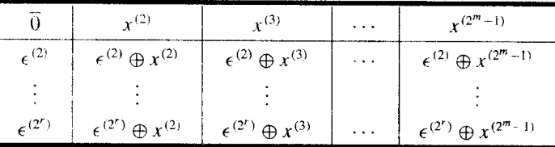
Decoding table
Constructing a decoding table, each row is a left coset of N with the first element ε^{(i)} the coset leader.

Slide 80
Decoding table
If we receive the word x_{t}, we locate it in the table. If x is the element of N that is at the top of the column containing x_{t}, then x is the code word closest to x_{t}.
  if x = e(b), then d(x_{t}) = b.

Slide 81
Example 4
Consider the (3, 6) group code
  N = {000000, 001100, 010011, 011111, 100101, 101001, 110110, 111010}
  = {x⁽¹⁾, x⁽²⁾,..., x⁽⁸⁾}.

Slide 82
Example 4
Constructing decoding table:
==============================================================
000000 001100 010011 011111 100101 101001 110110 111010
--------------------------------------------------------------
000001 001101 010010 111110 100100 101000 110111 111011
000010 001110 010001 011101 100111 101011 110100 111000
000100 001000 010111 011011 100001 101101 110010 111110
010000 011100 000011 001111 110101 111001 100110 101010
100000 101100 110011 111111 000101 001001 010110 011010
000110 001010 010101 011001 100011 101111 110000 111100
010100 011000 000111 001011 110001 111101 100010 101110
==============================================================
001010 000110 011001 010101 101111 100011 111100 110000

Slide 83
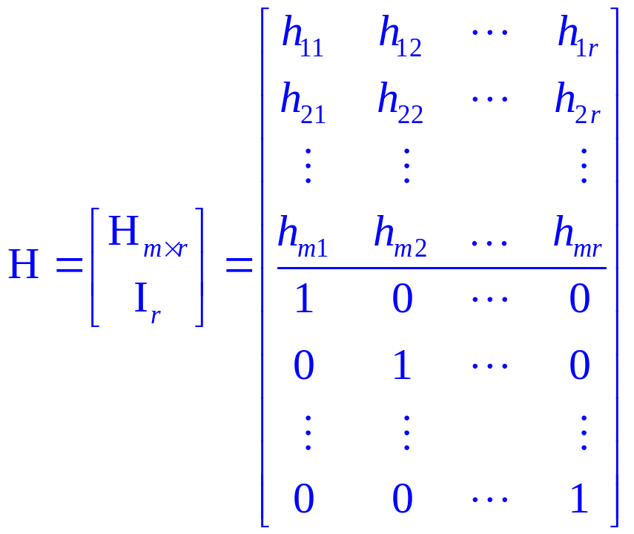
Simplified decoding technique
Suppose that the (m, n) group code is e_{H}: B^{m} → B^{n} , where H is a given parity check matrix.

Slide 84
Simplified decoding technique
Then the function f_{H}: B^{n} → B^{r} defined by
  f_{H}(x) = x*H, x ∈ B^{n}
is a homomorphism from the group B^{n} to the group B^{r}.

Slide 85
Theorem 3
If m, n, r, H, and f_{H} are as defined, then
  f_{H} is onto.
Proof
  Let b = b₁b₂…b_{r} be any element in B^{r}.
  Letting x = 0₁…0_{m}b₁b₂…b_{r}
  Then x*H = b.
  Thus f_{H}(x) = b, so f_{H} is onto.
    Q.E.D

Slide 86
Syndrome – 特征值
It follows from Corollary l of Section 9.5 that B^{r} and B^{n}/N are isomorphic, where
  N = {x ∈ B^{n} | x*H = 0} = ker(f_{H}) = e_{H}(B^{m} )
under the isomorphism g: B^{n}/N → B^{r} defined by
  g(xN) = f_{H}(x) = x*H
The element x*H is called the syndrome of x

Slide 87
Theorem 4
Let x and y be elements in B^{n}. Then
  x and y lie in the same left coset of N in B^{n}
if and only if
  f_{H}(x) = f_{H}(y)
if and only if
  they have the same syndrome.

Slide 88
Proof
It follows from Theorem 4 of Section 9.5 that x and y lie in the same left coset of N in B^{n} if and only if x ⊕ y = (-x) ⊕ y ∈ N.
Since N = ker(f_{H}),
  x ⊕ y ∈ N
if and only if
  f_{H}(x ⊕ y) = 0_{Br}
  f_{H}(x) ⊕ f_{H}(y) = 0_{Br}
  f_{H}(x) = f_{H}(y)
    Q.E.D.

Slide 89
Decoding procedure
Suppose that we compute the syndrome of each coset leader. If the word x_{t} is received, we also compute f_{H}(x_{t}), the syndrome of x_{t}. By comparing f_{H}(x_{t}) and the syndromes of the coset leaders, we find the coset in which x_{t} lies. Suppose that a coset leader of this coset is ε. We now compute x = x_{t} ⊕ ε. If x = e(b), we then decode x_{t} as b.

Slide 90
New procedure
Step 1: Determine all left cosets of N = e_{H}(B^{m} ) in B^{n}.
Step 2: For each coset, find a coset leader, and compute the syndrome of each leader
Step 3: If x_{t} is received, compute the syndrome of x_{t} and find the coset leader ε having the same syndrome. Then x_{t} ⊕ ε = x is a code word e_{H}(b), and d(x_{t}) = b.

Slide 91
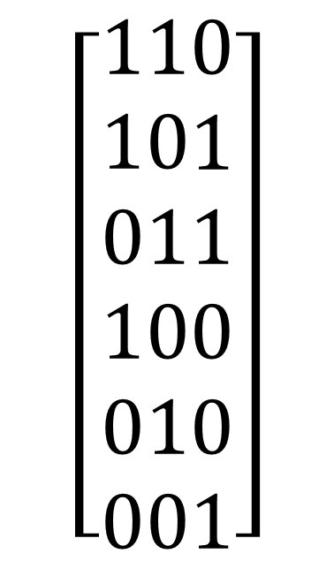
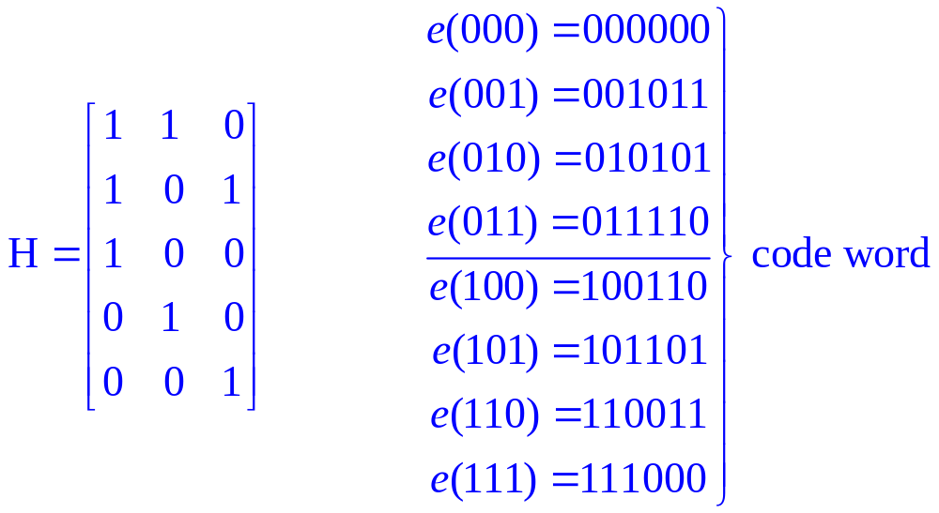
Example 5
Consider the parity check matrix and the (3, 6) group code e_{H}: B³ → B⁶.

Slide 92
Example 5
  N = {000000, 001011, 010101, 011110, 100110, 101101, 110011, 111000}
  Syndrome of Coset Leader | Coset leader
  --------------------------+-------------------
  000 | 000000
  001 | 000001
  010 | 000010
  011 | 001000
  100 | 000100
  101 | 010000
  110 | 100000
  111 | 001100
  --------------------------+-------------------

Slide 93
Example 5
  If x_{t} = 001110, then f_{H}(x_{t}) = x_{t} * H = 101, same as ε=010000.
  x = x_{t} ⊕ ε = 001110 ⊕ 01000 = 011110 = e(011), so decode 001110 as 011.
  Syndrome of Coset Leader | Coset leader
  --------------------------+-------------------
  000 | 000000
  001 | 000001
  010 | 000010
  011 | 001000
  100 | 000100
  101 | 010000
  110 | 100000
  111 | 001100
  --------------------------+-------------------

Slide 94
Homework
14, 18, 22 p421
24 p422

Slide 95
Key ideas for review
Message, word
(m, n) encoding function, one-to-one
  Code word, parity check code
  Detect, correct, k or fewer errors
Hamming distance
  Properties of distance
Group code and parity check matrix
  Minimum distance of a group code
Maximum likelihood technique
  Maximum likelihood decoding function
  Syndrome and decoding procedure for group code

Slide 96
End of the Course
Thank you for your attention!
Your suggestions are warmly welcome, please not hesitate to drop a line to:
  wubin@bupt.edu.cn

Slide 97
Good luck to you all!

