Slide 1
Lecture 1. Fundamentals of Circuit Modeling and Basic Laws
Part (1). Circuit Models and Circuit Laws

Slide 2
Fundamentals of Circuit Modeling and Basic Laws
Hello students!
Nice to meet you at this place.
Welcome to the course of The Principle of Circuit.
My name is Anrew Bochkarev, but you can just call me Mr. Teacher.
I am an associate professor at Samara State Technical University.
My specialization is measuring, electricity, electronics, web programming and microcontrollers programming.
In addition, machine learning and similar things are a very big part of my work as teacher and scientist.

Slide 3

Fundamentals of Circuit Modeling and Basic Laws
If you want, you can ask me not only about circuits and electricity, but also about issues of interest in my field that I mentioned earlier.
Let’s get started.
Important terms will be highlighted in bold text on subsequent slides. You must write this in your textbook to help yourself by your lecture notes at the preparing and, may be, passing the exam

Slide 4
Fundamentals of Circuit Modeling and Basic Laws
Before we begin, check out our rules in addition to your classic «rules of classroom behavior»:
If you don’t understand something – rise your hand and ask me
If want me to describe something in more detail – rise your hand and ask me
Don’t be shy to ask even if you don’t speak English well

Slide 5
Fundamentals of Circuit Modeling and Basic Laws
Now we prepared to really start our lecture
The Principle of Circuit is a professional basic course, which serves as a foundation for many courses in the automation major and related fields.
The primary objective of this course is to enable students to master the basic theories of circuits and the general methods of circuit analysis.
An accurate understanding of these principles is essential for solving practical engineering problems.

Slide 6
Fundamentals of Circuit Modeling and Basic Laws
This first lecture begins our study with the most fundamental concepts.
We will establish the terminology and conceptual framework used throughout our study.
To begin our course, we must distinguish between the physical reality of electrical systems and the theoretical models used to analyze them.
An actual circuit is a collection of physical devices such as batteries, generators, transmission lines, and integrated circuits connected to perform a specific function.

Slide 7
Fundamentals of Circuit Modeling and Basic Laws
These elements are complex; a simple connecting wire, for instance, possesses resistance, inductance, and capacitance simultaneously.
They can get hot, they can affect each other with magnetic fields, and they are not perfect.
Analyzing a physical device in its entirety, with all its parasitic effects and electromagnetic interferences, is mathematically complex and often unnecessary for the desired level of precision.

Slide 8
Fundamentals of Circuit Modeling and Basic Laws
We utilize the concept of the ideal «Circuit model» to simplify analysis while retaining essential behaviors.

Slide 9
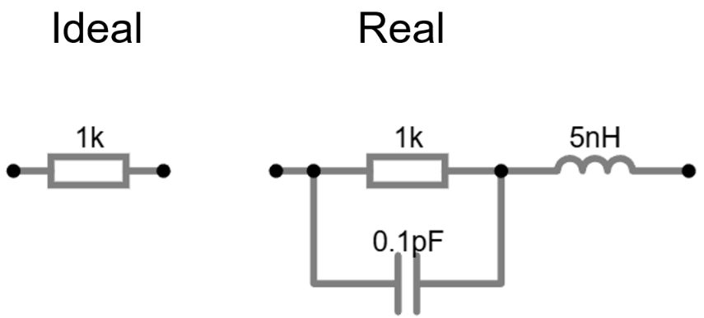
Fundamentals of Circuit Modeling and Basic Laws
A circuit model is an idealization of an actual circuit where physical components are represented by ideal circuit elements

Slide 10

Fundamentals of Circuit Modeling and Basic Laws
Each ideal element represents a single primary electromagnetic property.
For example, a resistor in a circuit model represents only the dissipation of energy (energy is converted into heat), ignoring any magnetic or capacitive effects that a physical resistor might have.

Slide 11
Fundamentals of Circuit Modeling and Basic Laws
Fundamentals of Circuit Modeling and Basic Laws
«Lumped Parameter Hypothesis» assumes that the physical dimensions of the circuit are significantly smaller than the wavelength of the electromagnetic waves associated with the signals involved.
Voltage and current are well-defined functions of time, independent of spatial coordinates along the conductor.

Slide 12
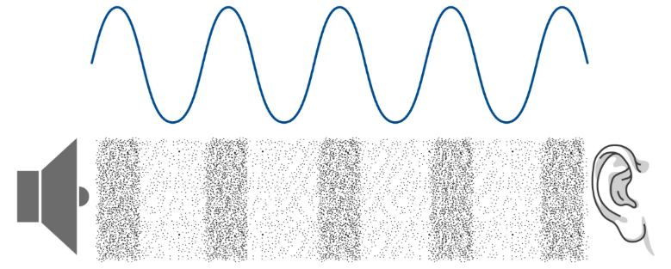
Fundamentals of Circuit Modeling and Basic Laws
Fundamentals of Circuit Modeling and Basic Laws
To understand the «Lumped Parameter Hypothesis» better, imagine a sound wave.

Slide 13
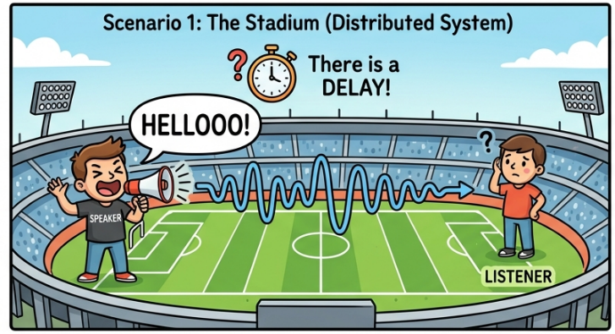
Fundamentals of Circuit Modeling and Basic Laws
Fundamentals of Circuit Modeling and Basic Laws
If you speak to someone across a large stadium, there is a delay.

Slide 14

Fundamentals of Circuit Modeling and Basic Laws
Fundamentals of Circuit Modeling and Basic Laws
But if you speak to someone right next to you, the sound seems instant.

Slide 15
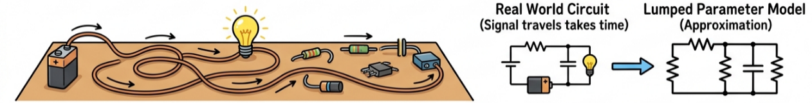
Fundamentals of Circuit Modeling and Basic Laws
Fundamentals of Circuit Modeling and Basic Laws
Circuits are similar. If the circuit is small or signals travel fast, we simplify by treating components as «lumped» together, ignoring travel time, just like speaking close up.

Slide 16
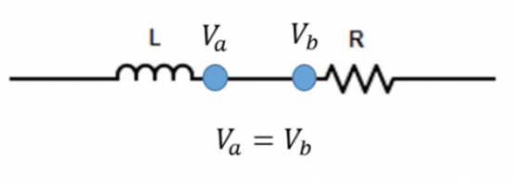

Fundamentals of Circuit Modeling and Basic Laws
Fundamentals of Circuit Modeling and Basic Laws
If the physical size of the circuit is small compared to the wavelength of the electromagnetic signal, we can treat the circuit as «lumped».

Slide 17
Fundamentals of Circuit Modeling and Basic Laws
Fundamentals of Circuit Modeling and Basic Laws
This means we assume the current entering a wire at one end arrives at the other end instantly.
For 50Hz or 60Hz power lines, the wavelength is thousands of kilometers.
So, even a house is a «small» point. But for high-speed computer chips working at Gigahertz frequencies, the wavelength is very short, and we might need to treat wires as «distributed» elements, like transmission lines.

Slide 18
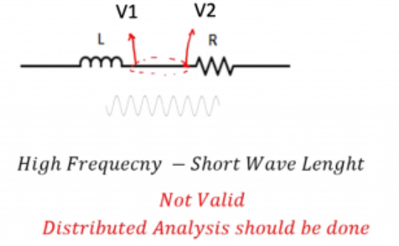
Fundamentals of Circuit Modeling and Basic Laws
Fundamentals of Circuit Modeling and Basic Laws
If frequency of signal is high enough to its wavelength be comparable with elements in circuit and lengths of wires in it there isn’t valid to use lumped parameter hypothesis.
In this case we need to use distributed analysis.

Slide 19
Fundamentals of Circuit Modeling and Basic Laws
Fundamentals of Circuit Modeling and Basic Laws
In this course, we assume all circuits are lumped, meaning signals travel instantly across wires.
We proceed to the quantification of electrical phenomena. The most fundamental quantity in circuit analysis is electric charge.
However, in dynamic circuits, we are primarily interested in the flow of this charge.

Slide 20
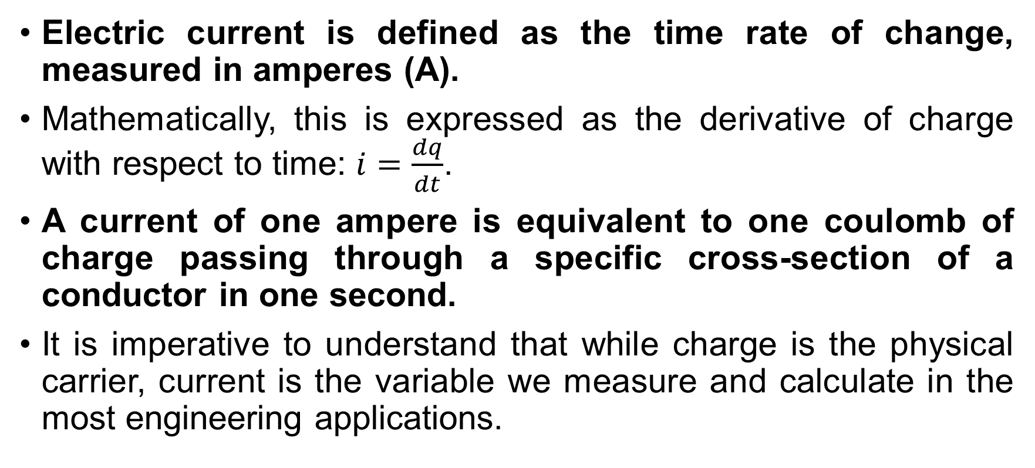
Fundamentals of Circuit Modeling and Basic Laws
Fundamentals of Circuit Modeling and Basic Laws
Electric current is defined as the time rate of change, measured in amperes (A).
Mathematically, this is expressed as the derivative of charge with respect to time: $i=\frac{dq}{dt}$.
A current of one ampere is equivalent to one coulomb of charge passing through a specific cross-section of a conductor in one second.
It is imperative to understand that while charge is the physical carrier, current is the variable we measure and calculate in the most engineering applications.

Slide 21
Fundamentals of Circuit Modeling and Basic Laws
Fundamentals of Circuit Modeling and Basic Laws
Here's a simple illustration of this phenomenon.
Imagine that counter of the red electrons is the yellow line perpendicular to the blue wire.

Slide 22
Fundamentals of Circuit Modeling and Basic Laws
Fundamentals of Circuit Modeling and Basic Laws
A very important aspect of analyzing current is understanding direction.
Here are the differences between the actual directions and reference directions of current and voltage.
The actual direction of current flow is physically defined by the movement of positive charge.
Historically, this was established before the discovery of the electron.

Slide 23
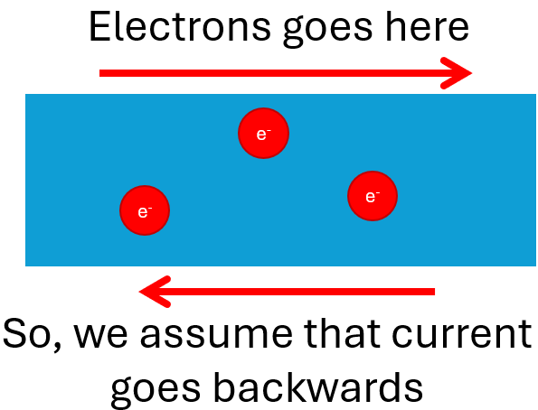
Fundamentals of Circuit Modeling and Basic Laws
Fundamentals of Circuit Modeling and Basic Laws
The actual direction of current is the direction of positive charge movement; consequently, electrons, being negatively charged, move in the direction opposite to the actual current.

Slide 24
Fundamentals of Circuit Modeling and Basic Laws
Fundamentals of Circuit Modeling and Basic Laws
In a metallic conductor, the physical charge carriers are electrons moving from negative to positive potential (later we will talk about potential), but for the purposes of circuit theory, we analyze the conventional current flowing from positive to negative.
In complex network analysis, determining the actual direction of current before solving the circuit is often impossible.
Therefore, we employ the concept of reference direction.

Slide 25
Fundamentals of Circuit Modeling and Basic Laws
Fundamentals of Circuit Modeling and Basic Laws
A reference direction is an arbitrarily selected direction of current flow used to set up algebraic equations for circuit analysis.
We assign an arrow to a branch in the circuit diagram to indicate this reference.
This assignment does not necessarily match the actual physical flow.
It serves as a coordinate system for the electrical variable.
Without a reference direction, the algebraic value of a current is meaningless, much like a vector quantity without a defined axis.

Slide 26

Fundamentals of Circuit Modeling and Basic Laws
Fundamentals of Circuit Modeling and Basic Laws
Here is an illustration of current $i$, also represented as moving yellow dots.
Here you see a simulation program which clearly shows the direction of current, but in real circuits, it can be reversed.

Slide 27
Fundamentals of Circuit Modeling and Basic Laws
Fundamentals of Circuit Modeling and Basic Laws
The algebraic sign of the calculated current indicates the relationship between the reference direction and the actual direction.
If the calculated value of current is positive, the actual direction of current flow coincides with the chosen reference direction.
Conversely, if the calculated value is negative, the actual direction of current flow is opposite to the chosen reference direction.

Slide 28
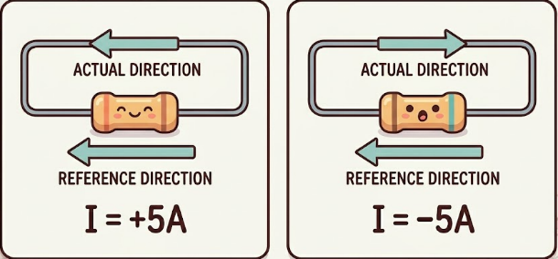
Fundamentals of Circuit Modeling and Basic Laws
Fundamentals of Circuit Modeling and Basic Laws
This principle allows us to assume directions arbitrarily, solve the linear equations governing the circuit, and interpret the physical reality based on the resulting signs.
This abstraction is necessary for analyzing alternating current (AC) where the direction changes periodically.

Slide 29
Fundamentals of Circuit Modeling and Basic Laws
Fundamentals of Circuit Modeling and Basic Laws
Let's practice reading signs with an example.
Imagine a battery and a light bulb and charging process for the rechargeable battery
The point is to determine signs of current in both cases.
Next slide is used to illustrate this example.

Slide 30
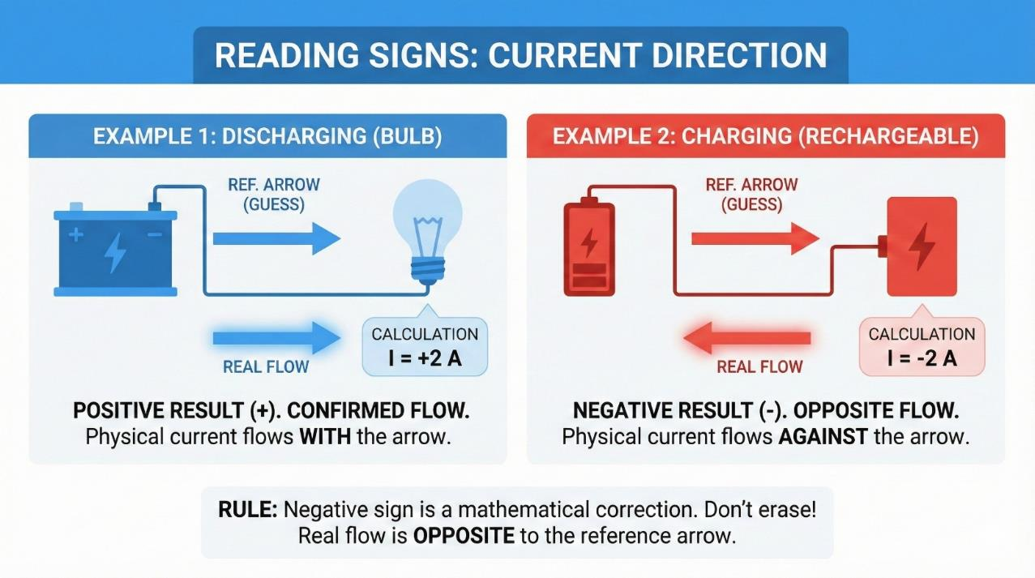
Fundamentals of Circuit Modeling and Basic Laws
If the calculated value of current is positive, the actual direction of current flow coincides with the chosen reference direction. Conversely, if the calculated value is negative, the actual direction of current flow is opposite to the chosen reference direction.

Slide 31
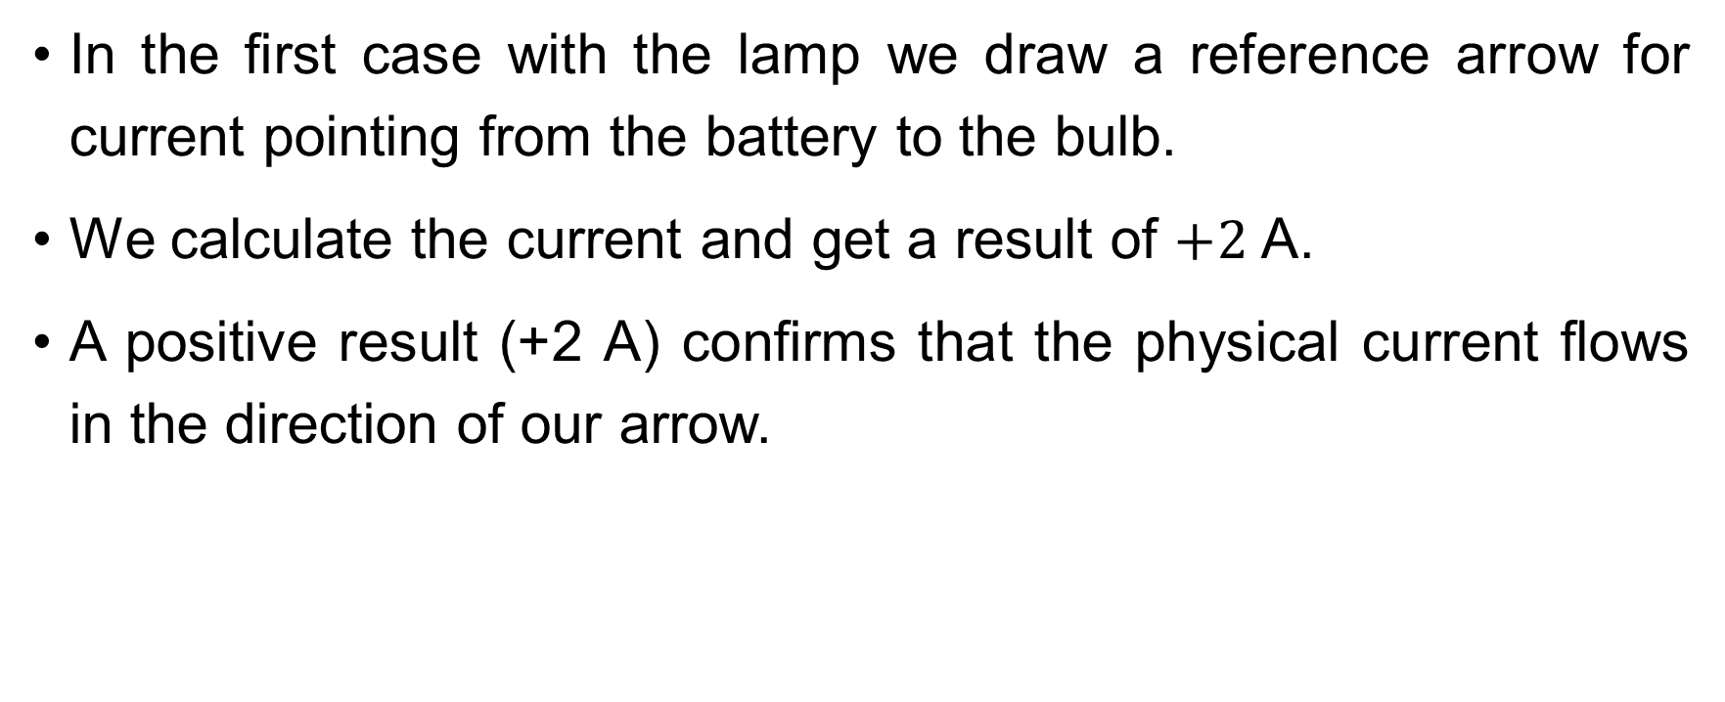
Fundamentals of Circuit Modeling and Basic Laws
Fundamentals of Circuit Modeling and Basic Laws
In the first case with the lamp we draw a reference arrow for current pointing from the battery to the bulb.
We calculate the current and get a result of $+2$ A.
A positive result (+2 A) confirms that the physical current flows in the direction of our arrow.

Slide 32
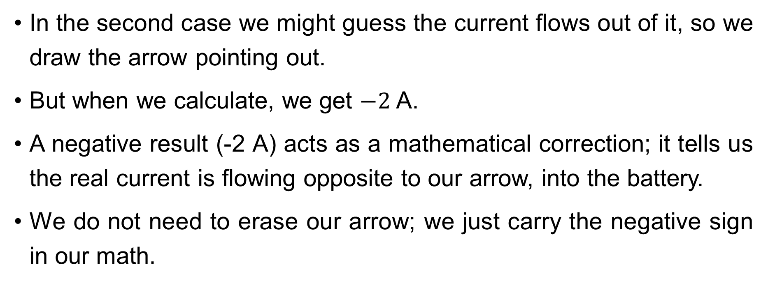
Fundamentals of Circuit Modeling and Basic Laws
Fundamentals of Circuit Modeling and Basic Laws
In the second case we might guess the current flows out of it, so we draw the arrow pointing out.
But when we calculate, we get $−2$ A.
A negative result (-2 A) acts as a mathematical correction; it tells us the real current is flowing opposite to our arrow, into the battery.
We do not need to erase our arrow; we just carry the negative sign in our math.

Slide 33
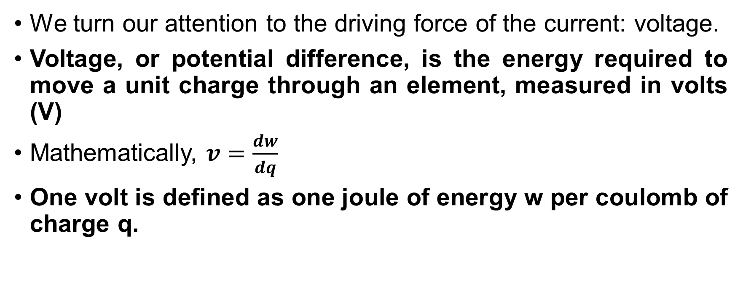
Fundamentals of Circuit Modeling and Basic Laws
Fundamentals of Circuit Modeling and Basic Laws
We turn our attention to the driving force of the current: voltage.
Voltage, or potential difference, is the energy required to move a unit charge through an element, measured in volts (V)
Mathematically, $v=\frac{dw}{dq}$
One volt is defined as one joule of energy w per coulomb of charge q.

Slide 34
Fundamentals of Circuit Modeling and Basic Laws
Fundamentals of Circuit Modeling and Basic Laws
It represents the work done by the electric field in moving charge between two distinct points.
Similar to current, voltage is a signed quantity that requires a polarity definition to be algebraically useful in circuit analysis.
It is the pressure that pushes charge through the resistance of the circuit components.

Slide 35
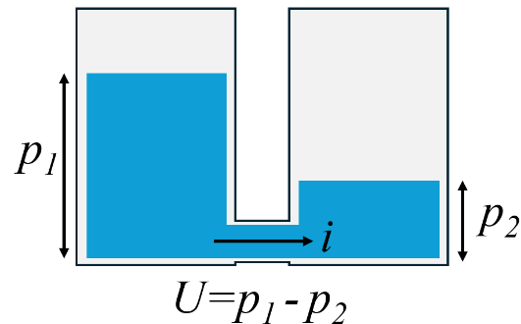
Fundamentals of Circuit Modeling and Basic Laws
Fundamentals of Circuit Modeling and Basic Laws
Here is an illustration of voltage with water analogy.
If we connect two water boils at their bottoms, the difference of the levels in boils will be affects to speed of water leaking from the left boil to the right one.

Slide 36

Fundamentals of Circuit Modeling and Basic Laws
Fundamentals of Circuit Modeling and Basic Laws
In electricity it’s all the same but instead of levels of water potentials of two different dots in circuits affects to the electrons speed that moved through wires from first point to the second.
Also, if electrons move, we know that some current $i$ will appear in circuit.

Slide 37
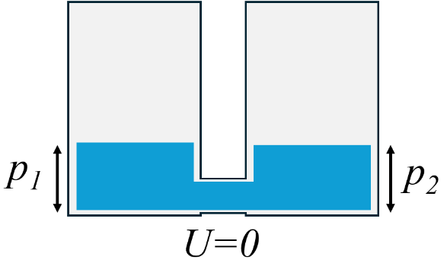
Fundamentals of Circuit Modeling and Basic Laws
Fundamentals of Circuit Modeling and Basic Laws
And here is a special case of last illustration. If there is no difference of levels in boils – there is no water leaking from one boil to another.
Therefore, if potentials of two points in the circuit are the same, the voltage between these points equals zero.
Thus, the current also equals zero.

Slide 38
Fundamentals of Circuit Modeling and Basic Laws
Fundamentals of Circuit Modeling and Basic Laws
Just as current requires a reference arrow, voltage requires reference polarity.
The reference polarity indicates the assumed high and low potential terminals of an element, typically denoted by plus (+) and minus (-) signs.
The positive sign represents the point of assumed higher potential.

Slide 39
Fundamentals of Circuit Modeling and Basic Laws
Fundamentals of Circuit Modeling and Basic Laws
If the calculated voltage is positive, the actual potential at the (+) terminal is higher than at the (-) terminal.
If the result is negative, the physical potential at the terminal marked (+) is actually lower than that at the terminal marked (-).
This distinction is vital when applying Kirchhoff’s Voltage Law.

Slide 40

Fundamentals of Circuit Modeling and Basic Laws
Fundamentals of Circuit Modeling and Basic Laws
The illustration here shows the direction of the current from the energy source – $i_{S}$.

Slide 41
Fundamentals of Circuit Modeling and Basic Laws
Fundamentals of Circuit Modeling and Basic Laws
The relationship between the reference directions of voltage and current defines how we calculate power.
This brings us to the «Associated Reference Direction» or Passive Sign Convention.

Slide 42
Fundamentals of Circuit Modeling and Basic Laws
Fundamentals of Circuit Modeling and Basic Laws
In the associated reference direction, the reference current is defined as entering the positive reference terminal of the voltage.

Slide 43
Fundamentals of Circuit Modeling and Basic Laws
Fundamentals of Circuit Modeling and Basic Laws
This is the standard convention used for passive components like resistors, inductors, and capacitors.
It implies that we are analyzing the element as a load that consumes energy from the circuit.
If we define the current as leaving the positive terminal, we are utilizing the non-associated reference direction, typically used for active sources.
Thus, when analyzing circuits, we assume that the current from the power source goes from its positive pole to its negative pole and the current of passive components goes in the opposite direction.

Slide 44
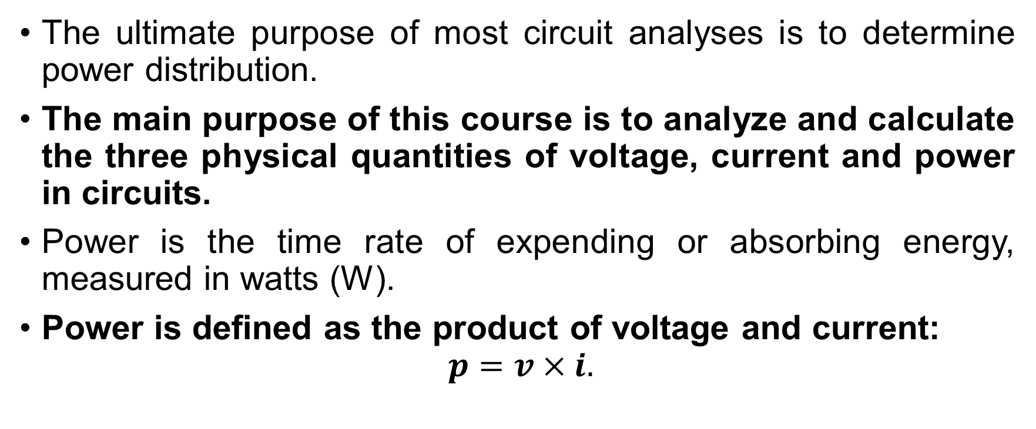
Fundamentals of Circuit Modeling and Basic Laws
Fundamentals of Circuit Modeling and Basic Laws
The ultimate purpose of most circuit analyses is to determine power distribution.
The main purpose of this course is to analyze and calculate the three physical quantities of voltage, current and power in circuits.
Power is the time rate of expending or absorbing energy, measured in watts (W).
Power is defined as the product of voltage and current:
$$p=v×i.$$

Slide 45
Fundamentals of Circuit Modeling and Basic Laws
Fundamentals of Circuit Modeling and Basic Laws
Since both voltage and current are functions of time, this product represents the instantaneous power.
To determine whether an element is absorbing or supplying power, we must strictly adhere to the sign conventions established in the previous slides regarding associated directions.

Slide 46

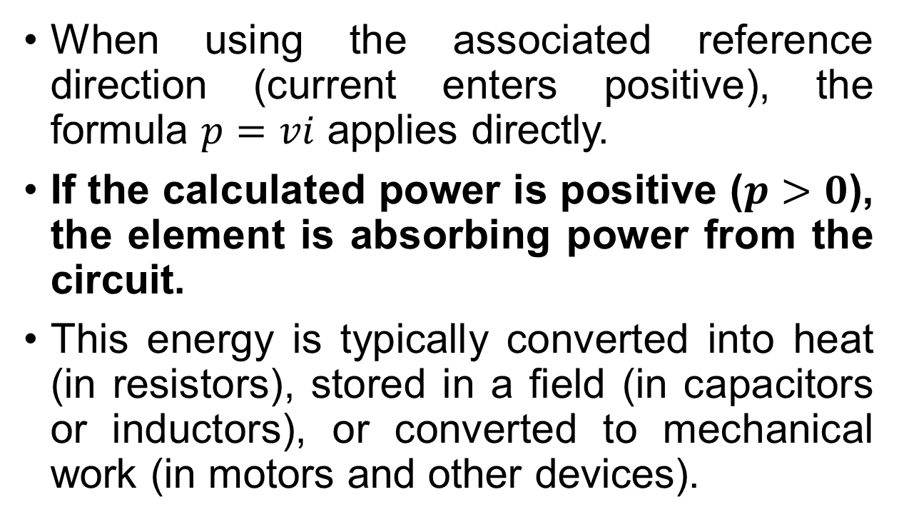
Fundamentals of Circuit Modeling and Basic Laws
Fundamentals of Circuit Modeling and Basic Laws
When using the associated reference direction (current enters positive), the formula $p=vi$ applies directly.
If the calculated power is positive ($p>0$), the element is absorbing power from the circuit.
This energy is typically converted into heat (in resistors), stored in a field (in capacitors or inductors), or converted to mechanical work (in motors and other devices).
OM NOM

Slide 47

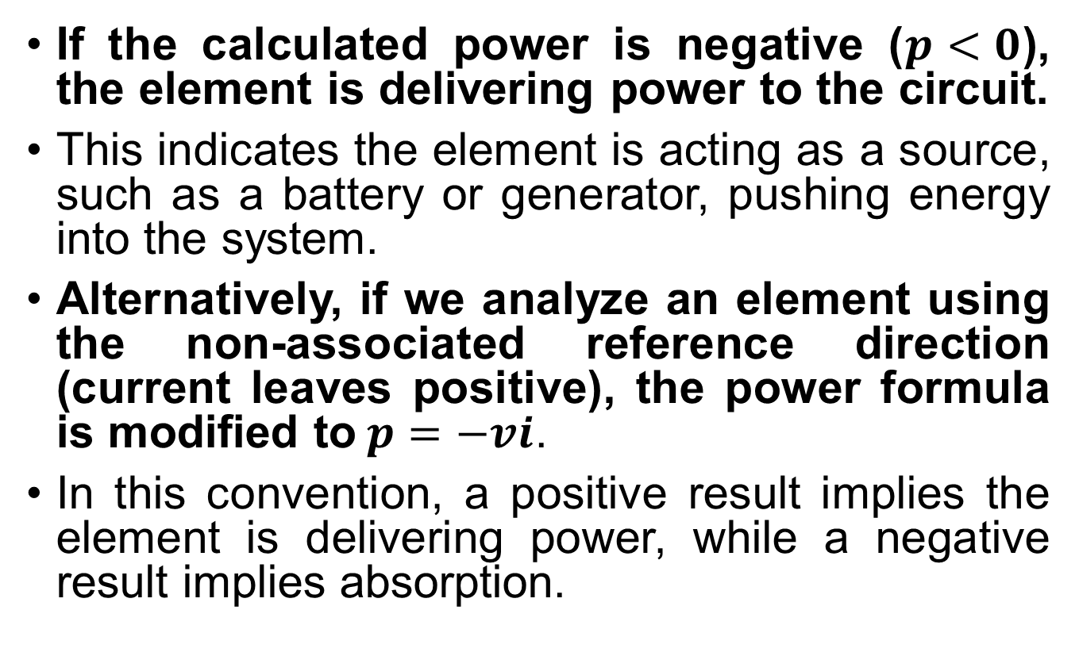
Fundamentals of Circuit Modeling and Basic Laws
Fundamentals of Circuit Modeling and Basic Laws
If the calculated power is negative ($p<0$), the element is delivering power to the circuit.
This indicates the element is acting as a source, such as a battery or generator, pushing energy into the system.
Alternatively, if we analyze an element using the non-associated reference direction (current leaves positive), the power formula is modified to$p=−vi$.
In this convention, a positive result implies the element is delivering power, while a negative result implies absorption.

Slide 48
Fundamentals of Circuit Modeling and Basic Laws
Fundamentals of Circuit Modeling and Basic Laws
To avoid confusion, I strongly recommend consistently using the associated reference direction for all passive components and carefully observing the arrows for sources.
A fundamental law of physics is the conservation of energy, which applies strictly to electrical circuits as Tellegen's Theorem (though we will address that formally later).
In any isolated electrical circuit, energy cannot be created or destroyed.

Slide 49
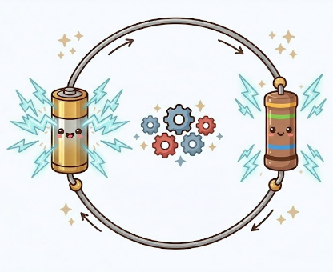
Fundamentals of Circuit Modeling and Basic Laws
Fundamentals of Circuit Modeling and Basic Laws
The algebraic sum of power in a circuit is zero at any instant of time.
This means that the total power supplied by the active sources must exactly equal the total power absorbed by the passive elements.
This balance serves as a powerful verification tool for your circuit calculations; if your powers do not sum to zero, an error exists in your analysis.

Slide 50
Fundamentals of Circuit Modeling and Basic Laws
Fundamentals of Circuit Modeling and Basic Laws
We now expand our understanding of voltage by introducing the concept of Electric Potential.
While voltage is the difference in potential between two points, electric potential is the voltage at a specific point with respect to a common reference point, often called «ground».

Slide 51

Fundamentals of Circuit Modeling and Basic Laws
Fundamentals of Circuit Modeling and Basic Laws
The potential of the reference point is arbitrarily defined as zero volts.
The potential at any other point in the circuit is simply the voltage drop from that point to the ground reference.
It’s called «ground» because we assume
the ground on Earth has zero potential
Furthermore, electrical grounding is often
connected to the actual earth for safety
reasons

Slide 52
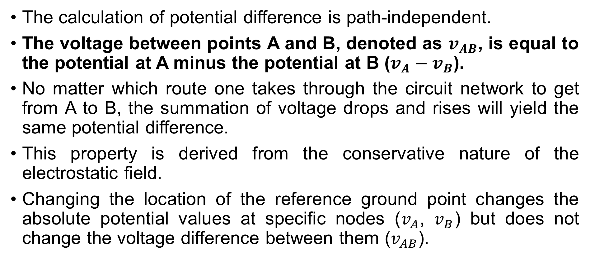
Fundamentals of Circuit Modeling and Basic Laws
Fundamentals of Circuit Modeling and Basic Laws
The calculation of potential difference is path-independent.
The voltage between points A and B, denoted as $v_{AB}$, is equal to the potential at A minus the potential at B ($v_{A}−v_{B}$).
No matter which route one takes through the circuit network to get from A to B, the summation of voltage drops and rises will yield the same potential difference.
This property is derived from the conservative nature of the electrostatic field.
Changing the location of the reference ground point changes the absolute potential values at specific nodes ($v_{A}$, $v_{B}$) but does not change the voltage difference between them ($v_{AB}$).

Slide 53
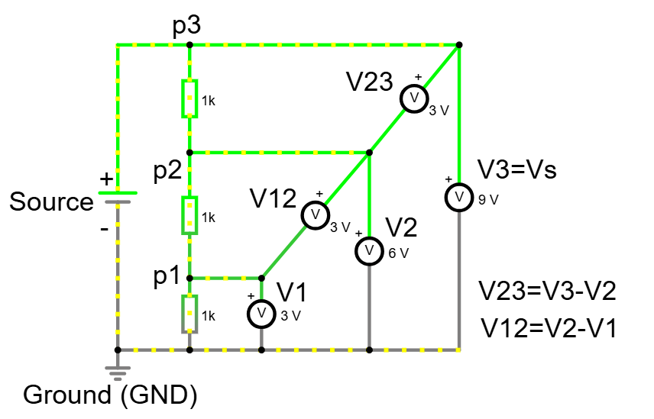
Fundamentals of Circuit Modeling and Basic Laws
Fundamentals of Circuit Modeling and Basic Laws
The illustration shows different voltages between different points of circuit with different potential.

Slide 54
Fundamentals of Circuit Modeling and Basic Laws
Fundamentals of Circuit Modeling and Basic Laws
We often use the term «Ground» (GND) for the reference point where the potential is zero.
The choice of the ground node is arbitrary (you can choose any one) and does not change the operation of the circuit, only the values of the potential numbers we write down.
Think of it like measuring height.
You can measure height from sea level or from the floor of this room.
You are not physically changing your height, only the reference zero.

Slide 55

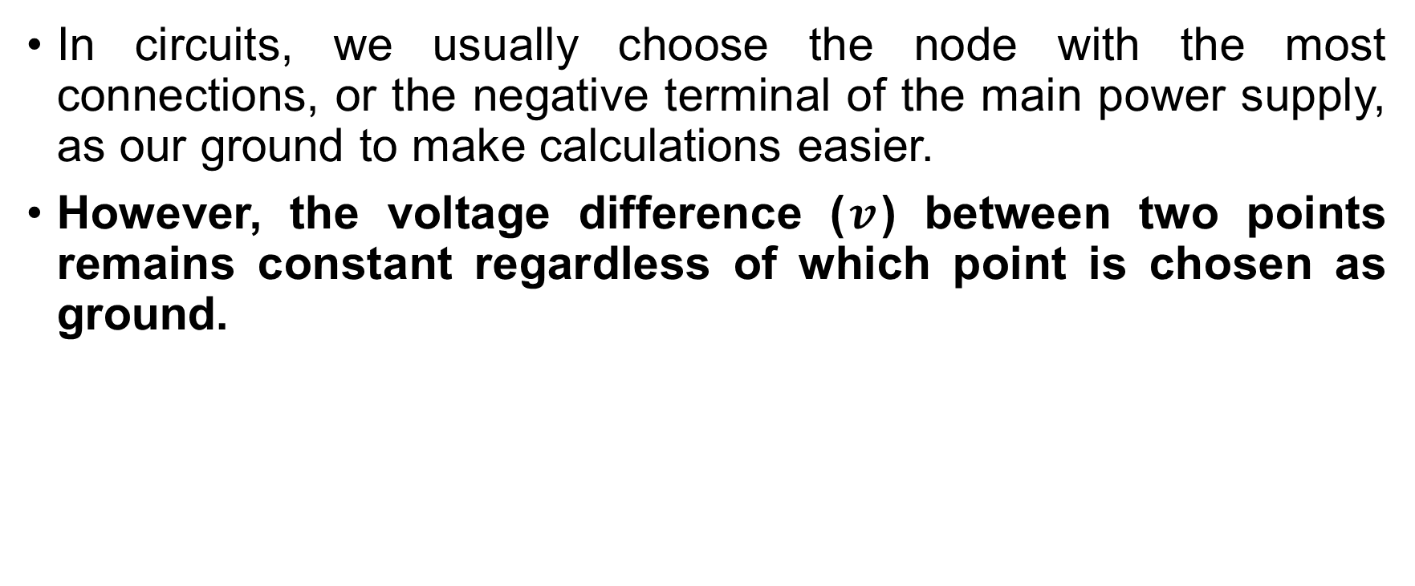
Fundamentals of Circuit Modeling and Basic Laws
Fundamentals of Circuit Modeling and Basic Laws
In circuits, we usually choose the node with the most connections, or the negative terminal of the main power supply, as our ground to make calculations easier.
However, the voltage difference ($v$) between two points remains constant regardless of which point is chosen as ground.

Slide 56
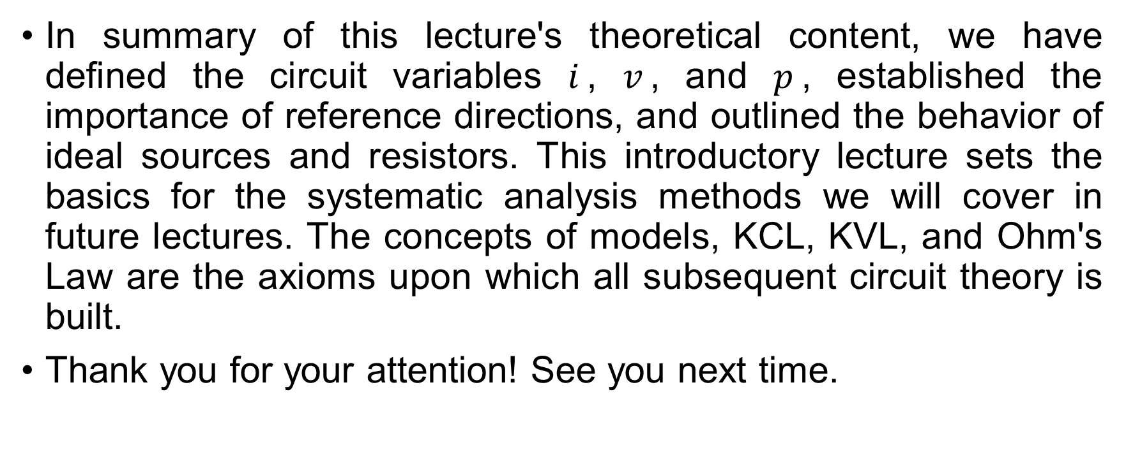
Fundamentals of Circuit Modeling and Basic Laws
Fundamentals of Circuit Modeling and Basic Laws
In summary of this lecture's theoretical content, we have defined the circuit variables $i$, $v$, and $p$, established the importance of reference directions, and outlined the behavior of ideal sources and resistors. This introductory lecture sets the basics for the systematic analysis methods we will cover in future lectures. The concepts of models, KCL, KVL, and Ohm's Law are the axioms upon which all subsequent circuit theory is built.
Thank you for your attention! See you next time.

