Slide 1
Lecture 10. Power in AC Circuits
Part (3). Analysis of Sinusoidal Steady-State AC Circuits

Slide 2
Systematic Analysis Methods
Power in AC Circuits
Welcome back to the course on The Principle of Circuit.
In our previous lectures, we mastered the language of phasors and the concept of impedance.
We learned how to calculate voltages and currents in circuits driven by sinusoidal sources.
However, in practical engineering, calculating voltage and current is rarely the final goal.

Slide 3
Systematic Analysis Methods
Power in AC Circuits
The ultimate purpose of an electrical system is to transfer energy.
Whether we are powering a massive industrial motor, a heater, or a computer processor, we must quantify the rate at which energy is delivered and consumed.

Slide 4
Systematic Analysis Methods
Power in AC Circuits
Today, we will explore the concept of Power in AC circuits.
We will discover that power in AC systems is more complex than in DC, splitting into three distinct forms: Active, Reactive, and Apparent Power.
Understanding these concepts is critical for efficient power transmission and is the foundation of the electrical power industry.

Slide 5
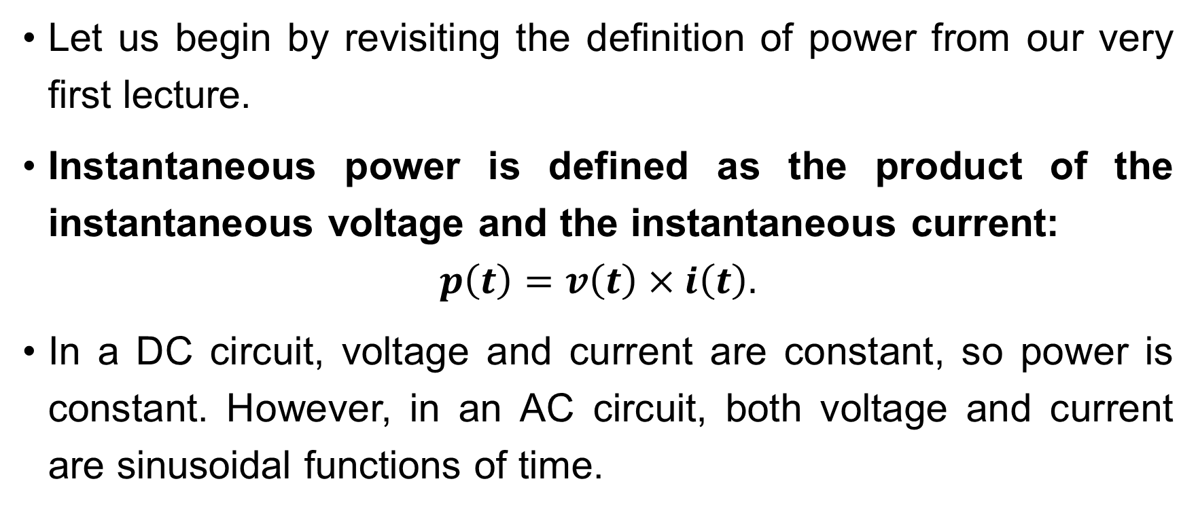
Systematic Analysis Methods
Power in AC Circuits
Let us begin by revisiting the definition of power from our very first lecture.
Instantaneous power is defined as the product of the instantaneous voltage and the instantaneous current:
$$p\left(t\right)=v\left(t\right)×i\left(t\right).$$
In a DC circuit, voltage and current are constant, so power is constant. However, in an AC circuit, both voltage and current are sinusoidal functions of time.

Slide 6
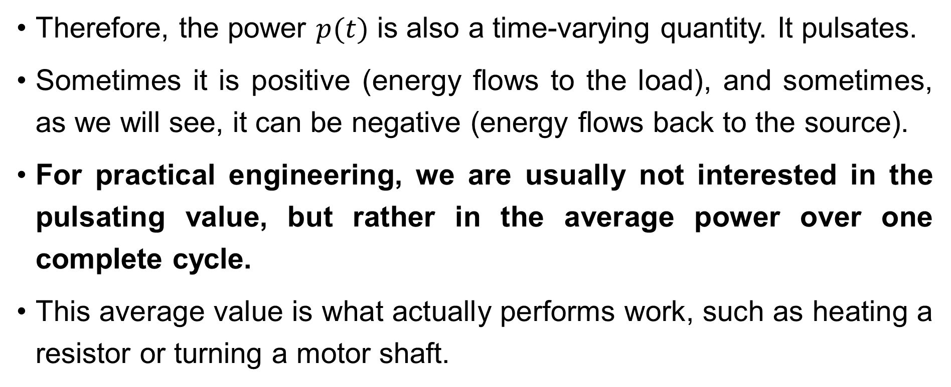
Systematic Analysis Methods
Power in AC Circuits
Therefore, the power $p(t)$ is also a time-varying quantity. It pulsates.
Sometimes it is positive (energy flows to the load), and sometimes, as we will see, it can be negative (energy flows back to the source).
For practical engineering, we are usually not interested in the pulsating value, but rather in the average power over one complete cycle.
This average value is what actually performs work, such as heating a resistor or turning a motor shaft.

Slide 7
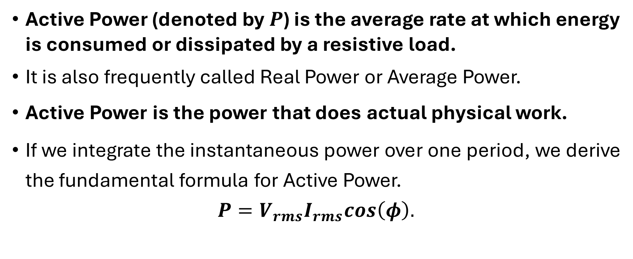
Systematic Analysis Methods
Power in AC Circuits
Active Power (denoted by $P$) is the average rate at which energy is consumed or dissipated by a resistive load.
It is also frequently called Real Power or Average Power.
Active Power is the power that does actual physical work.
If we integrate the instantaneous power over one period, we derive the fundamental formula for Active Power.
$$P=V_{rms}I_{rms}cos\left(φ\right).$$

Slide 8
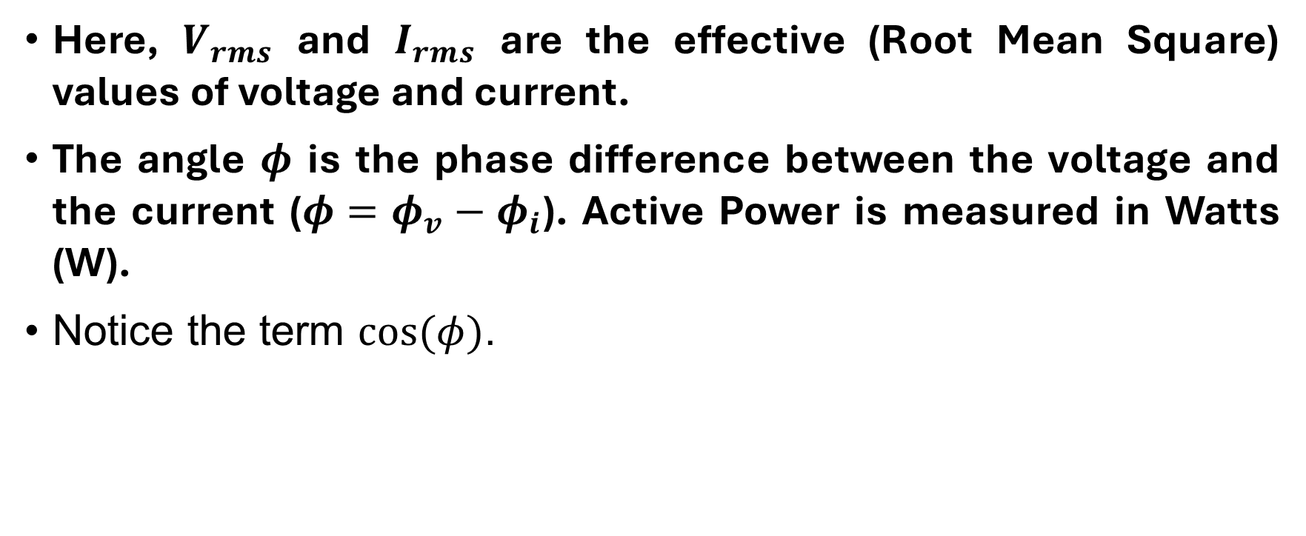
Systematic Analysis Methods
Power in AC Circuits
Here, $V_{rms}$ and $I_{rms}$ are the effective (Root Mean Square) values of voltage and current.
The angle $φ$ is the phase difference between the voltage and the current ($φ=φ_{v}−φ_{i}$). Active Power is measured in Watts (W).
Notice the term $cos(φ)$.

Slide 9
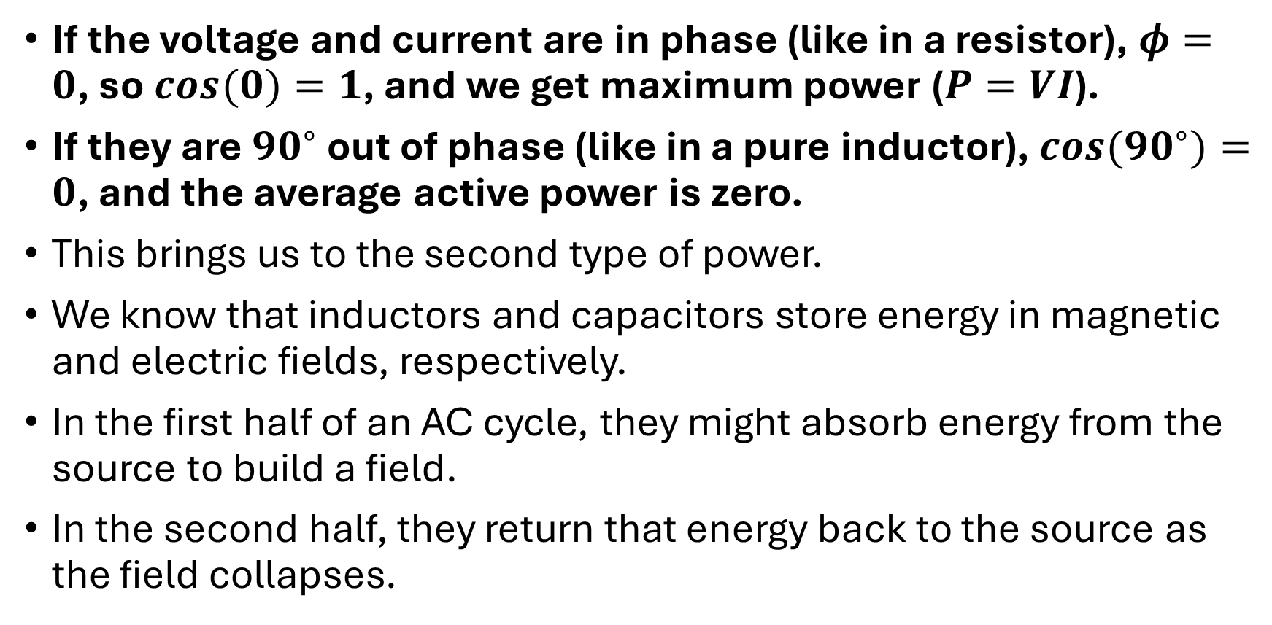
Systematic Analysis Methods
Power in AC Circuits
If the voltage and current are in phase (like in a resistor), $φ=0$, so $cos(0)=1$, and we get maximum power ($P=VI$).
If they are ${90}^{∘}$ out of phase (like in a pure inductor), $cos({90}^{∘})=0$, and the average active power is zero.
This brings us to the second type of power.
We know that inductors and capacitors store energy in magnetic and electric fields, respectively.
In the first half of an AC cycle, they might absorb energy from the source to build a field.
In the second half, they return that energy back to the source as the field collapses.

Slide 10
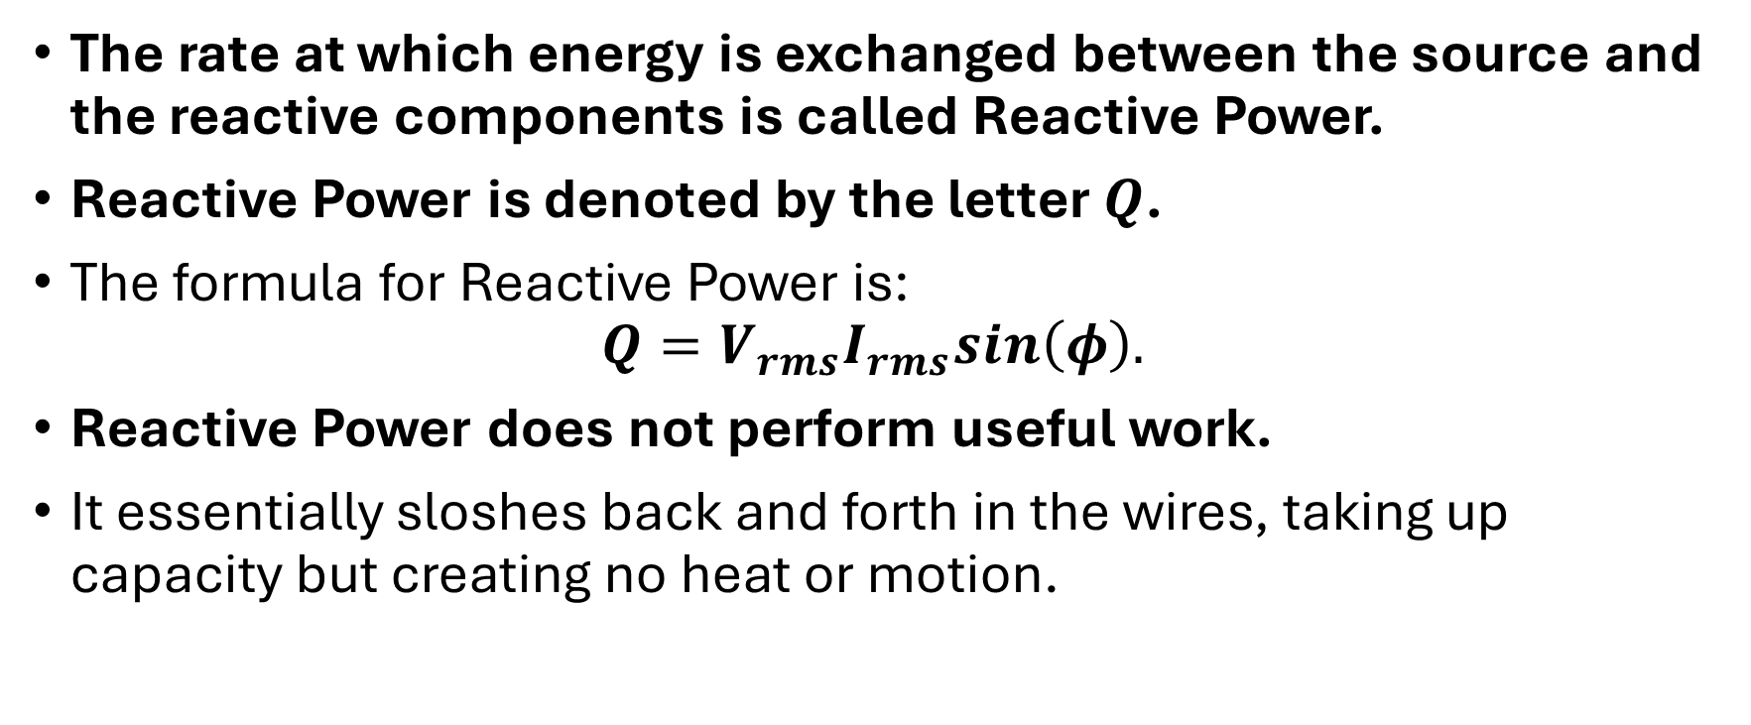
Systematic Analysis Methods
Power in AC Circuits
The rate at which energy is exchanged between the source and the reactive components is called Reactive Power.
Reactive Power is denoted by the letter $Q$.
The formula for Reactive Power is:
$$Q=V_{rms}I_{rms}sin\left(φ\right).$$
Reactive Power does not perform useful work.
It essentially sloshes back and forth in the wires, taking up capacity but creating no heat or motion.

Slide 11
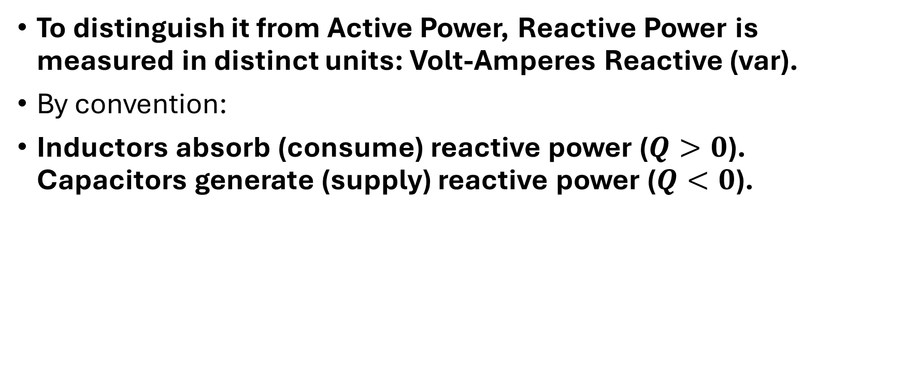
Systematic Analysis Methods
Power in AC Circuits
To distinguish it from Active Power, Reactive Power is measured in distinct units: Volt-Amperes Reactive (var).
By convention:
Inductors absorb (consume) reactive power ($Q>0$). Capacitors generate (supply) reactive power ($Q<0$).

Slide 12
Systematic Analysis Methods
Power in AC Circuits
Now we must consider the perspective of the power source or the transmission equipment.
Imagine a generator connected to a load.
The generator must withstand the total voltage and the total current, regardless of whether that current is doing useful work (Active) or just moving back and forth (Reactive).

Slide 13
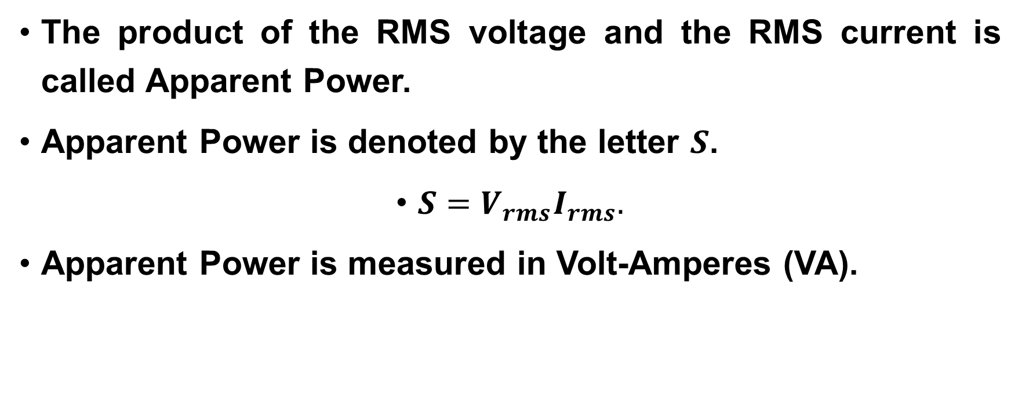
Systematic Analysis Methods
Power in AC Circuits
The product of the RMS voltage and the RMS current is called Apparent Power.
Apparent Power is denoted by the letter $S$.
$S=V_{rms}I_{rms}.$
Apparent Power is measured in Volt-Amperes (VA).

Slide 14
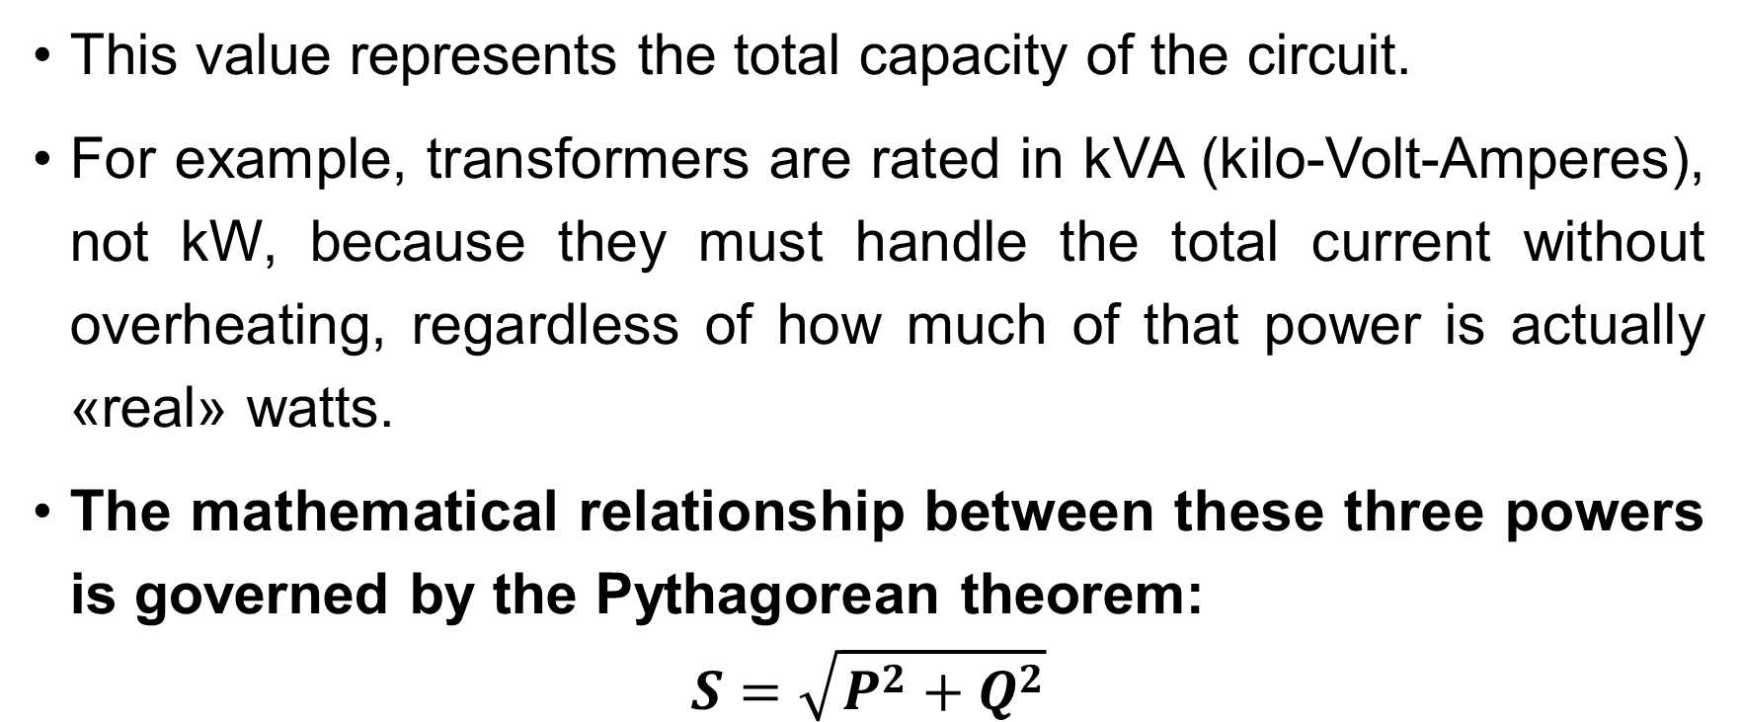
Systematic Analysis Methods
Power in AC Circuits
This value represents the total capacity of the circuit.
For example, transformers are rated in kVA (kilo-Volt-Amperes), not kW, because they must handle the total current without overheating, regardless of how much of that power is actually «real» watts.
The mathematical relationship between these three powers is governed by the Pythagorean theorem:
$$S=\sqrt{P^{2}+Q^{2}}$$

Slide 15
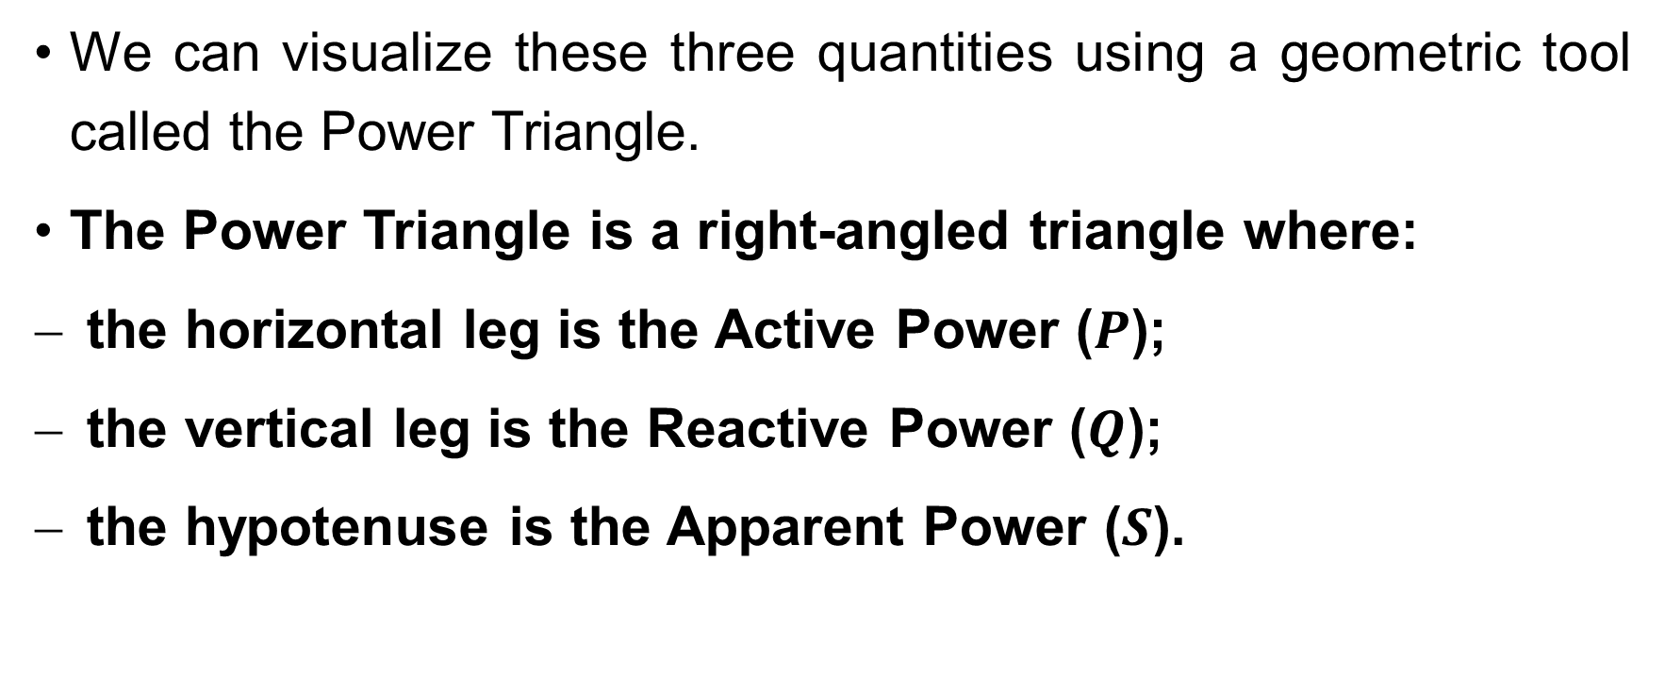
Systematic Analysis Methods
Power in AC Circuits
We can visualize these three quantities using a geometric tool called the Power Triangle.
The Power Triangle is a right-angled triangle where:
the horizontal leg is the Active Power ($P$);
the vertical leg is the Reactive Power ($Q$);
the hypotenuse is the Apparent Power ($S$).

Slide 16
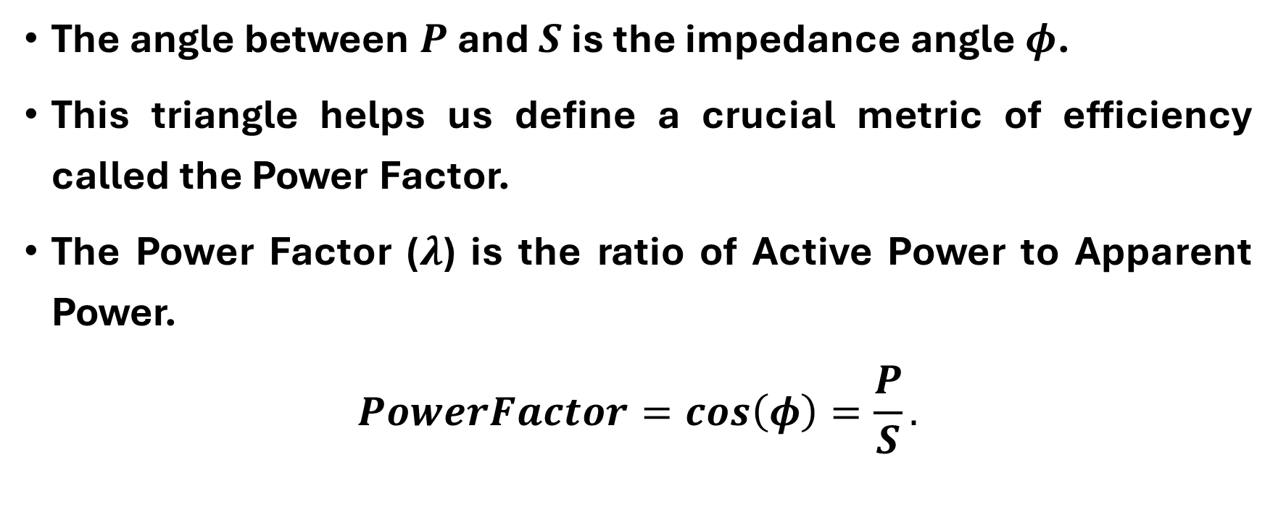
Systematic Analysis Methods
Power in AC Circuits
The angle between $P$ and $S$ is the impedance angle $φ$.
This triangle helps us define a crucial metric of efficiency called the Power Factor.
The Power Factor ($λ$) is the ratio of Active Power to Apparent Power.
$$PowerFactor=cos\left(φ\right)=\frac{P}{S}.$$

Slide 17
Systematic Analysis Methods
Power in AC Circuits
On the next slide you can see an illustration of the Power Triangle and Power Factor.
Note that converting Active Power to the Apparent Power can be accomplished by summing the Active and Reactive Power vectors.

Slide 18
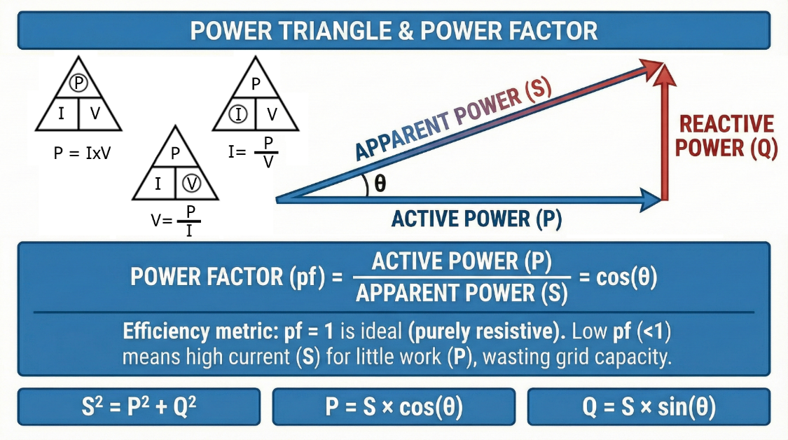
Systematic Analysis Methods
Power triangle and power factor
Power in AC Circuits

Slide 19
Systematic Analysis Methods
Power in AC Circuits
The Power Factor represents how efficiently the circuit converts the supplied capacity into useful work.
A Power Factor of 1.0 is ideal (purely resistive).
A low Power Factor (e.g., 0.5) means you are drawing a lot of current (high S) to do very little work (low P).
Power companies penalize industrial customers for having a low power factor because it wastes grid capacity.

Slide 20
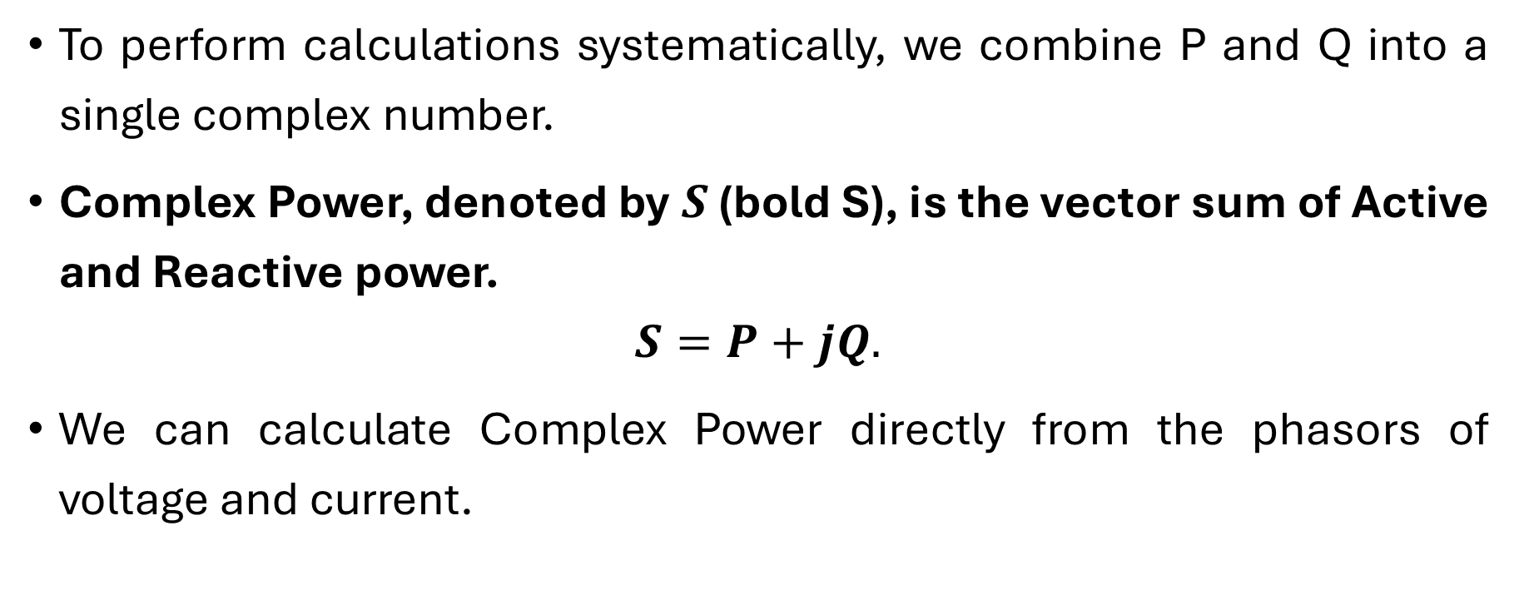
Systematic Analysis Methods
Power in AC Circuits
To perform calculations systematically, we combine P and Q into a single complex number.
Complex Power, denoted by $S$ (bold S), is the vector sum of Active and Reactive power.
$$S=P+jQ.$$
We can calculate Complex Power directly from the phasors of voltage and current.

Slide 21
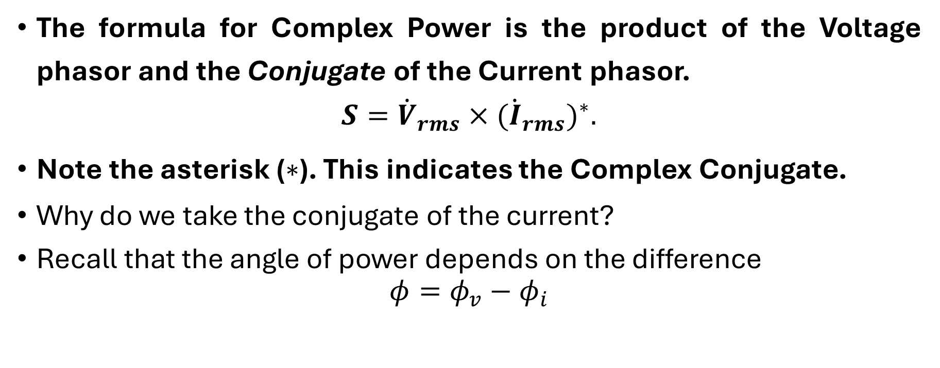
Systematic Analysis Methods
Power in AC Circuits
The formula for Complex Power is the product of the Voltage phasor and the Conjugate of the Current phasor.
$$S={\dot{V}}_{rms}×({\dot{I}}_{rms})^{∗}.$$
Note the asterisk ($∗$). This indicates the Complex Conjugate.
Why do we take the conjugate of the current?
Recall that the angle of power depends on the difference
$$φ=φ_{v}−φ_{i}$$

Slide 22
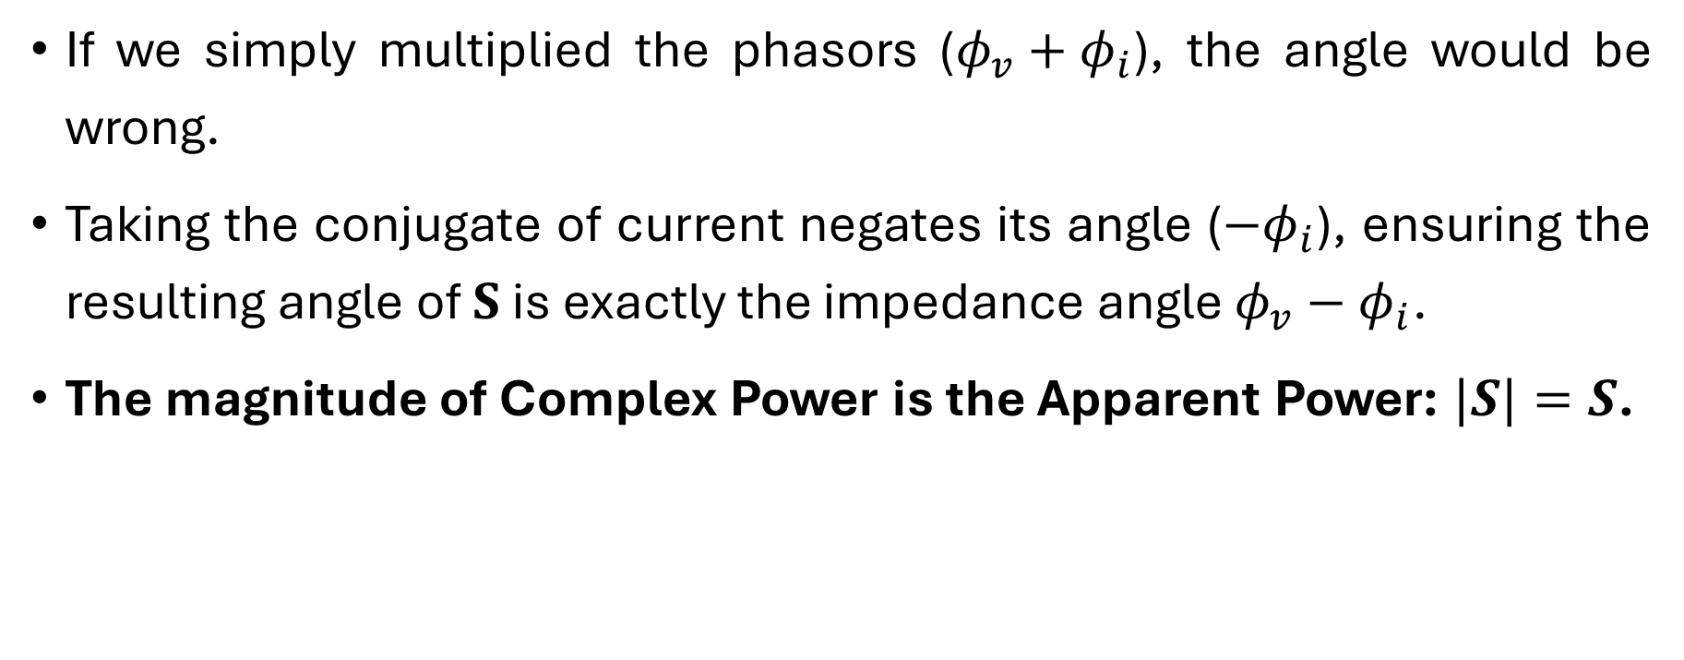
Systematic Analysis Methods
Power in AC Circuits
If we simply multiplied the phasors ($φ_{v}+φ_{i}$), the angle would be wrong.
Taking the conjugate of current negates its angle ($−φ_{i}$), ensuring the resulting angle of $S$ is exactly the impedance angle $φ_{v}−φ_{i}$.
The magnitude of Complex Power is the Apparent Power: $|S|=S$.

Slide 23

Systematic Analysis Methods
Power in AC Circuits
Do you have any questions at the moment?

Slide 24
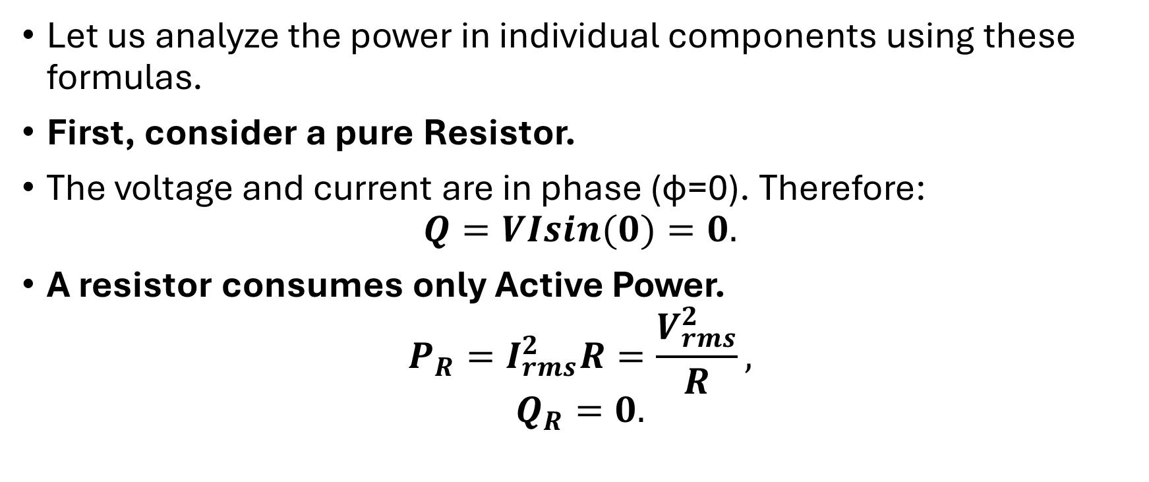
Systematic Analysis Methods
Power in AC Circuits
Let us analyze the power in individual components using these formulas.
First, consider a pure Resistor.
The voltage and current are in phase (ϕ=0). Therefore:
$$Q=VIsin(0)=0.$$
A resistor consumes only Active Power.
$$P_{R}=I_{rms}^{2}R=\frac{V_{rms}^{2}}{R},$$
$$Q_{R}=0.$$

Slide 25
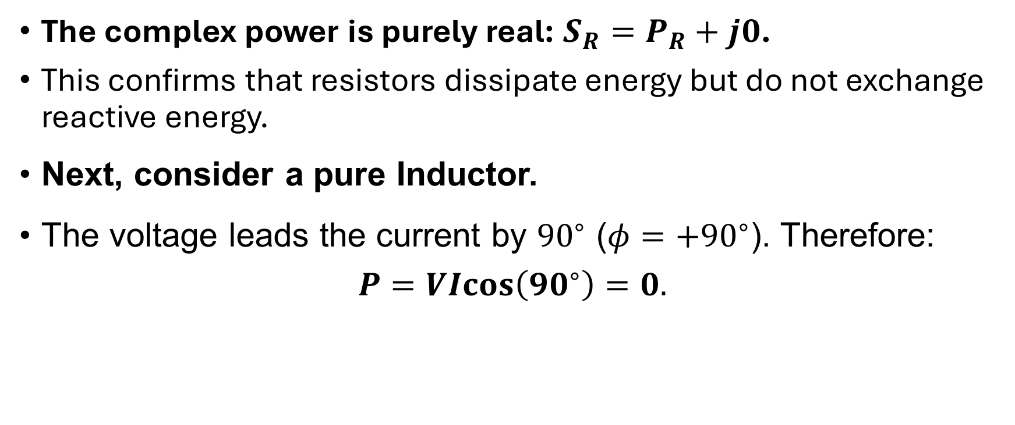
Systematic Analysis Methods
Power in AC Circuits
The complex power is purely real: $S_{R}=P_{R}+j0$.
This confirms that resistors dissipate energy but do not exchange reactive energy.
Next, consider a pure Inductor.
The voltage leads the current by ${90}^{∘}$ ($φ=+{90}^{∘}$). Therefore:
$$P=VIcos\left({90}^{∘}\right)=0.$$

Slide 26
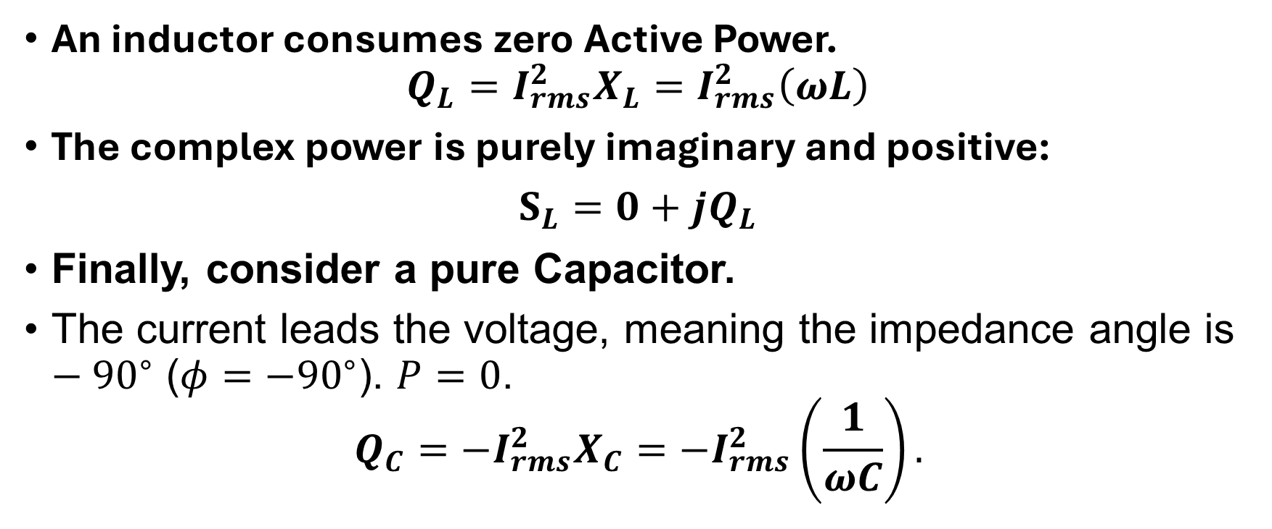
Systematic Analysis Methods
Power in AC Circuits
An inductor consumes zero Active Power.
$$Q_{L}=I_{rms}^{2}X_{L}=I_{rms}^{2}\left(ωL\right)$$
The complex power is purely imaginary and positive:
$S_{L}=0+jQ_{L}$
Finally, consider a pure Capacitor.
The current leads the voltage, meaning the impedance angle is $−{90}^{∘}$ ($φ=−{90}^{∘}$). $P=0$.
$$Q_{C}=−I_{rms}^{2}X_{C}=−I_{rms}^{2}\left(\frac{1}{ωC}\right).$$

Slide 27
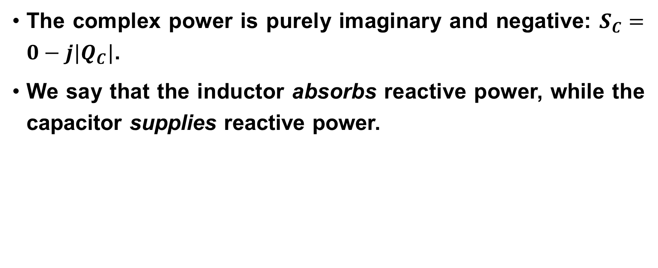
Systematic Analysis Methods
Power in AC Circuits
The complex power is purely imaginary and negative: $S_{C}=0−j|Q_{C}|$.
We say that the inductor absorbs reactive power, while the capacitor supplies reactive power.

Slide 28
Systematic Analysis Methods
Power in AC Circuits
Just as we have conservation of energy, we have the Conservation of AC Power.
This is an extension of Tellegen's Theorem to the complex domain.
In any electrical circuit, the sum of all complex powers supplied by the sources must equal the sum of all complex powers absorbed by the passive elements.

Slide 29
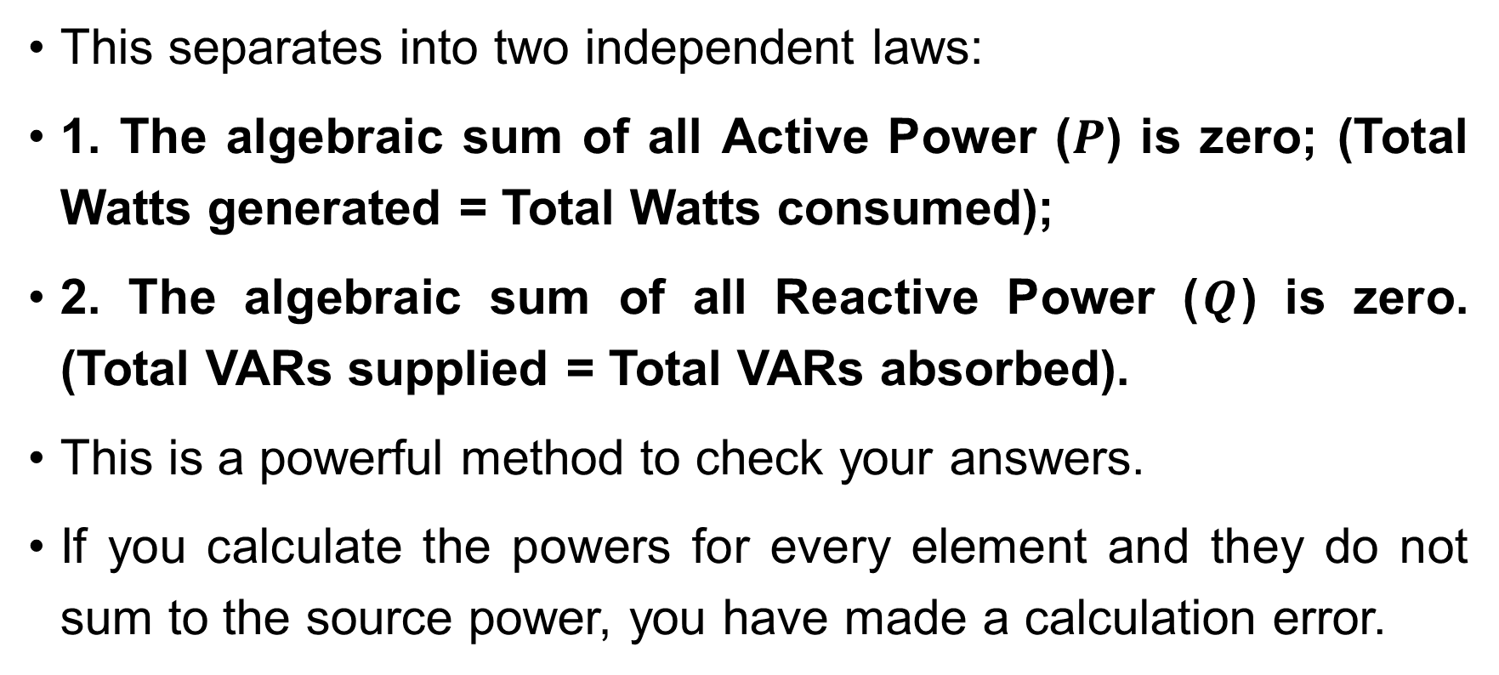
Systematic Analysis Methods
Power in AC Circuits
This separates into two independent laws:
1. The algebraic sum of all Active Power ($P$) is zero; (Total Watts generated = Total Watts consumed);
2. The algebraic sum of all Reactive Power ($Q$) is zero. (Total VARs supplied = Total VARs absorbed).
This is a powerful method to check your answers.
If you calculate the powers for every element and they do not sum to the source power, you have made a calculation error.

Slide 30
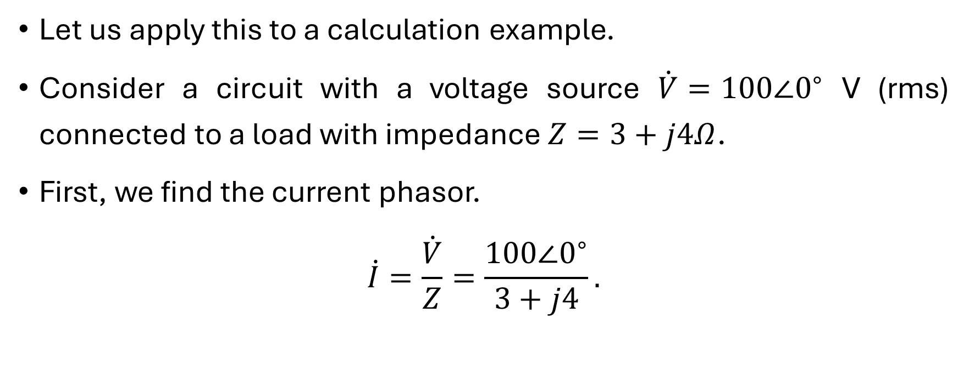
Systematic Analysis Methods
Power in AC Circuits
Let us apply this to a calculation example.
Consider a circuit with a voltage source $\dot{V}=100∠0^{∘}$ V (rms) connected to a load with impedance $Z=3+j4Ω$.
First, we find the current phasor.
$$\dot{I}=\frac{\dot{V}}{Z}=\frac{100∠0^{∘}}{3+j4}.$$

Slide 31
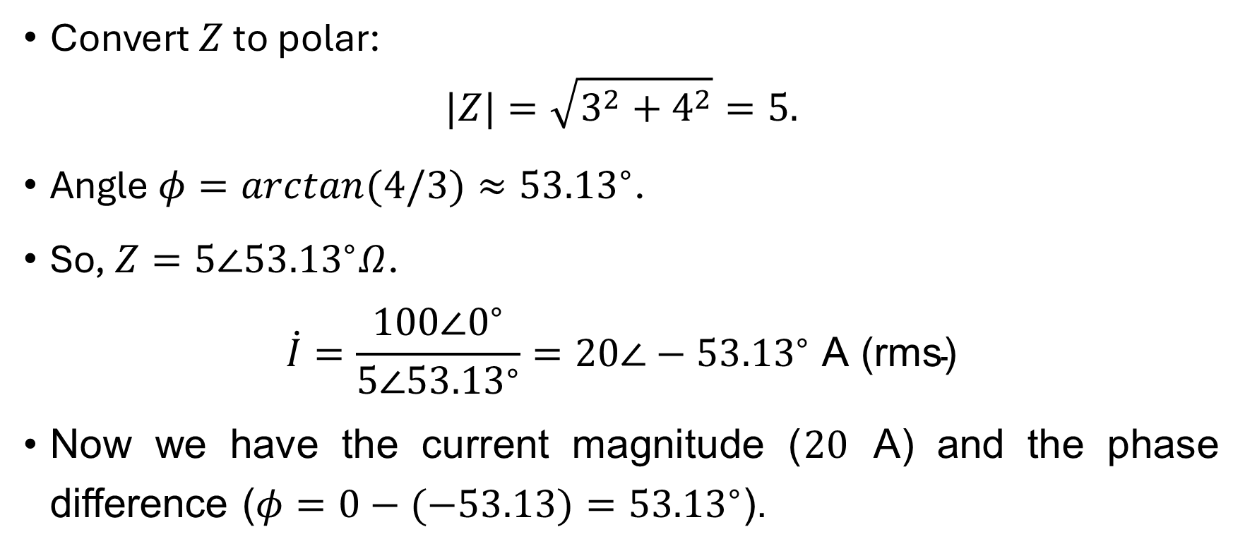
Systematic Analysis Methods
Power in AC Circuits
Convert $Z$ to polar:
$$|Z|=\sqrt{3^{2}+4^{2}}=5.$$
Angle $φ=arctan(4/3)≈{53.13}^{∘}$.
So, $Z=5∠{53.13}^{∘}Ω$.
$$\dot{I}=\frac{100∠0^{∘}}{5∠{53.13}^{∘}}=20∠−{53.13}^{∘} \text{A}\text{ (}\text{rms}\text{)}$$
Now we have the current magnitude ($20$ A) and the phase difference ($φ=0−(−53.13)={53.13}^{∘}$).

Slide 32
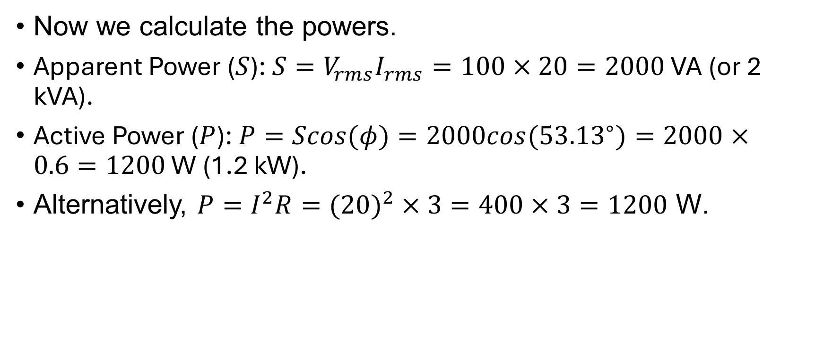
Systematic Analysis Methods
Power in AC Circuits
Now we calculate the powers.
Apparent Power ($S$): $S=V_{rms}I_{rms}=100×20=2000 \text{VA}$ (or 2 kVA).
Active Power ($P$): $P=Scos(φ)=2000cos({53.13}^{∘})=2000×0.6=1200 \text{W}$ (1.2 kW).
Alternatively, $P=I^{2}R=(20)^{2}×3=400×3=1200$ W.

Slide 33

Systematic Analysis Methods
Power in AC Circuits
Reactive Power ($Q$): $Q=Ssin(φ)=2000sin({53.13}^{∘})=2000×0.8=1600 \text{var}$ (1.6 kvar).
Alternatively, $Q=I^{2}X=(20)^{2}×4=400×4=1600$ var.
Complex Power ($S$): $S=1200+j1600 \text{VA}$.

Slide 34
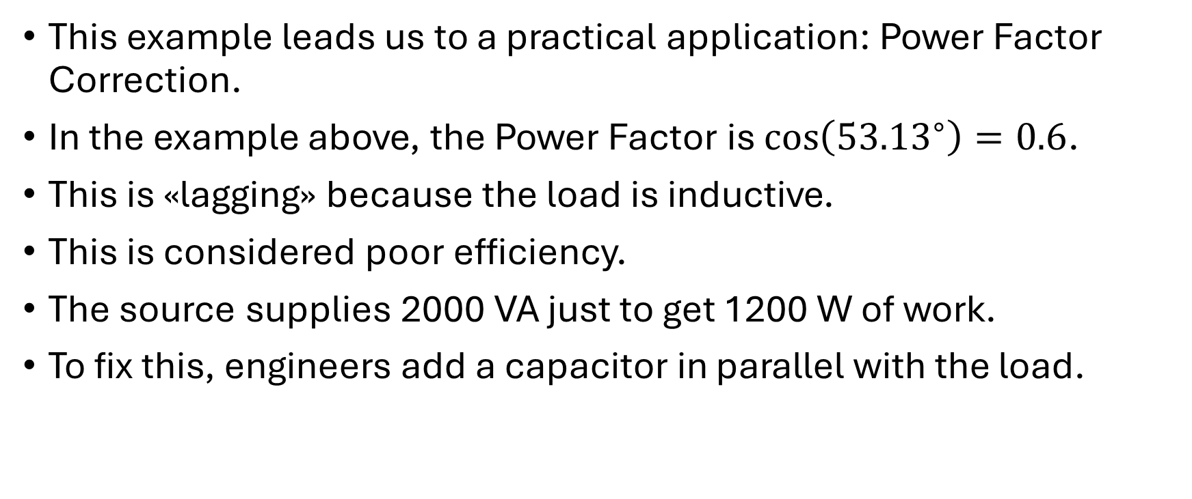
Systematic Analysis Methods
Power in AC Circuits
This example leads us to a practical application: Power Factor Correction.
In the example above, the Power Factor is $\cos\left({53.13}^{∘}\right)=0.6$.
This is «lagging» because the load is inductive.
This is considered poor efficiency.
The source supplies 2000 VA just to get 1200 W of work.
To fix this, engineers add a capacitor in parallel with the load.

Slide 35
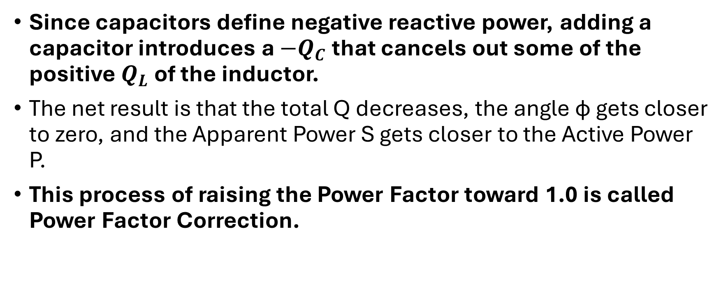
Systematic Analysis Methods
Power in AC Circuits
Since capacitors define negative reactive power, adding a capacitor introduces a $−Q_{C}$ that cancels out some of the positive $Q_{L}$ of the inductor.
The net result is that the total Q decreases, the angle ϕ gets closer to zero, and the Apparent Power S gets closer to the Active Power P.
This process of raising the Power Factor toward 1.0 is called Power Factor Correction.

Slide 36
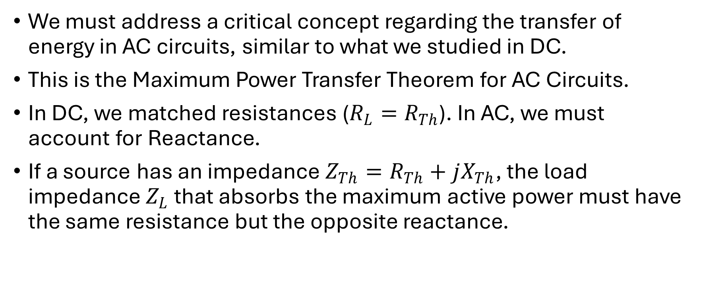
Systematic Analysis Methods
Power in AC Circuits
We must address a critical concept regarding the transfer of energy in AC circuits, similar to what we studied in DC.
This is the Maximum Power Transfer Theorem for AC Circuits.
In DC, we matched resistances ($R_{L}=R_{Th}$). In AC, we must account for Reactance.
If a source has an impedance $Z_{Th}=R_{Th}+jX_{Th}$, the load impedance $Z_{L}$ that absorbs the maximum active power must have the same resistance but the opposite reactance.

Slide 37
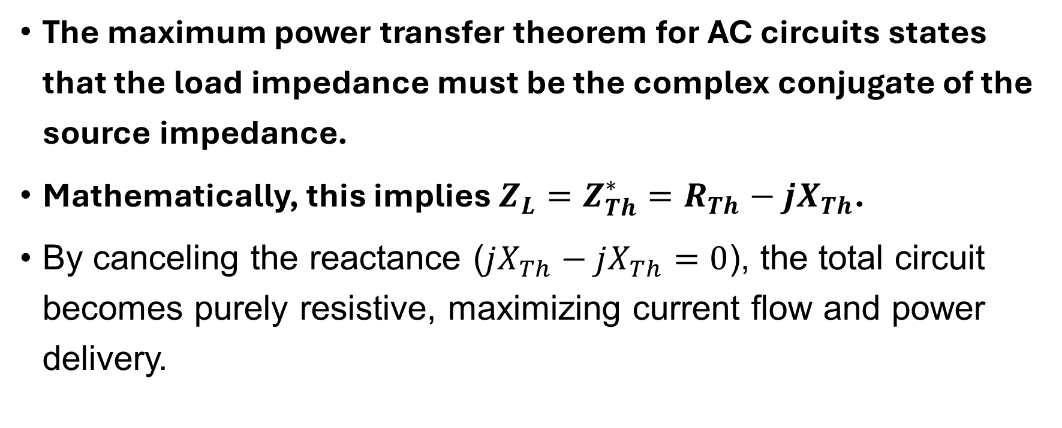
Systematic Analysis Methods
Power in AC Circuits
The maximum power transfer theorem for AC circuits states that the load impedance must be the complex conjugate of the source impedance.
Mathematically, this implies $Z_{L}=Z_{Th}^{∗}=R_{Th}−jX_{Th}$.
By canceling the reactance ($jX_{Th}−jX_{Th}=0$), the total circuit becomes purely resistive, maximizing current flow and power delivery.

Slide 38
Systematic Analysis Methods
Power in AC Circuits
Let us analyze the behavior of Instantaneous Power in more detail.
We previously stated that power pulsates, but we usually only calculate the average.
However, understanding the pulsation frequency is vital for vibration analysis in motors.

Slide 39
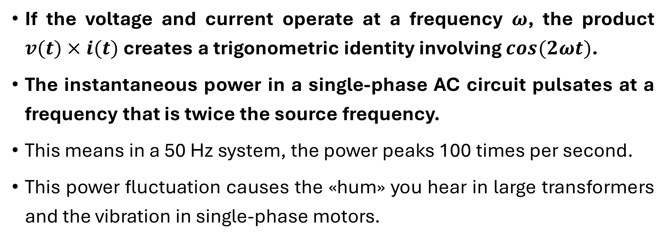
Systematic Analysis Methods
Power in AC Circuits
If the voltage and current operate at a frequency $ω$, the product $v(t)×i(t)$ creates a trigonometric identity involving $cos(2ωt)$.
The instantaneous power in a single-phase AC circuit pulsates at a frequency that is twice the source frequency.
This means in a 50 Hz system, the power peaks 100 times per second.
This power fluctuation causes the «hum» you hear in large transformers and the vibration in single-phase motors.

Slide 40
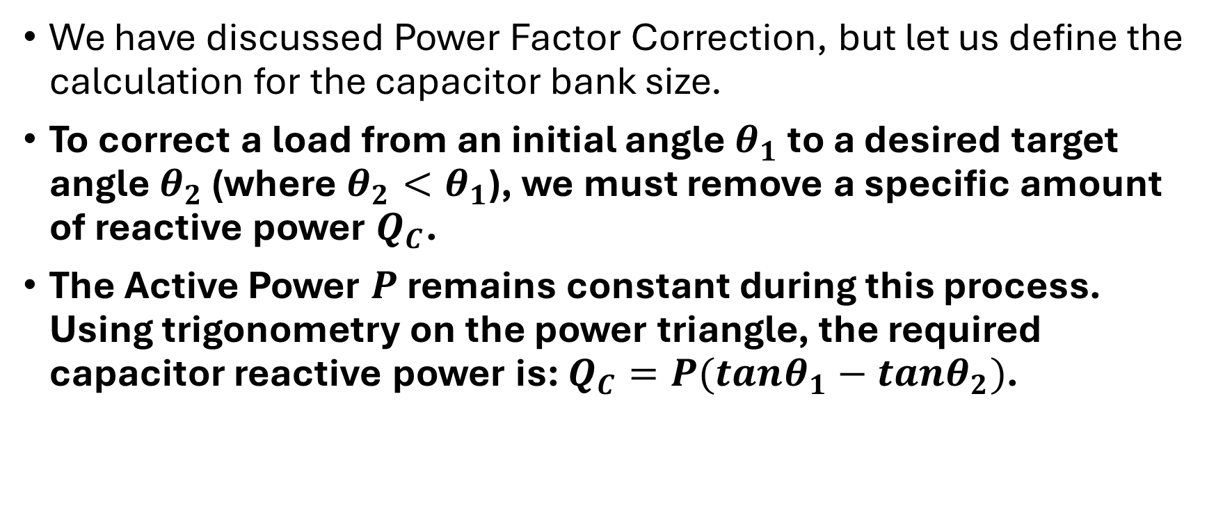
Systematic Analysis Methods
Power in AC Circuits
We have discussed Power Factor Correction, but let us define the calculation for the capacitor bank size.
To correct a load from an initial angle $θ_{1}$ to a desired target angle $θ_{2}$ (where $θ_{2}<θ_{1}$), we must remove a specific amount of reactive power $Q_{C}$.
The Active Power $P$ remains constant during this process. Using trigonometry on the power triangle, the required capacitor reactive power is: $Q_{C}=P(tanθ_{1}−tanθ_{2})$.

Slide 41
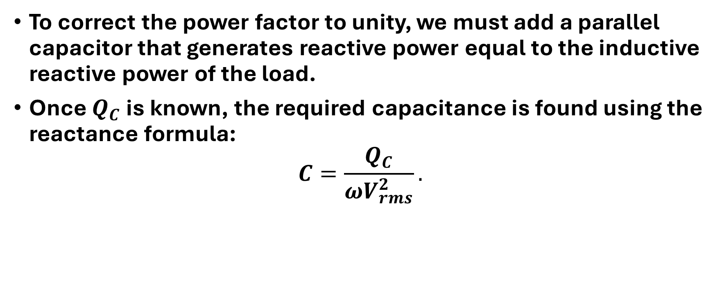
Systematic Analysis Methods
Power in AC Circuits
To correct the power factor to unity, we must add a parallel capacitor that generates reactive power equal to the inductive reactive power of the load.
Once $Q_{C}$ is known, the required capacitance is found using the reactance formula:
$$C=\frac{Q_{C}}{ωV_{rms}^{2}}.$$

Slide 42
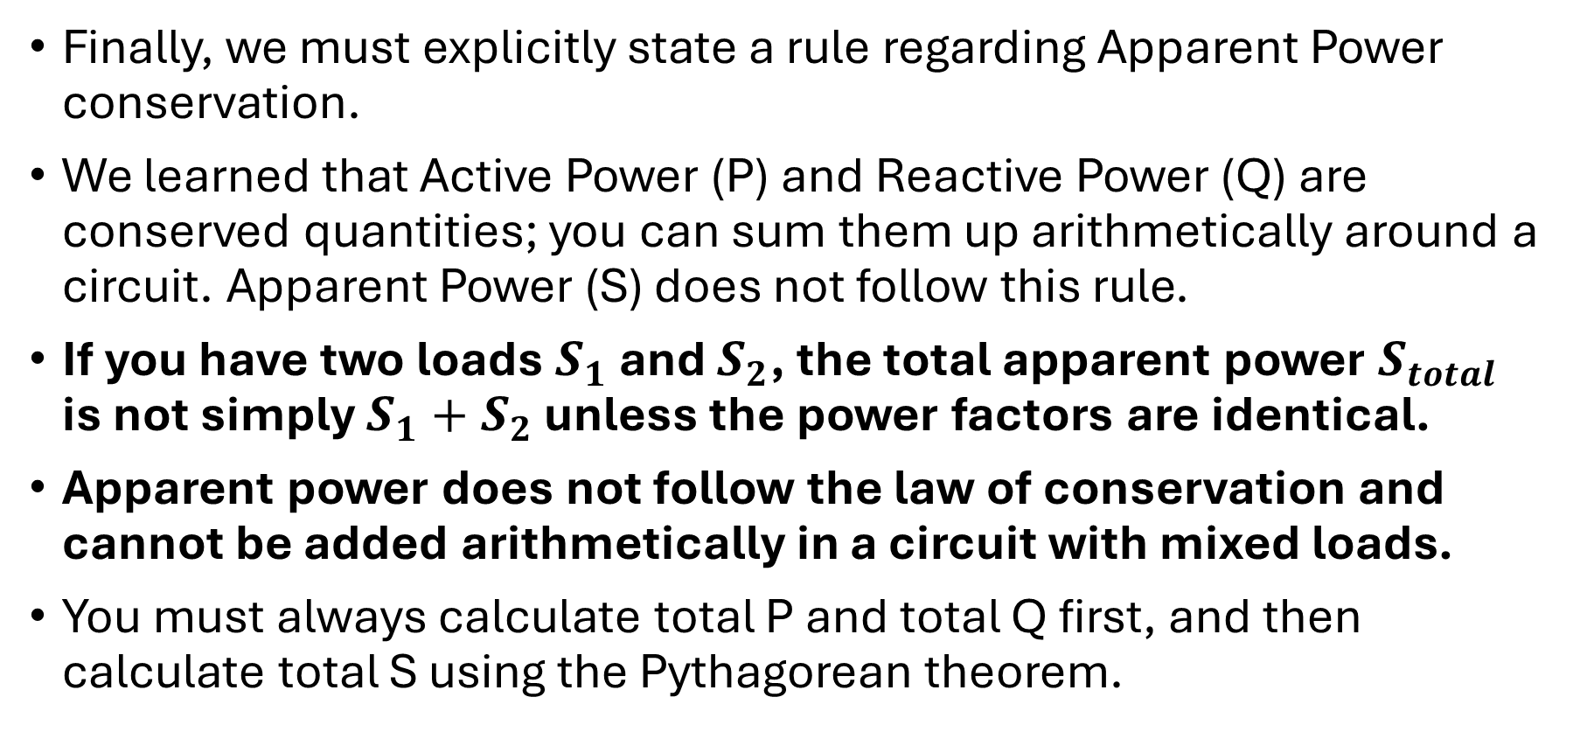
Systematic Analysis Methods
Power in AC Circuits
Finally, we must explicitly state a rule regarding Apparent Power conservation.
We learned that Active Power (P) and Reactive Power (Q) are conserved quantities; you can sum them up arithmetically around a circuit. Apparent Power (S) does not follow this rule.
If you have two loads $S_{1}$ and $S_{2}$, the total apparent power $S_{total}$ is not simply $S_{1}+S_{2}$ unless the power factors are identical.
Apparent power does not follow the law of conservation and cannot be added arithmetically in a circuit with mixed loads.
You must always calculate total P and total Q first, and then calculate total S using the Pythagorean theorem.

Slide 43
Systematic Analysis Methods
Power in AC Circuits
Thank you for your attention!
Do you have any questions?

