Slide 1
Lecture 11. Three-Phase Systems
Part (4). Three-Phase Alternating Current Circuit

Slide 2
Systematic Analysis Methods
Three-Phase Systems
Welcome to Part 4 of our course, «The Principle of Circuit».
In our previous lectures, we studied Single-Phase AC circuits, which are commonly found in household appliances like toasters and lamps.
However, when we look at the broader picture of electrical engineering – specifically power generation, transmission, and heavy industry – we rarely use single-phase systems for the main delivery of energy.

Slide 3
Systematic Analysis Methods
Three-Phase Systems
Today, we begin our study of Three-Phase Systems.
Almost all the electricity generated in the world is produced and distributed as three-phase power.
This lecture will explain how three-phase power is generated, how sources and loads are connected in «Wye» and «Delta» configurations, and why this system is more efficient than single-phase systems.

Slide 4
Systematic Analysis Methods
Three-Phase Systems
Mastering these concepts is essential for anyone interested in power systems, electric machines, or industrial automation.
What exactly is a Three-Phase System?
Imagine we have three separate single-phase voltage sources.

Slide 5
Systematic Analysis Methods
Three-Phase Systems
A balanced three-phase system consists of three sinusoidal voltages that have the same amplitude and the same frequency but are out of phase with each other by exactly 120 degrees.

Slide 6
Systematic Analysis Methods
Three-Phase Systems
If we plot these voltages versus time, we see three distinct waves. When one wave is at its peak, the others are not.

Slide 7
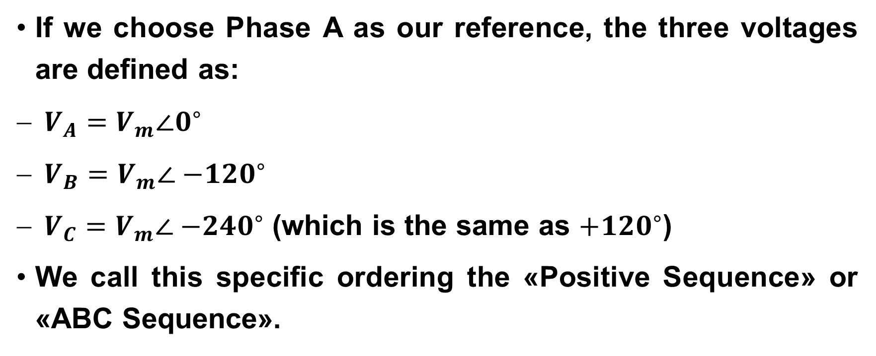
Systematic Analysis Methods
Three-Phase Systems
If we choose Phase A as our reference, the three voltages are defined as:
$V_{A}=V_{m}∠0^{∘}$
$V_{B}=V_{m}∠{−120}^{∘}$
$V_{C}=V_{m}∠{−240}^{∘}$ (which is the same as $+{120}^{∘}$)
We call this specific ordering the «Positive Sequence» or «ABC Sequence».

Slide 8
Systematic Analysis Methods
Three-Phase Systems
This sequence is very important because it determines the direction of rotation for three-phase electric motors which are used in many industrial and other devices.
If you swap any two phases, the motor will spin in the reverse direction.

Slide 9
Systematic Analysis Methods
Three-Phase Systems
Why do we go through the trouble of using three phases instead of just one? There are two major engineering reasons:
Constant Power Transfer: in a balanced three-phase system, the total instantaneous power delivered to the load is constant.
In a single-phase circuit, the power pulsates at double the frequency (it goes to zero every time the voltage crosses zero).

Slide 10
Systematic Analysis Methods
Three-Phase Systems
This causes vibrations in motors.
Three-phase motors run smoothly with no vibration torque.
Efficiency: three-phase systems can transmit the same amount of power using less wire material than equivalent single-phase systems.
This saves enormous amounts of copper and money over long transmission lines.

Slide 11
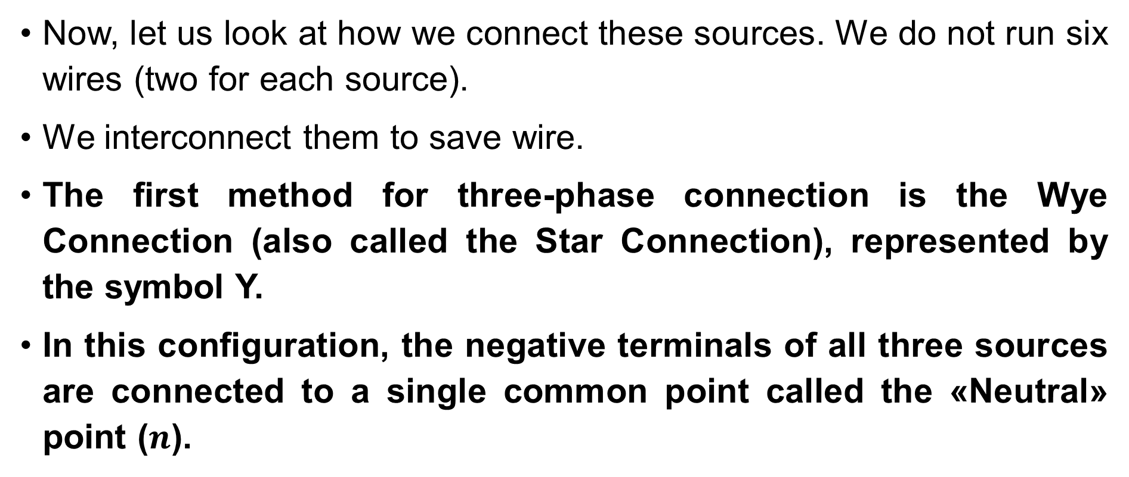
Systematic Analysis Methods
Three-Phase Systems
Now, let us look at how we connect these sources. We do not run six wires (two for each source).
We interconnect them to save wire.
The first method for three-phase connection is the Wye Connection (also called the Star Connection), represented by the symbol Y.
In this configuration, the negative terminals of all three sources are connected to a single common point called the «Neutral» point ($n$).

Slide 12
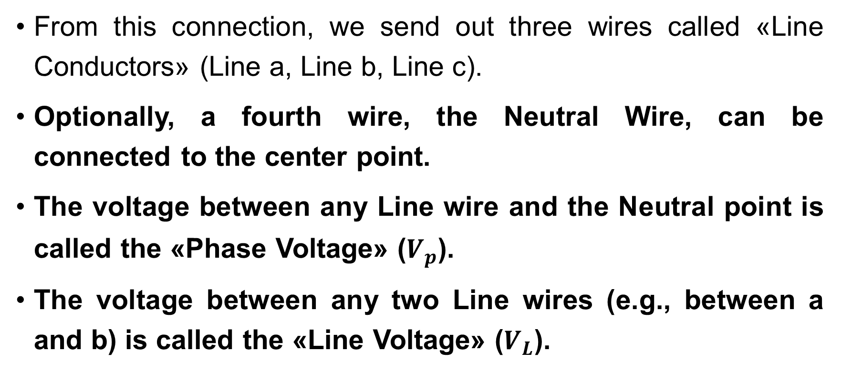
Systematic Analysis Methods
Three-Phase Systems
From this connection, we send out three wires called «Line Conductors» (Line a, Line b, Line c).
Optionally, a fourth wire, the Neutral Wire, can be connected to the center point.
The voltage between any Line wire and the Neutral point is called the «Phase Voltage» ($V_{p}$).
The voltage between any two Line wires (e.g., between a and b) is called the «Line Voltage» ($V_{L}$).

Slide 13

Systematic Analysis Methods
Three-Phase Systems
In the Wye (Y) connection, the relationship between Phase Voltage and Line Voltage is the most important formula you will learn today.
Let us analyze the voltage between Line A and Line B ($V_{AB}$).

Slide 14
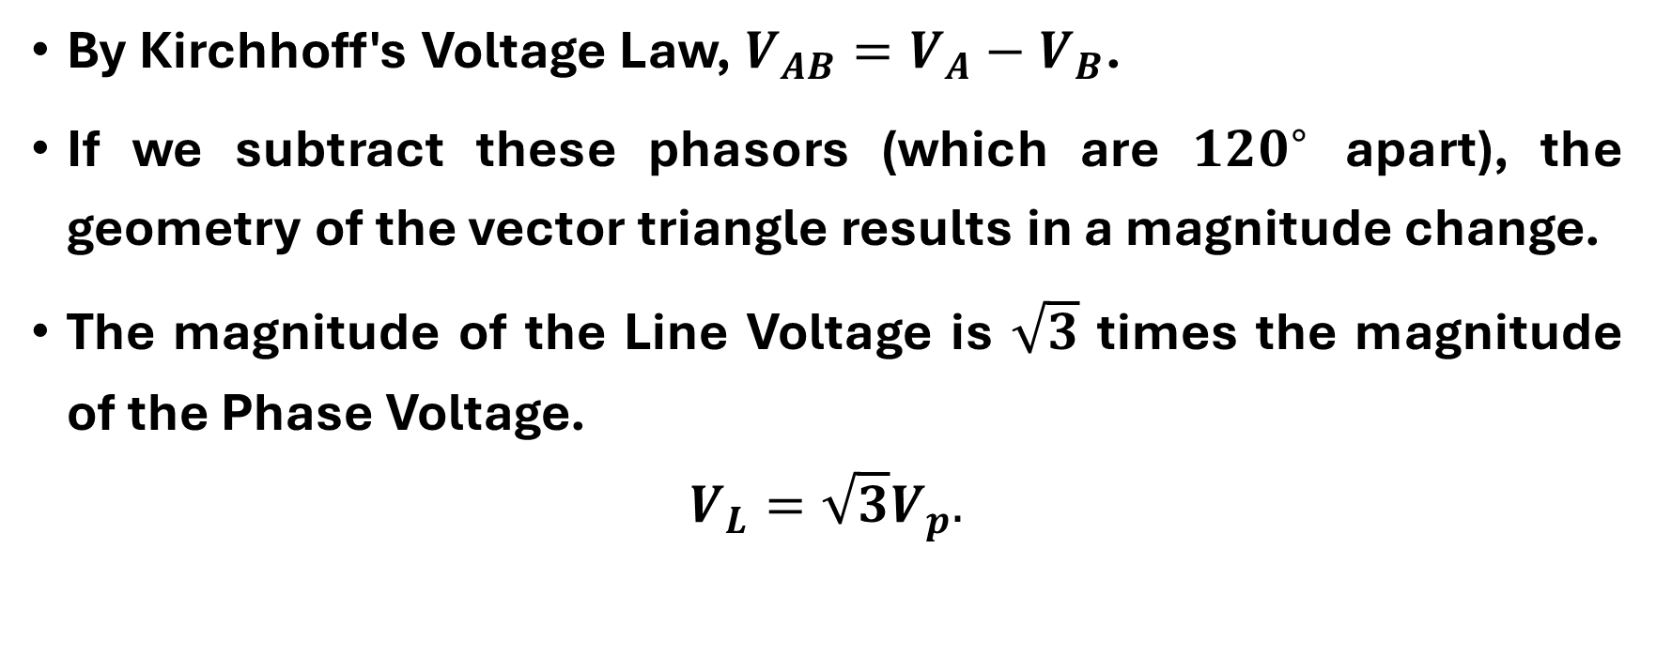
Systematic Analysis Methods
Three-Phase Systems
By Kirchhoff's Voltage Law, $V_{AB}=V_{A}−V_{B}$.
If we subtract these phasors (which are ${120}^{∘}$ apart), the geometry of the vector triangle results in a magnitude change.
The magnitude of the Line Voltage is $\sqrt{3}$ times the magnitude of the Phase Voltage.
$$V_{L}=\sqrt{3}V_{p}.$$

Slide 15
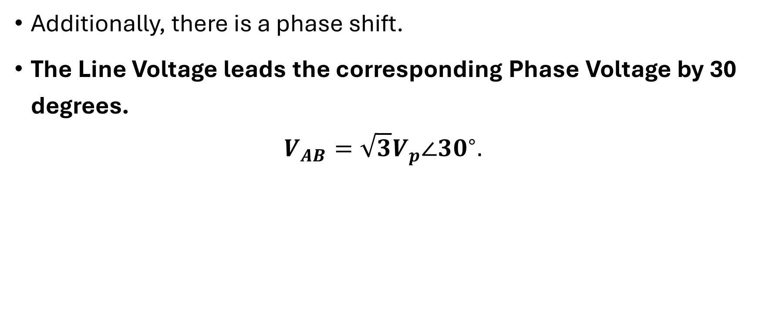
Systematic Analysis Methods
Three-Phase Systems
Additionally, there is a phase shift.
The Line Voltage leads the corresponding Phase Voltage by 30 degrees.
$$V_{AB}=\sqrt{3}V_{p}∠{30}^{∘}.$$

Slide 16
Systematic Analysis Methods
Three-Phase Systems
For example, in many countries, the wall outlet voltage is 230 V (Phase Voltage).
The voltage between the main transmission lines is 230×1.732≈400 V.
This is why you often see equipment rated for «230/400 V».

Slide 17
Systematic Analysis Methods
Three-Phase Systems
Regarding current in a Wye connection, the logic is simpler.
The current flows out of the source, through the line wire, and into the load.
There are no splitting paths at the source terminal.

Slide 18
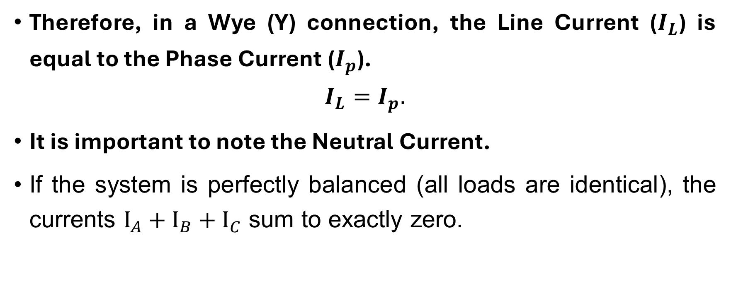
Systematic Analysis Methods
Three-Phase Systems
Therefore, in a Wye (Y) connection, the Line Current ($I_{L}$) is equal to the Phase Current ($I_{p}$).
$$I_{L}=I_{p}.$$
It is important to note the Neutral Current.
If the system is perfectly balanced (all loads are identical), the currents $I_{A}+I_{B}+I_{C}$ sum to exactly zero.

Slide 19
Systematic Analysis Methods
Three-Phase Systems
In a balanced system, zero current flows through the neutral wire.
This is why the neutral wire can sometimes be thinner or even omitted in high-voltage transmission towers.

Slide 20
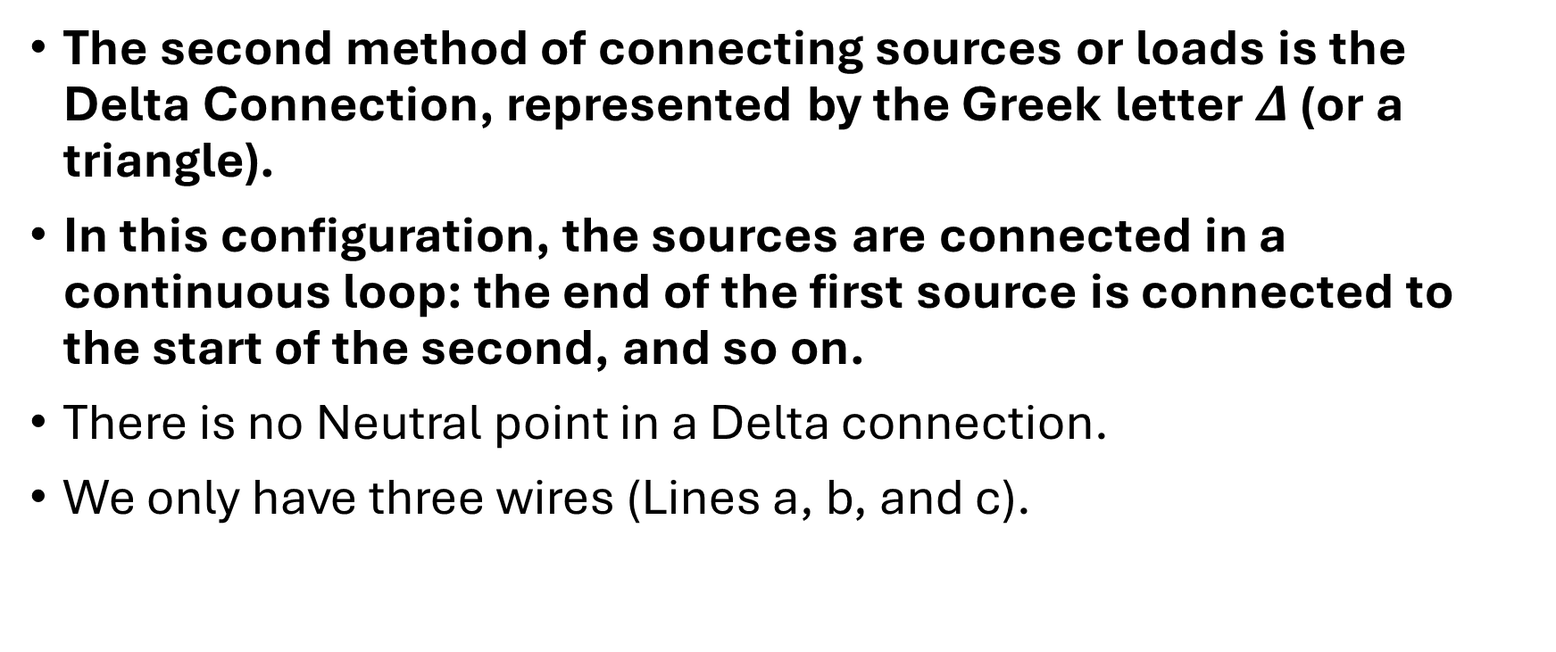
Systematic Analysis Methods
Three-Phase Systems
The second method of connecting sources or loads is the Delta Connection, represented by the Greek letter $Δ$ (or a triangle).
In this configuration, the sources are connected in a continuous loop: the end of the first source is connected to the start of the second, and so on.
There is no Neutral point in a Delta connection.
We only have three wires (Lines a, b, and c).

Slide 21

Systematic Analysis Methods
Three-Phase Systems
Because the Line wire is connected directly to the terminals of the phase source, in a Delta ($Δ$) connection, the Line Voltage is equal to the Phase Voltage.
$$V_{L}=V_{p}.$$

Slide 22
Systematic Analysis Methods
Three-Phase Systems
If you have a 400 V generator connected in Delta, the lines coming out of it are at 400 V. You can see an example of delta connection here.

Slide 23
Systematic Analysis Methods
Three-Phase Systems
However, the currents in a Delta connection behave differently.
At every corner (node) of the triangle, a Line wire connects to two Phase branches.
By applying KCL at a corner node, we find that the Line current is the difference between two Phase currents.
Just like with the voltages in the Wye connection, this vector subtraction introduces a factor of √3.

Slide 24
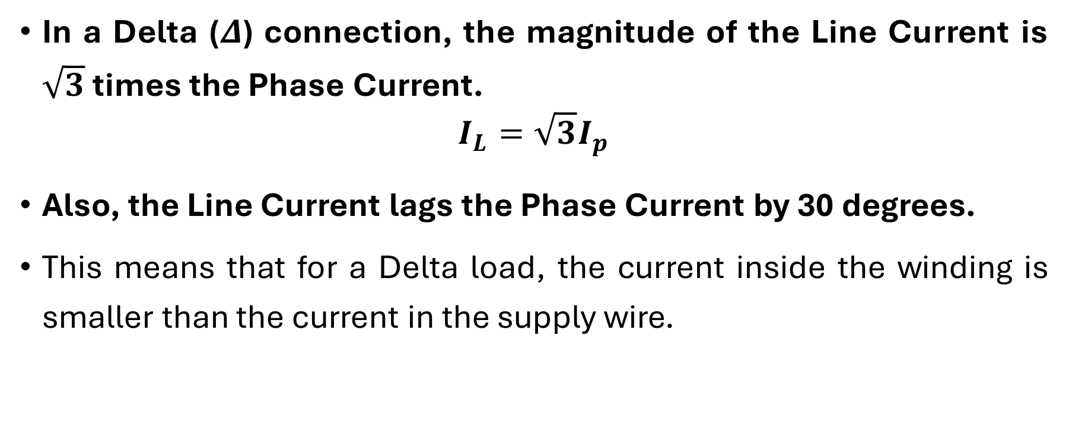
Systematic Analysis Methods
Three-Phase Systems
In a Delta ($Δ$) connection, the magnitude of the Line Current is $\sqrt{3}$ times the Phase Current.
$$I_{L}=\sqrt{3}I_{p}$$
Also, the Line Current lags the Phase Current by 30 degrees.
This means that for a Delta load, the current inside the winding is smaller than the current in the supply wire.

Slide 25

Systematic Analysis Methods
Three-Phase Systems
Do you have any questions at the moment?

Slide 26
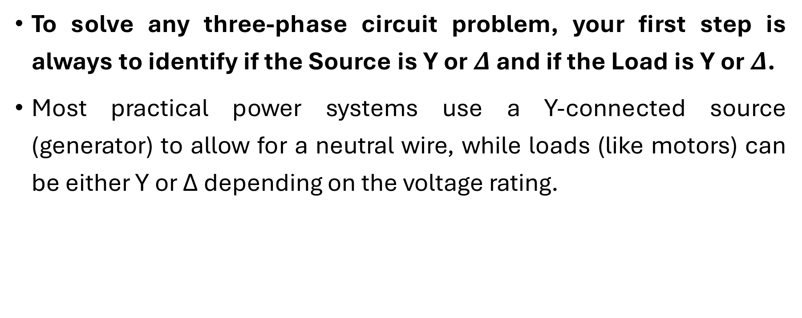
Systematic Analysis Methods
Three-Phase Systems
To solve any three-phase circuit problem, your first step is always to identify if the Source is Y or $Δ$ and if the Load is Y or $Δ$.
Most practical power systems use a Y-connected source (generator) to allow for a neutral wire, while loads (like motors) can be either Y or Δ depending on the voltage rating.

Slide 27
Systematic Analysis Methods
Three-Phase Systems
Now we move to Three-Phase Circuit Analysis.
If the system is balanced (the source is balanced and the load consists of three identical impedances), we do not need to solve the full complex circuit with three loops.
We can use the «Single-Phase Equivalent» technique.

Slide 28
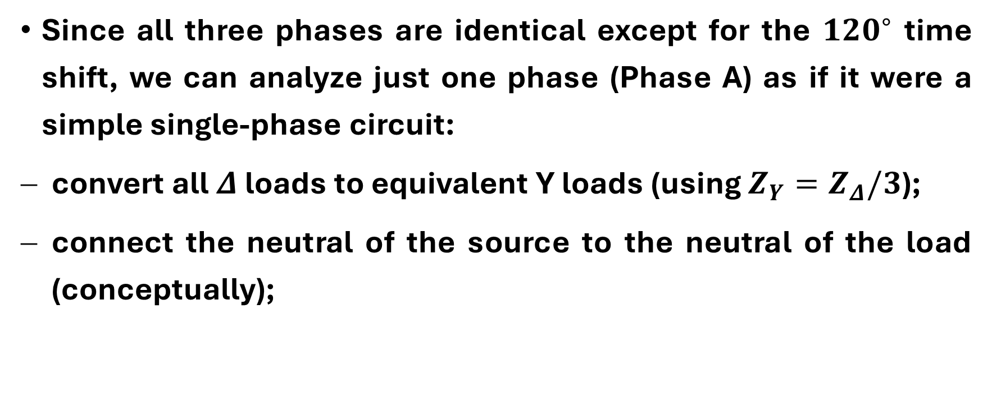
Systematic Analysis Methods
Three-Phase Systems
Since all three phases are identical except for the ${120}^{∘}$ time shift, we can analyze just one phase (Phase A) as if it were a simple single-phase circuit:
convert all $Δ$ loads to equivalent Y loads (using $Z_{Y}=Z_{Δ}/3$);
connect the neutral of the source to the neutral of the load (conceptually);

Slide 29

Systematic Analysis Methods
Three-Phase Systems
calculate the current for Phase A: $I_{A}=V_{phase}/Z_{phase}$;
the currents for Phase B and C will have the same magnitude but shifted angles ($−{120}^{∘}$ and $+{120}^{∘}$).

Slide 30
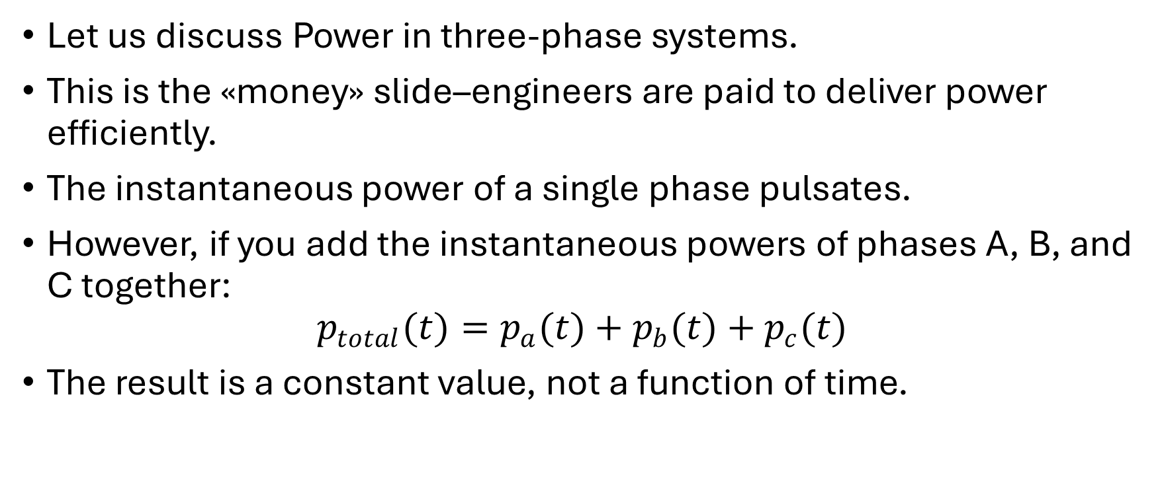
Systematic Analysis Methods
Three-Phase Systems
Let us discuss Power in three-phase systems.
This is the «money» slide–engineers are paid to deliver power efficiently.
The instantaneous power of a single phase pulsates.
However, if you add the instantaneous powers of phases A, B, and C together:
$$p_{total}(t)=p_{a}(t)+p_{b}(t)+p_{c}(t)$$
The result is a constant value, not a function of time.

Slide 31
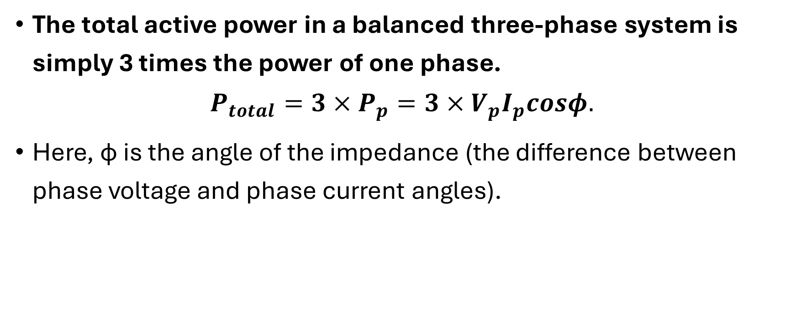
Systematic Analysis Methods
Three-Phase Systems
The total active power in a balanced three-phase system is simply 3 times the power of one phase.
$$P_{total}=3×P_{p}=3×V_{p}I_{p}cosφ.$$
Here, ϕ is the angle of the impedance (the difference between phase voltage and phase current angles).

Slide 32
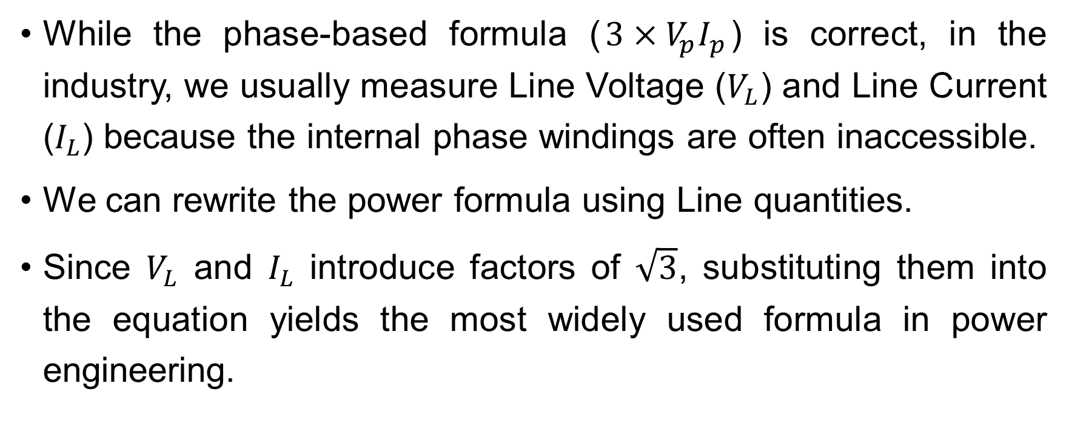
Systematic Analysis Methods
Three-Phase Systems
While the phase-based formula ($3×V_{p}I_{p}$) is correct, in the industry, we usually measure Line Voltage ($V_{L}$) and Line Current ($I_{L}$) because the internal phase windings are often inaccessible.
We can rewrite the power formula using Line quantities.
Since $V_{L}$ and $I_{L}$ introduce factors of $\sqrt{3}$, substituting them into the equation yields the most widely used formula in power engineering.

Slide 33
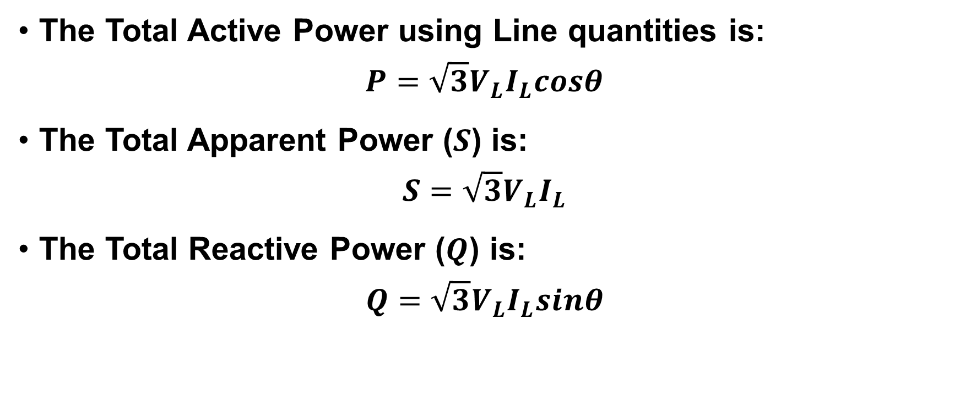
Systematic Analysis Methods
Three-Phase Systems
The Total Active Power using Line quantities is:
$$P=\sqrt{3}V_{L}I_{L}cosθ$$
The Total Apparent Power ($S$) is:
$$S=\sqrt{3}V_{L}I_{L}$$
The Total Reactive Power ($Q$) is:
$$Q=\sqrt{3}V_{L}I_{L}sinθ$$

Slide 34
Systematic Analysis Methods
Three-Phase Systems
Note that θ here is still the angle of the load impedance (the phase angle), not the angle of the line quantities.

Slide 35
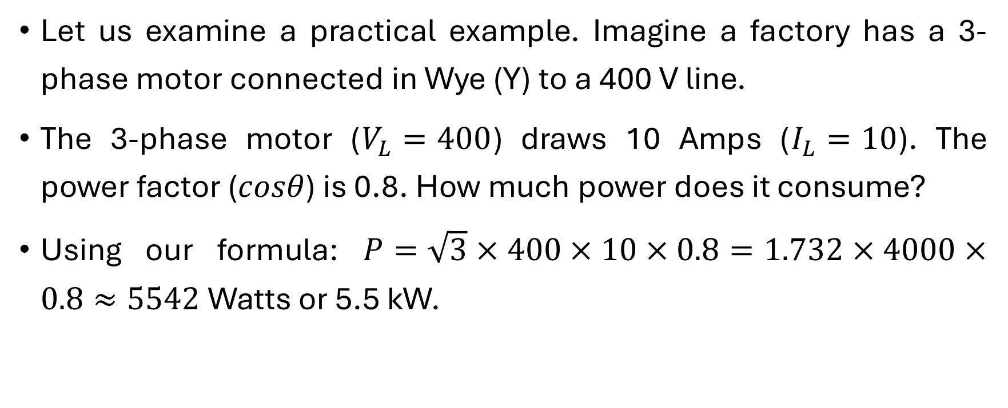
Systematic Analysis Methods
Three-Phase Systems
Let us examine a practical example. Imagine a factory has a 3-phase motor connected in Wye (Y) to a 400 V line.
The 3-phase motor ($V_{L}=400$) draws 10 Amps ($I_{L}=10$). The power factor ($cosθ$) is 0.8. How much power does it consume?
Using our formula: $P=\sqrt{3}×400×10×0.8=1.732×4000×0.8≈5542$ Watts or 5.5 kW.

Slide 36
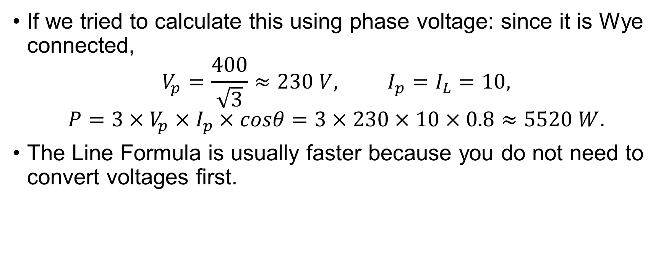
Systematic Analysis Methods
Three-Phase Systems
If we tried to calculate this using phase voltage: since it is Wye connected,
$$V_{p}=\frac{400}{\sqrt{3}}≈230 V, I_{p}=I_{L}=10,$$
$$P=3×V_{p}×I_{p}×cosθ=3×230×10×0.8≈5520 W.$$
The Line Formula is usually faster because you do not need to convert voltages first.

Slide 37
Systematic Analysis Methods
Three-Phase Systems
A brief note on Unbalanced Loads.
If the impedances on phases A, B, and C are not equal (e.g., a large heater on Phase A and no load on B and C), the system is unbalanced.
In an unbalanced Wye circuit, the neutral current is not zero.

Slide 38
Systematic Analysis Methods
Three-Phase Systems
A current will flow through the neutral wire to balance the system.
If the neutral wire is broken (cut) in an unbalanced system, the «Floating Neutral» problem occurs.
The neutral point shifts voltage, potentially causing high voltage on one phase (destroying appliances) and low voltage on another.
This is why the integrity of the Neutral connection is very important in building wiring.

Slide 39
Systematic Analysis Methods
Three-Phase Systems
An essential concept in three-phase motors and generators is the Phase Sequence.
The standard rotation we studied (A, then B, then C) is called the Positive Sequence.

Slide 40
Systematic Analysis Methods
Three-Phase Systems
However, if we swap any two wires, the order becomes A, then C, then B.
The phase sequence is the chronological order in which the voltages of each phase reach their maximum positive value.

Slide 41
Systematic Analysis Methods
Three-Phase Systems
In a «Negative Sequence» (ACB), the voltage in Phase C peaks 120 degrees before Phase B.
Engineers use a device called a phase sequence indicator to ensure that motors rotate in the correct direction before connecting them to the main power grid.

Slide 42
Systematic Analysis Methods
Three-Phase Systems
We must also address how to measure power in three-phase systems practically.
While we can use three separate wattmeters (one for each phase), it is expensive and requires a neutral wire.
For three-wire systems (Delta or Wye without neutral), we use the Two-Wattmeter Method.

Slide 43
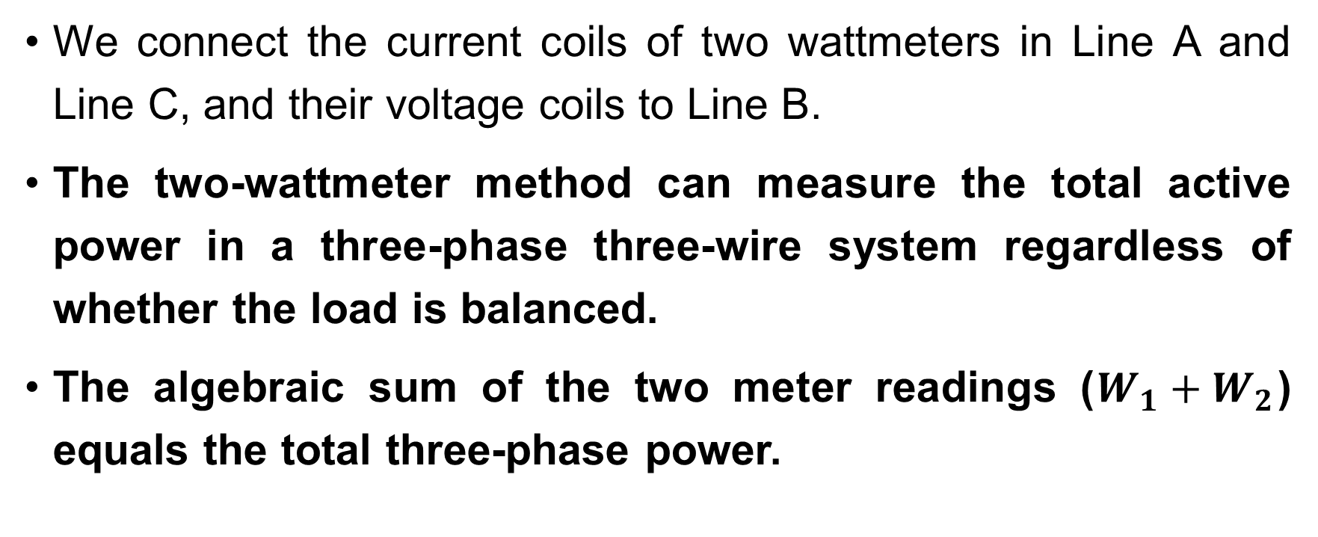
Systematic Analysis Methods
Three-Phase Systems
We connect the current coils of two wattmeters in Line A and Line C, and their voltage coils to Line B.
The two-wattmeter method can measure the total active power in a three-phase three-wire system regardless of whether the load is balanced.
The algebraic sum of the two meter readings ($W_{1}+W_{2}$) equals the total three-phase power.

Slide 44
Systematic Analysis Methods
Three-Phase Systems
Interestingly, if the power factor is 0.5, one meter will read zero; if it is below 0.5, one meter will actually read a negative value.
Sometimes we need to perform calculations on a mixed system where a Wye source feeds a Delta load.
To use the single-phase equivalent method, we must mathematically transform the load.
We recall the impedance transformation from Lecture 10, but for balanced three-phase loads, it is very simple.

Slide 45
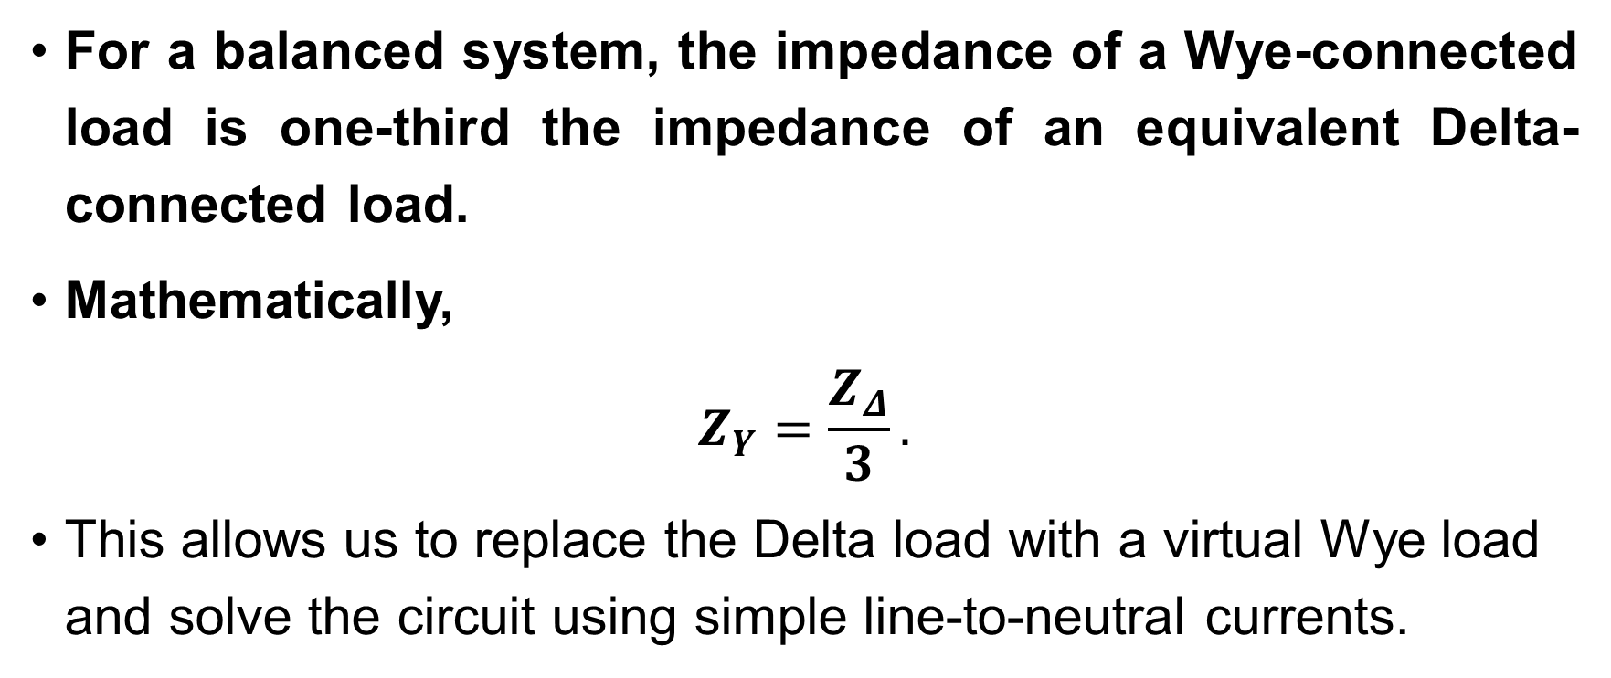
Systematic Analysis Methods
Three-Phase Systems
For a balanced system, the impedance of a Wye-connected load is one-third the impedance of an equivalent Delta-connected load.
Mathematically,
$$Z_{Y}=\frac{Z_{Δ}}{3}.$$
This allows us to replace the Delta load with a virtual Wye load and solve the circuit using simple line-to-neutral currents.

Slide 46
Systematic Analysis Methods
Three-Phase Systems
Let us discuss a failure mode.
Single Phasing: this occurs when one line of the three-phase supply breaks or a fuse blows while a motor is running.
The motor continues to run on the remaining two phases, but it becomes a single-phase machine with an auxiliary winding.

Slide 47
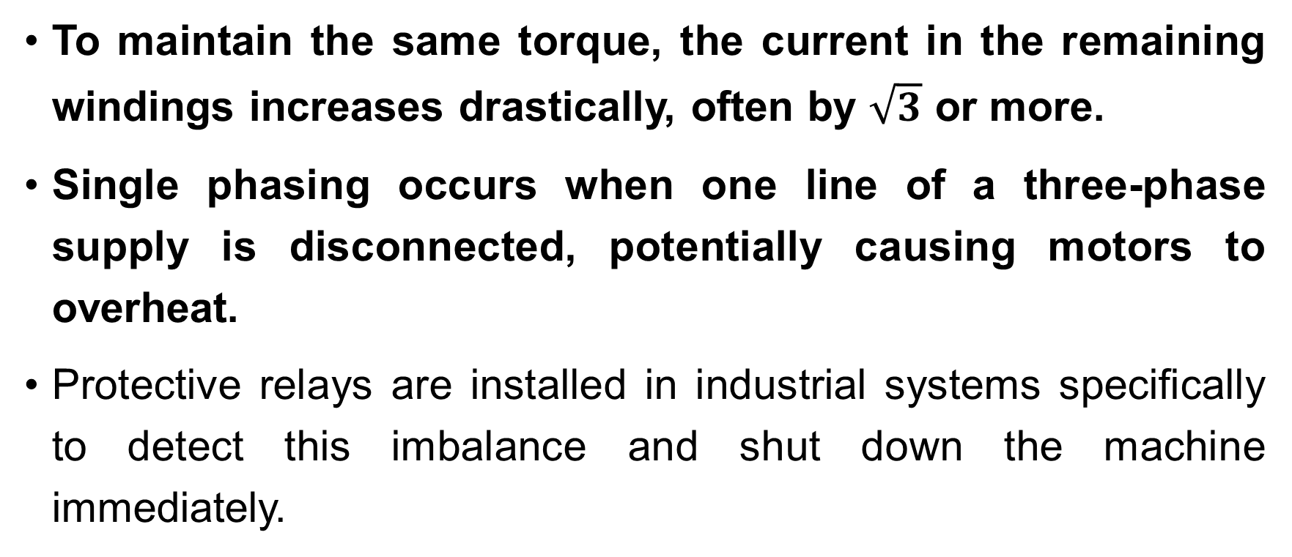
Systematic Analysis Methods
Three-Phase Systems
To maintain the same torque, the current in the remaining windings increases drastically, often by $\sqrt{3}$ or more.
Single phasing occurs when one line of a three-phase supply is disconnected, potentially causing motors to overheat.
Protective relays are installed in industrial systems specifically to detect this imbalance and shut down the machine immediately.

Slide 48
Systematic Analysis Methods
Three-Phase Systems
Finally, consider the advantage of the 4-wire Wye system over the 3-wire Delta system in building distribution.
A 4-wire system provides two distinct voltage levels: the Line Voltage (e.g., 400V) for heavy machinery and the Phase Voltage (e.g., 230V) for lighting and computers.
This flexibility allows one service entrance to supply both industrial and residential needs.

Slide 49
Systematic Analysis Methods
Three-Phase Systems
The four-wire Wye system allows the simultaneous connection of single-phase loads and three-phase loads to the same power supply.
To maintain safety and efficiency, we try to distribute the single-phase loads evenly across A, B, and C to keep the neutral current near zero.

Slide 50
Systematic Analysis Methods
Three-Phase Systems
Thank you for your attention!
Do you have any questions?

