Slide 1
Lecture 13. The Transition Process and First-Order Circuits
Part (6). Time-Domain Analysis of Dynamic Circuits

Slide 2
Systematic Analysis Methods
The Transition Process and First-Order Circuits
Welcome back to the course on The Principle of Circuit.
We have spent the last several lectures analyzing circuits in the «Steady State».
Whether it was DC (Direct Current) or AC (Alternating Current), we assumed that the circuit had been running for a long time and all voltages and currents were stable or repeating perfectly.

Slide 3
Systematic Analysis Methods
The Transition Process and First-Order Circuits
Today, we enter a new and exciting domain: Dynamic Circuits.
We will study what happens in the brief moments immediately after you flip a switch.
This lecture introduces the Transition Process, the Laws of Switching, and the analysis of First-Order Circuits.
This knowledge is critical because real-world electronics, from digital computers to power systems, rely on switching behavior.

Slide 4
Systematic Analysis Methods
The Transition Process and First-Order Circuits
To understand dynamic circuits, we must look at the components we use. In previous lectures, we dealt primarily with resistors.
Resistors are algebraic elements; they dissipate energy instantly.
If you change the voltage across a resistor, the current changes instantly.

Slide 5
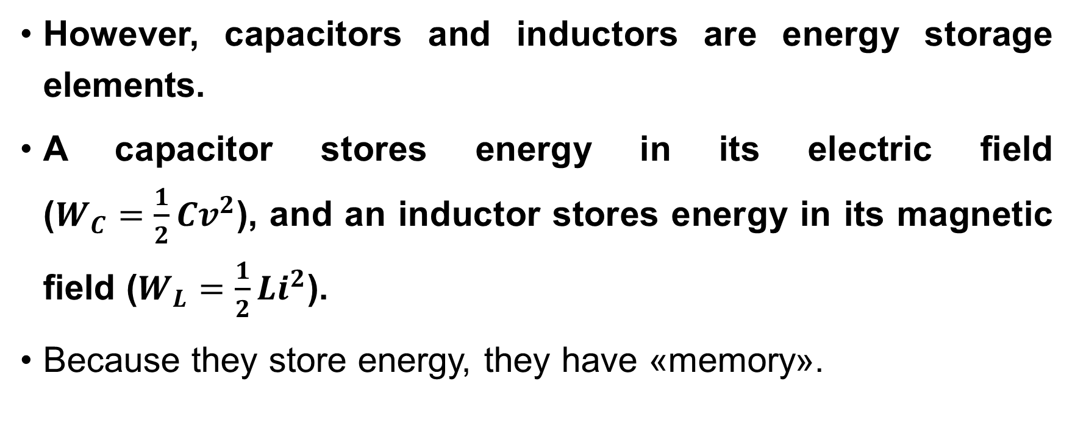
Systematic Analysis Methods
The Transition Process and First-Order Circuits
However, capacitors and inductors are energy storage elements.
A capacitor stores energy in its electric field ($W_{C}=\frac{1}{2}Cv^{2}$), and an inductor stores energy in its magnetic field ($W_{L}=\frac{1}{2}Li^{2}$).
Because they store energy, they have «memory».

Slide 6
Systematic Analysis Methods
The Transition Process and First-Order Circuits
They resist abrupt changes in their state.
A physical system cannot change its energy level from one value to another in zero time, because that would require infinite power.
Therefore, when we switch a circuit on or off, the voltages and currents need time to transition from their old value to their new value.
This period of adjustment is called the Transition Process or the Transient Response.

Slide 7
Systematic Analysis Methods
The Transition Process and First-Order Circuits
The Transition Process occurs when a circuit changes from one steady state to another.
This usually happens due to a «commutation» or switching event.
Commutation is the process of closing or opening a switch, or a sudden change in component parameters.

Slide 8
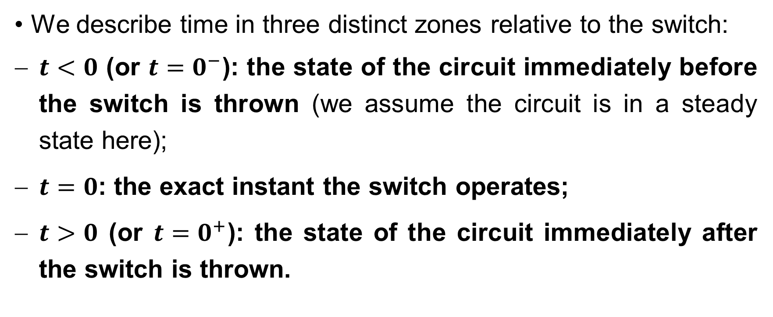
Systematic Analysis Methods
The Transition Process and First-Order Circuits
We describe time in three distinct zones relative to the switch:
$t<0$ (or $t=0^{−}$): the state of the circuit immediately before the switch is thrown (we assume the circuit is in a steady state here);
$t=0$: the exact instant the switch operates;
$t>0$ (or $t=0^{+}$): the state of the circuit immediately after the switch is thrown.

Slide 9
Systematic Analysis Methods
The Transition Process and First-Order Circuits
The last one is where the transition happens.
Our goal is to write equations that describe voltage and current as functions of time, v(t) and i(t), for t>0.
This figure illustrates the transition process in a capacitor and an inductor.
In the graphs (next slide), the green line represents voltage, and the gold line represents current.

Slide 10
Systematic Analysis Methods
The Transition Process and First-Order Circuits
When the switch is in the down position, voltage from the source charges the capacitor and forces current through the inductor.

Slide 11
Systematic Analysis Methods
The Transition Process and First-Order Circuits
When the switch is in the up position, all components are shorted, causing the inductor current and the charge from the capacitor to flow to ground.

Slide 12
Systematic Analysis Methods
The Transition Process and First-Order Circuits
The transition process can be observed between the switches.

Slide 13
Systematic Analysis Methods
The Transition Process and First-Order Circuits
To analyze the transition, we rely on two fundamental rules known as the Laws of Switching (or Laws of Commutation). These laws are based on the one principle:
Energy cannot change instantly.

Slide 14
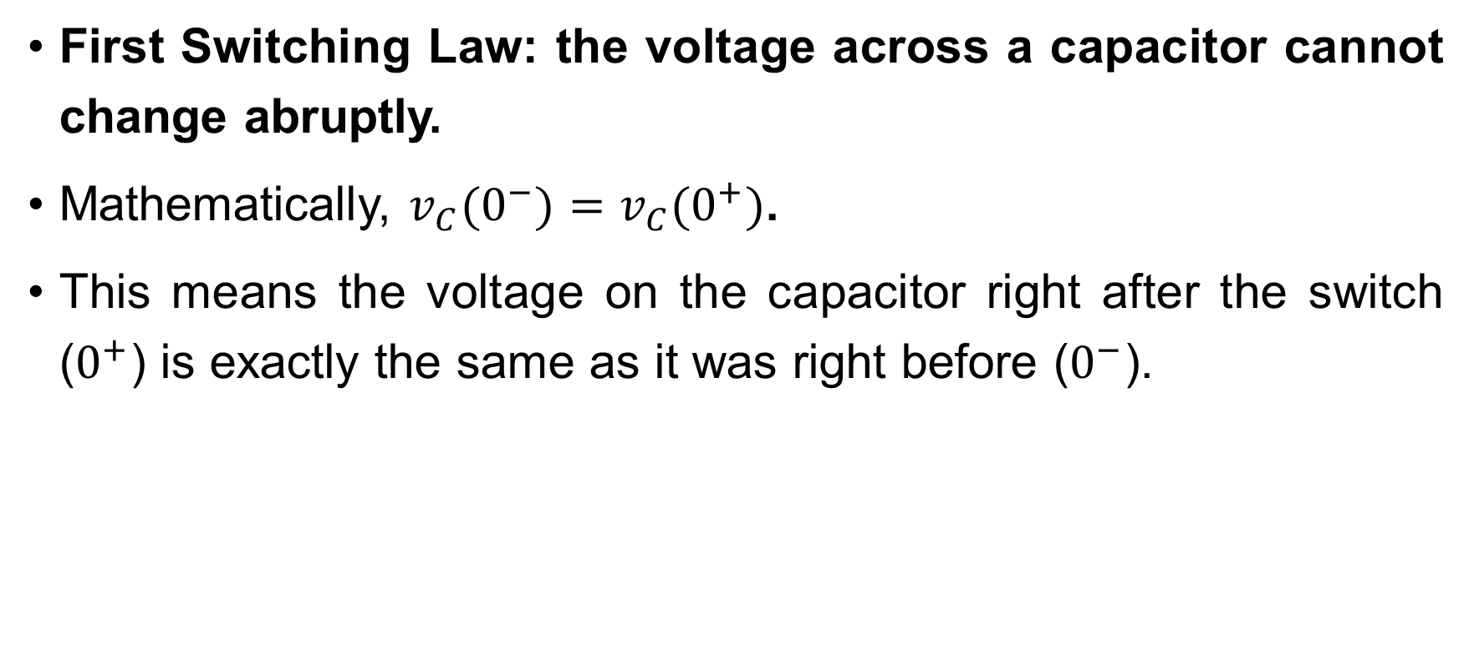
Systematic Analysis Methods
The Transition Process and First-Order Circuits
First Switching Law: the voltage across a capacitor cannot change abruptly.
Mathematically, $v_{C}(0^{−})=v_{C}(0^{+})$.
This means the voltage on the capacitor right after the switch ($0^{+}$) is exactly the same as it was right before ($0^{−}$).

Slide 15
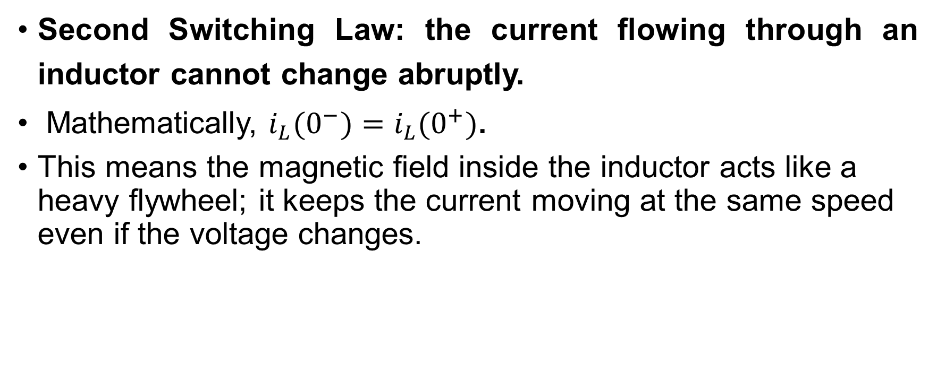
Systematic Analysis Methods
The Transition Process and First-Order Circuits
Second Switching Law: the current flowing through an inductor cannot change abruptly.
Mathematically, $i_{L}(0^{−})=i_{L}(0^{+})$.
This means the magnetic field inside the inductor acts like a heavy flywheel; it keeps the current moving at the same speed even if the voltage changes.

Slide 16
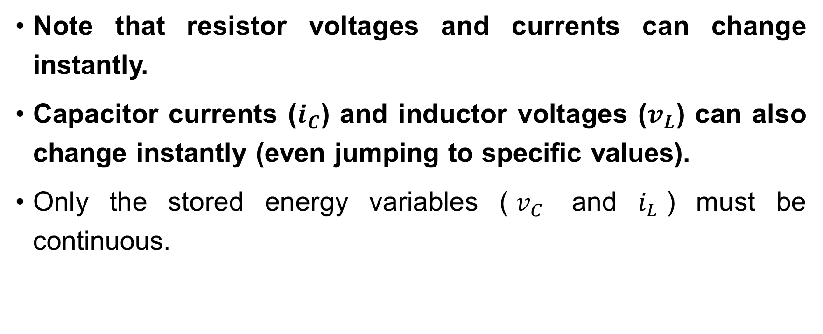
Systematic Analysis Methods
The Transition Process and First-Order Circuits
Note that resistor voltages and currents can change instantly.
Capacitor currents ($i_{C}$) and inductor voltages ($v_{L}$) can also change instantly (even jumping to specific values).
Only the stored energy variables ($v_{C}$ and $i_{L}$) must be continuous.

Slide 17
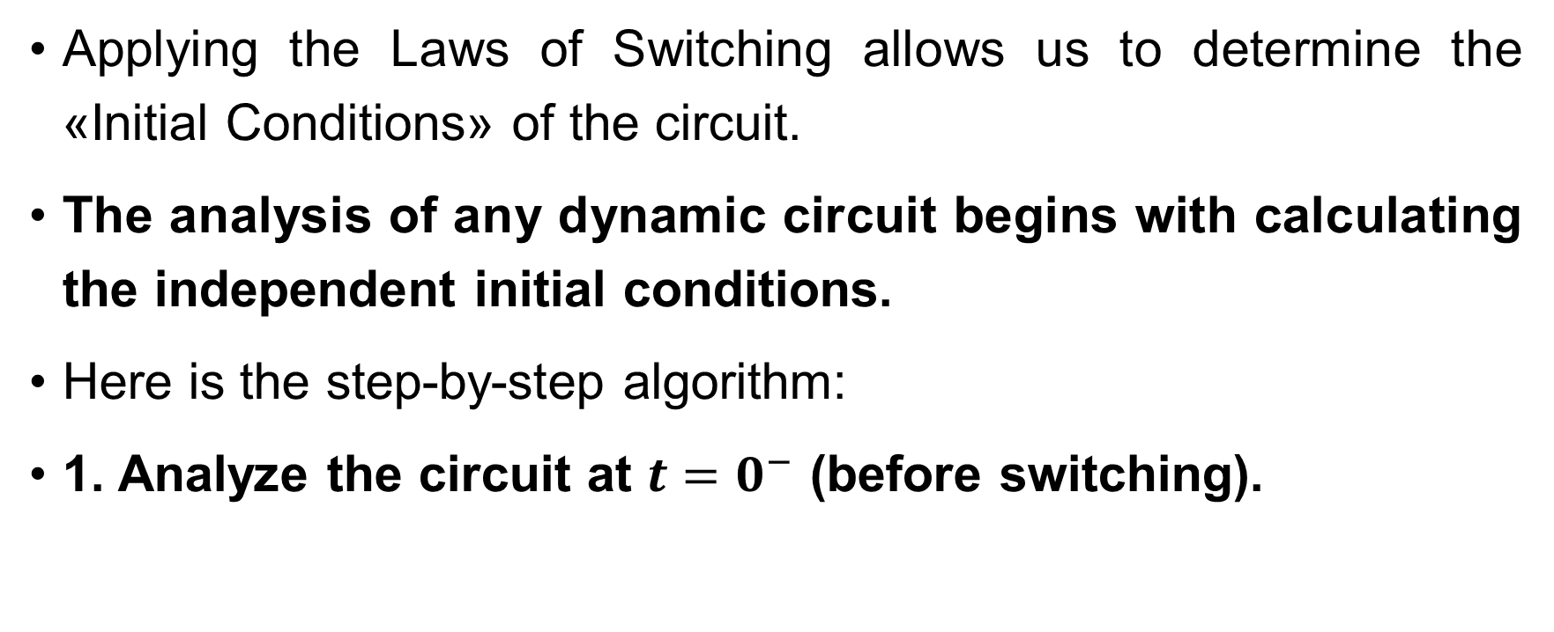
Systematic Analysis Methods
The Transition Process and First-Order Circuits
Applying the Laws of Switching allows us to determine the «Initial Conditions» of the circuit.
The analysis of any dynamic circuit begins with calculating the independent initial conditions.
Here is the step-by-step algorithm:
1. Analyze the circuit at $t=0^{−}$ (before switching).

Slide 18
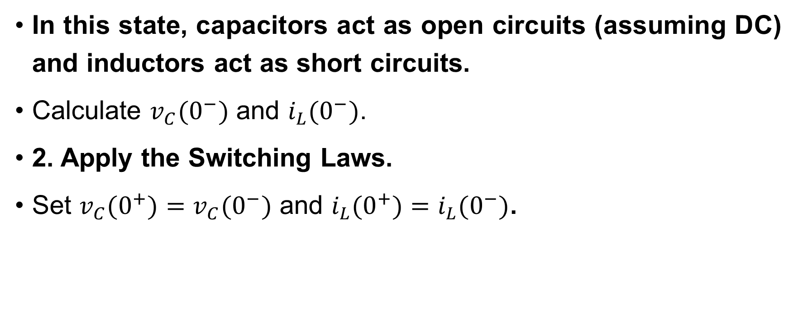
Systematic Analysis Methods
The Transition Process and First-Order Circuits
In this state, capacitors act as open circuits (assuming DC) and inductors act as short circuits.
Calculate $v_{C}(0^{−})$ and $i_{L}(0^{−})$.
2. Apply the Switching Laws.
Set $v_{C}(0^{+})=v_{C}(0^{−})$ and $i_{L}(0^{+})=i_{L}(0^{−})$.

Slide 19
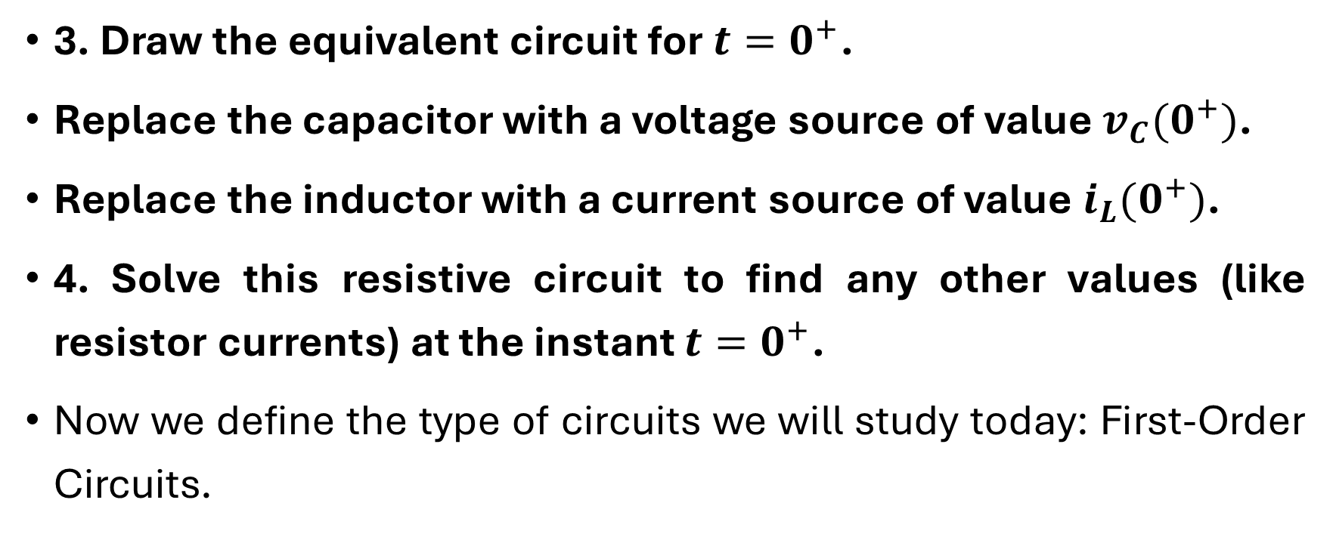
Systematic Analysis Methods
The Transition Process and First-Order Circuits
3. Draw the equivalent circuit for $t=0^{+}$.
Replace the capacitor with a voltage source of value $v_{C}(0^{+})$.
Replace the inductor with a current source of value $i_{L}(0^{+})$.
4. Solve this resistive circuit to find any other values (like resistor currents) at the instant $t=0^{+}$.
Now we define the type of circuits we will study today: First-Order Circuits.

Slide 20
Systematic Analysis Methods
The Transition Process and First-Order Circuits
A First-Order Circuit is a circuit that contains only one energy storage element (one Capacitor or one Inductor) and any number of resistors and sources.
Or, it may contain multiple capacitors or inductors that can be combined into a single equivalent element.
These circuits are described mathematically by a first-order linear differential equation.

Slide 21
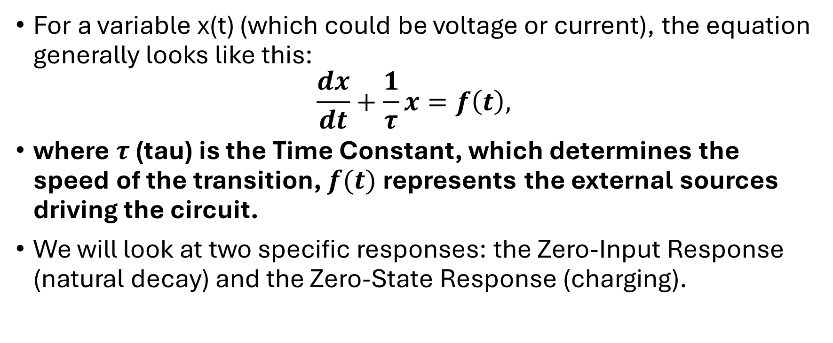
Systematic Analysis Methods
The Transition Process and First-Order Circuits
For a variable x(t) (which could be voltage or current), the equation generally looks like this:
$$\frac{dx}{dt}+\frac{1}{τ}x=f\left(t\right),$$
where $τ$ (tau) is the Time Constant, which determines the speed of the transition, $f(t)$ represents the external sources driving the circuit.
We will look at two specific responses: the Zero-Input Response (natural decay) and the Zero-State Response (charging).

Slide 22
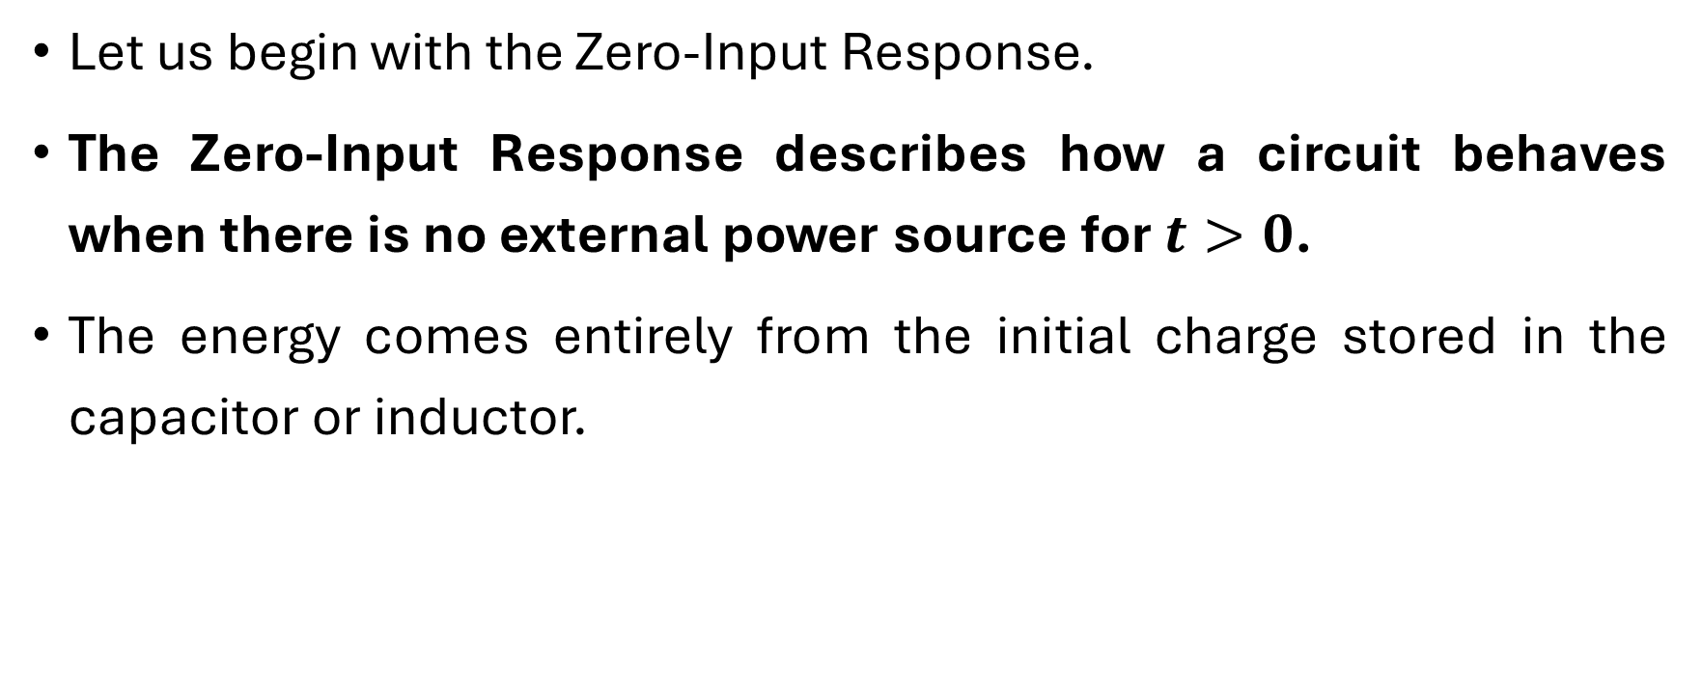
Systematic Analysis Methods
The Transition Process and First-Order Circuits
Let us begin with the Zero-Input Response.
The Zero-Input Response describes how a circuit behaves when there is no external power source for $t>0$.
The energy comes entirely from the initial charge stored in the capacitor or inductor.

Slide 23
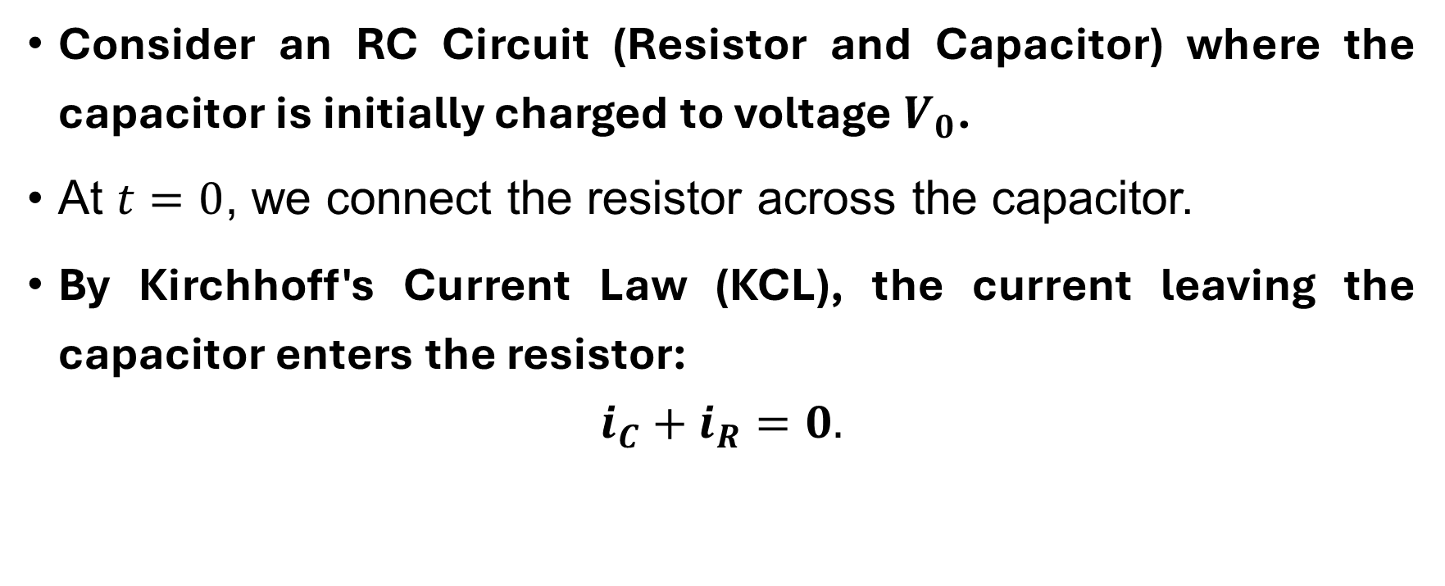
Systematic Analysis Methods
The Transition Process and First-Order Circuits
Consider an RC Circuit (Resistor and Capacitor) where the capacitor is initially charged to voltage $V_{0}$.
At $t=0$, we connect the resistor across the capacitor.
By Kirchhoff's Current Law (KCL), the current leaving the capacitor enters the resistor:
$$i_{C}+i_{R}=0.$$

Slide 24
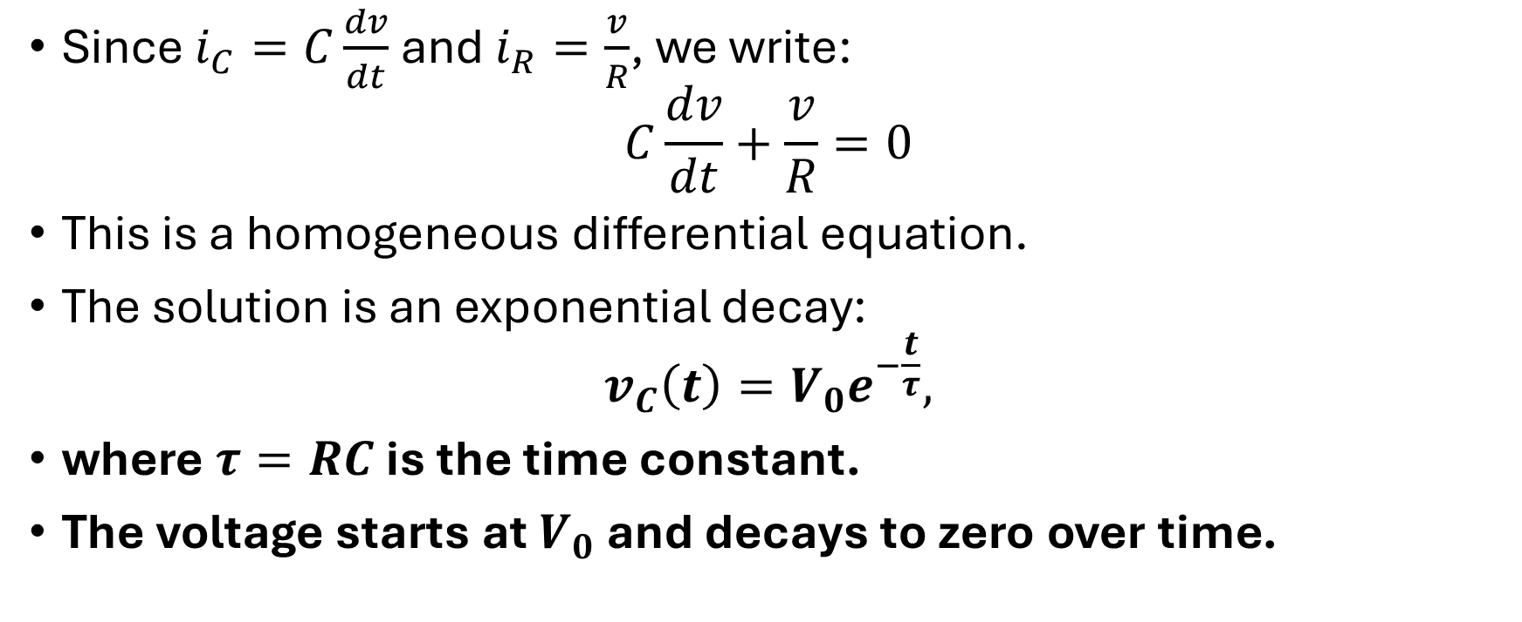
Systematic Analysis Methods
The Transition Process and First-Order Circuits
Since $i_{C}=C\frac{dv}{dt}$ and $i_{R}=\frac{v}{R}$, we write:
$$C\frac{dv}{dt}+\frac{v}{R}=0$$
This is a homogeneous differential equation.
The solution is an exponential decay:
$$v_{C}\left(t\right)=V_{0}e^{−\frac{t}{τ}},$$
where $τ=RC$ is the time constant.
The voltage starts at $V_{0}$ and decays to zero over time.

Slide 25

Systematic Analysis Methods
The Transition Process and First-Order Circuits
Do you have any questions at the moment?

Slide 26
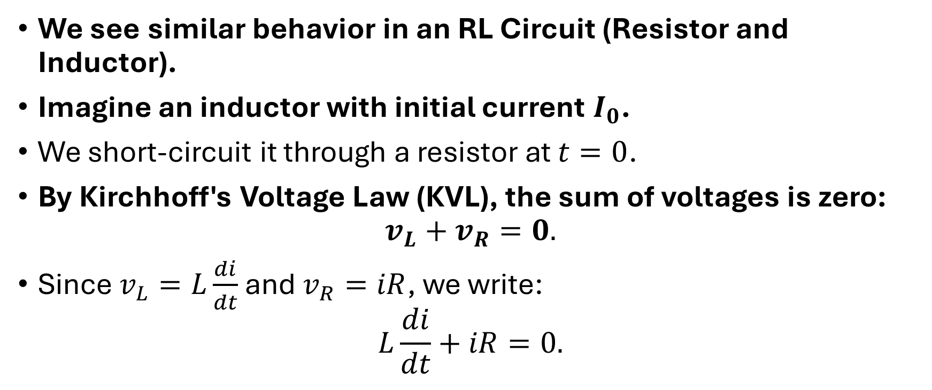
Systematic Analysis Methods
The Transition Process and First-Order Circuits
We see similar behavior in an RL Circuit (Resistor and Inductor).
Imagine an inductor with initial current $I_{0}$.
We short-circuit it through a resistor at $t=0$.
By Kirchhoff's Voltage Law (KVL), the sum of voltages is zero:
$$v_{L}+v_{R}=0.$$
Since $v_{L}=L\frac{di}{dt}$ and $v_{R}=iR$, we write:
$$L\frac{di}{dt}+iR=0.$$

Slide 27
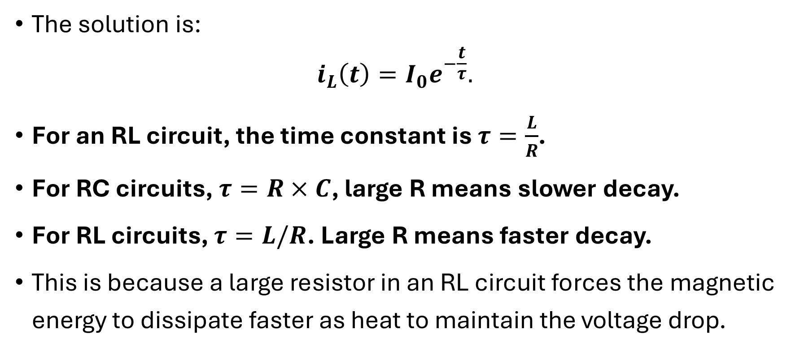
Systematic Analysis Methods
The Transition Process and First-Order Circuits
The solution is:
$$i_{L}\left(t\right)=I_{0}e^{−\frac{t}{τ}}.$$
For an RL circuit, the time constant is $τ=\frac{L}{R}$.
For RC circuits, $τ=R×C$, large R means slower decay.
For RL circuits, $τ=L/R$. Large R means faster decay.
This is because a large resistor in an RL circuit forces the magnetic energy to dissipate faster as heat to maintain the voltage drop.

Slide 28
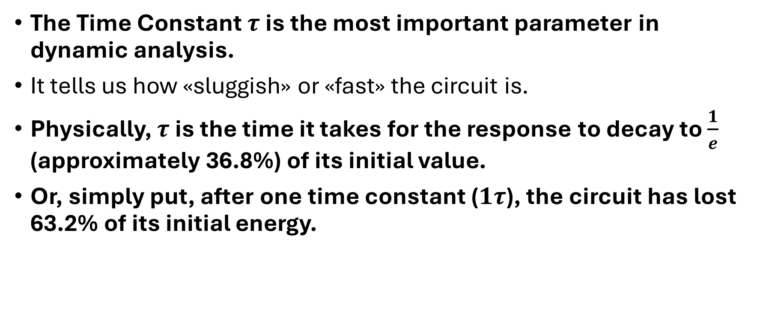
Systematic Analysis Methods
The Transition Process and First-Order Circuits
The Time Constant $τ$ is the most important parameter in dynamic analysis.
It tells us how «sluggish» or «fast» the circuit is.
Physically, $τ$ is the time it takes for the response to decay to $\frac{1}{e}$ (approximately 36.8%) of its initial value.
Or, simply put, after one time constant ($1τ$), the circuit has lost 63.2% of its initial energy.

Slide 29
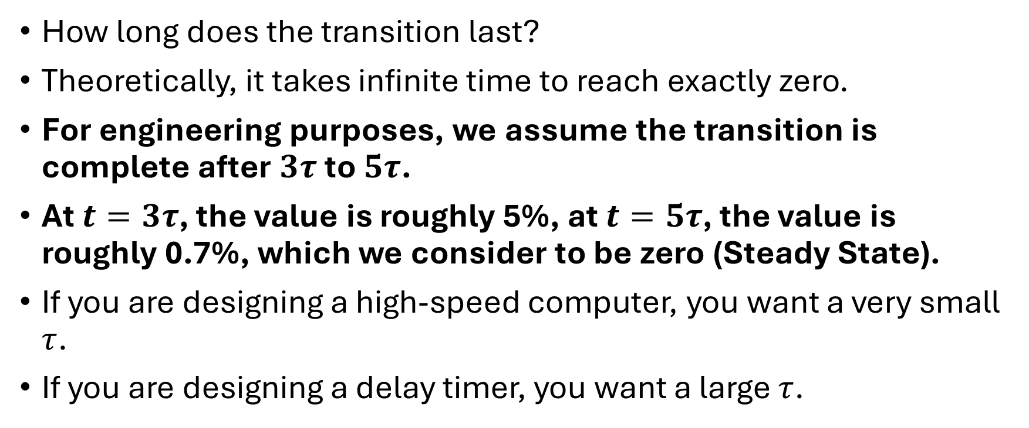
Systematic Analysis Methods
The Transition Process and First-Order Circuits
How long does the transition last?
Theoretically, it takes infinite time to reach exactly zero.
For engineering purposes, we assume the transition is complete after $3τ$ to $5τ$.
At $t=3τ$, the value is roughly 5%, at $t=5τ$, the value is roughly 0.7%, which we consider to be zero (Steady State).
If you are designing a high-speed computer, you want a very small $τ$.
If you are designing a delay timer, you want a large $τ$.

Slide 30
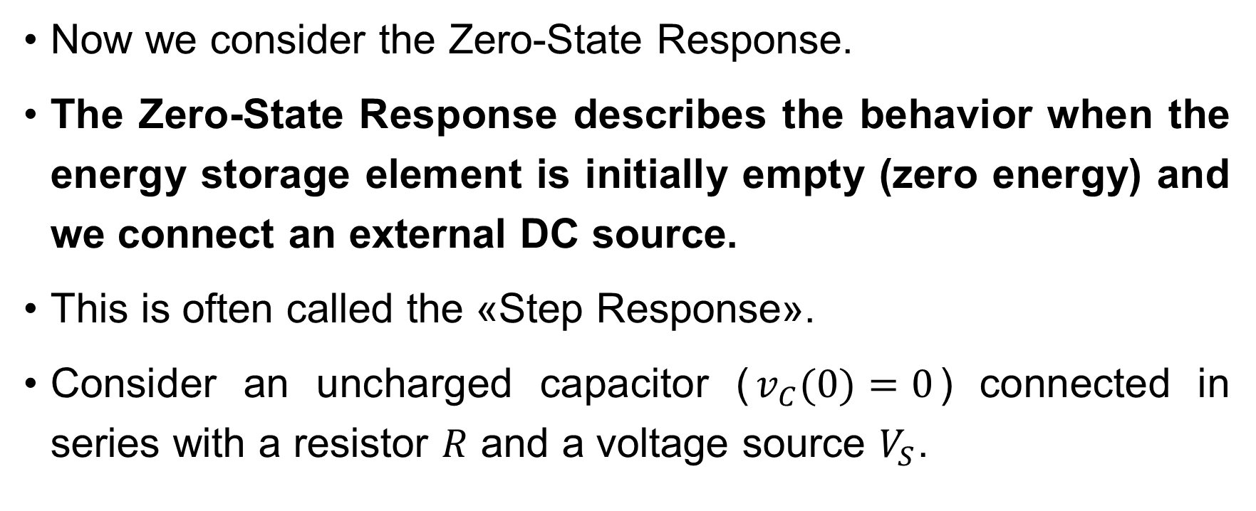
Systematic Analysis Methods
The Transition Process and First-Order Circuits
Now we consider the Zero-State Response.
The Zero-State Response describes the behavior when the energy storage element is initially empty (zero energy) and we connect an external DC source.
This is often called the «Step Response».
Consider an uncharged capacitor ($v_{C}(0)=0$) connected in series with a resistor $R$ and a voltage source $V_{S}$.

Slide 31

Systematic Analysis Methods
The Transition Process and First-Order Circuits
Using KVL:
$$V_{S}=v_{R}+v_{C},$$
$$V_{S}=RC\frac{dv_{C}}{dt}+v_{C}.$$
This is a non-homogeneous differential equation.

Slide 32
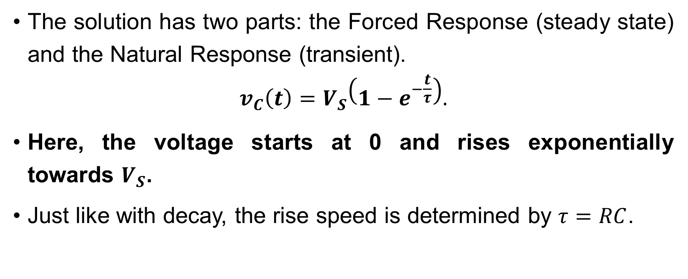
Systematic Analysis Methods
The Transition Process and First-Order Circuits
The solution has two parts: the Forced Response (steady state) and the Natural Response (transient).
$$v_{C}\left(t\right)=V_{S}\left(1−e^{−\frac{t}{τ}}\right).$$
Here, the voltage starts at 0 and rises exponentially towards $V_{S}$.
Just like with decay, the rise speed is determined by $τ=RC$.

Slide 33
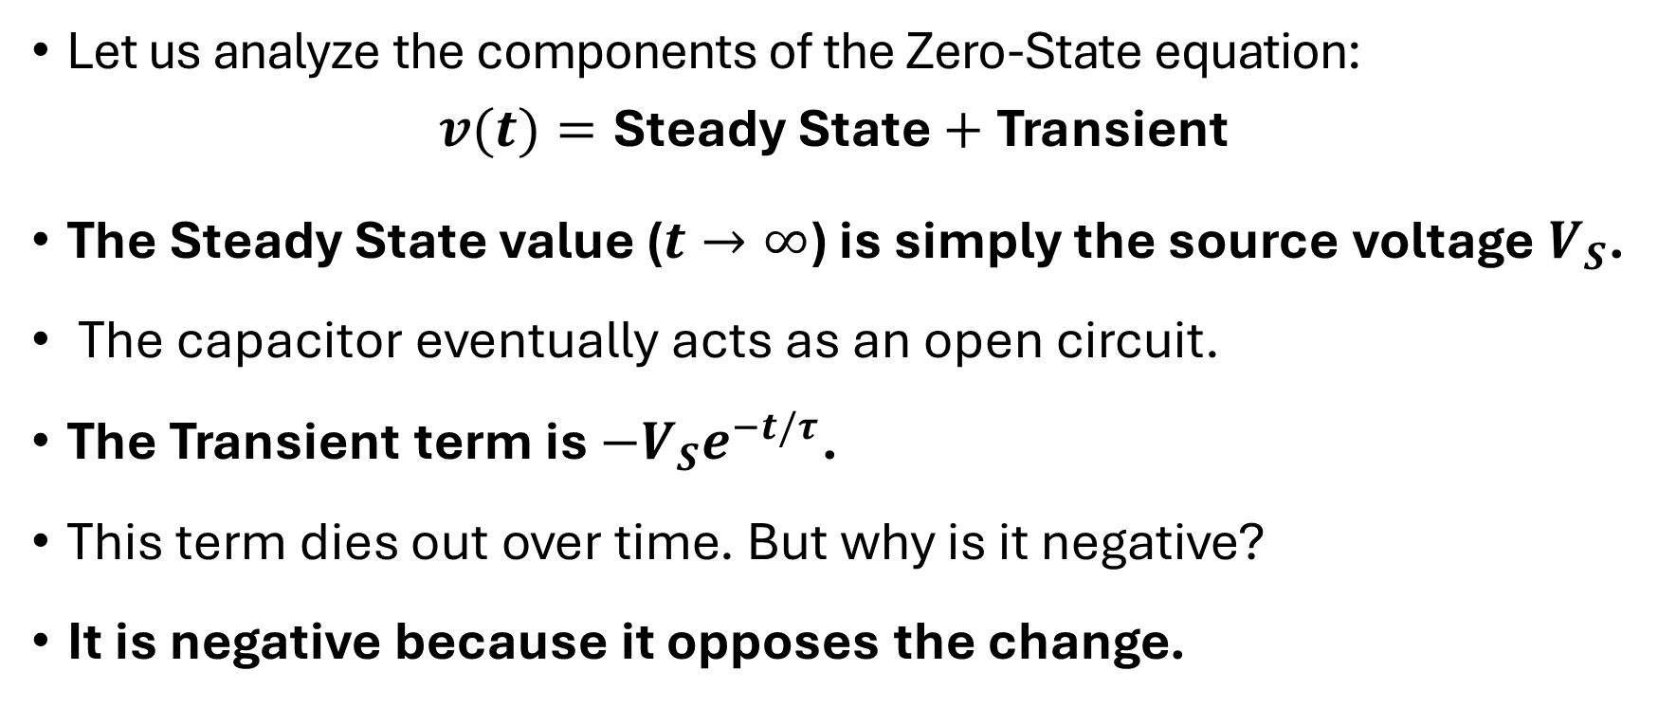
Systematic Analysis Methods
The Transition Process and First-Order Circuits
Let us analyze the components of the Zero-State equation:
$$v(t)=\text{Steady} \text{State}+\text{Transient}$$
The Steady State value ($t→∞$) is simply the source voltage $V_{S}$.
The capacitor eventually acts as an open circuit.
The Transient term is $−V_{S}e^{−t/τ}$.
This term dies out over time. But why is it negative?
It is negative because it opposes the change.

Slide 34
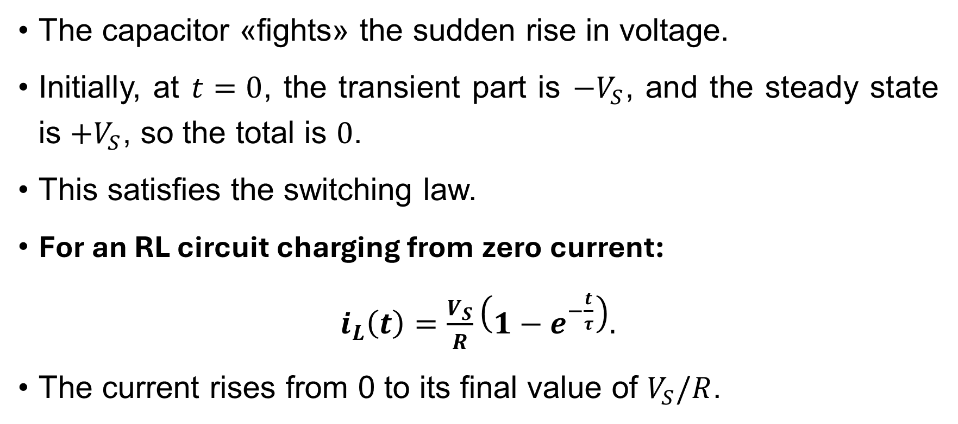
Systematic Analysis Methods
The Transition Process and First-Order Circuits
The capacitor «fights» the sudden rise in voltage.
Initially, at $t=0$, the transient part is $−V_{S}$, and the steady state is $+V_{S}$, so the total is $0$.
This satisfies the switching law.
For an RL circuit charging from zero current:
$i_{L}\left(t\right)=\frac{V_{S}}{R}\left(1−e^{−\frac{t}{τ}}\right).$
The current rises from 0 to its final value of $V_{S}/R$.

Slide 35
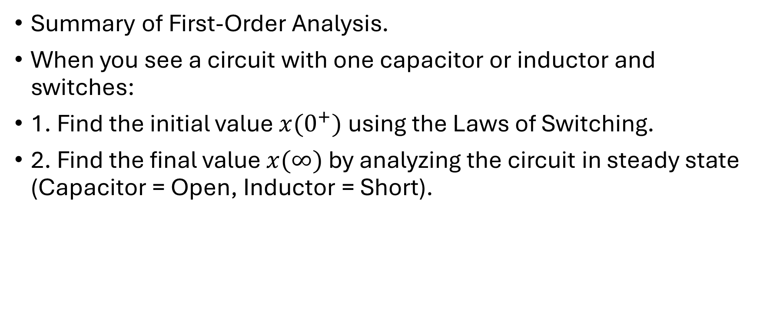
Systematic Analysis Methods
The Transition Process and First-Order Circuits
Summary of First-Order Analysis.
When you see a circuit with one capacitor or inductor and switches:
1. Find the initial value $x(0^{+})$ using the Laws of Switching.
2. Find the final value $x(∞)$ by analyzing the circuit in steady state (Capacitor = Open, Inductor = Short).

Slide 36
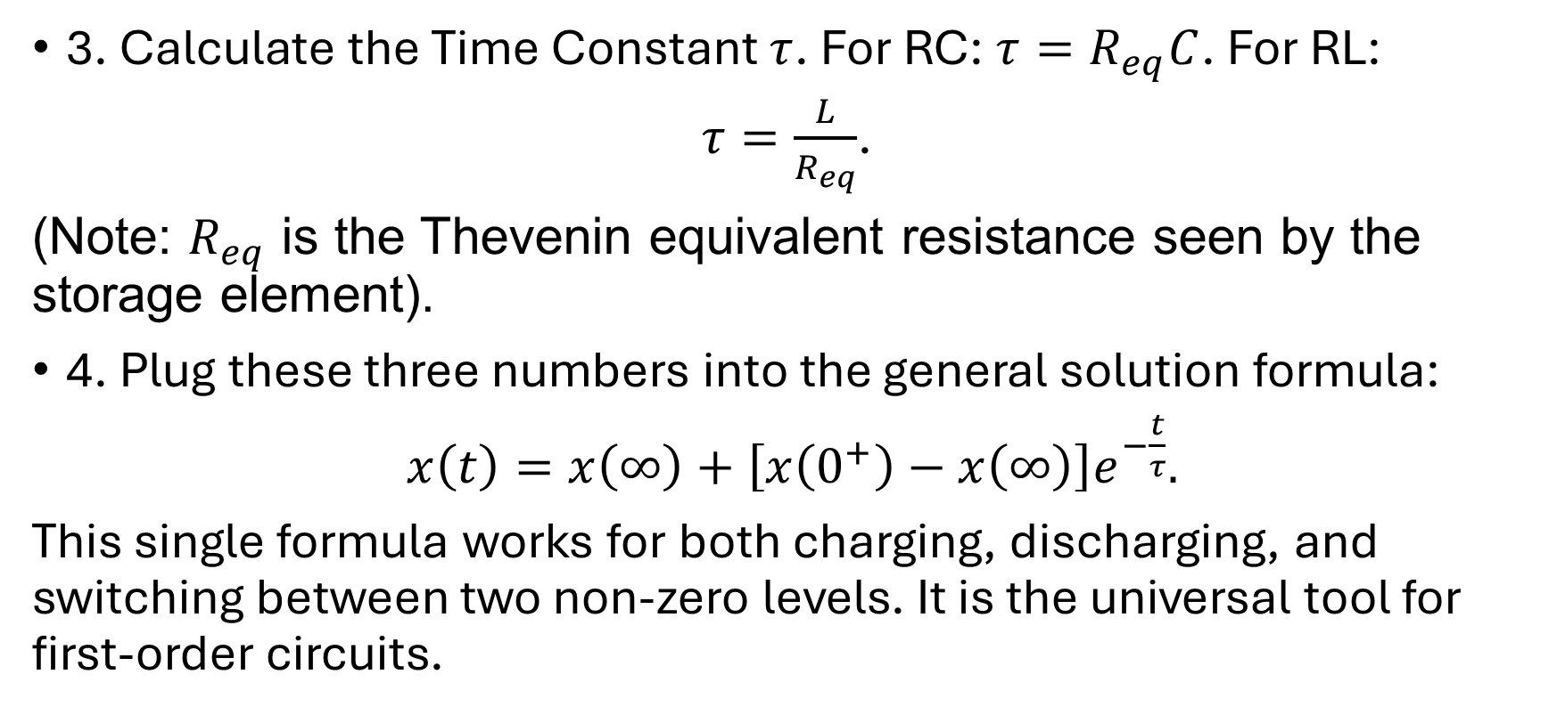
Systematic Analysis Methods
The Transition Process and First-Order Circuits
3. Calculate the Time Constant $τ$. For RC: $τ=R_{eq}C$. For RL:
$τ=\frac{L}{R_{eq}}$.
(Note: $R_{eq}$ is the Thevenin equivalent resistance seen by the storage element).
4. Plug these three numbers into the general solution formula:
$x\left(t\right)=x\left(∞\right)+\left[x\left(0^{+}\right)−x\left(∞\right)\right]e^{−\frac{t}{τ}}.$
This single formula works for both charging, discharging, and switching between two non-zero levels. It is the universal tool for first-order circuits.

Slide 37
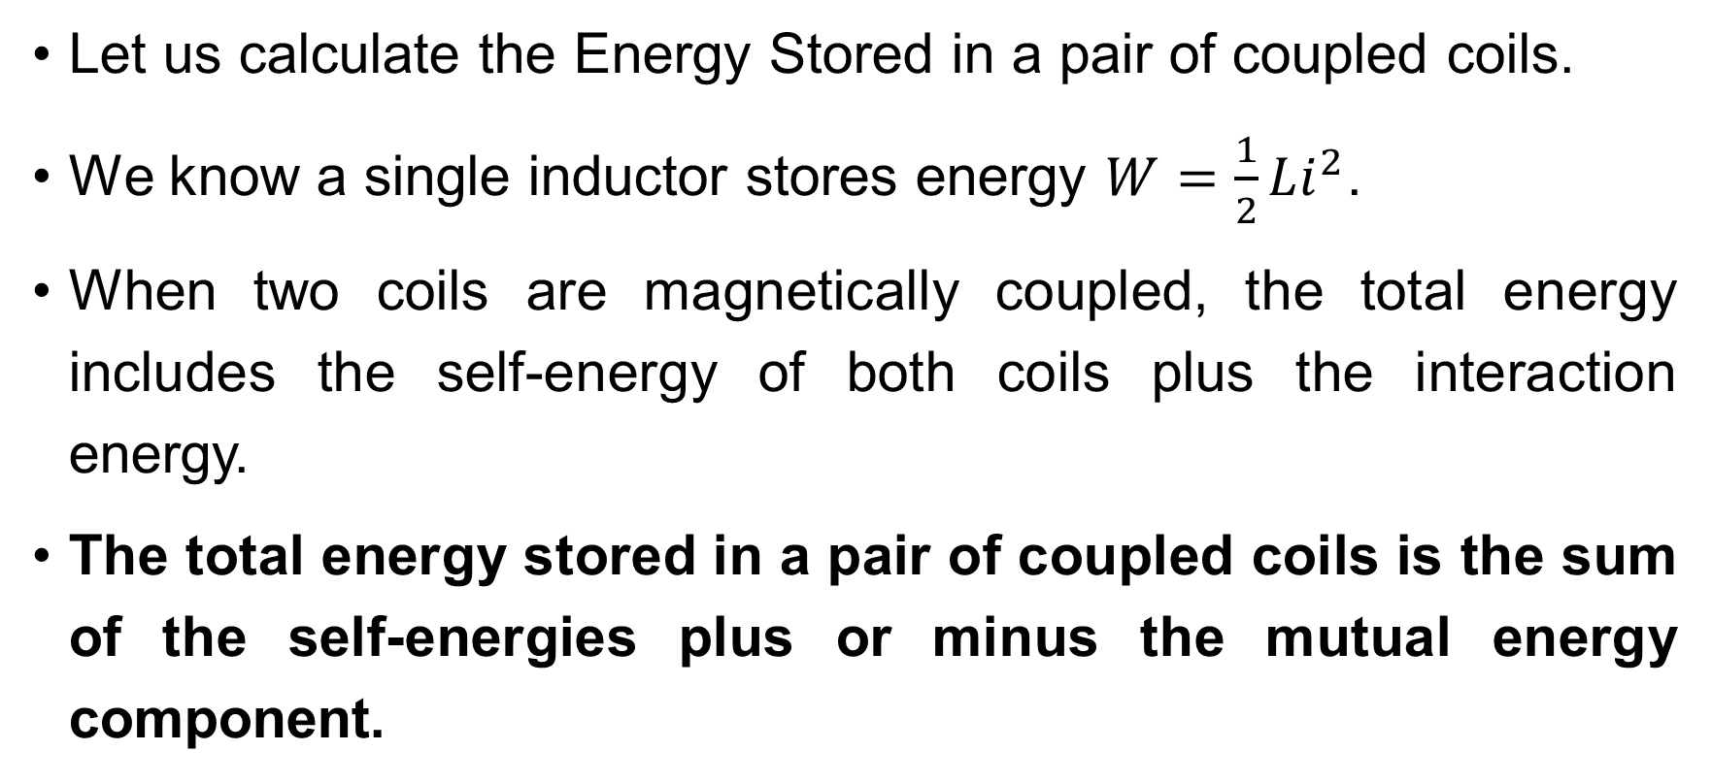
Systematic Analysis Methods
The Transition Process and First-Order Circuits
Let us calculate the Energy Stored in a pair of coupled coils.
We know a single inductor stores energy $W=\frac{1}{2}Li^{2}$.
When two coils are magnetically coupled, the total energy includes the self-energy of both coils plus the interaction energy.
The total energy stored in a pair of coupled coils is the sum of the self-energies plus or minus the mutual energy component.

Slide 38
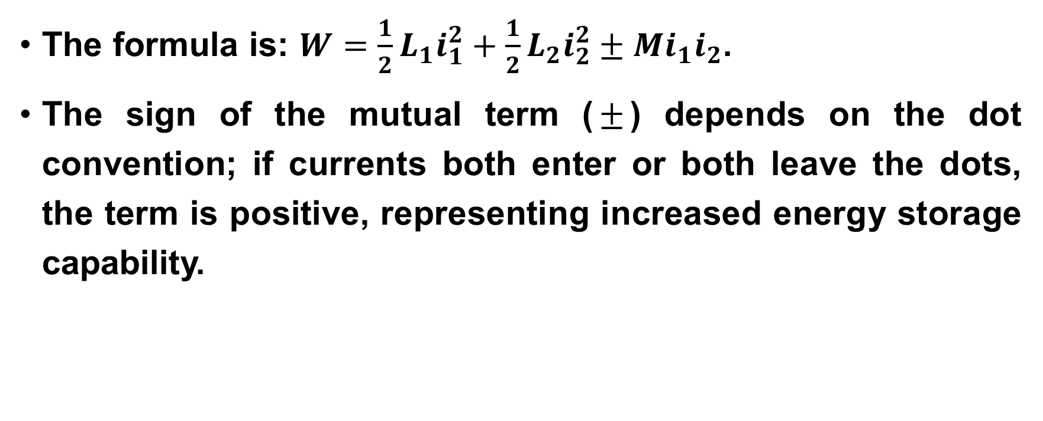
Systematic Analysis Methods
The Transition Process and First-Order Circuits
The formula is: $W=\frac{1}{2}L_{1}i_{1}^{2}+\frac{1}{2}L_{2}i_{2}^{2}±Mi_{1}i_{2}$.
The sign of the mutual term ($±$) depends on the dot convention; if currents both enter or both leave the dots, the term is positive, representing increased energy storage capability.

Slide 39
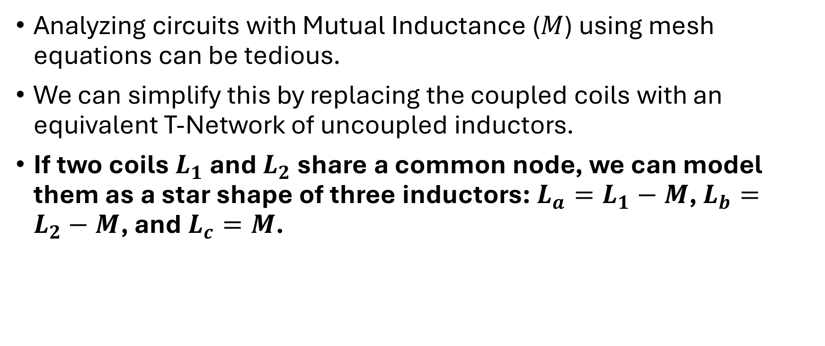
Systematic Analysis Methods
The Transition Process and First-Order Circuits
Analyzing circuits with Mutual Inductance ($M$) using mesh equations can be tedious.
We can simplify this by replacing the coupled coils with an equivalent T-Network of uncoupled inductors.
If two coils $L_{1}$ and $L_{2}$ share a common node, we can model them as a star shape of three inductors: $L_{a}=L_{1}−M$, $L_{b}=L_{2}−M$, and $L_{c}=M$.

Slide 40
Systematic Analysis Methods
The Transition Process and First-Order Circuits
We can replace a magnetically coupled pair of coils with an equivalent T-network of uncoupled inductors to simplify mesh analysis.
This transformation removes the magnetic link and allows us to treat the circuit as a standard inductive network, which is much easier to solve using Nodal or Mesh analysis.

Slide 41
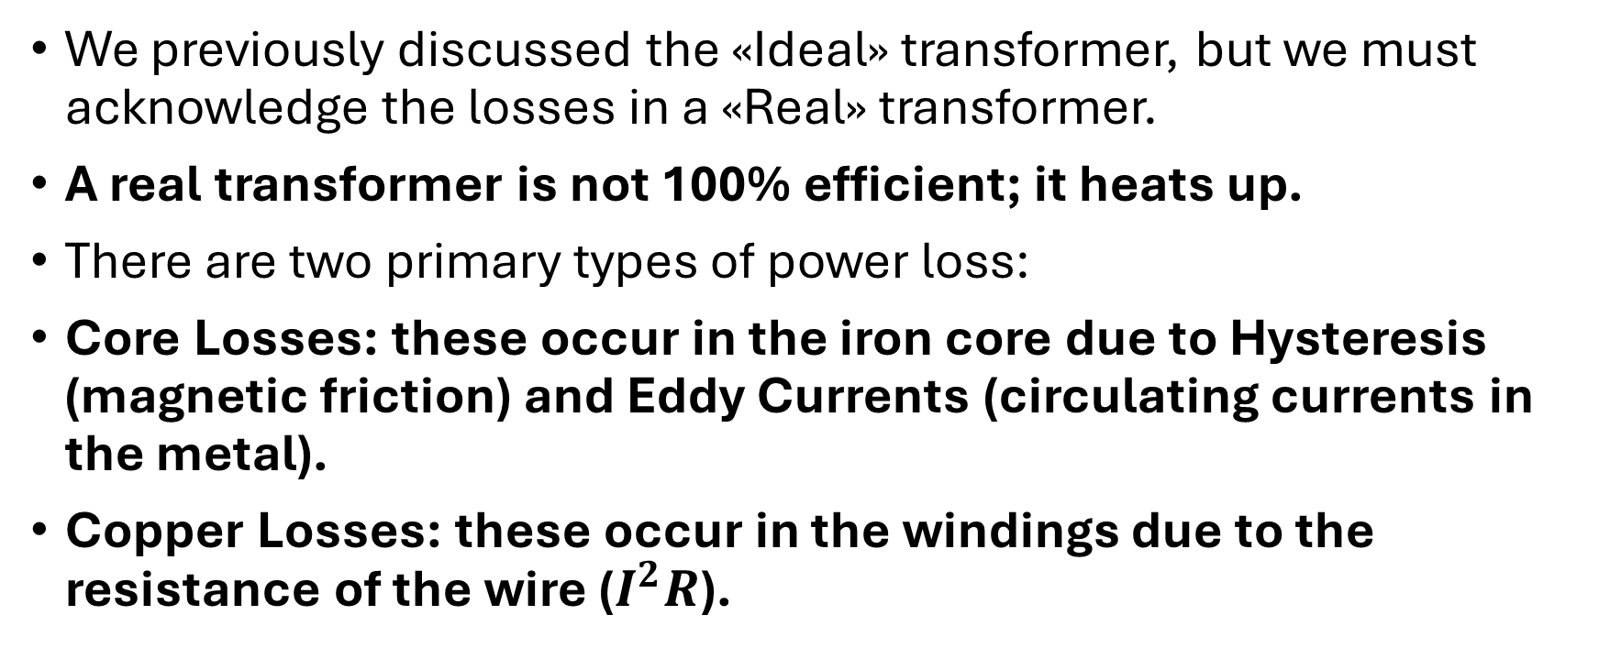
Systematic Analysis Methods
The Transition Process and First-Order Circuits
We previously discussed the «Ideal» transformer, but we must acknowledge the losses in a «Real» transformer.
A real transformer is not 100% efficient; it heats up.
There are two primary types of power loss:
Core Losses: these occur in the iron core due to Hysteresis (magnetic friction) and Eddy Currents (circulating currents in the metal).
Copper Losses: these occur in the windings due to the resistance of the wire ($I^{2}R$).

Slide 42
Systematic Analysis Methods
The Transition Process and First-Order Circuits
Real transformers experience core losses due to hysteresis and eddy currents, and copper losses due to the resistance of the windings.
We model these losses by adding a resistor in series (for copper loss) and a resistor in parallel (for core loss) to our transformer model.

Slide 43
Systematic Analysis Methods
The Transition Process and First-Order Circuits
Finally, there is a special type of transformer called the Autotransformer.
Unlike a standard transformer where the primary and secondary coils are electrically isolated, an autotransformer uses one continuous winding with a tap point.
Part of the winding is common to both the input and output sides.

Slide 44
Systematic Analysis Methods
The Transition Process and First-Order Circuits
An autotransformer uses a single continuous winding that is shared by both the primary and secondary sides.
This design uses less copper and is smaller than a standard transformer for the same power rating.
However, the disadvantage is the lack of electrical isolation; a failure in the winding can expose the low-voltage side to high voltage, which creates a safety hazard.

Slide 45
Systematic Analysis Methods
The Transition Process and First-Order Circuits
Thank you for your attention!
Do you have any questions?

