Slide 1
Lecture 14. Advanced Time-Domain Analysis
Part (6). Time-Domain Analysis of Dynamic Circuits

Slide 2
Systematic Analysis Methods
Advanced Time-Domain Analysis
Welcome to the fourteenth lecture of «The Principle of Circuit». In the previous lecture, we introduced the concept of the transition process.
We learned that energy in capacitors and inductors cannot change instantly, which leads to a temporary period of adjustment called the transient response.
We analyzed simple cases where a circuit either discharged its energy (Zero-Input) or charged up from zero (Zero-State).

Slide 3
Systematic Analysis Methods
Advanced Time-Domain Analysis
However, in real engineering practice, switching events are rarely that simple.
Often, a capacitor already has some voltage when we switch it to a new power source.
Or, a complex network of resistors must be simplified to understand the timing.
Today, we will master the «Complete Response» of first-order circuits.

Slide 4
Systematic Analysis Methods
Advanced Time-Domain Analysis
We will learn a powerful, universal tool called the «Three-Element Method», which allows us to write the solution equation immediately without solving differential equations from scratch every time.
We will also introduce two critical mathematical signals: the Step Function and the Impulse Function.
These signals are the building blocks for analyzing how circuits process information.

Slide 5
Systematic Analysis Methods
Advanced Time-Domain Analysis
Let us define what we mean by the Complete Response.
When a linear circuit is subjected to a change (like a switch closing), the total current or voltage response consists of two superimposed effects.
The Complete Response is the sum of the Zero-Input Response and the Zero-State Response. Complete Response = (Response due to initial energy) + (Response due to external source).

Slide 6
Systematic Analysis Methods
Advanced Time-Domain Analysis
Alternatively, mathematicians describe this solution as the sum of the «Homogeneous Solution» and the «Particular Solution». However, for engineers, it is often more intuitive to divide the response by time behavior:
Complete Response = Transient Response + Steady-State Response.
The Transient Response is the temporary part that decays to zero as time goes to infinity.
It exists because the circuit has «inertia» or «memory».

Slide 7
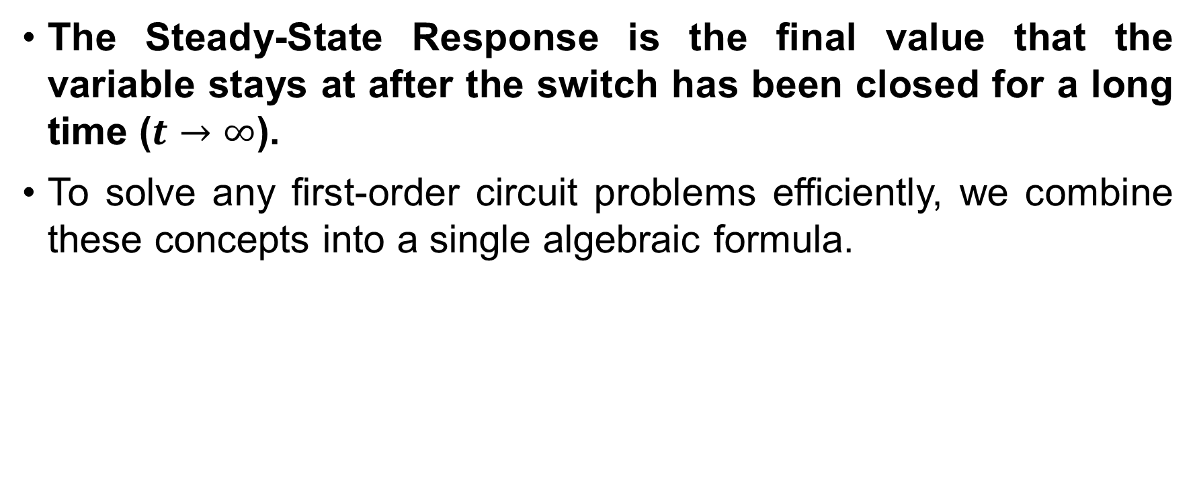
Systematic Analysis Methods
Advanced Time-Domain Analysis
The Steady-State Response is the final value that the variable stays at after the switch has been closed for a long time ($t→∞$).
To solve any first-order circuit problems efficiently, we combine these concepts into a single algebraic formula.

Slide 8
Systematic Analysis Methods
Advanced Time-Domain Analysis
We now introduce the most important practical tool for first-order circuit analysis: The Three-Element Method.
Since we know that the solution to a first-order differential equation always follows an exponential curve, we do not need to integrate derivatives every time.
We only need to find three specific numbers.

Slide 9
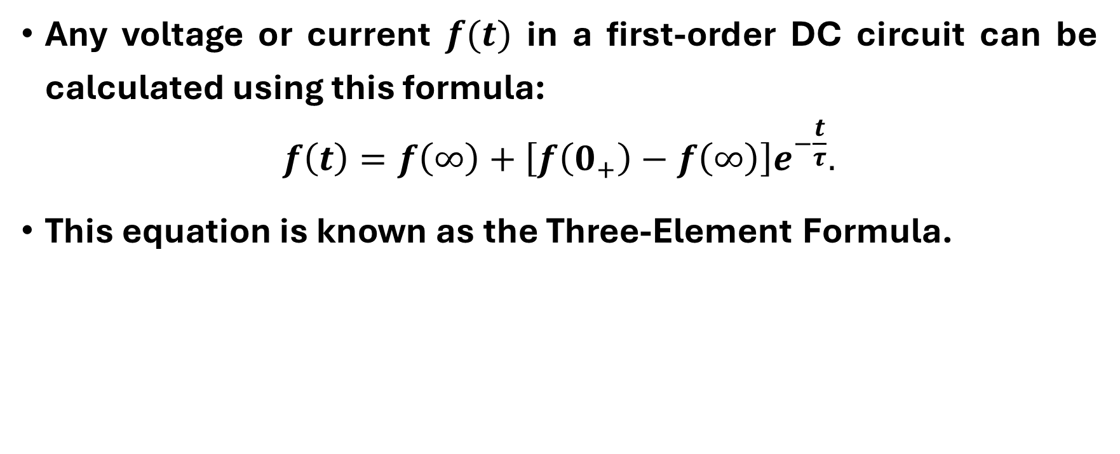
Systematic Analysis Methods
The Transition Process and First-Order Circuits
Any voltage or current $f(t)$ in a first-order DC circuit can be calculated using this formula:
$$f\left(t\right)=f\left(∞\right)+\left[f\left(0_{+}\right)−f\left(∞\right)\right]e^{−\frac{t}{τ}}.$$
This equation is known as the Three-Element Formula.

Slide 10
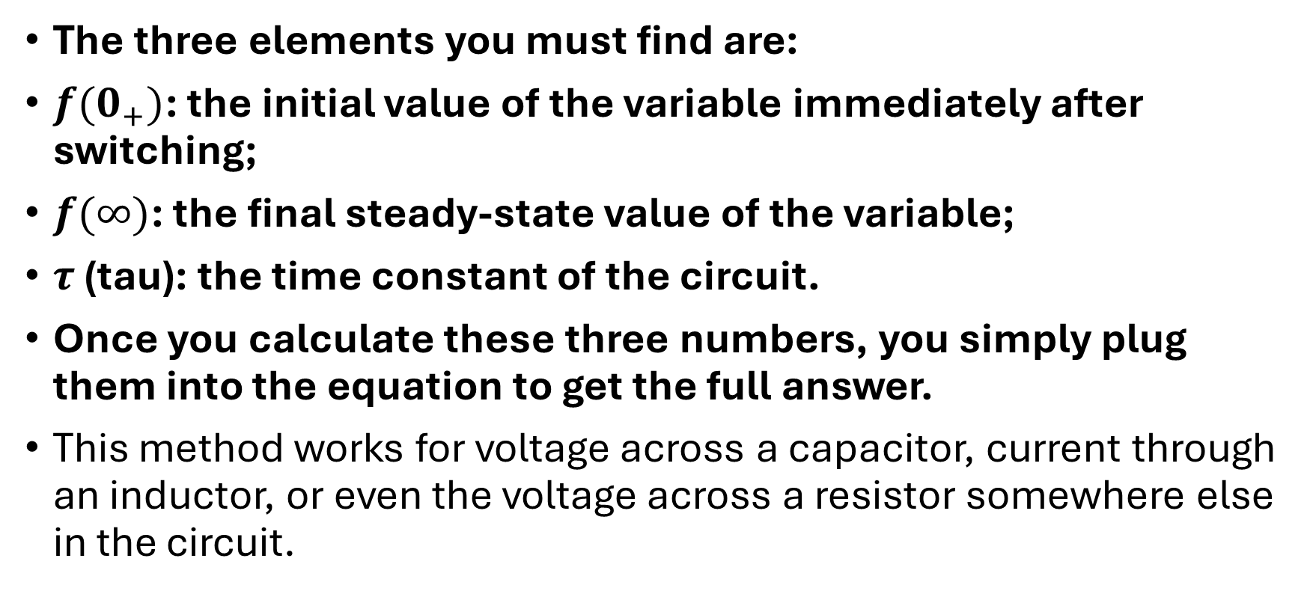
Systematic Analysis Methods
The Transition Process and First-Order Circuits
The three elements you must find are:
$f(0_{+})$: the initial value of the variable immediately after switching;
$f(∞)$: the final steady-state value of the variable;
$τ$ (tau): the time constant of the circuit.
Once you calculate these three numbers, you simply plug them into the equation to get the full answer.
This method works for voltage across a capacitor, current through an inductor, or even the voltage across a resistor somewhere else in the circuit.

Slide 11
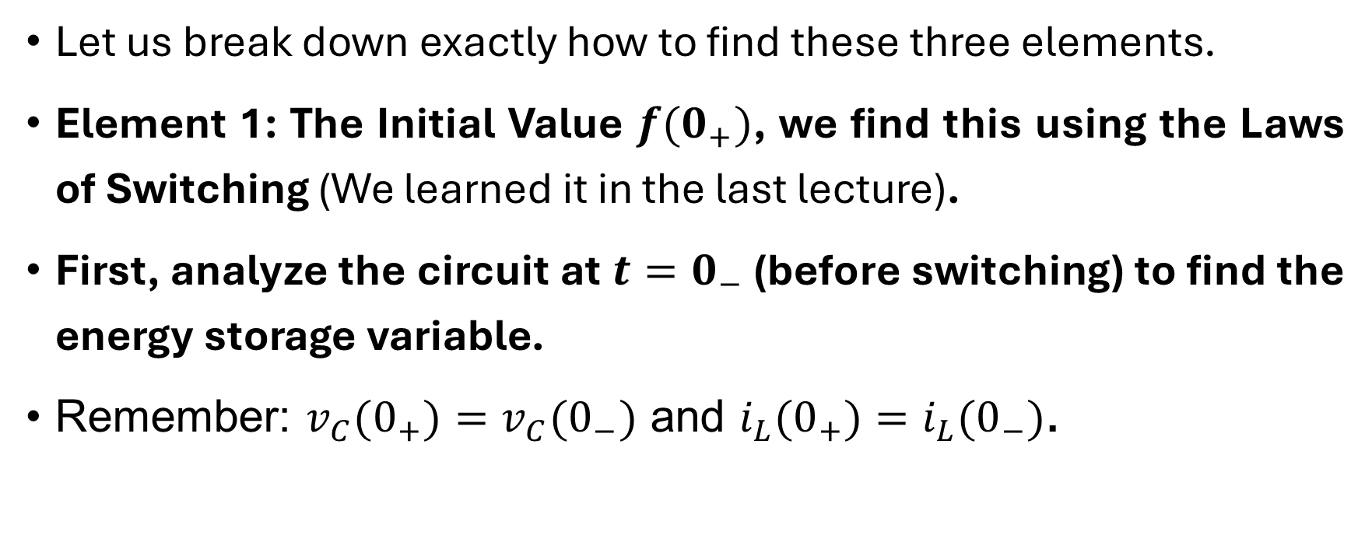
Systematic Analysis Methods
The Transition Process and First-Order Circuits
Let us break down exactly how to find these three elements.
Element 1: The Initial Value $f(0_{+})$, we find this using the Laws of Switching (We learned it in the last lecture).
First, analyze the circuit at $t=0_{−}$ (before switching) to find the energy storage variable.
Remember: $v_{C}(0_{+})=v_{C}(0_{−})$ and $i_{L}(0_{+})=i_{L}(0_{−})$.

Slide 12
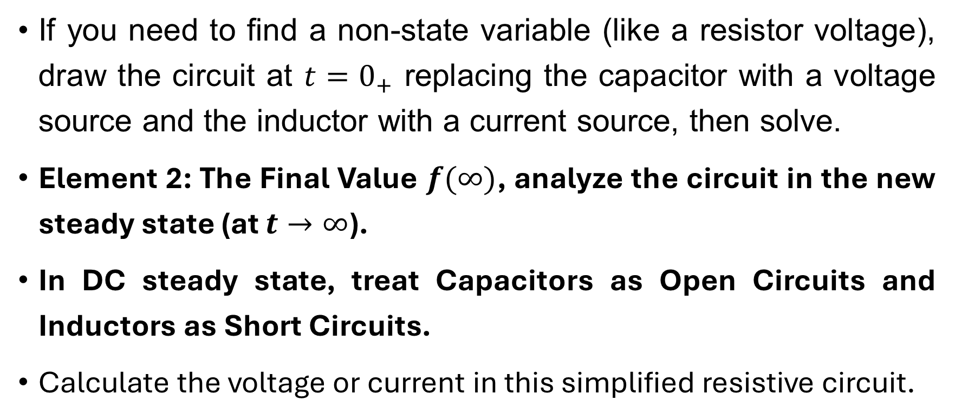
Systematic Analysis Methods
The Transition Process and First-Order Circuits
If you need to find a non-state variable (like a resistor voltage), draw the circuit at $t=0_{+}$ replacing the capacitor with a voltage source and the inductor with a current source, then solve.
Element 2: The Final Value $f(∞)$, analyze the circuit in the new steady state (at $t→∞$).
In DC steady state, treat Capacitors as Open Circuits and Inductors as Short Circuits.
Calculate the voltage or current in this simplified resistive circuit.

Slide 13
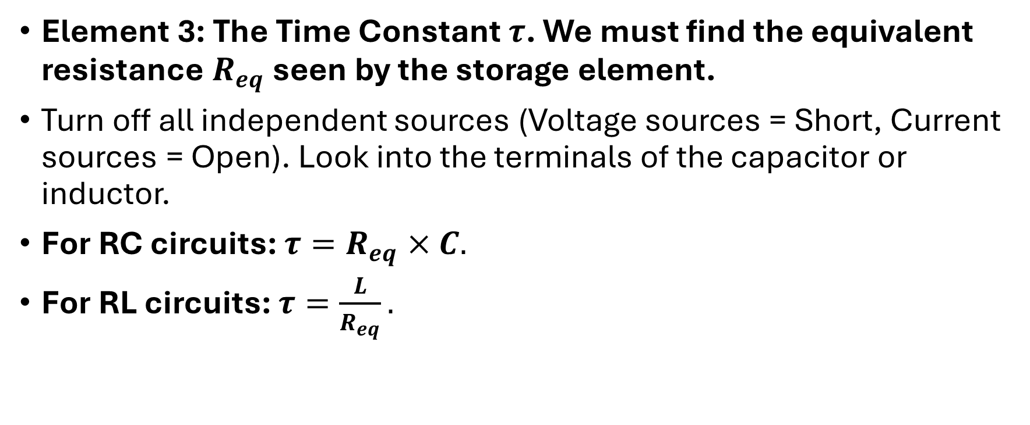
Systematic Analysis Methods
The Transition Process and First-Order Circuits
Element 3: The Time Constant $τ$. We must find the equivalent resistance $R_{eq}$ seen by the storage element.
Turn off all independent sources (Voltage sources = Short, Current sources = Open). Look into the terminals of the capacitor or inductor.
For RC circuits: $τ=R_{eq}×C.$
For RL circuits: $τ=\frac{L}{R_{eq}}.$

Slide 14
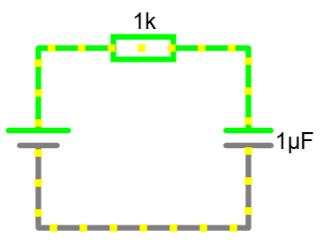
Systematic Analysis Methods
The Transition Process and First-Order Circuits
Let us apply the Three-Element Method to a practical example. Imagine a circuit like on the slide.

Slide 15
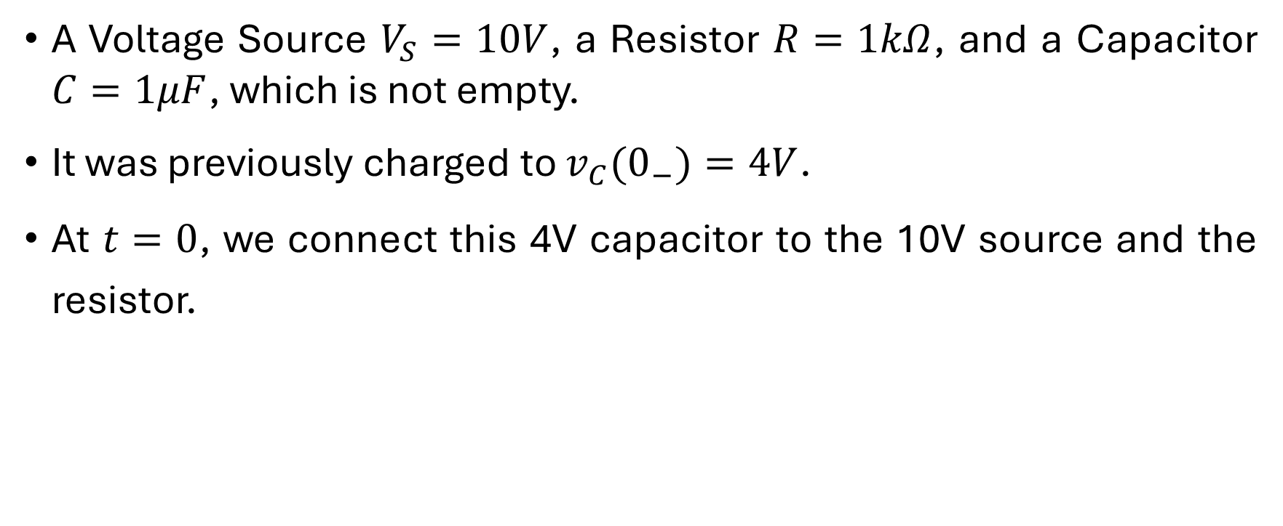
Systematic Analysis Methods
The Transition Process and First-Order Circuits
A Voltage Source $V_{S}=10V$, a Resistor $R=1kΩ$, and a Capacitor $C=1μF$, which is not empty.
It was previously charged to $v_{C}(0_{−})=4V$.
At $t=0$, we connect this 4V capacitor to the 10V source and the resistor.

Slide 16
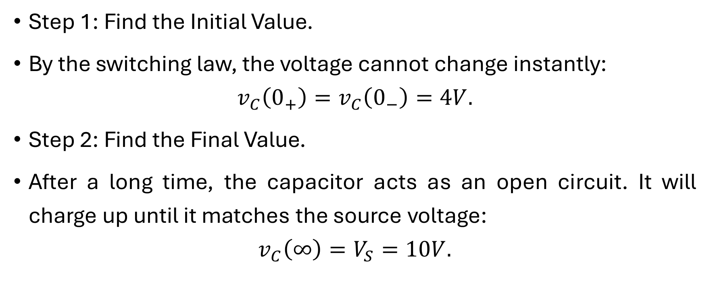
Systematic Analysis Methods
The Transition Process and First-Order Circuits
Step 1: Find the Initial Value.
By the switching law, the voltage cannot change instantly:
$$v_{C}\left(0_{+}\right)=v_{C}\left(0_{−}\right)=4V.$$
Step 2: Find the Final Value.
After a long time, the capacitor acts as an open circuit. It will charge up until it matches the source voltage:
$$v_{C}\left(∞\right)=V_{S}=10V.$$

Slide 17
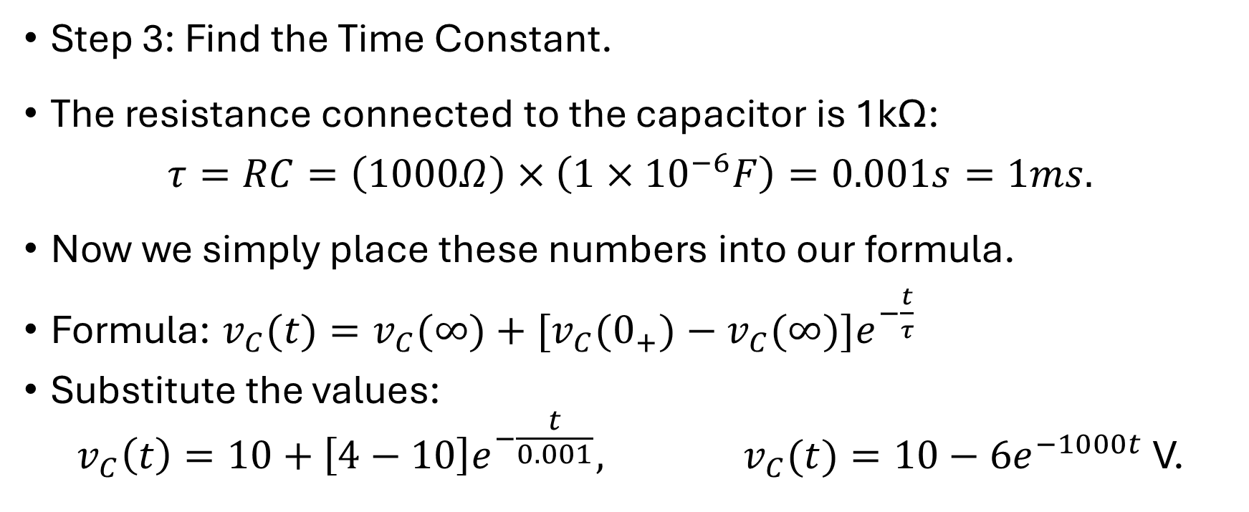
Systematic Analysis Methods
The Transition Process and First-Order Circuits
Step 3: Find the Time Constant.
The resistance connected to the capacitor is 1kΩ:
$$τ=RC=\left(1000Ω\right)×\left(1×{10}^{−6}F\right)=0.001s=1ms.$$
Now we simply place these numbers into our formula.
Formula: $v_{C}(t)=v_{C}(∞)+[v_{C}(0_{+})−v_{C}(∞)]e^{−\frac{t}{τ}}$
Substitute the values:
$$v_{C}\left(t\right)=10+\left[4−10\right]e^{−\frac{t}{0.001}}, v_{C}(t)=10−6e^{−1000t} \text{V}\text{.}$$

Slide 18
Systematic Analysis Methods
The Transition Process and First-Order Circuits
Let us analyze this result physically. The «10» represents the final destination (10 Volts). The «-6» represents the gap we need to bridge (we start at 4V, which is 6V below 10V). The exponential term makes that gap disappear over time.
Notice that if we had used the zero-state formula from the previous lecture, we would have assumed the start was 0V.
The Three-Element Method automatically handles the non-zero starting point.
This is the power of this technique: it is systematic and workfull.

Slide 19

Systematic Analysis Methods
The Transition Process and First-Order Circuits
Do you have any questions at the moment?

Slide 20
Systematic Analysis Methods
The Transition Process and First-Order Circuits
We now turn our attention to the types of input signals used to test dynamic circuits.
In engineering, we use standard «Singularity Functions» to model switching events.

Slide 21
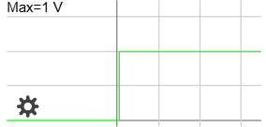
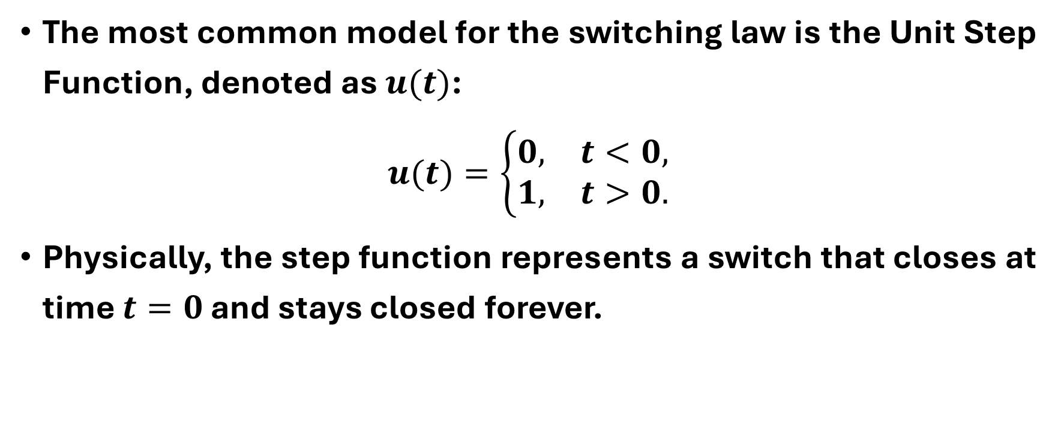
Systematic Analysis Methods
The Transition Process and First-Order Circuits
The most common model for the switching law is the Unit Step Function, denoted as $u(t)$:
$$u(t)=\left\{\begin{matrix}0, & t<0, \\ 1, & t>0.\end{matrix}\right.$$
Physically, the step function represents a switch that closes at time $t=0$ and stays closed forever.

Slide 22
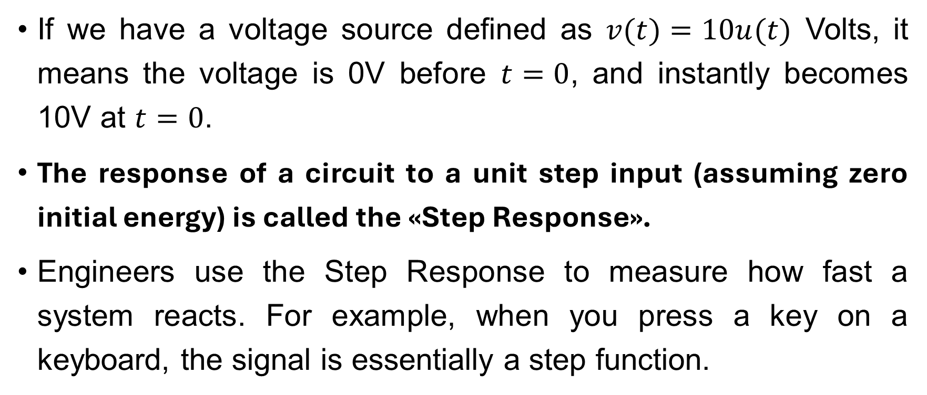
Systematic Analysis Methods
The Transition Process and First-Order Circuits
If we have a voltage source defined as $v(t)=10u(t)$ Volts, it means the voltage is 0V before $t=0$, and instantly becomes 10V at $t=0$.
The response of a circuit to a unit step input (assuming zero initial energy) is called the «Step Response».
Engineers use the Step Response to measure how fast a system reacts. For example, when you press a key on a keyboard, the signal is essentially a step function.

Slide 23

Systematic Analysis Methods
The Transition Process and First-Order Circuits
Let us formally state the Step Response of an RC circuit.
If we apply a current source step $I_{S}$to a parallel RC circuit, or a voltage source step $V_{S}$ to a series RC circuit. Using our Three-Element Method (with zero initial energy):
$$v_{C}\left(0_{+}\right)=0, v_{C}\left(∞\right)=V_{S}, τ=RC.$$

Slide 24
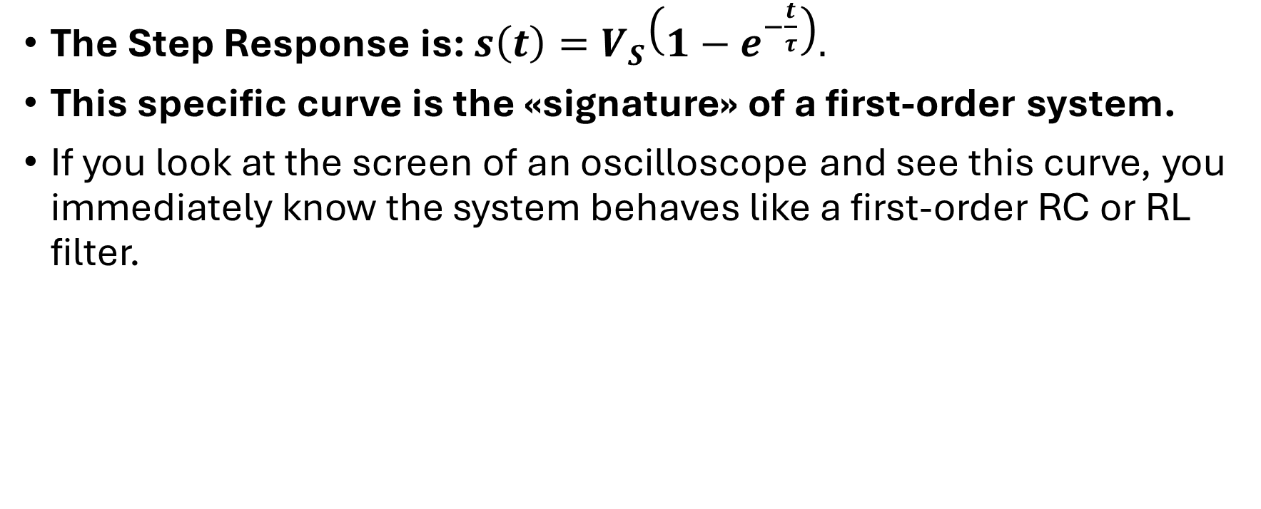
Systematic Analysis Methods
The Transition Process and First-Order Circuits
The Step Response is: $s\left(t\right)=V_{S}\left(1−e^{−\frac{t}{τ}}\right).$
This specific curve is the «signature» of a first-order system.
If you look at the screen of an oscilloscope and see this curve, you immediately know the system behaves like a first-order RC or RL filter.

Slide 25
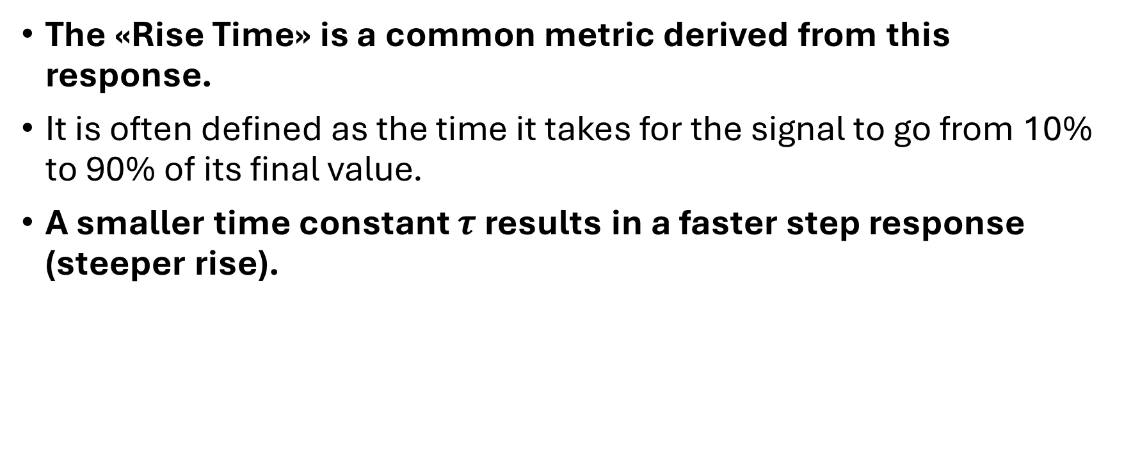
Systematic Analysis Methods
The Transition Process and First-Order Circuits
The «Rise Time» is a common metric derived from this response.
It is often defined as the time it takes for the signal to go from 10% to 90% of its final value.
A smaller time constant $τ$ results in a faster step response (steeper rise).

Slide 26
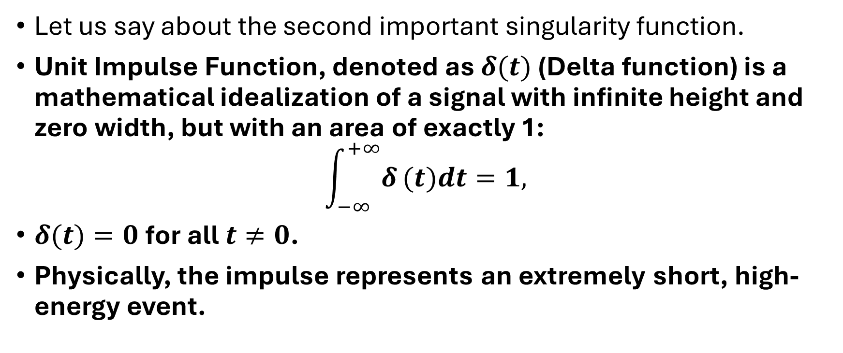
Systematic Analysis Methods
The Transition Process and First-Order Circuits
Let us say about the second important singularity function.
Unit Impulse Function, denoted as $δ(t)$ (Delta function) is a mathematical idealization of a signal with infinite height and zero width, but with an area of exactly 1:
$$\int_{−∞}^{+∞}{δ}(t)dt=1,$$
$δ(t)=0$ for all $t≠0$.
Physically, the impulse represents an extremely short, high-energy event.

Slide 27
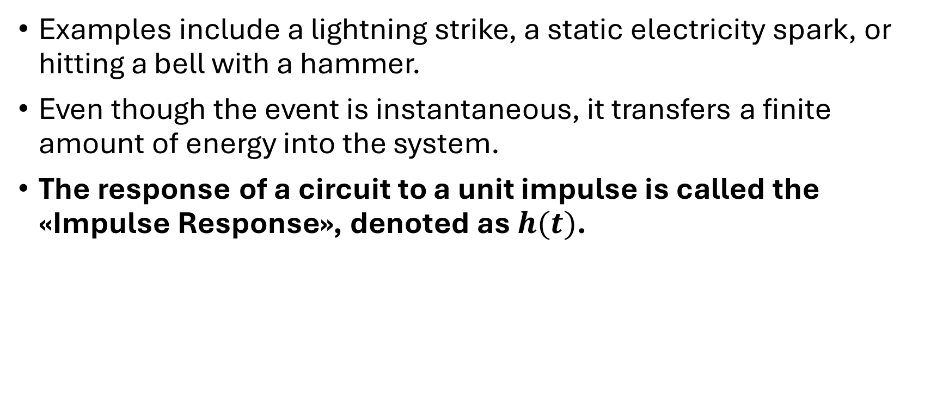
Systematic Analysis Methods
The Transition Process and First-Order Circuits
Examples include a lightning strike, a static electricity spark, or hitting a bell with a hammer.
Even though the event is instantaneous, it transfers a finite amount of energy into the system.
The response of a circuit to a unit impulse is called the «Impulse Response», denoted as $h(t)$.

Slide 28
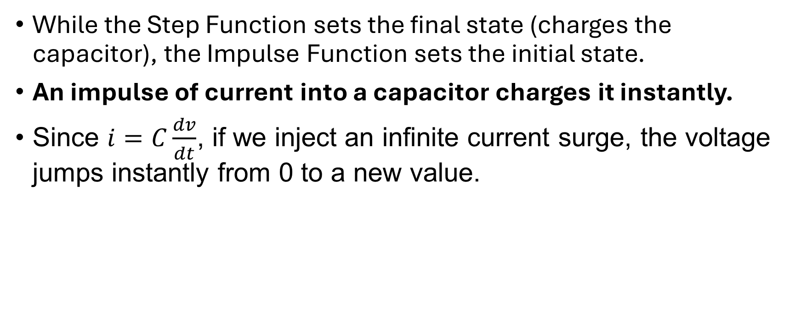
Systematic Analysis Methods
The Transition Process and First-Order Circuits
While the Step Function sets the final state (charges the capacitor), the Impulse Function sets the initial state.
An impulse of current into a capacitor charges it instantly.
Since $i=C\frac{dv}{dt}$, if we inject an infinite current surge, the voltage jumps instantly from 0 to a new value.

Slide 29
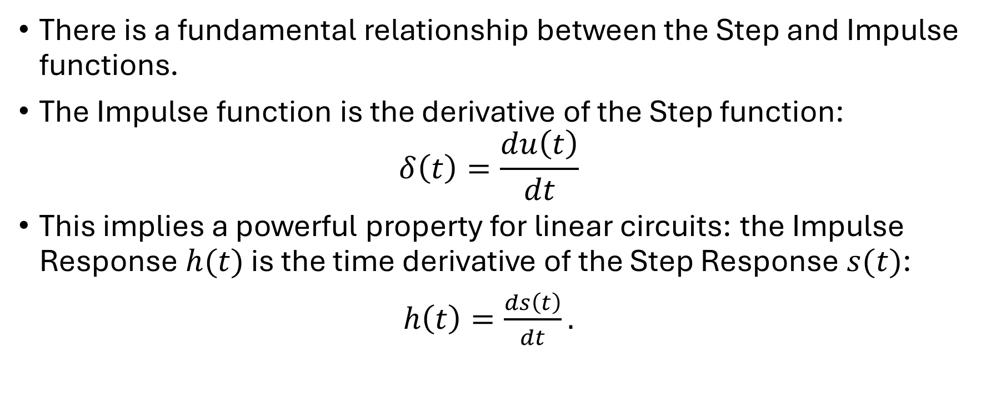
Systematic Analysis Methods
The Transition Process and First-Order Circuits
There is a fundamental relationship between the Step and Impulse functions.
The Impulse function is the derivative of the Step function:
$$δ\left(t\right)=\frac{du\left(t\right)}{dt}$$
This implies a powerful property for linear circuits: the Impulse Response $h(t)$ is the time derivative of the Step Response $s(t)$:
$h\left(t\right)=\frac{ds\left(t\right)}{dt}.$

Slide 30
Systematic Analysis Methods
The Transition Process and First-Order Circuits
This gives us a second way to solve circuits.
If we know the Step Response (which is easy to find using the Three-Element Method), we can simply differentiate it to find the Impulse Response.

Slide 31
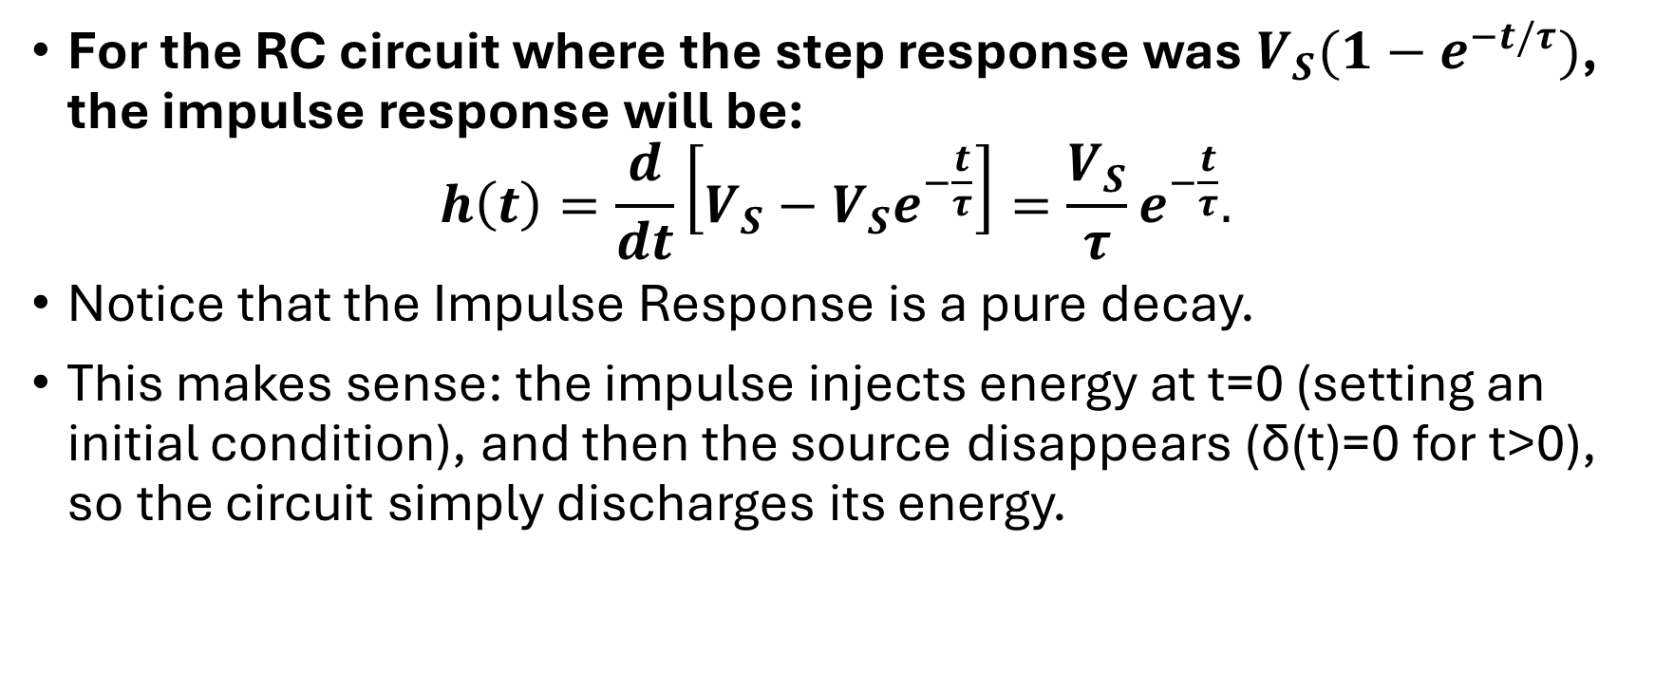
Systematic Analysis Methods
The Transition Process and First-Order Circuits
For the RC circuit where the step response was $V_{S}(1−e^{−t/τ})$, the impulse response will be:
$$h\left(t\right)=\frac{d}{dt}\left[V_{S}−V_{S}e^{−\frac{t}{τ}}\right]=\frac{V_{S}}{τ}e^{−\frac{t}{τ}}.$$
Notice that the Impulse Response is a pure decay.
This makes sense: the impulse injects energy at t=0 (setting an initial condition), and then the source disappears (δ(t)=0 for t>0), so the circuit simply discharges its energy.

Slide 32
Systematic Analysis Methods
The Transition Process and First-Order Circuits
Why do we study Step and Impulse responses?
Real-world signals are complex.
They are not simple DC values, but here’s a thing.
Any complex signal can be mathematically broken down into a series of steps or a series of impulses.
If we know how a circuit responds to an impulse (the Impulse Response), we can predict how it will respond to any input signal using a mathematical operation called Convolution.

Slide 33
Systematic Analysis Methods
The Transition Process and First-Order Circuits
While Convolution is a topic for the «Signals and Systems» course, understanding the physical basis in circuits is essential.
When you test a microphone or a speaker with a sharp «click» sound, you are testing its Impulse Response.
When you test a power supply by suddenly turning on a load, you are testing its Step Response.
These are the standard «stress tests» for dynamic systems.

Slide 34
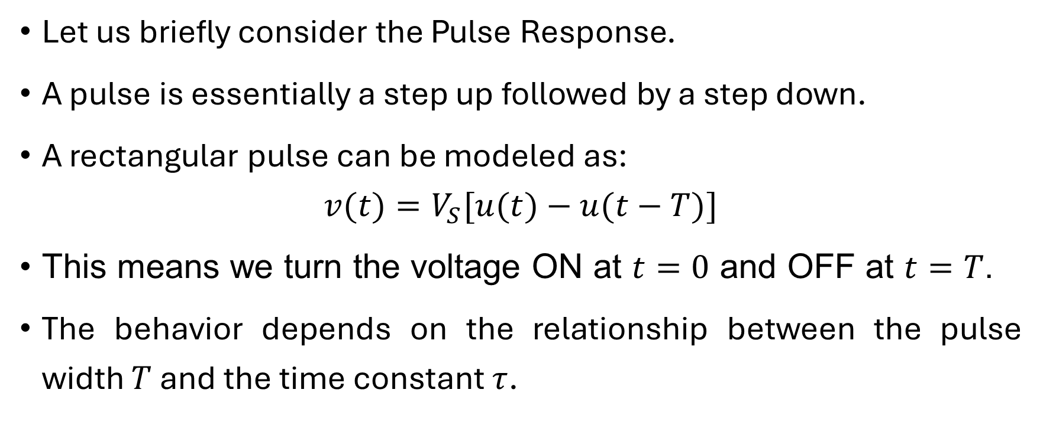
Systematic Analysis Methods
The Transition Process and First-Order Circuits
Let us briefly consider the Pulse Response.
A pulse is essentially a step up followed by a step down.
A rectangular pulse can be modeled as:
$$v(t)=V_{S}[u(t)−u(t−T)]$$
This means we turn the voltage ON at $t=0$ and OFF at $t=T$.
The behavior depends on the relationship between the pulse width $T$ and the time constant $τ$.

Slide 35
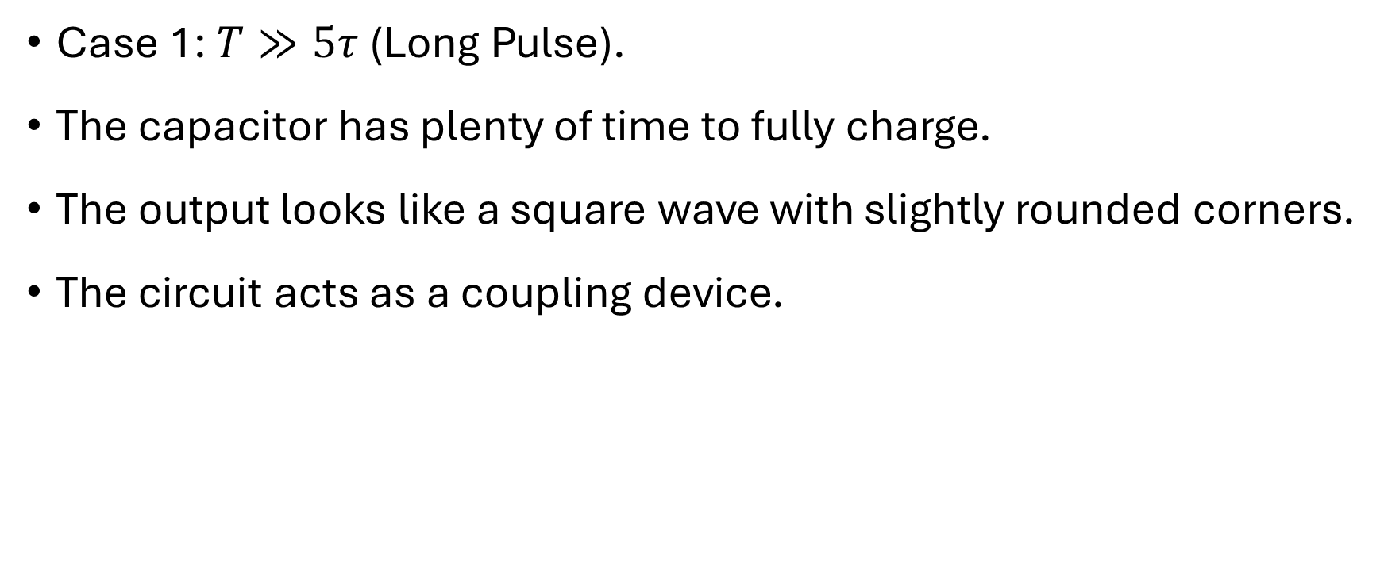
Systematic Analysis Methods
The Transition Process and First-Order Circuits
Case 1: $T≫5τ$ (Long Pulse).
The capacitor has plenty of time to fully charge.
The output looks like a square wave with slightly rounded corners.
The circuit acts as a coupling device.

Slide 36
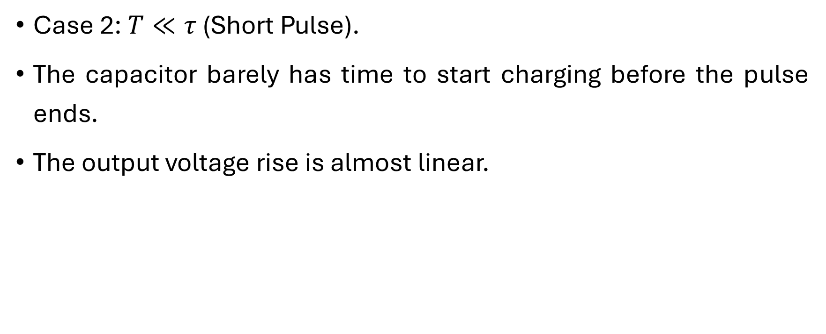
Systematic Analysis Methods
The Transition Process and First-Order Circuits
Case 2: $T≪τ$ (Short Pulse).
The capacitor barely has time to start charging before the pulse ends.
The output voltage rise is almost linear.

Slide 37
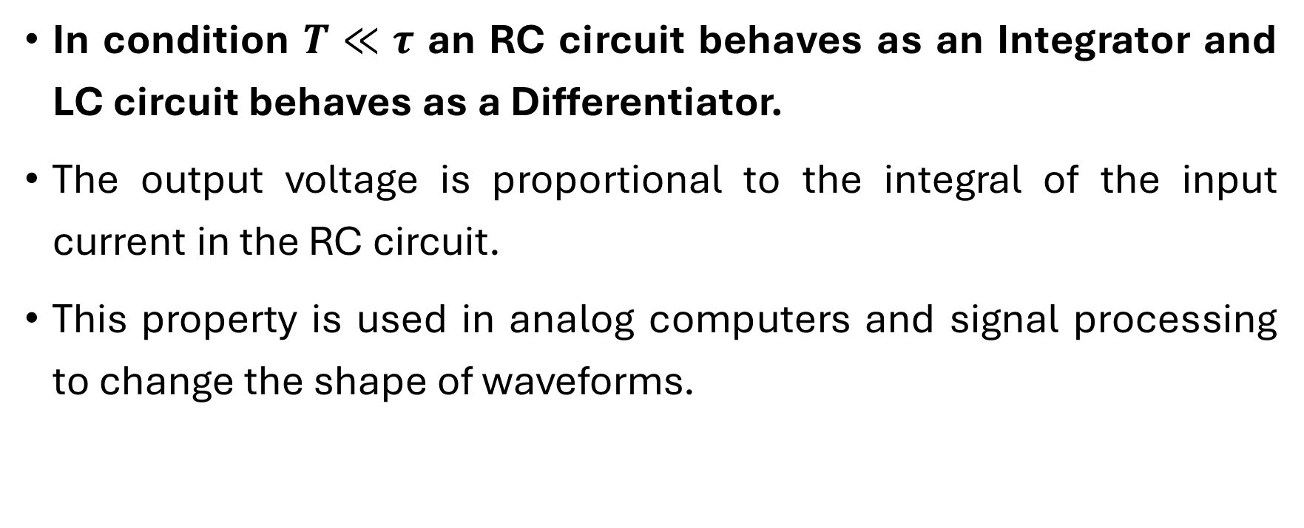
Systematic Analysis Methods
The Transition Process and First-Order Circuits
In condition $T≪τ$ an RC circuit behaves as an Integrator and LC circuit behaves as a Differentiator.
The output voltage is proportional to the integral of the input current in the RC circuit.
This property is used in analog computers and signal processing to change the shape of waveforms.

Slide 38
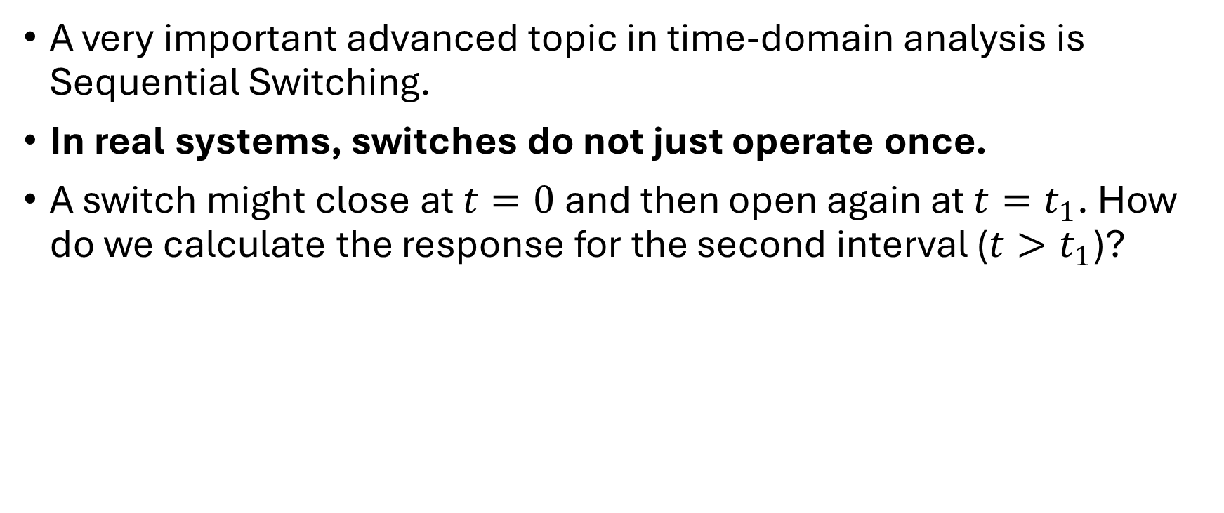
Systematic Analysis Methods
The Transition Process and First-Order Circuits
A very important advanced topic in time-domain analysis is Sequential Switching.
In real systems, switches do not just operate once.
A switch might close at $t=0$ and then open again at $t=t_{1}$. How do we calculate the response for the second interval ($t>t_{1}$)?

Slide 39
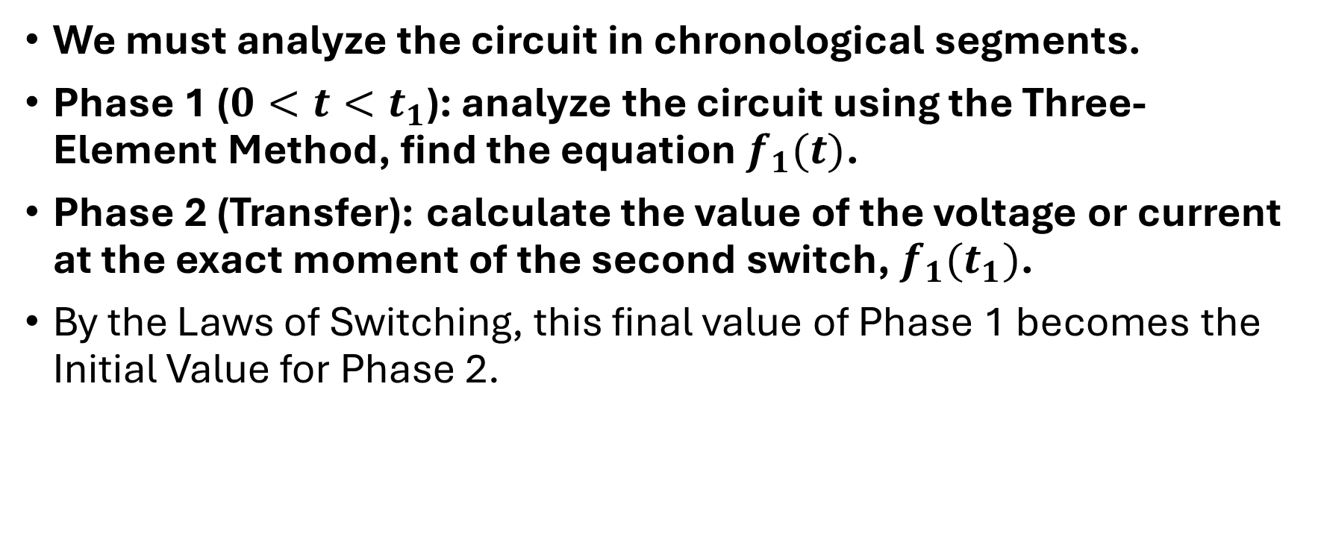
Systematic Analysis Methods
The Transition Process and First-Order Circuits
We must analyze the circuit in chronological segments.
Phase 1 ($0<t<t_{1}$): analyze the circuit using the Three-Element Method, find the equation $f_{1}(t)$.
Phase 2 (Transfer): calculate the value of the voltage or current at the exact moment of the second switch, $f_{1}(t_{1})$.
By the Laws of Switching, this final value of Phase 1 becomes the Initial Value for Phase 2.

Slide 40
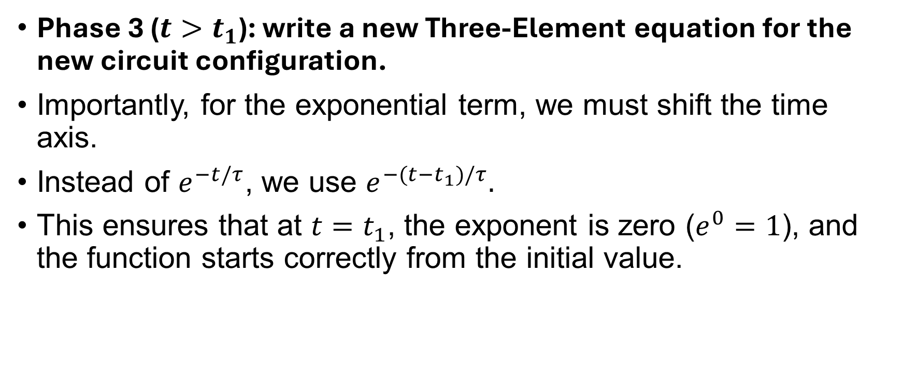
Systematic Analysis Methods
The Transition Process and First-Order Circuits
Phase 3 ($t>t_{1}$): write a new Three-Element equation for the new circuit configuration.
Importantly, for the exponential term, we must shift the time axis.
Instead of $e^{−t/τ}$, we use $e^{−(t−t_{1})/τ}.$
This ensures that at $t=t_{1}$, the exponent is zero ($e^{0}=1$), and the function starts correctly from the initial value.

Slide 41
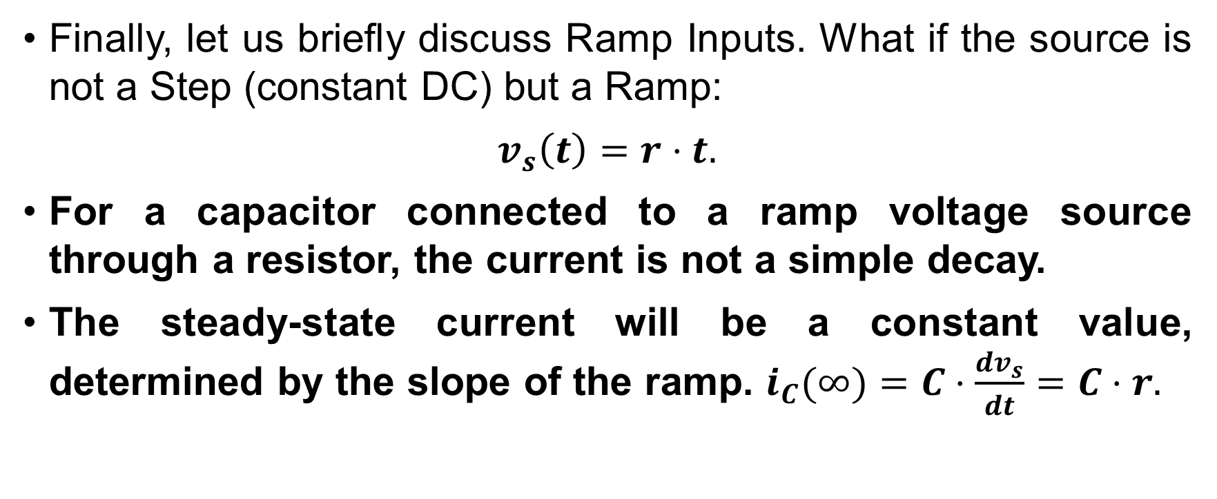
Systematic Analysis Methods
The Transition Process and First-Order Circuits
Finally, let us briefly discuss Ramp Inputs. What if the source is not a Step (constant DC) but a Ramp:
$v_{s}\left(t\right)=r⋅t.$
For a capacitor connected to a ramp voltage source through a resistor, the current is not a simple decay.
The steady-state current will be a constant value, determined by the slope of the ramp. $i_{C}(∞)=C⋅\frac{dv_{s}}{dt}=C⋅r.$

Slide 42
Systematic Analysis Methods
The Transition Process and First-Order Circuits
The complete response will be the sum of this constant steady-state current and a transient exponential decay that depends on the initial conditions.
This demonstrates that the «Steady State» is not always a constant number; it follows the shape of the input forcing function.
If the input is a ramp, the steady state output of the capacitor voltage is also a ramp, lagging behind the input.

Slide 43
Systematic Analysis Methods
The Transition Process and First-Order Circuits
We must distinguish the physical origins of the two parts of the Complete Response.
The Transient Response arises from the redistribution of internal energy stored in the field of the capacitor or inductor.
Because real circuits always have resistance, this internal energy is eventually dissipated as heat.

Slide 44
Systematic Analysis Methods
The Transition Process and First-Order Circuits
The transient response is generated by the release of internal stored energy and must eventually decay to zero in any stable circuit.
The Steady-State Response, on the other hand, is driven by the continuous supply of energy from the independent sources.
The steady-state response is sustained by the external power sources and persists as long as the switch remains closed.

Slide 45
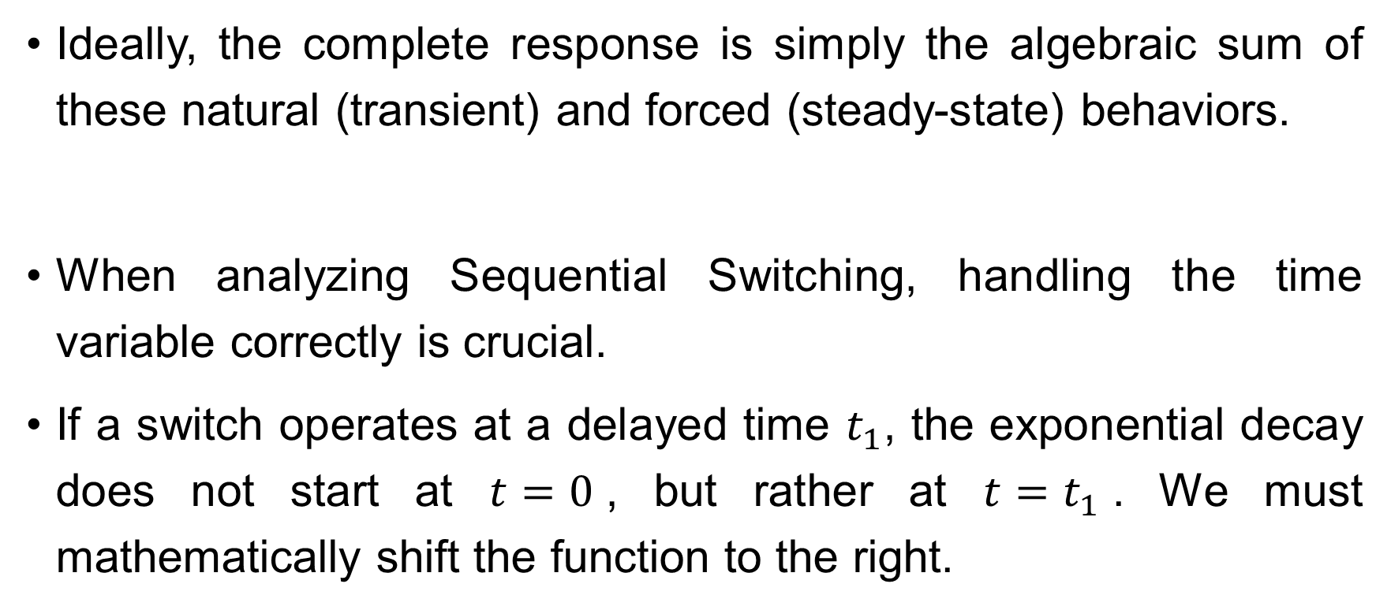
Systematic Analysis Methods
The Transition Process and First-Order Circuits
Ideally, the complete response is simply the algebraic sum of these natural (transient) and forced (steady-state) behaviors.
When analyzing Sequential Switching, handling the time variable correctly is crucial.
If a switch operates at a delayed time $t_{1}$, the exponential decay does not start at $t=0$, but rather at $t=t_{1}$. We must mathematically shift the function to the right.

Slide 46
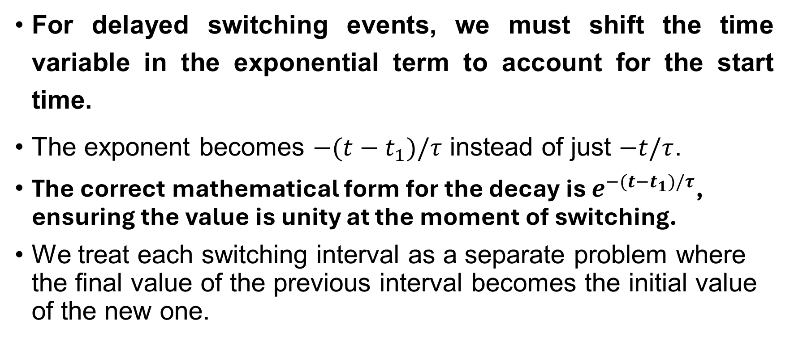
Systematic Analysis Methods
The Transition Process and First-Order Circuits
For delayed switching events, we must shift the time variable in the exponential term to account for the start time.
The exponent becomes $−(t−t_{1})/τ$ instead of just $−t/τ$.
The correct mathematical form for the decay is $e^{−(t−t_{1})/τ}$, ensuring the value is unity at the moment of switching.
We treat each switching interval as a separate problem where the final value of the previous interval becomes the initial value of the new one.

Slide 47
Systematic Analysis Methods
The Transition Process and First-Order Circuits
Thank you for your attention!
Do you have any questions?

