Slide 1
Lecture 15. The Laplace Transform and Operational Calculus
Part (7). Complex Frequency Domain Analysis of Dynamic Circuits

Slide 2
Systematic Analysis Methods
The Laplace Transform and Operational Calculus
Welcome to the fifteenth lecture of «The Principle of Circuit».
In our previous lectures on dynamic circuits, we worked exclusively in the time domain.
We solved differential equations directly or used the «Three-Element Method» for simple first-order circuits.
However, what happens when we face a second-order circuit (with both an inductor and a capacitor) or a complex network with multiple loops and nodes?

Slide 3
Systematic Analysis Methods
The Laplace Transform and Operational Calculus
Solving high-order differential equations becomes extremely difficult and prone to algebraic errors.
Today, we introduce a powerful mathematical tool that simplifies these problems: The Laplace Transform.

Slide 4
Systematic Analysis Methods
The Laplace Transform and Operational Calculus
This lecture marks the transition from time-domain analysis to the «S-Domain» or «Complex Frequency Domain».
Just as logarithms allow us to turn multiplication into addition, the Laplace Transform allows us to turn calculus (differentiation and integration) into simple algebra (multiplication and division).

Slide 5
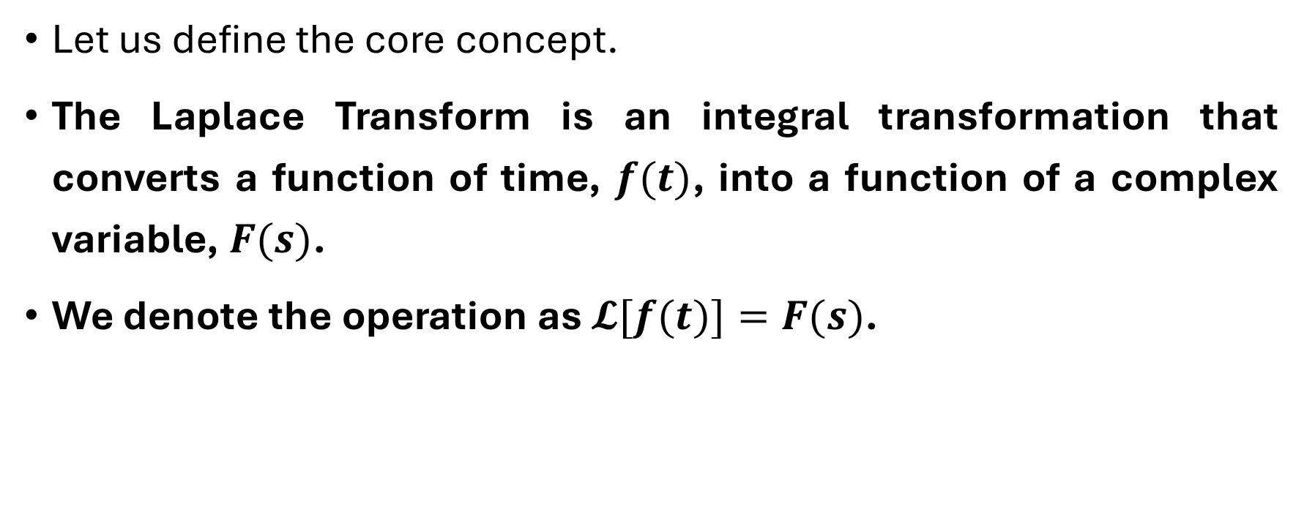
Systematic Analysis Methods
The Laplace Transform and Operational Calculus
Let us define the core concept.
The Laplace Transform is an integral transformation that converts a function of time, $f(t)$, into a function of a complex variable, $F(s)$.
We denote the operation as $𝓛[f(t)]=F(s)$.

Slide 6
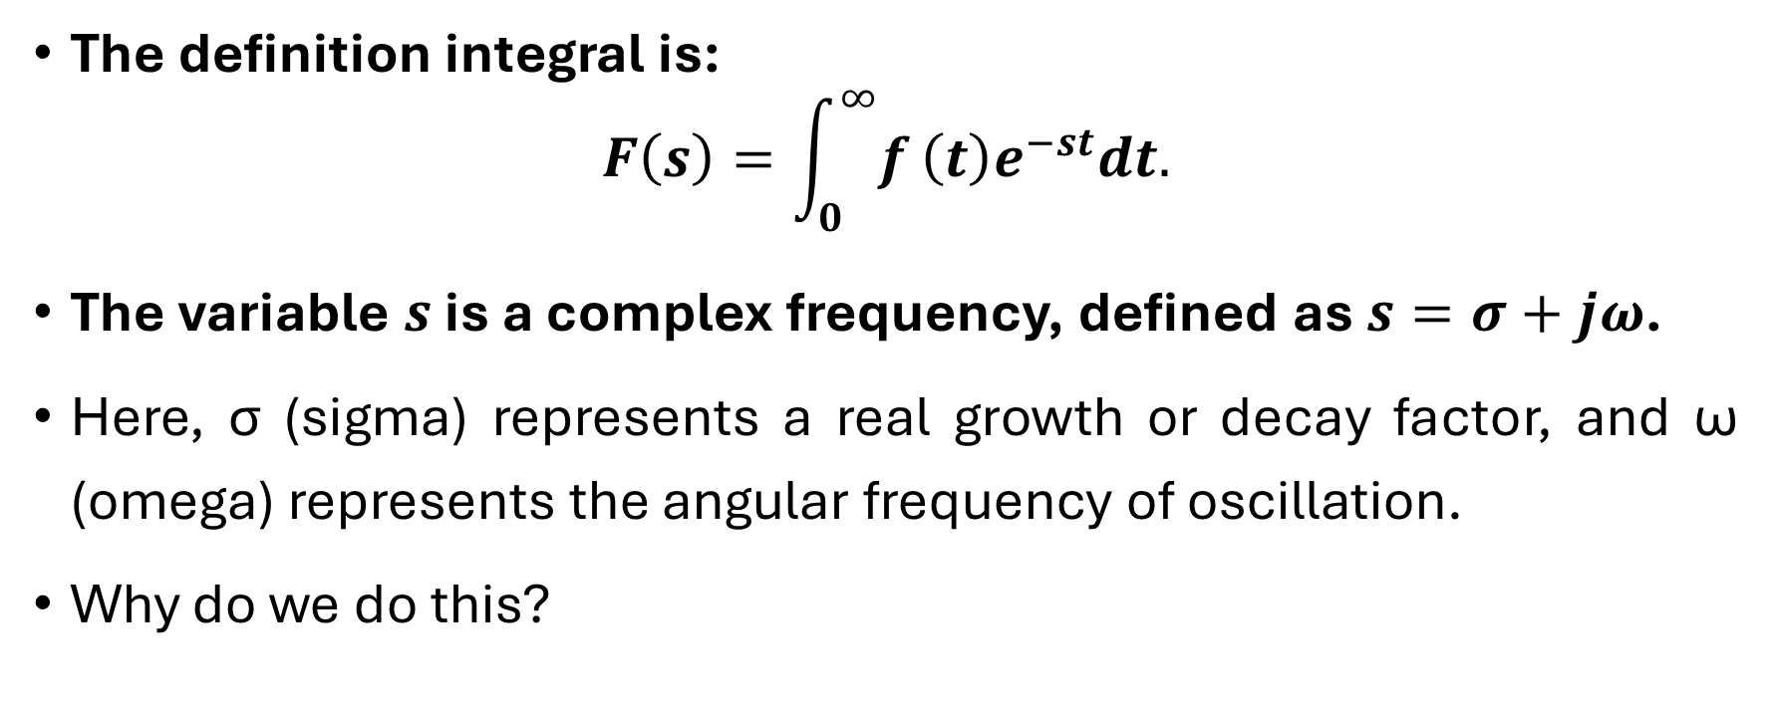
Systematic Analysis Methods
The Laplace Transform and Operational Calculus
The definition integral is:
$$F\left(s\right)=\int_{0}^{∞}{f}\left(t\right)e^{−st}dt.$$
The variable $s$ is a complex frequency, defined as $s=σ+jω$.
Here, σ (sigma) represents a real growth or decay factor, and ω (omega) represents the angular frequency of oscillation.
Why do we do this?

Slide 7
Systematic Analysis Methods
The Laplace Transform and Operational Calculus
In the time domain, circuits are described by differential equations.
In the s-domain, these same circuits are described by algebraic polynomial equations.
Solving a polynomial is much easier than solving a differential equation.
Once we solve the algebra in the s-domain, we use the Inverse Laplace Transform to convert the answer back to the time domain.

Slide 8
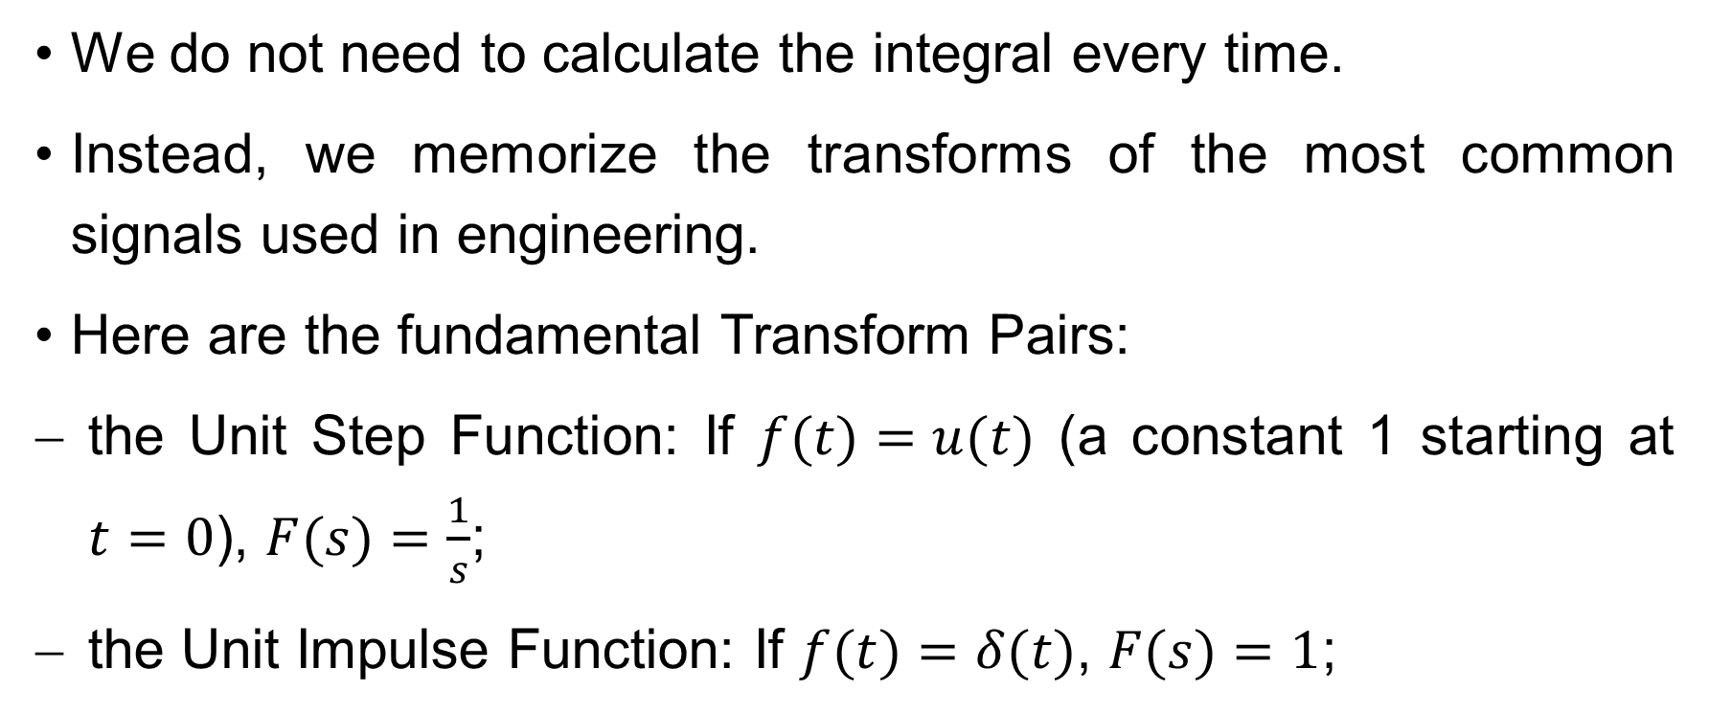
Systematic Analysis Methods
The Laplace Transform and Operational Calculus
We do not need to calculate the integral every time.
Instead, we memorize the transforms of the most common signals used in engineering.
Here are the fundamental Transform Pairs:
the Unit Step Function: If $f(t)=u(t)$ (a constant 1 starting at $t=0$), $F(s)=\frac{1}{s}$;
the Unit Impulse Function: If $f(t)=δ(t)$, $F(s)=1$;

Slide 9

Systematic Analysis Methods
The Laplace Transform and Operational Calculus
the Exponential Function: If $f(t)=e^{−at}u(t)$, $F(s)=\frac{1}{s+a}$; (this is the most common form in circuit analysis);
the Ramp Function: If $f(t)=tu(t)$, $F(s)=\frac{1}{s^{2}}$.

Slide 10
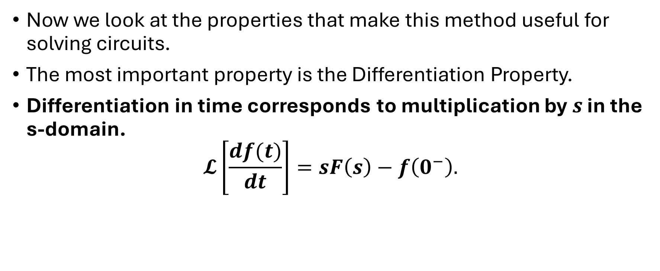
Systematic Analysis Methods
The Laplace Transform and Operational Calculus
Now we look at the properties that make this method useful for solving circuits.
The most important property is the Differentiation Property.
Differentiation in time corresponds to multiplication by $s$ in the s-domain.
$$𝓛\left[\frac{df(t)}{dt}\right]=sF\left(s\right)−f\left(0^{−}\right).$$

Slide 11
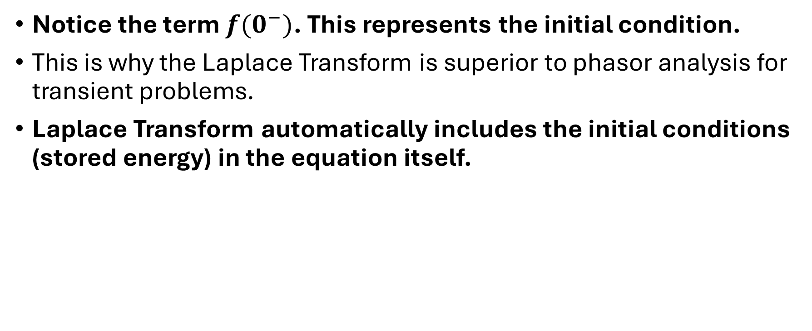
Systematic Analysis Methods
The Laplace Transform and Operational Calculus
Notice the term $f(0^{−})$. This represents the initial condition.
This is why the Laplace Transform is superior to phasor analysis for transient problems.
Laplace Transform automatically includes the initial conditions (stored energy) in the equation itself.

Slide 12
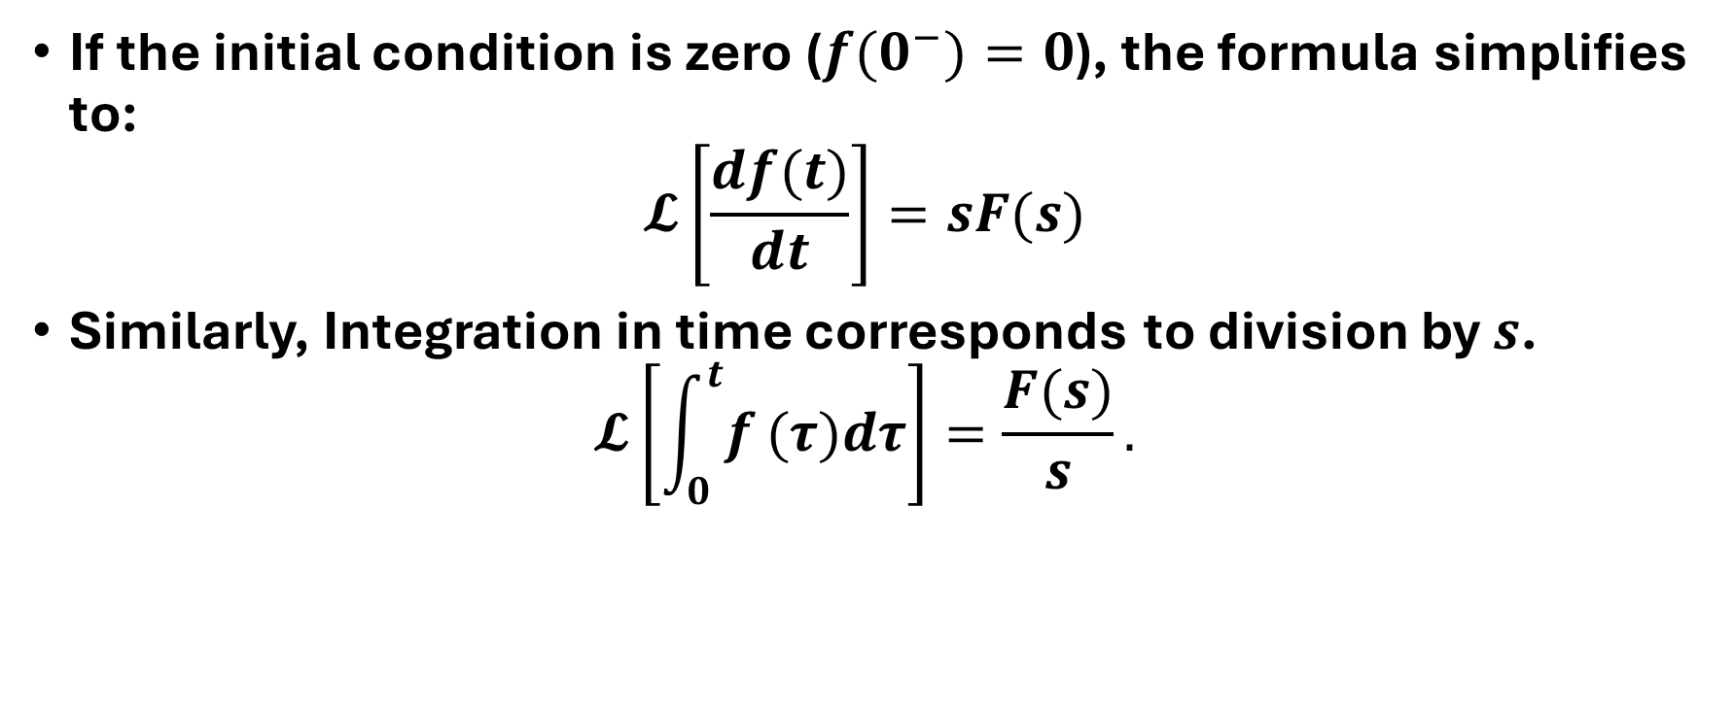
Systematic Analysis Methods
The Laplace Transform and Operational Calculus
If the initial condition is zero ($f(0^{−})=0$), the formula simplifies to:
$$𝓛\left[\frac{df(t)}{dt}\right]=sF(s)$$
Similarly, Integration in time corresponds to division by $s$.
$$𝓛\left[\int_{0}^{t}{f}(τ)dτ\right]=\frac{F(s)}{s}.$$

Slide 13
Systematic Analysis Methods
The Laplace Transform and Operational Calculus
We can now apply these properties to our circuit elements: Resistors, Inductors, and Capacitors.
We will create «S-Domain Models» for each component.

Slide 14

Systematic Analysis Methods
The Laplace Transform and Operational Calculus
1. The Resistor in the S-Domain. Ohm's Law in time is $v(t)=Ri(t).$Since R is a constant, the transform is simply:
$$V\left(s\right)=RI\left(s\right).$$
The resistance $R$ remains unchanged in the s-domain.

Slide 15
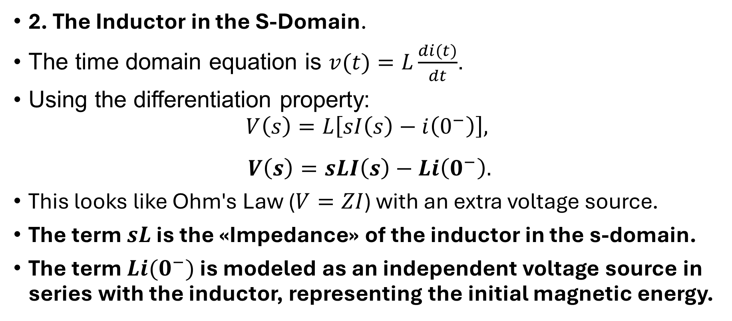
Systematic Analysis Methods
The Laplace Transform and Operational Calculus
2. The Inductor in the S-Domain.
The time domain equation is $v(t)=L\frac{di(t)}{dt}$.
Using the differentiation property:
$$V\left(s\right)=L\left[sI\left(s\right)−i\left(0^{−}\right)\right],$$
$$V\left(s\right)=sLI\left(s\right)−Li\left(0^{−}\right).$$
This looks like Ohm's Law ($V=ZI$) with an extra voltage source.
The term $sL$ is the «Impedance» of the inductor in the s-domain.
The term $Li(0^{−})$ is modeled as an independent voltage source in series with the inductor, representing the initial magnetic energy.

Slide 16
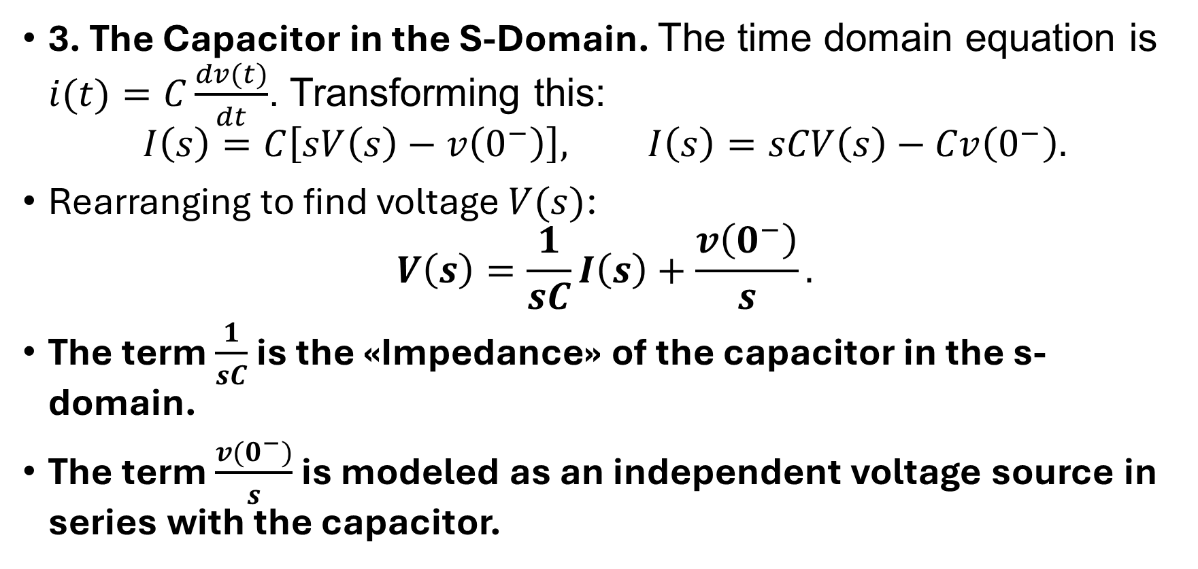
Systematic Analysis Methods
The Laplace Transform and Operational Calculus
3. The Capacitor in the S-Domain. The time domain equation is $i(t)=C\frac{dv(t)}{dt}$. Transforming this:
$$I\left(s\right)=C\left[sV\left(s\right)−v\left(0^{−}\right)\right], I\left(s\right)=sCV\left(s\right)−Cv\left(0^{−}\right).$$
Rearranging to find voltage $V(s)$:
$$V\left(s\right)=\frac{1}{sC}I\left(s\right)+\frac{v\left(0^{−}\right)}{s}.$$
The term $\frac{1}{sC}$ is the «Impedance» of the capacitor in the s-domain.
The term $\frac{v(0^{−})}{s}$ is modeled as an independent voltage source in series with the capacitor.

Slide 17
Systematic Analysis Methods
The Laplace Transform and Operational Calculus
Important Note: The polarity of these initial condition sources must be drawn carefully.
The source opposes the discharge of current.
Now we have a complete method for solving any linear circuit, called Operational Calculus.

Slide 18
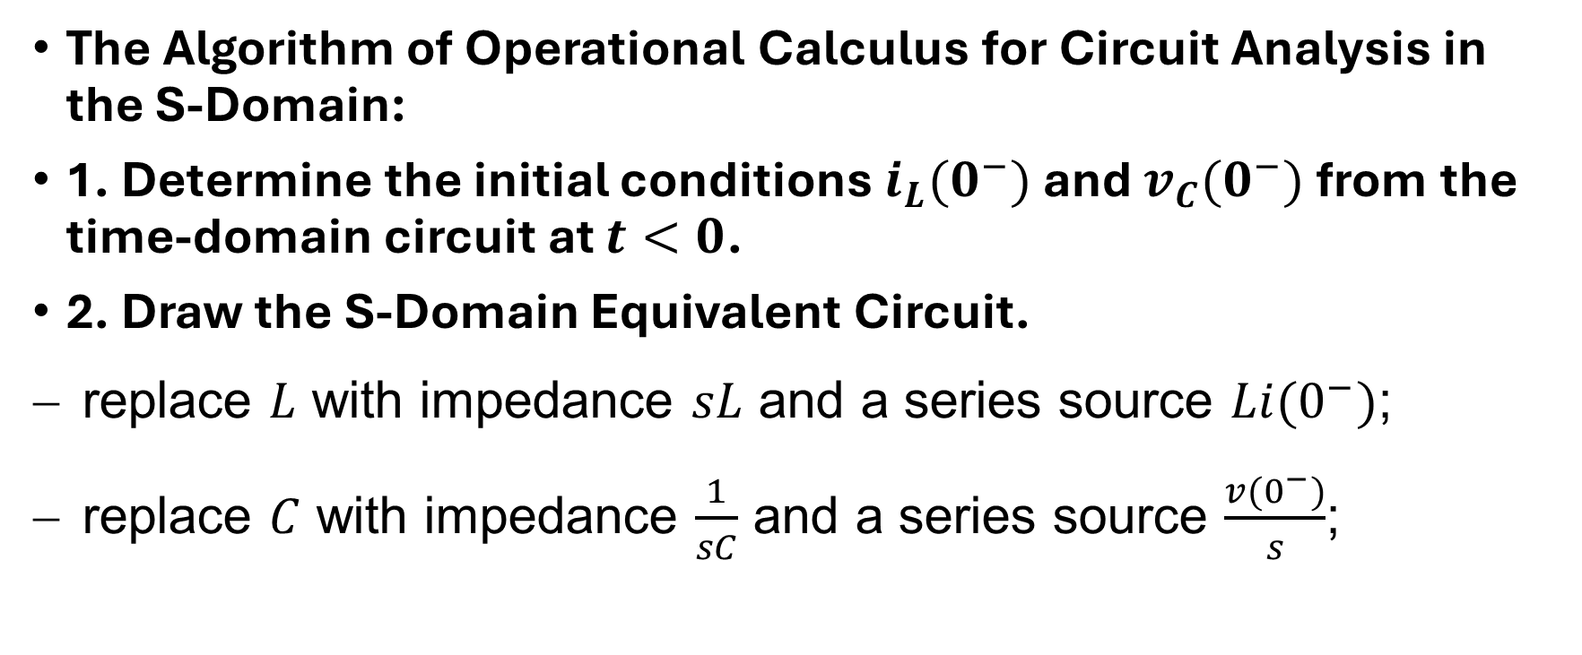
Systematic Analysis Methods
The Laplace Transform and Operational Calculus
The Algorithm of Operational Calculus for Circuit Analysis in the S-Domain:
1. Determine the initial conditions $i_{L}(0^{−})$ and $v_{C}(0^{−})$ from the time-domain circuit at $t<0$.
2. Draw the S-Domain Equivalent Circuit.
replace $L$ with impedance $sL$ and a series source $Li(0^{−})$;
replace $C$ with impedance $\frac{1}{sC}$ and a series source $\frac{v(0^{−})}{s}$;

Slide 19
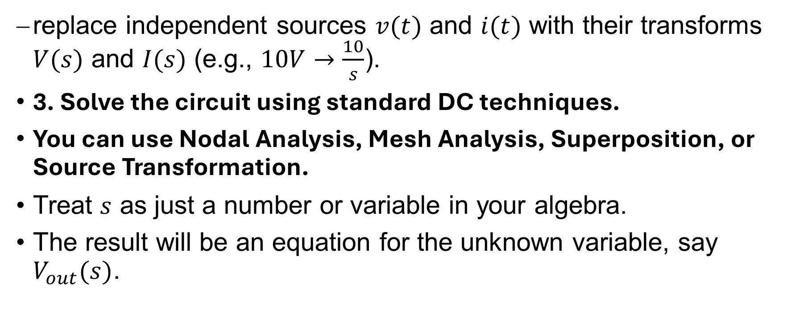
Systematic Analysis Methods
The Laplace Transform and Operational Calculus
replace independent sources $v(t)$ and $i(t)$ with their transforms $V(s)$ and $I(s)$ (e.g., $10V→\frac{10}{s}$).
3. Solve the circuit using standard DC techniques.
You can use Nodal Analysis, Mesh Analysis, Superposition, or Source Transformation.
Treat $s$ as just a number or variable in your algebra.
The result will be an equation for the unknown variable, say $V_{out}(s)$.

Slide 20

Systematic Analysis Methods
The Laplace Transform and Operational Calculus
Let's try a conceptual example.
Consider a series R-L circuit connected to a DC voltage $V_{dc}$ at $t=0$.
Initial current is zero.

Slide 21
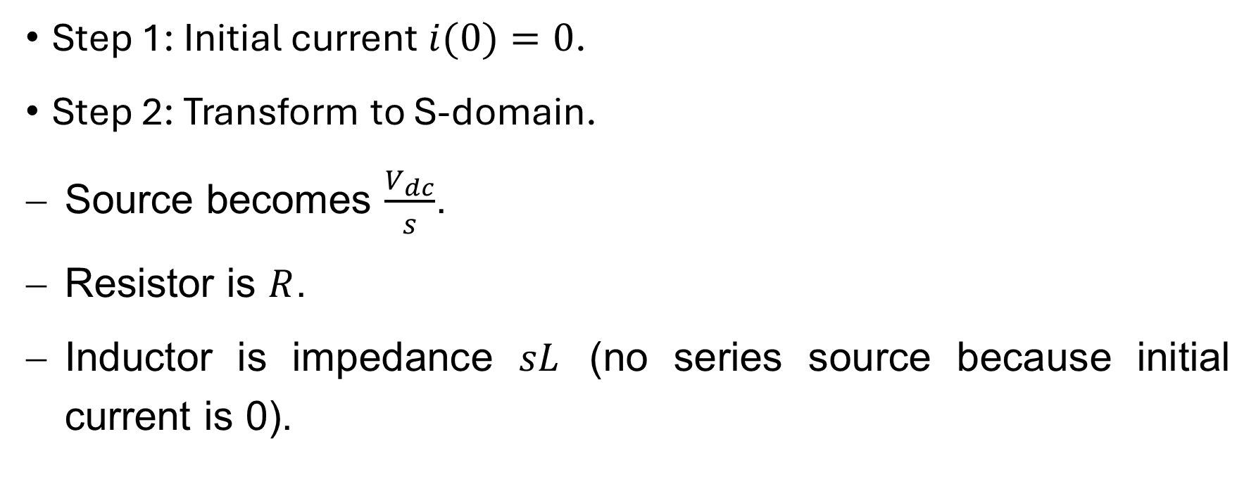
Systematic Analysis Methods
The Laplace Transform and Operational Calculus
Step 1: Initial current $i(0)=0$.
Step 2: Transform to S-domain.
Source becomes $\frac{V_{dc}}{s}$.
Resistor is $R$.
Inductor is impedance $sL$ (no series source because initial current is 0).

Slide 22
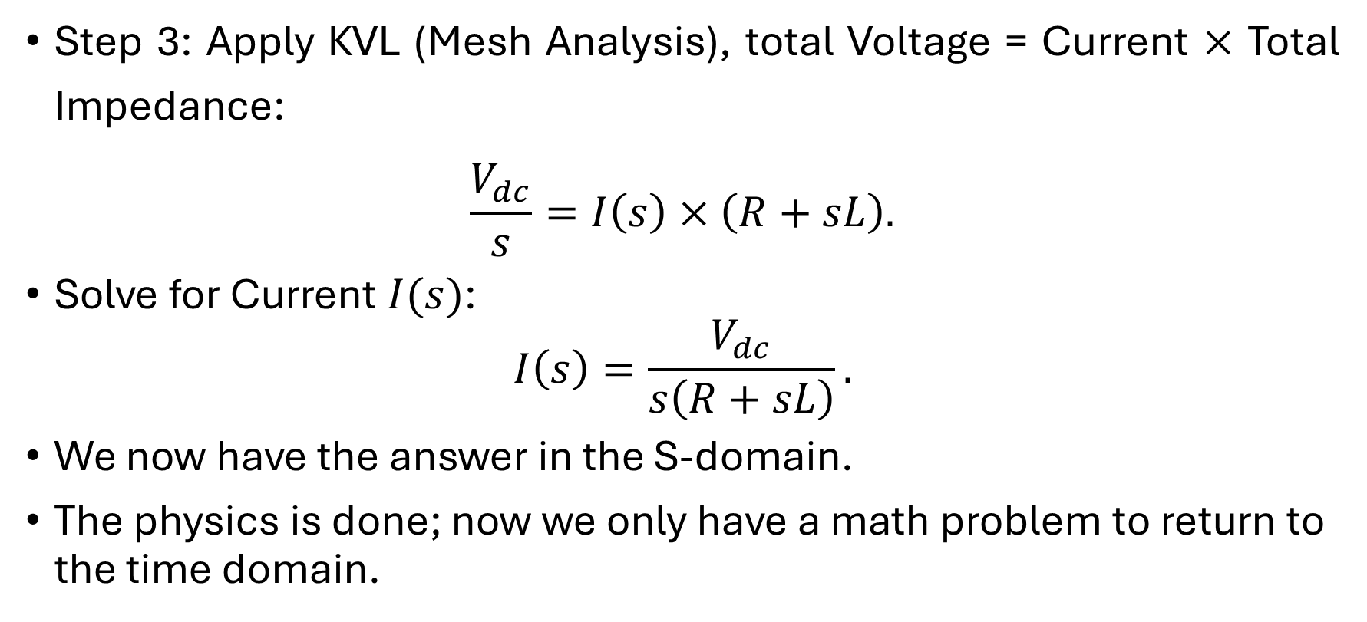
Systematic Analysis Methods
The Laplace Transform and Operational Calculus
Step 3: Apply KVL (Mesh Analysis), total Voltage = Current $×$ Total Impedance:
$$\frac{V_{dc}}{s}=I\left(s\right)×\left(R+sL\right).$$
Solve for Current $I(s)$:
$$I\left(s\right)=\frac{V_{dc}}{s\left(R+sL\right)}.$$
We now have the answer in the S-domain.
The physics is done; now we only have a math problem to return to the time domain.

Slide 23
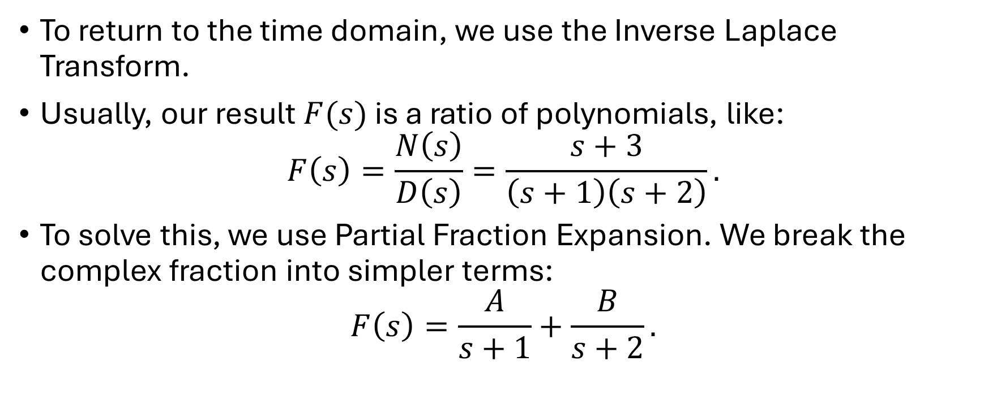
Systematic Analysis Methods
The Laplace Transform and Operational Calculus
To return to the time domain, we use the Inverse Laplace Transform.
Usually, our result $F(s)$ is a ratio of polynomials, like:
$$F\left(s\right)=\frac{N\left(s\right)}{D\left(s\right)}=\frac{s+3}{\left(s+1\right)\left(s+2\right)}.$$
To solve this, we use Partial Fraction Expansion. We break the complex fraction into simpler terms:
$$F\left(s\right)=\frac{A}{s+1}+\frac{B}{s+2}.$$

Slide 24

Systematic Analysis Methods
The Laplace Transform and Operational Calculus
Do you have any questions at the moment?

Slide 25
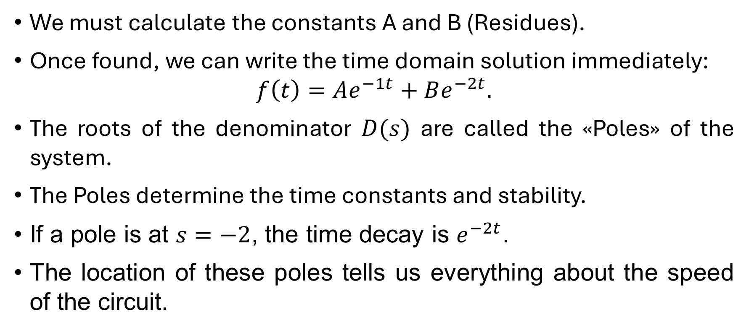
Systematic Analysis Methods
The Laplace Transform and Operational Calculus
We must calculate the constants A and B (Residues).
Once found, we can write the time domain solution immediately:
$$f\left(t\right)=Ae^{−1t}+Be^{−2t}.$$
The roots of the denominator $D(s)$ are called the «Poles» of the system.
The Poles determine the time constants and stability.
If a pole is at $s=−2$, the time decay is $e^{−2t}$.
The location of these poles tells us everything about the speed of the circuit.

Slide 26
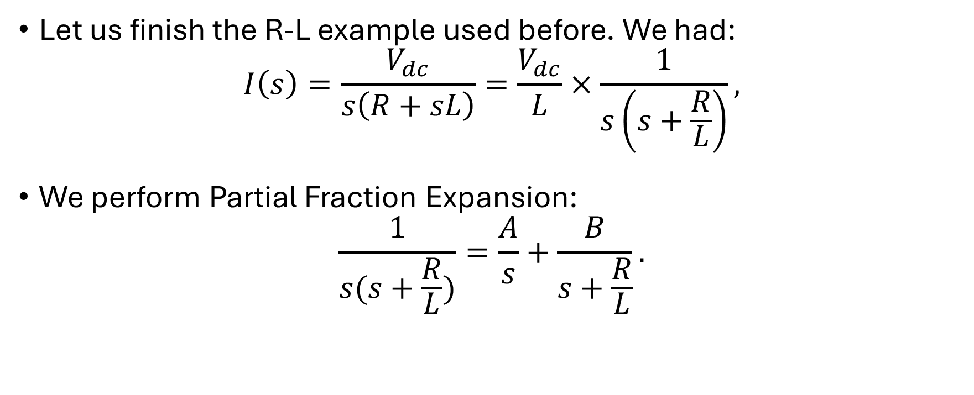
Systematic Analysis Methods
The Laplace Transform and Operational Calculus
Let us finish the R-L example used before. We had:
$$I\left(s\right)=\frac{V_{dc}}{s\left(R+sL\right)}=\frac{V_{dc}}{L}×\frac{1}{s\left(s+\frac{R}{L}\right)},$$
We perform Partial Fraction Expansion:
$$\frac{1}{s(s+\frac{R}{L})}=\frac{A}{s}+\frac{B}{s+\frac{R}{L}}.$$

Slide 27
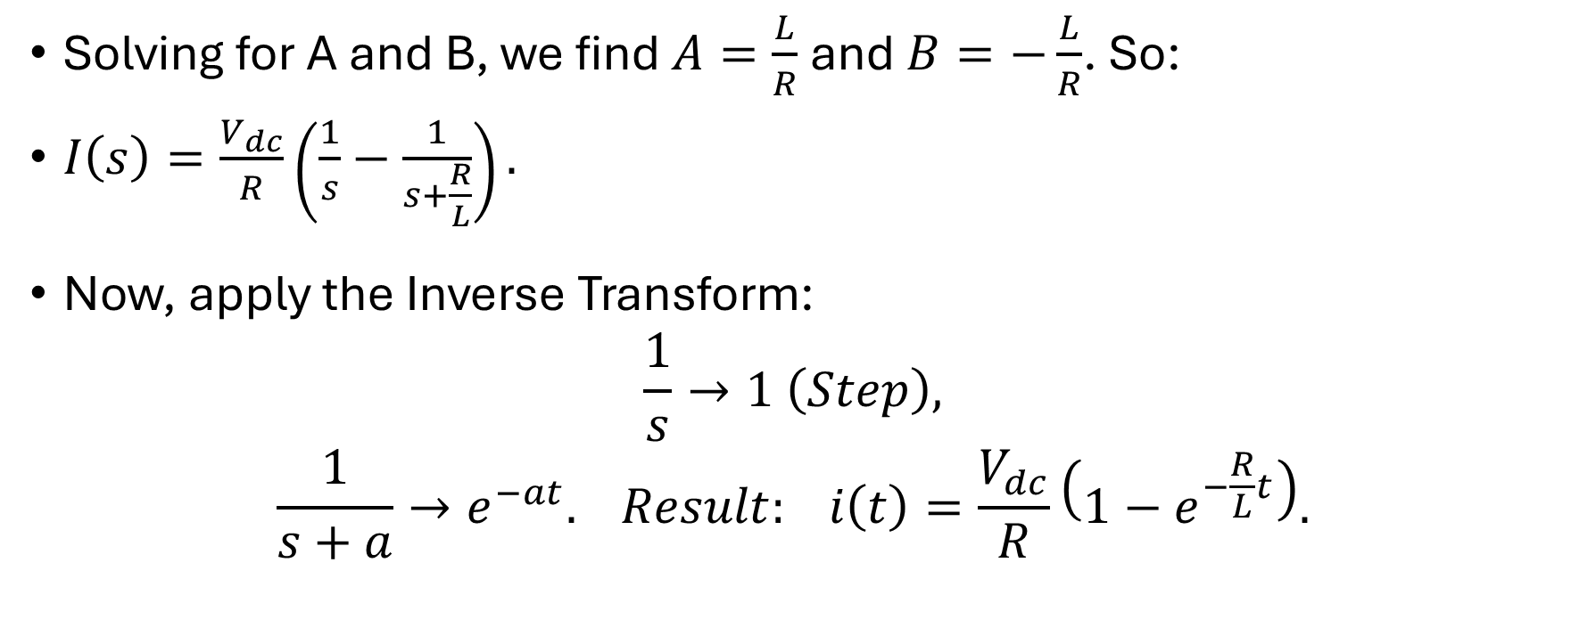
Systematic Analysis Methods
The Laplace Transform and Operational Calculus
Solving for A and B, we find $A=\frac{L}{R}$ and $B=−\frac{L}{R}$. So:
$I\left(s\right)=\frac{V_{dc}}{R}\left(\frac{1}{s}−\frac{1}{s+\frac{R}{L}}\right).$
Now, apply the Inverse Transform:
$$\frac{1}{s}→1 \left(Step\right),$$
$$\frac{1}{s+a}→e^{−at}. Result: i\left(t\right)=\frac{V_{dc}}{R}\left(1−e^{−\frac{R}{L}t}\right).$$

Slide 28
Systematic Analysis Methods
The Laplace Transform and Operational Calculus
This matches exactly the result we derived in Lecture 13 using differential equations.
The Laplace method confirms our previous work but is robust enough to handle much harder problems.
Why is the Laplace Transform so important for engineers?
It is not just for solving circuits.
It is the language of Control Theory and Signal Processing.

Slide 29
Systematic Analysis Methods
The Laplace Transform and Operational Calculus
Positives of the Laplace Transform:
1. It handles any input.
Whether the source is a sine wave, a step, an impulse, or an exponential, the method is exactly the same.
2. It handles initial conditions automatically.
You do not need to separate the «homogeneous» and «particular» solutions manually.

Slide 30
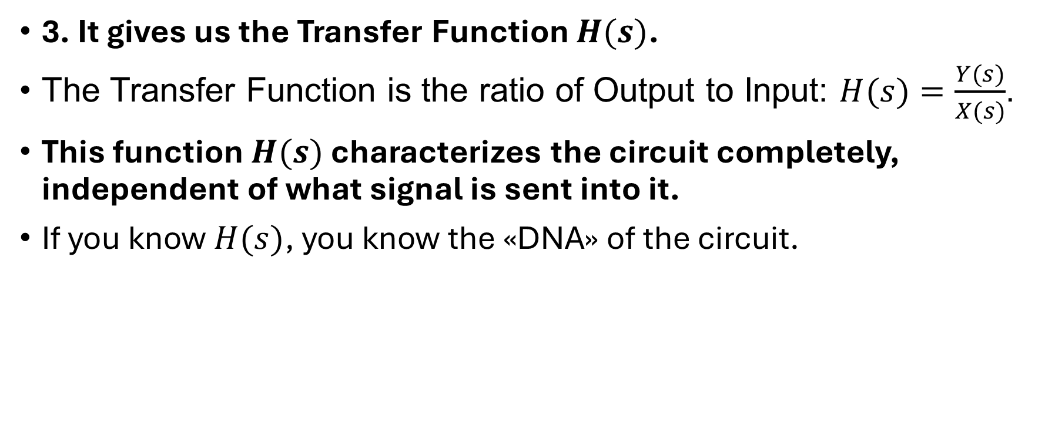
Systematic Analysis Methods
The Laplace Transform and Operational Calculus
3. It gives us the Transfer Function $H(s)$.
The Transfer Function is the ratio of Output to Input: $H(s)=\frac{Y(s)}{X(s)}$.
This function $H(s)$ characterizes the circuit completely, independent of what signal is sent into it.
If you know $H(s)$, you know the «DNA» of the circuit.

Slide 31

Systematic Analysis Methods
The Laplace Transform and Operational Calculus
A major advantage of working in the s-domain is the ability to check the behavior of the circuit at the limits of time without performing the inverse transform.
We use the Initial Value Theorem (IVT) to find the value at $t=0$.

Slide 32

Systematic Analysis Methods
The Laplace Transform and Operational Calculus
The Initial Value Theorem allows us to find the value of a time function at zero directly from its s-domain equation.
Mathematically, $\lim_{t→0}f(t)=\lim_{s→∞}sF(s)$.

Slide 33
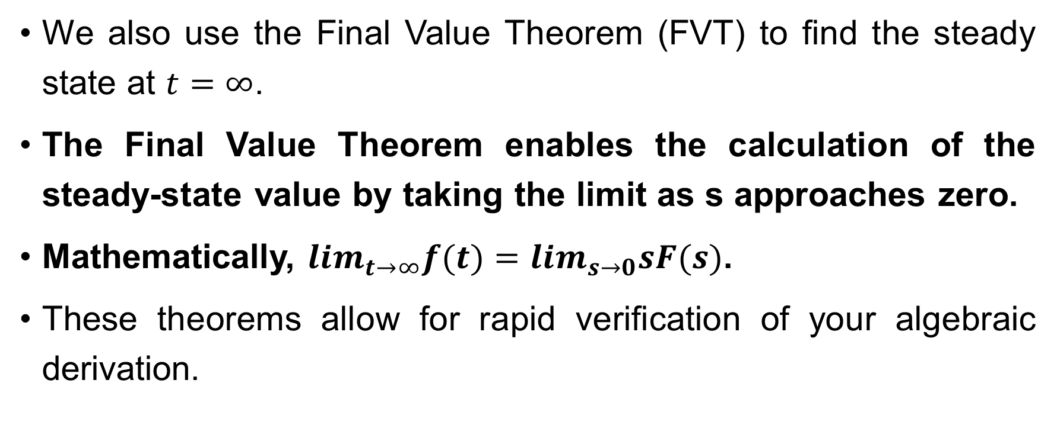
Systematic Analysis Methods
The Laplace Transform and Operational Calculus
We also use the Final Value Theorem (FVT) to find the steady state at $t=∞$.
The Final Value Theorem enables the calculation of the steady-state value by taking the limit as s approaches zero.
Mathematically, $\lim_{t→∞}f(t)=\lim_{s→0}sF(s)$.
These theorems allow for rapid verification of your algebraic derivation.

Slide 34
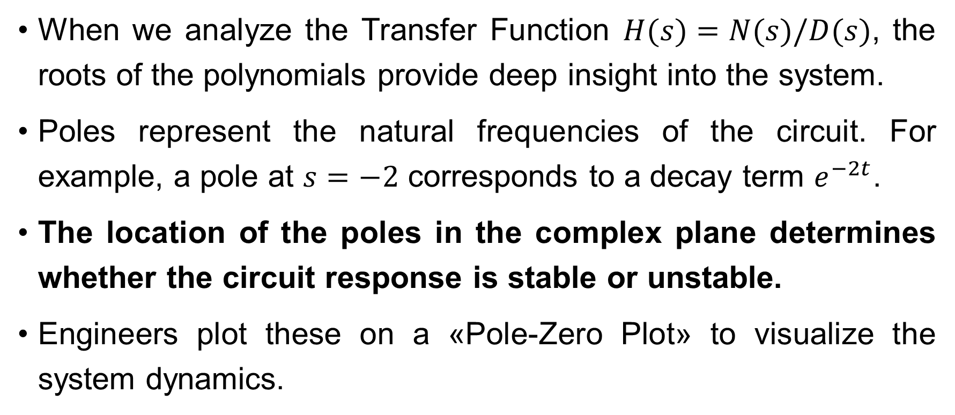
Systematic Analysis Methods
The Laplace Transform and Operational Calculus
When we analyze the Transfer Function $H(s)=N(s)/D(s)$, the roots of the polynomials provide deep insight into the system.
Poles represent the natural frequencies of the circuit. For example, a pole at $s=−2$ corresponds to a decay term $e^{−2t}$.
The location of the poles in the complex plane determines whether the circuit response is stable or unstable.
Engineers plot these on a «Pole-Zero Plot» to visualize the system dynamics.

Slide 35
Systematic Analysis Methods
The Laplace Transform and Operational Calculus
Stability is the most critical property of any dynamic system.
A stable system is one where the natural response eventually dies out to zero.
In the s-domain, this relates to the real part of the complex frequency σ.

Slide 36
Systematic Analysis Methods
The Laplace Transform and Operational Calculus
For a circuit to be stable, all poles of its transfer function must lie in the left half of the complex s-plane.
This means the real part of every pole must be negative (σ<0).
If any pole has a positive real part, the time response will grow exponentially and the system is unstable.
An unstable circuit, such as an improperly designed amplifier, will oscillate uncontrollably or saturate.

Slide 37
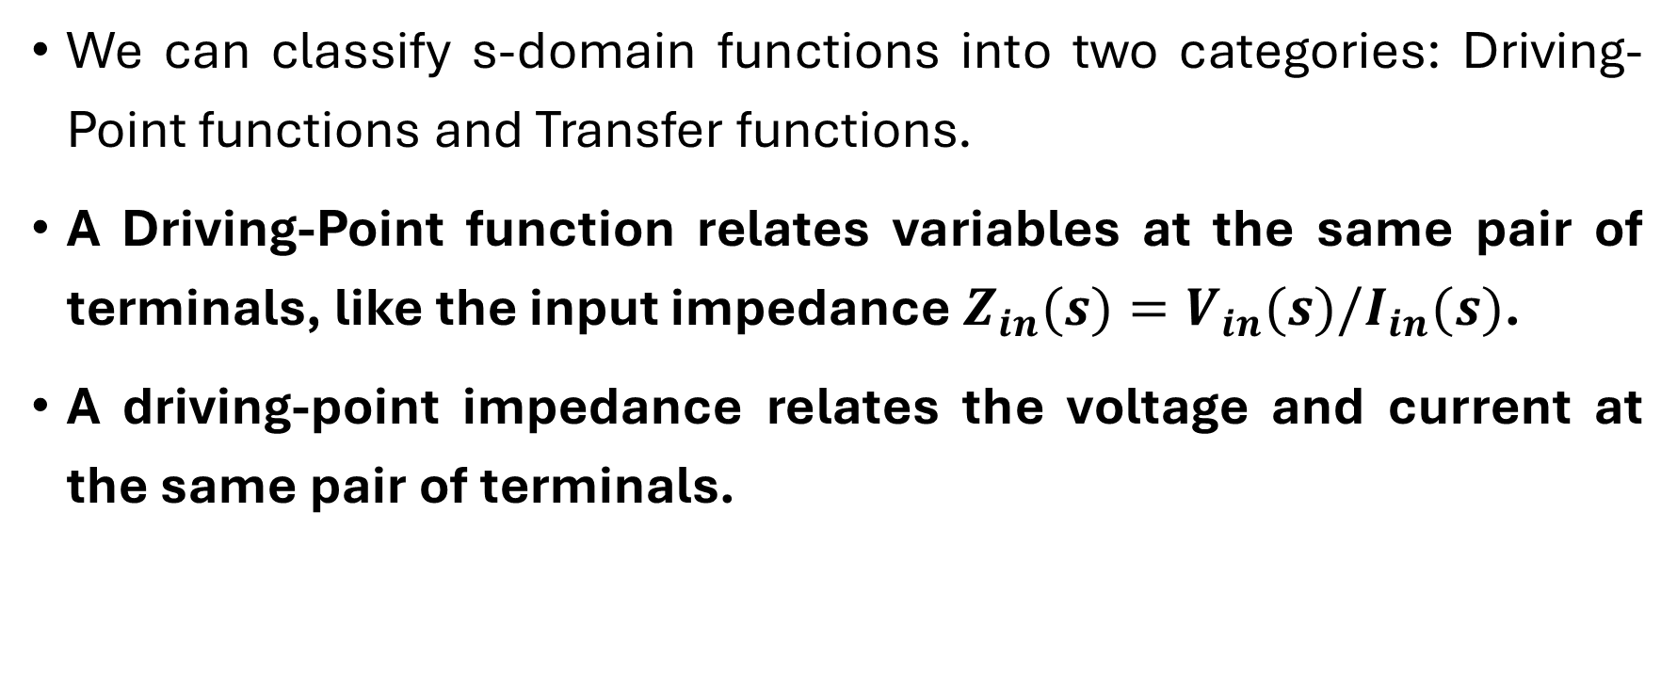
Systematic Analysis Methods
The Laplace Transform and Operational Calculus
We can classify s-domain functions into two categories: Driving-Point functions and Transfer functions.
A Driving-Point function relates variables at the same pair of terminals, like the input impedance $Z_{in}(s)=V_{in}(s)/I_{in}(s)$.
A driving-point impedance relates the voltage and current at the same pair of terminals.

Slide 38
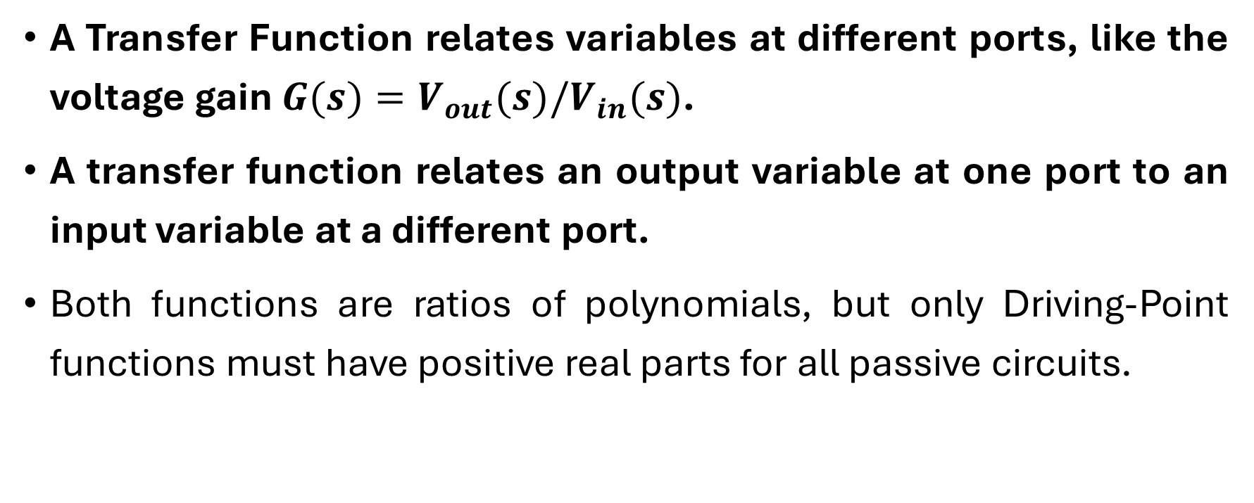
Systematic Analysis Methods
The Laplace Transform and Operational Calculus
A Transfer Function relates variables at different ports, like the voltage gain $G(s)=V_{out}(s)/V_{in}(s)$.
A transfer function relates an output variable at one port to an input variable at a different port.
Both functions are ratios of polynomials, but only Driving-Point functions must have positive real parts for all passive circuits.

Slide 39
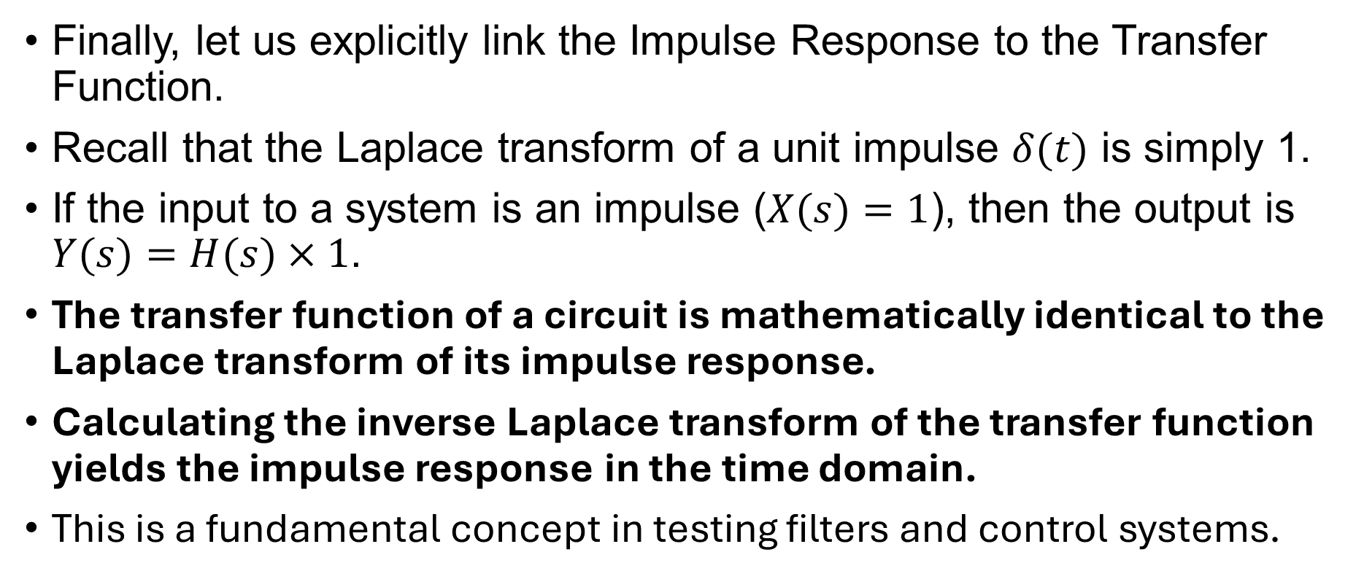
Systematic Analysis Methods
The Laplace Transform and Operational Calculus
Finally, let us explicitly link the Impulse Response to the Transfer Function.
Recall that the Laplace transform of a unit impulse $δ(t)$ is simply 1.
If the input to a system is an impulse ($X(s)=1$), then the output is $Y(s)=H(s)×1$.
The transfer function of a circuit is mathematically identical to the Laplace transform of its impulse response.
Calculating the inverse Laplace transform of the transfer function yields the impulse response in the time domain.
This is a fundamental concept in testing filters and control systems.

Slide 40
Systematic Analysis Methods
The Laplace Transform and Operational Calculus
Do you have any questions at the moment?

Slide 41
Systematic Analysis Methods
The Laplace Transform and Operational Calculus
Thank you for your attention! This concludes our course. It was a pleasure to teaching you.

