Slide 1
Lecture 3. Equivalent Transformations in Passive Networks
Part (1). Circuit Models and Circuit Laws

Slide 2
Equivalent Transformations in Passive Networks
Equivalent Transformations in Passive Networks
We often encounter circuits that can be simplified before applying full nodal or mesh analysis.
/57

Slide 3
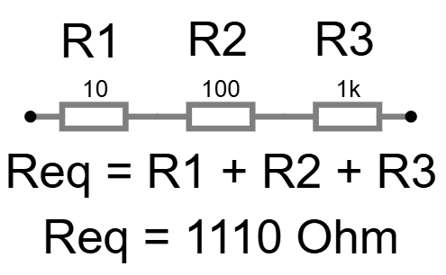
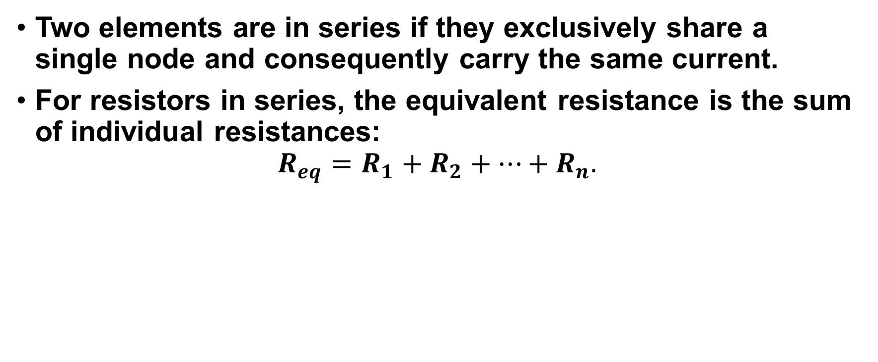
Equivalent Transformations in Passive Networks
Equivalent Transformations in Passive Networks
Two elements are in series if they exclusively share a single node and consequently carry the same current.
For resistors in series, the equivalent resistance is the sum of individual resistances:
$$R_{eq}=R_{1}+R_{2}+…+R_{n}.$$
/57

Slide 4
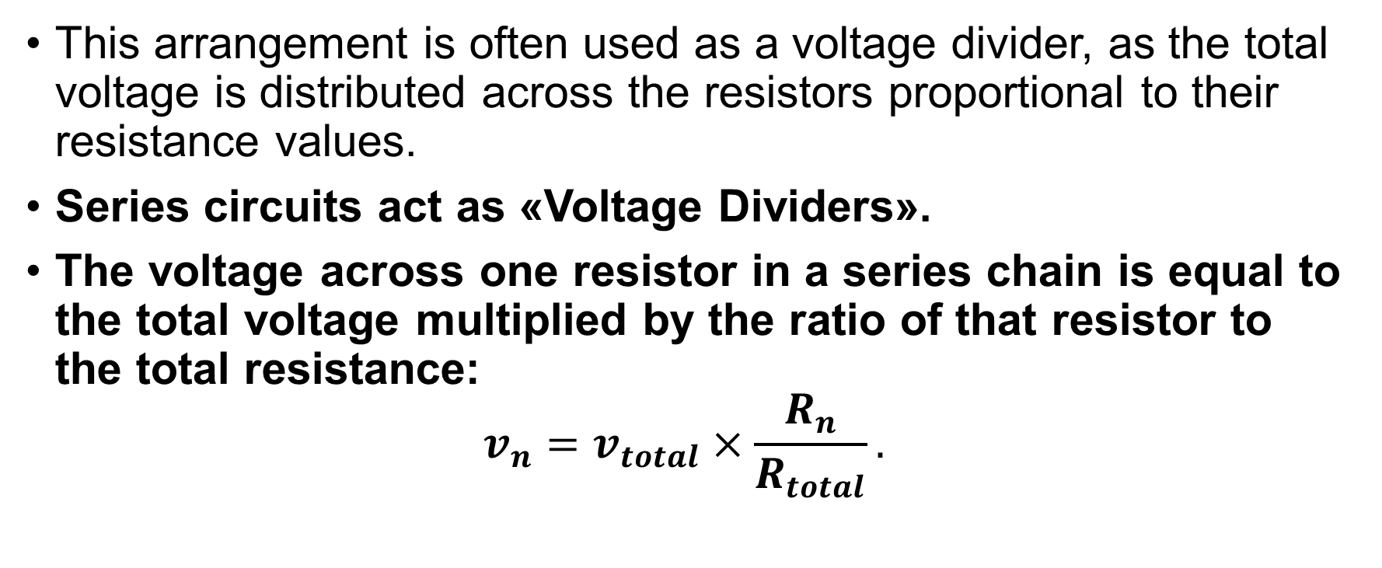
Equivalent Transformations in Passive Networks
Equivalent Transformations in Passive Networks
This arrangement is often used as a voltage divider, as the total voltage is distributed across the resistors proportional to their resistance values.
Series circuits act as «Voltage Dividers».
The voltage across one resistor in a series chain is equal to the total voltage multiplied by the ratio of that resistor to the total resistance:
$$v_{n}=v_{total}×\frac{R_{n}}{R_{total}}.$$
/57

Slide 5
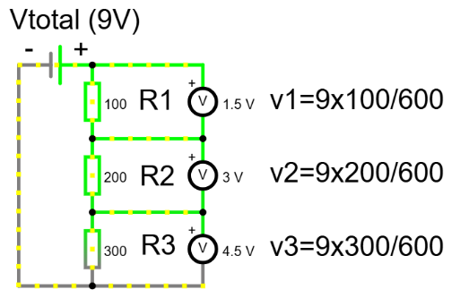
Equivalent Transformations in Passive Networks
Equivalent Transformations in Passive Networks
This concept is used in volume knobs and sensors.
If you have a light sensor that changes resistance, putting it in series with a fixed resistor converts that changing resistance into a changing voltage we can measure.
/57

Slide 6
Equivalent Transformations in Passive Networks
Equivalent Transformations in Passive Networks
Let us understand why the resistance adds up in series. Imagine the current is water flowing through a pipe.
If you force the water to go through one narrow filter (resistor), it slows down.
If you add a second filter immediately after the first one, the water must work even harder to get through both.
In a series circuit, every electron must pass through every resistor, so the total opposition to the flow increases.
Mathematically, this comes from Kirchhoff's Voltage Law.
/57

Slide 7
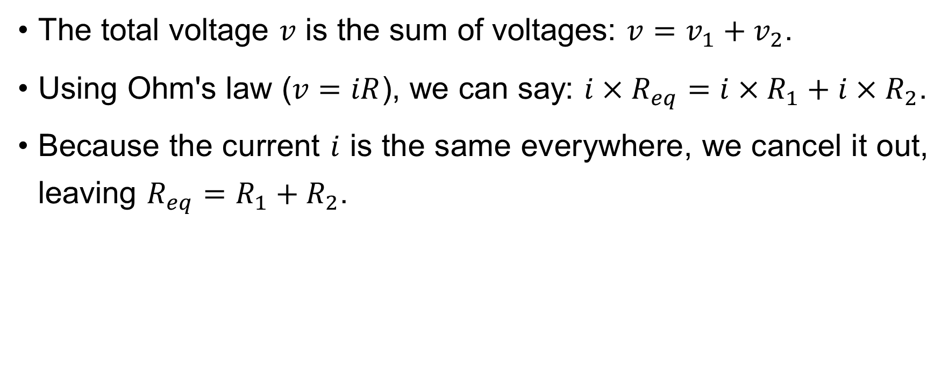
Equivalent Transformations in Passive Networks
Equivalent Transformations in Passive Networks
The total voltage $v$ is the sum of voltages: $v=v_{1}+v_{2}$.
Using Ohm's law ($v=iR$), we can say: $i×R_{eq}=i×R_{1}+i×R_{2}$.
Because the current $i$ is the same everywhere, we cancel it out, leaving $R_{eq}=R_{1}+R_{2}$.
/57

Slide 8
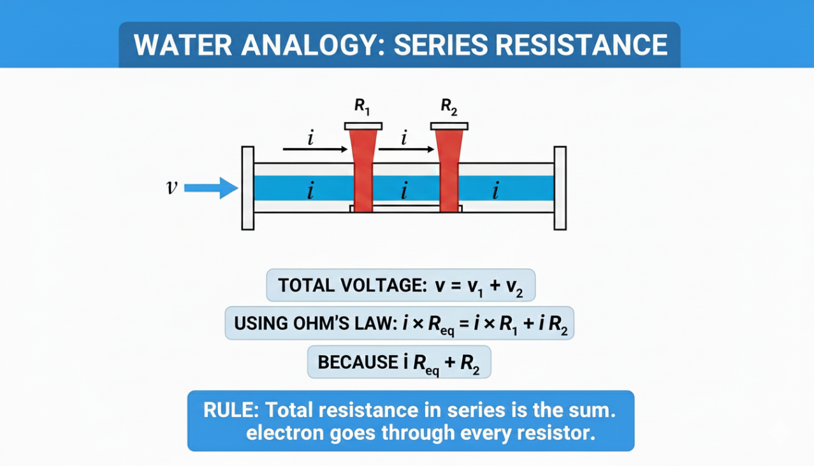
Equivalent Transformations in Passive Networks
In a series circuit, every electron must pass through every resistor, so the total opposition to the flow increases.
/57

Slide 9
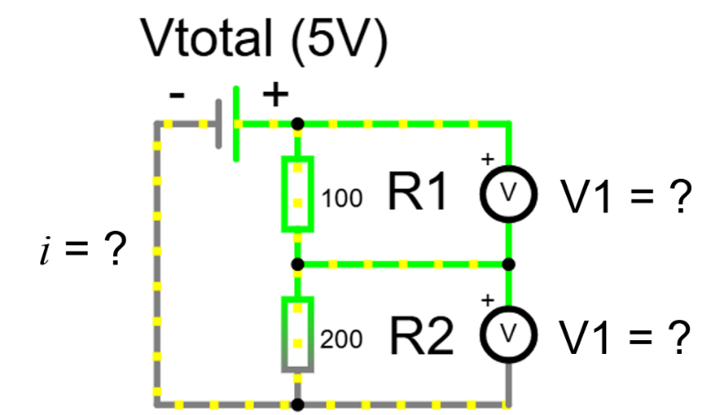
Equivalent Transformations in Passive Networks
Equivalent Transformations in Passive Networks
We must practice the Voltage Divider because it is very common.
Look at this illustration.
We have a 5 Volt source and two resistors: 100 Ohms and 200 Ohms.

Slide 10
Equivalent Transformations in Passive Networks
Equivalent Transformations in Passive Networks
The larger resistor will always take the larger portion of the voltage.
Since 200 Ohms is twice as big as 100 Ohms, it takes twice as much voltage.
Total resistance is 300 Ohms.
/57

Slide 11
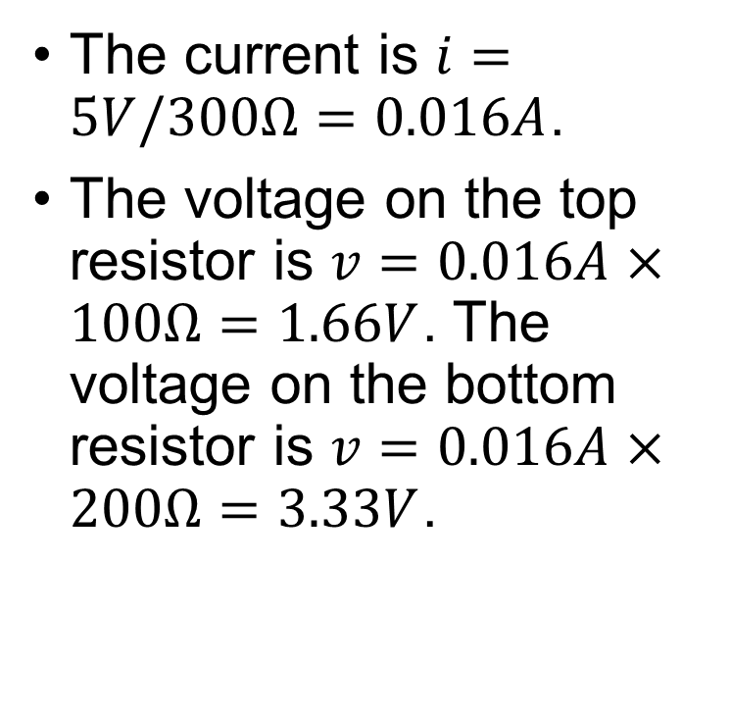
Equivalent Transformations in Passive Networks
Equivalent Transformations in Passive Networks
The current is $i=5V/300Ω=0.016A$.
The voltage on the top resistor is $v=0.016A×100Ω=1.66V$. The voltage on the bottom resistor is $v=0.016A×200Ω=3.33V$.
/57

Slide 12
Equivalent Transformations in Passive Networks
Equivalent Transformations in Passive Networks
The voltage divider formula allows us to calculate this without finding the current first.
/57

Slide 13
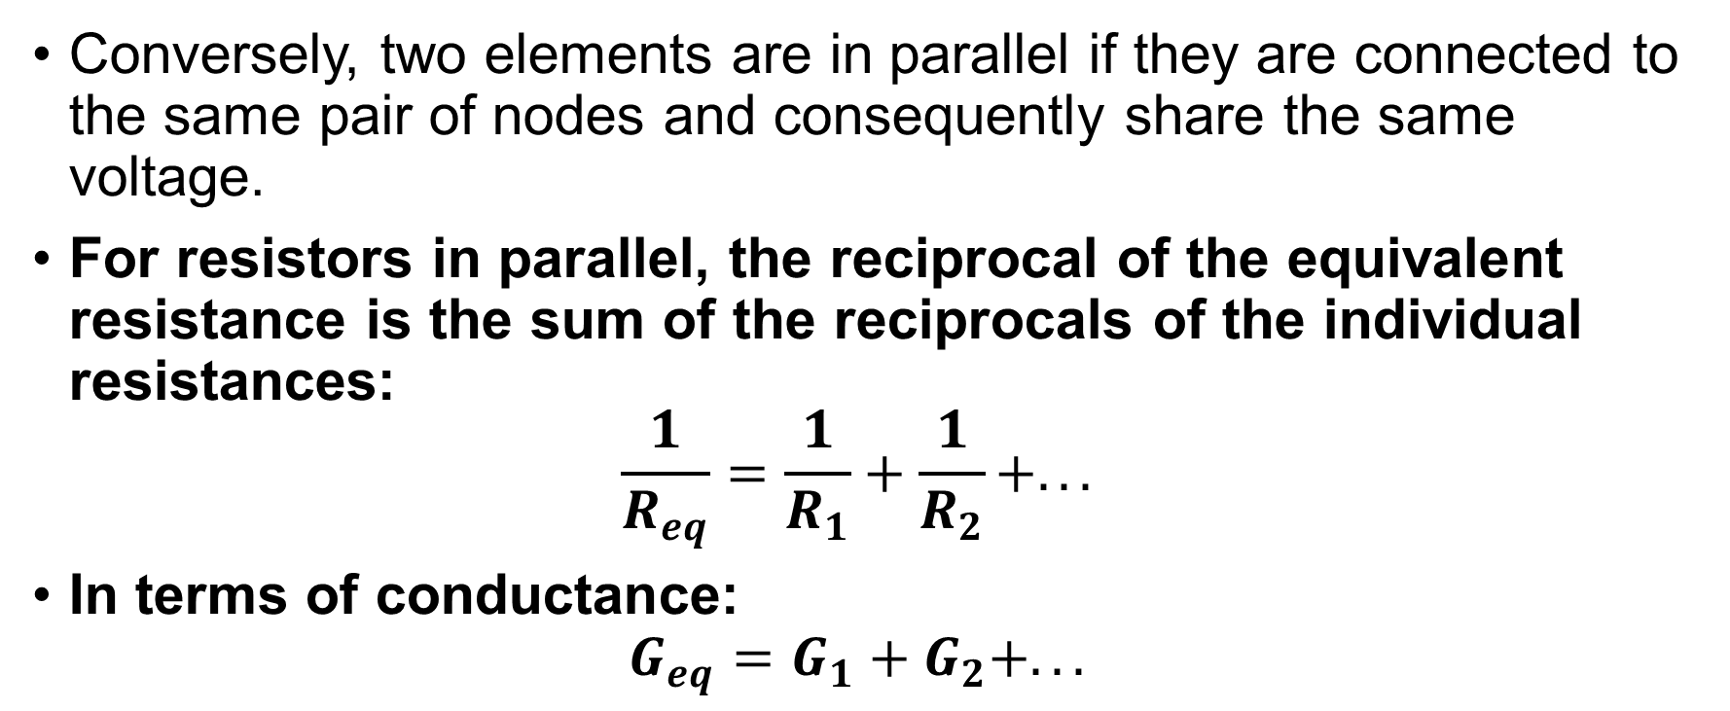
Equivalent Transformations in Passive Networks
Equivalent Transformations in Passive Networks
Conversely, two elements are in parallel if they are connected to the same pair of nodes and consequently share the same voltage.
For resistors in parallel, the reciprocal of the equivalent resistance is the sum of the reciprocals of the individual resistances:
$$\frac{1}{R_{eq}}=\frac{1}{R_{1}}+\frac{1}{R_{2}}+...$$
In terms of conductance:
$$G_{eq}=G_{1}+G_{2}+...$$
/57

Slide 14
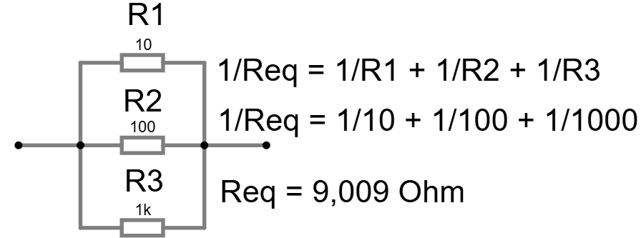
Equivalent Transformations in Passive Networks
Equivalent Transformations in Passive Networks
This arrangement acts as a current divider, where the total current splits among the branches inversely proportional to their resistance.
/57

Slide 15
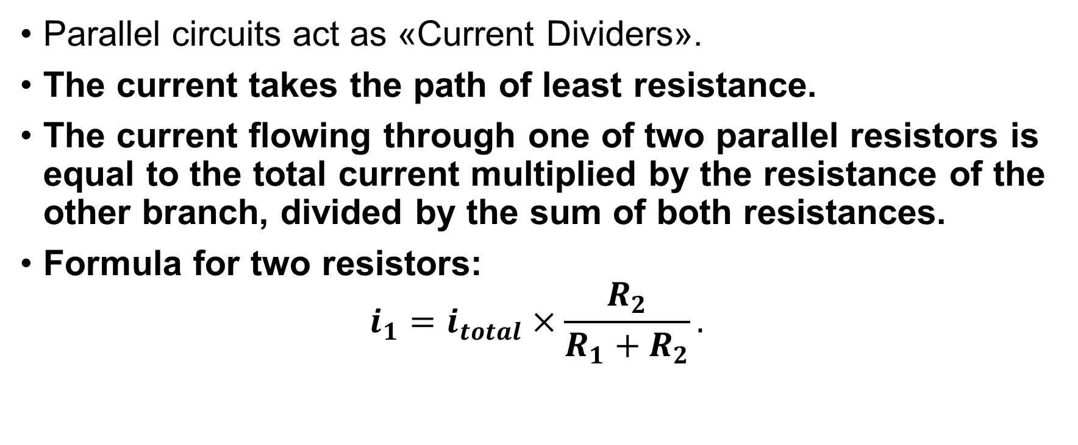
Equivalent Transformations in Passive Networks
Equivalent Transformations in Passive Networks
Parallel circuits act as «Current Dividers».
The current takes the path of least resistance.
The current flowing through one of two parallel resistors is equal to the total current multiplied by the resistance of the other branch, divided by the sum of both resistances.
Formula for two resistors:
$$i_{1}=i_{total}×\frac{R_{2}}{R_{1}+R_{2}}.$$
/57

Slide 16
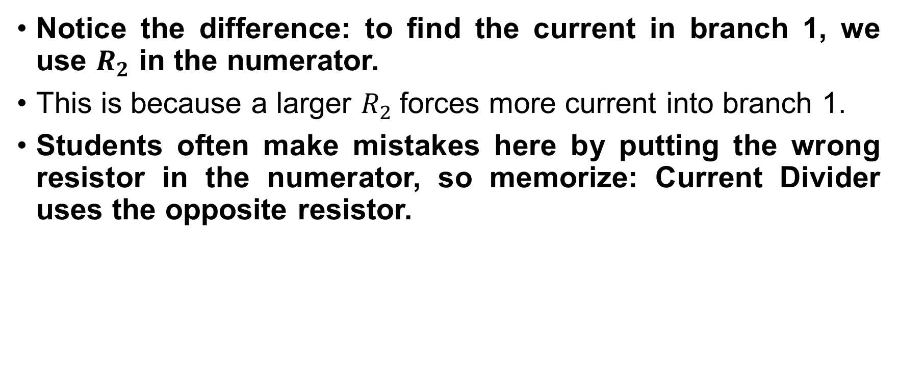
Equivalent Transformations in Passive Networks
Equivalent Transformations in Passive Networks
Notice the difference: to find the current in branch 1, we use $R_{2}$ in the numerator.
This is because a larger $R_{2}$forces more current into branch 1.
Students often make mistakes here by putting the wrong resistor in the numerator, so memorize: Current Divider uses the opposite resistor.
/57

Slide 17
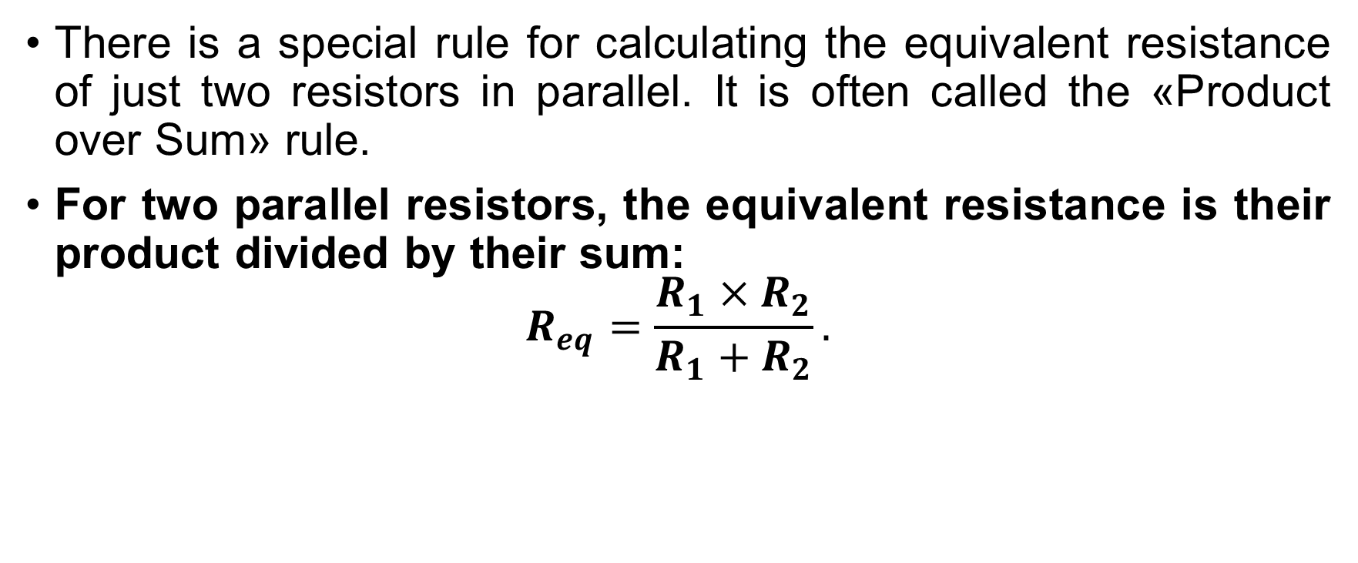
Equivalent Transformations in Passive Networks
Equivalent Transformations in Passive Networks
There is a special rule for calculating the equivalent resistance of just two resistors in parallel. It is often called the «Product over Sum» rule.
For two parallel resistors, the equivalent resistance is their product divided by their sum:
$$R_{eq}=\frac{R_{1}×R_{2}}{R_{1}+R_{2}}.$$
/57

Slide 18
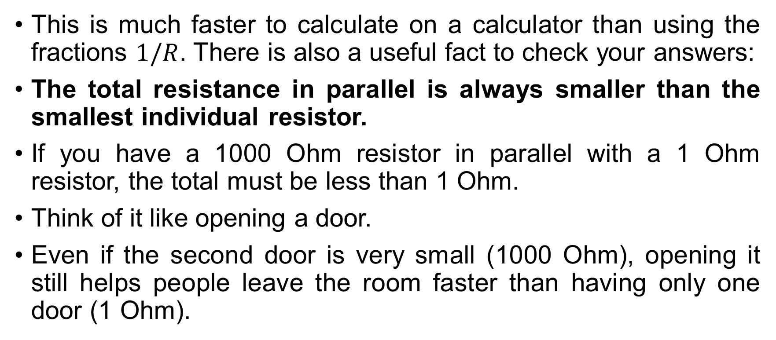
Equivalent Transformations in Passive Networks
Equivalent Transformations in Passive Networks
This is much faster to calculate on a calculator than using the fractions $1/R$. There is also a useful fact to check your answers:
The total resistance in parallel is always smaller than the smallest individual resistor.
If you have a 1000 Ohm resistor in parallel with a 1 Ohm resistor, the total must be less than 1 Ohm.
Think of it like opening a door.
Even if the second door is very small (1000 Ohm), opening it still helps people leave the room faster than having only one door (1 Ohm).
/57

Slide 19
Equivalent Transformations in Passive Networks
Equivalent Transformations in Passive Networks
We move to the concept of input resistance.
A one-port network is any circuit with two terminals accessible to the outside world.
If the network contains only passive elements (resistors) and dependent sources (but no independent sources), it can be modeled as a single equivalent resistance looking into the terminals which named input resistance.
Calculating this often involves series/parallel reduction or, for more complex networks, applying a test voltage and calculating the resulting current.
/57

Slide 20
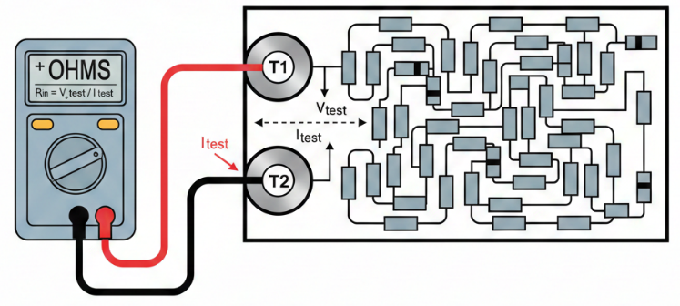

Equivalent Transformations in Passive Networks
Equivalent Transformations in Passive Networks
You can think of devices like this as simply a «Black Box» – a collection of many resistors connected together – and you can calculate its equivalent resistance by passing a current through it, measuring the voltage and then applying Ohm’s Law.
$$R_{in}={V_{test}}/{I_{test}}$$
/57

Slide 21

Equivalent Transformations in Passive Networks
Equivalent Transformations in Passive Networks
Do you have you any questions at the moment?
/57

Slide 22
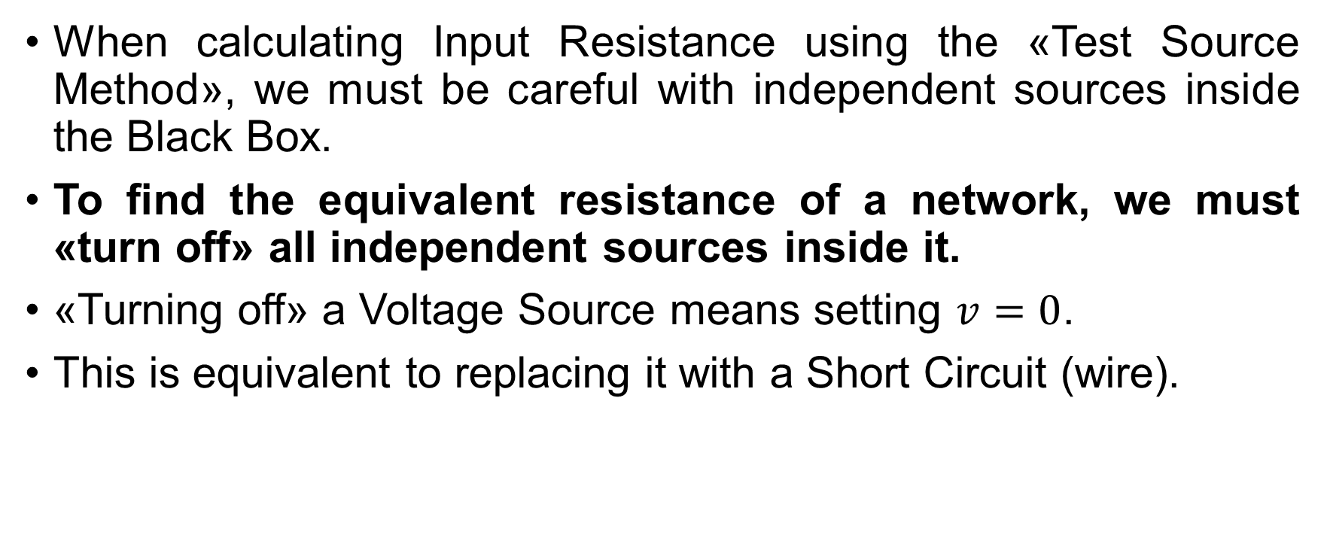
Equivalent Transformations in Passive Networks
Equivalent Transformations in Passive Networks
When calculating Input Resistance using the «Test Source Method», we must be careful with independent sources inside the Black Box.
To find the equivalent resistance of a network, we must «turn off» all independent sources inside it.
«Turning off» a Voltage Source means setting $v=0$.
This is equivalent to replacing it with a Short Circuit (wire).
/57

Slide 23
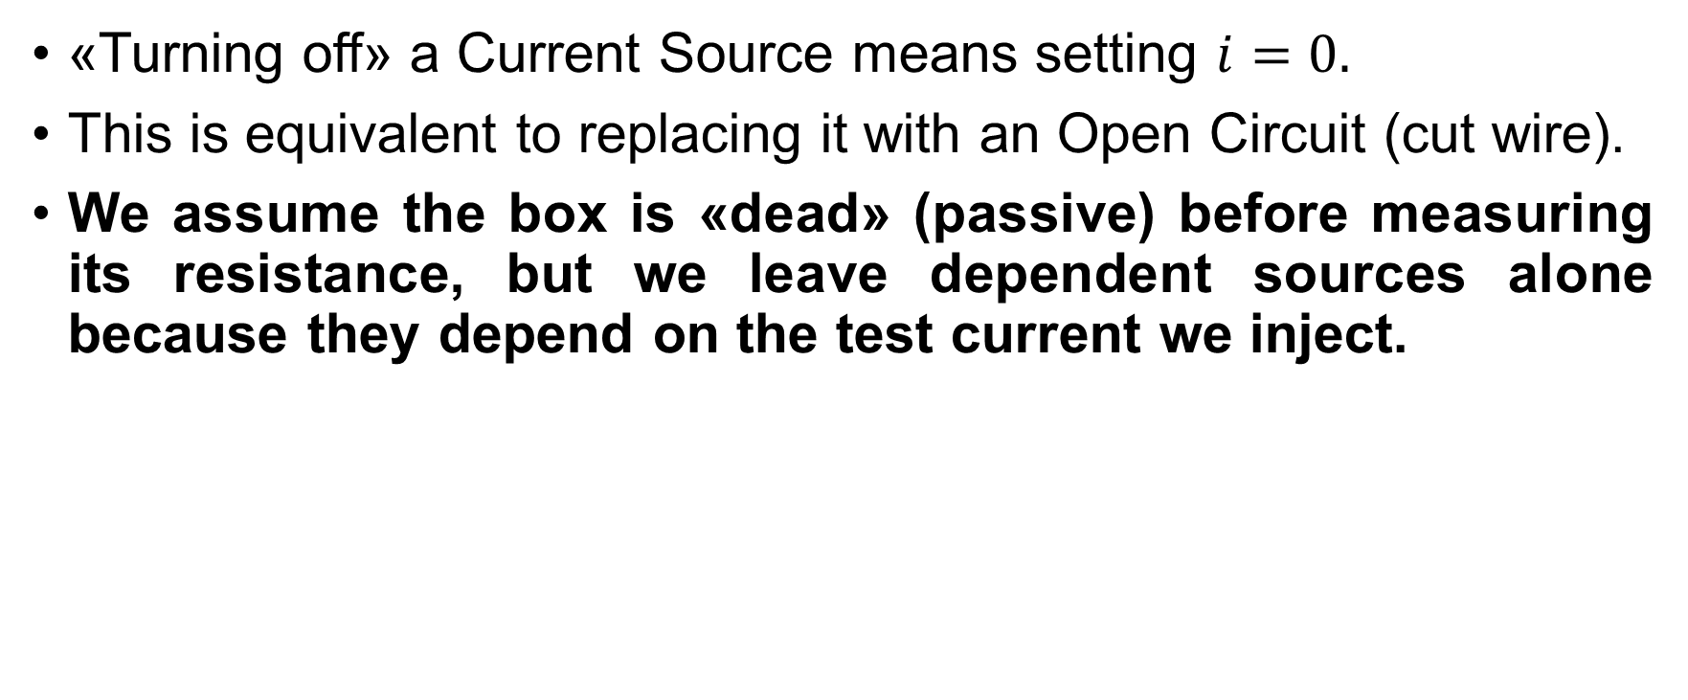
Equivalent Transformations in Passive Networks
Equivalent Transformations in Passive Networks
«Turning off» a Current Source means setting $i=0.$
This is equivalent to replacing it with an Open Circuit (cut wire).
We assume the box is «dead» (passive) before measuring its resistance, but we leave dependent sources alone because they depend on the test current we inject.
/57

Slide 24
Equivalent Transformations in Passive Networks
Equivalent Transformations in Passive Networks
Why do we care about Input Resistance? We care because of the «Loading Effect»: every time you connect a voltmeter to a circuit, the voltmeter itself becomes a parallel resistor.
If a measuring device has a low input resistance, it draws current from the circuit and changes the voltage it is trying to measure.
/57

Slide 25
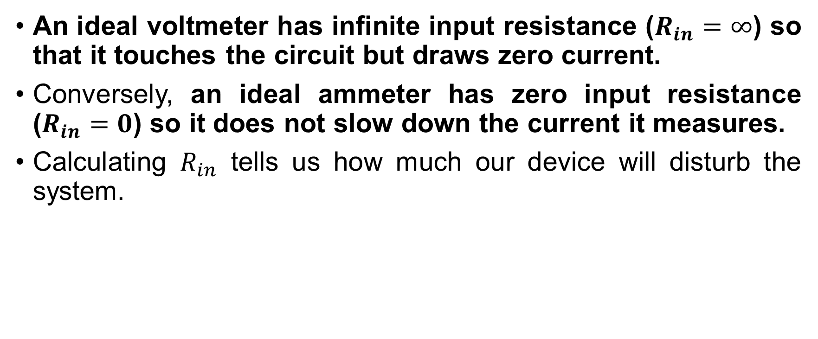
Equivalent Transformations in Passive Networks
Equivalent Transformations in Passive Networks
An ideal voltmeter has infinite input resistance ($R_{in}=∞$) so that it touches the circuit but draws zero current.
Conversely, an ideal ammeter has zero input resistance ($R_{in}=0$) so it does not slow down the current it measures.
Calculating $R_{in}$ tells us how much our device will disturb the system.
/57

Slide 26
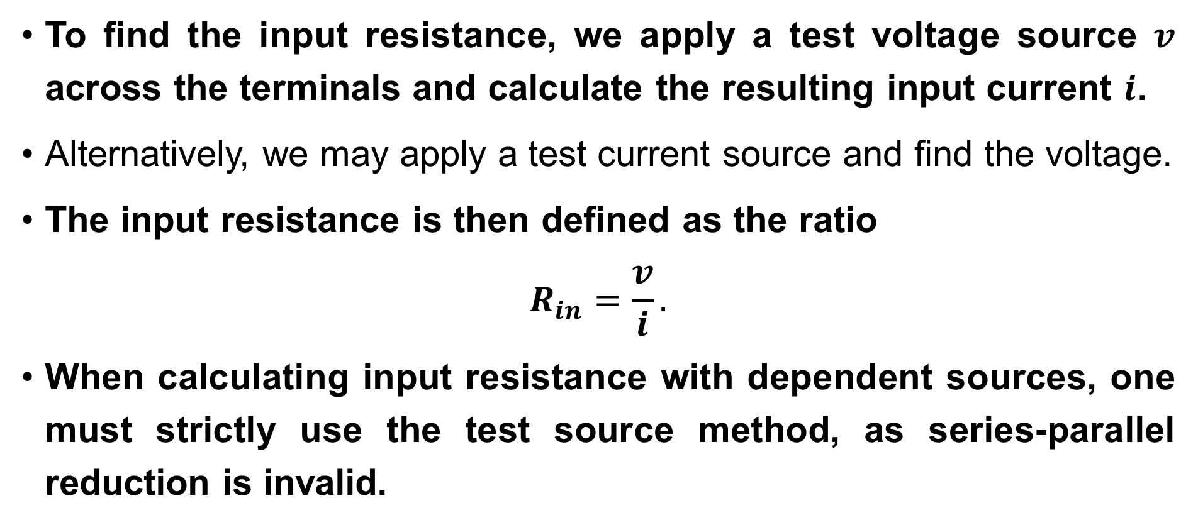
Equivalent Transformations in Passive Networks
Equivalent Transformations in Passive Networks
To find the input resistance, we apply a test voltage source $v$ across the terminals and calculate the resulting input current $i$.
Alternatively, we may apply a test current source and find the voltage.
The input resistance is then defined as the ratio
$$R_{in}=\frac{v}{i}.$$
When calculating input resistance with dependent sources, one must strictly use the test source method, as series-parallel reduction is invalid.
/57

Slide 27
Equivalent Transformations in Passive Networks
Equivalent Transformations in Passive Networks
Not all resistor networks are purely series or parallel.
We frequently encounter Bridge circuits, T-networks, and Pi-networks.
/57

Slide 28
Equivalent Transformations in Passive Networks
Equivalent Transformations in Passive Networks
A Y-network consists of three resistors connected to a common central node.
A Δ-network consists of three resistors forming a closed triangle loop.
We can mathematically transform a Δ network into an equivalent Y network (and vice versa) such that the terminal characteristics (voltage and current at the external nodes) remain identical.
/57

Slide 29
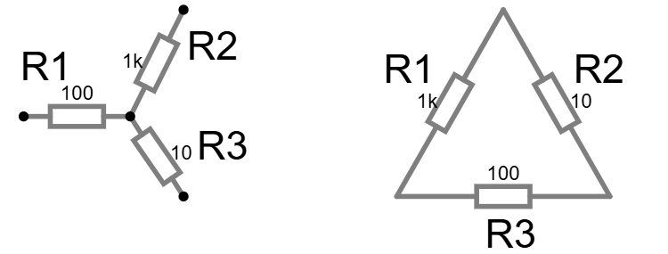
Equivalent Transformations in Passive Networks
Equivalent Transformations in Passive Networks
Here is an illustration of Y-network and Δ-network of resistors.
/57

Slide 30

Equivalent Transformations in Passive Networks
Equivalent Transformations in Passive Networks
A specific topological configuration that defies simple series-parallel reduction is the Y (Wye) and Δ (Delta) connection.
There is the equivalent transformation between Y and Δ configurations.
/57

Slide 31
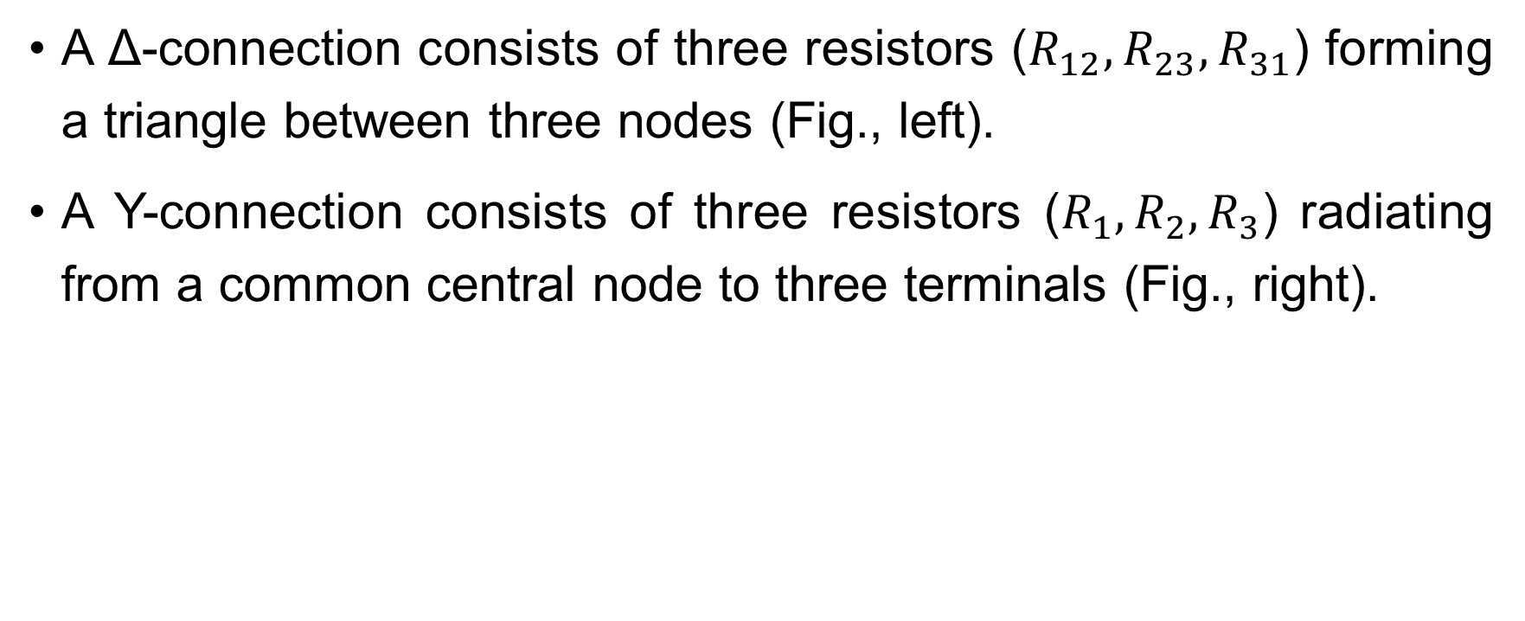
Equivalent Transformations in Passive Networks
Equivalent Transformations in Passive Networks
A Δ-connection consists of three resistors ($R_{12},R_{23},R_{31}$) forming a triangle between three nodes (Fig., left).
A Y-connection consists of three resistors ($R_{1},R_{2},R_{3}$) radiating from a common central node to three terminals (Fig., right).
/57

Slide 32
Equivalent Transformations in Passive Networks
Equivalent Transformations in Passive Networks
To simplify a circuit, we often need to mathematically replace a Δ with an equivalent Y, or vice versa.
The transformation formulas are derived by equating the input resistances between any pair of terminals while leaving the third open.
/57

Slide 33
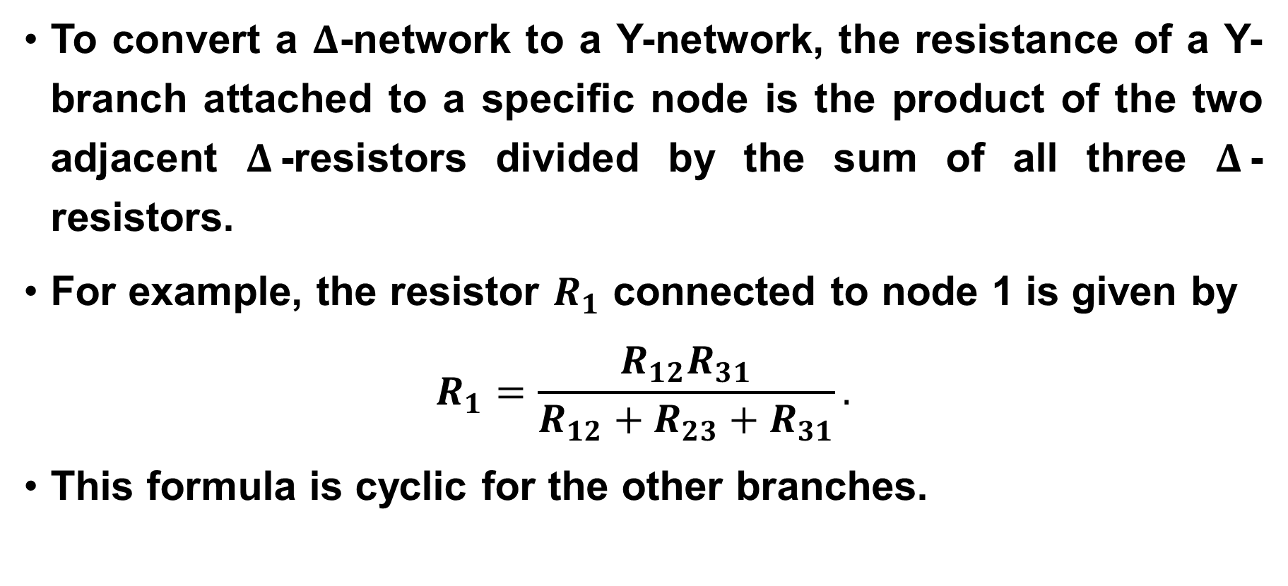
Equivalent Transformations in Passive Networks
Equivalent Transformations in Passive Networks
To convert a $Δ$-network to a Y-network, the resistance of a Y-branch attached to a specific node is the product of the two adjacent $Δ$-resistors divided by the sum of all three $Δ$-resistors.
For example, the resistor $R_{1}$ connected to node 1 is given by
$$R_{1}=\frac{R_{12}R_{31}}{R_{12}+R_{23}+R_{31}}.$$
This formula is cyclic for the other branches.
/57

Slide 34
Equivalent Transformations in Passive Networks
Equivalent Transformations in Passive Networks
The formulas for these transformations look difficult to memorize, but there is a visual trick. Imagine drawing the Y shape inside the Δ shape.
To find the value of a specific Y resistor, multiply the two Δ resistors attached to the same node, then divide by the total resistance.
/57

Slide 35
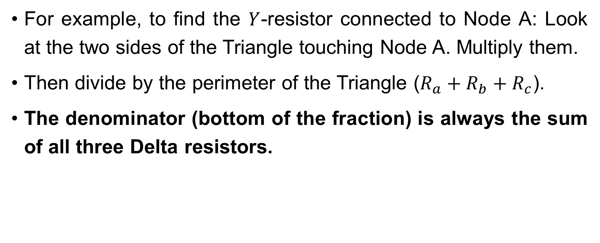
Equivalent Transformations in Passive Networks
Equivalent Transformations in Passive Networks
For example, to find the $Y$-resistor connected to Node A: Look at the two sides of the Triangle touching Node A. Multiply them.
Then divide by the perimeter of the Triangle ($R_{a}+R_{b}+R_{c}$).
The denominator (bottom of the fraction) is always the sum of all three Delta resistors.
/57

Slide 36
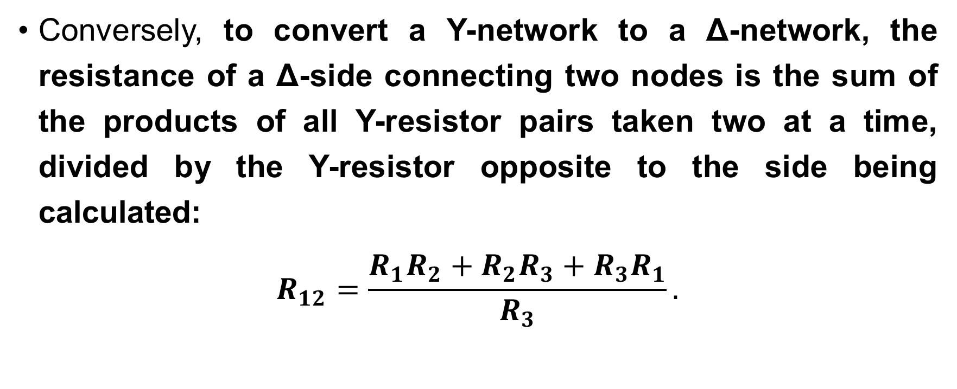
Equivalent Transformations in Passive Networks
Equivalent Transformations in Passive Networks
Conversely, to convert a Y-network to a Δ-network, the resistance of a Δ-side connecting two nodes is the sum of the products of all Y-resistor pairs taken two at a time, divided by the Y-resistor opposite to the side being calculated:
$$R_{12}=\frac{R_{1}R_{2}+R_{2}R_{3}+R_{3}R_{1}}{R_{3}}.$$
/57

Slide 37
Equivalent Transformations in Passive Networks
Equivalent Transformations in Passive Networks
For the reverse transformation (Y to Δ), there is also a pattern.
To find a specific Δ resistor, we calculate the sum of all pair products of the Y resistors, then divide by the opposite resistor.
Imagine you want to find the resistor on the top side of the triangle.
You look at the Y resistor pointing down (the opposite one).
/57

Slide 38
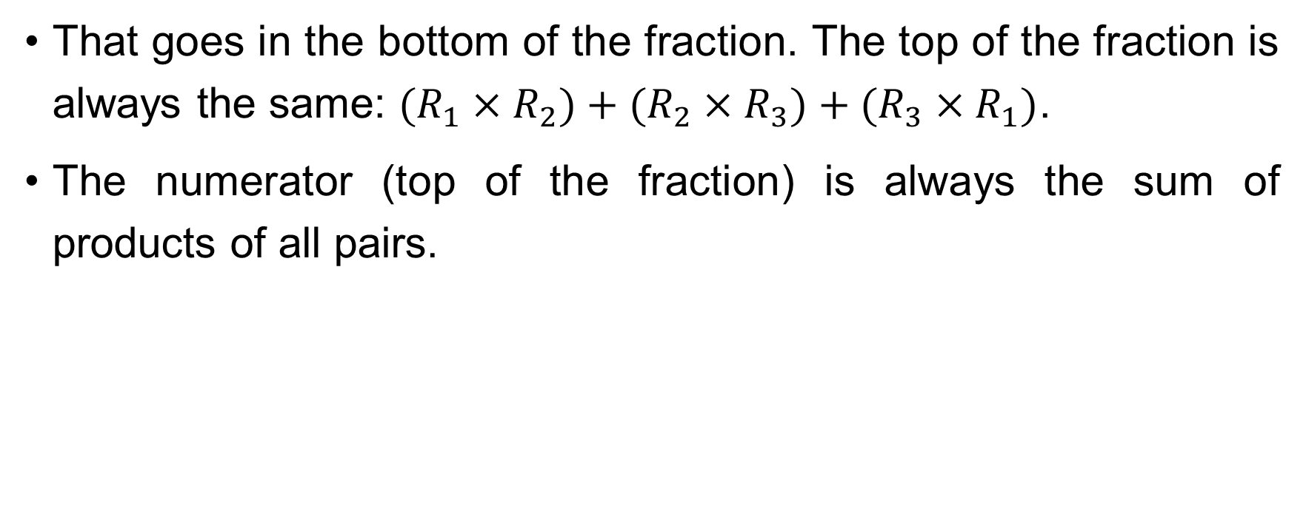
Equivalent Transformations in Passive Networks
Equivalent Transformations in Passive Networks
That goes in the bottom of the fraction. The top of the fraction is always the same: $(R_{1}×R_{2})+(R_{2}×R_{3})+(R_{3}×R_{1})$.
The numerator (top of the fraction) is always the sum of products of all pairs.
/57

Slide 39
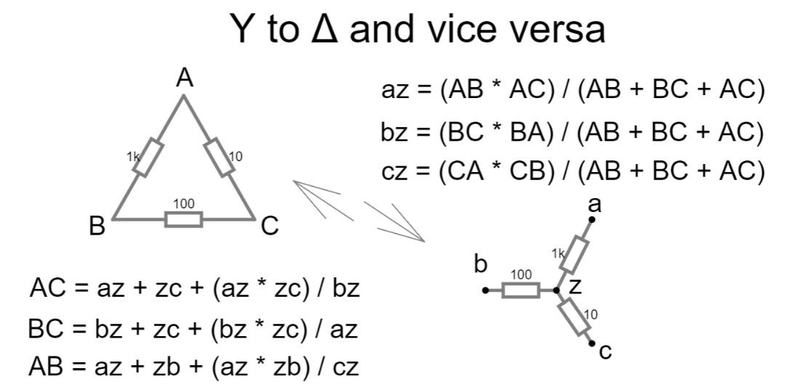
Equivalent Transformations in Passive Networks
Equivalent Transformations in Passive Networks
/57

Slide 40
Equivalent Transformations in Passive Networks
Equivalent Transformations in Passive Networks
But what happens if we connect two nodes of these networks in series in some branch, and connect one of them to ground?
You get a T-network and Pi-network.
Here is an illustration of T-network and Pi-network of resistors
/57

Slide 41
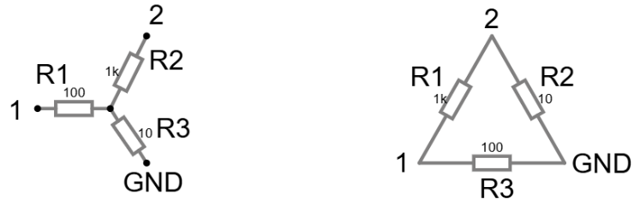
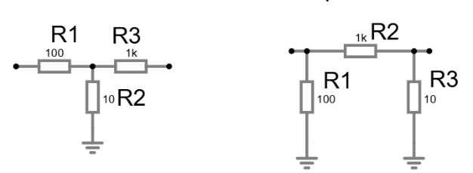
Equivalent Transformations in Passive Networks
Equivalent Transformations in Passive Networks
T-Networks circuits are often used in amplifiers to obtain high gain without high resistances due to their parasitic effects.
/57

Slide 42
Equivalent Transformations in Passive Networks
Equivalent Transformations in Passive Networks
Why do we need Y-Δ transformation? Consider a «Bridge Circuit» – a diamond shape of 5 resistors.
It looks like two triangles sharing a side.
A bridge circuit often has no resistors in series and no resistors in parallel.
We are stuck; we cannot use simple reduction. However, by replacing the top triangle (Delta) with a star shape (Y), we break the bridge.
/57

Slide 43
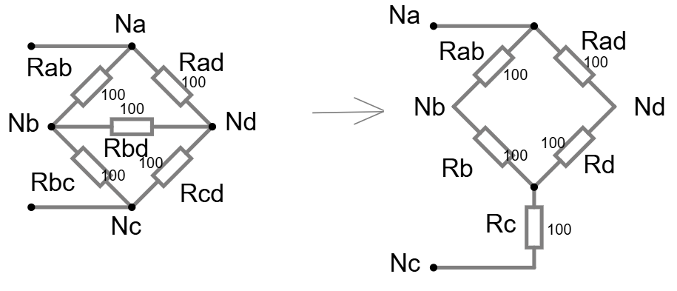
Equivalent Transformations in Passive Networks
Equivalent Transformations in Passive Networks
The new «Y» resistors will end up being in series with the bottom resistors of the bridge.
This magic trick turns an «impossible» circuit into a simple series-parallel problem that we can solve in minutes.
/57

Slide 44
Equivalent Transformations in Passive Networks
Equivalent Transformations in Passive Networks
Sometimes, it is hard to see the Δ (Pi) or Y (T) shapes because circuit diagrams can be drawn in messy ways. Do not look for triangles or letters. Look at the connections.
A Pi (Δ) network exists whenever you have three resistors forming a closed loop with no other elements inside the loop.
A T (Y) network exists whenever you have three resistors meeting at a single node, and that node connects to nothing else.
Being able to spot these shapes in a complex, «spaghetti» diagram is the first step to solving hard problems.
/57

Slide 45
Equivalent Transformations in Passive Networks
Equivalent Transformations in Passive Networks
Let us walk through the algorithm for solving a Bridge Circuit using this tool.
Identify the Bridge. You see five resistors. It is not series, and it is not parallel.
The Bridge is on the next slide.
/57

Slide 46
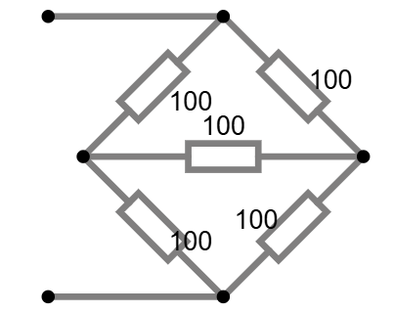
Equivalent Transformations in Passive Networks
Equivalent Transformations in Passive Networks
/57

Slide 47

Equivalent Transformations in Passive Networks
Equivalent Transformations in Passive Networks
Check for Balance: multiply the opposite resistors ($R_{1}×R_{4}$ and $R_{2}×R_{3}$).
If they are equal, the bridge is «balanced».
/57

Slide 48
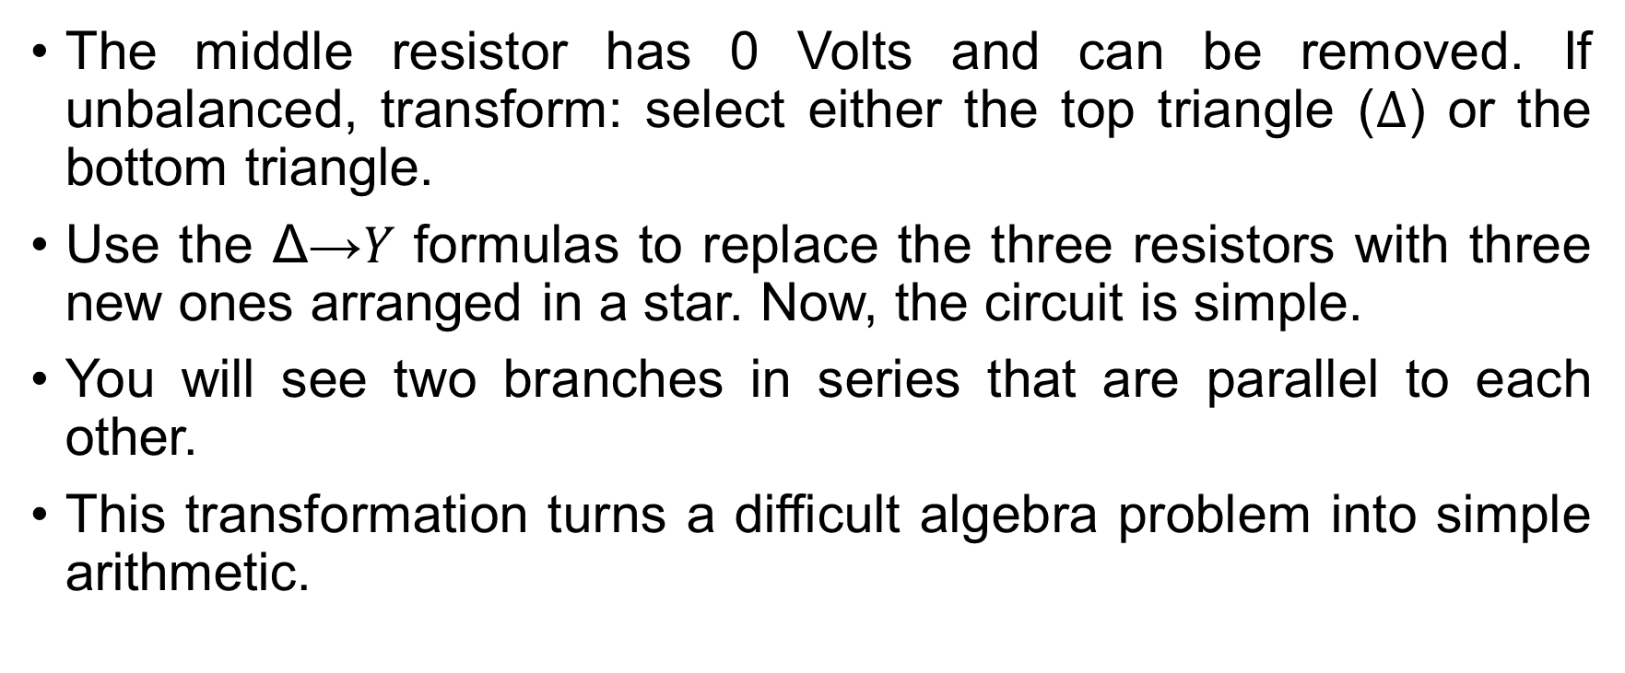
Equivalent Transformations in Passive Networks
Equivalent Transformations in Passive Networks
The middle resistor has 0 Volts and can be removed. If unbalanced, transform: select either the top triangle ($Δ$) or the bottom triangle.
Use the Δ→𝑌 formulas to replace the three resistors with three new ones arranged in a star. Now, the circuit is simple.
You will see two branches in series that are parallel to each other.
This transformation turns a difficult algebra problem into simple arithmetic.
/57

Slide 49
Equivalent Transformations in Passive Networks
Equivalent Transformations in Passive Networks
We now transition to the characterization of passive networks through the concept of Input Resistance.
As we said before, passive one-port network is a collection of resistive elements with two access terminals, containing no independent sources.
To the external circuit, this entire network behaves as a single equivalent resistor.
The calculation of this resistance is used to match resistances in circuits and analyze the effect of load.
/57

Slide 50
Equivalent Transformations in Passive Networks
Equivalent Transformations in Passive Networks
For networks consisting purely of series and parallel combinations, the input resistance is found by successive simplification, as discussed before.
However, for non-series-parallel topologies, such as bridge circuits, we must employ the «Test Source Method».
/57

Slide 51
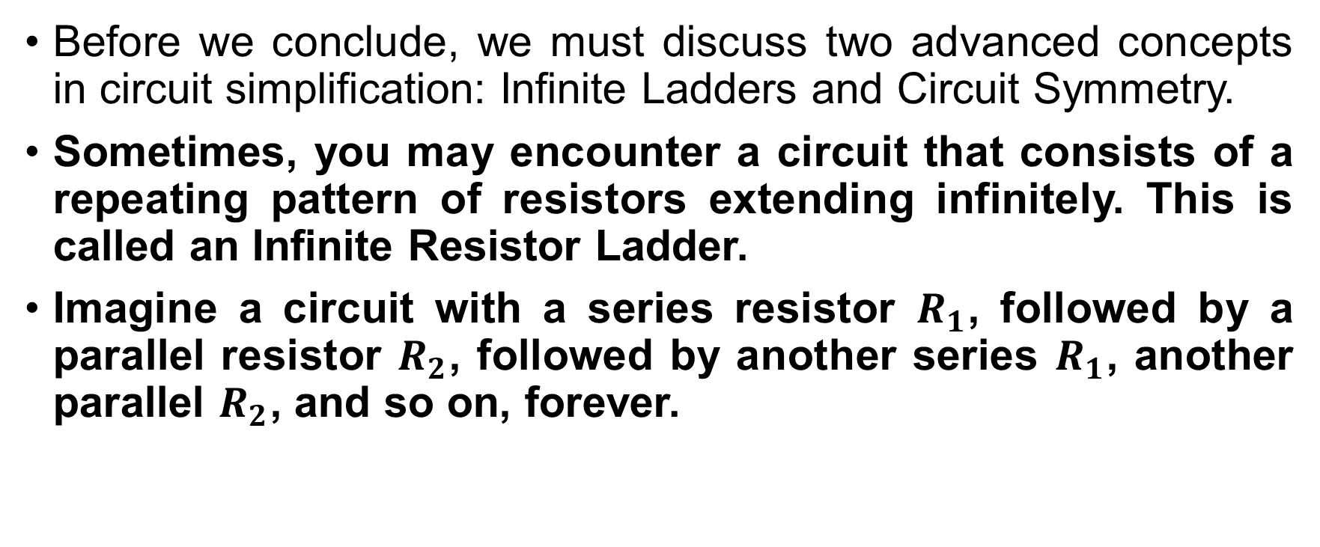
Equivalent Transformations in Passive Networks
Equivalent Transformations in Passive Networks
Before we conclude, we must discuss two advanced concepts in circuit simplification: Infinite Ladders and Circuit Symmetry.
Sometimes, you may encounter a circuit that consists of a repeating pattern of resistors extending infinitely. This is called an Infinite Resistor Ladder.
Imagine a circuit with a series resistor $R_{1}$, followed by a parallel resistor $R_{2}$, followed by another series $R_{1}$, another parallel $R_{2}$, and so on, forever.
/57

Slide 52
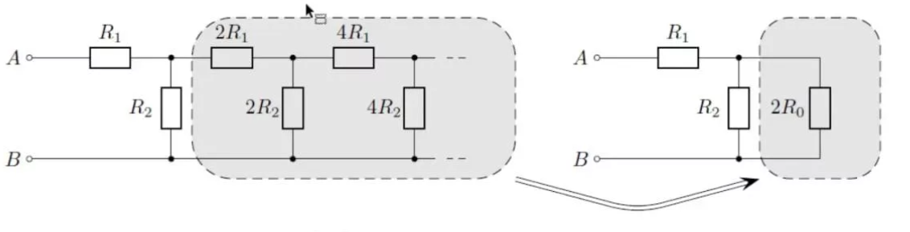

Equivalent Transformations in Passive Networks
Equivalent Transformations in Passive Networks
How do we calculate the input resistance of an infinite chain?
We use a logical trick. Since the ladder is infinite, if we remove the first «stage» (the first $R_{1}$ and $R_{2}$), the remaining circuit is still an infinite ladder.
/57

Slide 53
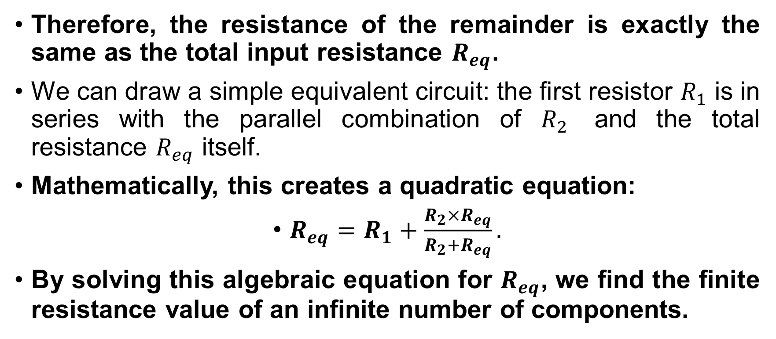
Equivalent Transformations in Passive Networks
Equivalent Transformations in Passive Networks
Therefore, the resistance of the remainder is exactly the same as the total input resistance $R_{eq}$.
We can draw a simple equivalent circuit: the first resistor $R_{1}$ is in series with the parallel combination of $R_{2}$ and the total resistance $R_{eq}$ itself.
Mathematically, this creates a quadratic equation:
$R_{eq}=R_{1}+\frac{R_{2}×R_{eq}}{R_{2}+R_{eq}}.$
By solving this algebraic equation for $R_{eq}$, we find the finite resistance value of an infinite number of components.
/57

Slide 54
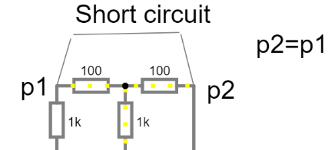
Equivalent Transformations in Passive Networks
Equivalent Transformations in Passive Networks
The second concept is Geometric Symmetry. Many complex circuits, like the cube of resistors or complex bridges, are symmetrical.
If a circuit is symmetrical, points that are in geometrically identical positions often have the same potential.
Equipotential Node Rule: if two nodes in a symmetrical circuit have the same potential, we can connect them with a short wire without changing the
circuit currents. Alternatively, we can
disconnect them entirely.
/57

Slide 55
Equivalent Transformations in Passive Networks
Equivalent Transformations in Passive Networks
Current does not flow between points of equal potential. For example, in a balanced bridge, the center connection carries no current because of symmetry.
Recognizing symmetry allows you to «fold» a complex 3D circuit into a simple 2D parallel circuit, avoiding long calculations with Y-Δ transformations.
In this lecture we explored some transformations within circuits that can be very useful in real-world analysis. I recommend paying special attention to voltage and current dividers, as well as bridge circuits.
/57

Slide 56

Equivalent Transformations in Passive Networks
Equivalent Transformations in Passive Networks
Thank you for your attention!
Do you have you any questions?
/57

