Slide 1
Lecture 4. Systematic Analysis Methods
Part (2). Analysis of Resistive Circuits

Slide 2
Systematic Analysis Methods
Systematic Analysis Methods
Welcome back to our course on The Principle of Circuit.
In our previous lectures, we established the fundamental behavior of ideal elements and explored how to simplify circuits using equivalent transformations, such as series, parallel, and Delta-Star conversions.
However, not all circuits can be simplified using these basic reduction techniques.
When we encounter complex networks with multiple sources and interconnections that are neither series nor parallel, we require more powerful mathematical tools.

Slide 3
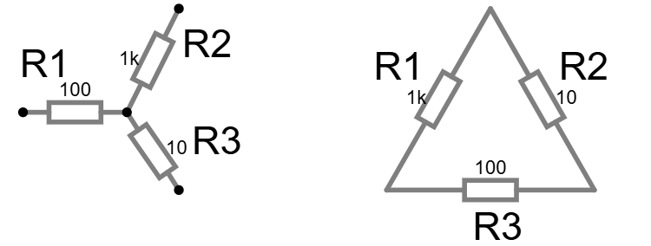
Systematic Analysis Methods
Systematic Analysis Methods
But first of all, let’s review the example of Y-Δ transform because it is not so obvious to understand

Slide 4
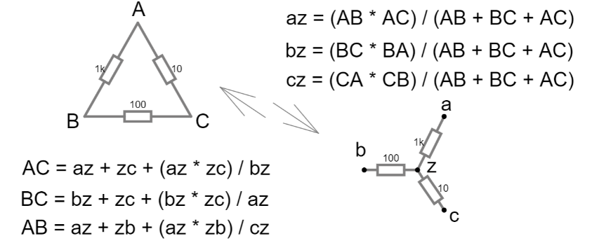
Systematic Analysis Methods
Systematic Analysis Methods
So, we can designate the resistors AC, BC and AB at the Δ-circuit and az, bz and cz at the Y-circuit to make the formulas look more geometric, now we are talking about resistors between two points.
These formulas can be written as on the slide

Slide 5
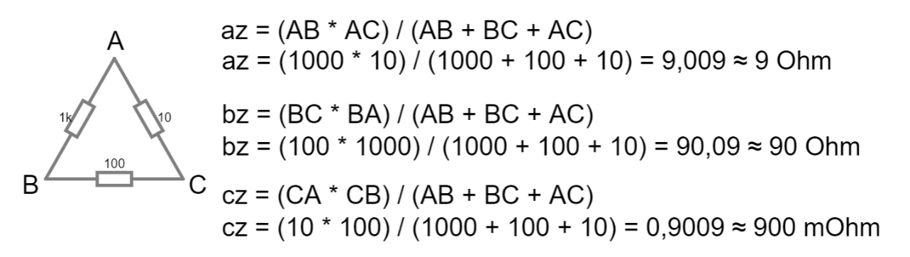
Systematic Analysis Methods
Systematic Analysis Methods
Let’s apply these formulas to transform Δ to Y circuit

Slide 6
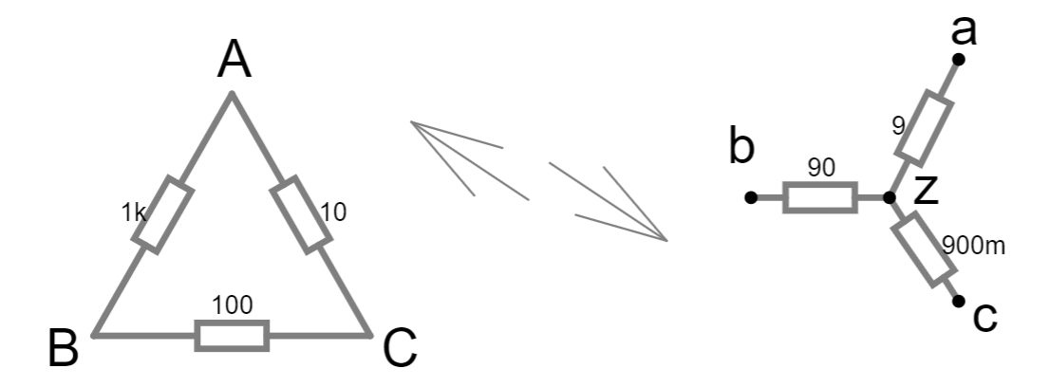
Systematic Analysis Methods
Systematic Analysis Methods
Therefore, we will have the new Y-circuit, equivalent to the Δ one

Slide 7
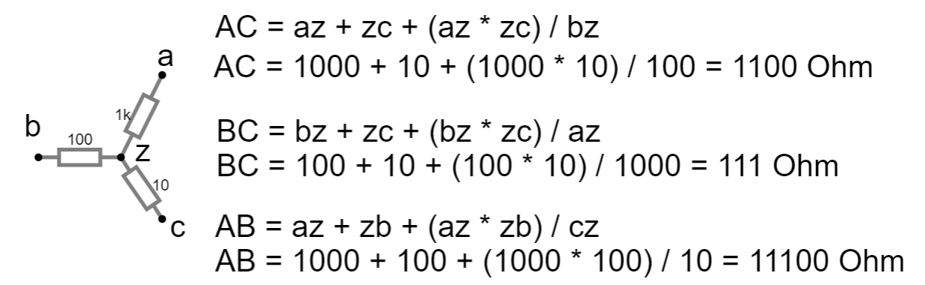
Systematic Analysis Methods
Systematic Analysis Methods
And now let’s try an Y-Δ transform

Slide 8
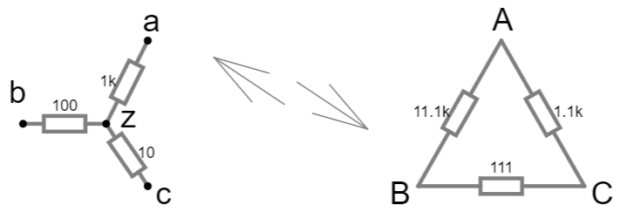
Systematic Analysis Methods
Systematic Analysis Methods
Therefore, we will have the new Δ-circuit, equivalent to the Y one

Slide 9
Systematic Analysis Methods
Systematic Analysis Methods
Equivalent transform means, that if you change Δ-shaped part in a circuit to calculated equivalent Y-shaped part nothing will changes in this circuit
Voltages and currents must be stable

Slide 10
Systematic Analysis Methods
Systematic Analysis Methods
You can see that current doesn’t change after transformation here

Slide 11
Systematic Analysis Methods
Systematic Analysis Methods
And here

Slide 12
Systematic Analysis Methods
Systematic Analysis Methods
Now we can go next.
Today, we begin the study of systematic analysis methods.
These are algorithmic procedures that allow us to convert any linear circuit into a system of simultaneous algebraic equations.
The primary objective of this lecture is to master the Branch Current Method, the Nodal Voltage Method, and the Mesh Current Method.
These three techniques form the toolkit of every professional electrical engineer.

Slide 13
Systematic Analysis Methods
Systematic Analysis Methods
Systematic analysis methods provide a structured step-by-step approach to writing exactly enough independent equations to solve the circuit.
We will trade the visual intuition of circuit reduction for the mathematical rigor of linear algebra.
While circuit reduction changes the structure of the circuit to find a single value, systematic methods leave the circuit structure intact and solve for all variables simultaneously.

Slide 14
Systematic Analysis Methods
Systematic Analysis Methods
To understand why we need these methods, consider a circuit with two voltage sources and three resistors arranged in two loops.
We know Kirchhoff's Laws hold true: the sum of currents at any node is zero (KCL) and the sum of voltages in any loop is zero (KVL).
If we apply these laws randomly, we might end up with more equations than variables, or equations that are redundant. Systematic analysis methods provide a structured step-by-step approach to writing exactly enough independent equations to solve the circuit.

Slide 15
Systematic Analysis Methods
Systematic Analysis Methods
We will trade the visual intuition of circuit reduction for the mathematical rigor of linear algebra.
While circuit reduction changes the structure of the circuit to find a single value, systematic methods leave the circuit structure intact and solve for all variables simultaneously.

Slide 16
Systematic Analysis Methods
Systematic Analysis Methods
Before we proceed, we must strictly define our topological terminology. As we defined in Lecture 2:
a Node is a connection point between two or more elements;
a Branch is a path containing a single element connecting two nodes;
a Loop is any closed path through the circuit.
To these, we add a specific type of loop called a «Mesh».

Slide 17
Systematic Analysis Methods
Systematic Analysis Methods
A Mesh is a loop that does not contain any other loops within it.
You can think of a mesh as a «window pane» in the circuit diagram. In Fig. here you can see that sum of all meshes can be named «loop».

Slide 18
Systematic Analysis Methods
Systematic Analysis Methods
The number of independent equations required to solve a circuit is determined by its topology.
If a circuit has n nodes and b branches, we need a specific number of KCL and KVL equations to find every current and voltage.

Slide 19
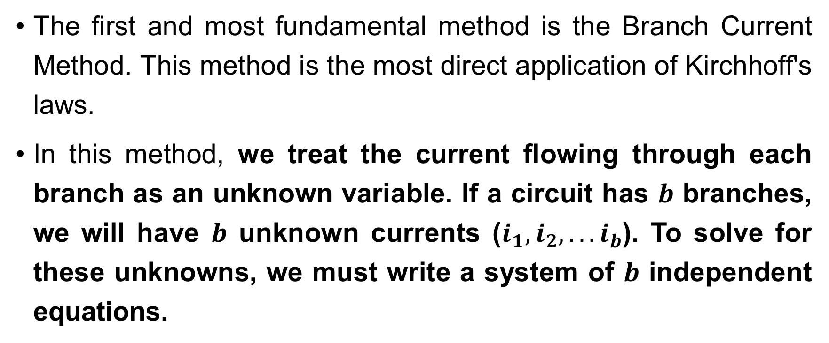
Systematic Analysis Methods
Systematic Analysis Methods
The first and most fundamental method is the Branch Current Method. This method is the most direct application of Kirchhoff's laws.
In this method, we treat the current flowing through each branch as an unknown variable. If a circuit has $b$ branches, we will have $b$ unknown currents ($i_{1},i_{2},...i_{b}$). To solve for these unknowns, we must write a system of $b$ independent equations.

Slide 20
Systematic Analysis Methods
Systematic Analysis Methods
The Branch Current Method is universally applicable to any circuit, but it is computationally inefficient.
For a circuit with just 5 branches, you must solve a system of 5 simultaneous equations.
While this is easy for a computer, it is boring for a human.
However, understanding this method is crucial because it proves that KCL and KVL are sufficient to solve any network.

Slide 21
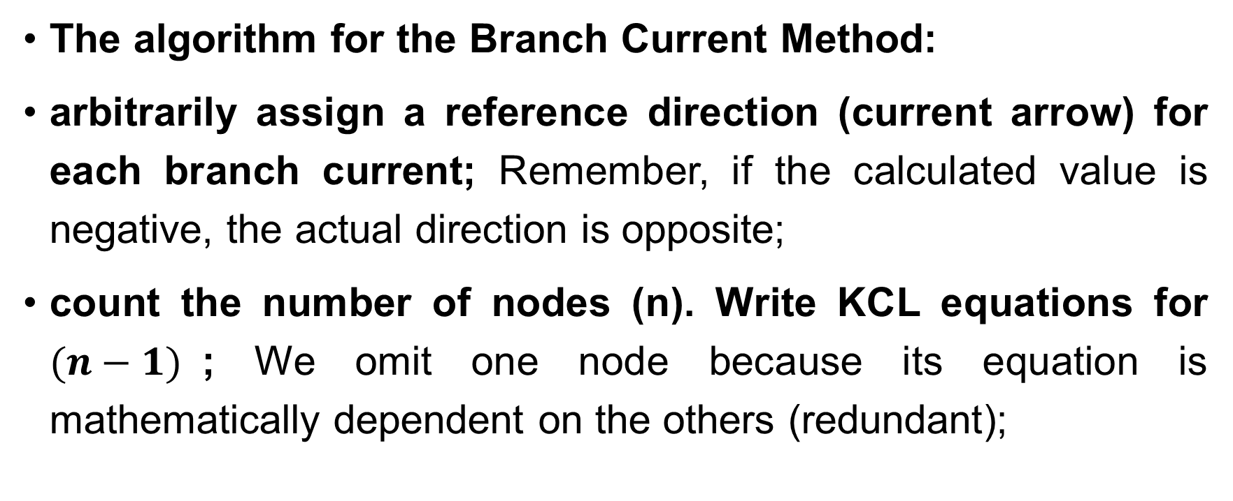
Systematic Analysis Methods
Systematic Analysis Methods
The algorithm for the Branch Current Method:
arbitrarily assign a reference direction (current arrow) for each branch current; Remember, if the calculated value is negative, the actual direction is opposite;
count the number of nodes (n). Write KCL equations for $(n−1)$; We omit one node because its equation is mathematically dependent on the others (redundant);

Slide 22
Systematic Analysis Methods
Systematic Analysis Methods
count the number of independent loops (meshes). Write KVL equations for these loops;
solve the resulting system of linear equations to determine the individual branch currents.

Slide 23

Systematic Analysis Methods
Systematic Analysis Methods
It is imperative to follow the passive sign convention when writing the KVL equations: voltage drops across resistors are positive in the direction of the current ($+iR$), and voltage rises are negative.

Slide 24
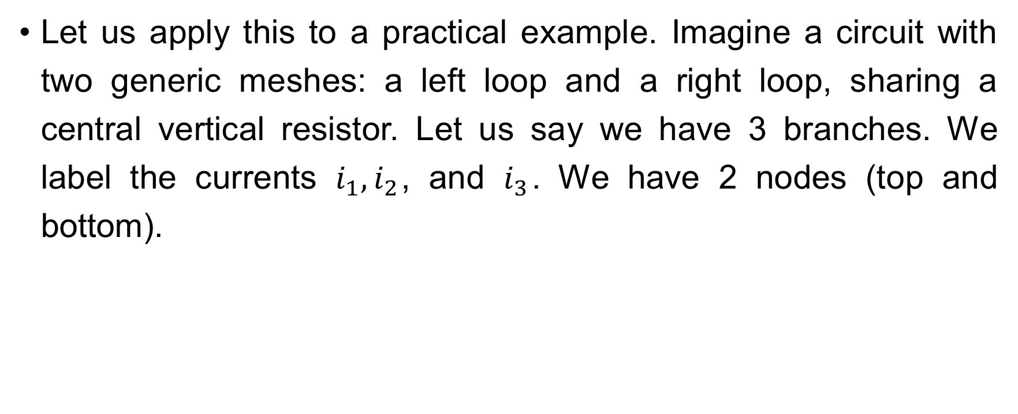
Systematic Analysis Methods
Systematic Analysis Methods
Let us apply this to a practical example. Imagine a circuit with two generic meshes: a left loop and a right loop, sharing a central vertical resistor. Let us say we have 3 branches. We label the currents $i_{1},i_{2}$, and $i_{3}$. We have 2 nodes (top and bottom).

Slide 25
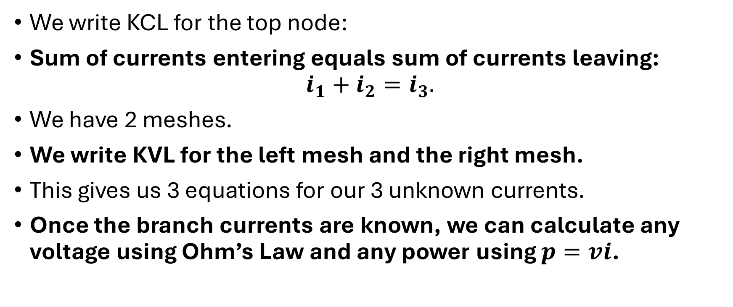
Systematic Analysis Methods
Systematic Analysis Methods
We write KCL for the top node:
Sum of currents entering equals sum of currents leaving:
$$i_{1}+i_{2}=i_{3}.$$
We have 2 meshes.
We write KVL for the left mesh and the right mesh.
This gives us 3 equations for our 3 unknown currents.
Once the branch currents are known, we can calculate any voltage using Ohm’s Law and any power using $p=vi$.

Slide 26
Systematic Analysis Methods
Systematic Analysis Methods
Let’s look at two examples that fit that problem.
First, let’s consider a circuit similar to Fig. Let the voltage of the sources be the same and amount to 9 V.

Slide 27
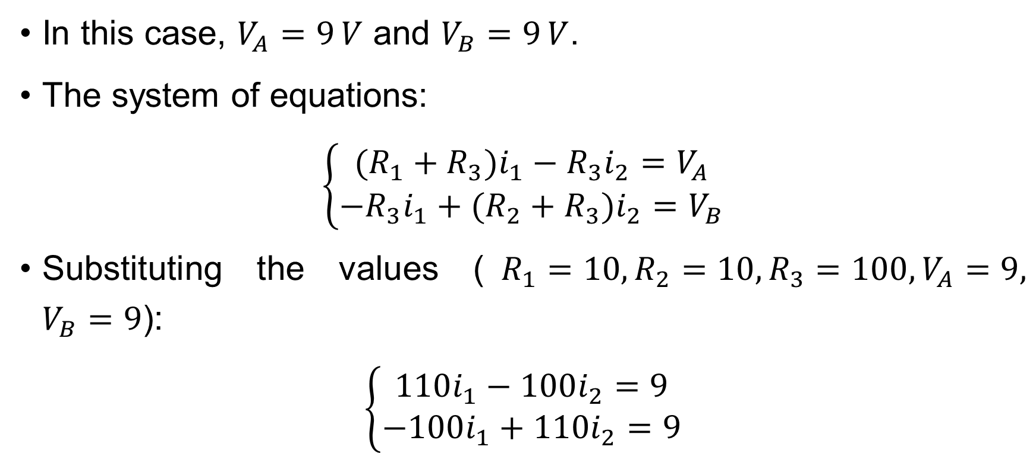
Systematic Analysis Methods
Systematic Analysis Methods
In this case, $V_{A}=9 V$ and $V_{B}=9 V$.
The system of equations:
$$\left\{\begin{matrix}(R_{1}+R_{3})i_{1}−R_{3}i_{2}=V_{A} \\ −R_{3}i_{1}+(R_{2}+R_{3})i_{2}=V_{B}\end{matrix}\right.$$
Substituting the values ($R_{1}=10,R_{2}=10,R_{3}=100,V_{A}=9,$ $V_{B}=9$):
$$\left\{\begin{matrix}110i_{1}−100i_{2}=9 \\ −100i_{1}+110i_{2}=9\end{matrix}\right.$$

Slide 28

Systematic Analysis Methods
Systematic Analysis Methods
The symmetry of the circuit and sources means $i_{1}=i_{2}$. Substituting $i_{1}$ for $i_{2}$ in the first equation:
$$110i_{1}−100i_{1}=9, 10i_{1}=9, i_{1}=\frac{9}{10}=0.9 A$$
Current | Value (A)
𝑖1 (Left Mesh Current) | 0.9 A
𝑖2 (Right Mesh Current) | 0.9 A
𝑖(100 Ω) (Center Branch Current) | 𝑖1−𝑖2=0 𝐴

Slide 29
Systematic Analysis Methods
Systematic Analysis Methods
Second, let’s consider a different circuit with one source only.
In this case, the source in the left mesh is V=9 V, and the source in the right mesh is 0 V.

Slide 30
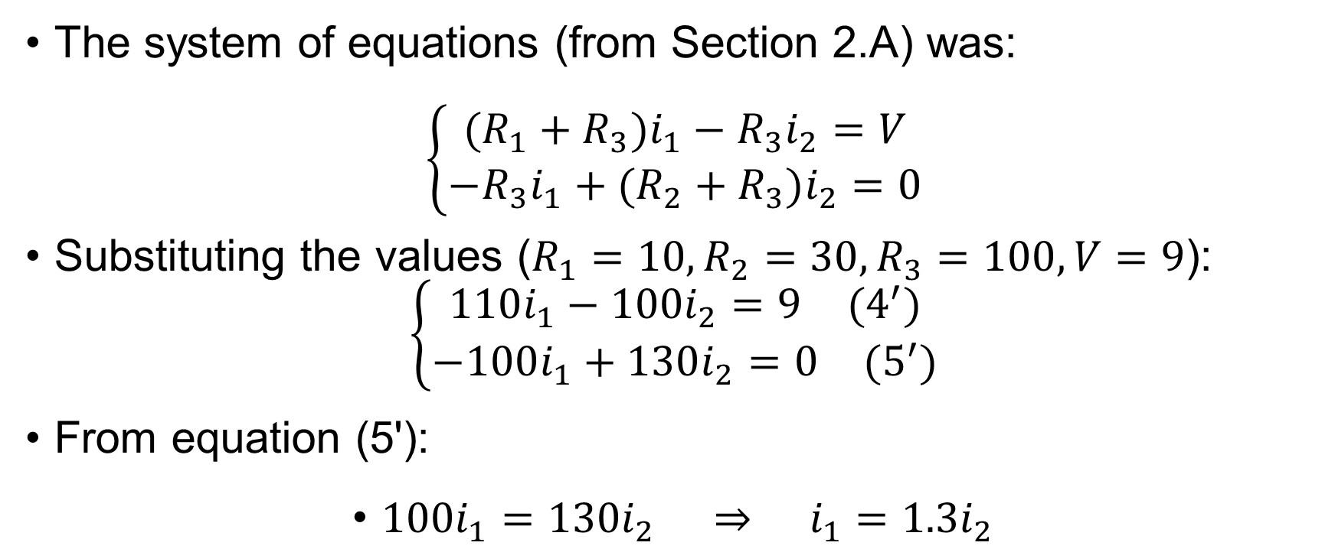
Systematic Analysis Methods
Systematic Analysis Methods
The system of equations (from Section 2.A) was:
$$\left\{\begin{matrix}(R_{1}+R_{3})i_{1}−R_{3}i_{2}=V \\ −R_{3}i_{1}+(R_{2}+R_{3})i_{2}=0\end{matrix}\right.$$
Substituting the values ($R_{1}=10,R_{2}=30,R_{3}=100,V=9$):
$$\left\{\begin{matrix}110i_{1}−100i_{2}=9 (4^{′}) \\ −100i_{1}+130i_{2}=0 (5^{′})\end{matrix}\right.$$
From equation (5'):
$100i_{1}=130i_{2} ⇒ i_{1}=1.3i_{2}$

Slide 31
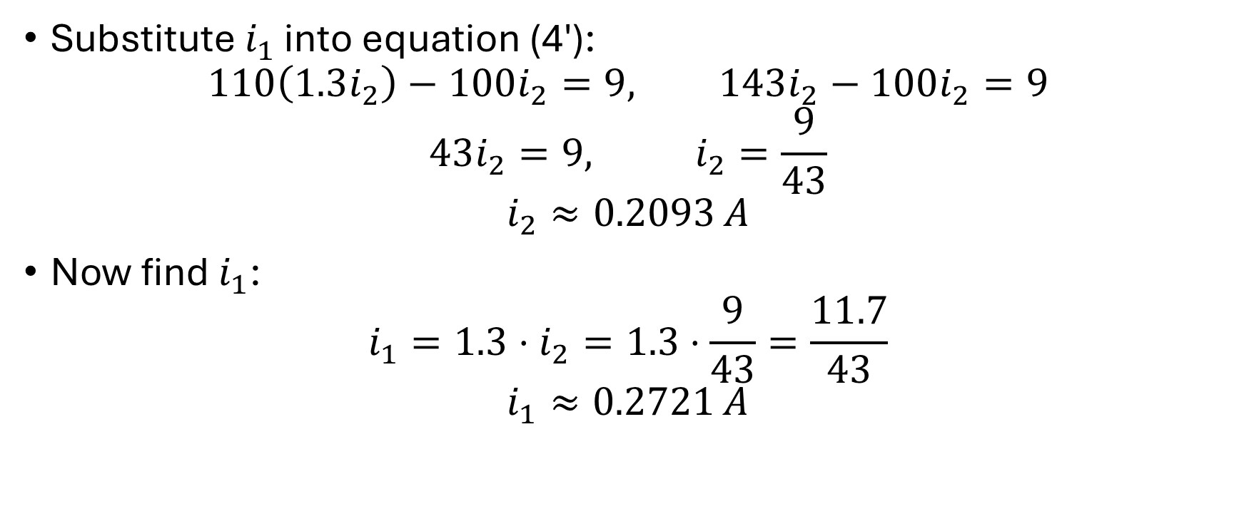
Systematic Analysis Methods
Systematic Analysis Methods
Substitute $i_{1}$ into equation (4'):
$$110\left(1.3i_{2}\right)−100i_{2}=9, 143i_{2}−100i_{2}=9$$
$$43i_{2}=9, i_{2}=\frac{9}{43}$$
$$i_{2}≈0.2093 A$$
Now find $i_{1}$:
$$i_{1}=1.3⋅i_{2}=1.3⋅\frac{9}{43}=\frac{11.7}{43}$$
$$i_{1}≈0.2721 A$$

Slide 32
Systematic Analysis Methods
Systematic Analysis Methods
Here are all results in one table.
Current | Value (A)
𝑖1 (Left Mesh Current) | 9⋅(1.3)/43≈0.2721 𝐴
𝑖2 (Right Mesh Current) | 9/43≈0.2093 𝐴
𝑖(100 Ω) (Center Branch Current) | 𝑖1 −𝑖2 =0.0628 𝐴

Slide 33

Systematic Analysis Methods
Systematic Analysis Methods
Do you have you any questions at the moment?

Slide 34
Systematic Analysis Methods
Systematic Analysis Methods
As you can see, the Branch Current Method generates a large number of equations. Engineers prefer efficiency. We want to solve for fewer variables. This leads us to The Nodal Voltage Method
It reduces the number of equations by solving for «Node Voltages» instead of currents.
Recall from Lecture 1 that electric potential is the voltage at a specific point with respect to a common reference point (Ground).

Slide 35
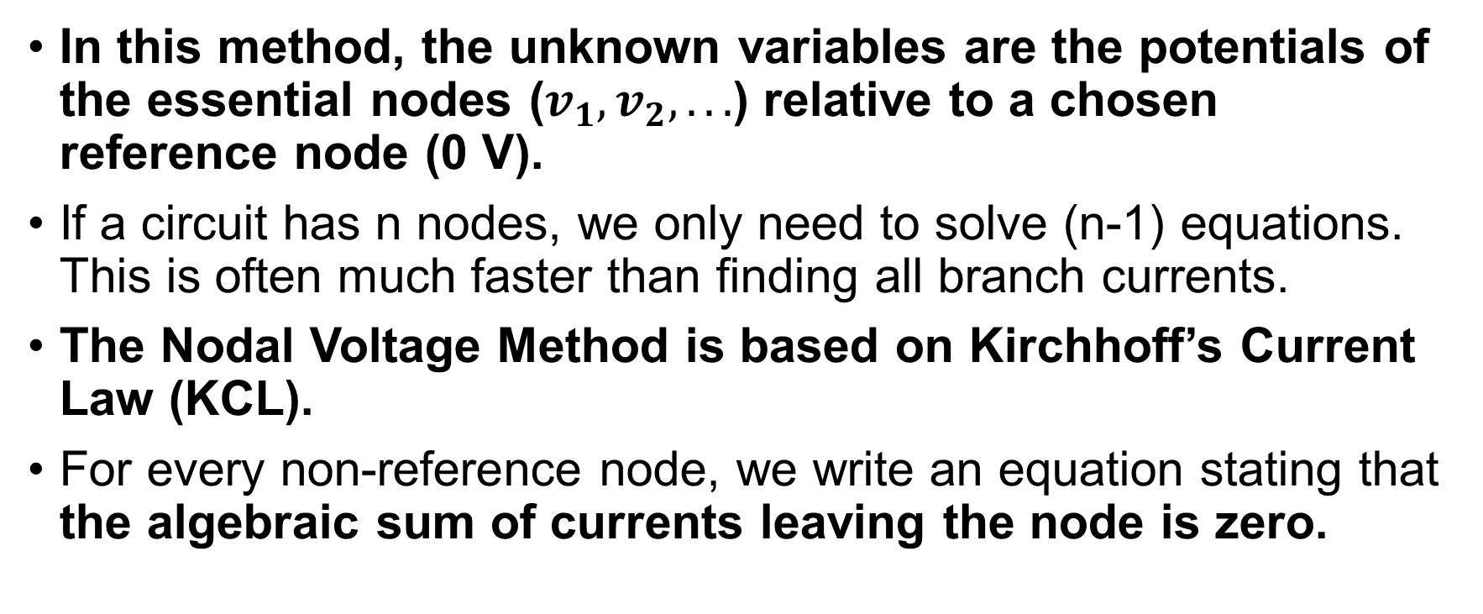
Systematic Analysis Methods
Systematic Analysis Methods
In this method, the unknown variables are the potentials of the essential nodes ($v_{1},v_{2},...$) relative to a chosen reference node (0 V).
If a circuit has n nodes, we only need to solve (n-1) equations. This is often much faster than finding all branch currents.
The Nodal Voltage Method is based on Kirchhoff’s Current Law (KCL).
For every non-reference node, we write an equation stating that the algebraic sum of currents leaving the node is zero.

Slide 36
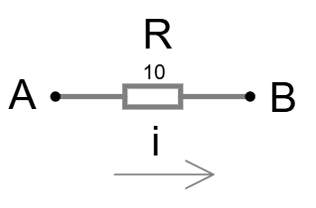
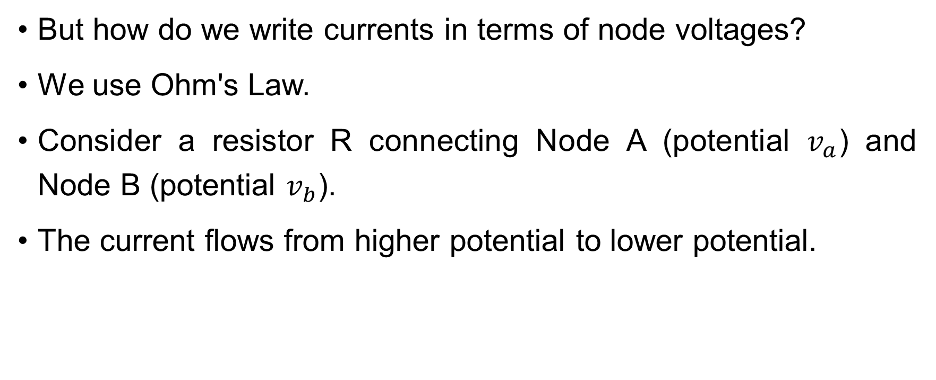
Systematic Analysis Methods
Systematic Analysis Methods
But how do we write currents in terms of node voltages?
We use Ohm's Law.
Consider a resistor R connecting Node A (potential $v_{a}$) and Node B (potential $v_{b}$).
The current flows from higher potential to lower potential.

Slide 37
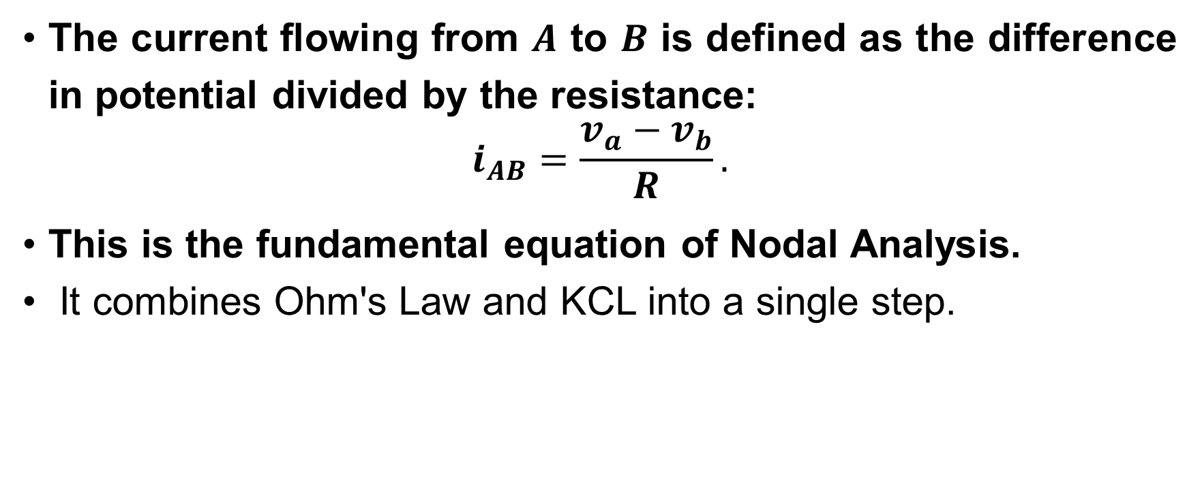
Systematic Analysis Methods
Systematic Analysis Methods
The current flowing from $A$ to $B$ is defined as the difference in potential divided by the resistance:
$$i_{AB}=\frac{v_{a}−v_{b}}{R}.$$
This is the fundamental equation of Nodal Analysis.
It combines Ohm's Law and KCL into a single step.

Slide 38
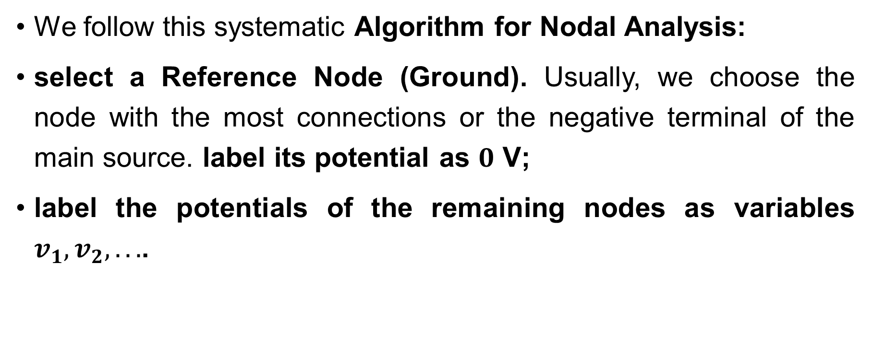
Systematic Analysis Methods
Systematic Analysis Methods
We follow this systematic Algorithm for Nodal Analysis:
select a Reference Node (Ground). Usually, we choose the node with the most connections or the negative terminal of the main source. label its potential as $0$ V;
label the potentials of the remaining nodes as variables $v_{1},v_{2},...$.

Slide 39

Systematic Analysis Methods
Systematic Analysis Methods
write a KCL equation for each non-reference node. Express every branch current as
$$\frac{v_{node}−v_{neighbor}}{R},$$

Slide 40
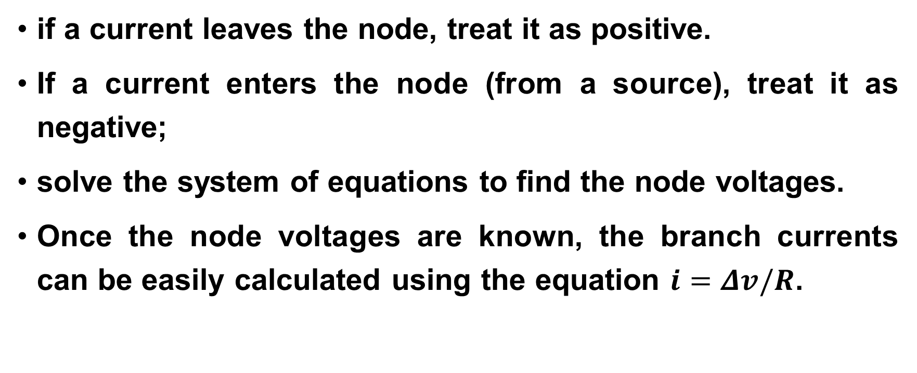
Systematic Analysis Methods
Systematic Analysis Methods
if a current leaves the node, treat it as positive.
If a current enters the node (from a source), treat it as negative;
solve the system of equations to find the node voltages.
Once the node voltages are known, the branch currents can be easily calculated using the equation $i=Δv/R$.

Slide 41
Systematic Analysis Methods
Systematic Analysis Methods
Let us look at a specific case involving current sources.
Nodal analysis is extremely powerful when the circuit contains independent current sources.
Because a current source forces a known value into the node, we do not need to use the v/R term for that branch;

Slide 42
Systematic Analysis Methods
Systematic Analysis Methods
We simply substitute the known source current value directly into the KCL equation.
For example, if a 5A source pumps current into Node 1, the KCL equation simply includes a «-5» term (negative because it enters).
If the circuit contains only current sources and resistors, the Nodal equations can be written by inspection using the conductance matrix.

Slide 43
Systematic Analysis Methods
Systematic Analysis Methods
What if we have voltage sources?
If a voltage source is connected between the reference node and a non-reference node, the analysis is even easier.
The voltage of that node is simply equal to the source voltage.
We do not need to write an equation for it; the variable is already known.

Slide 44
Systematic Analysis Methods
Systematic Analysis Methods
However, if an ideal voltage source is connected between two non-reference nodes, we use the concept of a Supernode.
A Supernode is formed by enclosing the voltage source and its two connecting nodes inside a boundary.
We treat this entire boundary as a single point and apply KCL to it.

Slide 45

Systematic Analysis Methods
Systematic Analysis Methods
We need one auxiliary equation: the difference between the two node voltages inside the supernode equals the source voltage ($v_{a}−v_{b}=v_{source}$).

Slide 46
Systematic Analysis Methods
Systematic Analysis Methods
Now we turn to the third method, which is the counterpart to Nodal Analysis – the Mesh Current Method (Mesh Analysis)
While Nodal Analysis relies on KCL and node voltages, Mesh Analysis relies on Kirchhoff’s Voltage Law (KVL) and «Mesh Currents».
This method is generally preferred when a circuit contains many voltage sources and series connections.

Slide 47
Systematic Analysis Methods
Systematic Analysis Methods
A mesh current is a hypothetical current that flows around a closed loop (mesh).
Unlike branch currents, which are physically measurable, mesh currents are a mathematical abstraction.
The physical current in a branch is the algebraic sum of the mesh currents flowing through it.
Let us visualize the mesh current. Imagine each mesh is a separate gear rotating clockwise. In a branch that is shared by two meshes, two «gears» touch.

Slide 48

Systematic Analysis Methods
Systematic Analysis Methods
If mesh current $i_{1}$ goes down through a shared resistor and mesh current $i_{2}$ goes up through the same resistor, the actual physical current is the difference:
$$i_{actual}=i_{1}−i_{2}.$$

Slide 49
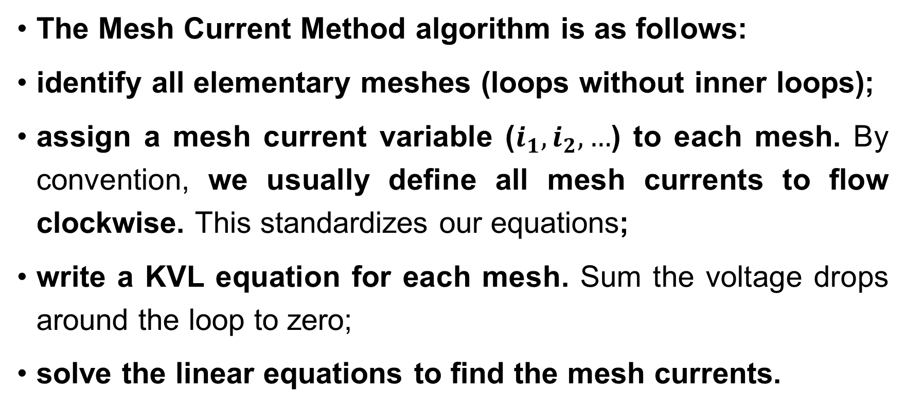
Systematic Analysis Methods
Systematic Analysis Methods
The Mesh Current Method algorithm is as follows:
identify all elementary meshes (loops without inner loops);
assign a mesh current variable ($i_{1},i_{2},…$) to each mesh. By convention, we usually define all mesh currents to flow clockwise. This standardizes our equations;
write a KVL equation for each mesh. Sum the voltage drops around the loop to zero;
solve the linear equations to find the mesh currents.

Slide 50
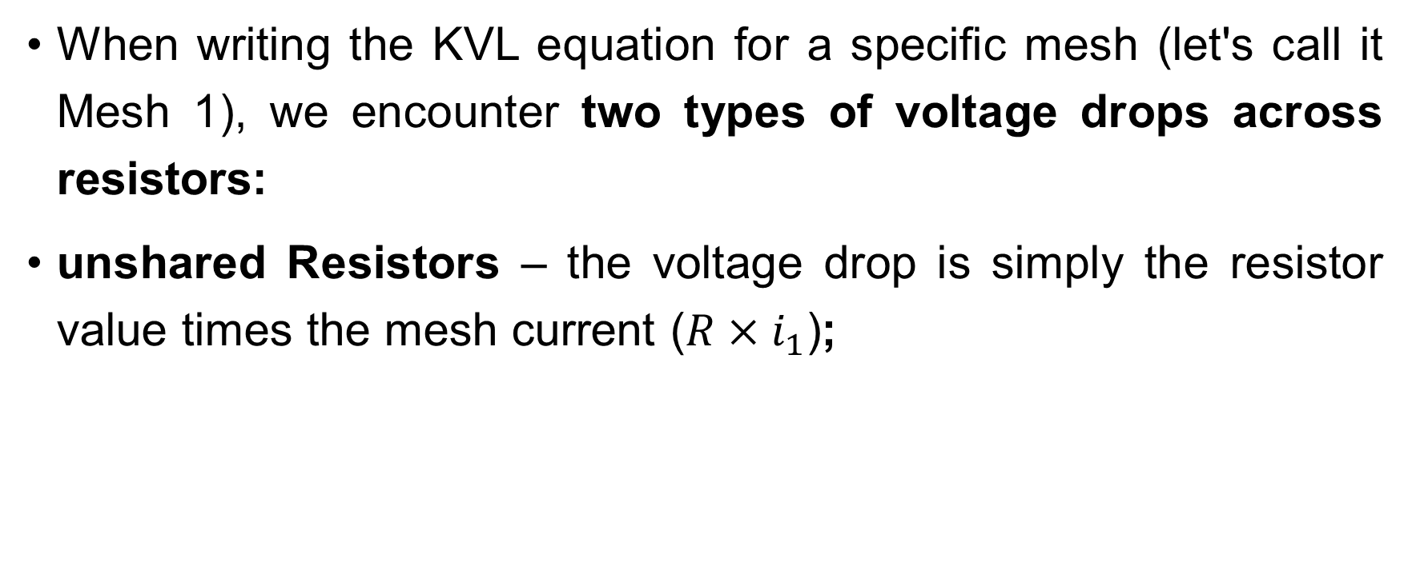
Systematic Analysis Methods
Systematic Analysis Methods
When writing the KVL equation for a specific mesh (let's call it Mesh 1), we encounter two types of voltage drops across resistors:
unshared Resistors – the voltage drop is simply the resistor value times the mesh current ($R×i_{1}$);

Slide 51

Systematic Analysis Methods
Systematic Analysis Methods
shared Resistors – for a resistor $R$ shared between Mesh 1 and Mesh 2, the current flowing through it is $(i_{1}−i_{2})$ (assuming clockwise direction), therefore, the voltage drop is $R×(i_{1}−i_{2})$.

Slide 52
Systematic Analysis Methods
Systematic Analysis Methods
The general pattern for the KVL equation of Mesh 1 is:
This «Self-Resistance minus Mutual-Resistance» pattern makes it very easy to check your work for errors.
$Sum of Voltage Rises=\left(Sum of R in Mesh 1\right)×i_{1}−\left(Shared R\right)×i_{2}$.

Slide 53
Systematic Analysis Methods
Systematic Analysis Methods
Let's illustrate the concept of shared resistance and mesh currents.
Imagine two loops of water pipes sharing a common wall.
The water in the left loop circulates clockwise.
The water in the right loop also circulates clockwise.

Slide 54
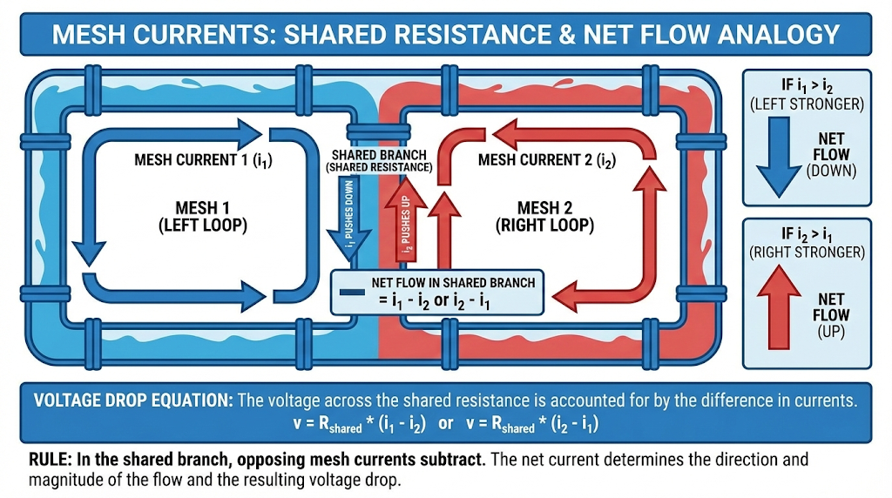
Systematic Analysis Methods

Slide 55
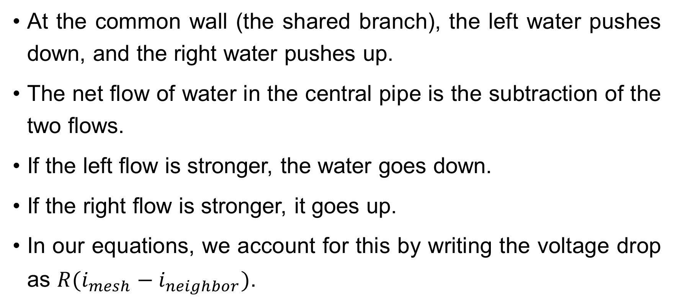
Systematic Analysis Methods
Systematic Analysis Methods
At the common wall (the shared branch), the left water pushes down, and the right water pushes up.
The net flow of water in the central pipe is the subtraction of the two flows.
If the left flow is stronger, the water goes down.
If the right flow is stronger, it goes up.
In our equations, we account for this by writing the voltage drop as $R(i_{mesh}−i_{neighbor})$.

Slide 56
Systematic Analysis Methods
Systematic Analysis Methods
Just as current sources simplified Nodal Analysis, Voltage Sources simplify Mesh Analysis. If a branch contains a voltage source, it simply adds a constant term to the KVL equation.
However, if a Current Source exists in a branch shared by two meshes, we have a problem: we cannot define the voltage drop across an ideal current source directly.
In this case, we use the concept of a Supermesh.

Slide 57
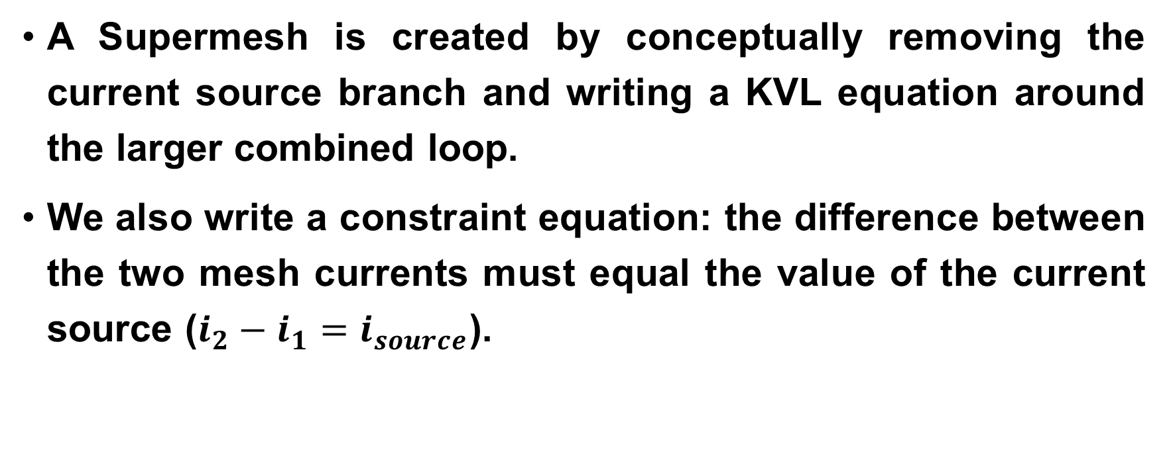
Systematic Analysis Methods
Systematic Analysis Methods
A Supermesh is created by conceptually removing the current source branch and writing a KVL equation around the larger combined loop.
We also write a constraint equation: the difference between the two mesh currents must equal the value of the current source ($i_{2}−i_{1}=i_{source}$).

Slide 58
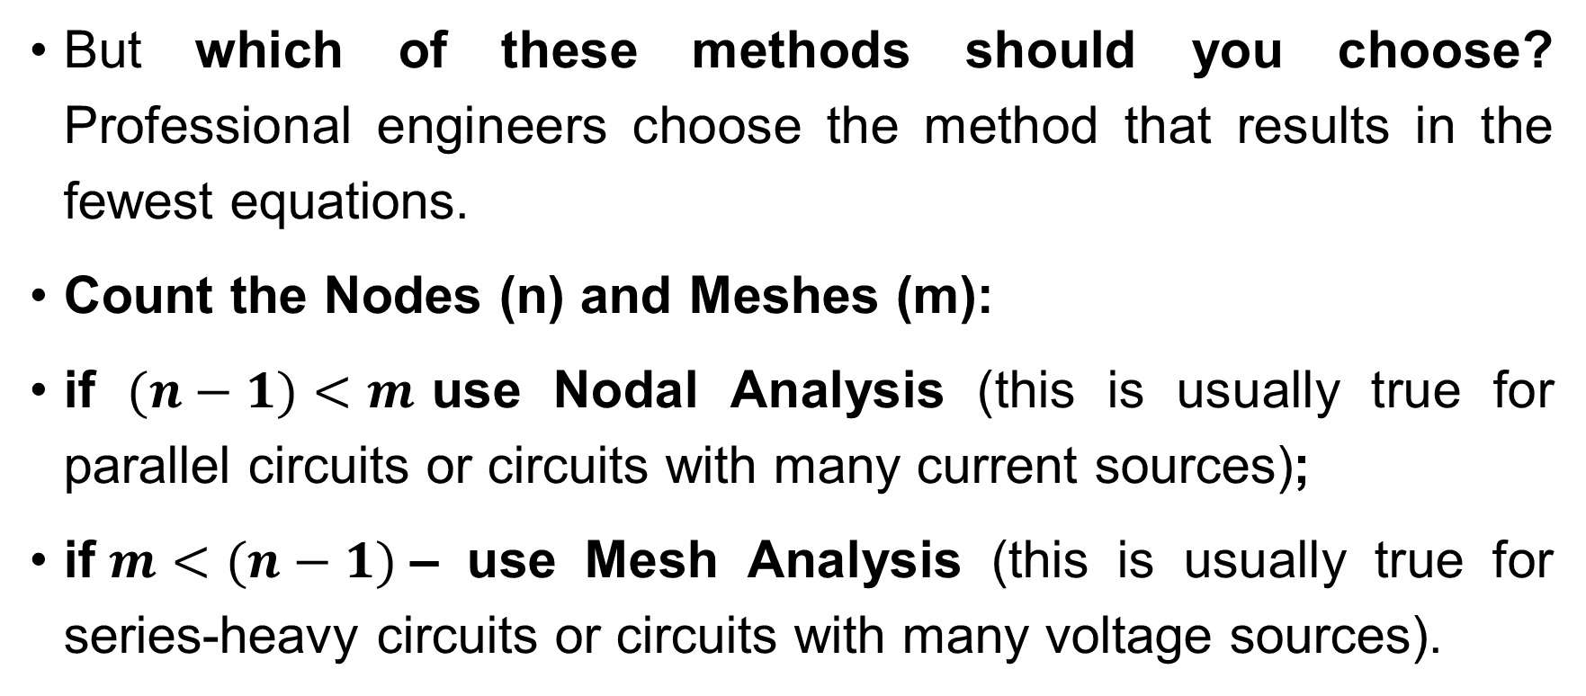
Systematic Analysis Methods
Systematic Analysis Methods
But which of these methods should you choose? Professional engineers choose the method that results in the fewest equations.
Count the Nodes (n) and Meshes (m):
if $(n−1)<m$use Nodal Analysis (this is usually true for parallel circuits or circuits with many current sources);
if$m<(n−1)$– use Mesh Analysis (this is usually true for series-heavy circuits or circuits with many voltage sources).

Slide 59
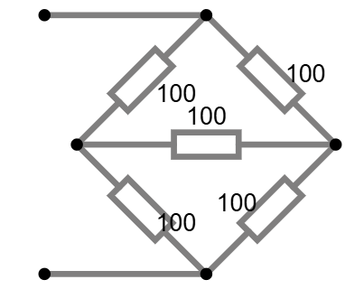
Systematic Analysis Methods
Systematic Analysis Methods
Example: a bridge circuit has 4 nodes and 3 meshes.
Nodal Analysis requires 4-1=3 equations.
Mesh Analysis requires 3 equations.
They are equal in difficulty.
However, if we ground the bottom node,
Nodal might feel more intuitive for finding voltages.

Slide 60
Systematic Analysis Methods
Systematic Analysis Methods
Let us practice with a quick thought experiment. Imagine a circuit with 10 parallel resistors and one voltage source.

Slide 61
Systematic Analysis Methods
Systematic Analysis Methods
Number of Meshes – 10 (you would need to solve a 10×10 matrix). Number of Essential Nodes – 2 (top wire and bottom wire).

Slide 62
Systematic Analysis Methods
Systematic Analysis Methods
Using Nodal Analysis, you solve one equation. Using Mesh Analysis, you solve ten.
Choosing the correct systematic method saves you hours of work.

Slide 63
Systematic Analysis Methods
Systematic Analysis Methods
In summary of this lecture, we have moved from ad-hoc analysis to rigorous algorithms:
the Branch Current Method uses fundamental KCL/KVL but generates many variables;
the Nodal Voltage Method is best for finding voltages and works well with current sources. It is based on KCL;
the Mesh Current Method is best for finding loop currents and works well with voltage sources. It is based on KVL.

Slide 64
Systematic Analysis Methods
Systematic Analysis Methods
Mastery of these three methods is the «literacy» of circuit theory.
You cannot proceed to complex electronics, AC analysis, or power systems without them. In the next lecture, we will explore Fundamental Circuit Theorems like Superposition and Thevenin’s Theorem, which allow us to break complex circuits into simpler pieces.

Slide 65
Systematic Analysis Methods
Systematic Analysis Methods
Thank you for your attention!
Do you have you any questions?

