Slide 1
Lecture 5. Fundamental Circuit Theorems (I)
Part (2). Analysis of Resistive Circuits

Slide 2
Systematic Analysis Methods
Fundamental Circuit Theorems (I)
Welcome to the fifth lecture of our course on The Principle of Circuit.
In our previous session, we mastered the systematic methods of analysis: Branch Current, Nodal Voltage, and Mesh Current Analysis.
These methods are powerful because they are universal; they can solve any circuit, no matter how complex.

Slide 3
Systematic Analysis Methods
Fundamental Circuit Theorems (I)
However, they can be mathematically heavy.
If you have a circuit with ten sources and twenty resistors, Nodal Analysis will give you the answer, but it might take you a long time to calculate it.
Today, we shift our focus from «brute force» calculation to elegant simplification.
We will study Circuit Theorems.

Slide 4
Systematic Analysis Methods
Fundamental Circuit Theorems (I)
Unlike the systematic methods which solve the entire circuit at once, circuit theorems allow us to focus on specific parts of a circuit or to break a complex problem into several smaller, easier problems.

Slide 5
Systematic Analysis Methods
Fundamental Circuit Theorems (I)
The theme of this lecture is Linearity and Simplification. We will cover two of the most important concepts in electrical engineering: The Superposition Theorem and Thevenin’s Theorem.
These tools will allow you to look at a complicated schematic and see the simple structure hidden underneath.

Slide 6
Systematic Analysis Methods
Fundamental Circuit Theorems (I)
Before we can use these theorems, we must define a critical property of the circuits we study.
Linearity – a linear circuit is one whose output is linearly related to its input.
This means the circuit consists only of linear elements (resistors, capacitors, inductors) and linear sources.

Slide 7
Systematic Analysis Methods
Fundamental Circuit Theorems (I)
Linearity is defined by two mathematical properties that you must understand:
1) homogeneity (scaling) – if the input is multiplied by a constant k, the output is multiplied by the same constant k;
For example, if solving a circuit with a 10V source gives you 2A of current, then replacing it with a 20V source (doubling the input) will give you 4A (doubling the output);

Slide 8
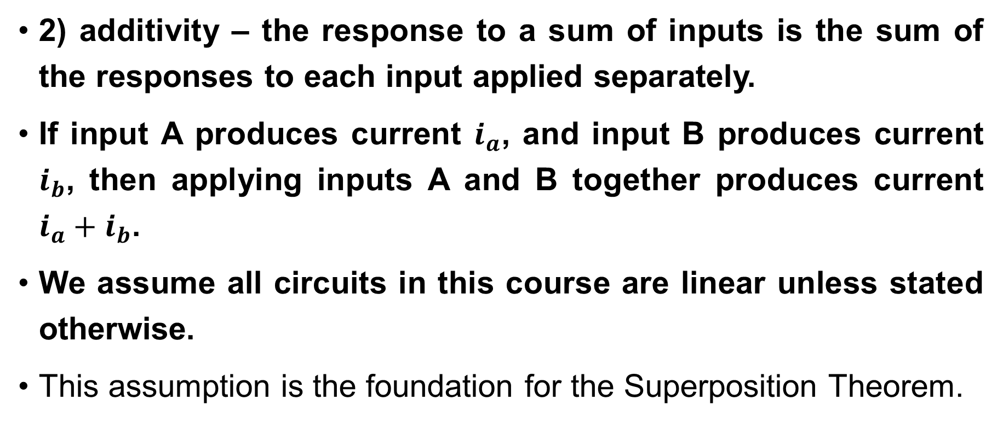
Systematic Analysis Methods
Fundamental Circuit Theorems (I)
2) additivity – the response to a sum of inputs is the sum of the responses to each input applied separately.
If input A produces current $i_{a}$, and input B produces current $i_{b}$, then applying inputs A and B together produces current $i_{a}+i_{b}$.
We assume all circuits in this course are linear unless stated otherwise.
This assumption is the foundation for the Superposition Theorem.

Slide 9
Systematic Analysis Methods
Fundamental Circuit Theorems (I)
The Superposition Theorem is the direct application of the Additivity property: in any linear circuit containing multiple independent sources, the current or voltage at any point is the algebraic sum of the currents or voltages produced by each source acting alone.
Think about what this means. It means we do not have to solve the circuit with all N sources active at the same time.

Slide 10
Systematic Analysis Methods
Fundamental Circuit Theorems (I)
We can solve the circuit N times, each time with only one source active.
This turns one difficult problem into N very easy problems.
Usually, when only one source is active, the circuit can be solved using simple series-parallel reduction, without needing Nodal or Mesh analysis.

Slide 11
Systematic Analysis Methods
Fundamental Circuit Theorems (I)
To use Superposition, we must understand how to «turn off» the sources we are not using. We cannot just remove them from the drawing; we must replace them with their internal resistance:
to turn off an ideal Voltage Source (V=0), replace it with a Short Circuit; Recall from Lecture 2 that a short circuit connects two points with a wire of zero resistance. This forces the voltage difference to be zero, effectively «killing» the voltage source;

Slide 12
Systematic Analysis Methods
Fundamental Circuit Theorems (I)
to turn off an ideal Current Source (I=0), replace it with an Open Circuit.
Recall that an open circuit is a break in the wire. No current can flow through a break, effectively «killing» the current source.

Slide 13
Systematic Analysis Methods
Fundamental Circuit Theorems (I)
Dependent sources (controlled sources) are different. Never turn off a dependent source.
Dependent sources are not inputs; they are part of the circuit's structure, like a resistor. If you turn off the main source controlling them, they will naturally go to zero, but you must leave them in the diagram.

Slide 14
Systematic Analysis Methods
Fundamental Circuit Theorems (I)
Here is the systematic Algorithm for the Superposition Theorem:
identify all independent sources in the circuit. Let's say there are N sources;
turn off all sources except the first one; Replace voltage sources with short circuits and current sources with open circuits;

Slide 15
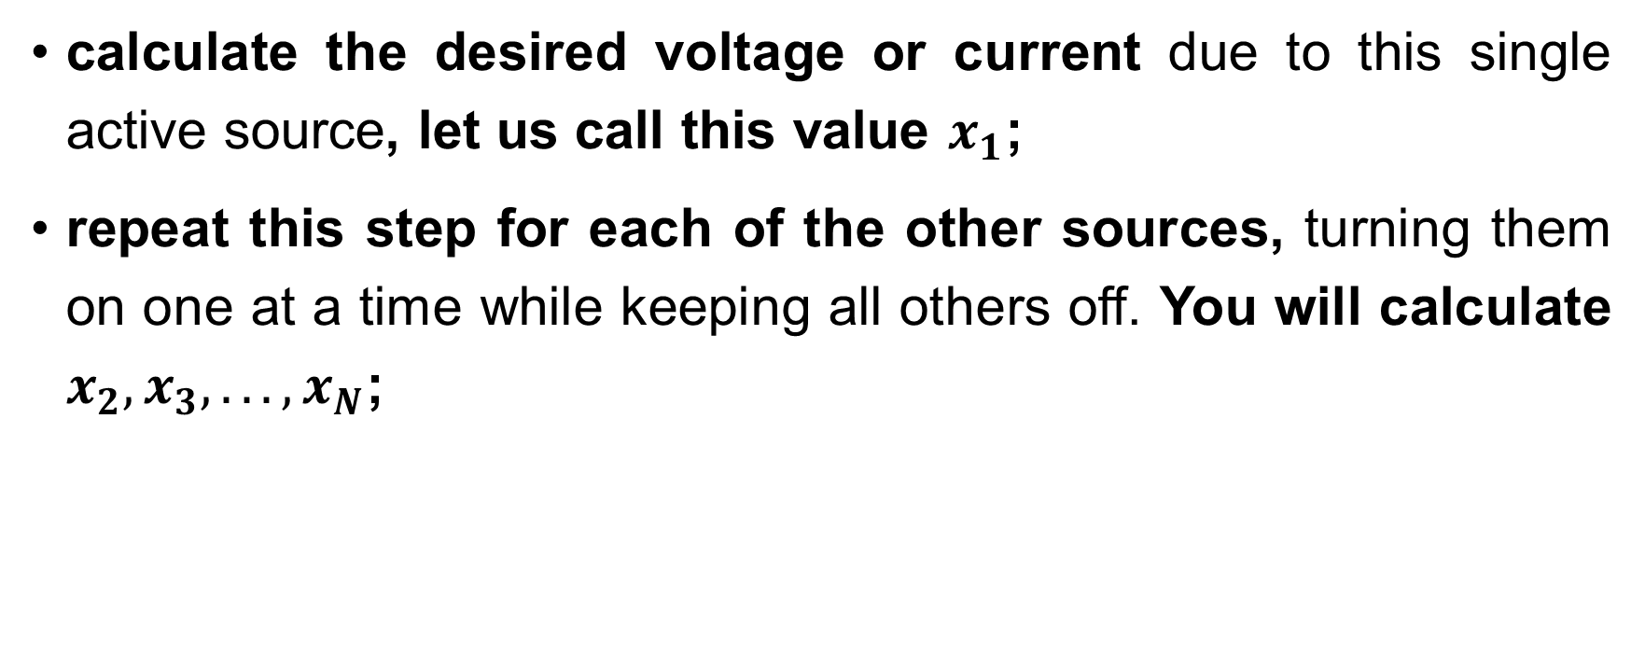
Systematic Analysis Methods
Fundamental Circuit Theorems (I)
calculate the desired voltage or current due to this single active source, let us call this value $x_{1}$;
repeat this step for each of the other sources, turning them on one at a time while keeping all others off. You will calculate $x_{2},x_{3},...,x_{N}$;

Slide 16
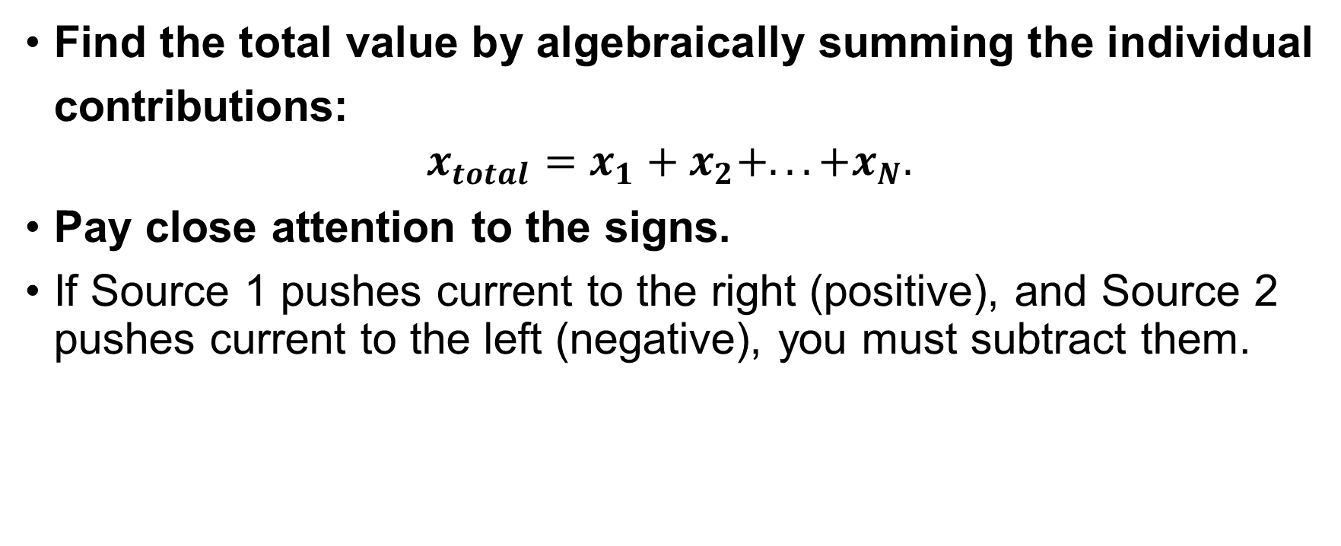
Systematic Analysis Methods
Fundamental Circuit Theorems (I)
Find the total value by algebraically summing the individual contributions:
$$x_{total}=x_{1}+x_{2}+...+x_{N}.$$
Pay close attention to the signs.
If Source 1 pushes current to the right (positive), and Source 2 pushes current to the left (negative), you must subtract them.

Slide 17

Systematic Analysis Methods
Fundamental Circuit Theorems (I)
Let us visualize an example. Imagine a circuit with a Voltage Source ($V_{s}$) on the left and a Current Source ($I_{s}$) on the right, with a resistor ($R_{1}$) in Voltage Source loop and a resistor ($R_{2}$) in the middle. We want to find the current in the middle resistor.

Slide 18
Systematic Analysis Methods
Fundamental Circuit Theorems (I)
Step 1. We replace the Current Source on the right with an open circuit (a cut wire).
Now the circuit is just a simple series loop.

Slide 19
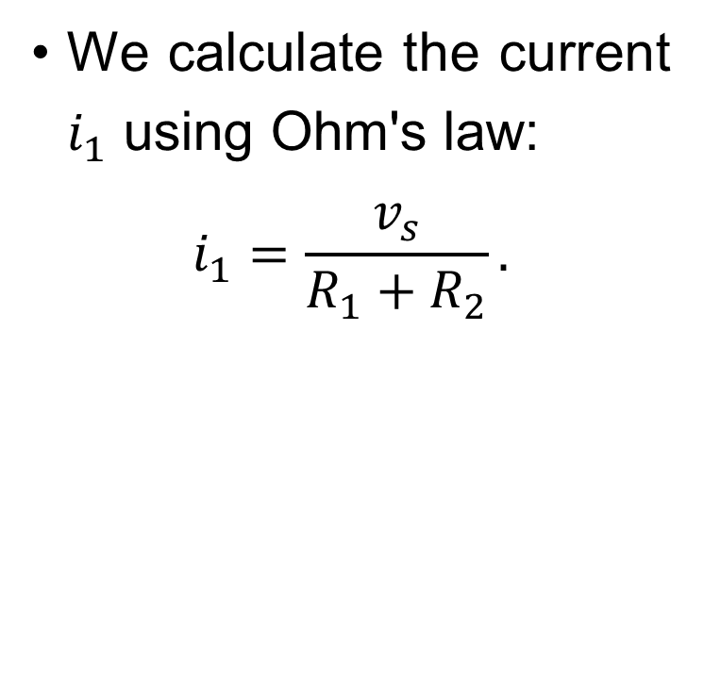
Systematic Analysis Methods
Fundamental Circuit Theorems (I)
We calculate the current $i_{1}$ using Ohm's law:
$$i_{1}=\frac{v_{s}}{R_{1}+R_{2}}.$$

Slide 20
Systematic Analysis Methods
Fundamental Circuit Theorems (I)
Step 2. We replace the Voltage Source on the left with a short circuit (a wire).
Now the resistor is in parallel with the current source.

Slide 21
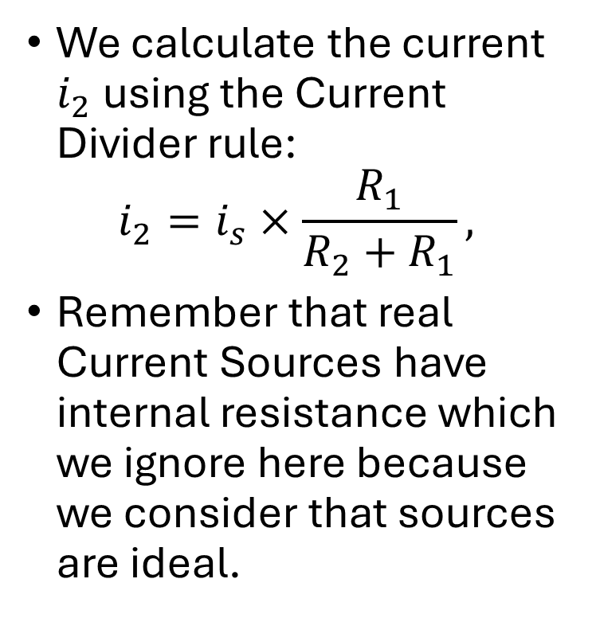
Systematic Analysis Methods
Fundamental Circuit Theorems (I)
We calculate the current $i_{2}$ using the Current Divider rule:
$$i_{2}=i_{s}×\frac{R_{1}}{R_{2}+R_{1}},$$
Remember that real Current Sources have internal resistance which we ignore here because we consider that sources are ideal.

Slide 22
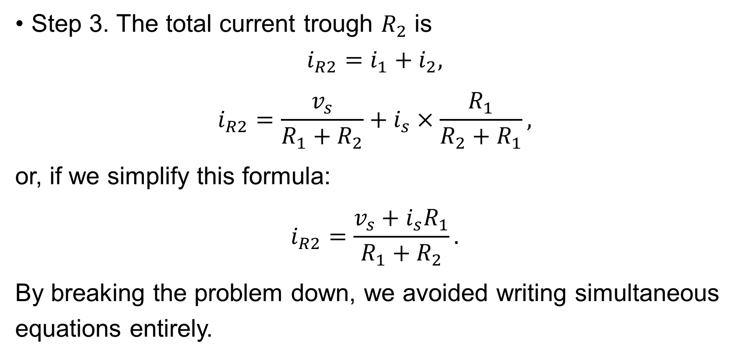
Systematic Analysis Methods
Fundamental Circuit Theorems (I)
Step 3. The total current trough $R_{2}$ is
$$i_{R2}=i_{1}+i_{2},$$
$$i_{R2}=\frac{v_{s}}{R_{1}+R_{2}}+i_{s}×\frac{R_{1}}{R_{2}+R_{1}},$$
or, if we simplify this formula:
$$i_{R2}=\frac{v_{s}+i_{s}R_{1}}{R_{1}+R_{2}}.$$
By breaking the problem down, we avoided writing simultaneous equations entirely.

Slide 23

Systematic Analysis Methods
Fundamental Circuit Theorems (I)
Do you have you any questions at the moment?

Slide 24
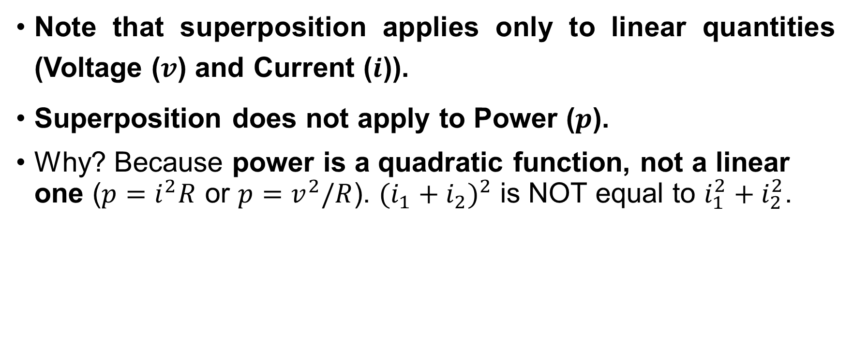
Systematic Analysis Methods
Fundamental Circuit Theorems (I)
Note that superposition applies only to linear quantities (Voltage ($v$) and Current ($i$)).
Superposition does not apply to Power ($p$).
Why? Because power is a quadratic function, not a linear one ($p=i^{2}R$ or $p=v^{2}/R$). $(i_{1}+i_{2})^{2}$ is NOT equal to $i_{1}^{2}+i_{2}^{2}$.

Slide 25
Systematic Analysis Methods
Fundamental Circuit Theorems (I)
You cannot calculate the power from Source 1, then the power from Source 2, and add them.
To find power using superposition, you must first find the total voltage or total current using superposition, and then calculate the power using the total value.
Power is non-linear and cannot be superposed.

Slide 26
Systematic Analysis Methods
Fundamental Circuit Theorems (I)
We now transition to the second major topic – Thevenin’s Theorem.
In engineering, we often care about only one specific part of a circuit, which we call the «Load».
This could be a speaker connected to an amplifier, or a light bulb connected to a battery.
The rest of the circuit might be incredibly complex, containing hundreds of resistors and sources.
Does the Load care about that complexity? No.

Slide 27
Systematic Analysis Methods
Fundamental Circuit Theorems (I)
From the perspective of the load, the entire complex circuit behaves like a simple «Black Box» that provides a specific voltage and has a specific internal resistance.
Thevenin’s Theorem allows us to replace any complex linear one-port network with a simple equivalent circuit.

Slide 28
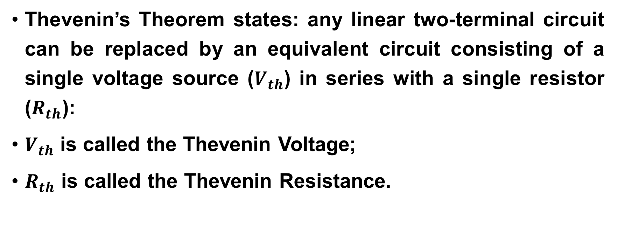
Systematic Analysis Methods
Fundamental Circuit Theorems (I)
Thevenin’s Theorem states: any linear two-terminal circuit can be replaced by an equivalent circuit consisting of a single voltage source ($V_{th}$) in series with a single resistor ($R_{th}$):
$V_{th}$ is called the Thevenin Voltage;
$R_{th}$ is called the Thevenin Resistance.

Slide 29
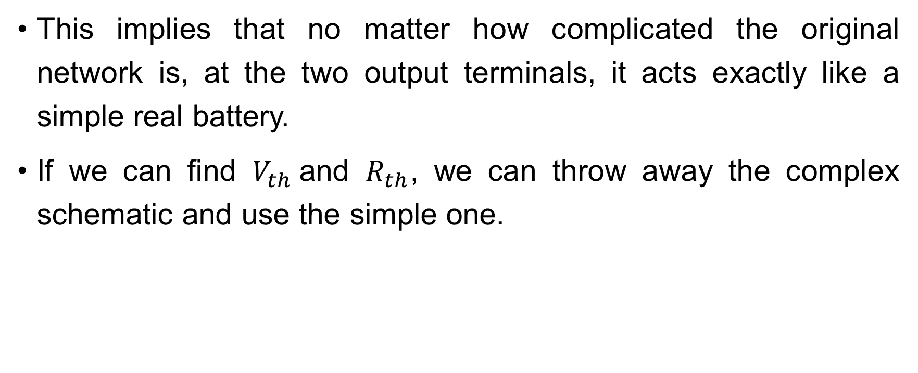
Systematic Analysis Methods
Fundamental Circuit Theorems (I)
This implies that no matter how complicated the original network is, at the two output terminals, it acts exactly like a simple real battery.
If we can find $V_{th}$and $R_{th}$, we can throw away the complex schematic and use the simple one.

Slide 30
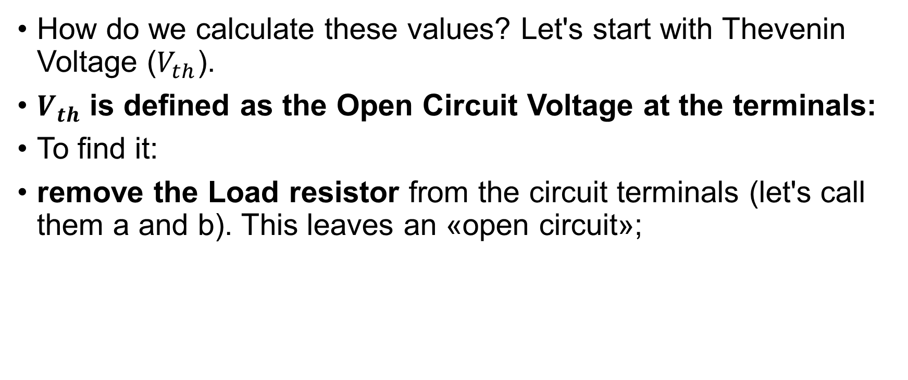
Systematic Analysis Methods
Fundamental Circuit Theorems (I)
How do we calculate these values? Let's start with Thevenin Voltage ($V_{th}$).
$V_{th}$ is defined as the Open Circuit Voltage at the terminals:
To find it:
remove the Load resistor from the circuit terminals (let's call them a and b). This leaves an «open circuit»;

Slide 31
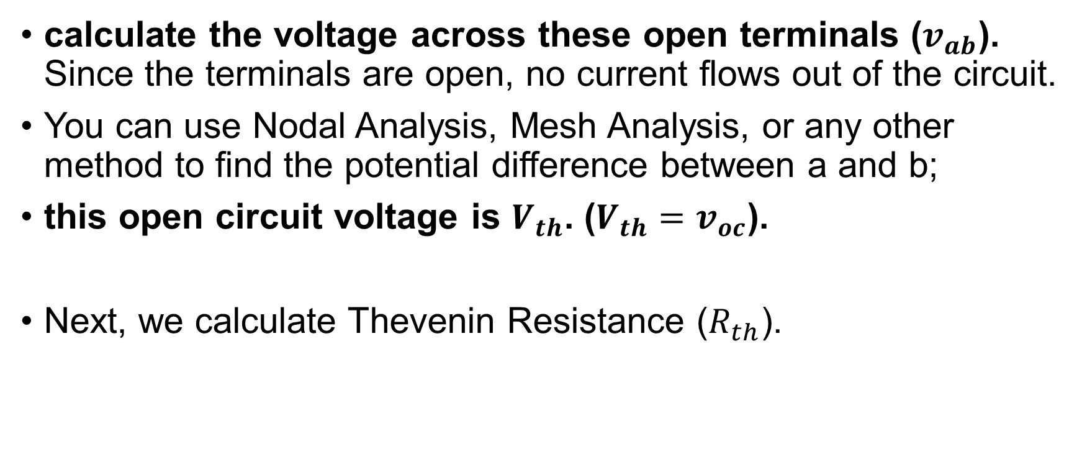
Systematic Analysis Methods
Fundamental Circuit Theorems (I)
calculate the voltage across these open terminals ($v_{ab}$). Since the terminals are open, no current flows out of the circuit.
You can use Nodal Analysis, Mesh Analysis, or any other method to find the potential difference between a and b;
this open circuit voltage is $V_{th}$. ($V_{th}=v_{oc}$).
Next, we calculate Thevenin Resistance ($R_{th}$).

Slide 32
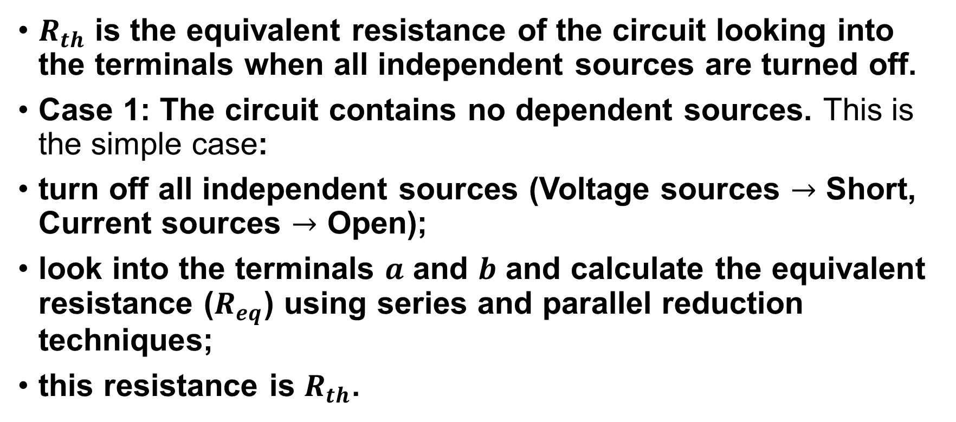
Systematic Analysis Methods
Fundamental Circuit Theorems (I)
$R_{th}$ is the equivalent resistance of the circuit looking into the terminals when all independent sources are turned off.
Case 1: The circuit contains no dependent sources. This is the simple case:
turn off all independent sources (Voltage sources $→$ Short, Current sources $→$ Open);
look into the terminals $a$ and $b$ and calculate the equivalent resistance ($R_{eq}$) using series and parallel reduction techniques;
this resistance is $R_{th}$.

Slide 33
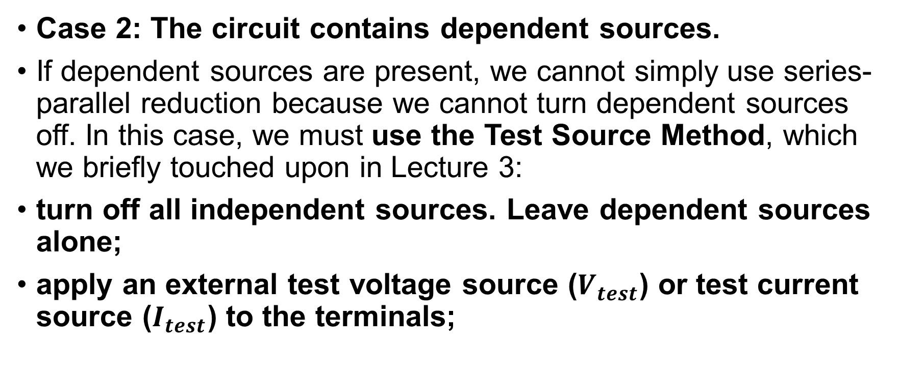
Systematic Analysis Methods
Fundamental Circuit Theorems (I)
Case 2: The circuit contains dependent sources.
If dependent sources are present, we cannot simply use series-parallel reduction because we cannot turn dependent sources off. In this case, we must use the Test Source Method, which we briefly touched upon in Lecture 3:
turn off all independent sources. Leave dependent sources alone;
apply an external test voltage source ($V_{test}$) or test current source ($I_{test}$) to the terminals;

Slide 34
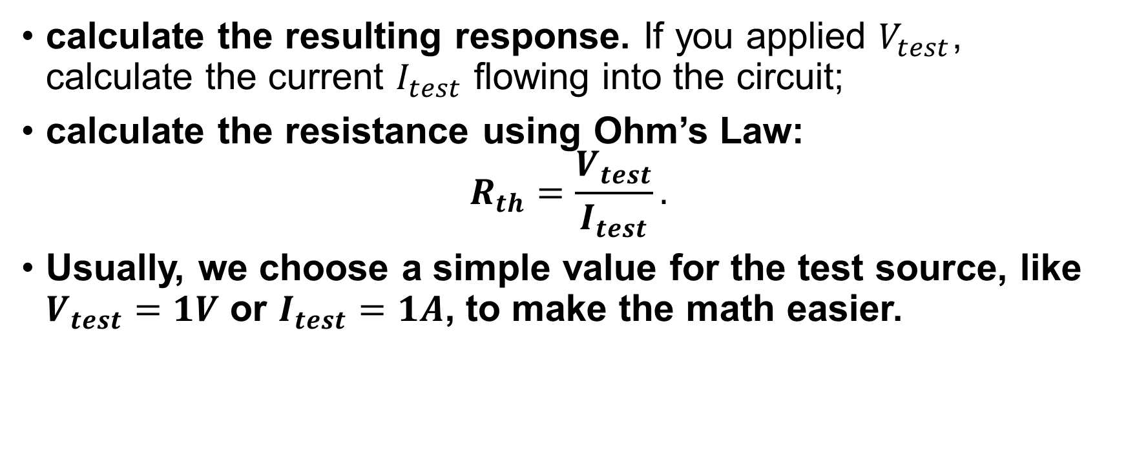
Systematic Analysis Methods
Fundamental Circuit Theorems (I)
calculate the resulting response. If you applied $V_{test}$, calculate the current $I_{test}$ flowing into the circuit;
calculate the resistance using Ohm’s Law:
$$R_{th}=\frac{V_{test}}{I_{test}}.$$
Usually, we choose a simple value for the test source, like $V_{test}=1V$ or $I_{test}=1A$, to make the math easier.

Slide 35
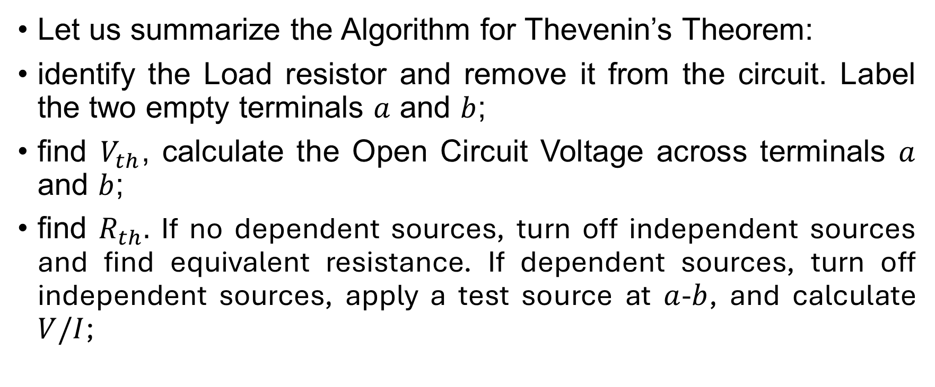
Systematic Analysis Methods
Fundamental Circuit Theorems (I)
Let us summarize the Algorithm for Thevenin’s Theorem:
identify the Load resistor and remove it from the circuit. Label the two empty terminals $a$ and $b$;
find $V_{th}$, calculate the Open Circuit Voltage across terminals $a$ and $b$;
find $R_{th}.$ If no dependent sources, turn off independent sources and find equivalent resistance. If dependent sources, turn off independent sources, apply a test source at $a$-$b$, and calculate $V/I$;

Slide 36
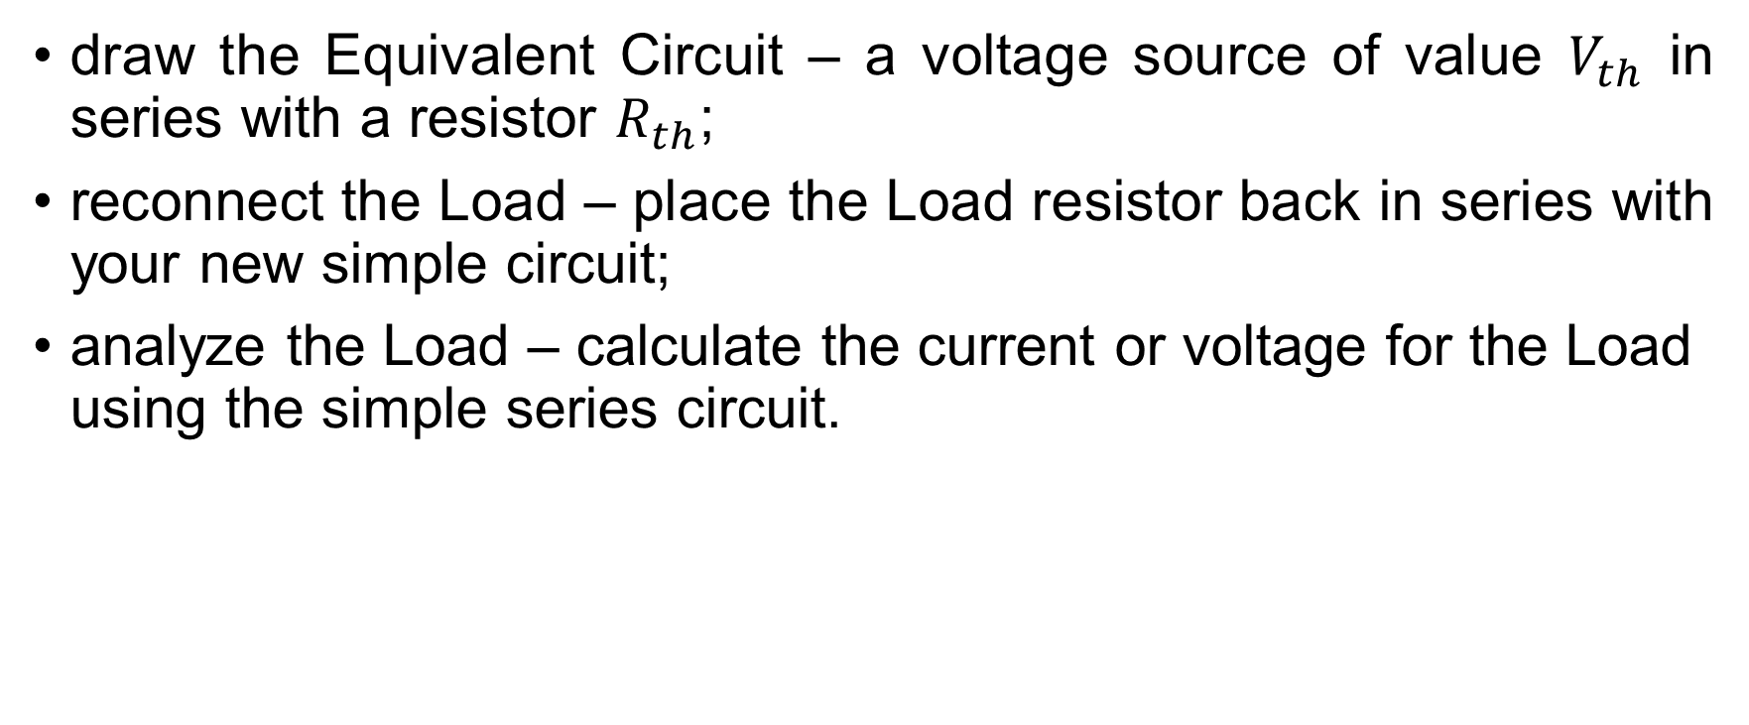
Systematic Analysis Methods
Fundamental Circuit Theorems (I)
draw the Equivalent Circuit – a voltage source of value $V_{th}$ in series with a resistor $R_{th}$;
reconnect the Load – place the Load resistor back in series with your new simple circuit;
analyze the Load – calculate the current or voltage for the Load using the simple series circuit.

Slide 37
Systematic Analysis Methods
Fundamental Circuit Theorems (I)
Why is Thevenin’s Theorem so important? It separates the Source circuit from the Load circuit.
Imagine you are designing a power supply for a computer. The load (the computer) changes constantly – sometimes it sleeps (high resistance), sometimes it runs a game (low resistance).
If you solved the full circuit using Nodal Analysis, you would have to redo the entire calculation every time the load resistance changed.

Slide 38
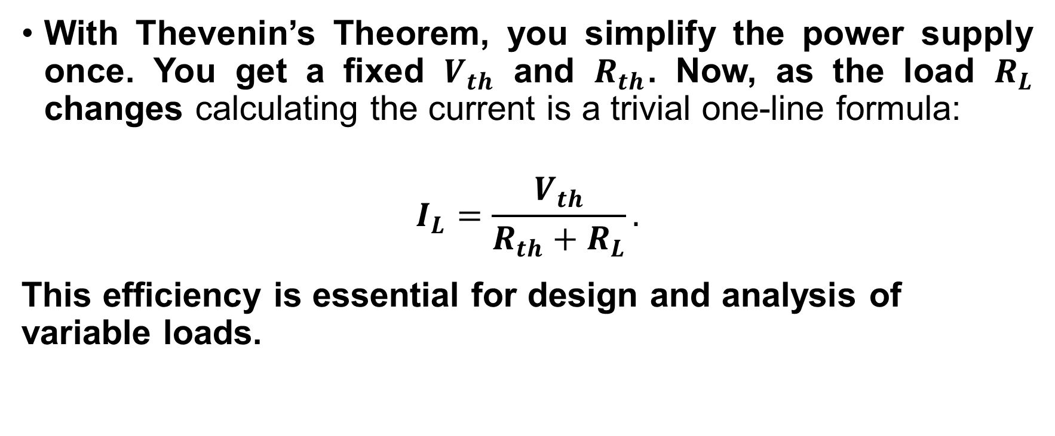
Systematic Analysis Methods
Fundamental Circuit Theorems (I)
With Thevenin’s Theorem, you simplify the power supply once. You get a fixed $V_{th}$ and $R_{th}$. Now, as the load $R_{L}$ changes calculating the current is a trivial one-line formula:
$$I_{L}=\frac{V_{th}}{R_{th}+R_{L}}.$$
This efficiency is essential for design and analysis of variable loads.

Slide 39
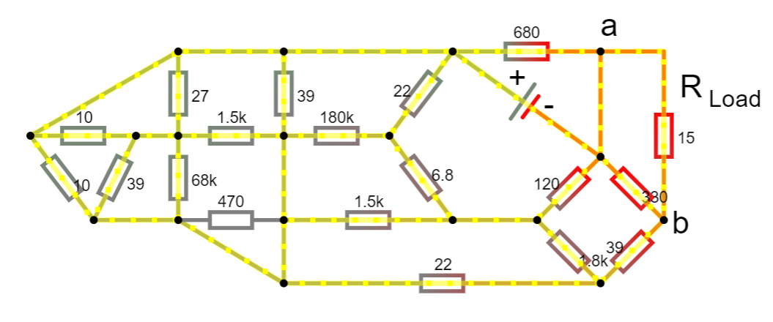
Systematic Analysis Methods
Fundamental Circuit Theorems (I)
Let's visualize the transformation process. Original Circuit – a messy web of loops and nodes.

Slide 40
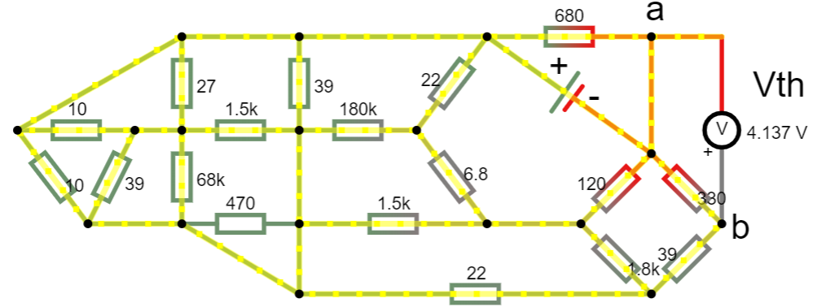

Systematic Analysis Methods
Fundamental Circuit Theorems (I)
Step 1 (Remove Load) – we have two hanging wires. We measure the voltage between them.
That is our «pressure» ($V_{th}$). In this example $V_{th}=4,14V$

Slide 41
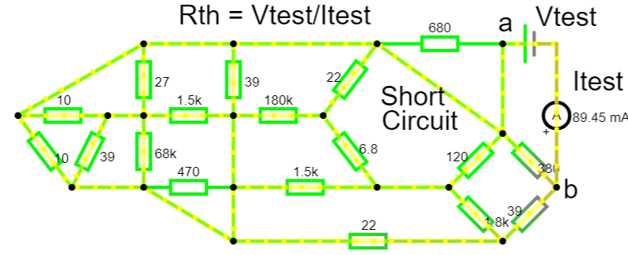


Systematic Analysis Methods
Fundamental Circuit Theorems (I)
Step 2 (Turn off Sources) – we look back into the wires. We see how much resistance opposes current entering the circuit.
That is our «friction» ($R_{th}$). In this example to find the $R_{th}$ we measure current $I_{th}$ and then use the Ohm’s Law.
By calculations we have
$R_{th}=55,897 Ω$.

Slide 42
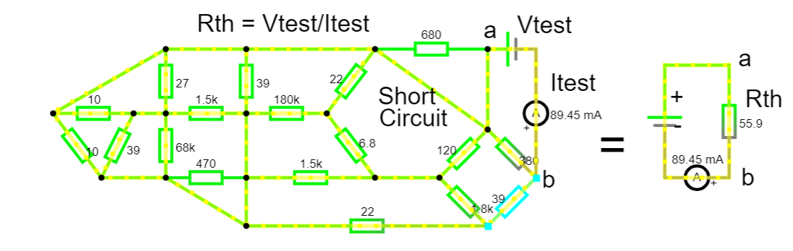

Systematic Analysis Methods
Fundamental Circuit Theorems (I)
As you can see current is the same in the equivalent circuit where all mess was replaced by calculated $R_{th}$

Slide 43
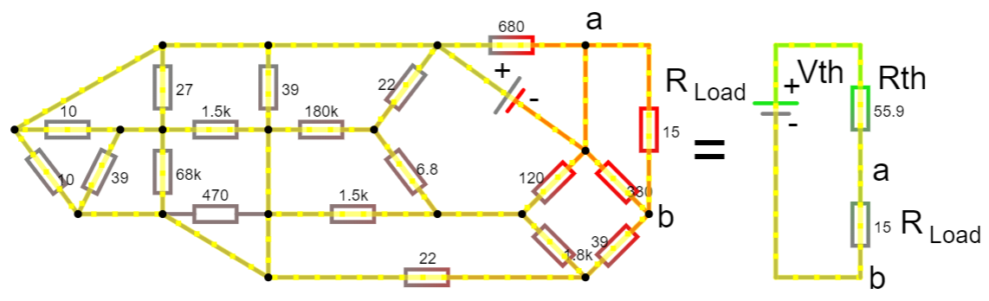
Systematic Analysis Methods
Fundamental Circuit Theorems (I)
Step 3 (Rebuild) – we replace the mess with one battery and one resistor.
The behavior at the terminals is mathematically identical.

Slide 44
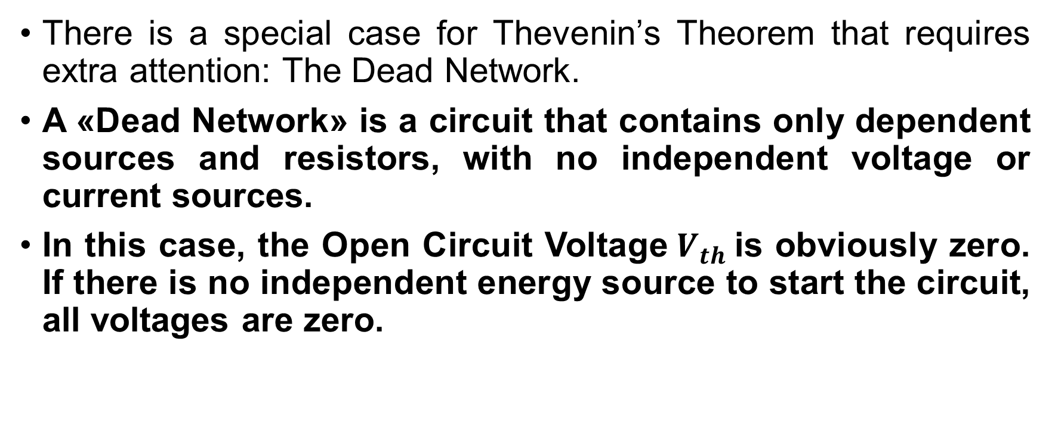
Systematic Analysis Methods
Fundamental Circuit Theorems (I)
There is a special case for Thevenin’s Theorem that requires extra attention: The Dead Network.
A «Dead Network» is a circuit that contains only dependent sources and resistors, with no independent voltage or current sources.
In this case, the Open Circuit Voltage$V_{th}$is obviously zero. If there is no independent energy source to start the circuit, all voltages are zero.

Slide 45
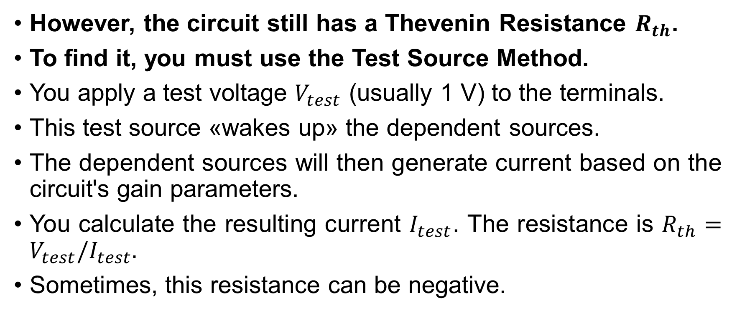
Systematic Analysis Methods
Fundamental Circuit Theorems (I)
However, the circuit still has a Thevenin Resistance $R_{th}$.
To find it, you must use the Test Source Method.
You apply a test voltage $V_{test}$ (usually 1 V) to the terminals.
This test source «wakes up» the dependent sources.
The dependent sources will then generate current based on the circuit's gain parameters.
You calculate the resulting current $I_{test}$. The resistance is $R_{th}=V_{test}/I_{test}.$
Sometimes, this resistance can be negative.

Slide 46
Systematic Analysis Methods
Fundamental Circuit Theorems (I)
A negative resistance implies the circuit is active and acts like a generator, supplying power to the test source.
We must also clarify how Superposition handles dependent sources.
A common mistake is trying to «turn off» a dependent source when using Superposition.
Rule: You must never turn off a dependent source during Superposition analysis.
When you analyze the contribution of Independent Source, the dependent sources remain active.

Slide 47
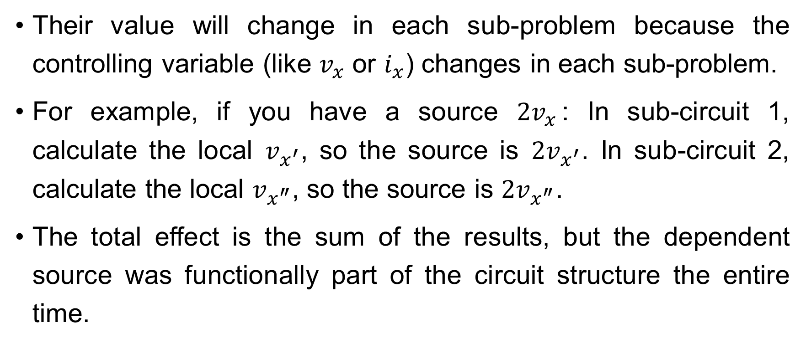
Systematic Analysis Methods
Fundamental Circuit Theorems (I)
Their value will change in each sub-problem because the controlling variable (like $v_{x}$ or $i_{x}$) changes in each sub-problem.
For example, if you have a source $2v_{x}$: In sub-circuit 1, calculate the local $v_{x^{′}}$, so the source is $2v_{x^{′}}$. In sub-circuit 2, calculate the local $v_{x^{″}}$, so the source is $2v_{x^{″}}$.
The total effect is the sum of the results, but the dependent source was functionally part of the circuit structure the entire time.

Slide 48
Systematic Analysis Methods
Fundamental Circuit Theorems (I)
In summary of this lecture, we have introduced the concept of Equivalence.
We learned that:
the Superposition Theorem allows us to solve complex circuits by analyzing one source at a time.
It relies on the property of Linearity;
Thevenin’s Theorem allows us to simplify any complex linear network into a single voltage source and a single series resistor.

Slide 49
Systematic Analysis Methods
Fundamental Circuit Theorems (I)
These theorems are not just calculation tricks; they are conceptual tools. They help us understand how a circuit behaves – how it drives a load and how different sources interact.
Thank you for your attention!
Do you have any questions?

