Slide 1
Lecture 6. Fundamental Circuit Theorems (II)
Part (2). Analysis of Resistive Circuits

Slide 2
Systematic Analysis Methods
Fundamental Circuit Theorems (II)
Welcome back to the course on The Principle of Circuit. In our previous lecture, we began our exploration of fundamental circuit theorems.
We discussed the property of linearity, the Superposition Theorem, and the extremely powerful Thevenin’s Theorem.
We learned that any complex linear one-port network can be replaced by a single voltage source in series with a resistor.

Slide 3
Systematic Analysis Methods
Fundamental Circuit Theorems (II)
Today, we will complete our study of DC circuit theorems by introducing the «dual» of Thevenin’s theorem, known as Norton’s Theorem.
Furthermore, we will answer a critical engineering question: How do we choose a load to extract the maximum possible energy from a source?

Slide 4
Systematic Analysis Methods
Fundamental Circuit Theorems (II)
This brings us to the Maximum Power Transfer Theorem.
These concepts are essential for understanding power matching in audio systems, radio transmitters, and signal processing.

Slide 5
Systematic Analysis Methods
Fundamental Circuit Theorems (II)
Let us begin with Norton's Theorem.
Just as Thevenin’s theorem reduces a complex circuit to a voltage source and a series resistor, Norton’s theorem reduces it to a current source and a parallel resistor.
Edward Lawry Norton, an engineer at Bell Labs, proposed this method independently, shortly after Helmholtz and Thevenin.

Slide 6
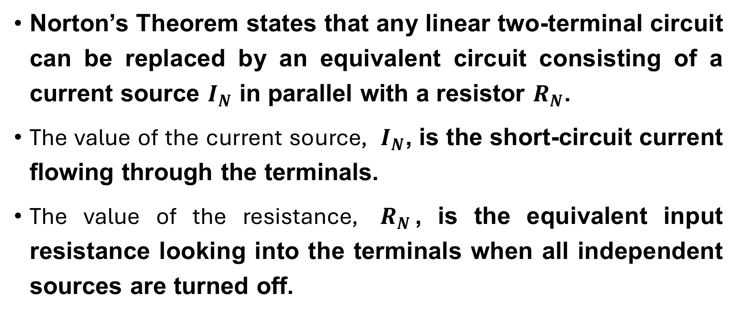
Systematic Analysis Methods
Fundamental Circuit Theorems (II)
Norton’s Theorem states that any linear two-terminal circuit can be replaced by an equivalent circuit consisting of a current source $I_{N}$ in parallel with a resistor $R_{N}$.
The value of the current source, $I_{N}$, is the short-circuit current flowing through the terminals.
The value of the resistance, $R_{N}$, is the equivalent input resistance looking into the terminals when all independent sources are turned off.

Slide 7
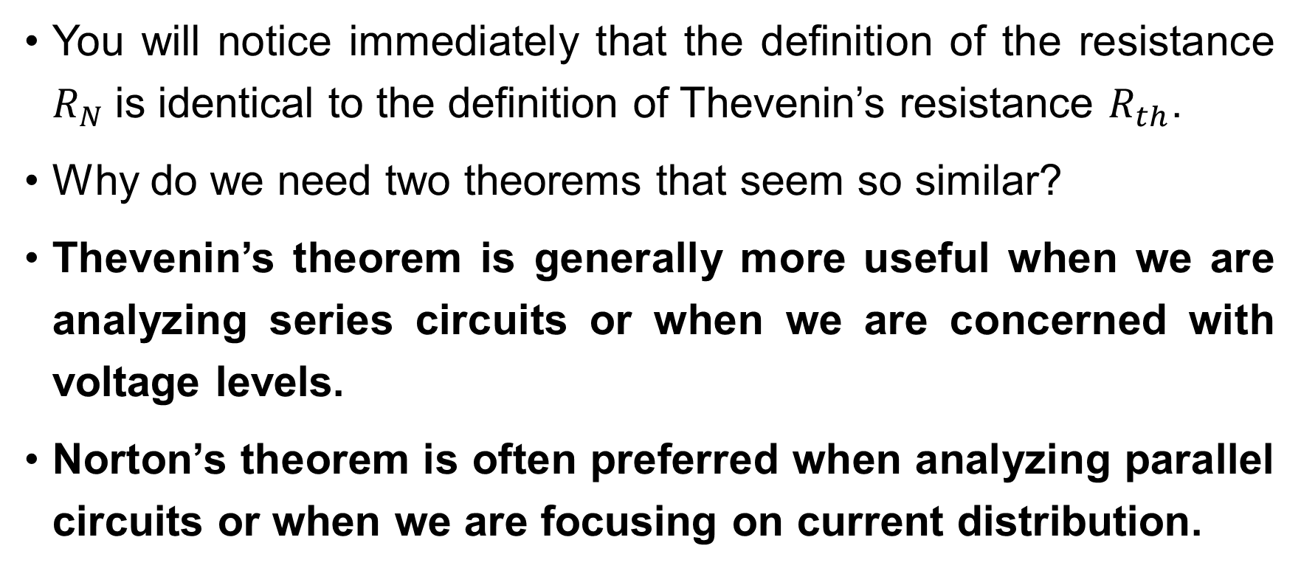
Systematic Analysis Methods
Fundamental Circuit Theorems (II)
You will notice immediately that the definition of the resistance $R_{N}$is identical to the definition of Thevenin’s resistance $R_{th}$.
Why do we need two theorems that seem so similar?
Thevenin’s theorem is generally more useful when we are analyzing series circuits or when we are concerned with voltage levels.
Norton’s theorem is often preferred when analyzing parallel circuits or when we are focusing on current distribution.

Slide 8
Systematic Analysis Methods
Fundamental Circuit Theorems (II)
In many cases, the choice is simply a matter of personal preference or computational convenience.
However, conceptualizing a circuit as a current source is vital for understanding devices like transistors (BJTs) and certain sensors, which naturally behave more like Norton sources than Thevenin sources.

Slide 9
Systematic Analysis Methods
Fundamental Circuit Theorems (II)
The Norton equivalent circuit acts as a practical model for a non-ideal current source.
Now, let us establish the systematic algorithm for applying this theorem.
To determine the Norton Equivalent Circuit of a network, we follow these specific steps:

Slide 10
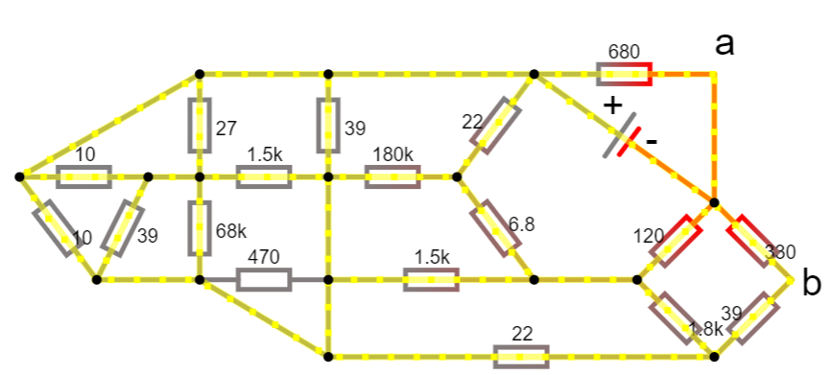
Systematic Analysis Methods
Fundamental Circuit Theorems (II)
remove the load resistor or the component of interest, leaving two open terminals (let's call them a and b);

Slide 11
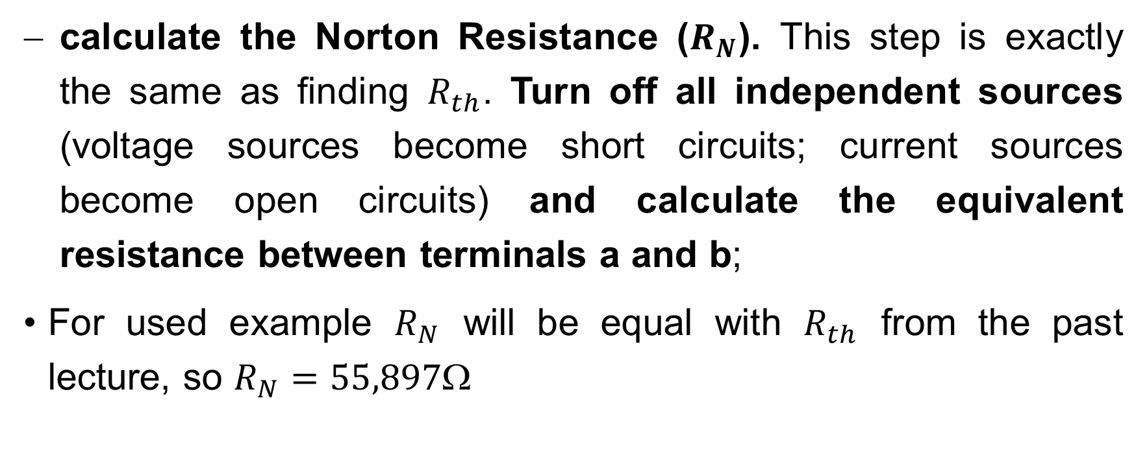
Systematic Analysis Methods
Fundamental Circuit Theorems (II)
calculate the Norton Resistance ($R_{N}$). This step is exactly the same as finding $R_{th}$. Turn off all independent sources (voltage sources become short circuits; current sources become open circuits) and calculate the equivalent resistance between terminals a and b;
For used example $R_{N}$ will be equal with $R_{th}$ from the past lecture, so $R_{N}=55,897$

Slide 12
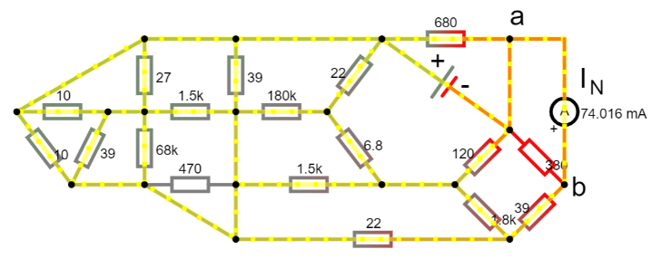

Systematic Analysis Methods
Fundamental Circuit Theorems (II)
calculate the Norton Current ($I_{N}$). This is the distinct step. Place a short circuit (a direct wire connection) between terminals a and b. Then, calculate the current flowing through this short wire. This current is $I_{N}$;

Slide 13
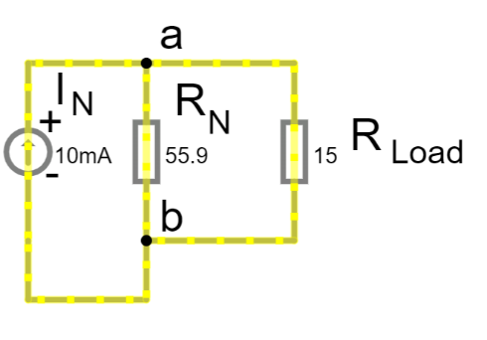

Systematic Analysis Methods
Fundamental Circuit Theorems (II)
draw the equivalent circuit. Connect the current source $I_{N}$ in parallel with the resistance $R_{N}$, and re-connect your load to the terminals.

Slide 14
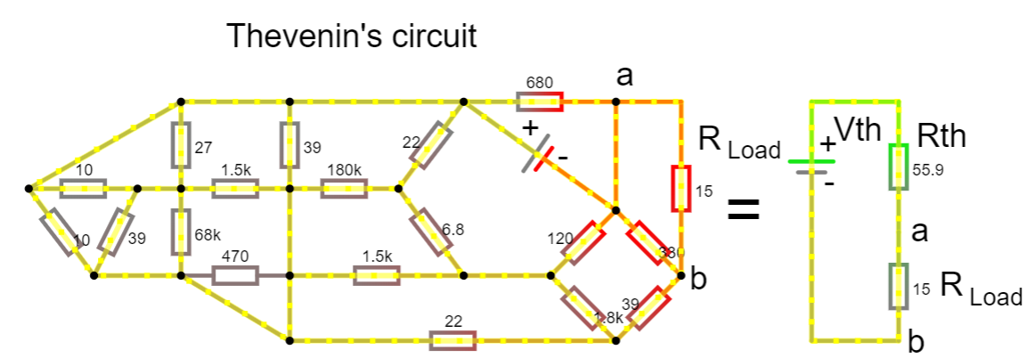
Systematic Analysis Methods
Fundamental Circuit Theorems (II)
Result of these steps will be very similar to the result of Thevenin’s theorem.

Slide 15
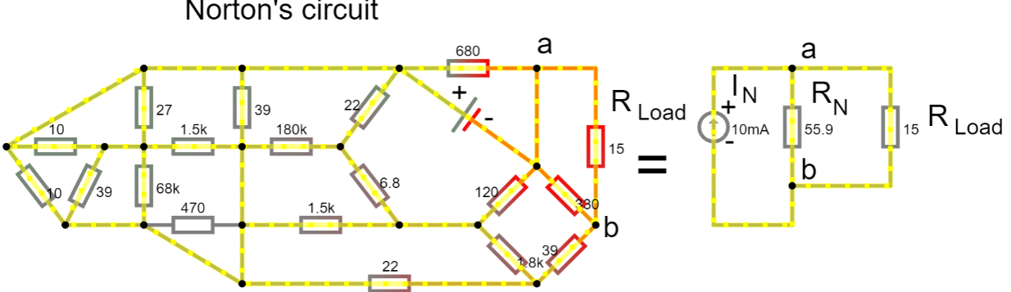

Systematic Analysis Methods
Fundamental Circuit Theorems (II)
But a and b terminals are placed at the both sides of equivalent resistance, thus load in Norton’s circuit connected in parallel with $R_{N}$ and in Thevenin’s circuit it connected in series with $R_{th}$

Slide 16
Systematic Analysis Methods
Fundamental Circuit Theorems (II)
Let us look closer at Step 3, because this is where students often make mistakes.
When we found Thevenin’s voltage, we left the terminals open and calculated the voltage across them.
For Norton’s current, we must short-circuit the output terminals.
By connecting a wire with zero resistance between the terminals, we force the voltage difference to be zero.

Slide 17
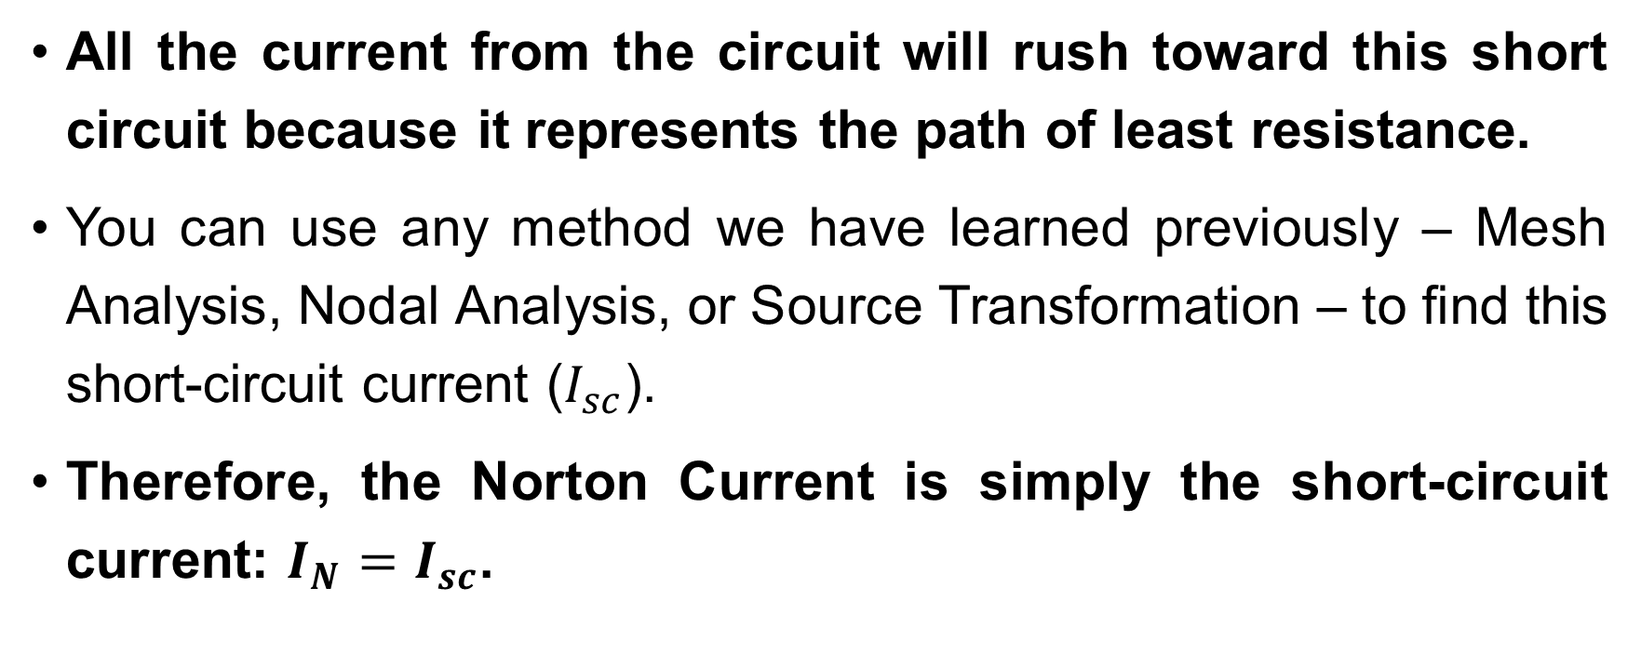
Systematic Analysis Methods
Fundamental Circuit Theorems (II)
All the current from the circuit will rush toward this short circuit because it represents the path of least resistance.
You can use any method we have learned previously – Mesh Analysis, Nodal Analysis, or Source Transformation – to find this short-circuit current ($I_{sc}$).
Therefore, the Norton Current is simply the short-circuit current: $I_{N}=I_{sc}$.

Slide 18
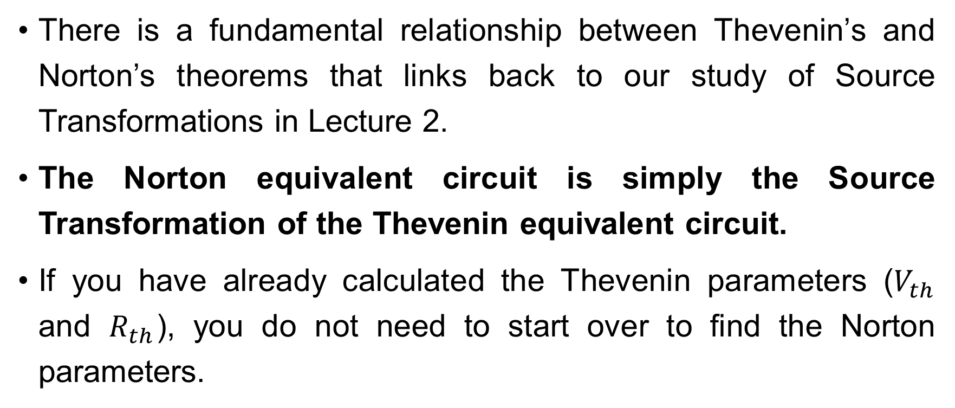
Systematic Analysis Methods
Fundamental Circuit Theorems (II)
There is a fundamental relationship between Thevenin’s and Norton’s theorems that links back to our study of Source Transformations in Lecture 2.
The Norton equivalent circuit is simply the Source Transformation of the Thevenin equivalent circuit.
If you have already calculated the Thevenin parameters ($V_{th}$ and $R_{th}$), you do not need to start over to find the Norton parameters.

Slide 19
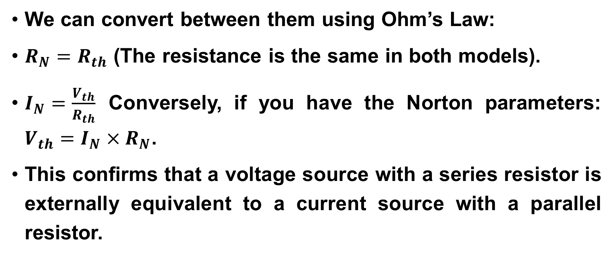
Systematic Analysis Methods
Fundamental Circuit Theorems (II)
We can convert between them using Ohm’s Law:
$R_{N}=R_{th}$ (The resistance is the same in both models).
$I_{N}=\frac{V_{th}}{R_{th}}$ Conversely, if you have the Norton parameters: $V_{th}=I_{N}×R_{N}$.
This confirms that a voltage source with a series resistor is externally equivalent to a current source with a parallel resistor.

Slide 20
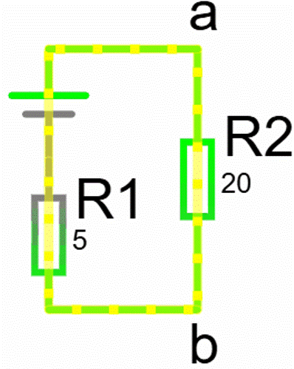
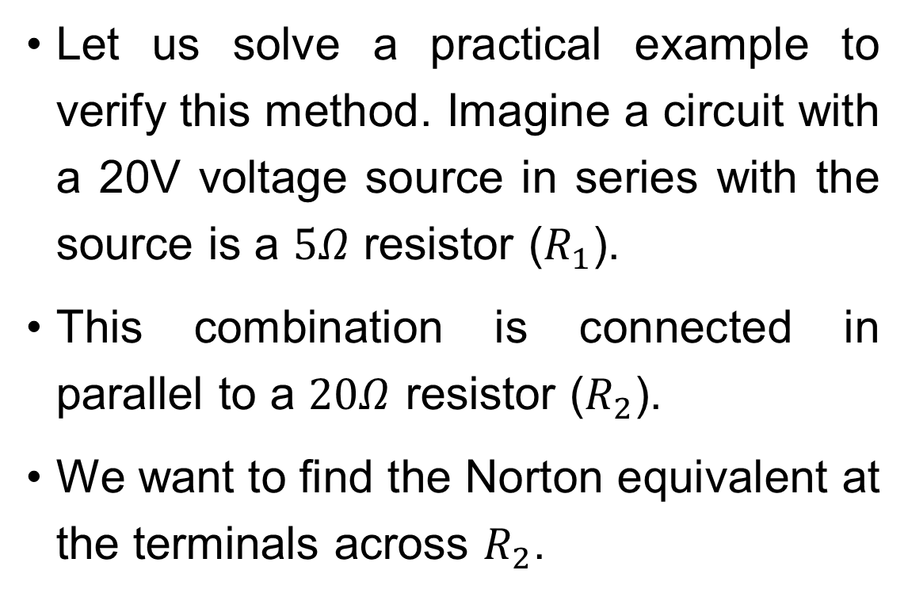
Systematic Analysis Methods
Fundamental Circuit Theorems (II)
Let us solve a practical example to verify this method. Imagine a circuit with a 20V voltage source in series with the source is a $5Ω$ resistor ($R_{1}$).
This combination is connected in parallel to a $20Ω$ resistor ($R_{2}$).
We want to find the Norton equivalent at the terminals across $R_{2}$.

Slide 21
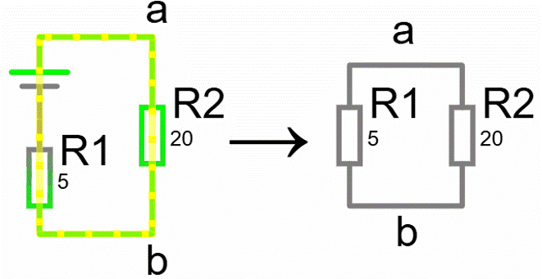

Systematic Analysis Methods
Fundamental Circuit Theorems (II)
First, we find $R_{N}$. We turn off the 20V source (replace it with a short wire). Looking into the terminals, we see $R_{1}$and $R_{2}$are in parallel: $R_{N}=R_{1}||R_{2}=\frac{5×20}{5+20}=\frac{100}{25}=4Ω.$

Slide 22
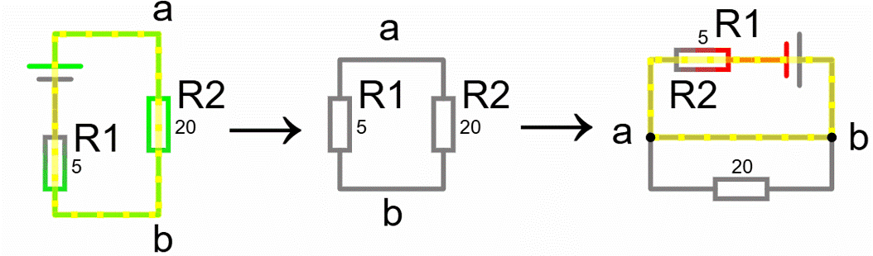

Systematic Analysis Methods
Fundamental Circuit Theorems (II)
Next, we find $I_{N}$.
We short-circuit the terminals a and b. Be careful here.

Slide 23

Systematic Analysis Methods
Fundamental Circuit Theorems (II)
If we place a short circuit across $R_{2}$, the current will bypass $R_{2}$ entirely.
The current prefers the zero-resistance wire over the 20Ω resistor. Therefore, the total resistance seen by the source is just $R_{1}$(5Ω).

Slide 24

Systematic Analysis Methods
Fundamental Circuit Theorems (II)
$$I_{N}=\frac{20V}{5Ω}=4A$$
So, our Norton equivalent is a 4A source in parallel with a 4Ω resistor.

Slide 25

Systematic Analysis Methods
Fundamental Circuit Theorems (II)
Do you have you any questions at the moment?

Slide 26
Systematic Analysis Methods
Fundamental Circuit Theorems (II)
We now transition to the second major theme of this lecture: Power Optimization.
In Lecture 1, we defined the primary objective of circuit analysis as solving for voltage, current, and power.
Often in engineering, we are not just analyzing a circuit; we are designing it to perform a task.
One of the most common tasks is to deliver energy from a source (like an antenna, a microphone, or a battery) to a load (like a radio receiver, a speaker, or a motor).

Slide 27
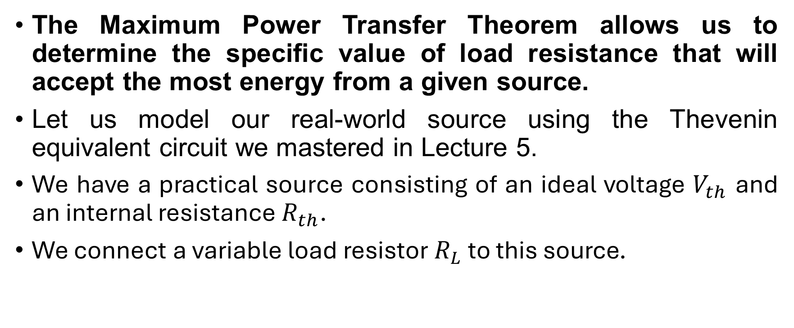
Systematic Analysis Methods
Fundamental Circuit Theorems (II)
The Maximum Power Transfer Theorem allows us to determine the specific value of load resistance that will accept the most energy from a given source.
Let us model our real-world source using the Thevenin equivalent circuit we mastered in Lecture 5.
We have a practical source consisting of an ideal voltage $V_{th}$ and an internal resistance $R_{th}$.
We connect a variable load resistor $R_{L}$ to this source.

Slide 28
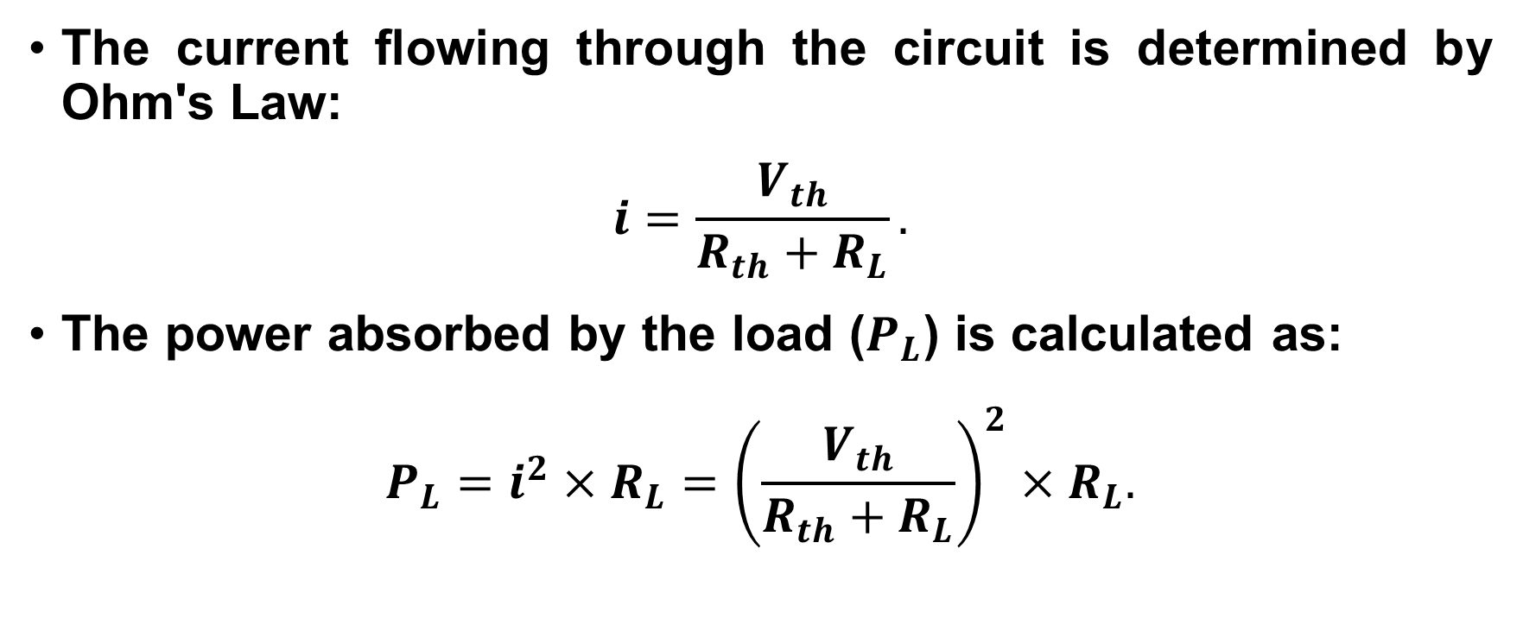
Systematic Analysis Methods
Fundamental Circuit Theorems (II)
The current flowing through the circuit is determined by Ohm's Law:
$$i=\frac{V_{th}}{R_{th}+R_{L}}.$$
The power absorbed by the load ($P_{L}$) is calculated as:
$$P_{L}=i^{2}×R_{L}={\left(\frac{V_{th}}{R_{th}+R_{L}}\right)}^{2}×R_{L}.$$

Slide 29
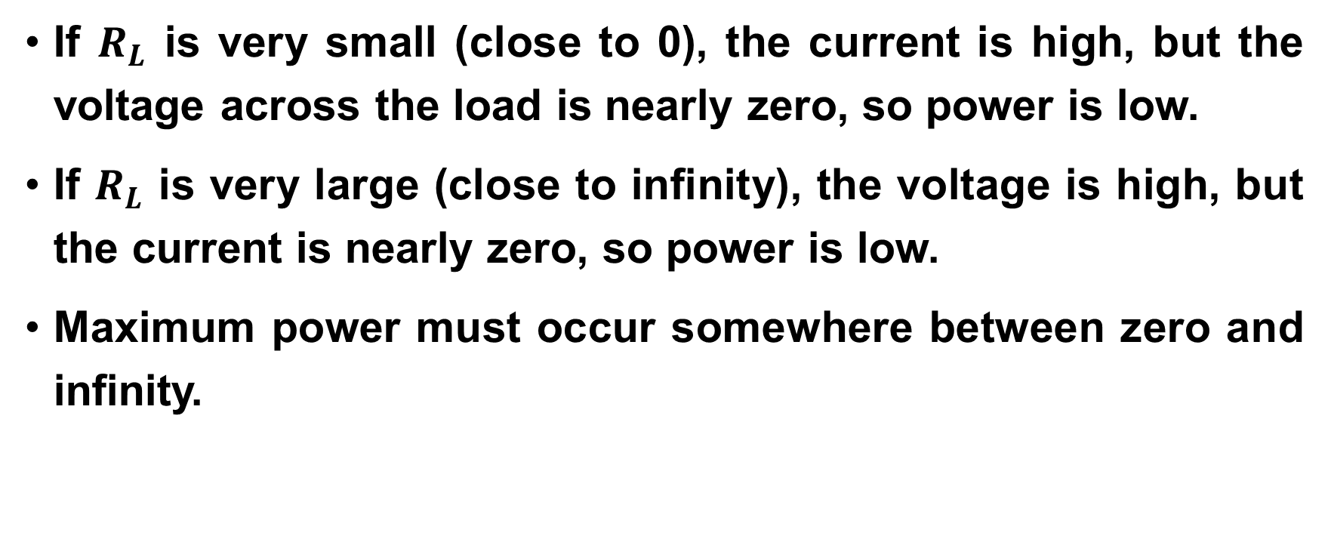
Systematic Analysis Methods
Fundamental Circuit Theorems (II)
If $R_{L}$ is very small (close to 0), the current is high, but the voltage across the load is nearly zero, so power is low.
If $R_{L}$ is very large (close to infinity), the voltage is high, but the current is nearly zero, so power is low.
Maximum power must occur somewhere between zero and infinity.

Slide 30
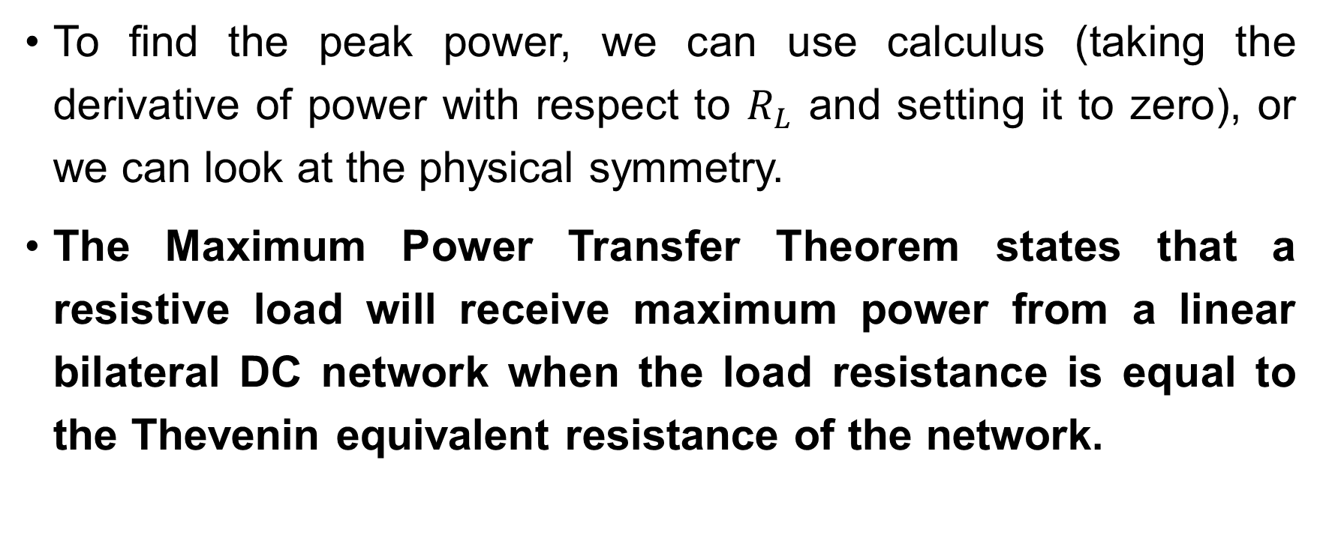
Systematic Analysis Methods
Fundamental Circuit Theorems (II)
To find the peak power, we can use calculus (taking the derivative of power with respect to $R_{L}$ and setting it to zero), or we can look at the physical symmetry.
The Maximum Power Transfer Theorem states that a resistive load will receive maximum power from a linear bilateral DC network when the load resistance is equal to the Thevenin equivalent resistance of the network.

Slide 31
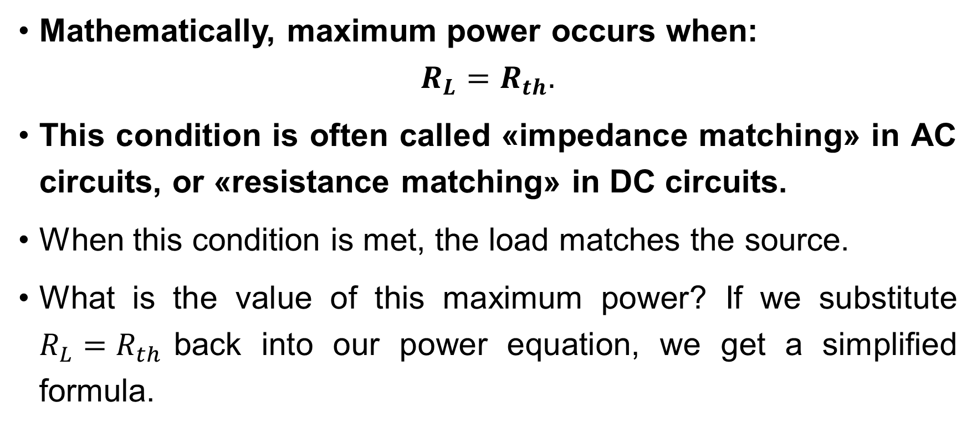
Systematic Analysis Methods
Fundamental Circuit Theorems (II)
Mathematically, maximum power occurs when:
$$R_{L}=R_{th}.$$
This condition is often called «impedance matching» in AC circuits, or «resistance matching» in DC circuits.
When this condition is met, the load matches the source.
What is the value of this maximum power? If we substitute $R_{L}=R_{th}$back into our power equation, we get a simplified formula.

Slide 32

Systematic Analysis Methods
Fundamental Circuit Theorems (II)
Current at max power:
$$i=\frac{V_{th}}{R_{th}+R_{th}}=\frac{V_{th}}{2R_{th}}.$$
Thus:
$$P_{max}=(\frac{V_{th}}{2R_{th}})^{2}×R_{th}=\frac{V_{th}^{2}}{4R_{th}^{2}}×R_{th}.$$

Slide 33
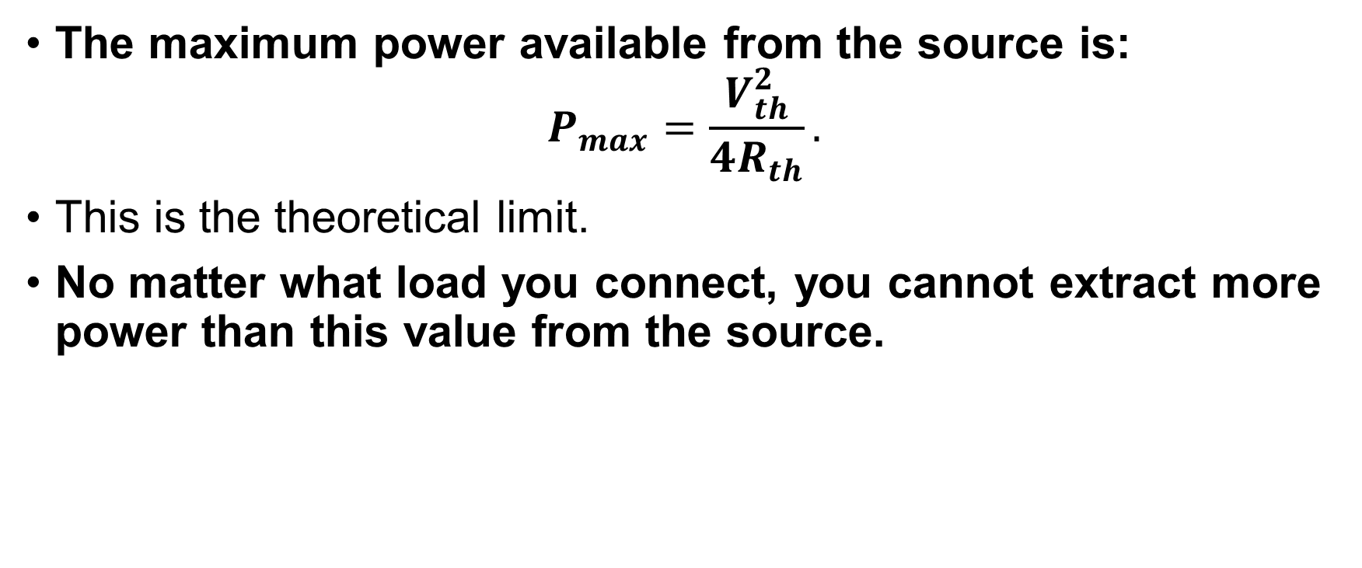
Systematic Analysis Methods
Fundamental Circuit Theorems (II)
The maximum power available from the source is:
$$P_{max}=\frac{V_{th}^{2}}{4R_{th}}.$$
This is the theoretical limit.
No matter what load you connect, you cannot extract more power than this value from the source.

Slide 34
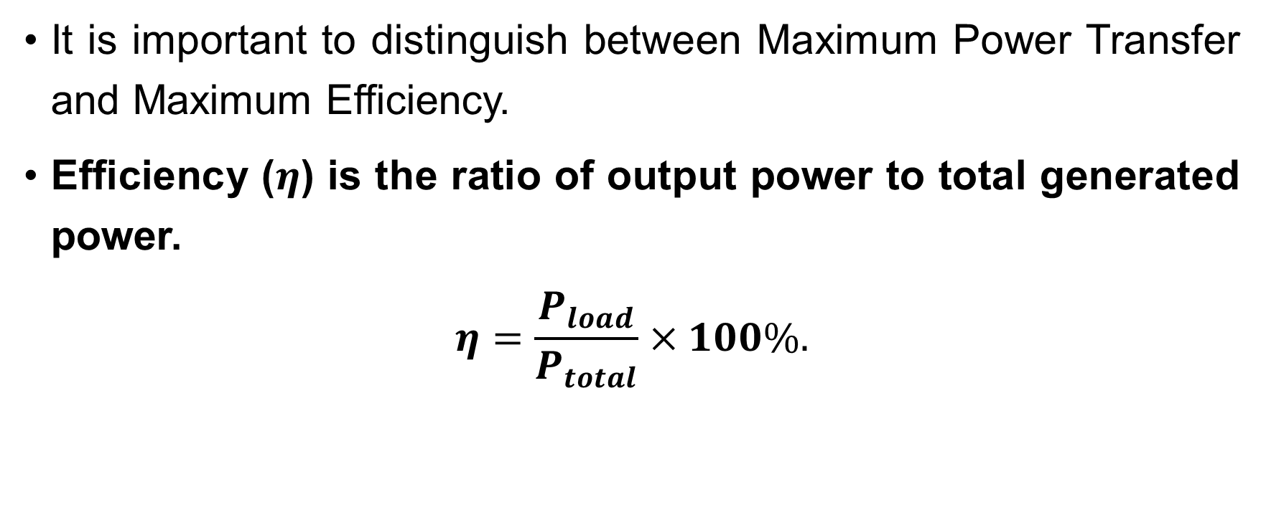
Systematic Analysis Methods
Fundamental Circuit Theorems (II)
It is important to distinguish between Maximum Power Transfer and Maximum Efficiency.
Efficiency ($η$) is the ratio of output power to total generated power.
$$η=\frac{P_{load}}{P_{total}}×100\%.$$

Slide 35
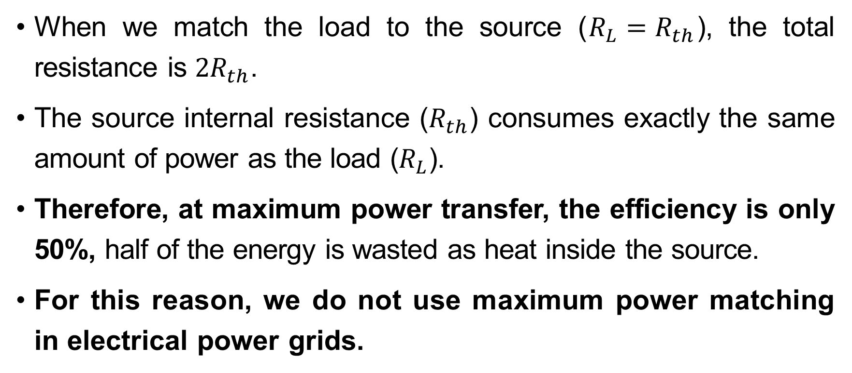
Systematic Analysis Methods
Fundamental Circuit Theorems (II)
When we match the load to the source ($R_{L}=R_{th}$), the total resistance is $2R_{th}$.
The source internal resistance ($R_{th}$) consumes exactly the same amount of power as the load ($R_{L}$).
Therefore, at maximum power transfer, the efficiency is only 50%, half of the energy is wasted as heat inside the source.
For this reason, we do not use maximum power matching in electrical power grids.

Slide 36
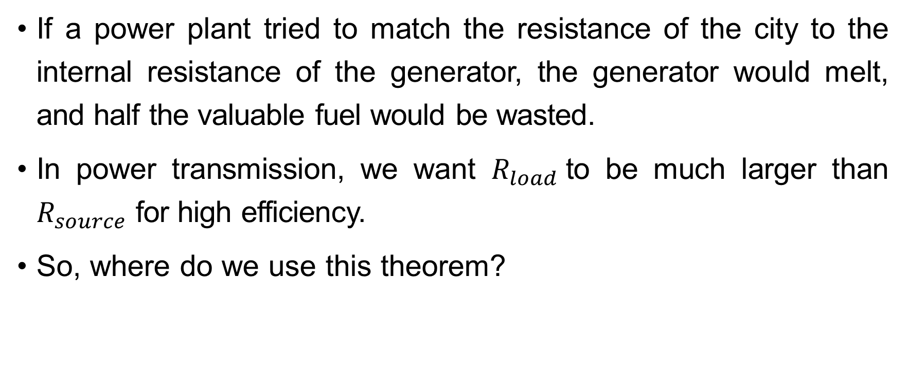
Systematic Analysis Methods
Fundamental Circuit Theorems (II)
If a power plant tried to match the resistance of the city to the internal resistance of the generator, the generator would melt, and half the valuable fuel would be wasted.
In power transmission, we want $R_{load}$to be much larger than $R_{source}$ for high efficiency.
So, where do we use this theorem?

Slide 37
Systematic Analysis Methods
Fundamental Circuit Theorems (II)
We use Maximum Power Transfer in telecommunications and signal processing, where the signal is weak, and we need to capture every bit of energy.
Consider a radio antenna picking up a signal from a satellite.
The power is usually picowatts (trillionths of a watt).
We do not care about efficiency; we do not care if we «waste» 50% of a picowatt.

Slide 38
Systematic Analysis Methods
Fundamental Circuit Theorems (II)
We care about hearing the signal.
To get the loudest signal, the receiver circuit's input resistance must match the antenna's resistance.
If the resistances are mismatched, the signal reflects back, and we lose information.

Slide 39
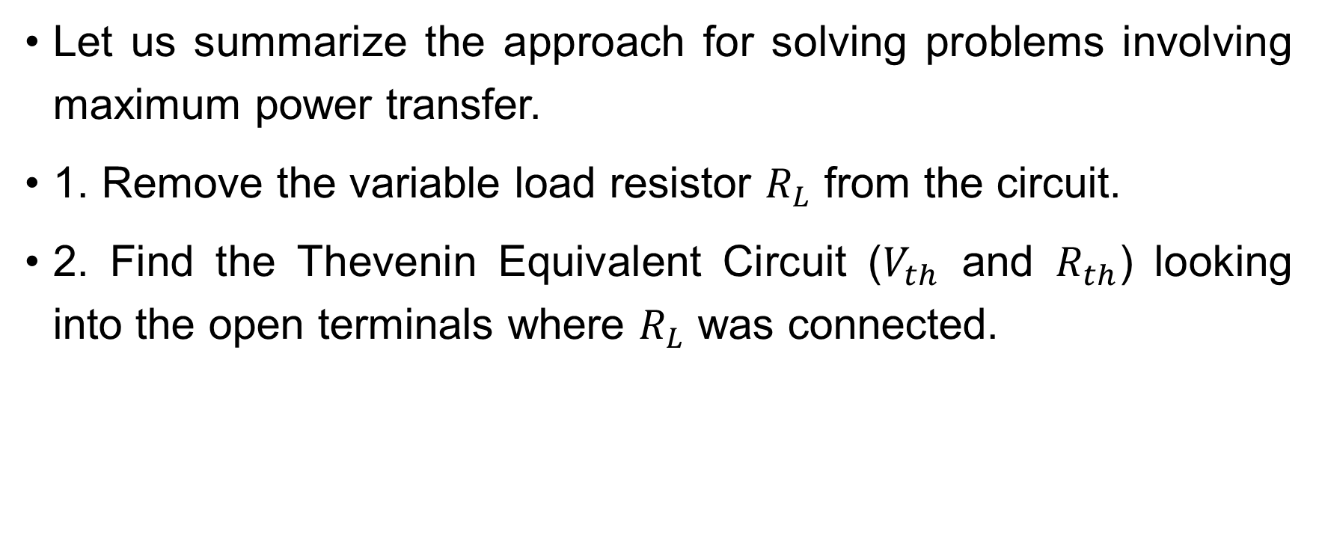
Systematic Analysis Methods
Fundamental Circuit Theorems (II)
Let us summarize the approach for solving problems involving maximum power transfer.
1. Remove the variable load resistor $R_{L}$ from the circuit.
2. Find the Thevenin Equivalent Circuit ($V_{th}$ and $R_{th}$) looking into the open terminals where $R_{L}$ was connected.

Slide 40
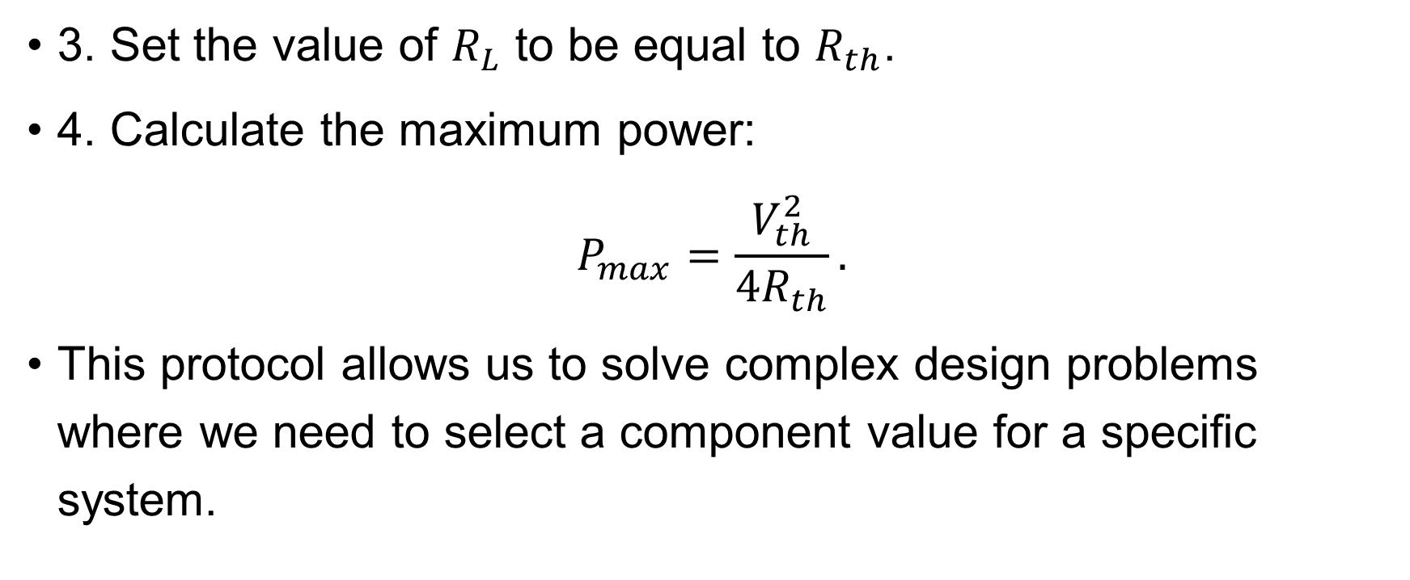
Systematic Analysis Methods
Fundamental Circuit Theorems (II)
3. Set the value of $R_{L}$ to be equal to $R_{th}$.
4. Calculate the maximum power:
$$P_{max}=\frac{V_{th}^{2}}{4R_{th}}.$$
This protocol allows us to solve complex design problems where we need to select a component value for a specific system.

Slide 41

Systematic Analysis Methods
Fundamental Circuit Theorems (II)
Let's look at a numerical example. We have a circuit with a Voltage Source $V_{s}=12V$and an internal resistance of 50Ω. We want to connect a speaker.

Slide 42
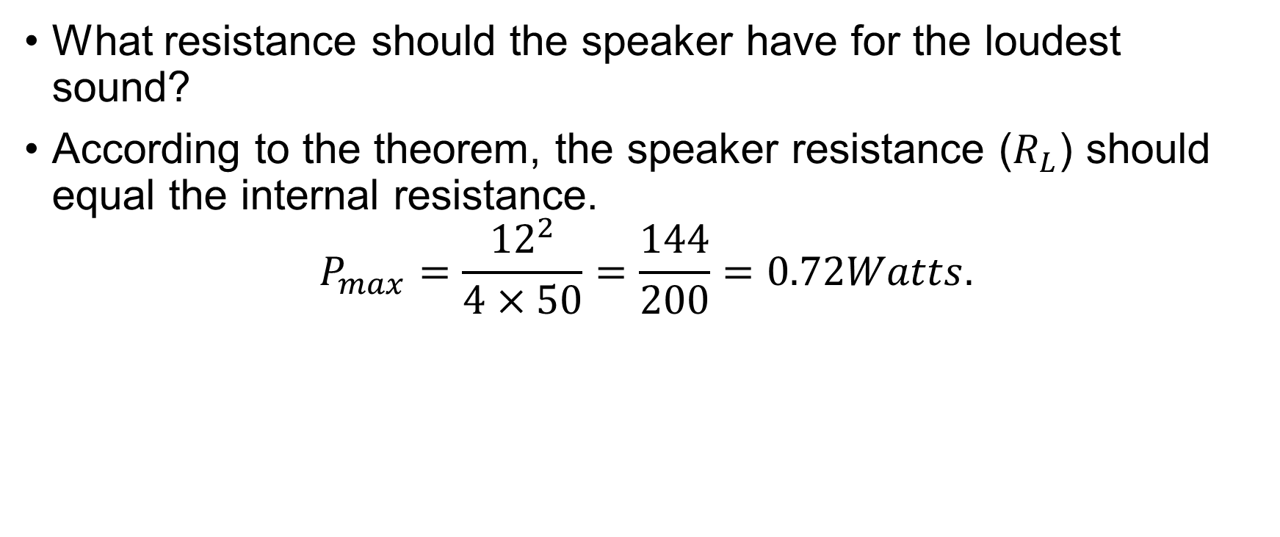
Systematic Analysis Methods
Fundamental Circuit Theorems (II)
What resistance should the speaker have for the loudest sound?
According to the theorem, the speaker resistance ($R_{L}$) should equal the internal resistance.
$$P_{max}=\frac{{12}^{2}}{4×50}=\frac{144}{200}=0.72Watts.$$

Slide 43
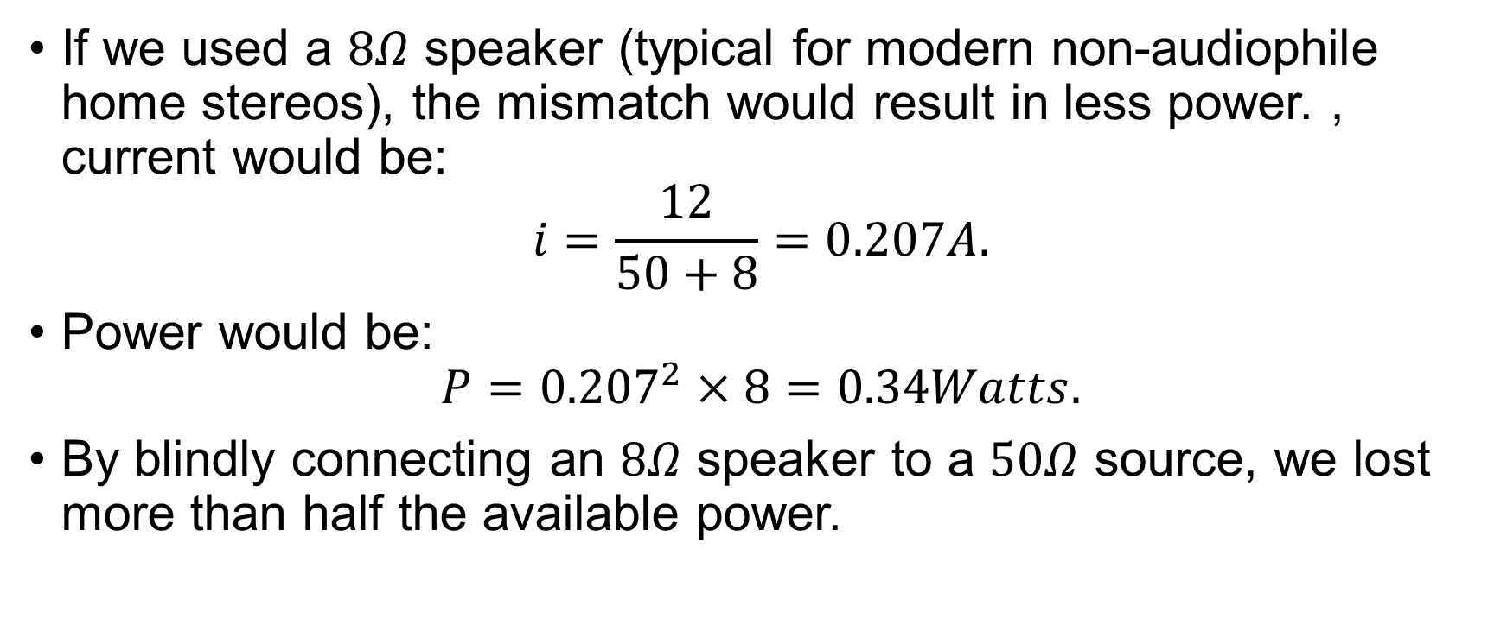
Systematic Analysis Methods
Fundamental Circuit Theorems (II)
If we used a $8Ω$ speaker (typical for modern non-audiophile home stereos), the mismatch would result in less power. , current would be:
$$i=\frac{12}{50+8}=0.207A.$$
Power would be:
$$P={0.207}^{2}×8=0.34Watts.$$
By blindly connecting an $8Ω$ speaker to a $50Ω$ source, we lost more than half the available power.

Slide 44
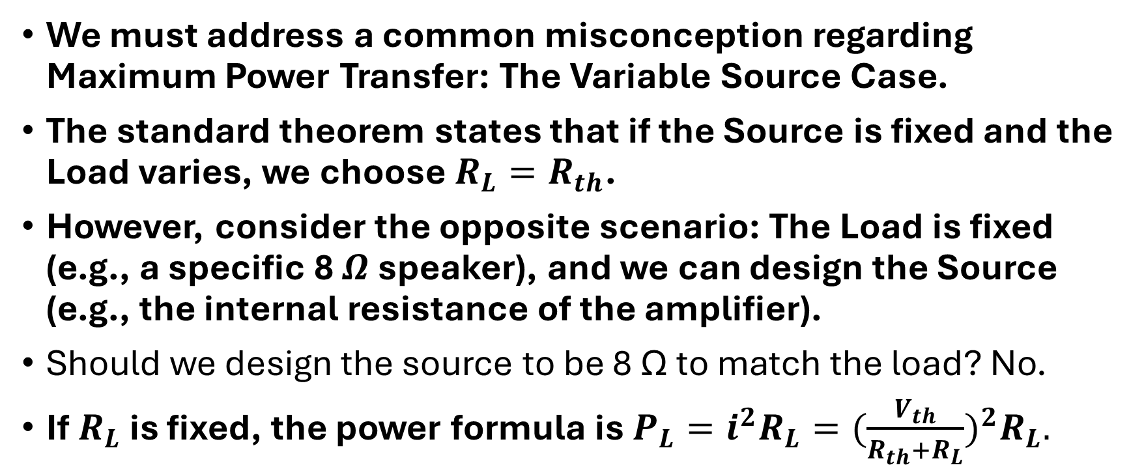
Systematic Analysis Methods
Fundamental Circuit Theorems (II)
We must address a common misconception regarding Maximum Power Transfer: The Variable Source Case.
The standard theorem states that if the Source is fixed and the Load varies, we choose $R_{L}=R_{th}$.
However, consider the opposite scenario: The Load is fixed (e.g., a specific 8 $Ω$ speaker), and we can design the Source (e.g., the internal resistance of the amplifier).
Should we design the source to be 8 Ω to match the load? No.
If $R_{L}$ is fixed, the power formula is $P_{L}=i^{2}R_{L}=(\frac{V_{th}}{R_{th}+R_{L}})^{2}R_{L}.$

Slide 45
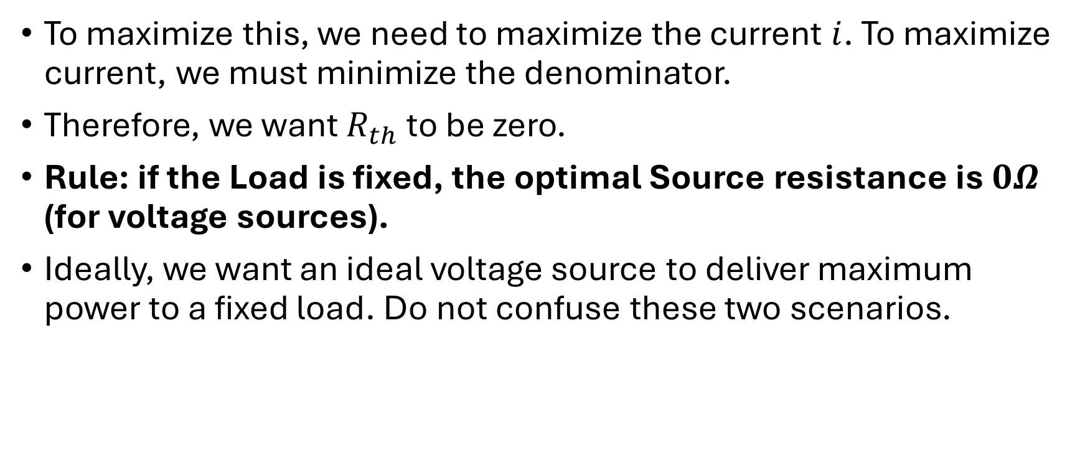
Systematic Analysis Methods
Fundamental Circuit Theorems (II)
To maximize this, we need to maximize the current $i$. To maximize current, we must minimize the denominator.
Therefore, we want $R_{th}$ to be zero.
Rule: if the Load is fixed, the optimal Source resistance is $0Ω$ (for voltage sources).
Ideally, we want an ideal voltage source to deliver maximum power to a fixed load. Do not confuse these two scenarios.

Slide 46
Systematic Analysis Methods
Fundamental Circuit Theorems (II)
Sometimes, we encounter a situation where the source and load are both fixed and mismatched, but we cannot change either of them.
For example, connecting a 50Ω cable to a 75Ω antenna.
In this case, we use a Resistive Matching Network (often called an L-Pad or Attenuator).

Slide 47
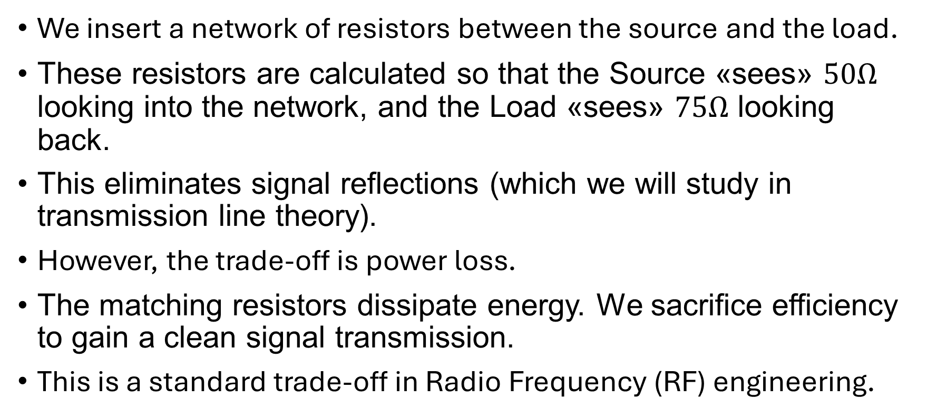
Systematic Analysis Methods
Fundamental Circuit Theorems (II)
We insert a network of resistors between the source and the load.
These resistors are calculated so that the Source «sees» $50Ω$ looking into the network, and the Load «sees» $75Ω$ looking back.
This eliminates signal reflections (which we will study in transmission line theory).
However, the trade-off is power loss.
The matching resistors dissipate energy. We sacrifice efficiency to gain a clean signal transmission.
This is a standard trade-off in Radio Frequency (RF) engineering.

Slide 48
Systematic Analysis Methods
Fundamental Circuit Theorems (II)
This concludes Part 2 of our course on Resistive Circuit Analysis.
Thank you for your attention!
Do you have any questions?

