Slide 1
Lecture 7. Sinusoidal Quantities and Phasors
Part (3). Analysis of Sinusoidal Steady-State AC Circuits

Slide 2
Systematic Analysis Methods
Sinusoidal Quantities and Phasors
Welcome to Part 3 of our course, «The Principle of Circuit».
In the previous lectures, we focused on Direct Current (DC) circuits, where voltages and currents were constant over time.
We mastered the fundamental laws such as Kirchhoff's Laws and various analysis methods like Node Voltage and Mesh Current analysis.
Today, we mark a significant transition in our studies. We are moving from the static world of DC to the dynamic world of Alternating Current (AC).

Slide 3
Systematic Analysis Methods
Sinusoidal Quantities and Phasors
This lecture serves as the foundation for analyzing AC circuits, which power our homes, industries, and communication systems.
We will define the mathematical properties of sinusoidal waves and introduce a powerful mathematical tool called the «Phasor» to simplify our calculations.
First, let us define what we mean by Alternating Current.

Slide 4
Systematic Analysis Methods
Sinusoidal Quantities and Phasors
Unlike DC (Direct Current), where electrons flow in one direction, in an AC (Alternating Current) circuit, the direction of current and the polarity of voltage change periodically with time.
While many waveforms can change with time (such as square waves or triangular waves), we focus almost exclusively on the Sinusoidal Wave (Sine or Cosine wave).

Slide 5
Systematic Analysis Methods
Sinusoidal Quantities and Phasors
There are two main reasons for this:
generation – AC generators in power plants naturally produce sinusoidal voltages due to the rotation of magnetic fields;
stability – the sinusoidal function is the only mathematical waveform that does not change its shape when added, subtracted, differentiated, or integrated.
If you send a sine wave voltage into a capacitor or inductor, the resulting current is also a sine wave. This property is unique and makes analysis much simpler.

Slide 6
Systematic Analysis Methods
Sinusoidal Quantities and Phasors
Here’s an illustration of the water analogy for alter.
As you can see piston which moved by power source is moving water in one direction while moving forwards and into another direction while moving backwards.

Slide 7
Systematic Analysis Methods
Sinusoidal Quantities and Phasors
If we make a circuit for this analogy there, we’ll have one AC source and one resistor.

Slide 8
Systematic Analysis Methods
Sinusoidal Quantities and Phasors
In this circuit, the current flow graph will have the same shape as AC (sinusoidal) and it will move back and forth cyclically.

Slide 9
Systematic Analysis Methods
Sinusoidal Quantities and Phasors
The graph next to the circuit shows the current flow diagram through the resistor.

Slide 10
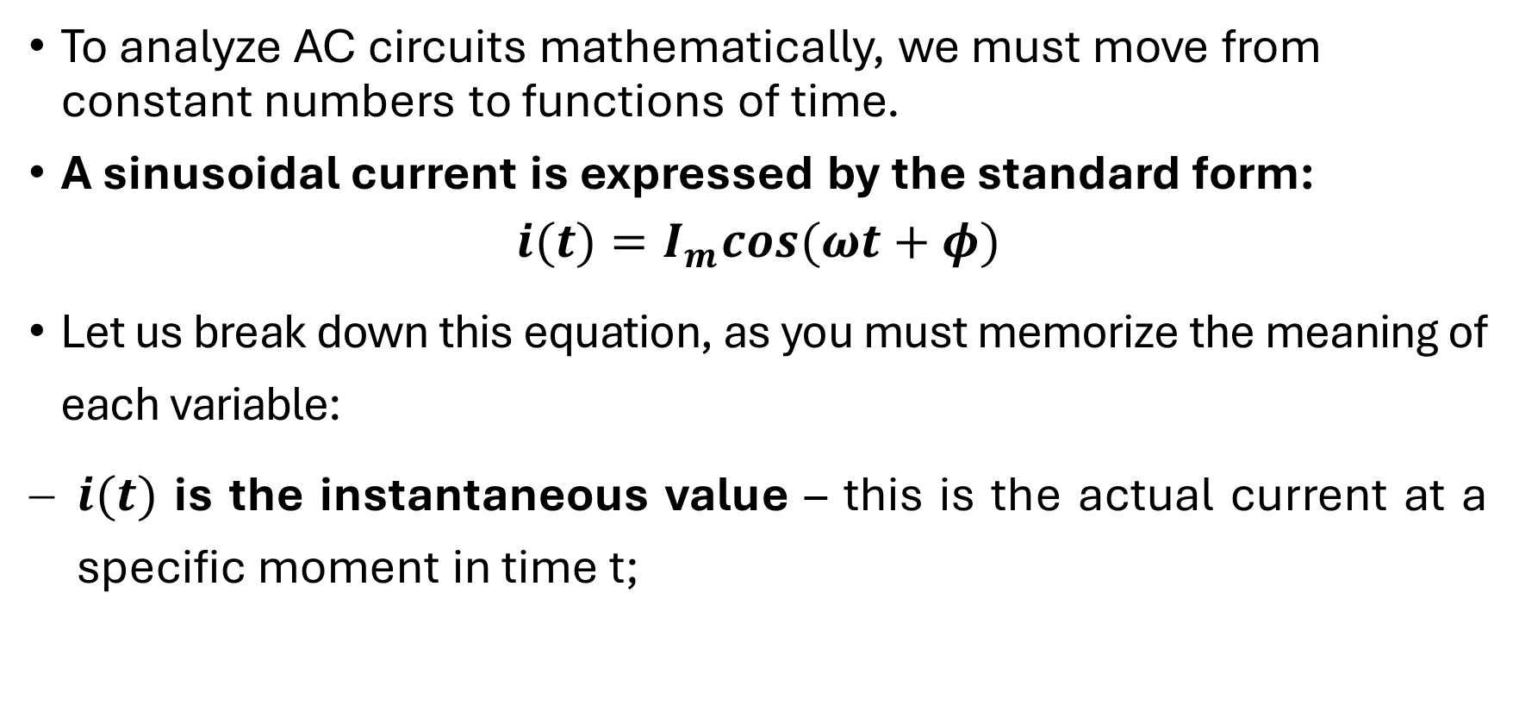
Systematic Analysis Methods
Sinusoidal Quantities and Phasors
To analyze AC circuits mathematically, we must move from constant numbers to functions of time.
A sinusoidal current is expressed by the standard form:
$$i(t)=I_{m}cos(ωt+φ)$$
Let us break down this equation, as you must memorize the meaning of each variable:
$i(t)$ is the instantaneous value – this is the actual current at a specific moment in time t;

Slide 11
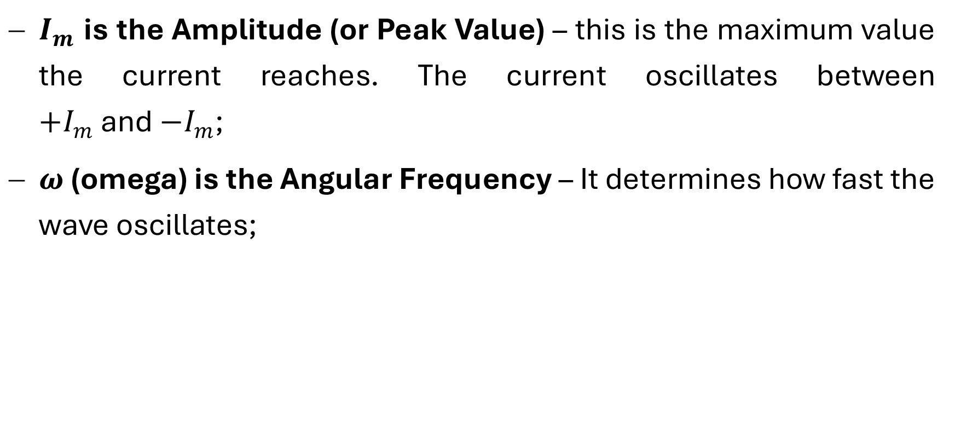
Systematic Analysis Methods
Sinusoidal Quantities and Phasors
$I_{m}$ is the Amplitude (or Peak Value) – this is the maximum value the current reaches. The current oscillates between $+I_{m}$ and $−I_{m}$;
$ω$ (omega) is the Angular Frequency – It determines how fast the wave oscillates;

Slide 12
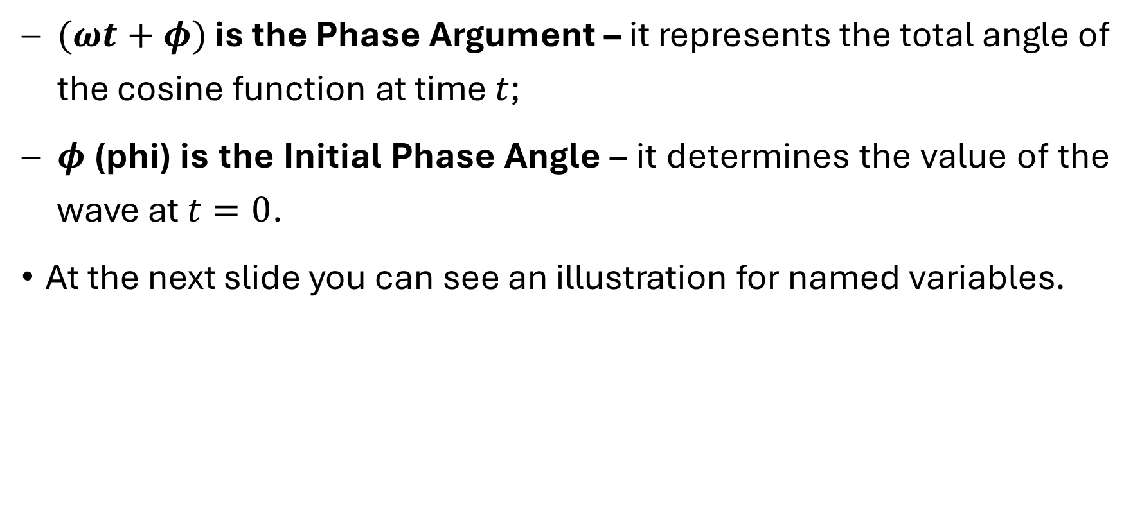
Systematic Analysis Methods
Sinusoidal Quantities and Phasors
$(ωt+φ)$ is the Phase Argument – it represents the total angle of the cosine function at time $t$;
$φ$ (phi) is the Initial Phase Angle – it determines the value of the wave at $t=0$.
At the next slide you can see an illustration for named variables.

Slide 13
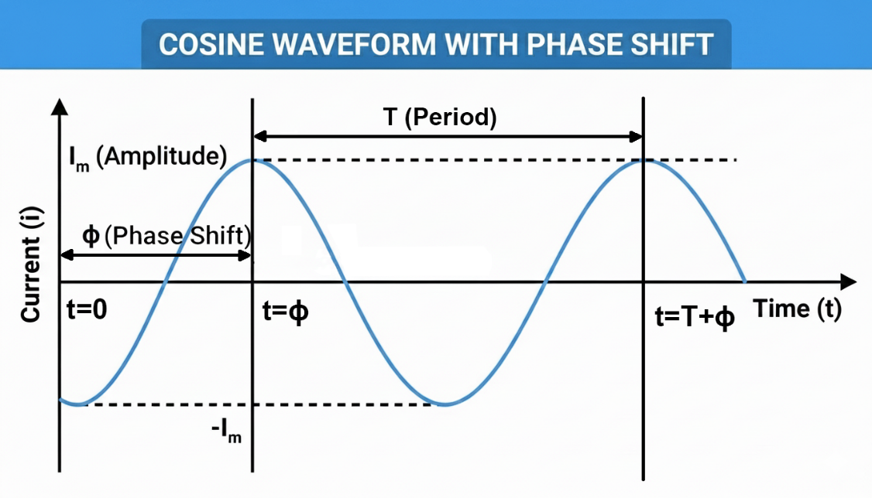
Systematic Analysis Methods
Sinusoidal Quantities and Phasors

Slide 14
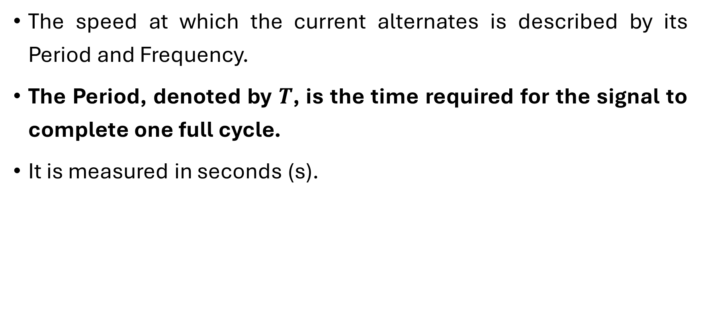
Systematic Analysis Methods
Sinusoidal Quantities and Phasors
The speed at which the current alternates is described by its Period and Frequency.
The Period, denoted by $T$, is the time required for the signal to complete one full cycle.
It is measured in seconds (s).

Slide 15
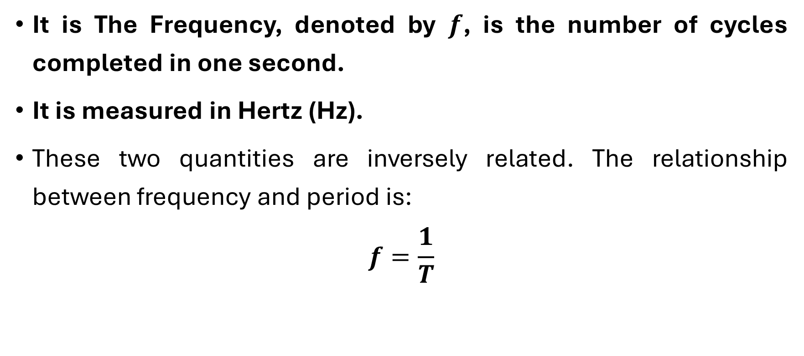
Systematic Analysis Methods
Sinusoidal Quantities and Phasors
It is The Frequency, denoted by $f$, is the number of cycles completed in one second.
It is measured in Hertz (Hz).
These two quantities are inversely related. The relationship between frequency and period is:
$$f=\frac{1}{T}$$

Slide 16
Systematic Analysis Methods
Sinusoidal Quantities and Phasors
For example, the standard power line frequency in Europe and Asia is 50 Hz, meaning the current changes direction 100 times (50 full cycles) every second. In North America, it is 60 Hz.

Slide 17
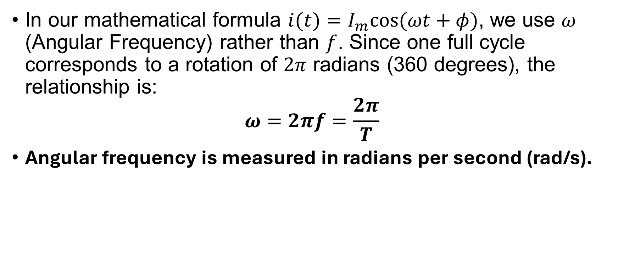
Systematic Analysis Methods
Sinusoidal Quantities and Phasors
In our mathematical formula $i(t)=I_{m}cos(ωt+φ)$, we use $ω$ (Angular Frequency) rather than $f$. Since one full cycle corresponds to a rotation of $2π$ radians (360 degrees), the relationship is:
$$ω=2πf=\frac{2π}{T}$$
Angular frequency is measured in radians per second (rad/s).

Slide 18

Systematic Analysis Methods
Sinusoidal Quantities and Phasors
It is important to be comfortable converting between these units. If you are given a frequency of 60 Hz, the angular frequency is: ω=2×3.14159×60≈377 rad/s. If you are given 50 Hz, ω≈314 rad/s.
Always check your calculator mode. When using $ω$, your calculator must be in Radian mode, not Degree mode.

Slide 19
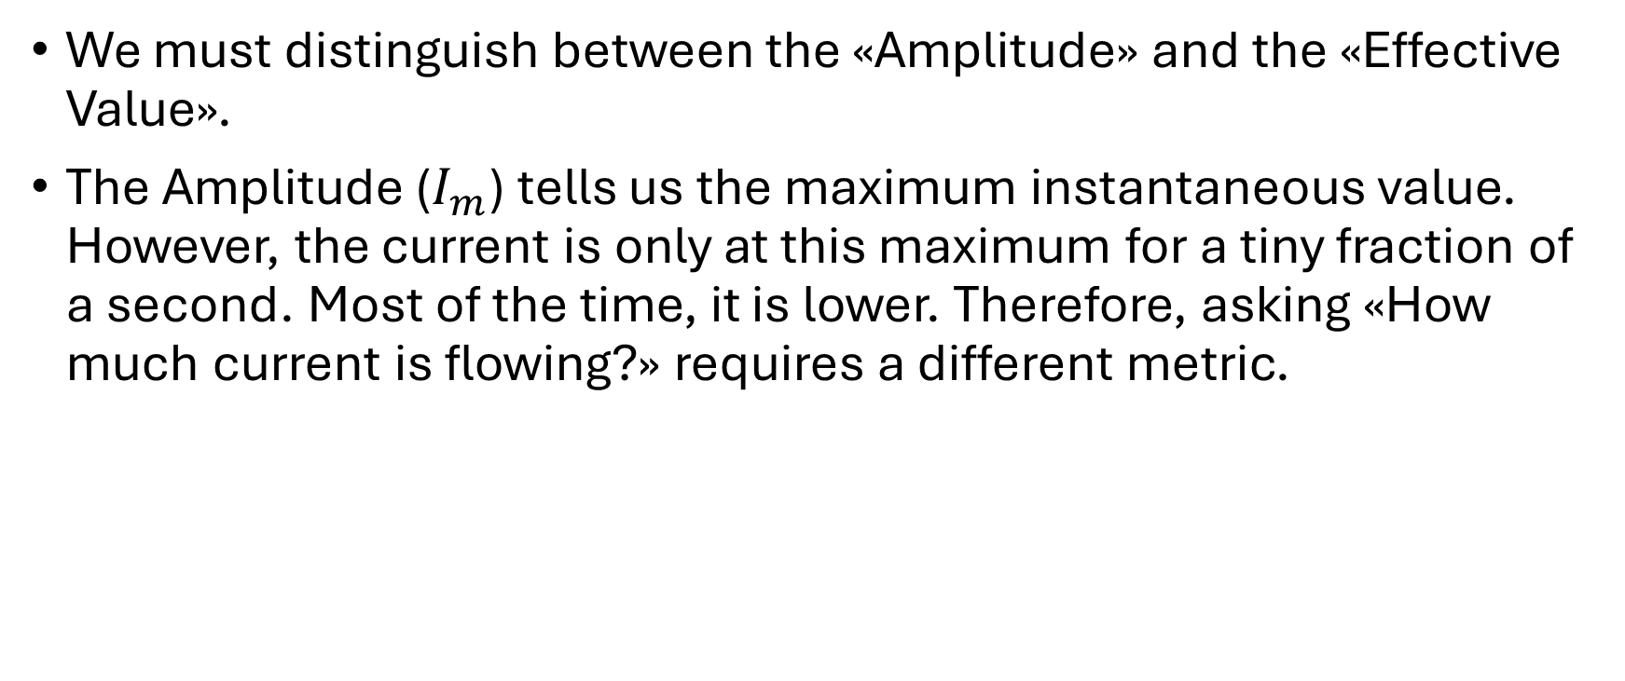
Systematic Analysis Methods
Sinusoidal Quantities and Phasors
We must distinguish between the «Amplitude» and the «Effective Value».
The Amplitude ($I_{m}$) tells us the maximum instantaneous value. However, the current is only at this maximum for a tiny fraction of a second. Most of the time, it is lower. Therefore, asking «How much current is flowing?» requires a different metric.

Slide 20
Systematic Analysis Methods
Sinusoidal Quantities and Phasors
RMS (Root Mean Square) value, also known as the Effective Value.
The Effective Value of an AC current is equivalent to the DC current that would deliver the same average power to a resistor.
If you have a toaster, it produces heat. If you power it with 10 Amps DC, it gets hot.
If you power it with AC, you need an AC current with an Effective Value of 10 Amps to produce the exact same amount of heat.

Slide 21
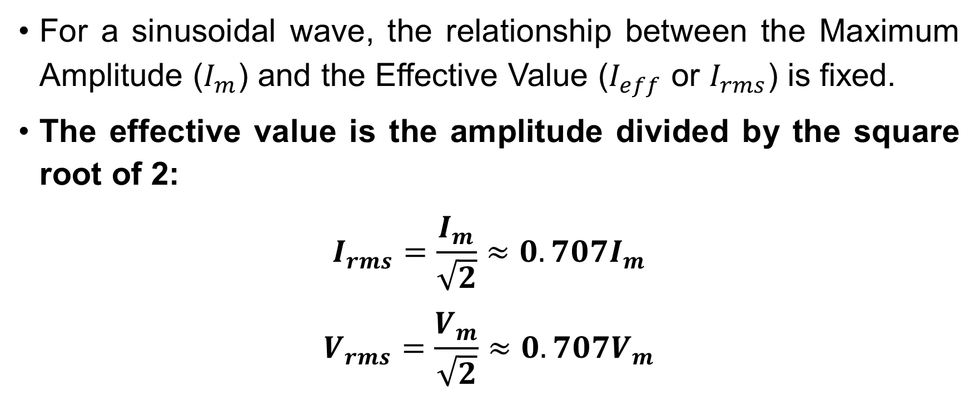
Systematic Analysis Methods
Sinusoidal Quantities and Phasors
For a sinusoidal wave, the relationship between the Maximum Amplitude ($I_{m}$) and the Effective Value ($I_{eff}$ or $I_{rms}$) is fixed.
The effective value is the amplitude divided by the square root of 2:
$$I_{rms}=\frac{I_{m}}{\sqrt{2}}≈0.707I_{m}$$
$$V_{rms}=\frac{V_{m}}{\sqrt{2}}≈0.707V_{m}$$

Slide 22
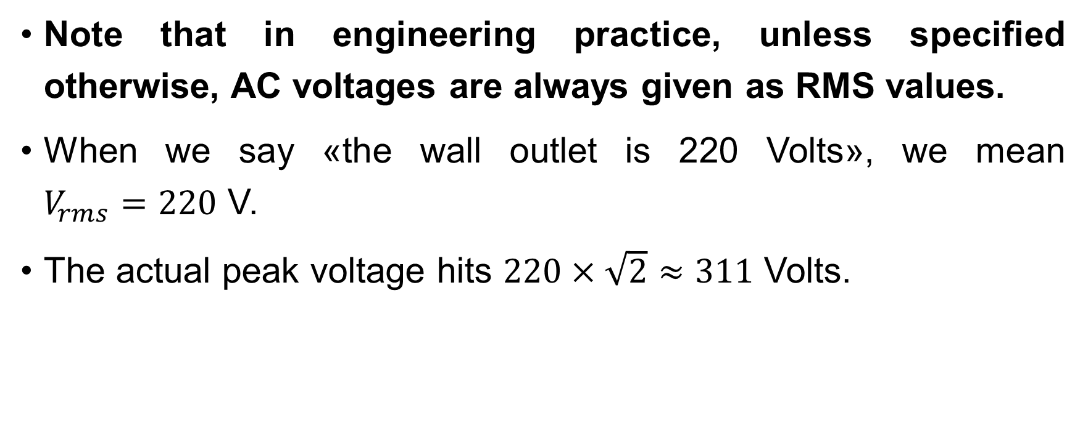
Systematic Analysis Methods
Sinusoidal Quantities and Phasors
Note that in engineering practice, unless specified otherwise, AC voltages are always given as RMS values.
When we say «the wall outlet is 220 Volts», we mean $V_{rms}=220$ V.
The actual peak voltage hits $220×\sqrt{2}≈311$ Volts.

Slide 23

Systematic Analysis Methods
Sinusoidal Quantities and Phasors
Do you have you any questions at the moment?

Slide 24
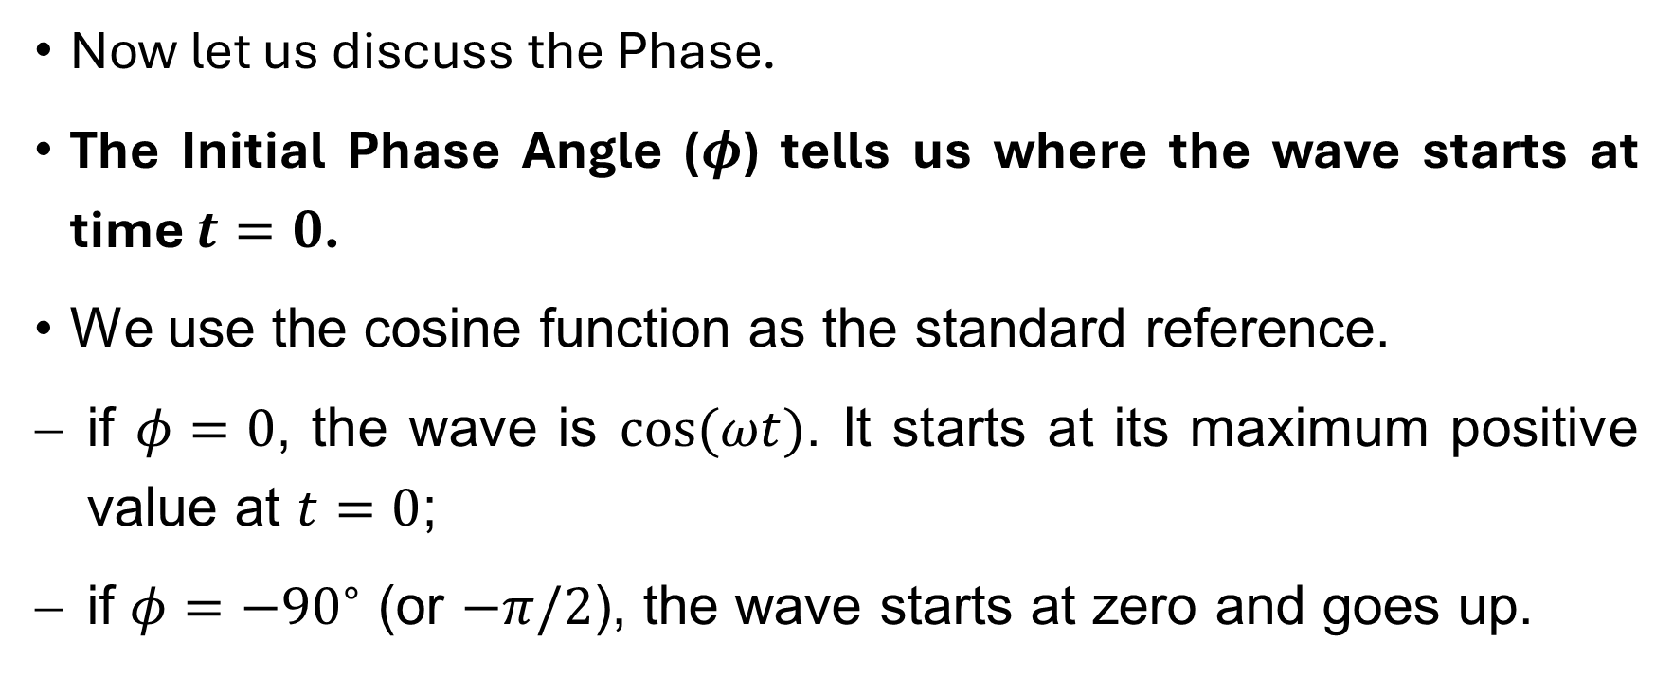
Systematic Analysis Methods
Sinusoidal Quantities and Phasors
Now let us discuss the Phase.
The Initial Phase Angle ($φ$) tells us where the wave starts at time $t=0$.
We use the cosine function as the standard reference.
if $φ=0$, the wave is $cos(ωt)$. It starts at its maximum positive value at $t=0$;
if $φ=−{90}^{∘}$ (or $−π/2$), the wave starts at zero and goes up.

Slide 25
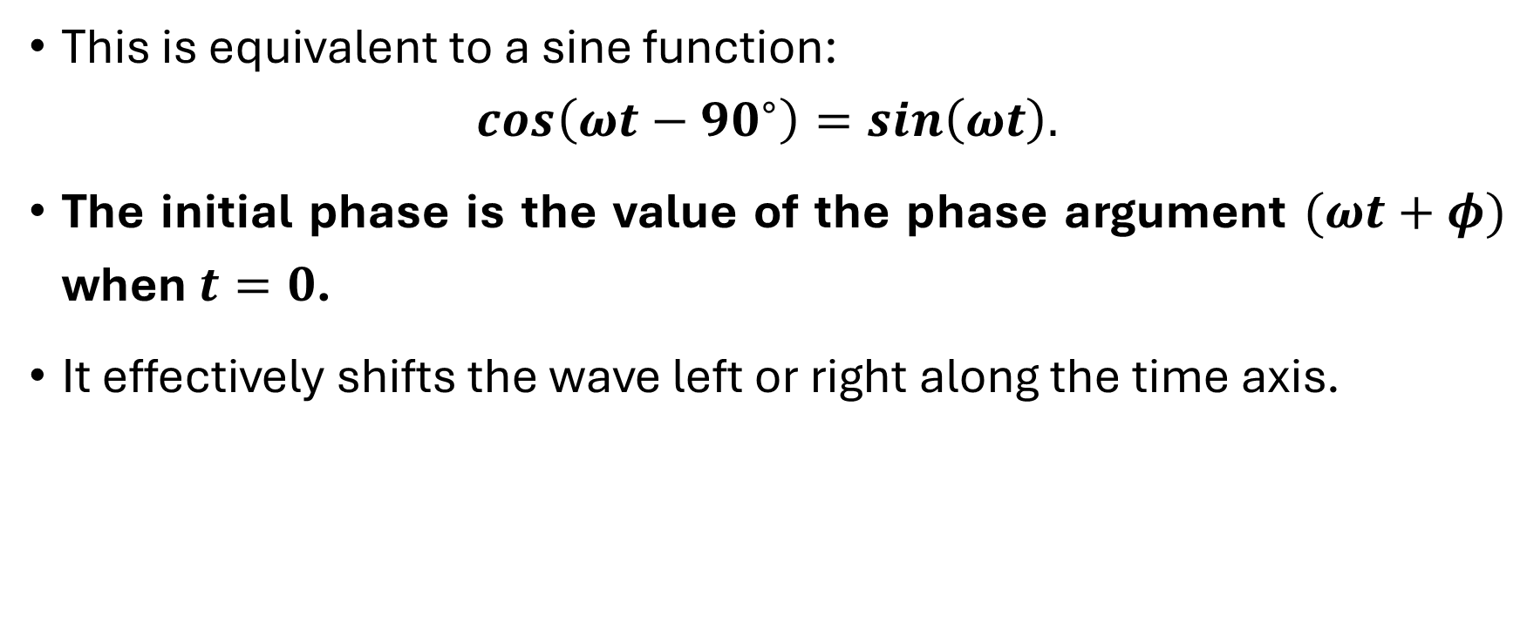
Systematic Analysis Methods
Sinusoidal Quantities and Phasors
This is equivalent to a sine function:
$$cos\left(ωt−{90}^{∘}\right)=sin\left(ωt\right).$$
The initial phase is the value of the phase argument $(ωt+φ)$ when $t=0$.
It effectively shifts the wave left or right along the time axis.

Slide 26
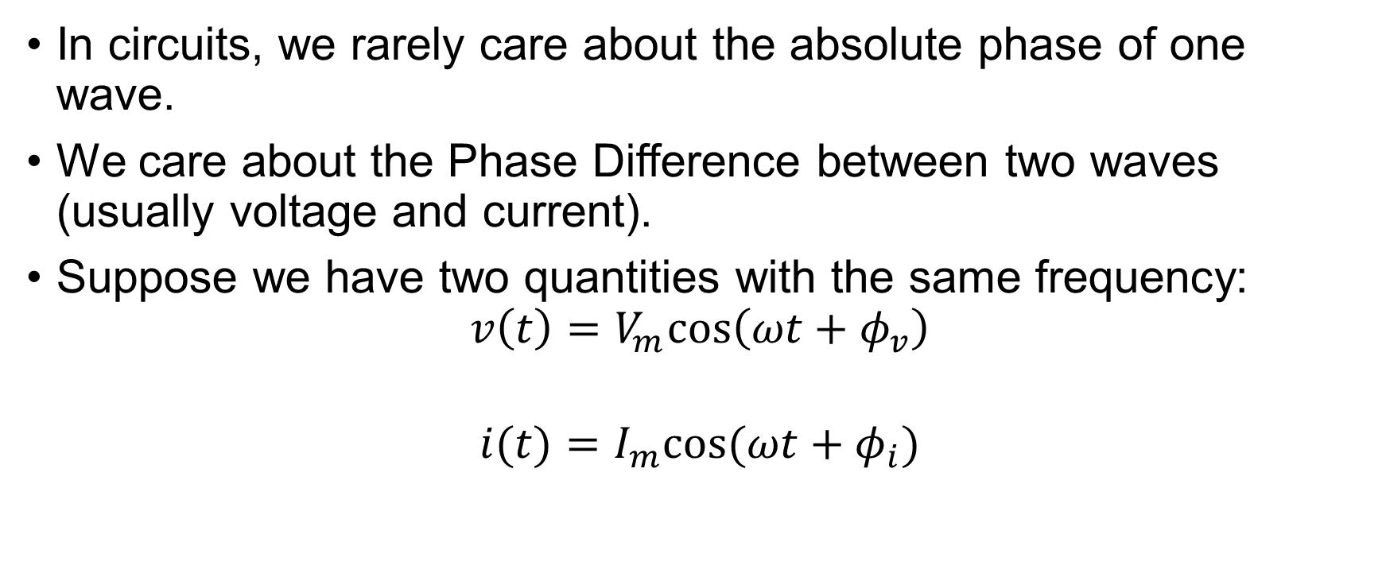
Systematic Analysis Methods
Sinusoidal Quantities and Phasors
In circuits, we rarely care about the absolute phase of one wave.
We care about the Phase Difference between two waves (usually voltage and current).
Suppose we have two quantities with the same frequency:
$$v\left(t\right)=V_{m}cos\left(ωt+φ_{v}\right)$$
$$i(t)=I_{m}cos(ωt+φ_{i})$$

Slide 27
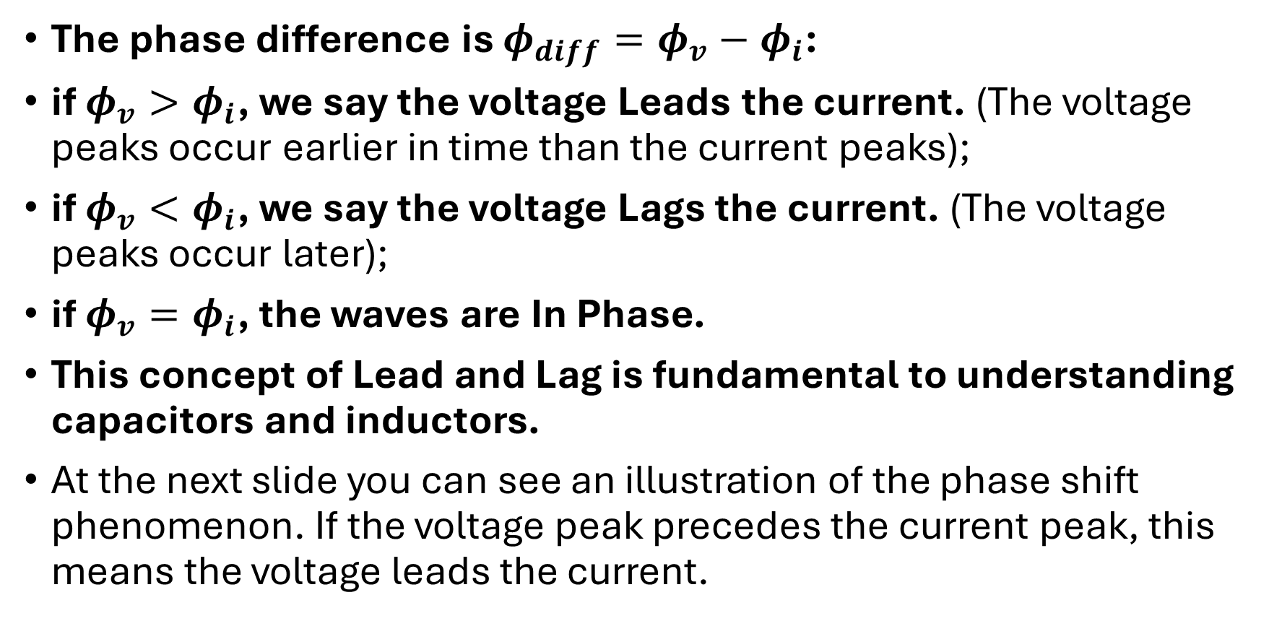
Systematic Analysis Methods
Sinusoidal Quantities and Phasors
The phase difference is $φ_{diff}=φ_{v}−φ_{i}$:
if $φ_{v}>φ_{i}$, we say the voltage Leads the current. (The voltage peaks occur earlier in time than the current peaks);
if $φ_{v}<φ_{i}$, we say the voltage Lags the current. (The voltage peaks occur later);
if $φ_{v}=φ_{i}$, the waves are In Phase.
This concept of Lead and Lag is fundamental to understanding capacitors and inductors.
At the next slide you can see an illustration of the phase shift phenomenon. If the voltage peak precedes the current peak, this means the voltage leads the current.

Slide 28
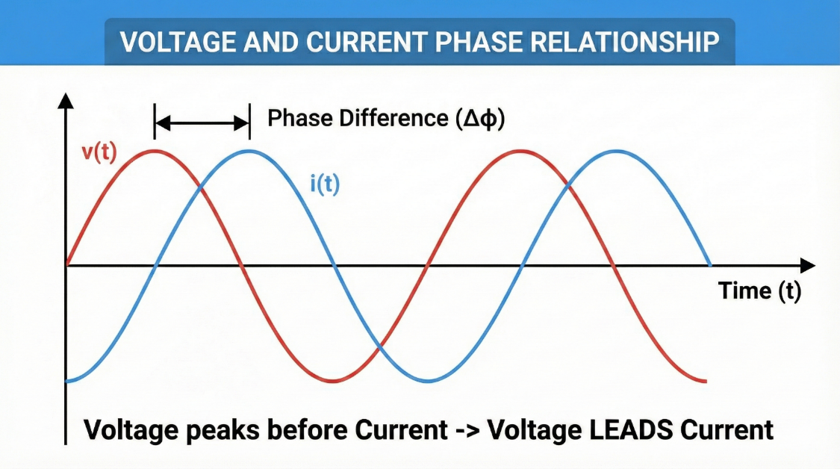
Systematic Analysis Methods
Sinusoidal Quantities and Phasors

Slide 29
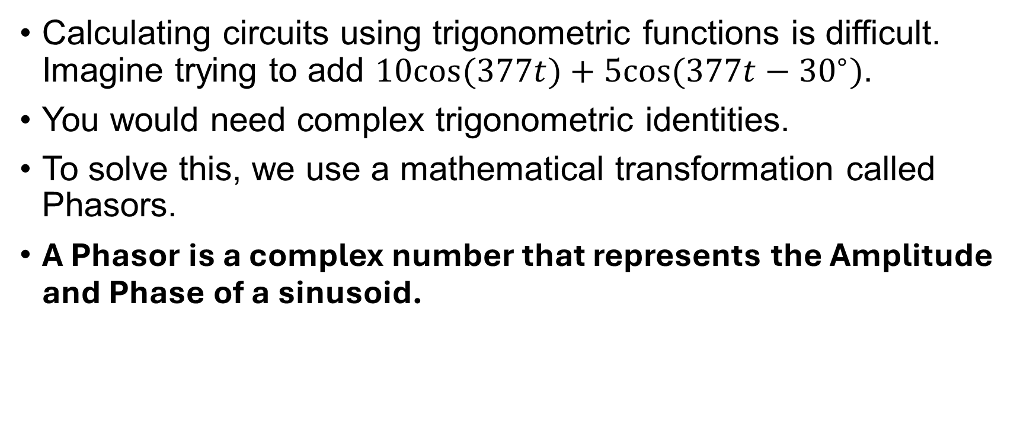
Systematic Analysis Methods
Sinusoidal Quantities and Phasors
Calculating circuits using trigonometric functions is difficult. Imagine trying to add $10cos(377t)+5cos(377t−{30}^{∘})$.
You would need complex trigonometric identities.
To solve this, we use a mathematical transformation called Phasors.
A Phasor is a complex number that represents the Amplitude and Phase of a sinusoid.

Slide 30
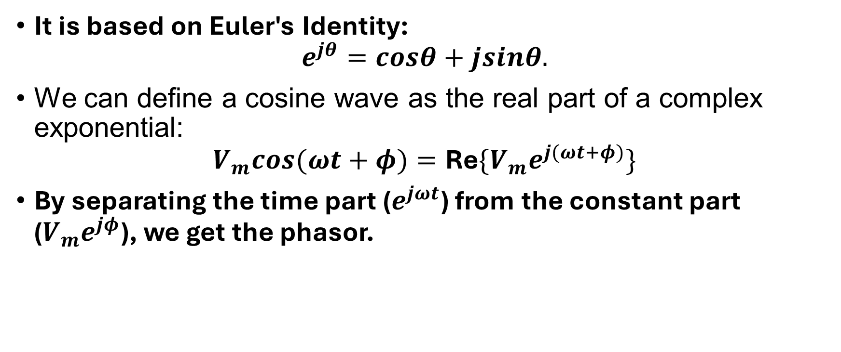
Systematic Analysis Methods
Sinusoidal Quantities and Phasors
It is based on Euler's Identity:
$$e^{jθ}=cosθ+jsinθ.$$
We can define a cosine wave as the real part of a complex exponential:
$$V_{m}cos(ωt+φ)=\text{Re}\{V_{m}e^{j(ωt+φ)}\}$$
By separating the time part ($e^{jωt}$) from the constant part ($V_{m}e^{jφ}$), we get the phasor.

Slide 31
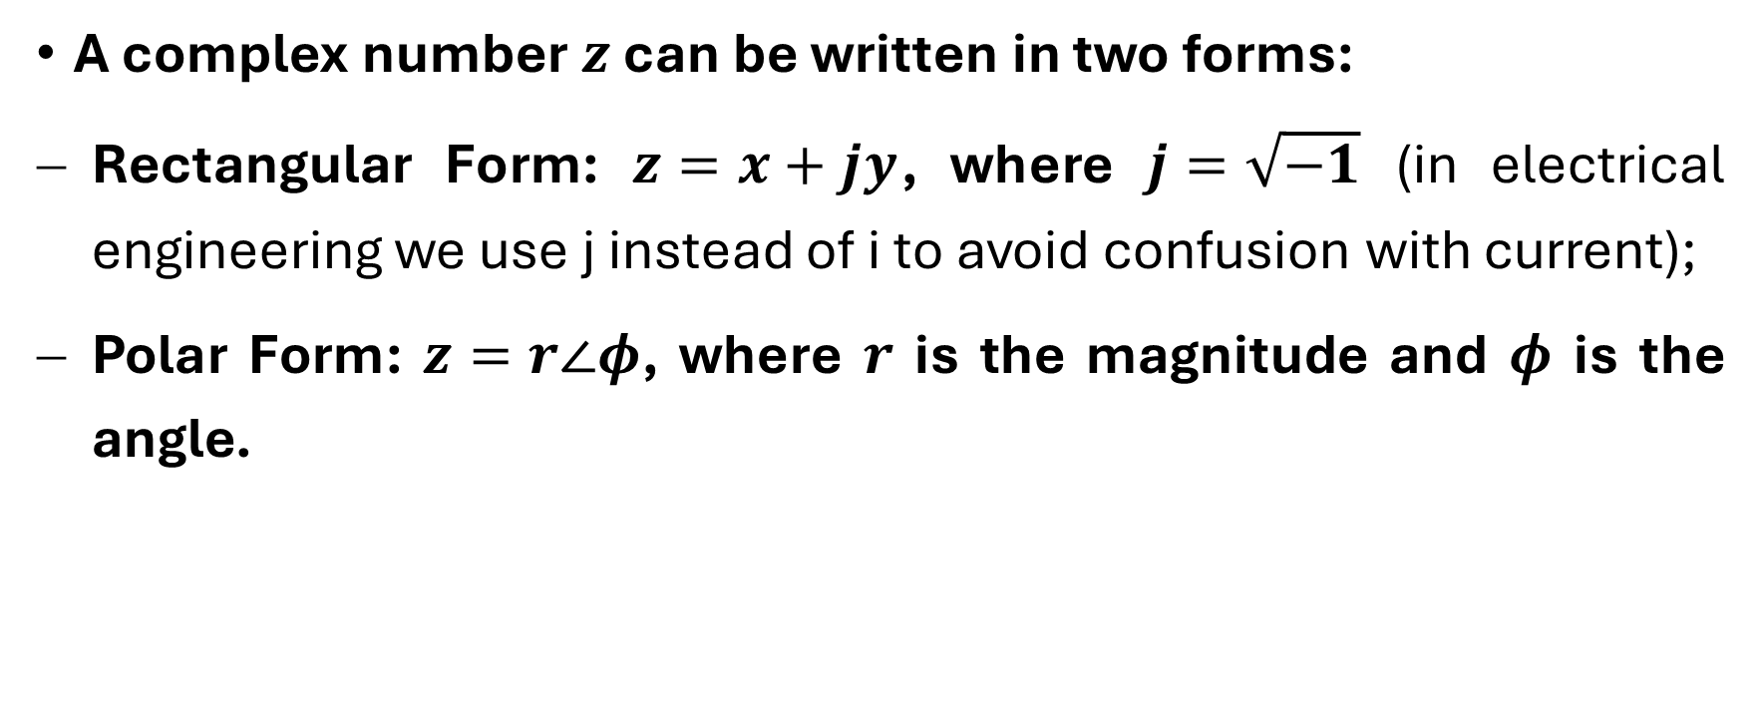
Systematic Analysis Methods
Sinusoidal Quantities and Phasors
A complex number $z$ can be written in two forms:
Rectangular Form: $z=x+jy$, where $j=\sqrt{−1}$ (in electrical engineering we use j instead of i to avoid confusion with current);
Polar Form: $z=r∠φ$, where $r$ is the magnitude and $φ$ is the angle.

Slide 32
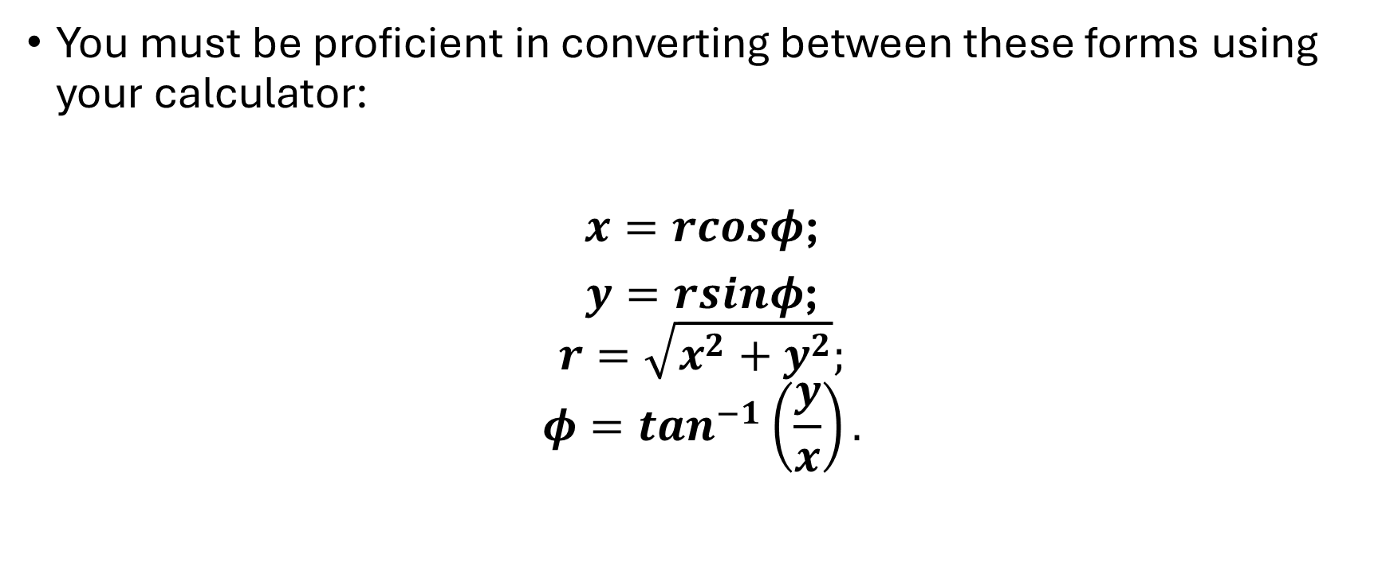
Systematic Analysis Methods
Sinusoidal Quantities and Phasors
You must be proficient in converting between these forms using your calculator:
$x=rcosφ$;
$y=rsinφ$;
$$r=\sqrt{x^{2}+y^{2}};$$
$$φ=\tan^{−1}\left(\frac{y}{x}\right).$$

Slide 33
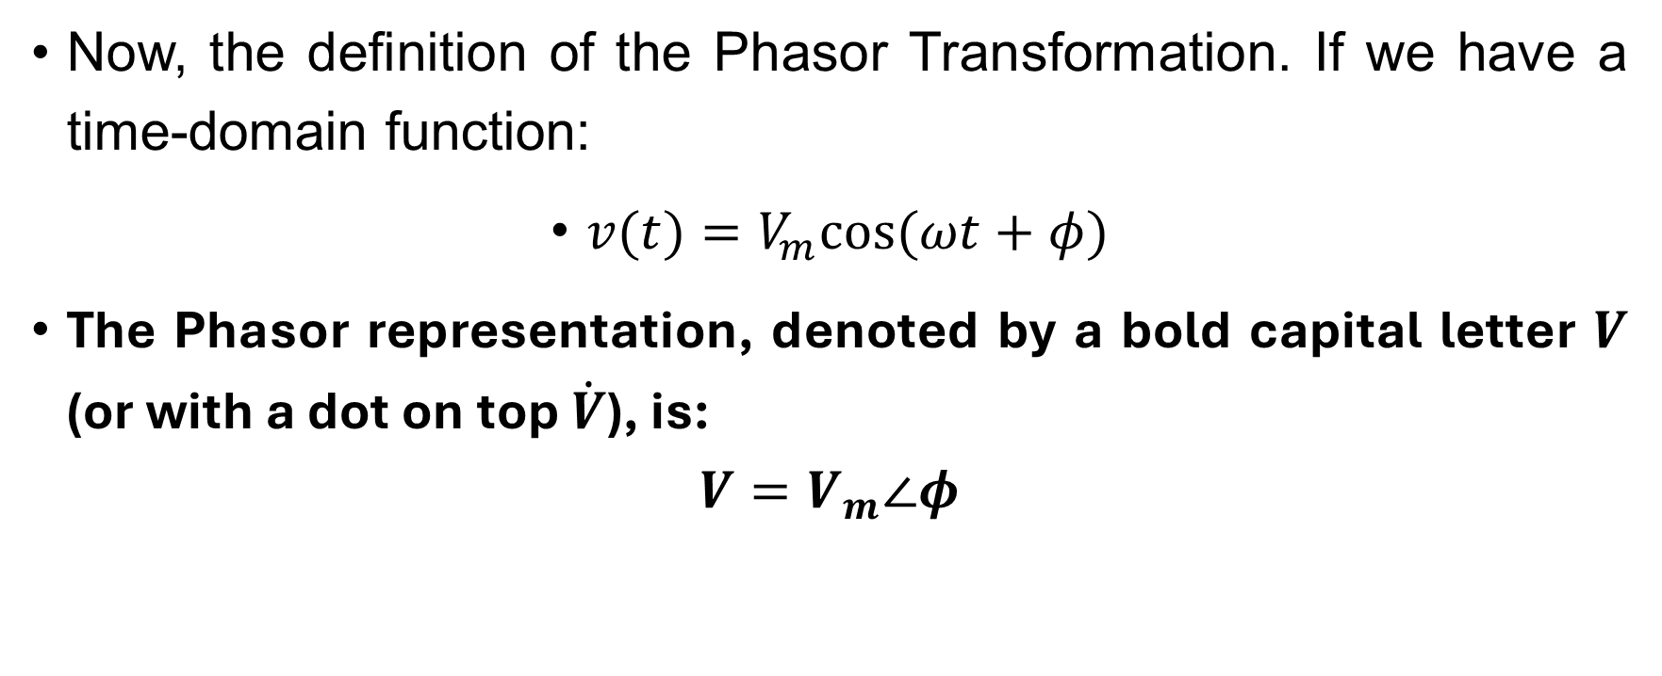
Systematic Analysis Methods
Sinusoidal Quantities and Phasors
Now, the definition of the Phasor Transformation. If we have a time-domain function:
$v(t)=V_{m}cos(ωt+φ)$
The Phasor representation, denoted by a bold capital letter $V$ (or with a dot on top $\dot{V}$), is:
$$V=V_{m}∠φ$$

Slide 34
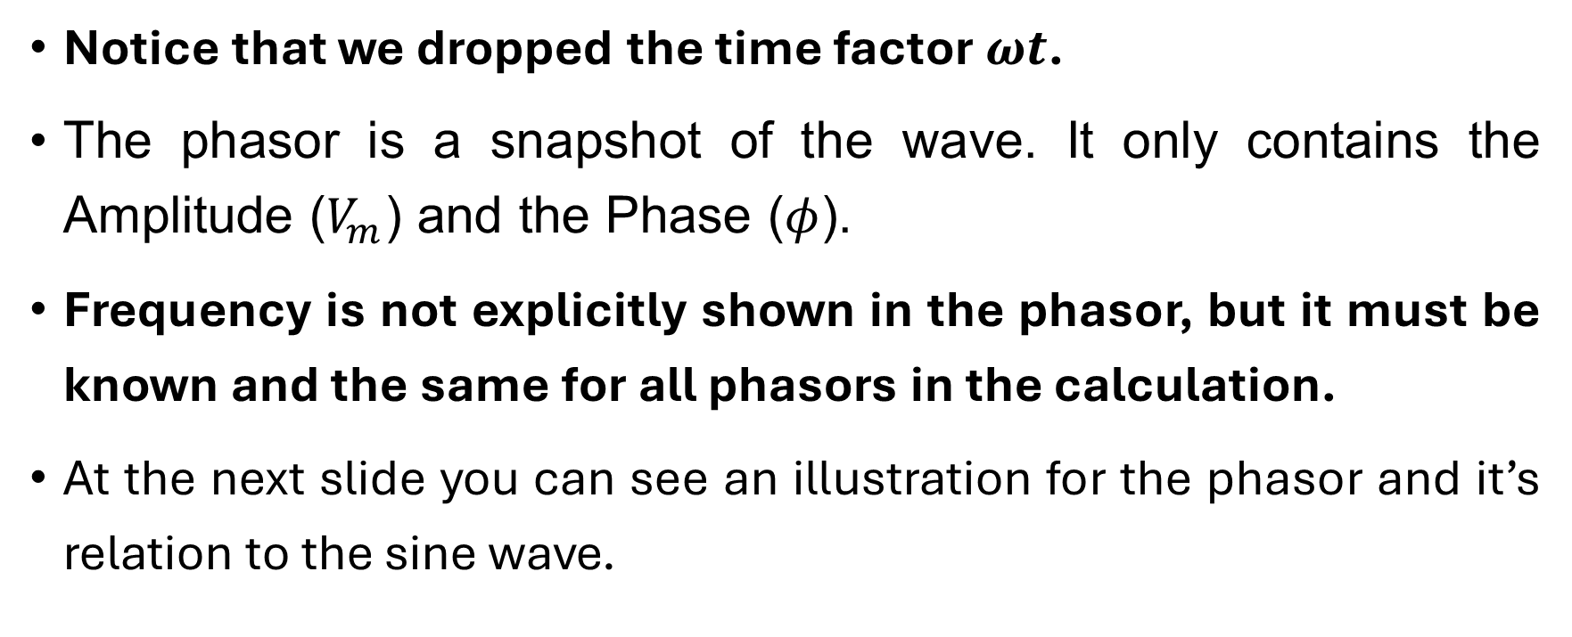
Systematic Analysis Methods
Sinusoidal Quantities and Phasors
Notice that we dropped the time factor $ωt$.
The phasor is a snapshot of the wave. It only contains the Amplitude ($V_{m}$) and the Phase ($φ$).
Frequency is not explicitly shown in the phasor, but it must be known and the same for all phasors in the calculation.
At the next slide you can see an illustration for the phasor and it’s relation to the sine wave.

Slide 35
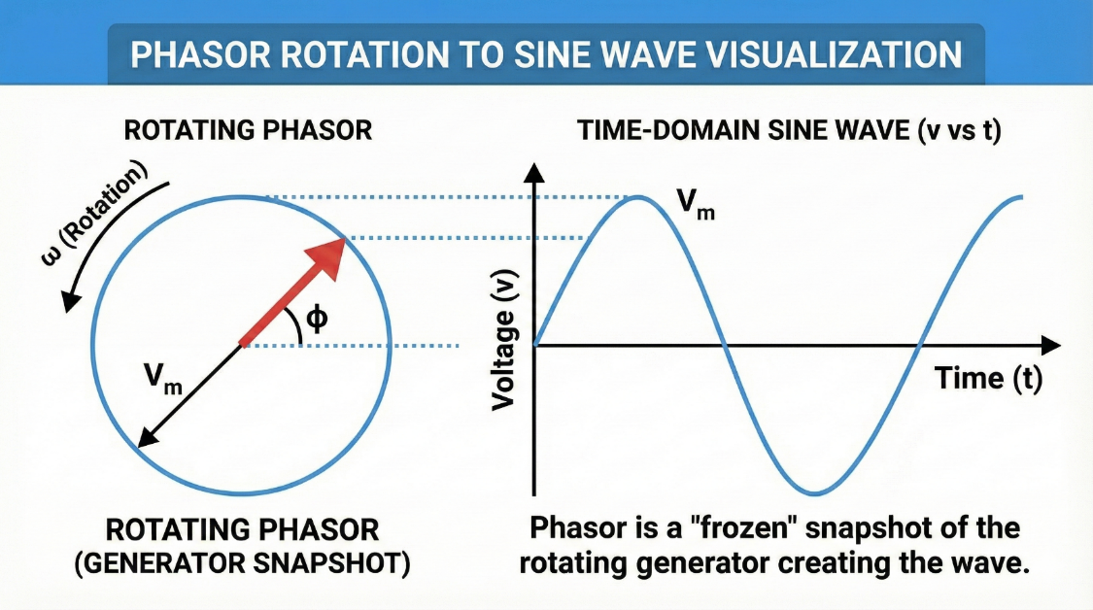
Systematic Analysis Methods
Sinusoidal Quantities and Phasors

Slide 36
Systematic Analysis Methods
Sinusoidal Quantities and Phasors
Why do we do this?
Because operations on complex numbers are easier than trigonometry.
Addition and Subtraction of sinusoids become Addition and Subtraction of Complex Numbers.
To add voltages, we convert them to phasors and add them in Rectangular Form.

Slide 37
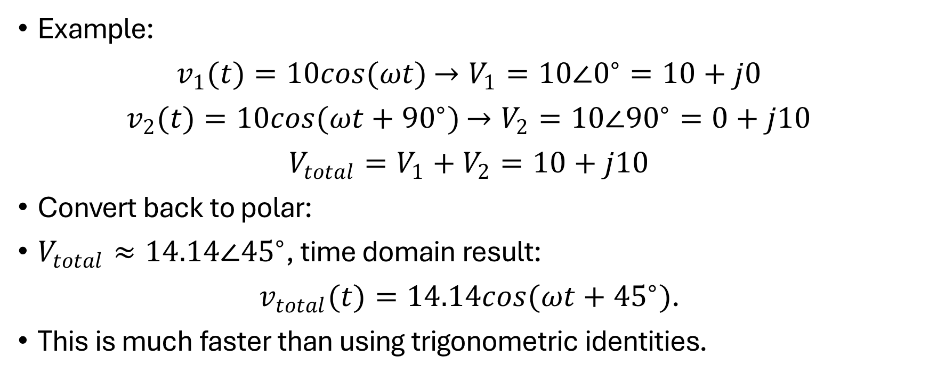
Systematic Analysis Methods
Sinusoidal Quantities and Phasors
Example:
$v_{1}(t)=10cos(ωt)$ $→V_{1}=10∠0^{∘}=10+j0$
$v_{2}(t)=10cos(ωt+{90}^{∘})$ $→V_{2}=10∠{90}^{∘}=0+j10$
$V_{total}=V_{1}+V_{2}=10+j10$
Convert back to polar:
$V_{total}≈14.14∠{45}^{∘}$, time domain result:
$v_{total}(t)=14.14cos(ωt+{45}^{∘})$.
This is much faster than using trigonometric identities.

Slide 38
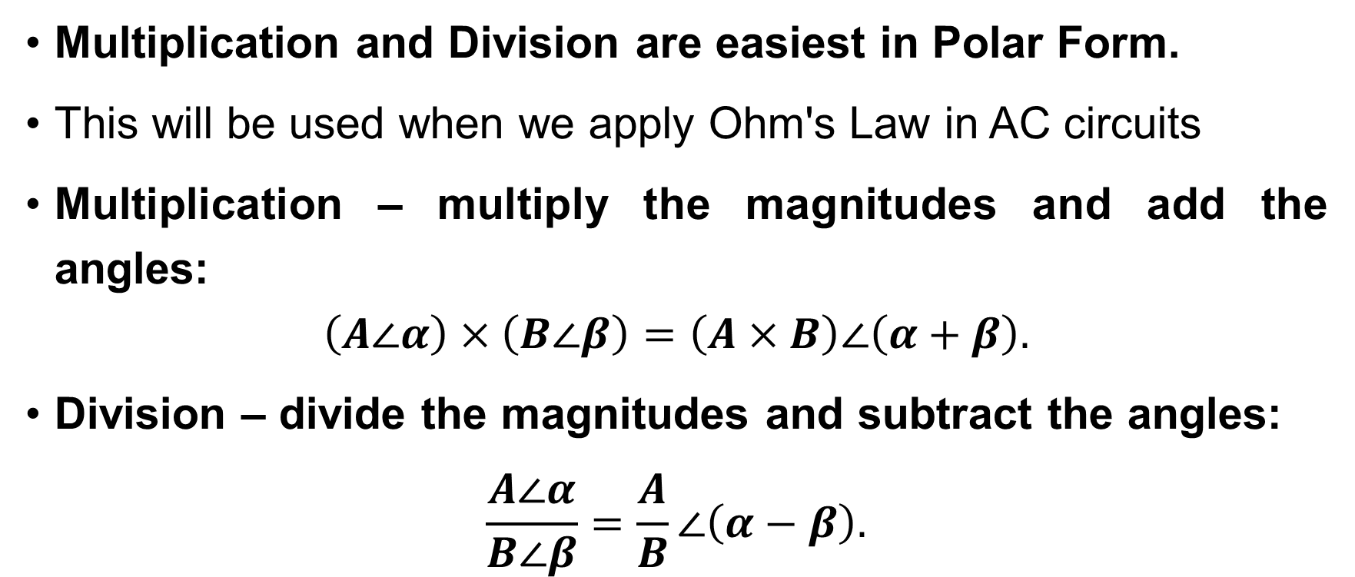
Systematic Analysis Methods
Sinusoidal Quantities and Phasors
Multiplication and Division are easiest in Polar Form.
This will be used when we apply Ohm's Law in AC circuits
Multiplication – multiply the magnitudes and add the angles:
$$\left(A∠α\right)×\left(B∠β\right)=\left(A×B\right)∠\left(α+β\right).$$
Division – divide the magnitudes and subtract the angles:
$$\frac{A∠α}{B∠β}=\frac{A}{B}∠\left(α−β\right).$$

Slide 39
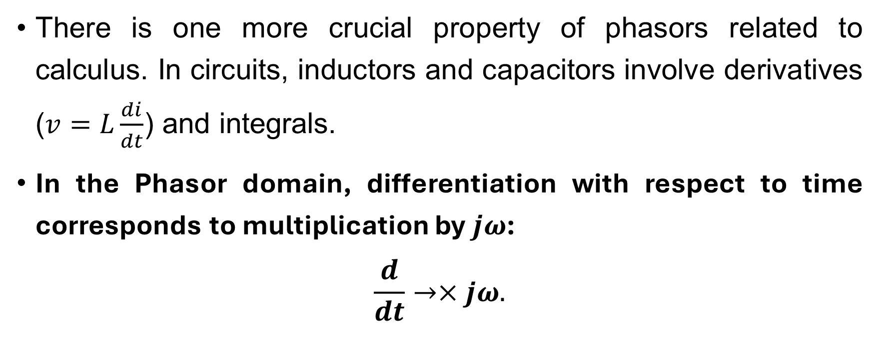
Systematic Analysis Methods
Sinusoidal Quantities and Phasors
There is one more crucial property of phasors related to calculus. In circuits, inductors and capacitors involve derivatives ($v=L\frac{di}{dt}$) and integrals.
In the Phasor domain, differentiation with respect to time corresponds to multiplication by $jω$:
$$\frac{d}{dt}→×jω.$$

Slide 40
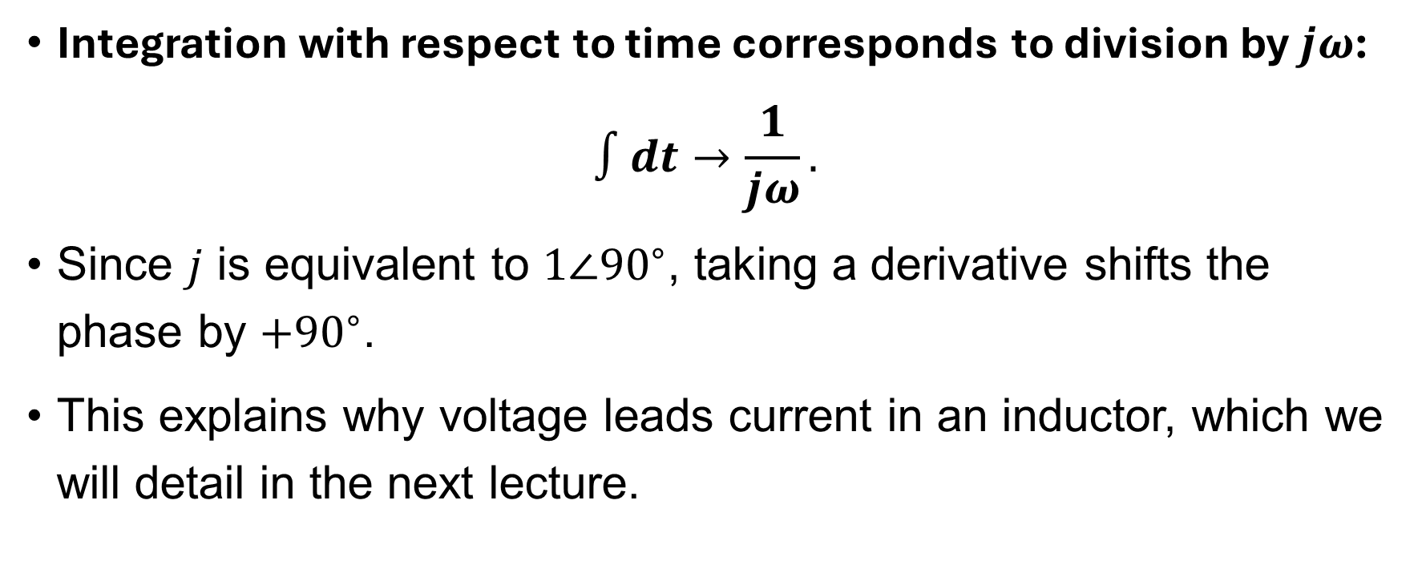
Systematic Analysis Methods
Sinusoidal Quantities and Phasors
Integration with respect to time corresponds to division by $jω$:
$$∫dt→\frac{1}{jω}.$$
Since $j$ is equivalent to $1∠{90}^{∘}$, taking a derivative shifts the phase by $+{90}^{∘}$.
This explains why voltage leads current in an inductor, which we will detail in the next lecture.

Slide 41
Systematic Analysis Methods
Sinusoidal Quantities and Phasors
We must also discuss two important metrics used to describe the shape of an AC waveform: the Average Value and the Form Factor.
The mathematical average of a pure sine wave over one full cycle is zero, because the positive half cancels the negative half.
In engineering, when we speak of the «Average Value» of a sine wave, we usually refer to the average over a half-cycle (or the average of the absolute value).
This is very important for designing AC-to-DC converters (rectifiers).

Slide 42
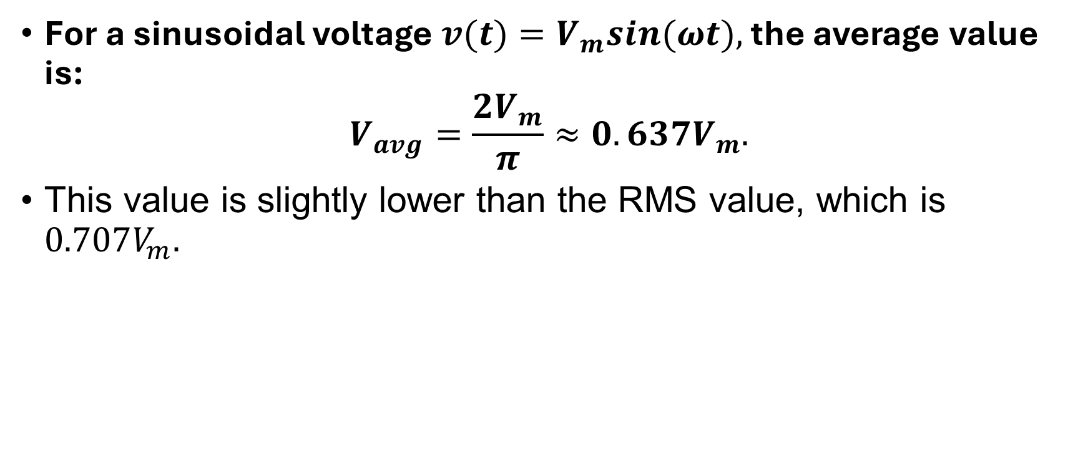
Systematic Analysis Methods
Sinusoidal Quantities and Phasors
For a sinusoidal voltage $v(t)=V_{m}sin(ωt),$ the average value is:
$$V_{avg}=\frac{2V_{m}}{π}≈0.637V_{m}.$$
This value is slightly lower than the RMS value, which is $0.707V_{m}.$

Slide 43
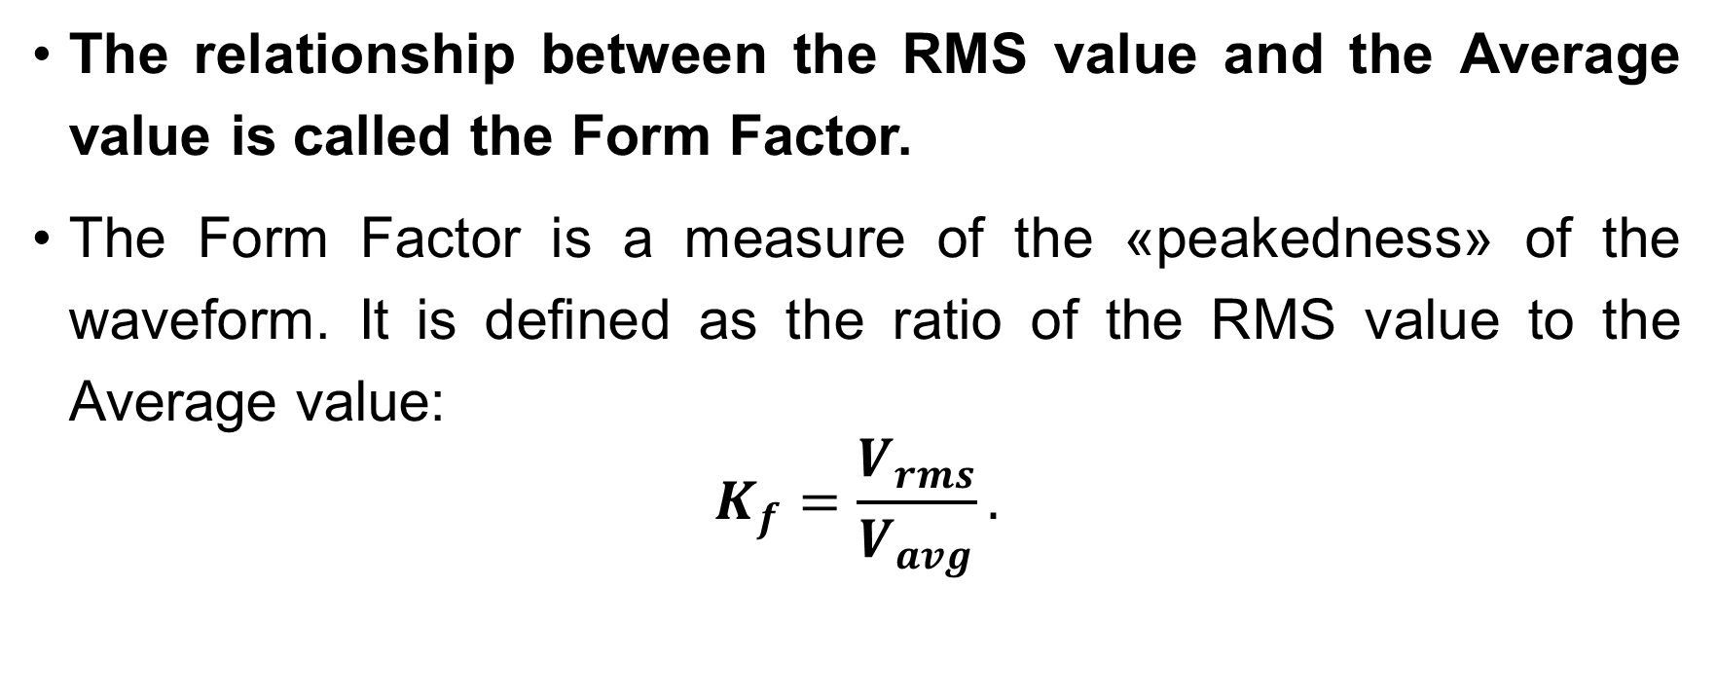
Systematic Analysis Methods
Sinusoidal Quantities and Phasors
The relationship between the RMS value and the Average value is called the Form Factor.
The Form Factor is a measure of the «peakedness» of the waveform. It is defined as the ratio of the RMS value to the Average value:
$$K_{f}=\frac{V_{rms}}{V_{avg}}.$$

Slide 44
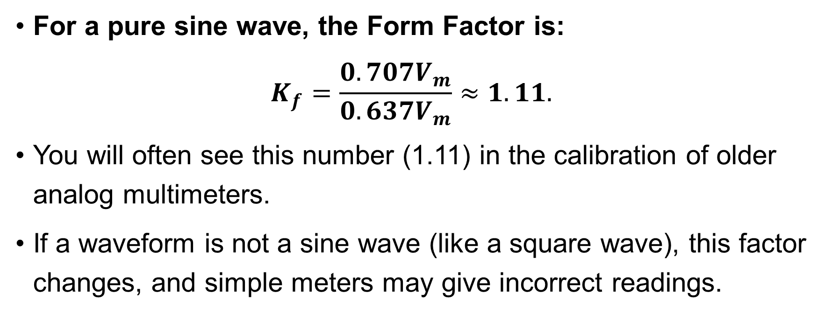
Systematic Analysis Methods
Sinusoidal Quantities and Phasors
For a pure sine wave, the Form Factor is:
$$K_{f}=\frac{0.707V_{m}}{0.637V_{m}}≈1.11.$$
You will often see this number (1.11) in the calibration of older analog multimeters.
If a waveform is not a sine wave (like a square wave), this factor changes, and simple meters may give incorrect readings.

Slide 45
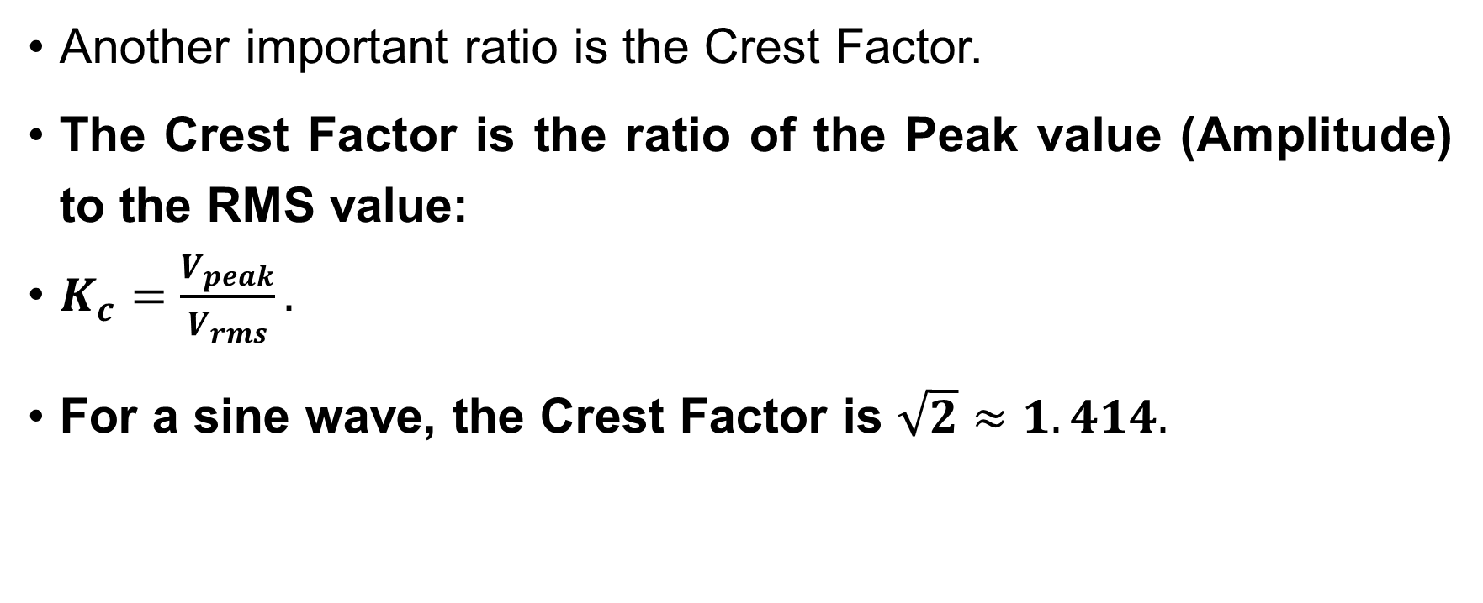
Systematic Analysis Methods
Sinusoidal Quantities and Phasors
Another important ratio is the Crest Factor.
The Crest Factor is the ratio of the Peak value (Amplitude) to the RMS value:
$K_{c}=\frac{V_{peak}}{V_{rms}}.$
For a sine wave, the Crest Factor is $\sqrt{2}≈1.414.$

Slide 46
Systematic Analysis Methods
Sinusoidal Quantities and Phasors
This number tells us how much stress the insulation must withstand.
A wire carrying 100 V RMS must have insulation capable of handling at least 141 V Peak.
For pulsed signals or noise, the Crest Factor can be much higher, meaning the peak voltage is dangerous even if the RMS (heating) value is low.

Slide 47
Systematic Analysis Methods
Sinusoidal Quantities and Phasors
Let us refine our understanding of the Complex Conjugate in phasor analysis.
Sometimes in calculations, specifically for power (which we will study later), we need to change the sign of the imaginary part.

Slide 48
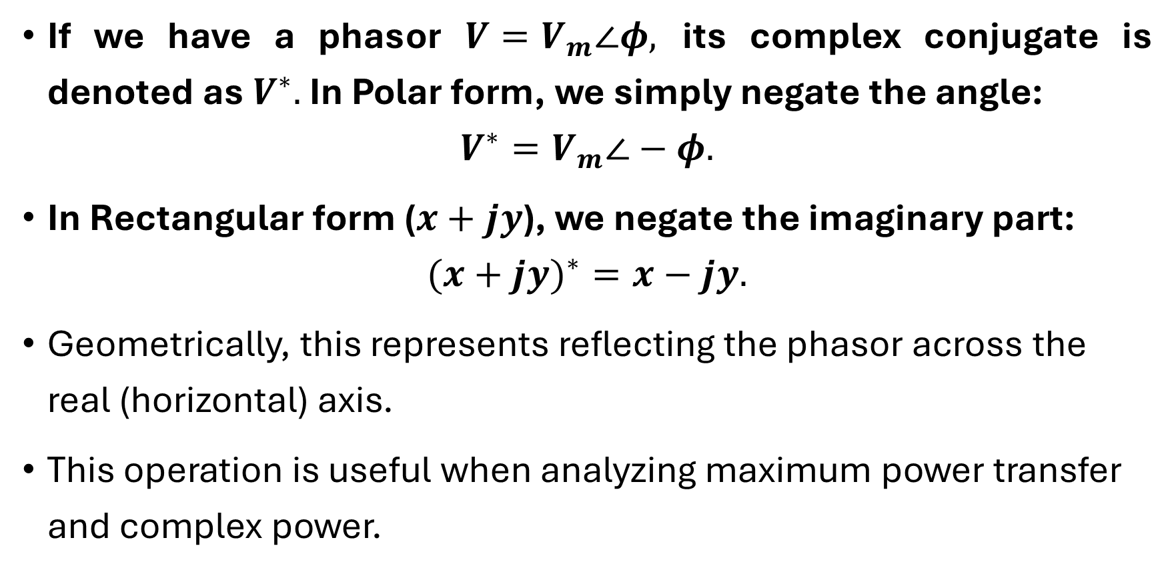
Systematic Analysis Methods
Sinusoidal Quantities and Phasors
If we have a phasor $V=V_{m}∠φ,$ its complex conjugate is denoted as $V^{∗}.$ In Polar form, we simply negate the angle:
$$V^{∗}=V_{m}∠−φ.$$
In Rectangular form ($x+jy$), we negate the imaginary part:
$$(x+jy)^{∗}=x−jy.$$
Geometrically, this represents reflecting the phasor across the real (horizontal) axis.
This operation is useful when analyzing maximum power transfer and complex power.

Slide 49
Systematic Analysis Methods
Sinusoidal Quantities and Phasors
To summarize, today we have established a language for describing AC circuits. In the upcoming lectures, we will refine it to a level suitable for practical application.
Thank you for your attention!
Do you have any questions?

