Slide 1
Lecture 8. Component Characteristics in AC
Part (3). Analysis of Sinusoidal Steady-State AC Circuits

Slide 2
Systematic Analysis Methods
Component Characteristics in AC
Welcome back to the course on The Principle of Circuit. In our previous lecture, we introduced the concept of sinusoidal quantities and the powerful mathematical tool known as the Phasor.
We learned that we can represent time-varying sine waves as static complex numbers (vectors) in a complex plane.
Today, we apply this phasor concept to the three fundamental passive elements: the Resistor (R), the Inductor (L), and the Capacitor (C).

Slide 3
Systematic Analysis Methods
Component Characteristics in AC
We will see how each component behaves differently when subjected to an Alternating Current (AC) frequency.
Finally, we will combine these behaviors into a single, unified concept called Complex Impedance, which is the AC equivalent of resistance.
A thorough understanding of these individual characteristics is the prerequisite for analyzing any AC circuit, from simple filters to complex power grids.

Slide 4
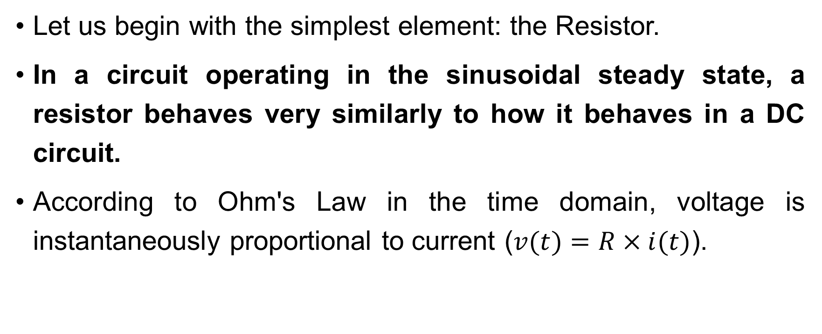
Systematic Analysis Methods
Component Characteristics in AC
Let us begin with the simplest element: the Resistor.
In a circuit operating in the sinusoidal steady state, a resistor behaves very similarly to how it behaves in a DC circuit.
According to Ohm's Law in the time domain, voltage is instantaneously proportional to current ($v(t)=R×i(t)$).

Slide 5
Systematic Analysis Methods
Component Characteristics in AC
For a resistor, the sinusoidal voltage and current are always «in phase».
This means that they reach their peak positive values at the exact same moment and cross zero at the exact same moment.

Slide 6
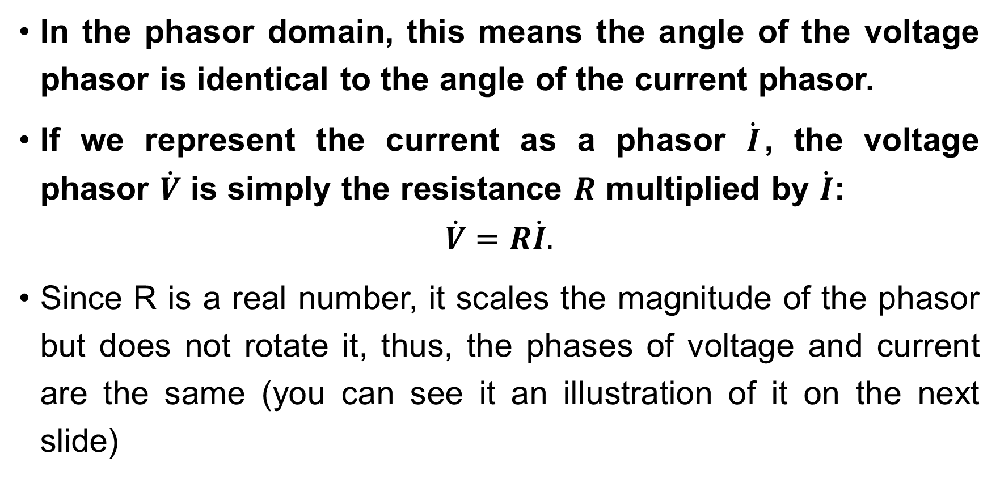
Systematic Analysis Methods
Component Characteristics in AC
In the phasor domain, this means the angle of the voltage phasor is identical to the angle of the current phasor.
If we represent the current as a phasor $\dot{I}$, the voltage phasor $\dot{V}$ is simply the resistance $R$ multiplied by $\dot{I}$:
$$\dot{V}=R\dot{I}.$$
Since R is a real number, it scales the magnitude of the phasor but does not rotate it, thus, the phases of voltage and current are the same (you can see it an illustration of it on the next slide)

Slide 7
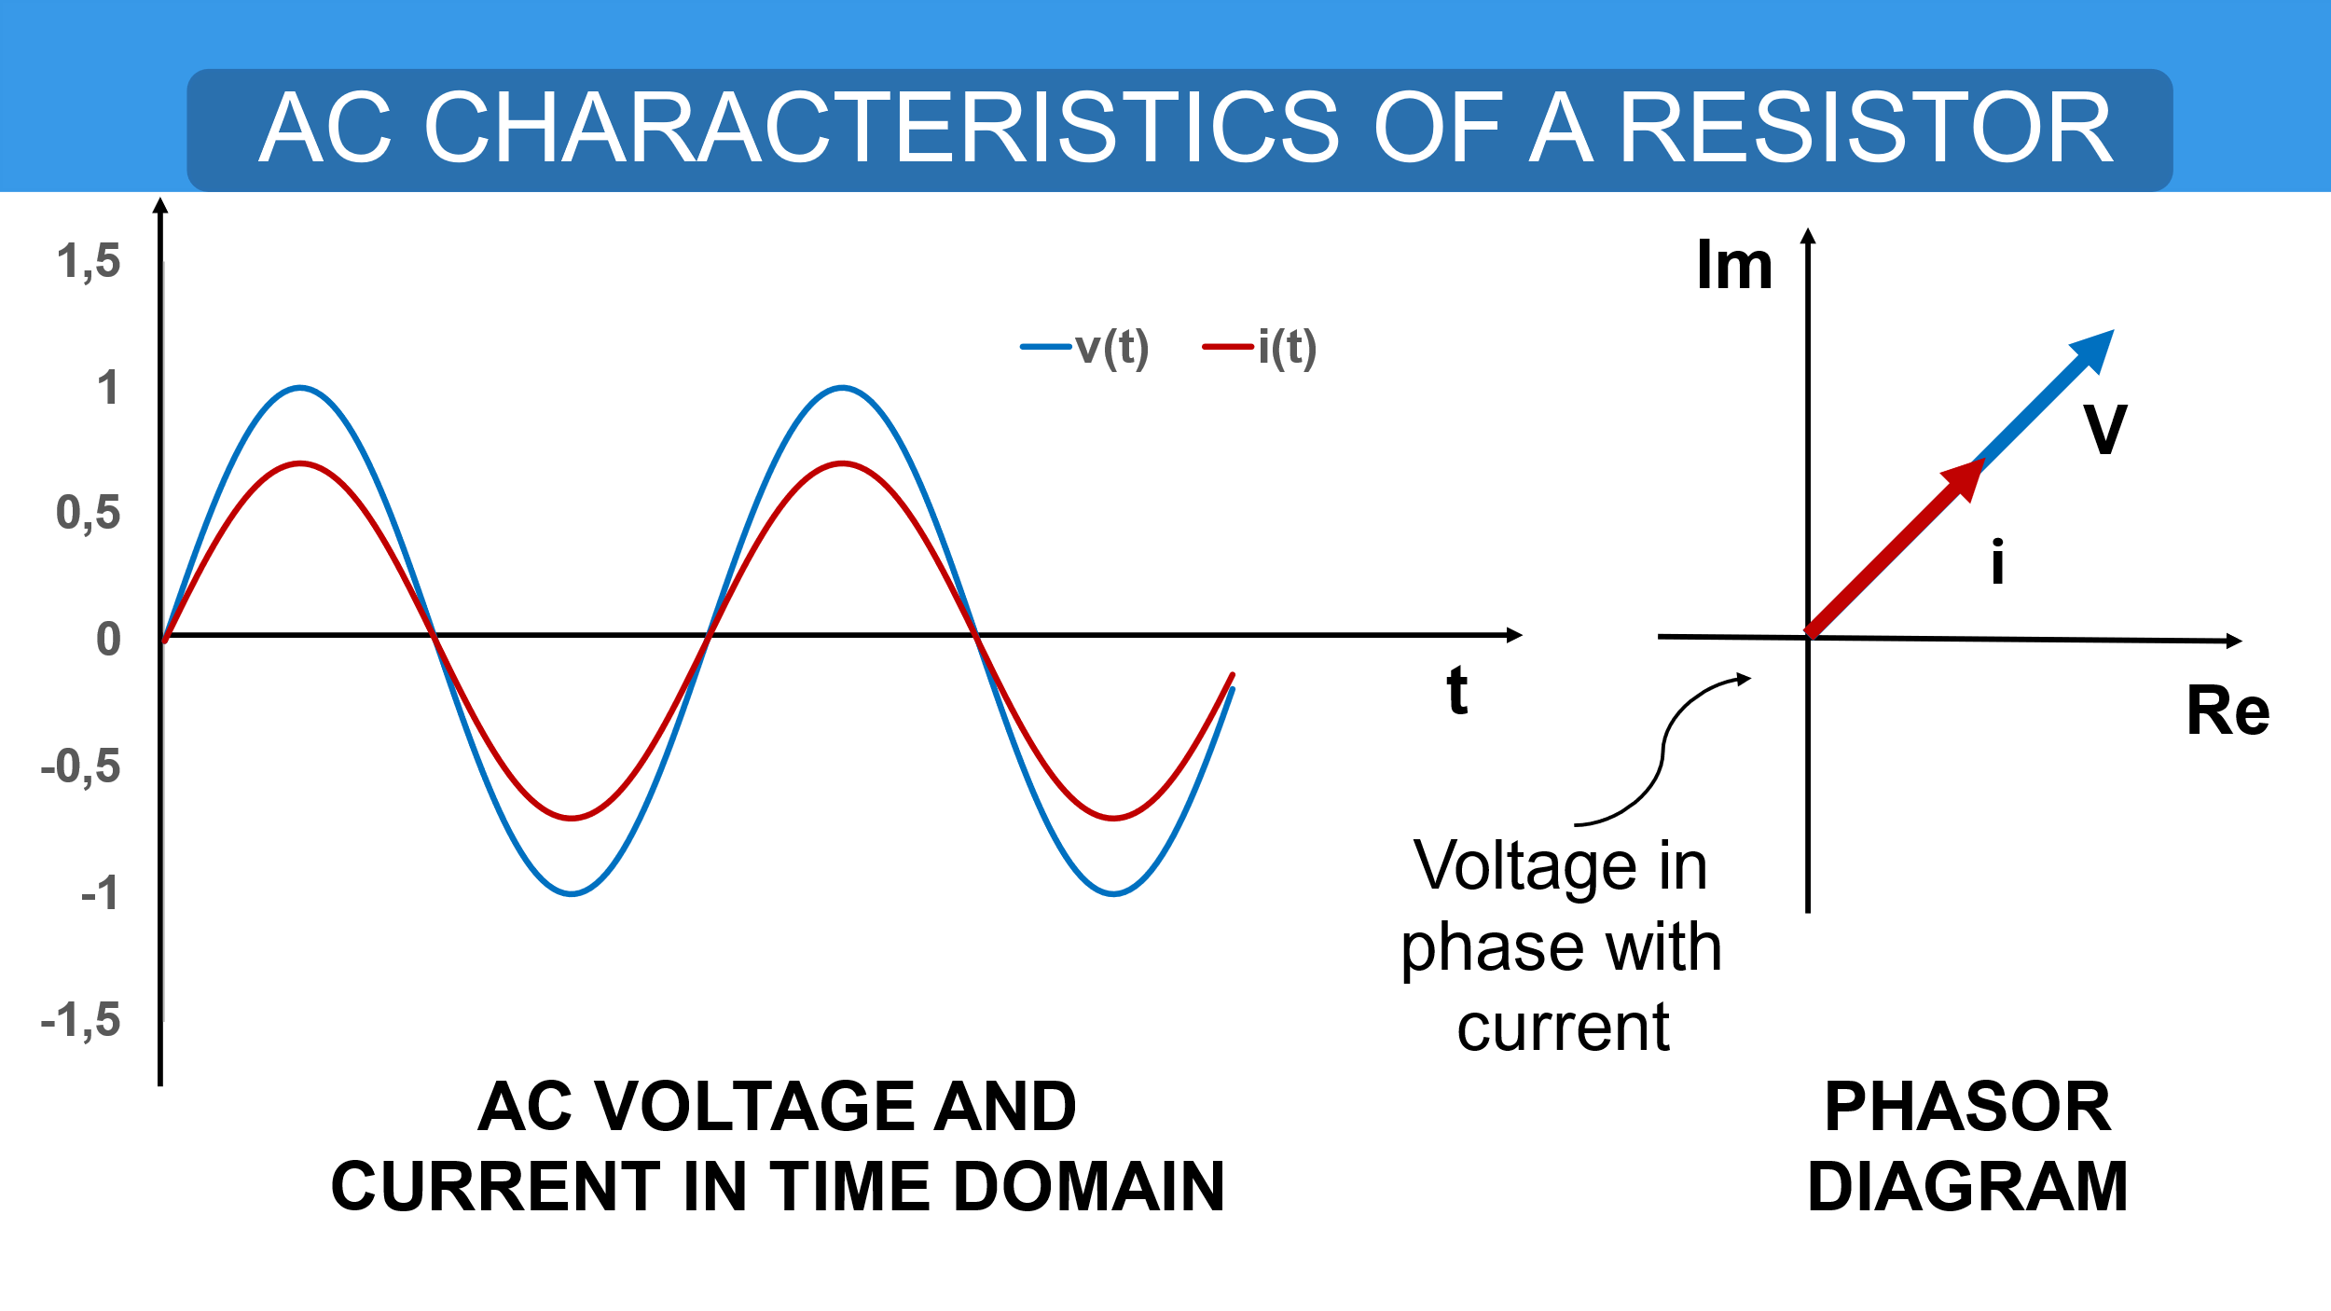
Systematic Analysis Methods
Component Characteristics in AC

Slide 8
Systematic Analysis Methods
Component Characteristics in AC
Now, we move to the Inductor.
The behavior here is quite different.
Recall from physics that an inductor opposes any change in current flow.

Slide 9
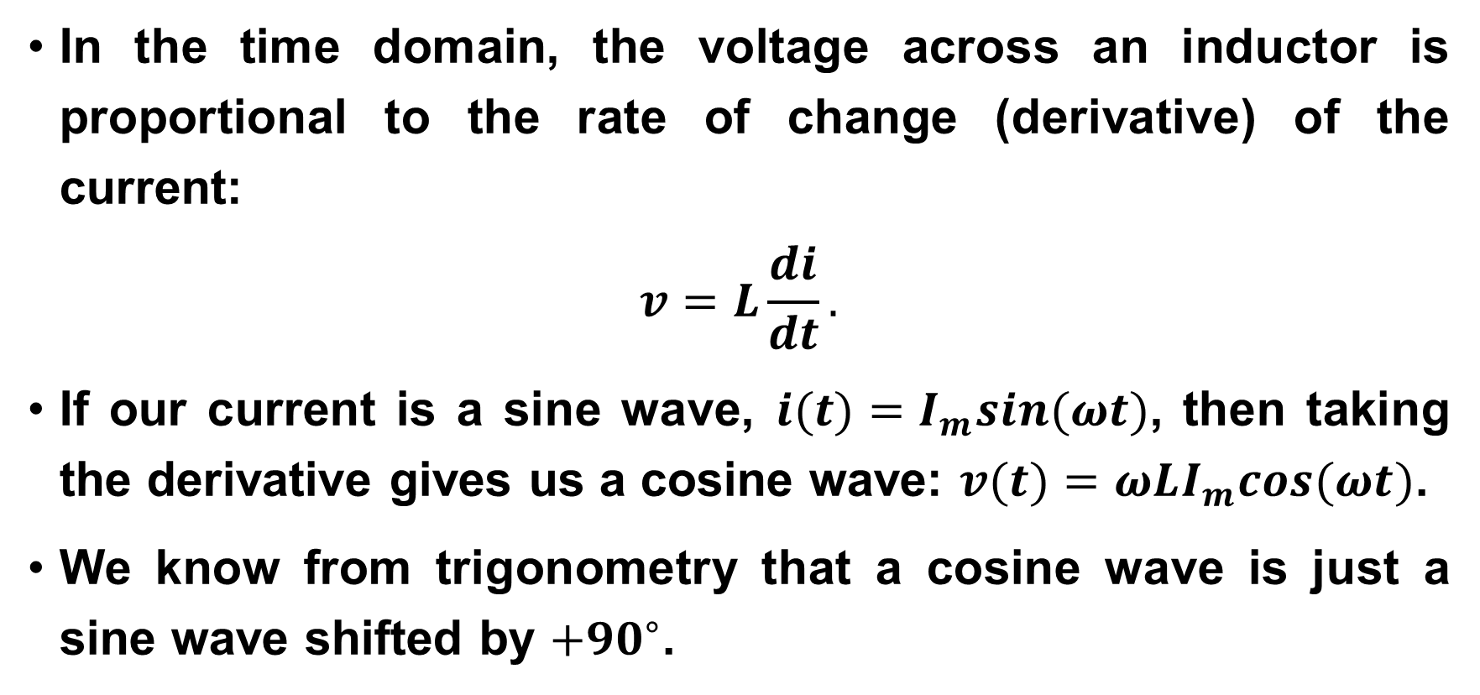
Systematic Analysis Methods
Component Characteristics in AC
In the time domain, the voltage across an inductor is proportional to the rate of change (derivative) of the current:
$$v=L\frac{di}{dt}.$$
If our current is a sine wave, $i(t)=I_{m}sin(ωt)$, then taking the derivative gives us a cosine wave: $v(t)=ωLI_{m}cos(ωt)$.
We know from trigonometry that a cosine wave is just a sine wave shifted by $+{90}^{∘}$.

Slide 10
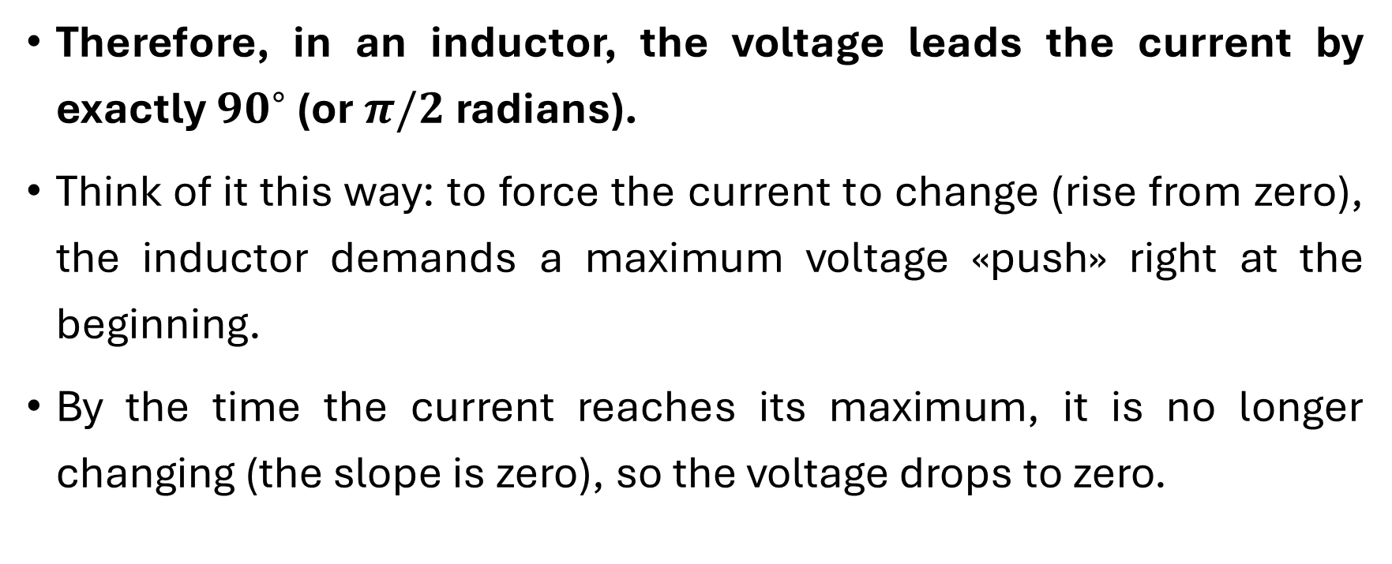
Systematic Analysis Methods
Component Characteristics in AC
Therefore, in an inductor, the voltage leads the current by exactly ${90}^{∘}$ (or $π/2$ radians).
Think of it this way: to force the current to change (rise from zero), the inductor demands a maximum voltage «push» right at the beginning.
By the time the current reaches its maximum, it is no longer changing (the slope is zero), so the voltage drops to zero.

Slide 11

Systematic Analysis Methods
Component Characteristics in AC
How do we express this ${90}^{∘}$ phase shift using phasors?
In the complex plane, rotating a vector by $+{90}^{∘}$ is mathematically equivalent to multiplying by the imaginary unit $j$ (where $j=\sqrt{−1}$).

Slide 12
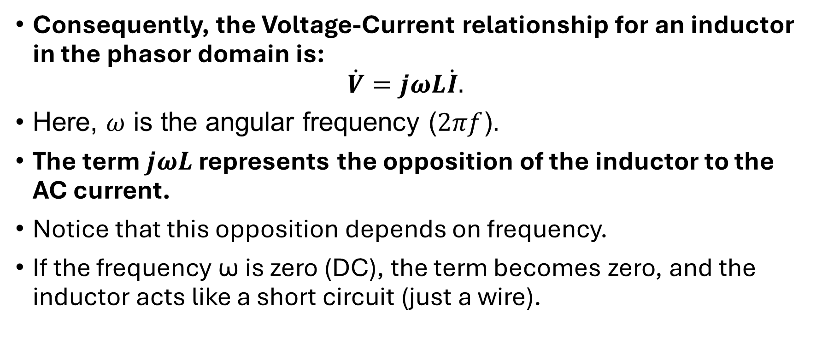
Systematic Analysis Methods
Component Characteristics in AC
Consequently, the Voltage-Current relationship for an inductor in the phasor domain is:
$$\dot{V}=jωL\dot{I}.$$
Here, $ω$ is the angular frequency ($2πf$).
The term $jωL$ represents the opposition of the inductor to the AC current.
Notice that this opposition depends on frequency.
If the frequency ω is zero (DC), the term becomes zero, and the inductor acts like a short circuit (just a wire).

Slide 13
Systematic Analysis Methods
Component Characteristics in AC
If the frequency is very high, the opposition becomes very large, effectively blocking the current.
At the next slide you can see an illustration of the phase relationship of current and voltage for an inductor.

Slide 14
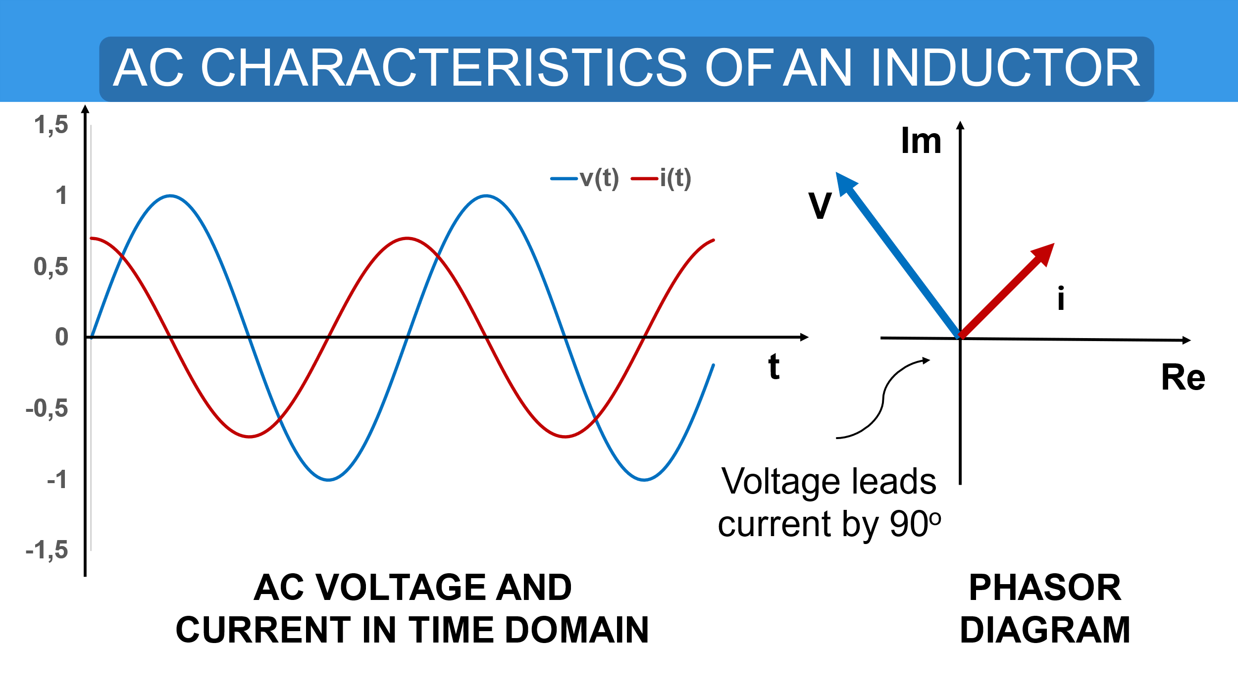
Systematic Analysis Methods
Component Characteristics in AC

Slide 15
Systematic Analysis Methods
Component Characteristics in AC
Next, we consider the Capacitor.
Its behavior is the inverse of the inductor.
A capacitor opposes changes in voltage.
Current only flows when the voltage across the plates is changing.

Slide 16
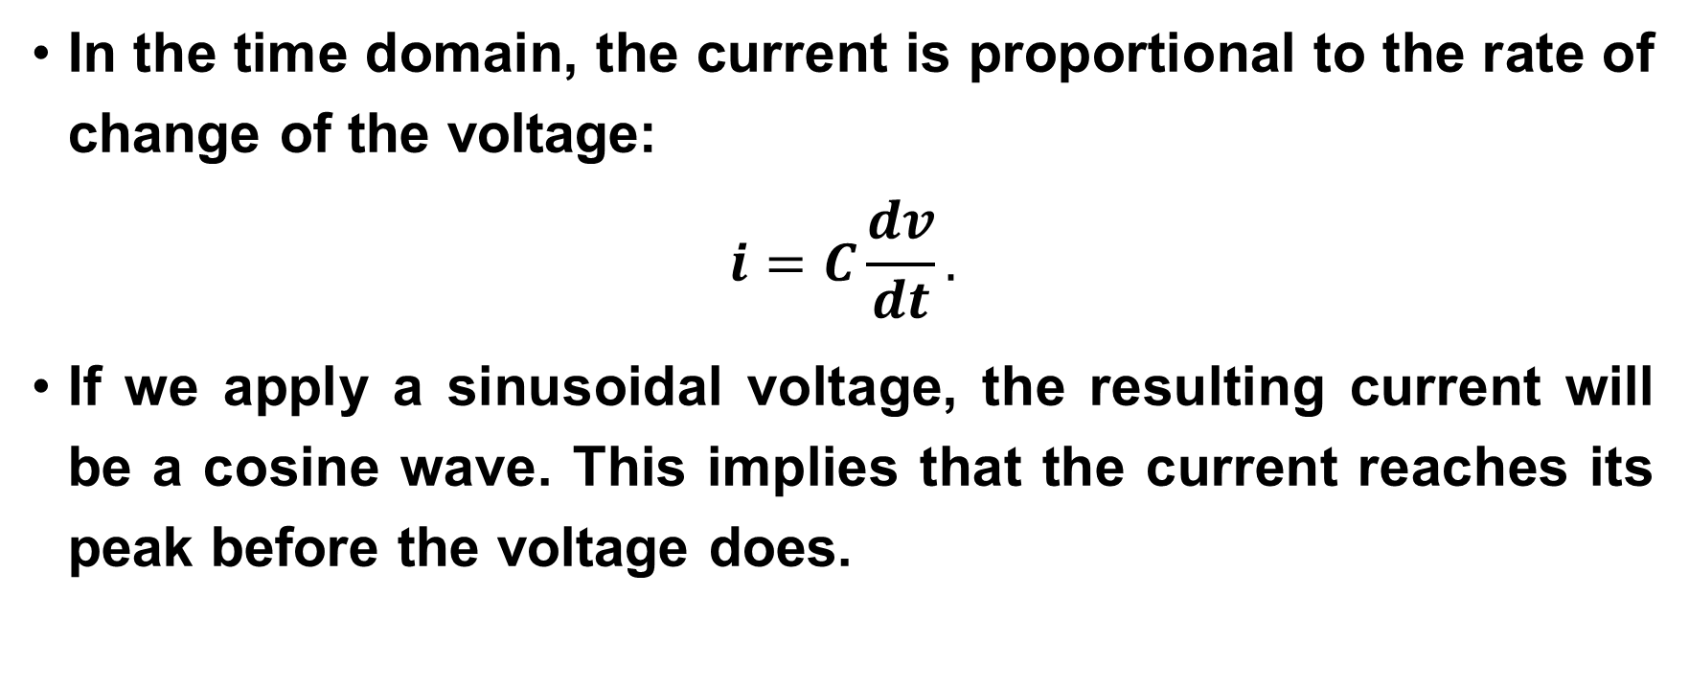
Systematic Analysis Methods
Component Characteristics in AC
In the time domain, the current is proportional to the rate of change of the voltage:
$$i=C\frac{dv}{dt}.$$
If we apply a sinusoidal voltage, the resulting current will be a cosine wave. This implies that the current reaches its peak before the voltage does.

Slide 17
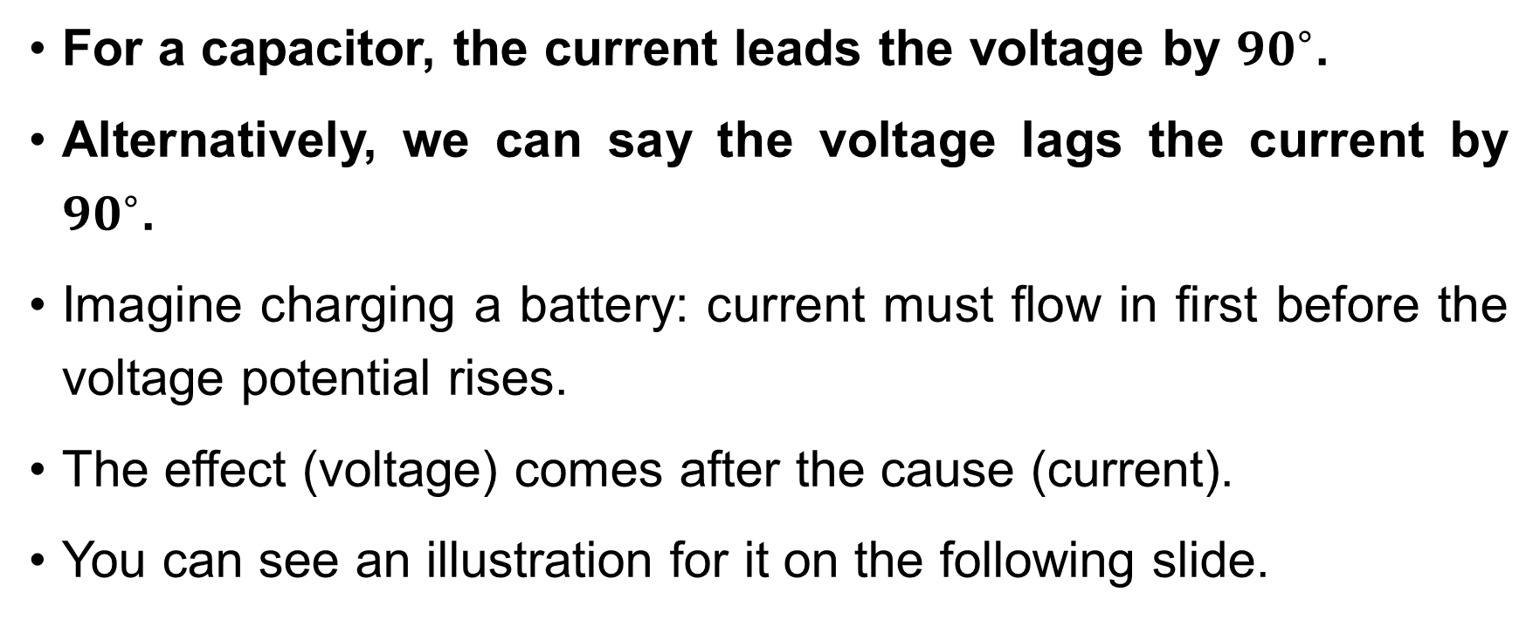
Systematic Analysis Methods
Component Characteristics in AC
For a capacitor, the current leads the voltage by ${90}^{∘}$.
Alternatively, we can say the voltage lags the current by ${90}^{∘}$.
Imagine charging a battery: current must flow in first before the voltage potential rises.
The effect (voltage) comes after the cause (current).
You can see an illustration for it on the following slide.

Slide 18
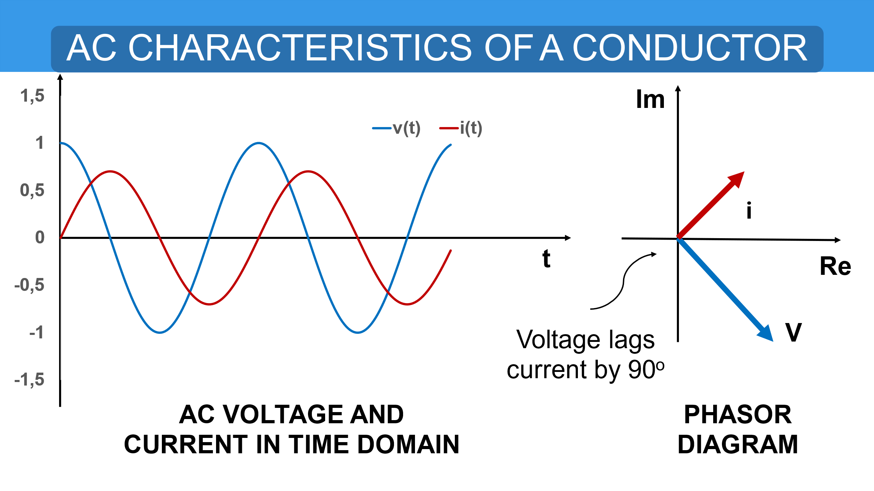
Systematic Analysis Methods
Component Characteristics in AC

Slide 19
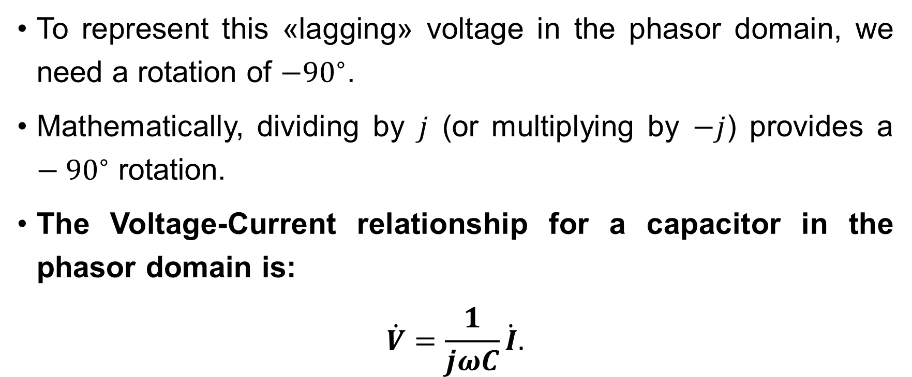
Systematic Analysis Methods
Component Characteristics in AC
To represent this «lagging» voltage in the phasor domain, we need a rotation of $−{90}^{∘}$.
Mathematically, dividing by $j$ (or multiplying by $−j$) provides a $−{90}^{∘}$ rotation.
The Voltage-Current relationship for a capacitor in the phasor domain is:
$$\dot{V}=\frac{1}{jωC}\dot{I}.$$

Slide 20
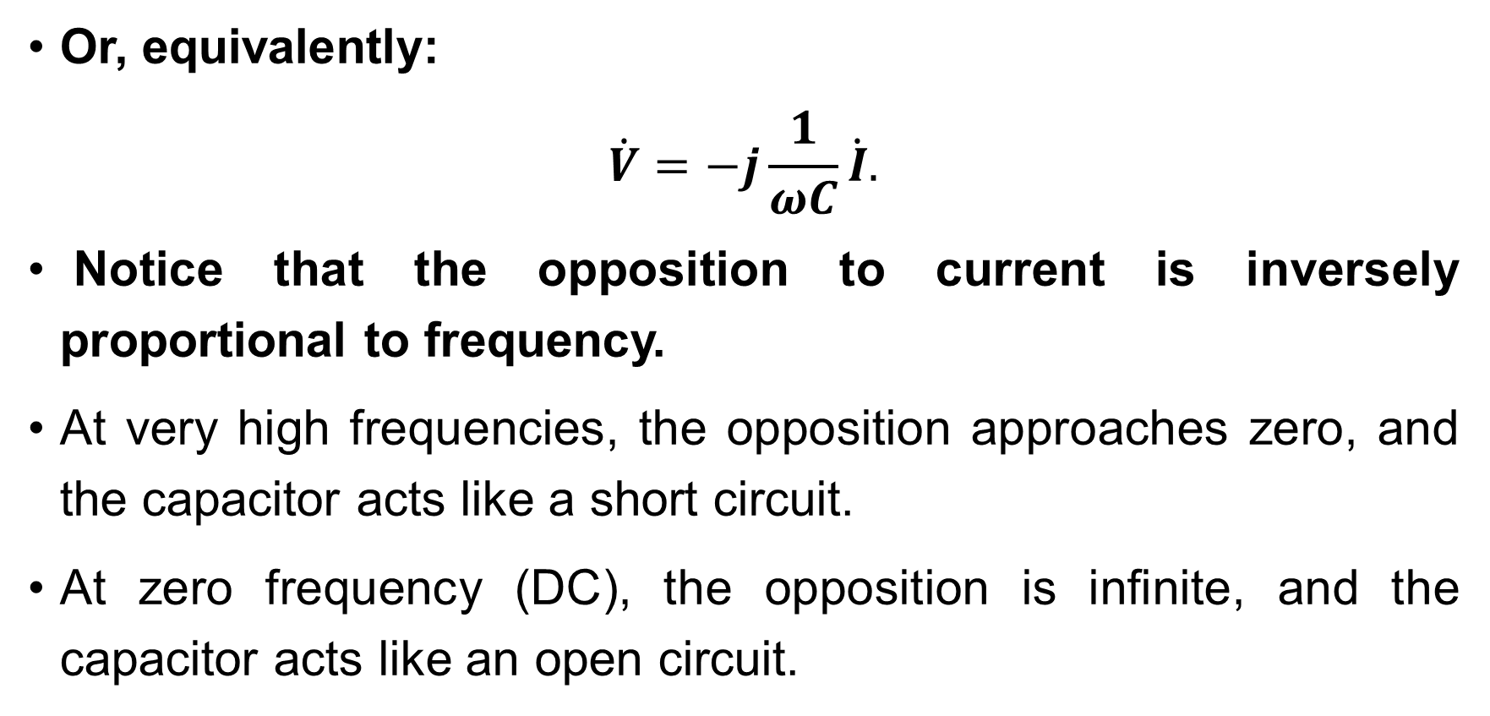
Systematic Analysis Methods
Component Characteristics in AC
Or, equivalently:
$$\dot{V}=−j\frac{1}{ωC}\dot{I}.$$
Notice that the opposition to current is inversely proportional to frequency.
At very high frequencies, the opposition approaches zero, and the capacitor acts like a short circuit.
At zero frequency (DC), the opposition is infinite, and the capacitor acts like an open circuit.

Slide 21
Systematic Analysis Methods
Component Characteristics in AC
Students often confuse which component leads and which lags.
To remember these phase relationships, engineers use the famous mnemonic: «ELI the ICE man».
ELI: In an inductor (L), Voltage (E – electromotive force) comes before (leads) Current (I).
ICE: In a capacitor (C), Current (I) comes before (leads) Voltage (E).
This simple phrase will save you from many sign errors in your calculations. Just remember: Voltage leads in L, Current leads in C.

Slide 22
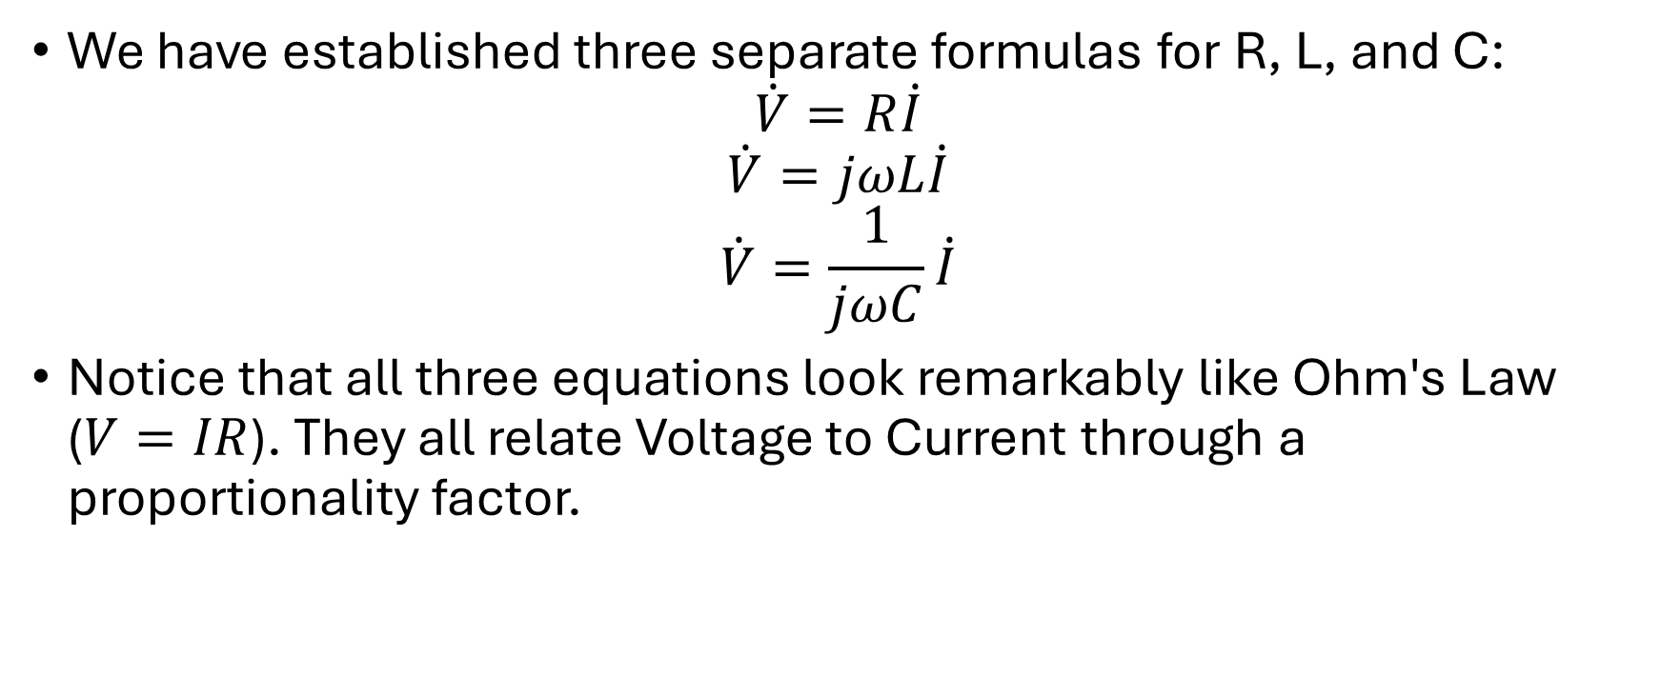
Systematic Analysis Methods
Component Characteristics in AC
We have established three separate formulas for R, L, and C:
$$\dot{V}=R\dot{I}$$
$$\dot{V}=jωL\dot{I}$$
$$\dot{V}=\frac{1}{jωC}\dot{I}$$
Notice that all three equations look remarkably like Ohm's Law ($V=IR$). They all relate Voltage to Current through a proportionality factor.

Slide 23
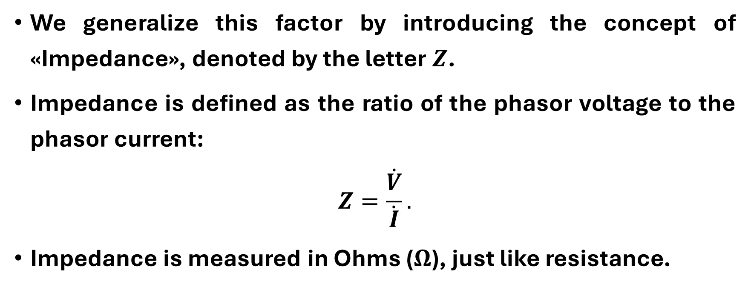
Systematic Analysis Methods
Component Characteristics in AC
We generalize this factor by introducing the concept of «Impedance», denoted by the letter $Z$.
Impedance is defined as the ratio of the phasor voltage to the phasor current:
$$Z=\frac{\dot{V}}{\dot{I}}.$$
Impedance is measured in Ohms ($Ω$), just like resistance.

Slide 24
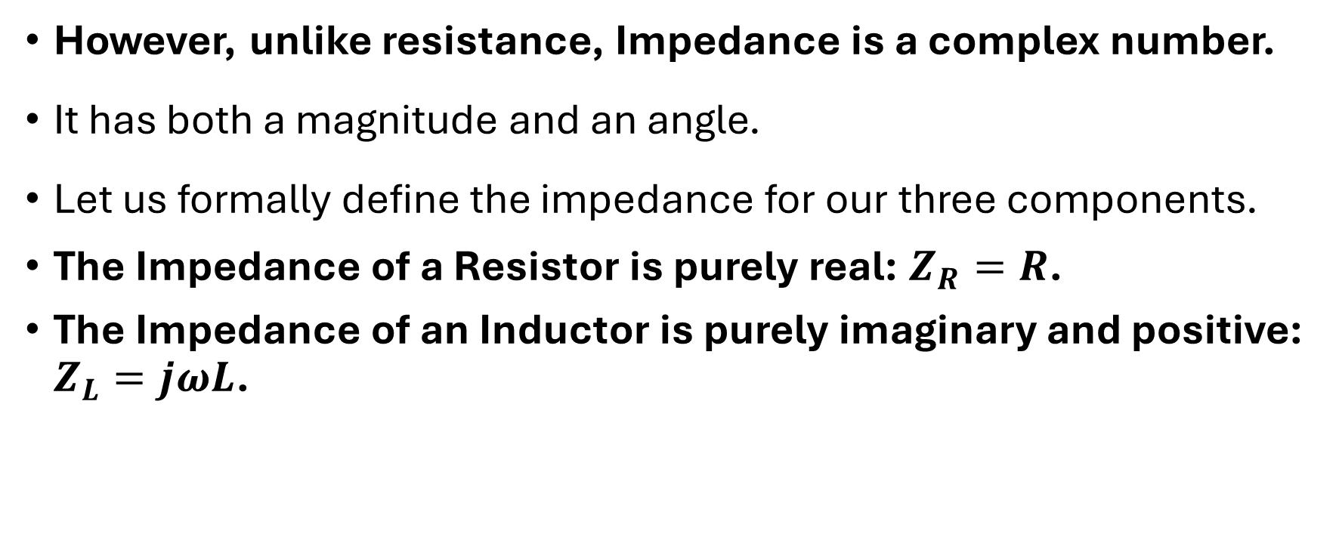
Systematic Analysis Methods
Component Characteristics in AC
However, unlike resistance, Impedance is a complex number.
It has both a magnitude and an angle.
Let us formally define the impedance for our three components.
The Impedance of a Resistor is purely real: $Z_{R}=R$.
The Impedance of an Inductor is purely imaginary and positive: $Z_{L}=jωL$.

Slide 25
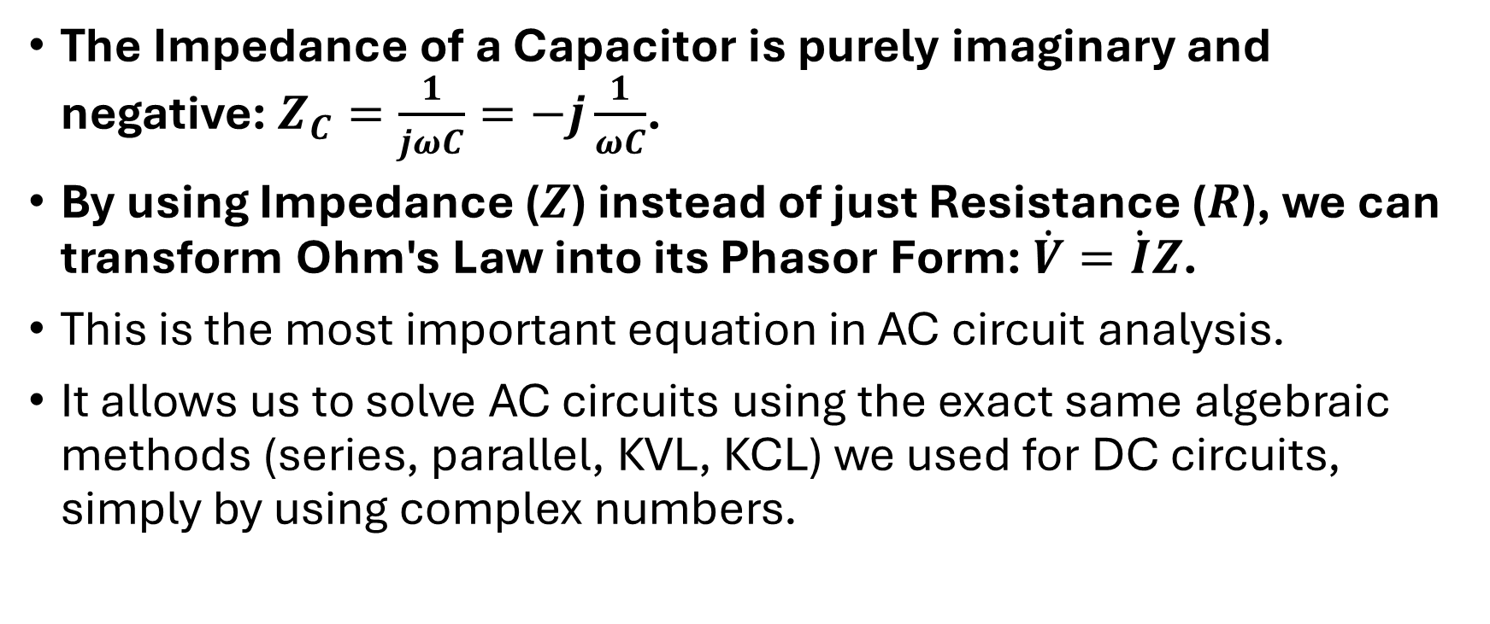
Systematic Analysis Methods
Component Characteristics in AC
The Impedance of a Capacitor is purely imaginary and negative: $Z_{C}=\frac{1}{jωC}=−j\frac{1}{ωC}$.
By using Impedance ($Z$) instead of just Resistance ($R$), we can transform Ohm's Law into its Phasor Form: $\dot{V}=\dot{I}Z$.
This is the most important equation in AC circuit analysis.
It allows us to solve AC circuits using the exact same algebraic methods (series, parallel, KVL, KCL) we used for DC circuits, simply by using complex numbers.

Slide 26

Systematic Analysis Methods
Component Characteristics in AC
Do you have you any questions at the moment?

Slide 27
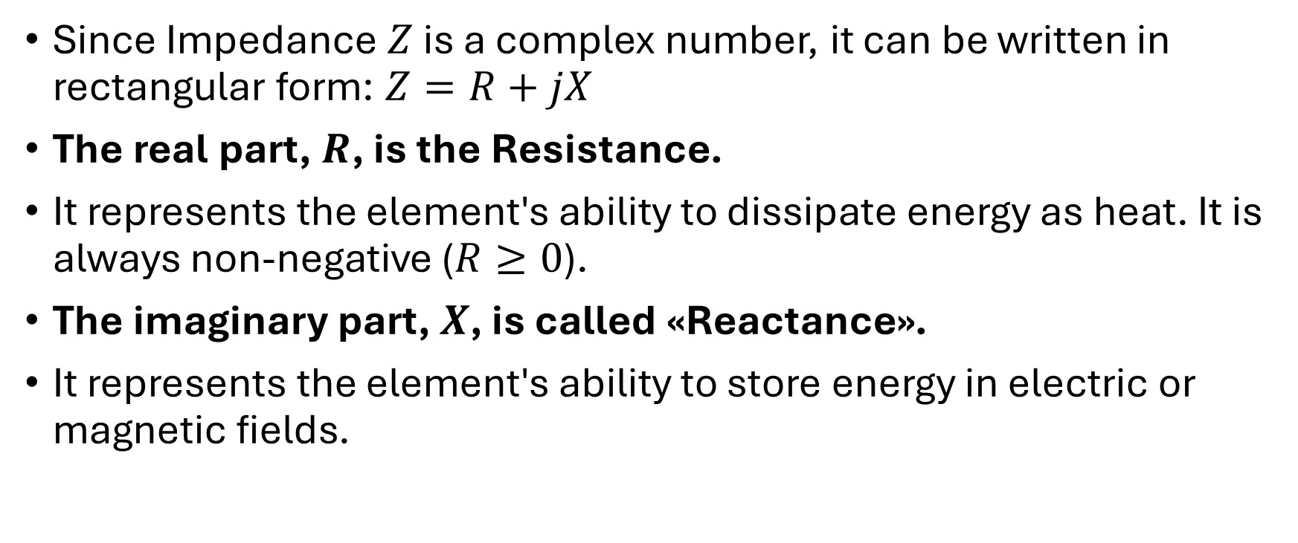
Systematic Analysis Methods
Component Characteristics in AC
Since Impedance $Z$ is a complex number, it can be written in rectangular form: $Z=R+jX$
The real part, $R$, is the Resistance.
It represents the element's ability to dissipate energy as heat. It is always non-negative ($R≥0$).
The imaginary part, $X$, is called «Reactance».
It represents the element's ability to store energy in electric or magnetic fields.

Slide 28
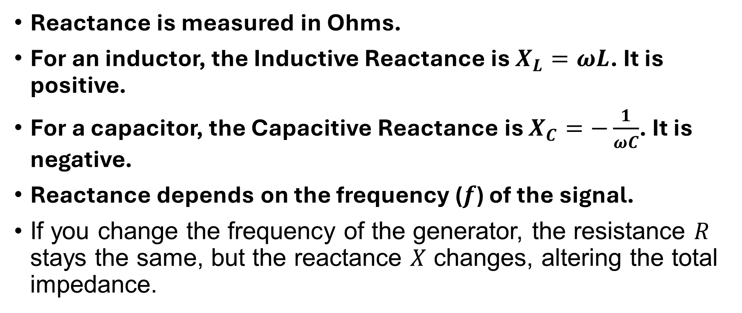
Systematic Analysis Methods
Component Characteristics in AC
Reactance is measured in Ohms.
For an inductor, the Inductive Reactance is $X_{L}=ωL$. It is positive.
For a capacitor, the Capacitive Reactance is $X_{C}=−\frac{1}{ωC}$. It is negative.
Reactance depends on the frequency ($f$) of the signal.
If you change the frequency of the generator, the resistance $R$ stays the same, but the reactance $X$ changes, altering the total impedance.

Slide 29
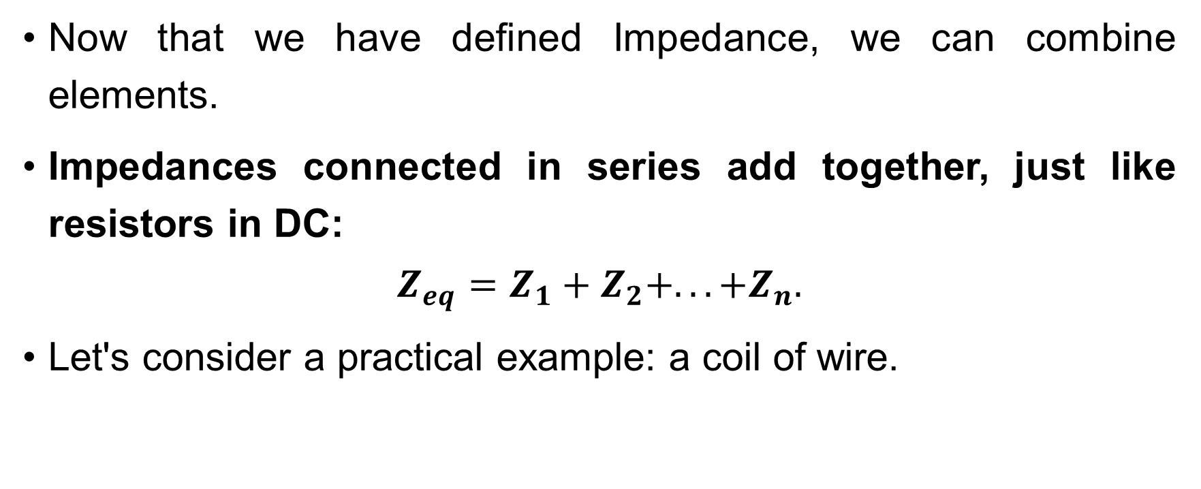
Systematic Analysis Methods
Component Characteristics in AC
Now that we have defined Impedance, we can combine elements.
Impedances connected in series add together, just like resistors in DC:
$$Z_{eq}=Z_{1}+Z_{2}+...+Z_{n}.$$
Let's consider a practical example: a coil of wire.

Slide 30
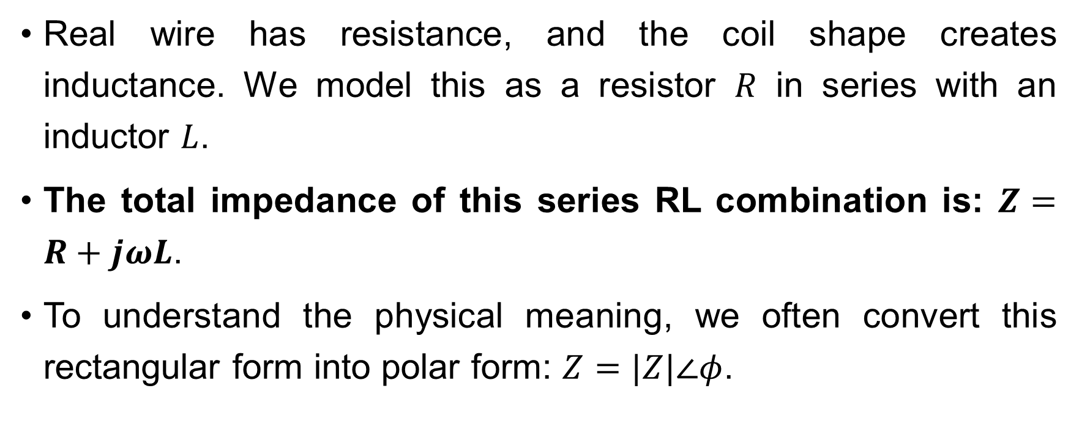
Systematic Analysis Methods
Component Characteristics in AC
Real wire has resistance, and the coil shape creates inductance. We model this as a resistor $R$ in series with an inductor $L$.
The total impedance of this series RL combination is: $Z=R+jωL$.
To understand the physical meaning, we often convert this rectangular form into polar form: $Z=|Z|∠φ$.

Slide 31
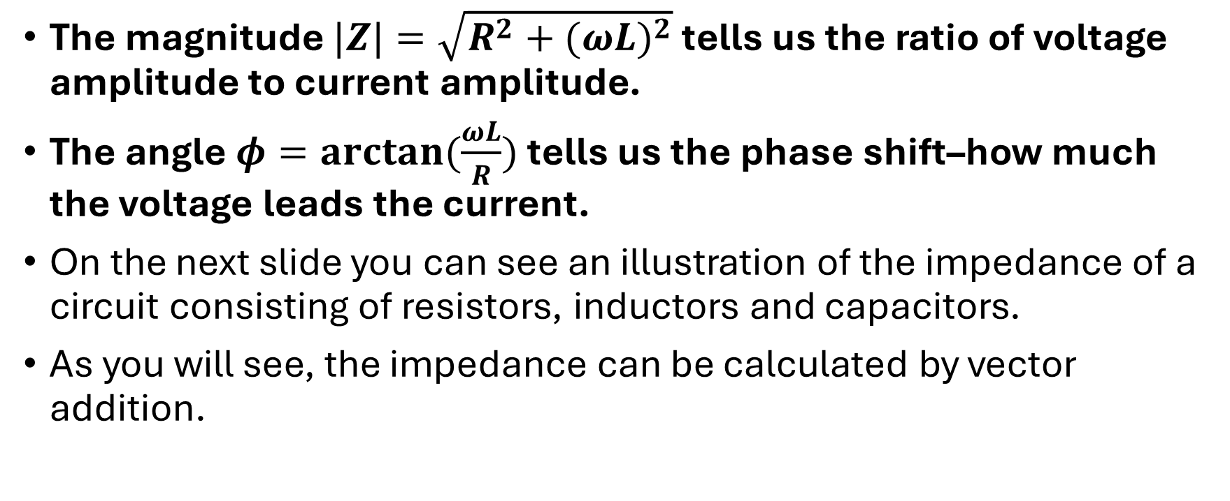
Systematic Analysis Methods
Component Characteristics in AC
The magnitude $|Z|=\sqrt{R^{2}+(ωL)^{2}}$ tells us the ratio of voltage amplitude to current amplitude.
The angle $φ=arctan(\frac{ωL}{R})$ tells us the phase shift–how much the voltage leads the current.
On the next slide you can see an illustration of the impedance of a circuit consisting of resistors, inductors and capacitors.
As you will see, the impedance can be calculated by vector addition.

Slide 32
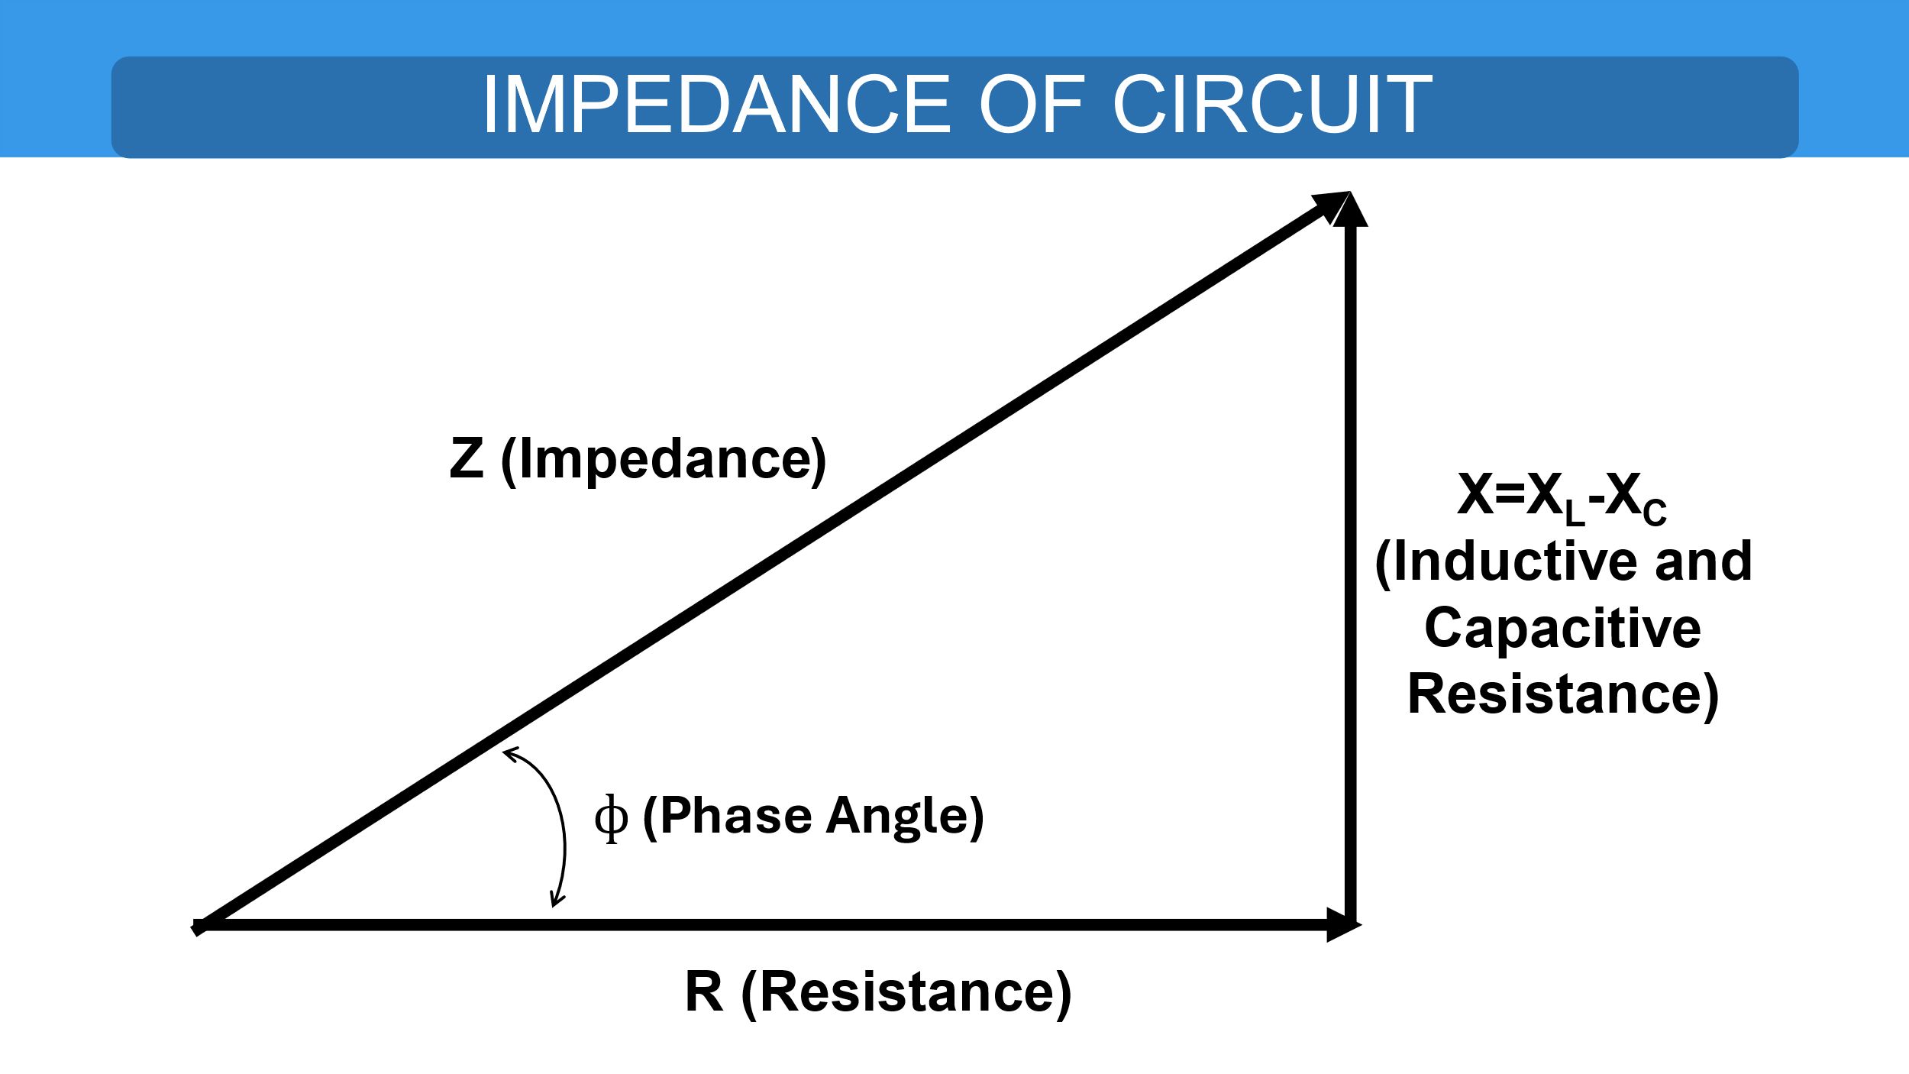
Systematic Analysis Methods
Component Characteristics in AC

Slide 33
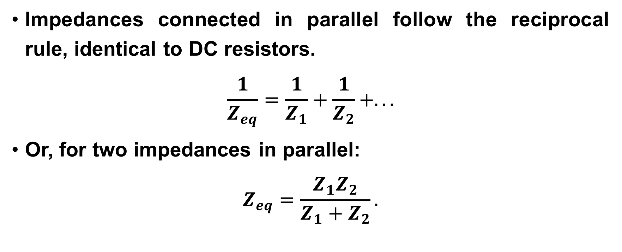
Systematic Analysis Methods
Component Characteristics in AC
Impedances connected in parallel follow the reciprocal rule, identical to DC resistors.
$$\frac{1}{Z_{eq}}=\frac{1}{Z_{1}}+\frac{1}{Z_{2}}+...$$
Or, for two impedances in parallel:
$$Z_{eq}=\frac{Z_{1}Z_{2}}{Z_{1}+Z_{2}}.$$

Slide 34
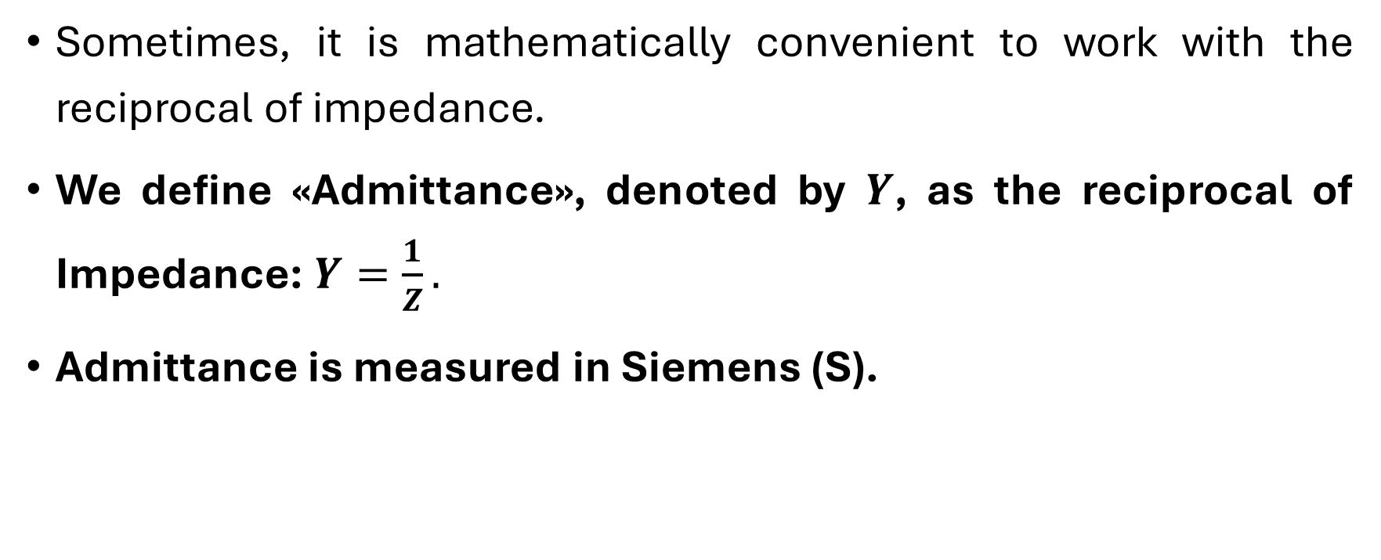
Systematic Analysis Methods
Component Characteristics in AC
Sometimes, it is mathematically convenient to work with the reciprocal of impedance.
We define «Admittance», denoted by $Y$, as the reciprocal of Impedance: $Y=\frac{1}{Z}.$
Admittance is measured in Siemens (S).

Slide 35
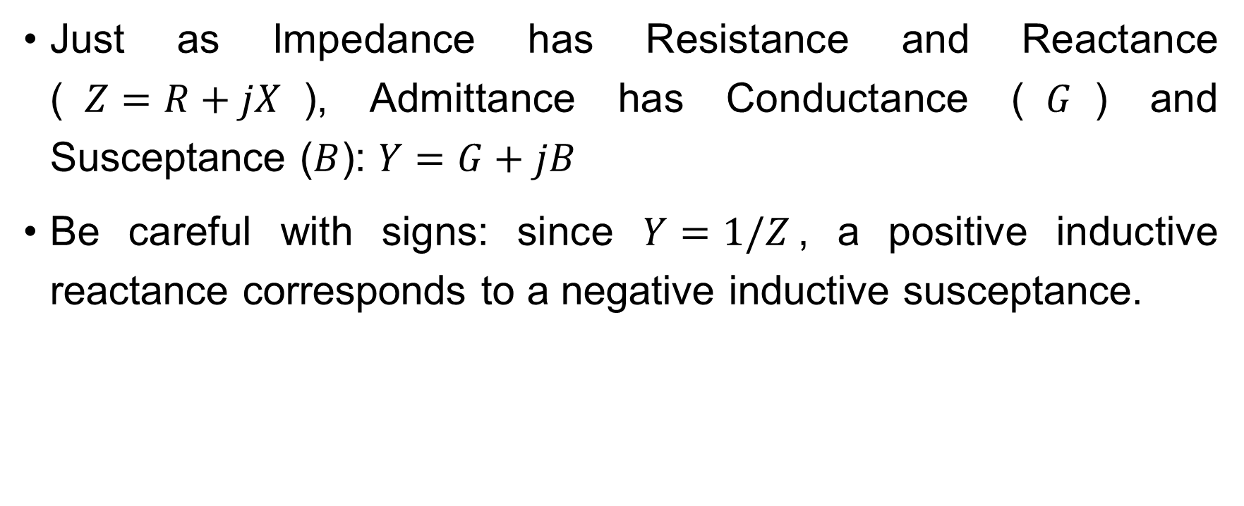
Systematic Analysis Methods
Component Characteristics in AC
Just as Impedance has Resistance and Reactance ($Z=R+jX$), Admittance has Conductance ($G$) and Susceptance ($B$): $Y=G+jB$
Be careful with signs: since $Y=1/Z$, a positive inductive reactance corresponds to a negative inductive susceptance.

Slide 36
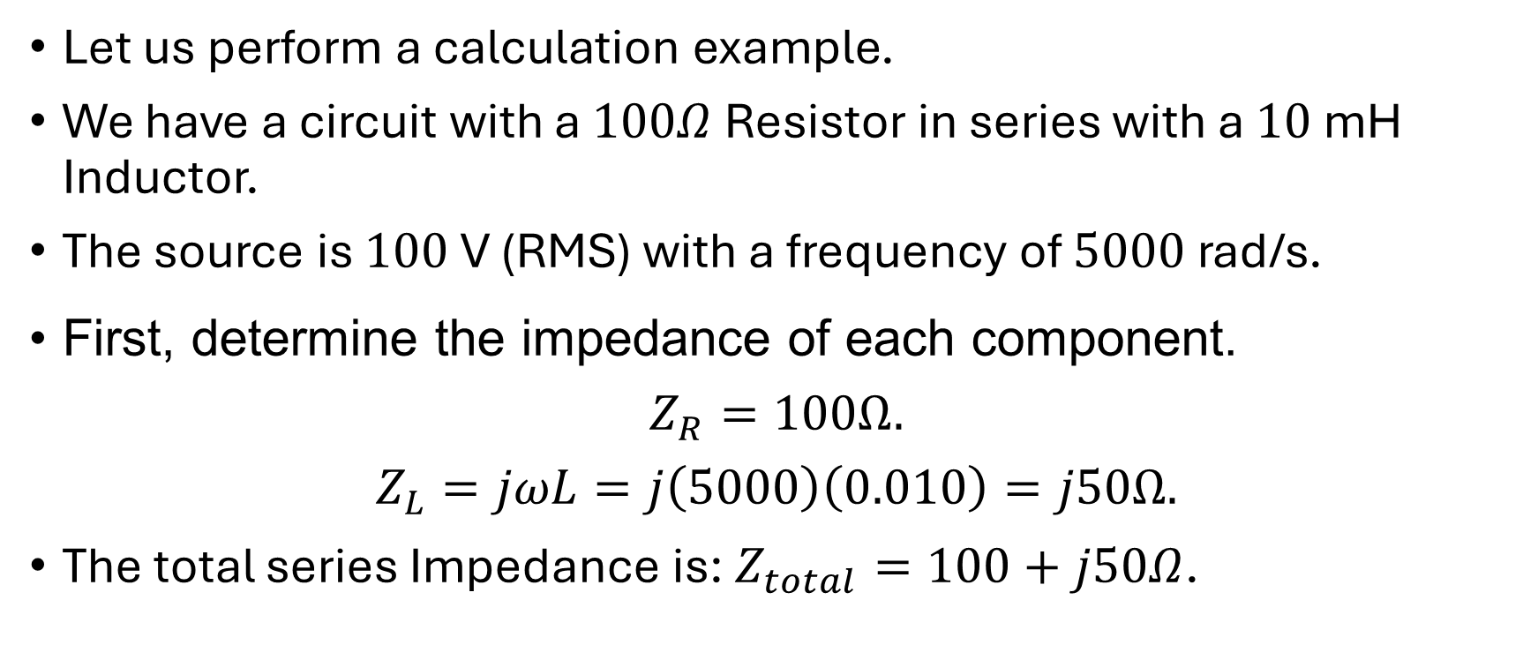
Systematic Analysis Methods
Component Characteristics in AC
Let us perform a calculation example.
We have a circuit with a $100Ω$ Resistor in series with a $10$ mH Inductor.
The source is $100$ V (RMS) with a frequency of $5000$ rad/s.
First, determine the impedance of each component.
$$Z_{R}=100Ω.$$
$$Z_{L}=jωL=j\left(5000\right)\left(0.010\right)=j50Ω.$$
The total series Impedance is: $Z_{total}=100+j50Ω$.

Slide 37
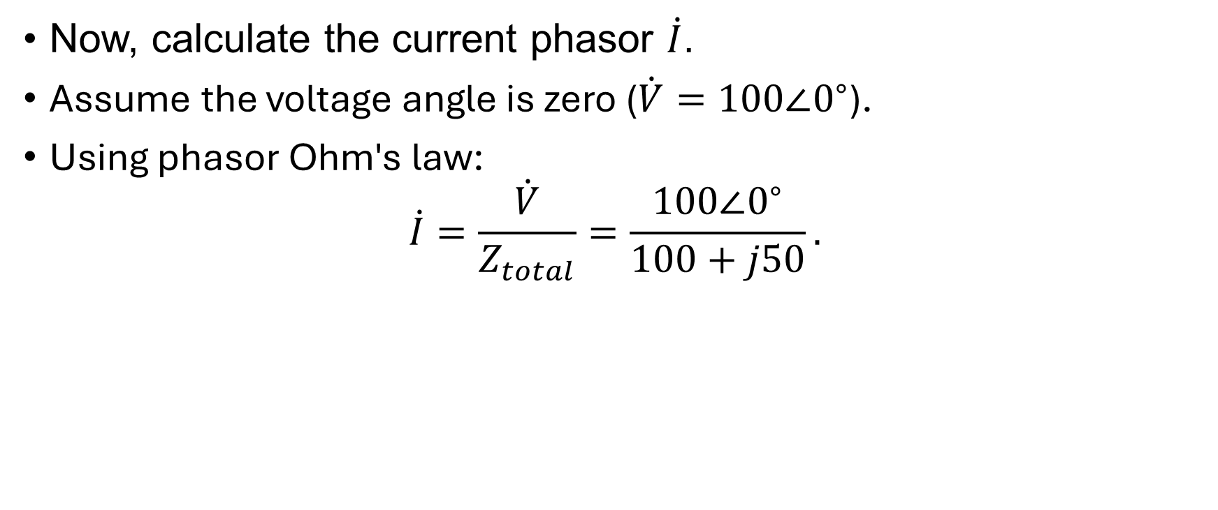
Systematic Analysis Methods
Component Characteristics in AC
Now, calculate the current phasor $\dot{I}$.
Assume the voltage angle is zero ($\dot{V}=100∠0^{∘}$).
Using phasor Ohm's law:
$$\dot{I}=\frac{\dot{V}}{Z_{total}}=\frac{100∠0^{∘}}{100+j50}.$$

Slide 38
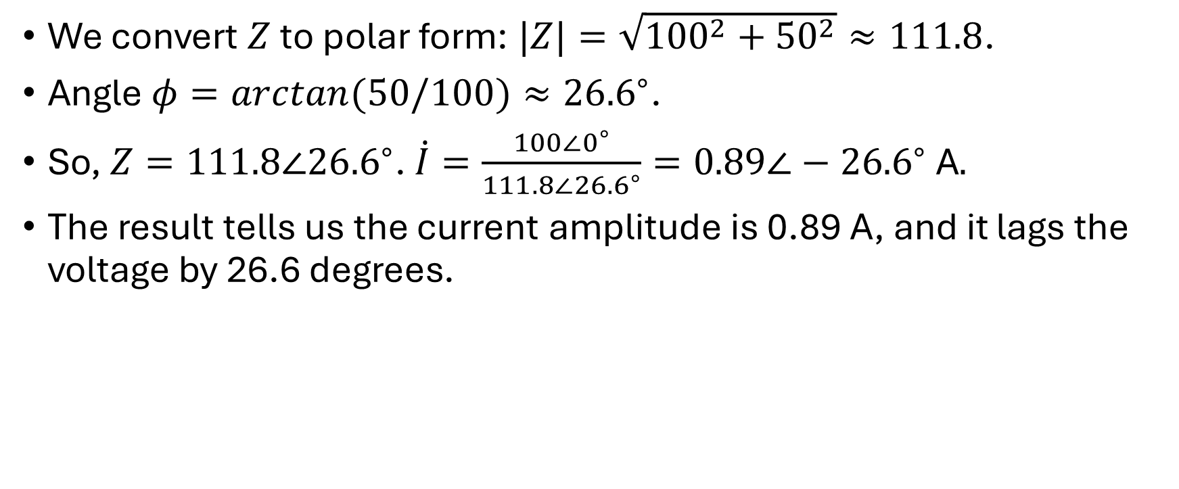
Systematic Analysis Methods
Component Characteristics in AC
We convert $Z$ to polar form: $|Z|=\sqrt{{100}^{2}+{50}^{2}}≈111.8$.
Angle $φ=arctan(50/100)≈{26.6}^{∘}$.
So, $Z=111.8∠{26.6}^{∘}$. $\dot{I}=\frac{100∠0^{∘}}{111.8∠{26.6}^{∘}}=0.89∠−{26.6}^{∘} \text{A}.$
The result tells us the current amplitude is 0.89 A, and it lags the voltage by 26.6 degrees.

Slide 39
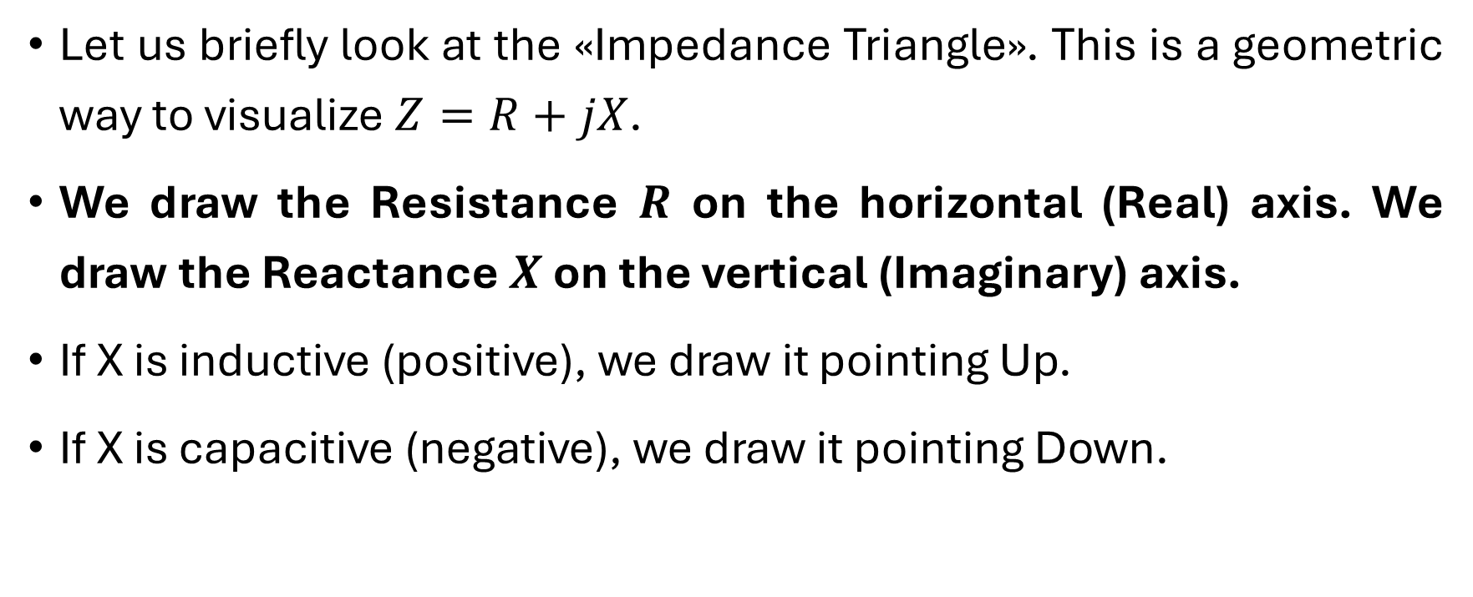
Systematic Analysis Methods
Component Characteristics in AC
Let us briefly look at the «Impedance Triangle». This is a geometric way to visualize $Z=R+jX$.
We draw the Resistance $R$ on the horizontal (Real) axis. We draw the Reactance $X$ on the vertical (Imaginary) axis.
If X is inductive (positive), we draw it pointing Up.
If X is capacitive (negative), we draw it pointing Down.

Slide 40
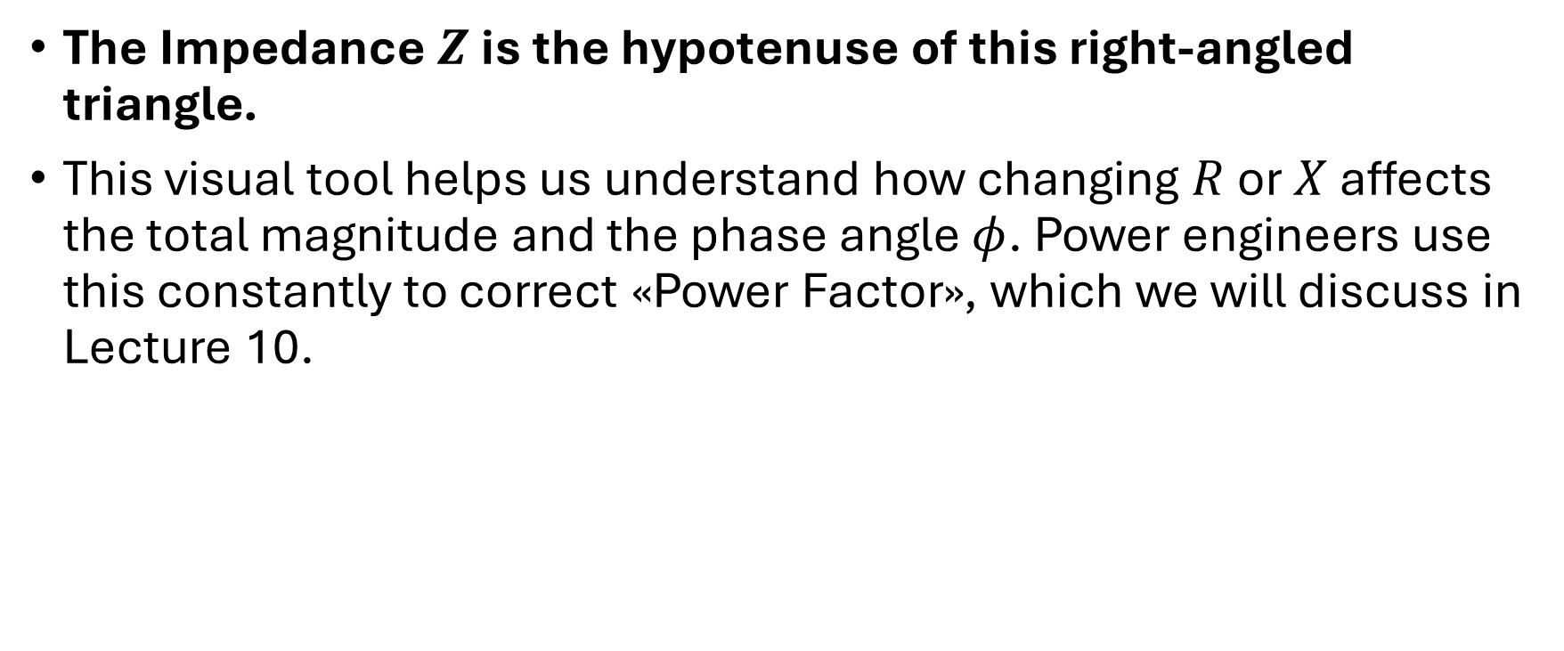
Systematic Analysis Methods
Component Characteristics in AC
The Impedance $Z$ is the hypotenuse of this right-angled triangle.
This visual tool helps us understand how changing $R$ or $X$ affects the total magnitude and the phase angle $φ$. Power engineers use this constantly to correct «Power Factor», which we will discuss in Lecture 10.

Slide 41
Systematic Analysis Methods
Component Characteristics in AC
We must discuss the behavior of «Real» components versus «Ideal» components in AC.
Ideally, an inductor has only inductance (L), and a capacitor has only capacitance (C).
However, in the real world, materials are not perfect.
A real inductor is made of a long wire coiled up, this wire has resistance.

Slide 42
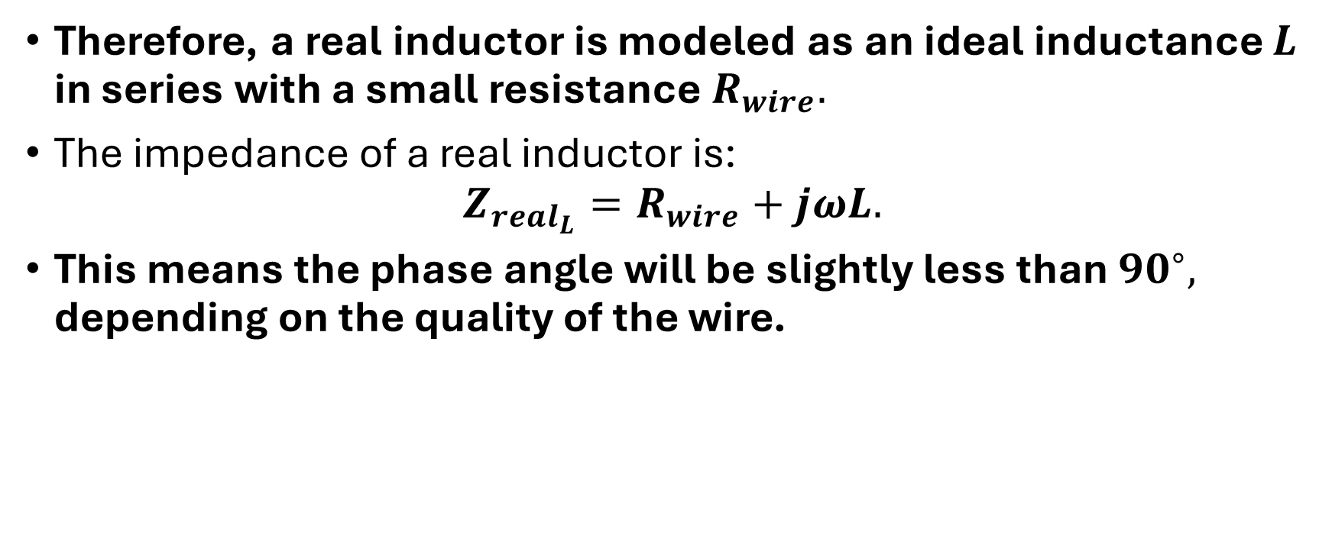
Systematic Analysis Methods
Component Characteristics in AC
Therefore, a real inductor is modeled as an ideal inductance $L$ in series with a small resistance $R_{wire}.$
The impedance of a real inductor is:
$$Z_{real_{L}}=R_{wire}+jωL.$$
This means the phase angle will be slightly less than ${90}^{∘},$ depending on the quality of the wire.

Slide 43
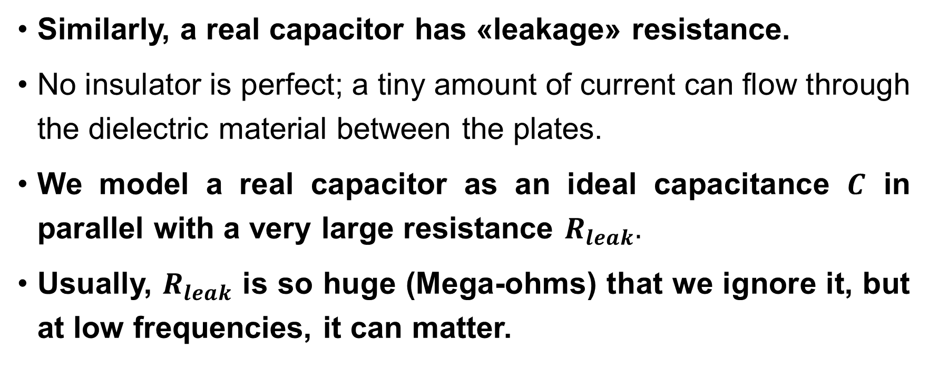
Systematic Analysis Methods
Component Characteristics in AC
Similarly, a real capacitor has «leakage» resistance.
No insulator is perfect; a tiny amount of current can flow through the dielectric material between the plates.
We model a real capacitor as an ideal capacitance $C$ in parallel with a very large resistance $R_{leak}.$
Usually, $R_{leak}$ is so huge (Mega-ohms) that we ignore it, but at low frequencies, it can matter.

Slide 44
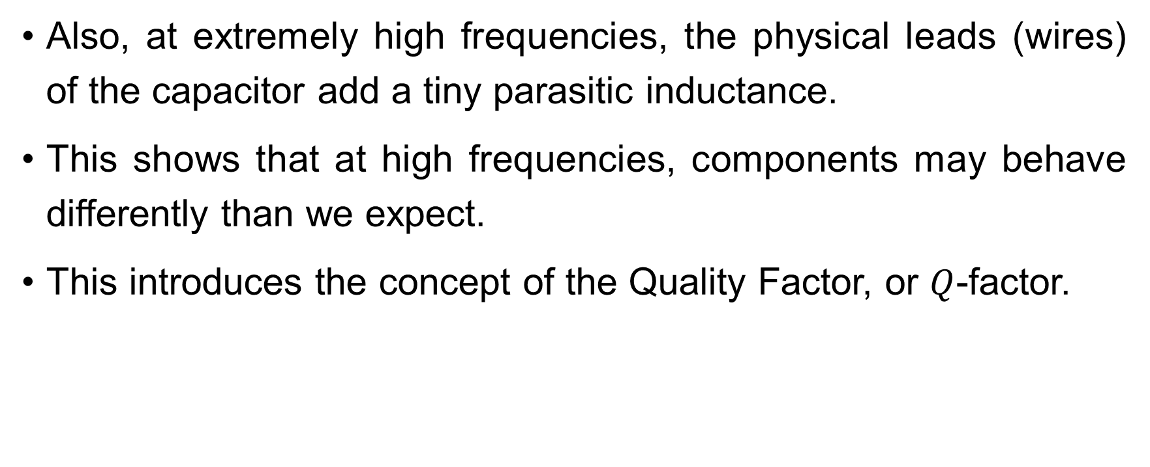
Systematic Analysis Methods
Component Characteristics in AC
Also, at extremely high frequencies, the physical leads (wires) of the capacitor add a tiny parasitic inductance.
This shows that at high frequencies, components may behave differently than we expect.
This introduces the concept of the Quality Factor, or $Q$-factor.

Slide 45
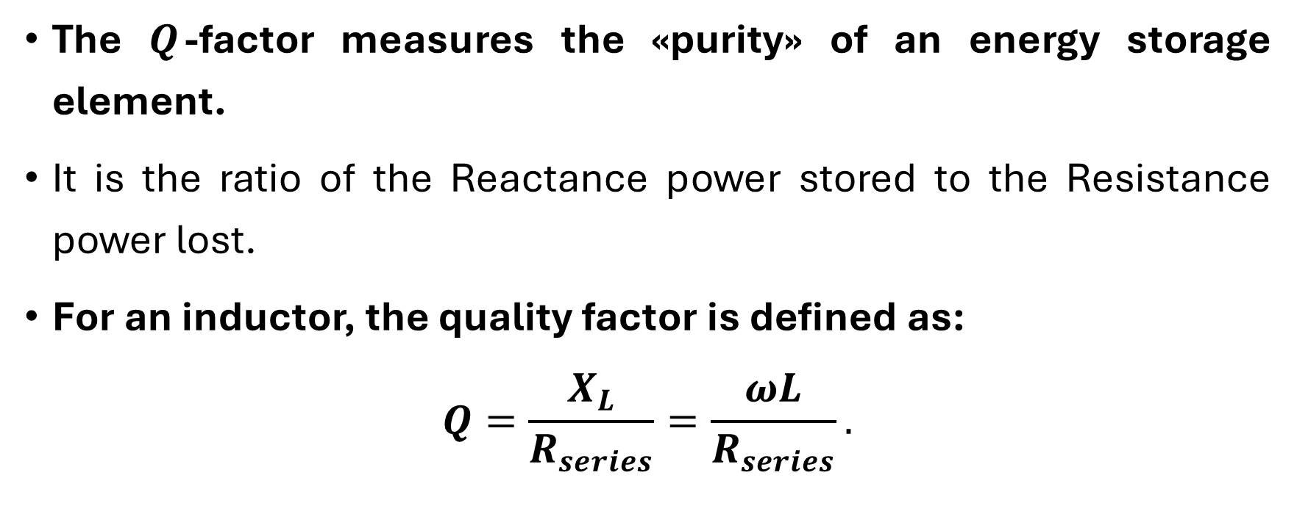
Systematic Analysis Methods
Component Characteristics in AC
The $Q$-factor measures the «purity» of an energy storage element.
It is the ratio of the Reactance power stored to the Resistance power lost.
For an inductor, the quality factor is defined as:
$$Q=\frac{X_{L}}{R_{series}}=\frac{ωL}{R_{series}}.$$

Slide 46
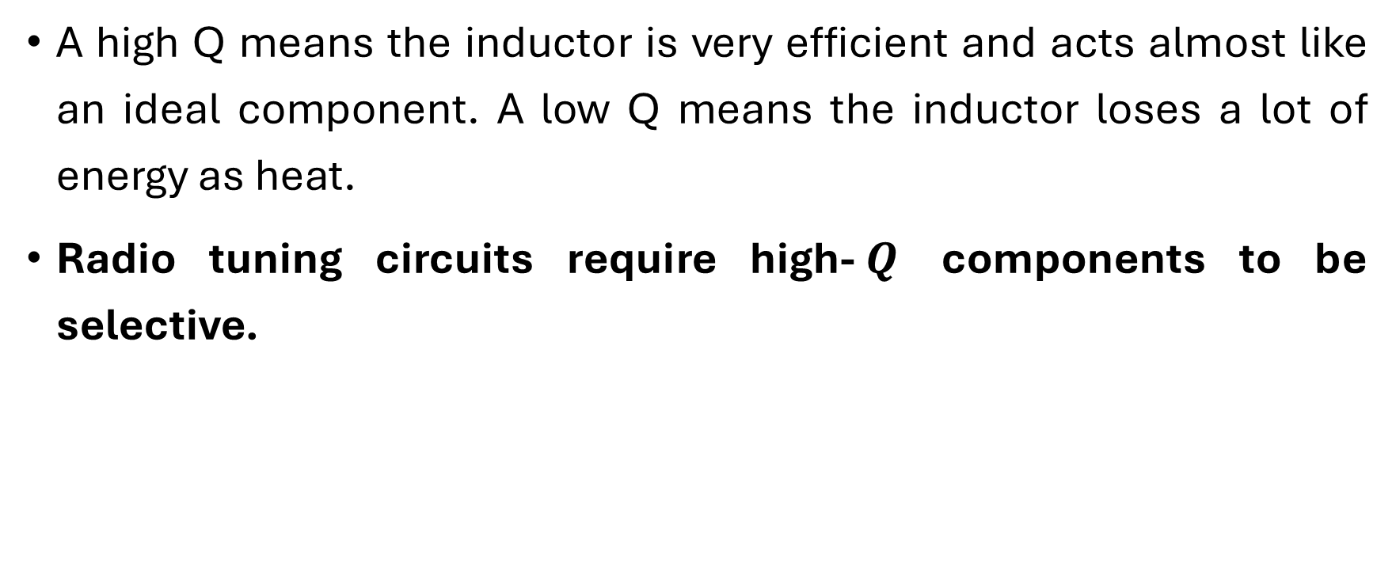
Systematic Analysis Methods
Component Characteristics in AC
A high Q means the inductor is very efficient and acts almost like an ideal component. A low Q means the inductor loses a lot of energy as heat.
Radio tuning circuits require high-$Q$ components to be selective.

Slide 47
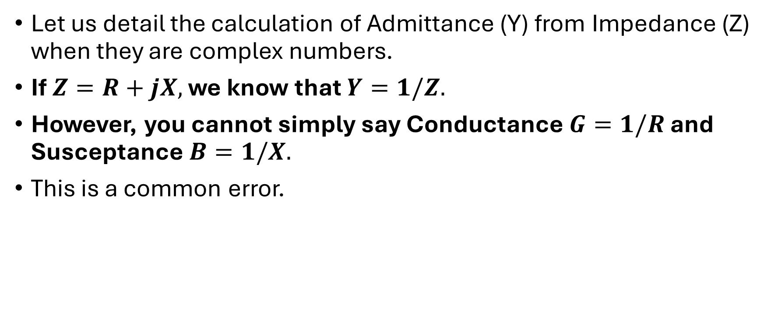
Systematic Analysis Methods
Component Characteristics in AC
Let us detail the calculation of Admittance (Y) from Impedance (Z) when they are complex numbers.
If $Z=R+jX,$ we know that $Y=1/Z.$
However, you cannot simply say Conductance $G=1/R$ and Susceptance $B=1/X.$
This is a common error.

Slide 48
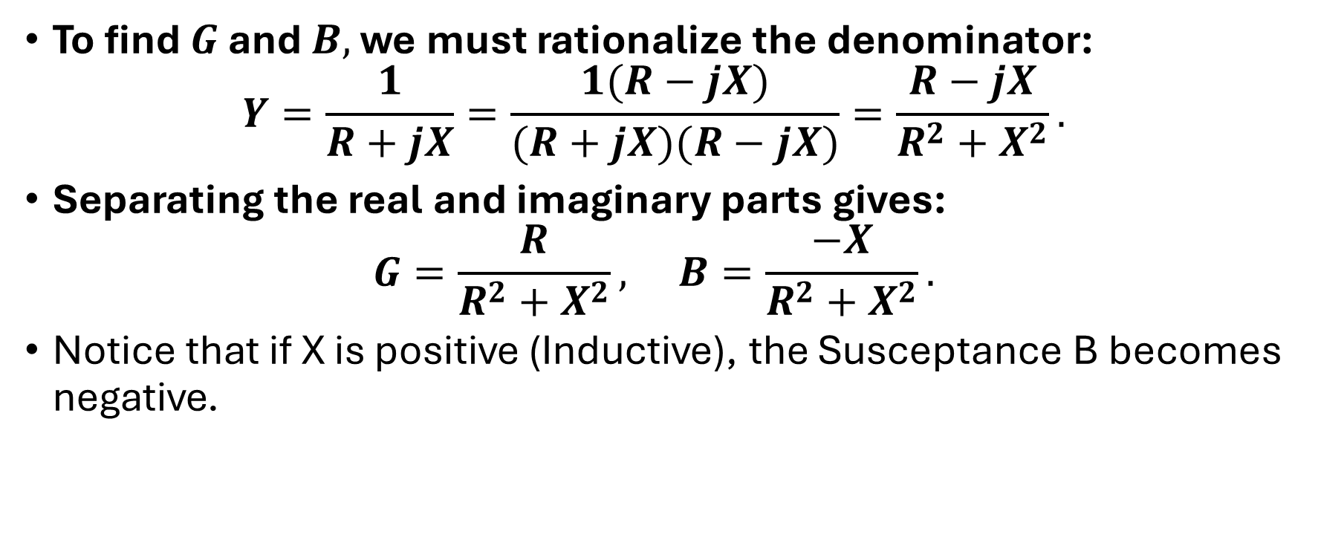
Systematic Analysis Methods
Component Characteristics in AC
To find $G$ and $B,$ we must rationalize the denominator:
$$Y=\frac{1}{R+jX}=\frac{1(R−jX)}{(R+jX)(R−jX)}=\frac{R−jX}{R^{2}+X^{2}}.$$
Separating the real and imaginary parts gives:
$$G=\frac{R}{R^{2}+X^{2}}, B=\frac{−X}{R^{2}+X^{2}}.$$
Notice that if X is positive (Inductive), the Susceptance B becomes negative.

Slide 49
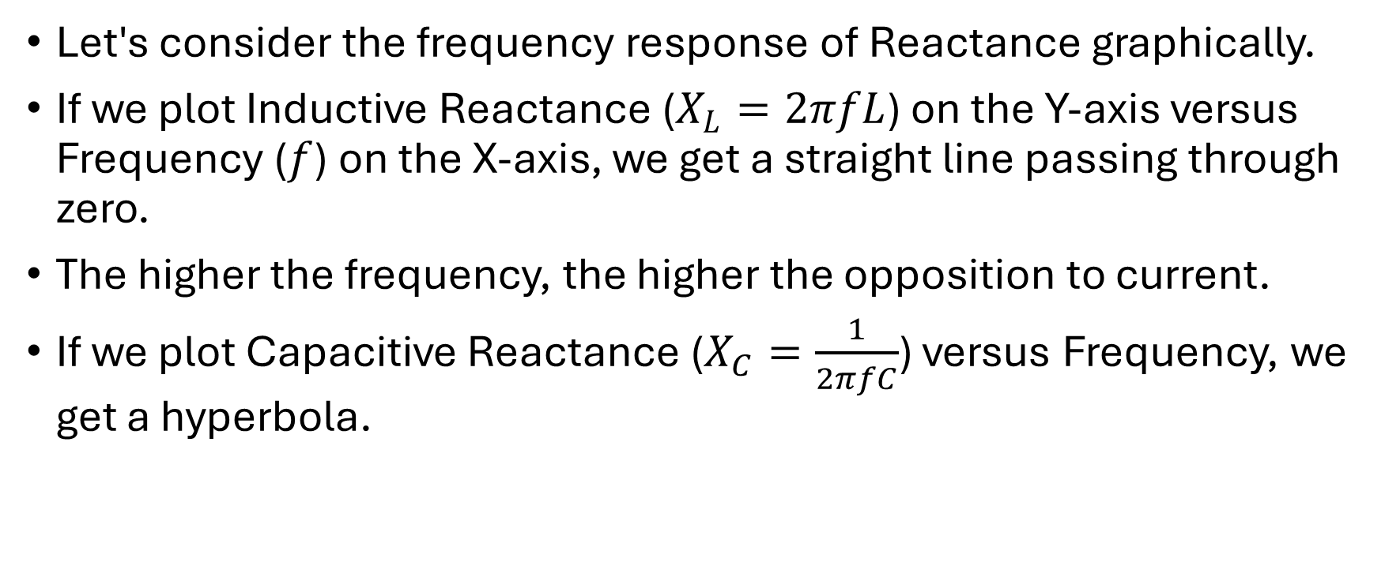
Systematic Analysis Methods
Component Characteristics in AC
Let's consider the frequency response of Reactance graphically.
If we plot Inductive Reactance ($X_{L}=2πfL$) on the Y-axis versus Frequency ($f$) on the X-axis, we get a straight line passing through zero.
The higher the frequency, the higher the opposition to current.
If we plot Capacitive Reactance ($X_{C}=\frac{1}{2πfC}$) versus Frequency, we get a hyperbola.

Slide 50
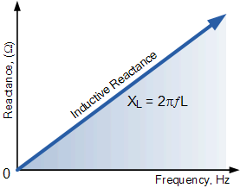
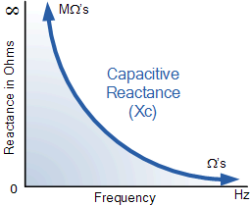
Systematic Analysis Methods
Component Characteristics in AC
Here are these plots.

Slide 51

Systematic Analysis Methods
Component Characteristics in AC
At low frequency, $X_{C}$ is high.
At high frequency, $X_{C}$ approaches zero.

Slide 52



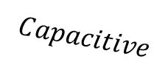


Systematic Analysis Methods
Component Characteristics in AC
There is a specific frequency where $X_{L}=X_{C}.$
This point is called «Resonance», where the effects of the inductor and capacitor cancel each other out completely.
$$Inductive$$
$$Reactance, Ohm$$
$$Capacitive$$
$$f_{Resonance}$$
$$Frequency, Hz$$

Slide 53
Systematic Analysis Methods
Component Characteristics in AC
Today we learned a lot of new things about reactance and impedance.
Thank you for your attention!
Do you have any questions?

