Slide 1
Lecture 9. Phasor Analysis Techniques
Part (3). Analysis of Sinusoidal Steady-State AC Circuits

Slide 2
Systematic Analysis Methods
Phasor Analysis Techniques
Welcome back to the course «The Principle of Circuit».
In our previous lecture, we examined the behavior of individual components – resistors, inductors, and capacitors – when subjected to a sinusoidal AC signal.
We introduced the concept of Complex Impedance (Z), which combines resistance and reactance into a single complex number.

Slide 3
Systematic Analysis Methods
Phasor Analysis Techniques
Today, we take the next logical step.
We will combine these components to analyze complete circuits.
The goal of this lecture is to teach you how to solve for unknown voltages and currents in AC circuits using the Phasor Method.

Slide 4
Systematic Analysis Methods
Phasor Analysis Techniques
You will see that all the analysis methods we learned for DC circuits – such as Ohm’s Law, Kirchhoff’s Laws, and Series/Parallel reduction – apply perfectly to AC circuits, provided we use complex numbers.
We will also learn how to draw Phasor Diagrams, which are vital visual tools for engineers to understand the timing relationships between signals.

Slide 5
Systematic Analysis Methods
Phasor Analysis Techniques
Let us review the «Frequency Domain» strategy.
Analyzing circuits directly in the «Time Domain» (using sine and cosine functions) requires solving differential equations, which is mathematically difficult and slow.
To simplify analysis, we transform the circuit into the «Frequency Domain» (or Phasor Domain):

Slide 6
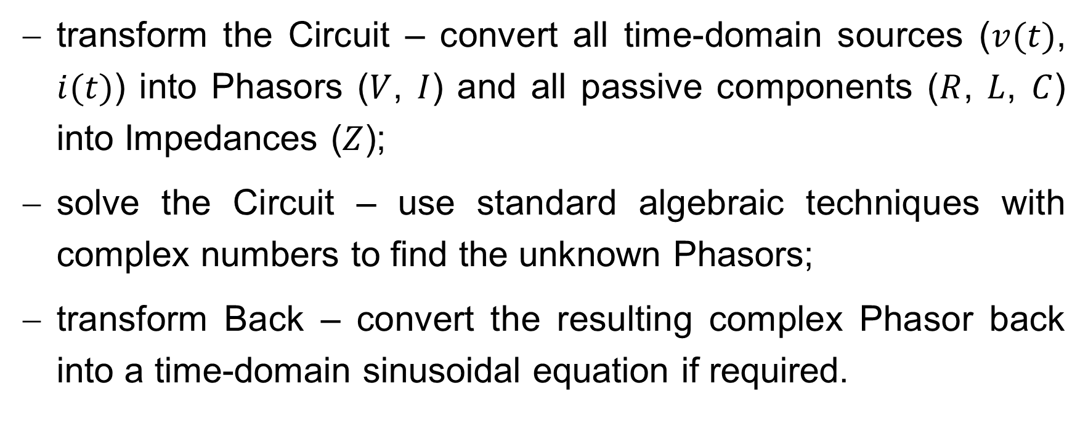
Systematic Analysis Methods
Phasor Analysis Techniques
transform the Circuit – convert all time-domain sources ($v(t)$, $i(t)$) into Phasors ($V$, $I$) and all passive components ($R$, $L$, $C$) into Impedances ($Z$);
solve the Circuit – use standard algebraic techniques with complex numbers to find the unknown Phasors;
transform Back – convert the resulting complex Phasor back into a time-domain sinusoidal equation if required.

Slide 7
Systematic Analysis Methods
Phasor Analysis Techniques
In this lecture, we assume the circuit is in a «Sinusoidal Steady-State».
This means the circuit has been running for a long time, and all transient startup effects have vanished.
All voltages and currents are constant sinusoids at the same frequency.

Slide 8
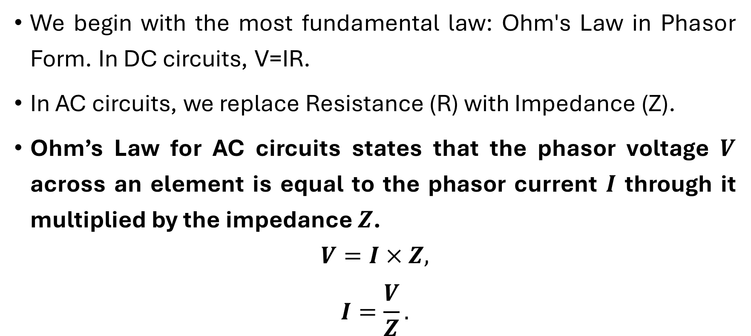
Systematic Analysis Methods
Phasor Analysis Techniques
We begin with the most fundamental law: Ohm's Law in Phasor Form. In DC circuits, V=IR.
In AC circuits, we replace Resistance (R) with Impedance (Z).
Ohm’s Law for AC circuits states that the phasor voltage $V$ across an element is equal to the phasor current $I$ through it multiplied by the impedance $Z$.
$$V=I×Z,$$
$$I=\frac{V}{Z}.$$

Slide 9
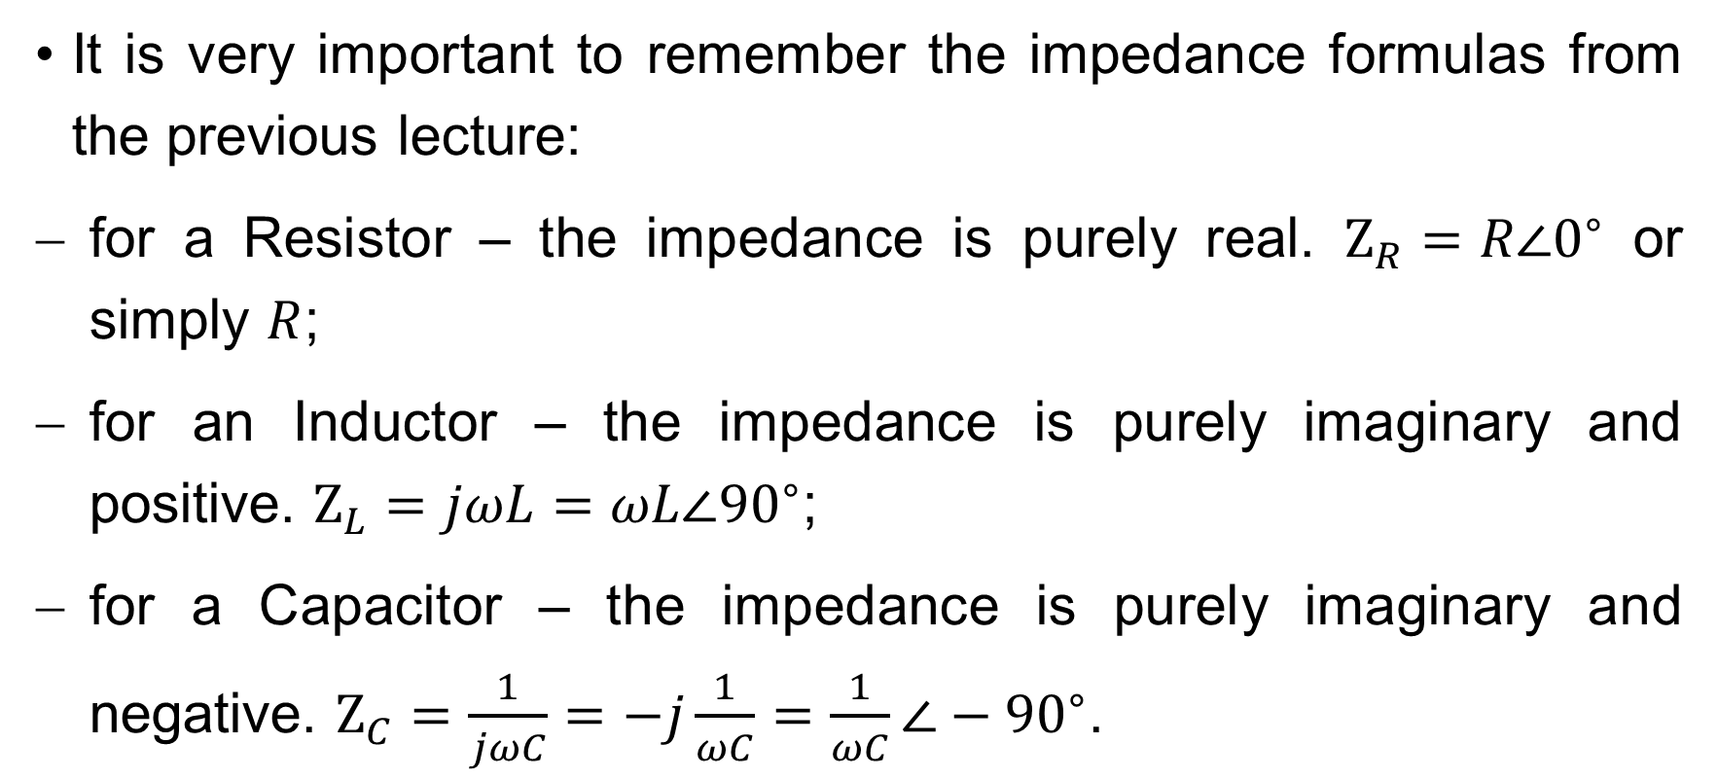
Systematic Analysis Methods
Phasor Analysis Techniques
It is very important to remember the impedance formulas from the previous lecture:
for a Resistor – the impedance is purely real. $Z_{R}=R∠0^{∘}$ or simply $R$;
for an Inductor – the impedance is purely imaginary and positive. $Z_{L}=jωL=ωL∠{90}^{∘}$;
for a Capacitor – the impedance is purely imaginary and negative. $Z_{C}=\frac{1}{jωC}=−j\frac{1}{ωC}=\frac{1}{ωC}∠−{90}^{∘}$.

Slide 10
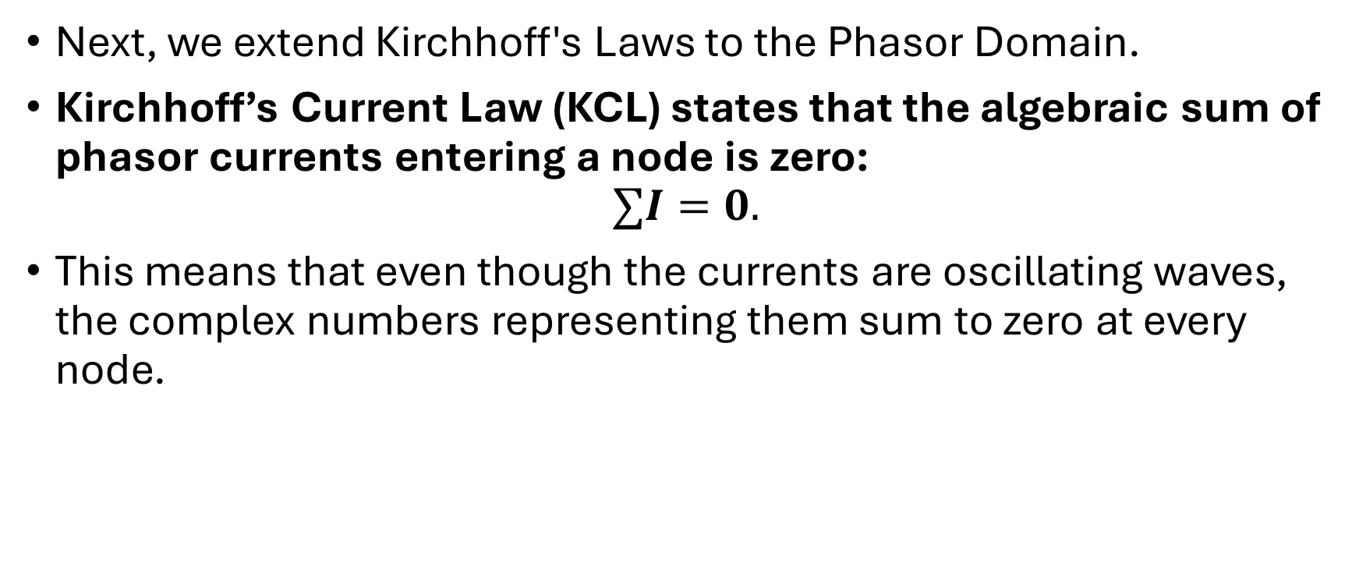
Systematic Analysis Methods
Phasor Analysis Techniques
Next, we extend Kirchhoff's Laws to the Phasor Domain.
Kirchhoff’s Current Law (KCL) states that the algebraic sum of phasor currents entering a node is zero:
$$∑I=0.$$
This means that even though the currents are oscillating waves, the complex numbers representing them sum to zero at every node.

Slide 11
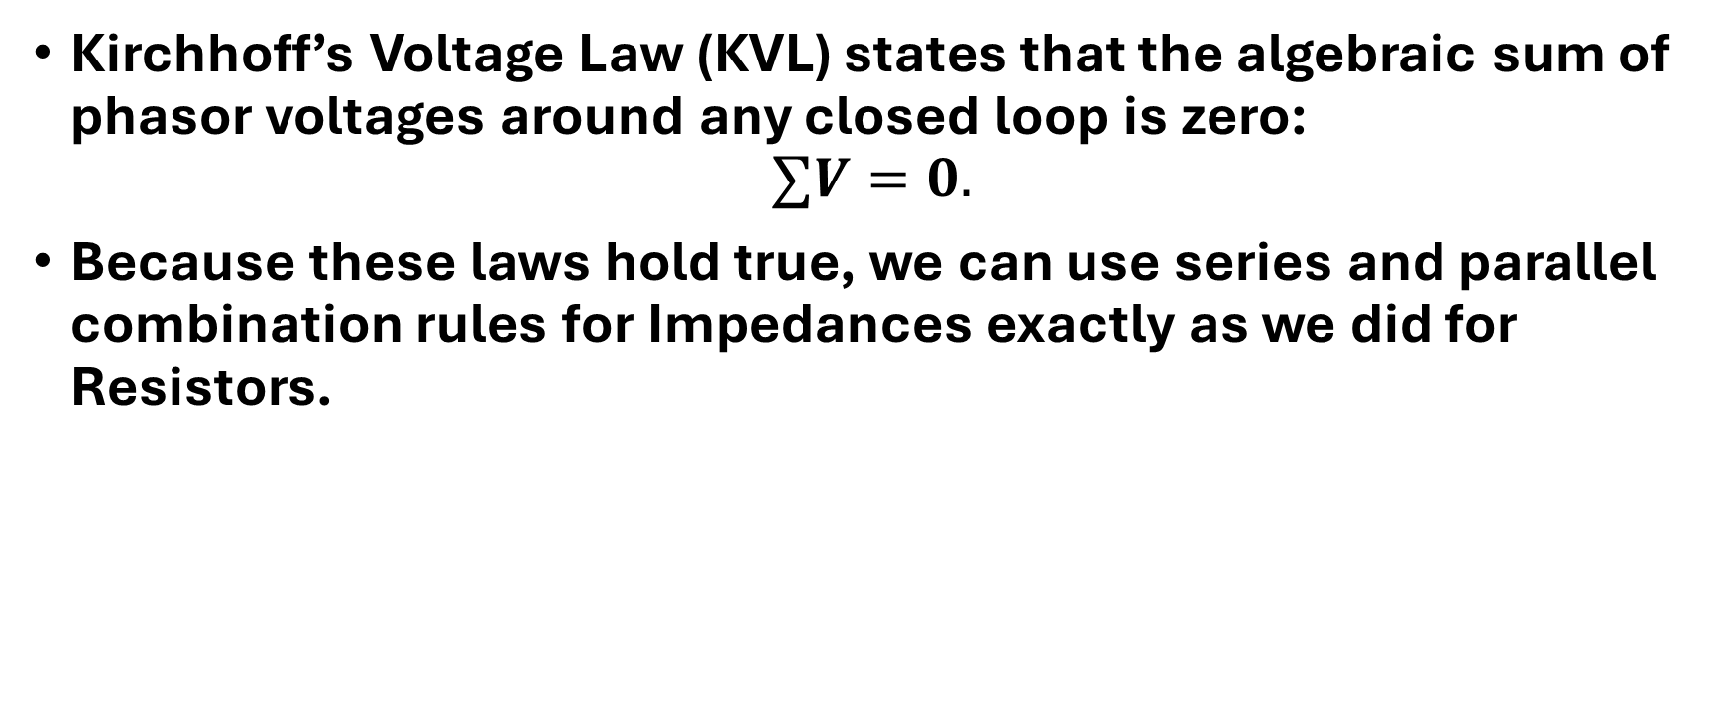
Systematic Analysis Methods
Phasor Analysis Techniques
Kirchhoff’s Voltage Law (KVL) states that the algebraic sum of phasor voltages around any closed loop is zero:
$$∑V=0.$$
Because these laws hold true, we can use series and parallel combination rules for Impedances exactly as we did for Resistors.

Slide 12
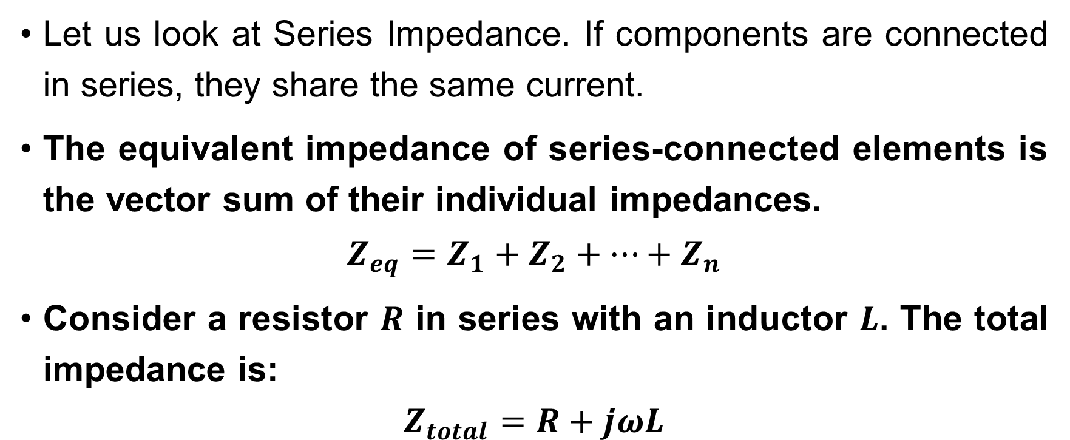
Systematic Analysis Methods
Phasor Analysis Techniques
Let us look at Series Impedance. If components are connected in series, they share the same current.
The equivalent impedance of series-connected elements is the vector sum of their individual impedances.
$$Z_{eq}=Z_{1}+Z_{2}+…+Z_{n}$$
Consider a resistor $R$ in series with an inductor $L$. The total impedance is:
$$Z_{total}=R+jωL$$

Slide 13
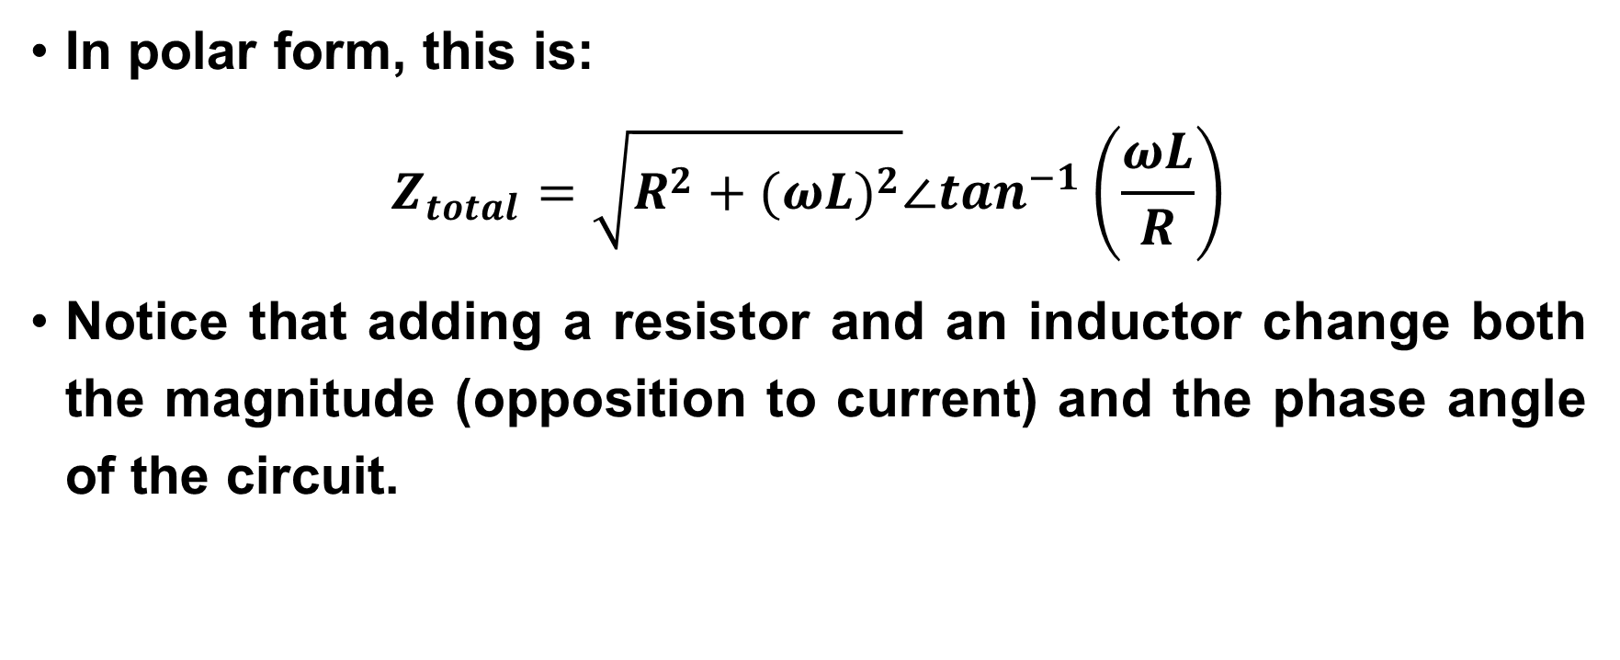
Systematic Analysis Methods
Phasor Analysis Techniques
In polar form, this is:
$$Z_{total}=\sqrt{R^{2}+(ωL)^{2}}∠\tan^{−1}\left(\frac{ωL}{R}\right)$$
Notice that adding a resistor and an inductor change both the magnitude (opposition to current) and the phase angle of the circuit.

Slide 14
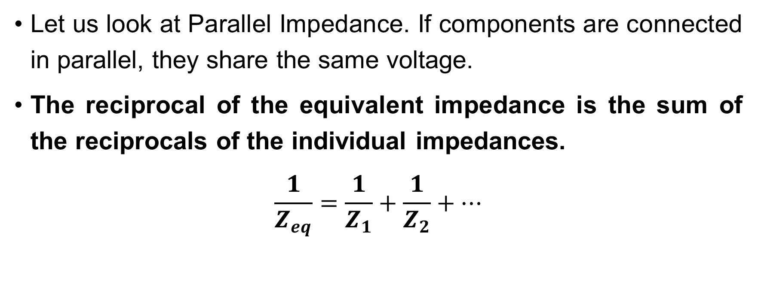
Systematic Analysis Methods
Phasor Analysis Techniques
Let us look at Parallel Impedance. If components are connected in parallel, they share the same voltage.
The reciprocal of the equivalent impedance is the sum of the reciprocals of the individual impedances.
$$\frac{1}{Z_{eq}}=\frac{1}{Z_{1}}+\frac{1}{Z_{2}}+…$$

Slide 15
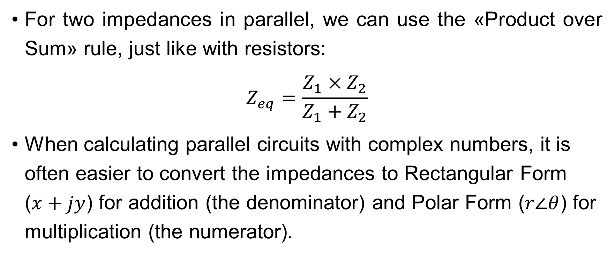
Systematic Analysis Methods
Phasor Analysis Techniques
For two impedances in parallel, we can use the «Product over Sum» rule, just like with resistors:
$$Z_{eq}=\frac{Z_{1}×Z_{2}}{Z_{1}+Z_{2}}$$
When calculating parallel circuits with complex numbers, it is often easier to convert the impedances to Rectangular Form ($x+jy$) for addition (the denominator) and Polar Form ($r∠θ$) for multiplication (the numerator).

Slide 16
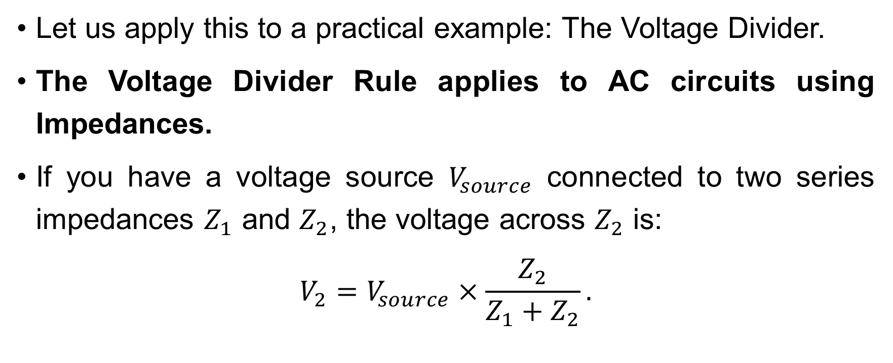
Systematic Analysis Methods
Phasor Analysis Techniques
Let us apply this to a practical example: The Voltage Divider.
The Voltage Divider Rule applies to AC circuits using Impedances.
If you have a voltage source $V_{source}$ connected to two series impedances $Z_{1}$ and $Z_{2}$, the voltage across $Z_{2}$ is:
$$V_{2}=V_{source}×\frac{Z_{2}}{Z_{1}+Z_{2}}.$$

Slide 17
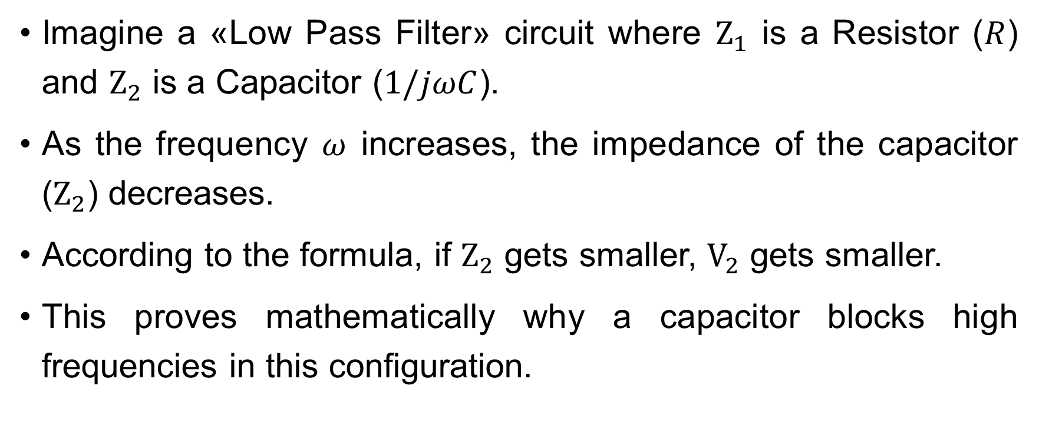
Systematic Analysis Methods
Phasor Analysis Techniques
Imagine a «Low Pass Filter» circuit where $Z_{1}$ is a Resistor ($R$) and $Z_{2}$ is a Capacitor ($1/jωC$).
As the frequency $ω$ increases, the impedance of the capacitor ($Z_{2}$) decreases.
According to the formula, if $Z_{2}$ gets smaller, $V_{2}$ gets smaller.
This proves mathematically why a capacitor blocks high frequencies in this configuration.

Slide 18
Systematic Analysis Methods
Phasor Analysis Techniques
Here is an illustration of a Voltage Divider operating with AC.
The voltmeters display the RMS voltage.

Slide 19

Systematic Analysis Methods
Phasor Analysis Techniques
Do you have you any questions at the moment?

Slide 20
Systematic Analysis Methods
Phasor Analysis Techniques
We now introduce a new visual tool: the Phasor Diagram.
While the algebra gives us the correct numbers, it does not give us a good «feeling» for the circuit.
A Phasor Diagram is a graphical representation of the magnitude and phase relationships between voltages and currents in a circuit.

Slide 21
Systematic Analysis Methods
Phasor Analysis Techniques
It consists of rotating vectors (phasors) plotted on the Complex Plane:
the length of the arrow represents the Amplitude (or RMS value);
the angle of the arrow relative to the horizontal axis represents the Phase Difference.
Engineers use these diagrams to quickly check if a voltage leads or lags a current and to estimate the sum of voltages.

Slide 22
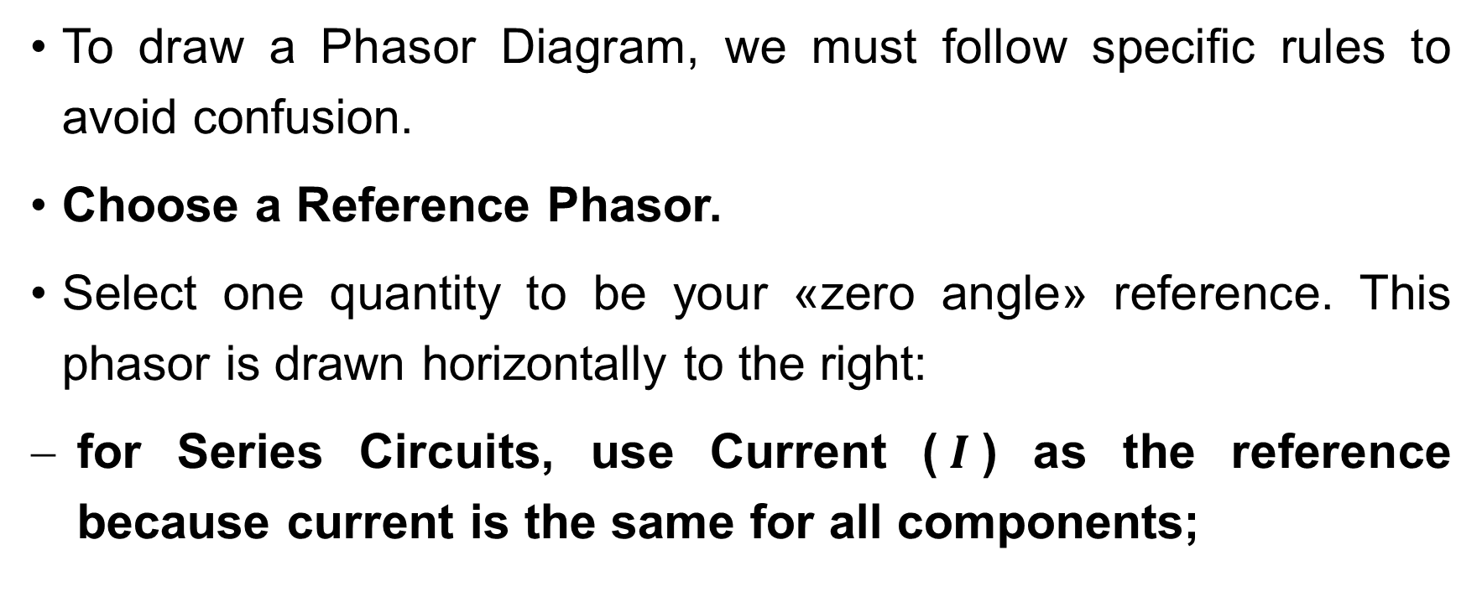
Systematic Analysis Methods
Phasor Analysis Techniques
To draw a Phasor Diagram, we must follow specific rules to avoid confusion.
Choose a Reference Phasor.
Select one quantity to be your «zero angle» reference. This phasor is drawn horizontally to the right:
for Series Circuits, use Current ($I$) as the reference because current is the same for all components;

Slide 23
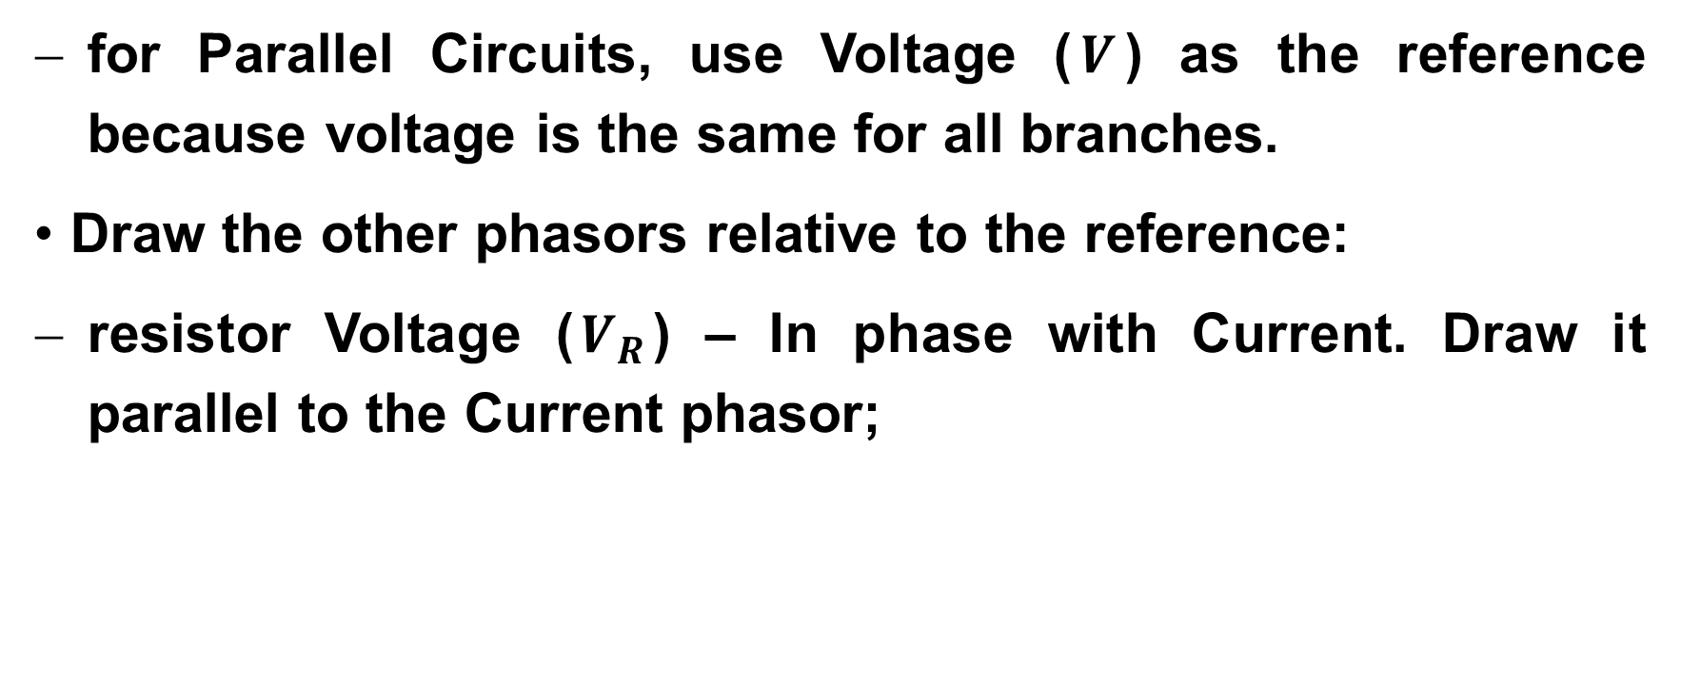
Systematic Analysis Methods
Phasor Analysis Techniques
for Parallel Circuits, use Voltage ($V$) as the reference because voltage is the same for all branches.
Draw the other phasors relative to the reference:
resistor Voltage ($V_{R}$) – In phase with Current. Draw it parallel to the Current phasor;

Slide 24
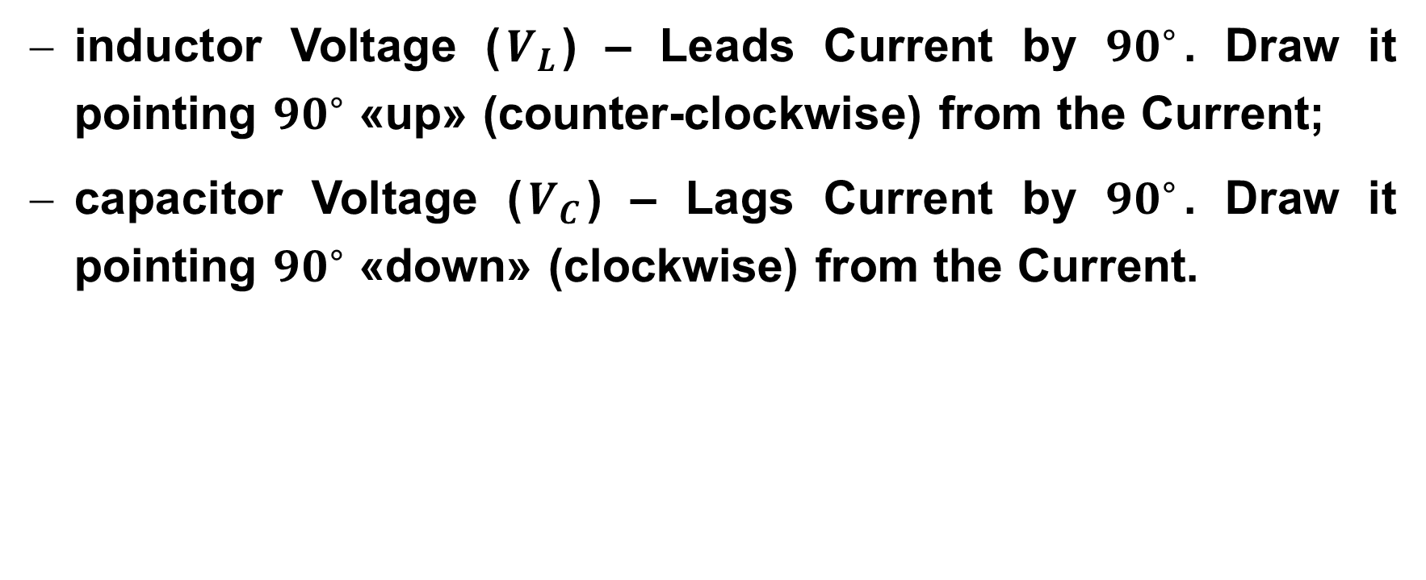
Systematic Analysis Methods
Phasor Analysis Techniques
inductor Voltage ($V_{L}$) – Leads Current by ${90}^{∘}$. Draw it pointing ${90}^{∘}$ «up» (counter-clockwise) from the Current;
capacitor Voltage ($V_{C}$) – Lags Current by ${90}^{∘}$. Draw it pointing ${90}^{∘}$ «down» (clockwise) from the Current.

Slide 25
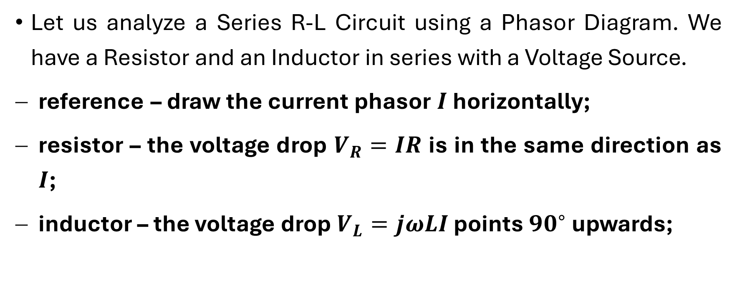
Systematic Analysis Methods
Phasor Analysis Techniques
Let us analyze a Series R-L Circuit using a Phasor Diagram. We have a Resistor and an Inductor in series with a Voltage Source.
reference – draw the current phasor $I$ horizontally;
resistor – the voltage drop $V_{R}=IR$ is in the same direction as $I$;
inductor – the voltage drop $V_{L}=jωLI$ points ${90}^{∘}$ upwards;

Slide 26
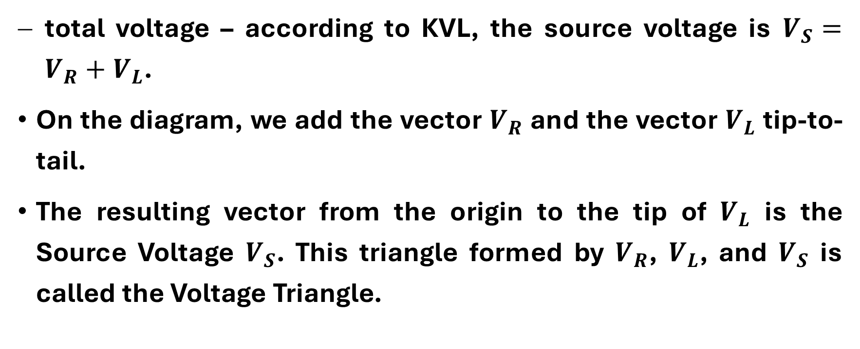
Systematic Analysis Methods
Phasor Analysis Techniques
total voltage – according to KVL, the source voltage is $V_{S}=V_{R}+V_{L}$.
On the diagram, we add the vector $V_{R}$ and the vector $V_{L}$ tip-to-tail.
The resulting vector from the origin to the tip of $V_{L}$ is the Source Voltage $V_{S}$. This triangle formed by $V_{R}$, $V_{L}$, and $V_{S}$ is called the Voltage Triangle.

Slide 27

Systematic Analysis Methods
Phasor Analysis Techniques
From this geometry – as shown in the illustration on the next slide – we seethat the total voltage leads the current by an angle θ, where $tanθ=V_{L}/V_{R}$.

Slide 28
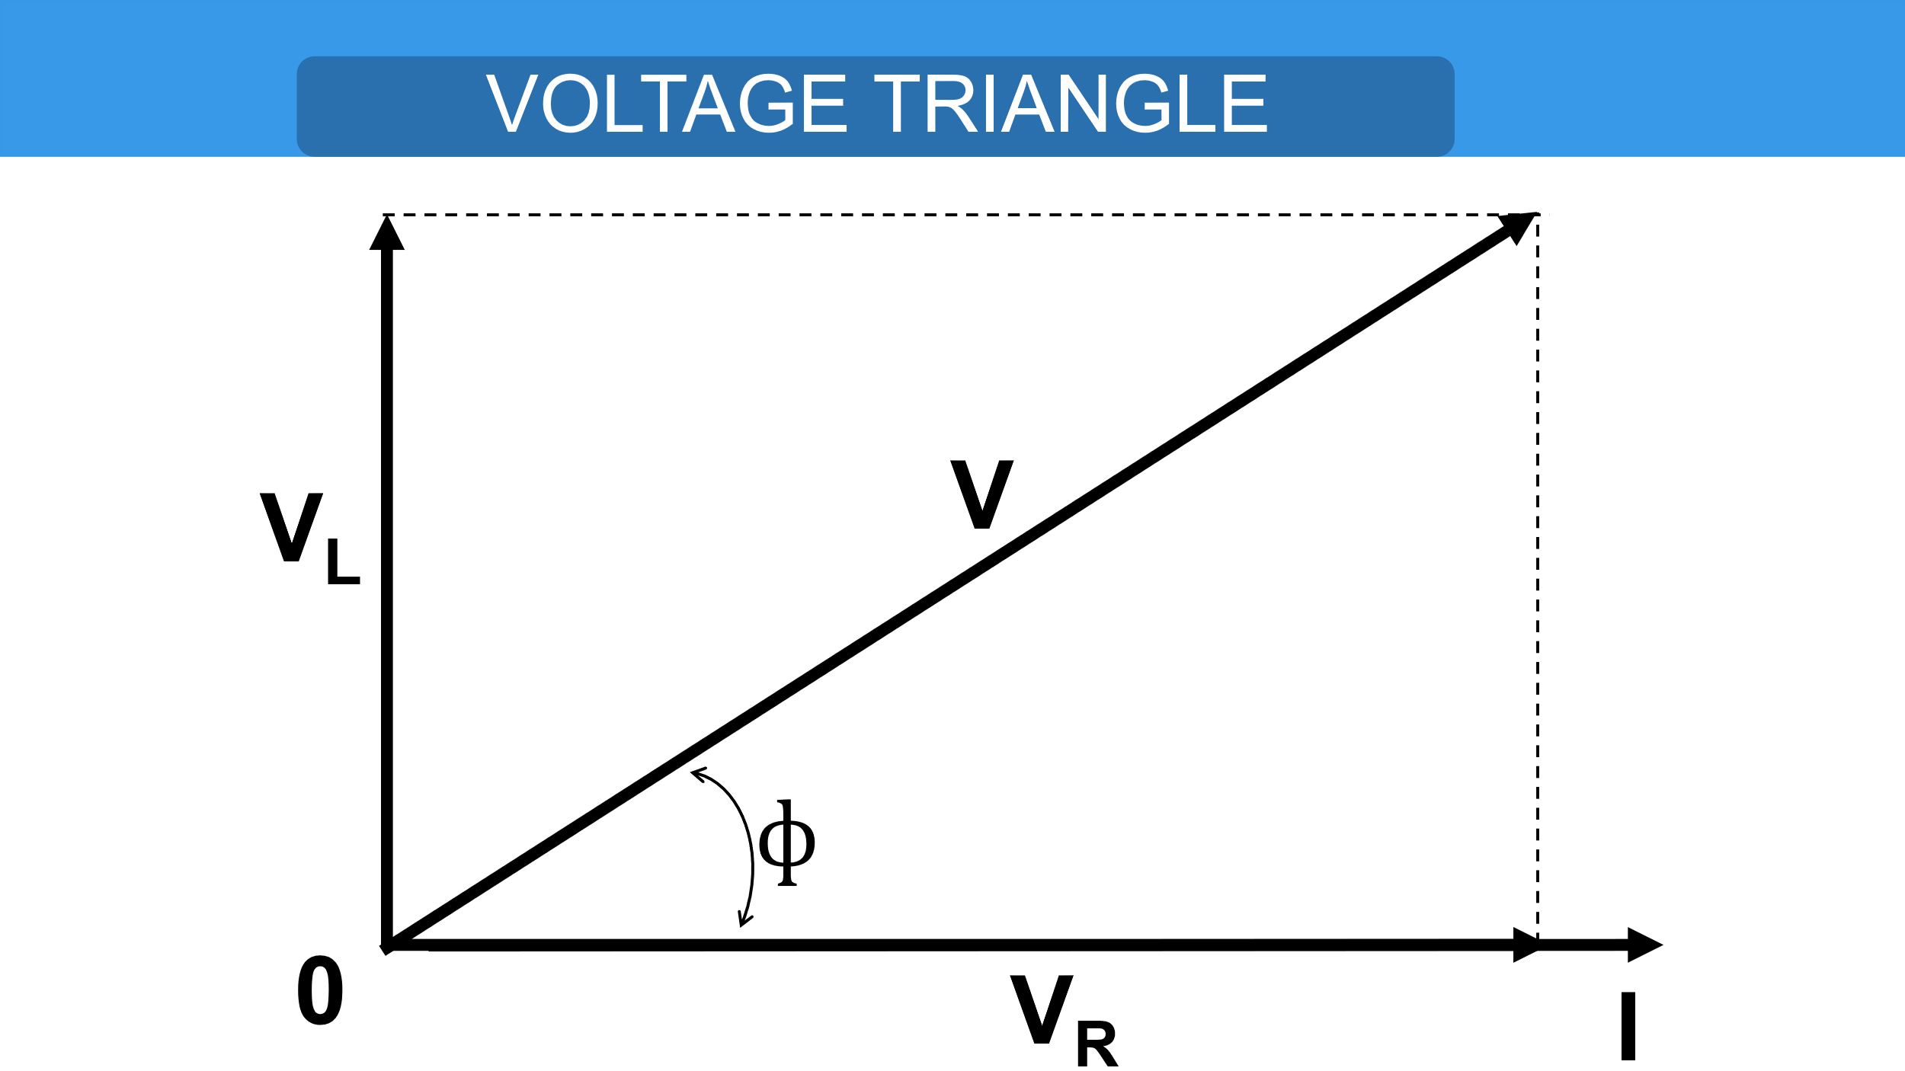
Systematic Analysis Methods
Fundamental Circuit Theorems (II)

Slide 29
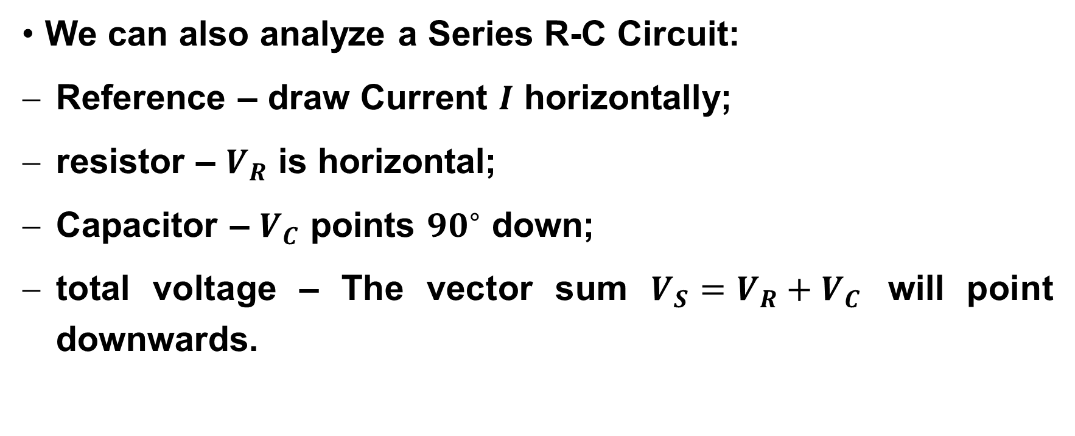
Systematic Analysis Methods
Phasor Analysis Techniques
We can also analyze a Series R-C Circuit:
Reference – draw Current $I$ horizontally;
resistor – $V_{R}$ is horizontal;
Capacitor – $V_{C}$ points ${90}^{∘}$ down;
total voltage ­– The vector sum $V_{S}=V_{R}+V_{C}$ will point downwards.

Slide 30
Systematic Analysis Methods
Phasor Analysis Techniques
This visualizes clearly that in an RC circuit, the source voltage lags behind the source current.
This creates a «capacitive» power factor, which we will discuss in the next lecture on Power.
Now we introduce the concept of Admittance, which is useful for parallel AC circuits.

Slide 31
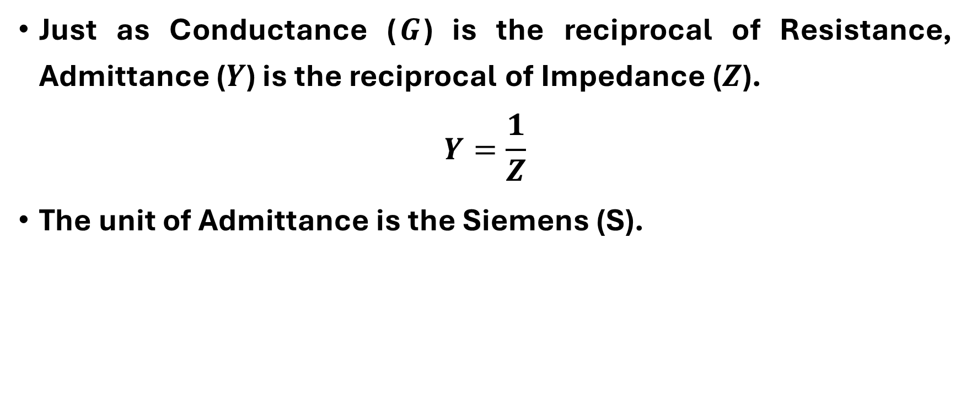
Systematic Analysis Methods
Phasor Analysis Techniques
Just as Conductance ($G$) is the reciprocal of Resistance, Admittance ($Y$) is the reciprocal of Impedance ($Z$).
$$Y=\frac{1}{Z}$$
The unit of Admittance is the Siemens (S).

Slide 32
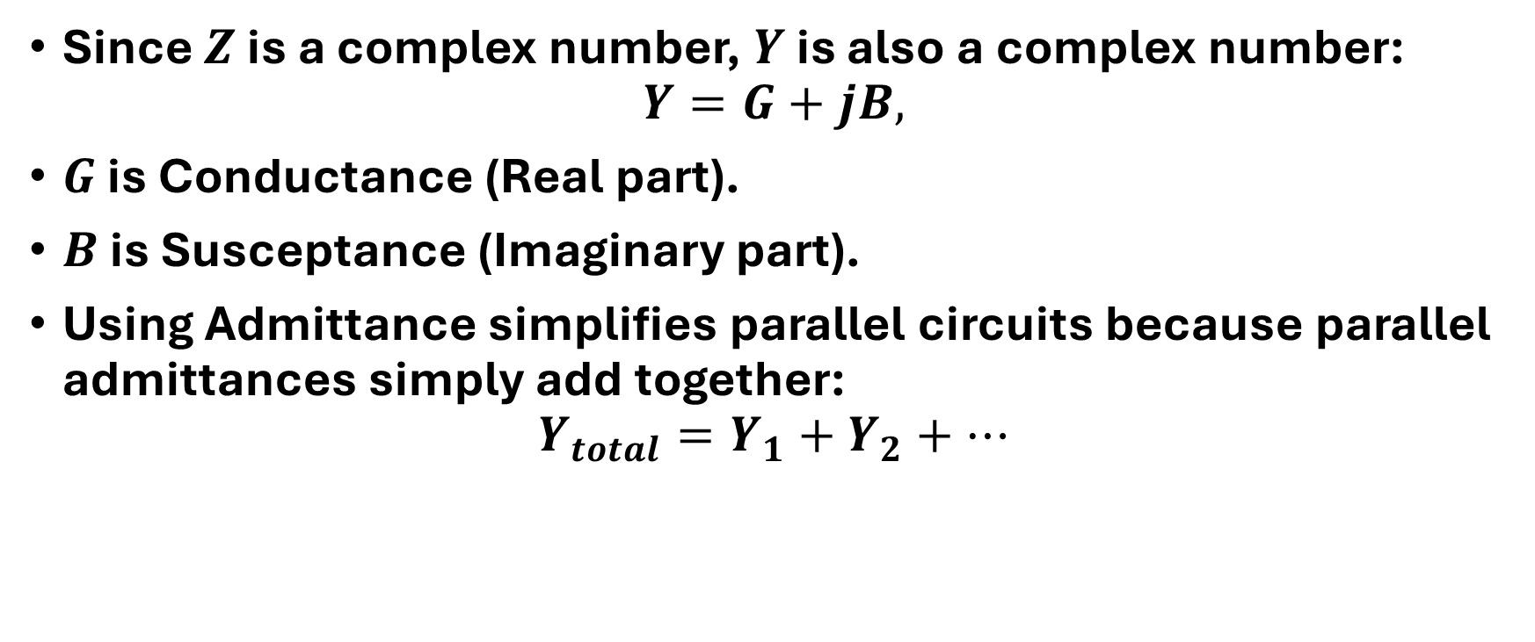
Systematic Analysis Methods
Phasor Analysis Techniques
Since $Z$ is a complex number, $Y$ is also a complex number:
$$Y=G+jB,$$
$G$ is Conductance (Real part).
$B$ is Susceptance (Imaginary part).
Using Admittance simplifies parallel circuits because parallel admittances simply add together:
$$Y_{total}=Y_{1}+Y_{2}+…$$

Slide 33
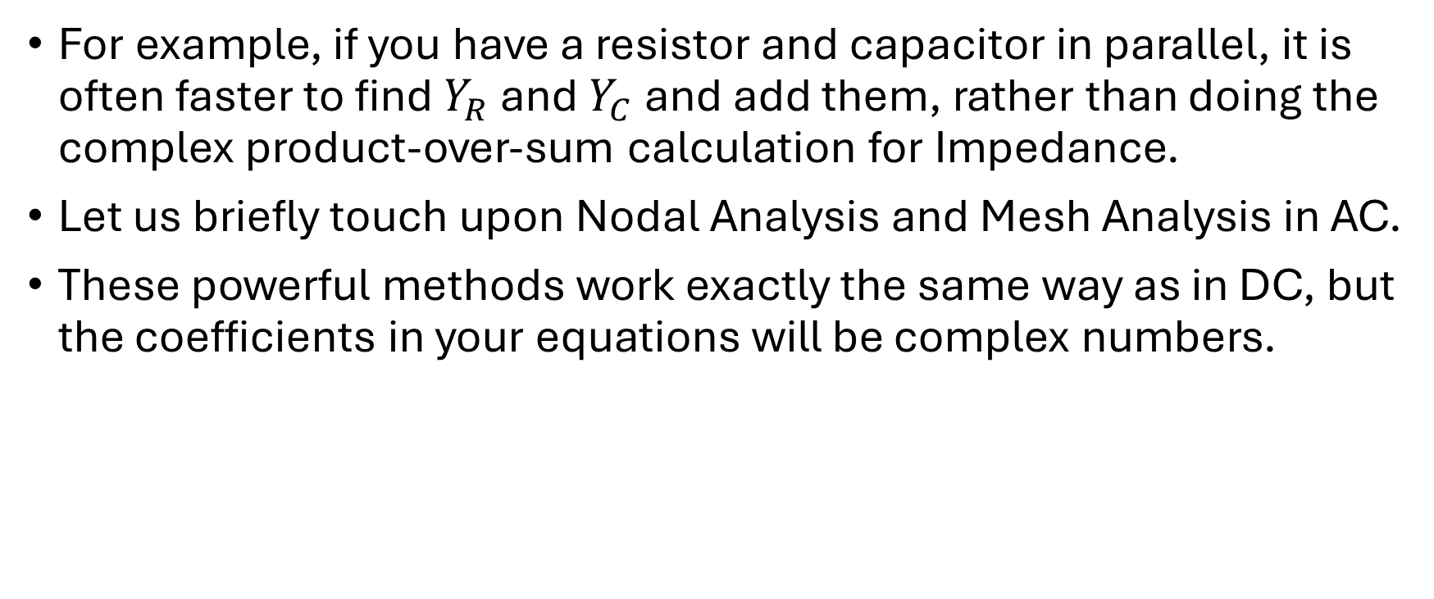
Systematic Analysis Methods
Phasor Analysis Techniques
For example, if you have a resistor and capacitor in parallel, it is often faster to find $Y_{R}$ and $Y_{C}$and add them, rather than doing the complex product-over-sum calculation for Impedance.
Let us briefly touch upon Nodal Analysis and Mesh Analysis in AC.
These powerful methods work exactly the same way as in DC, but the coefficients in your equations will be complex numbers.

Slide 34
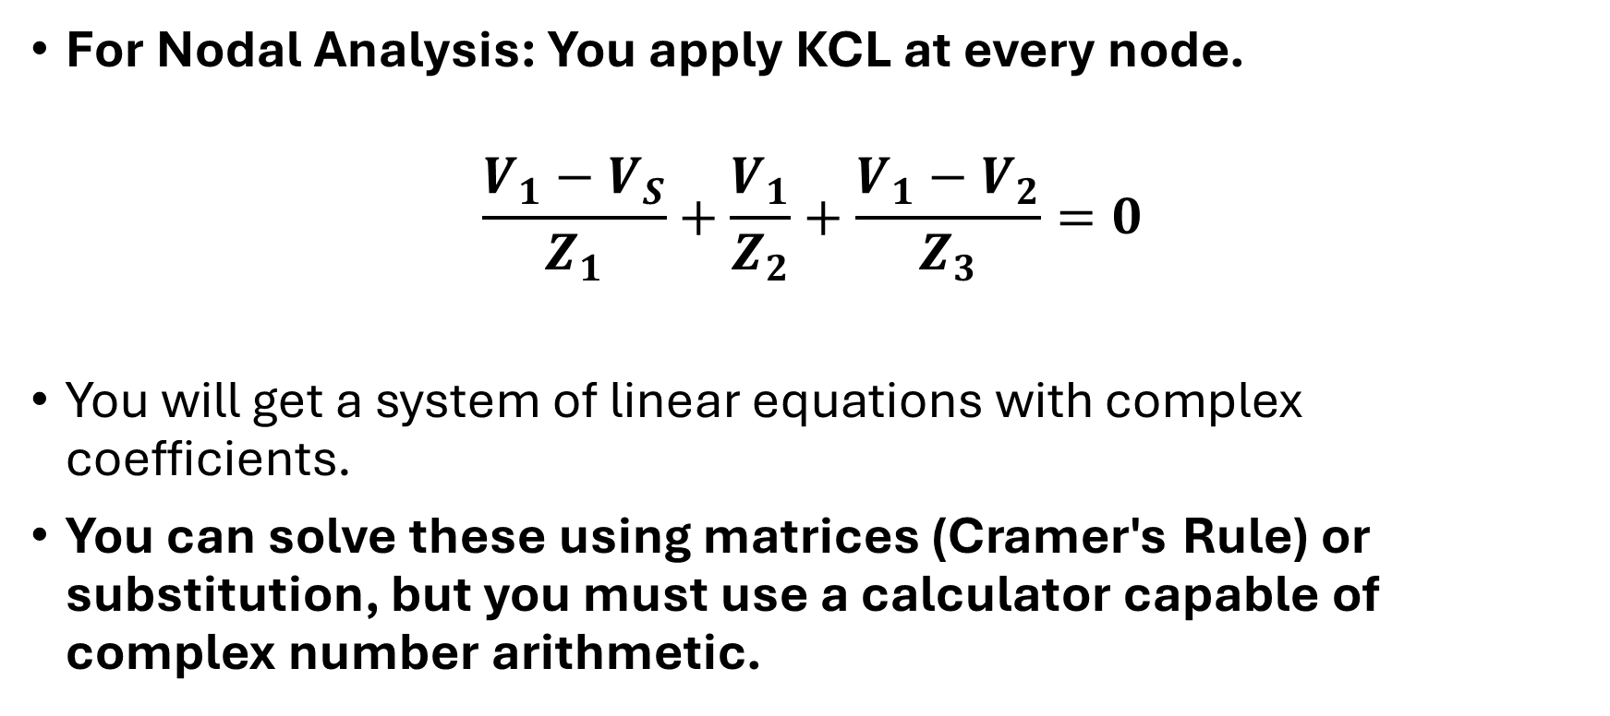
Systematic Analysis Methods
Phasor Analysis Techniques
For Nodal Analysis: You apply KCL at every node.
$$\frac{V_{1}−V_{S}}{Z_{1}}+\frac{V_{1}}{Z_{2}}+\frac{V_{1}−V_{2}}{Z_{3}}=0$$
You will get a system of linear equations with complex coefficients.
You can solve these using matrices (Cramer's Rule) or substitution, but you must use a calculator capable of complex number arithmetic.

Slide 35
Systematic Analysis Methods
Phasor Analysis Techniques
Students often make sign errors here.
Always carefully track the phase angles when subtracting phasors.
Subtracting a vector is equivalent to adding a vector pointing in the opposite direction.
Just as we used Source Transformation in DC circuits, we can use Phasor Source Transformation in AC circuits.

Slide 36
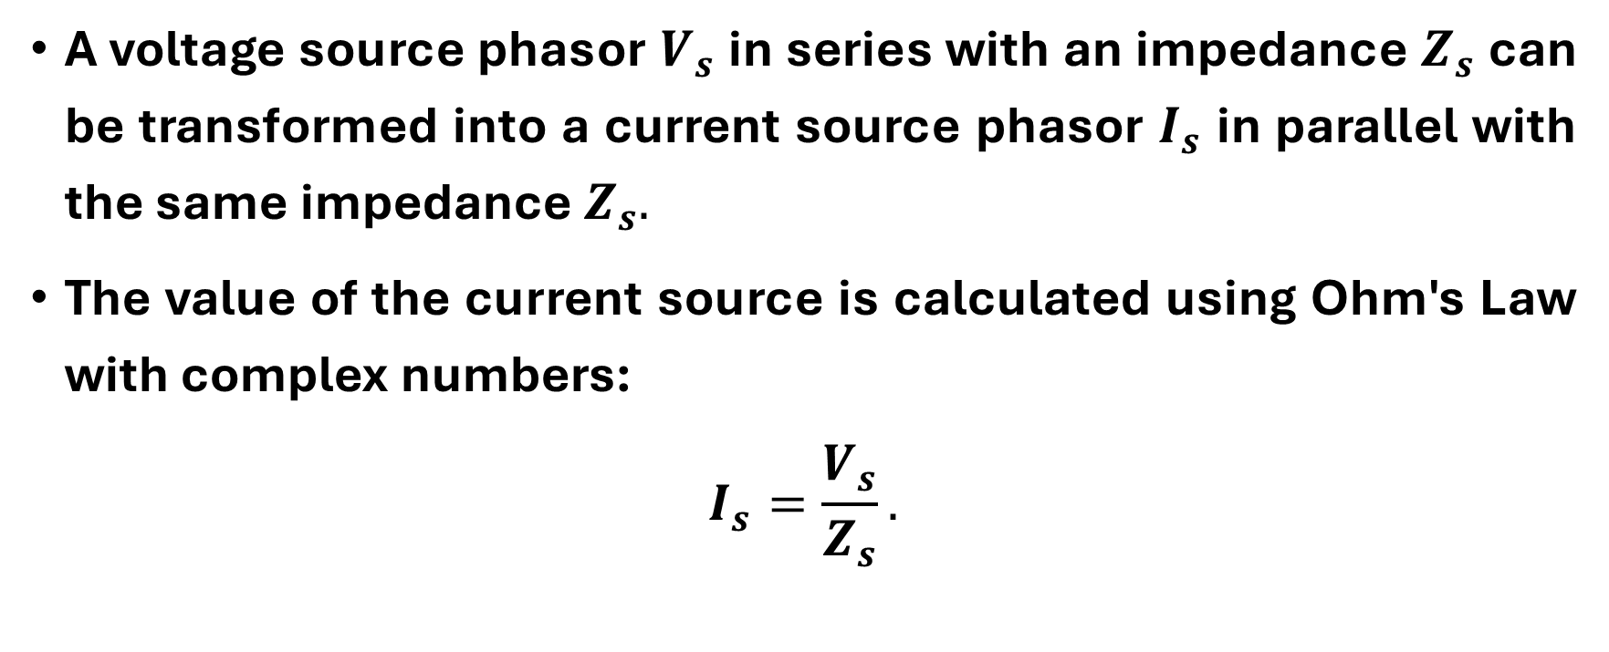
Systematic Analysis Methods
Phasor Analysis Techniques
A voltage source phasor $V_{s}$ in series with an impedance $Z_{s}$ can be transformed into a current source phasor $I_{s}$ in parallel with the same impedance $Z_{s}.$
The value of the current source is calculated using Ohm's Law with complex numbers:
$$I_{s}=\frac{V_{s}}{Z_{s}}.$$

Slide 37
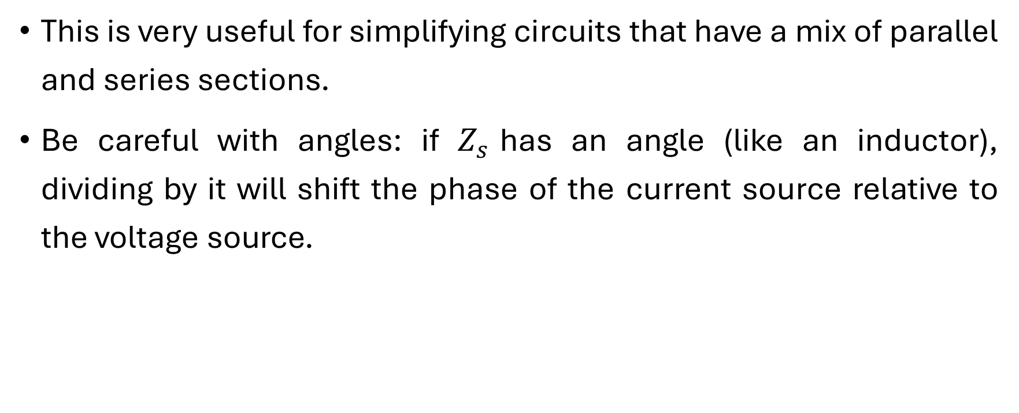
Systematic Analysis Methods
Phasor Analysis Techniques
This is very useful for simplifying circuits that have a mix of parallel and series sections.
Be careful with angles: if $Z_{s}$has an angle (like an inductor), dividing by it will shift the phase of the current source relative to the voltage source.

Slide 38
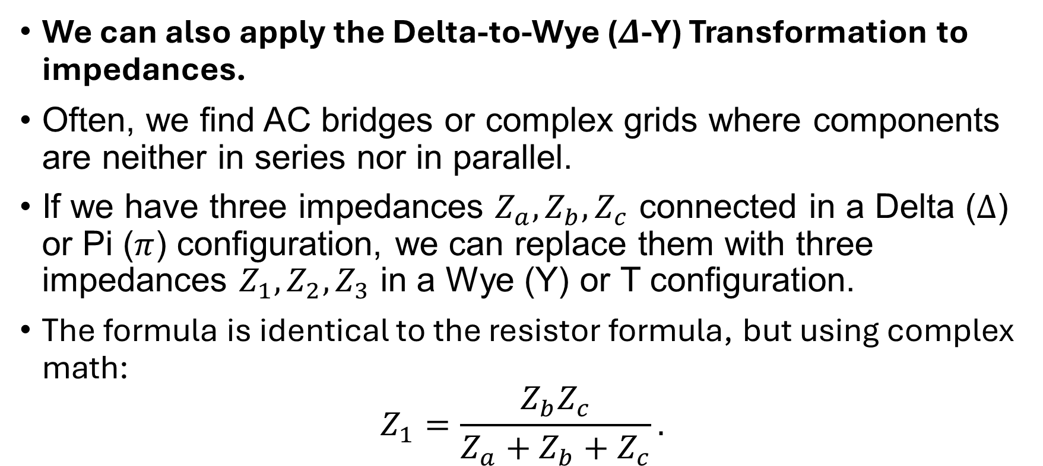
Systematic Analysis Methods
Phasor Analysis Techniques
We can also apply the Delta-to-Wye ($Δ$-Y) Transformation to impedances.
Often, we find AC bridges or complex grids where components are neither in series nor in parallel.
If we have three impedances $Z_{a},Z_{b},Z_{c}$ connected in a Delta ($Δ$) or Pi ($π$) configuration, we can replace them with three impedances $Z_{1},Z_{2},Z_{3}$ in a Wye (Y) or T configuration.
The formula is identical to the resistor formula, but using complex math:
$$Z_{1}=\frac{Z_{b}Z_{c}}{Z_{a}+Z_{b}+Z_{c}}.$$

Slide 39
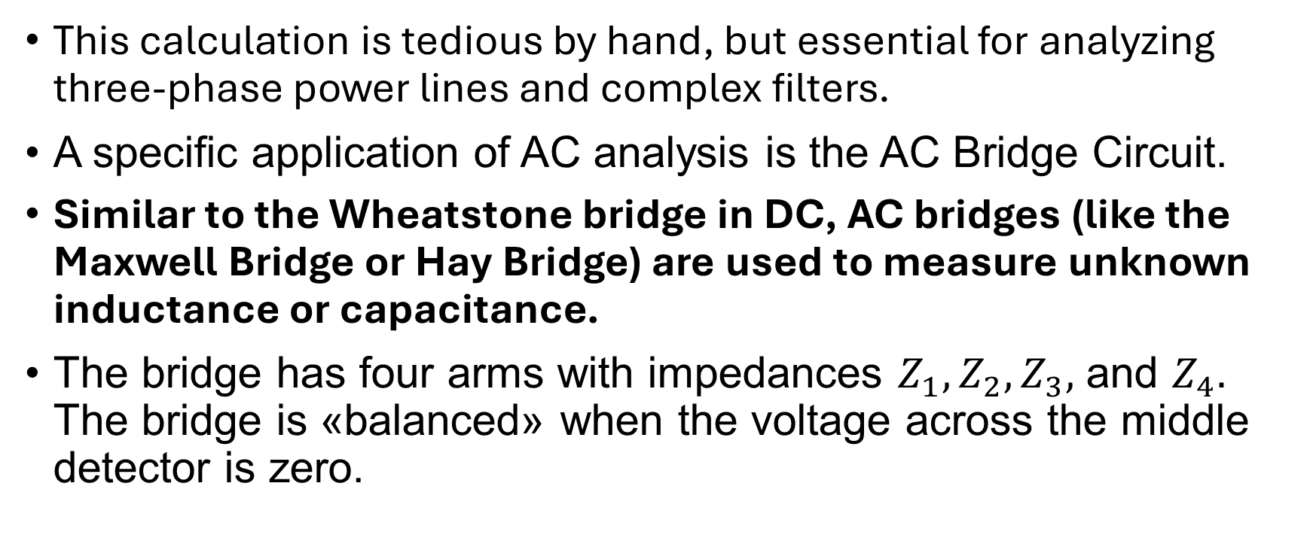
Systematic Analysis Methods
Phasor Analysis Techniques
This calculation is tedious by hand, but essential for analyzing three-phase power lines and complex filters.
A specific application of AC analysis is the AC Bridge Circuit.
Similar to the Wheatstone bridge in DC, AC bridges (like the Maxwell Bridge or Hay Bridge) are used to measure unknown inductance or capacitance.
The bridge has four arms with impedances $Z_{1},Z_{2},Z_{3},$ and $Z_{4}.$ The bridge is «balanced» when the voltage across the middle detector is zero.

Slide 40

Systematic Analysis Methods
Phasor Analysis Techniques
The condition for balance is:
$$Z_{1}Z_{4}=Z_{2}Z_{3}.$$
This equation requires both the magnitudes to equate and the phase angles to equate:
$$|Z_{1}||Z_{4}|=|Z_{2}||Z_{3}| \text{and} ∠θ_{1}+∠θ_{4}=∠θ_{2}+∠θ_{3}.$$

Slide 41
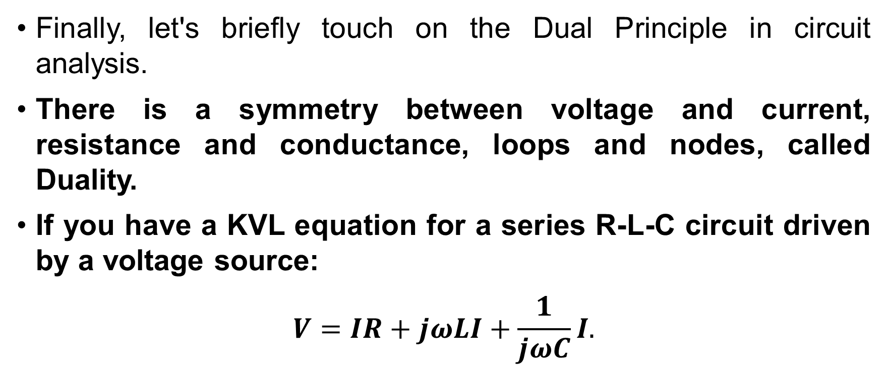
Systematic Analysis Methods
Phasor Analysis Techniques
Finally, let's briefly touch on the Dual Principle in circuit analysis.
There is a symmetry between voltage and current, resistance and conductance, loops and nodes, called Duality.
If you have a KVL equation for a series R-L-C circuit driven by a voltage source:
$$V=IR+jωLI+\frac{1}{jωC}I.$$

Slide 42
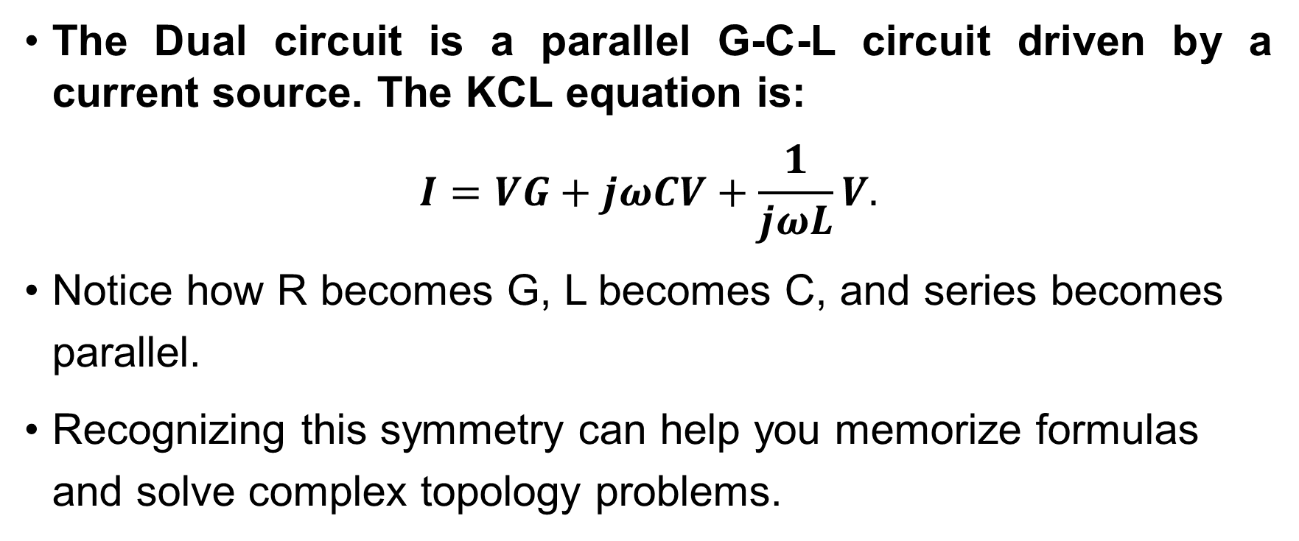
Systematic Analysis Methods
Phasor Analysis Techniques
The Dual circuit is a parallel G-C-L circuit driven by a current source. The KCL equation is:
$$I=VG+jωCV+\frac{1}{jωL}V.$$
Notice how R becomes G, L becomes C, and series becomes parallel.
Recognizing this symmetry can help you memorize formulas and solve complex topology problems.

Slide 43
Systematic Analysis Methods
Phasor Analysis Techniques
Thank you for your attention!
Do you have any questions?

