Slide 1
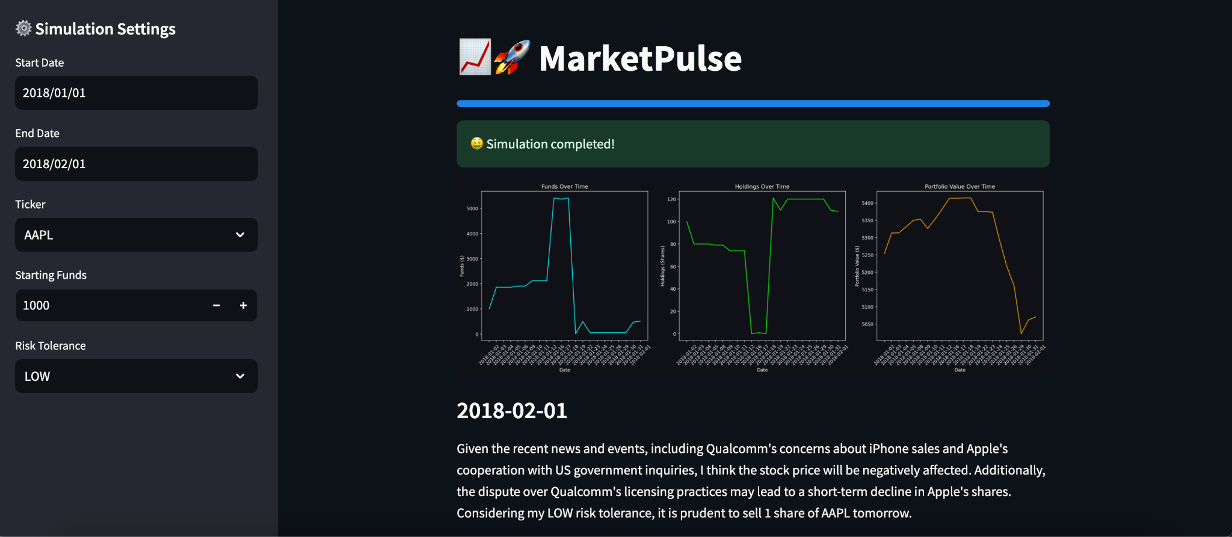
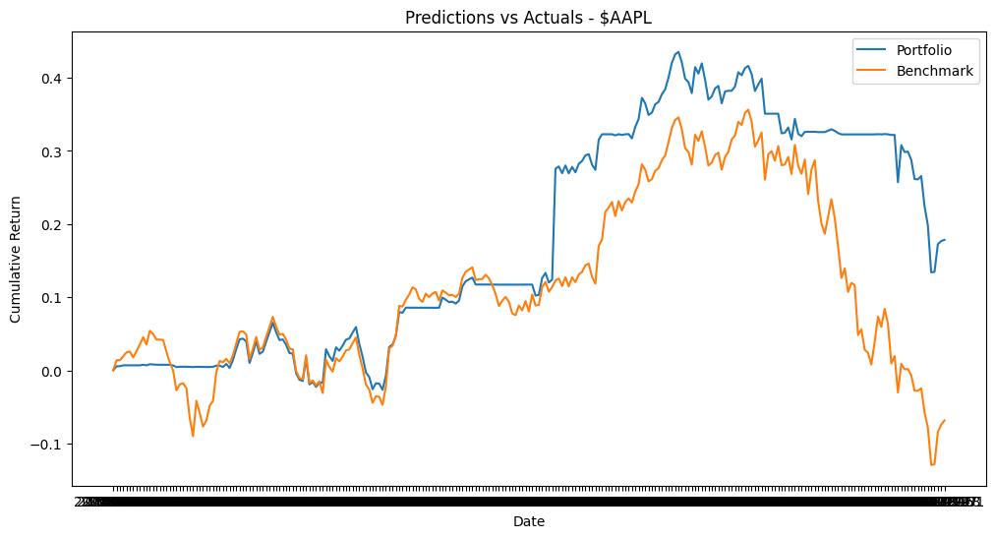
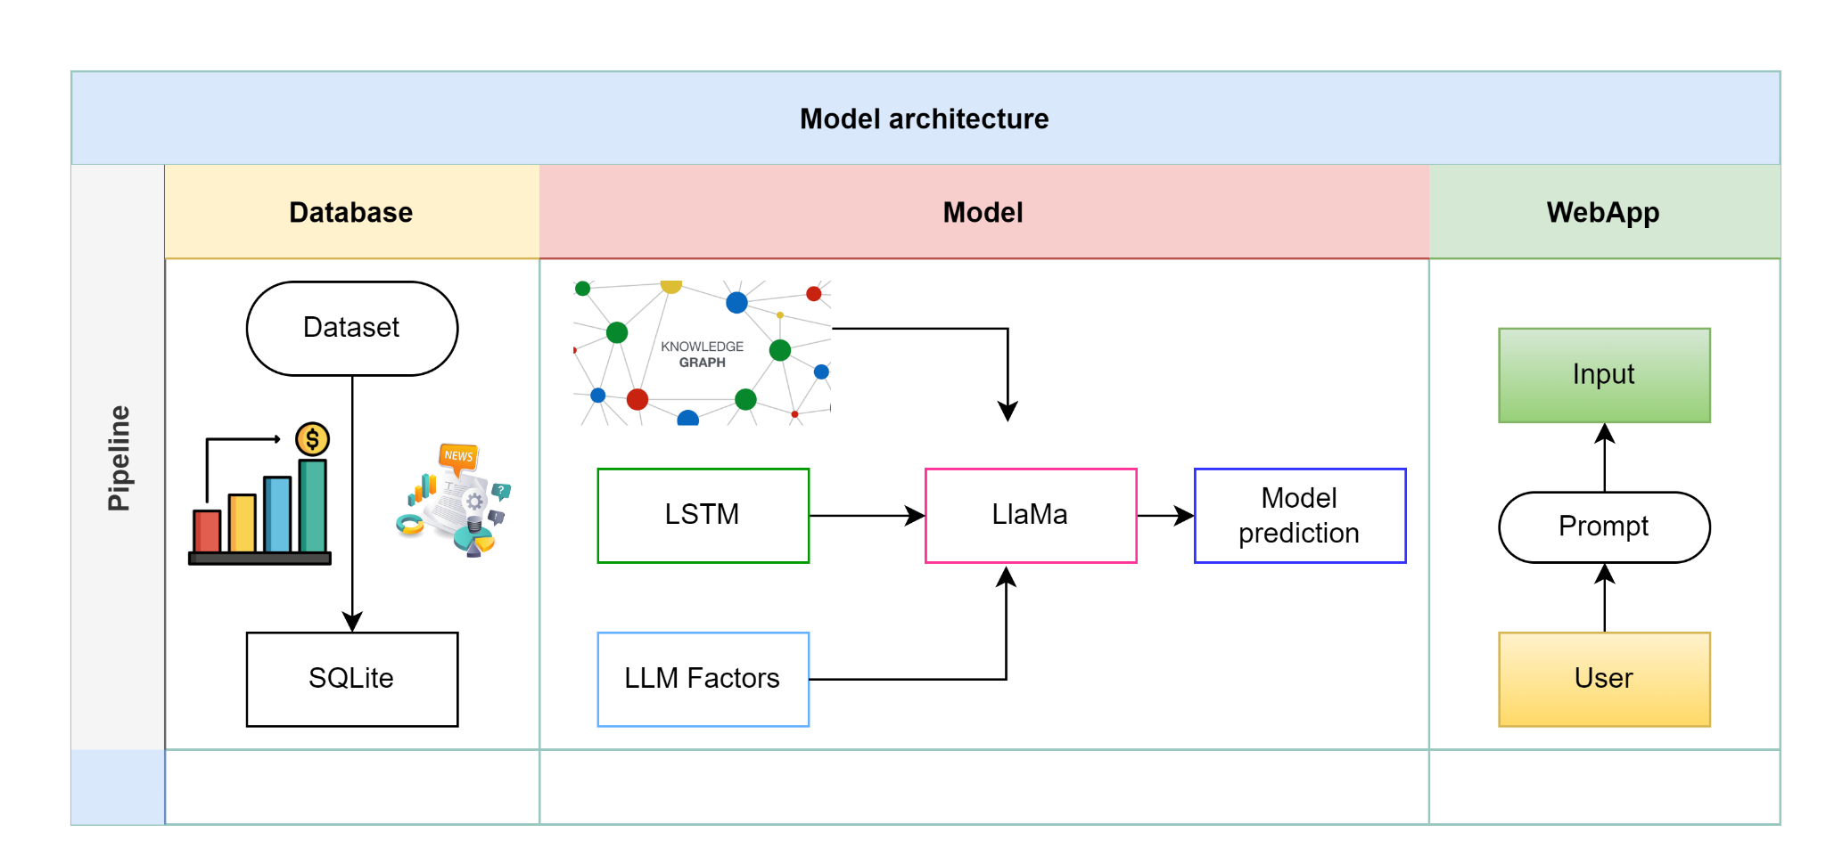
MarketPulse:
Stock Market Prediction with AI
Odai Athamneh, Devin Cline, Semir Hot, Namuun Lkhagvadorj
Introduction
The stock market is a complex subject matter
Making the correct choice, buy/sell seems like a 50/50 but in reality it's not
Only 1-4% of day traders are profitable, the remaining 96% lose money on their day trading
Humans often trade with emotion and will let their emotions get in the way of making the most optimal decisions
What if we took something emotionless, computers, and combined it with stock market data and taught an emotionless object how to trade?
Method
Predict stock price using machine learning.
Develop knowledge graph of financial news data
Generate factors that may affect stock prices
Utilize LLM to make a trading decision
.
Results
RMSE for the following models
SVM:
Linear Regression:
Random Forest
Stacking Regressor
ARIMA:
Discussion
Conclusion
Objectives
Make predictions using a variety of tools
Simulate predictions
Provide UI to drive and visualize simulatiom
References
Wang, M., Izumi, K., & Sakaji, H. (2024). LLMFactor: Extracting Profitable Factors through Prompts for Explainable Stock Movement Prediction. Findings of ACL 2024. arXiv. https://doi.org/10.48550/arXiv.2406.10811

