Slide 1
NCSPCA Online Statute Database

Slide 2
The Team

Slide 3
Gina Lee - Front-End Developer
Peter Ko - Technical Manager
Cole Reschke - Client Liaison
Parker Slote - UI/UX Designer
Noah Tebben - Project Manager

Slide 4
The Client

Slide 5
NCSPCA
Nassau County Society for Prevention of Cruelty to Animals
Volunteer non-profit organization
Fully funded by donations
Fully trained peace officers and detectives
Education, community involvement, enforcement

Slide 6


Client Architecture

Slide 7
Project Plan
Communication
The team conducts scrum meetings twice a week and weekly client calls. We’re using Teamweek and Trello for collaboration and project management.
Management
The project manager is keeping everyone on track with assignment and project schedule deadlines. Members are moving items to their current status on Trello and modifying the timeline on Teamweek if necessary.
Timeframe
This project is scheduled to take 12 weeks to complete, including planning, development, testing, and deployment.

Slide 8
Statute Reference Guide
Purpose:
A reference for officers out on the field
Objectives:
Mobile-friendly
Fix broken links
Documentation for Admin
Notes:
We will keep adding on to the admin reference guide
- Documentation for easy hand-off

Slide 9
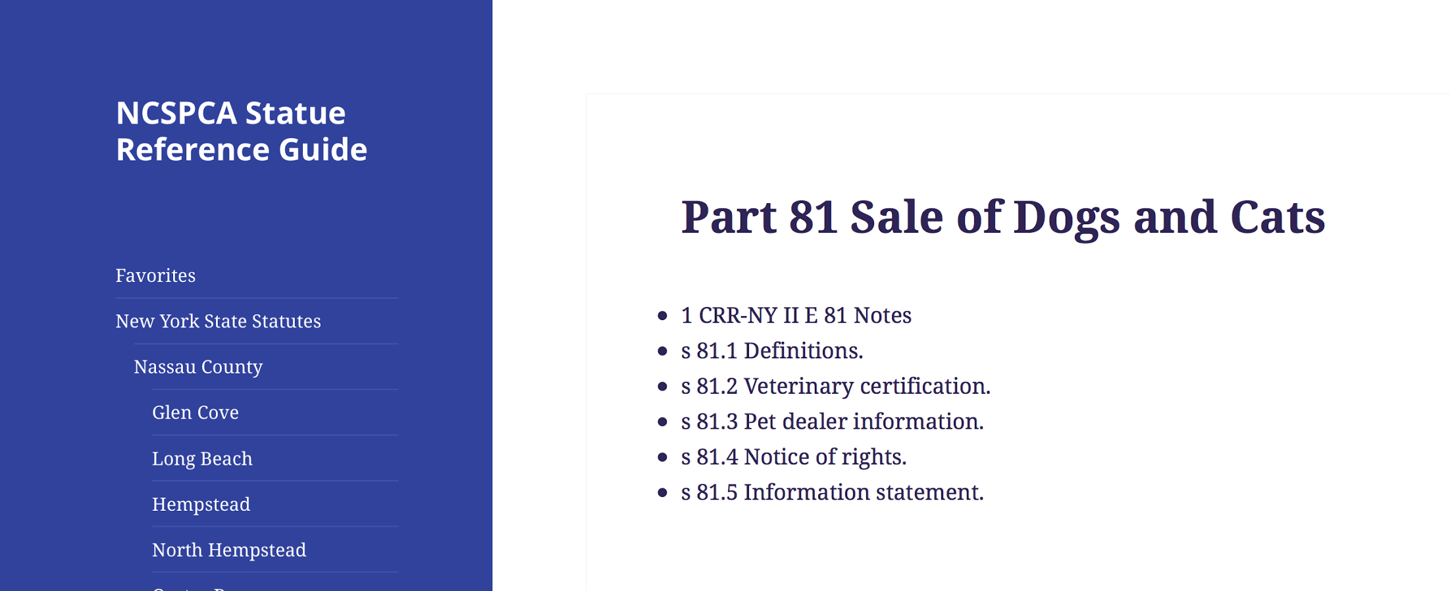
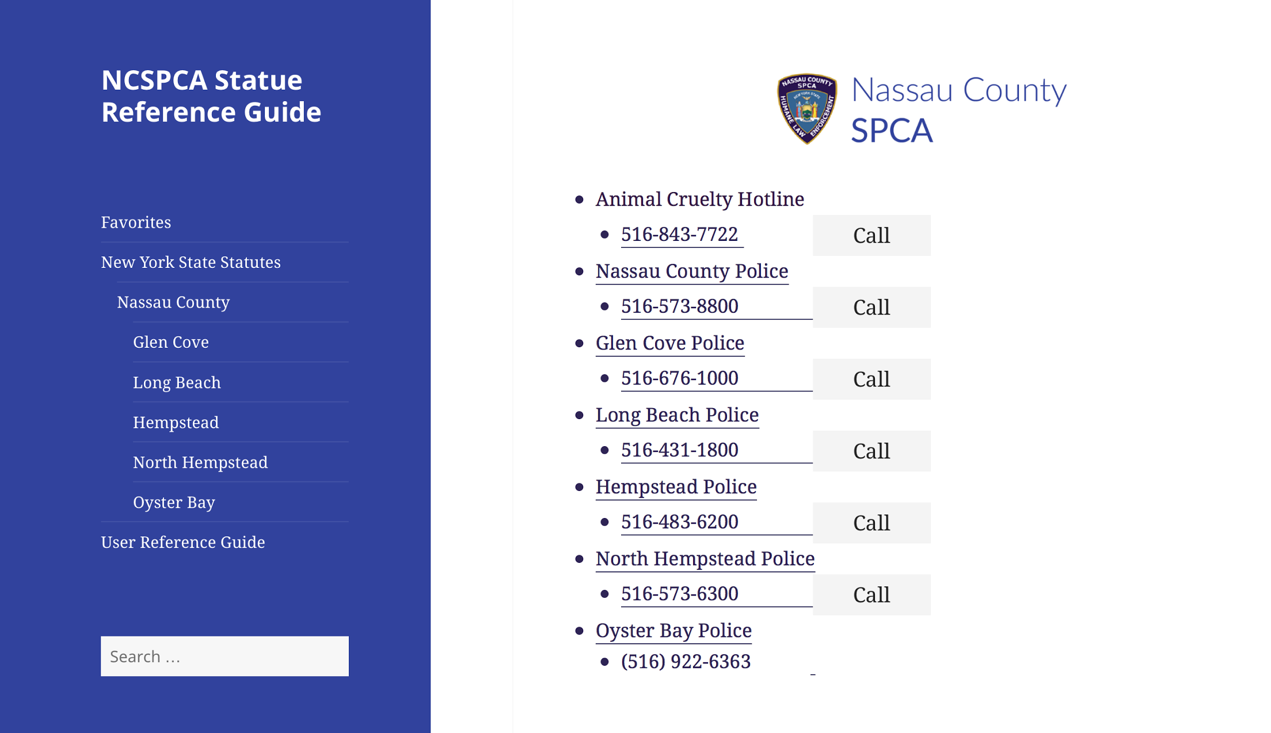
Notes:
Formatting, add another call button, some tweaking.

Slide 10
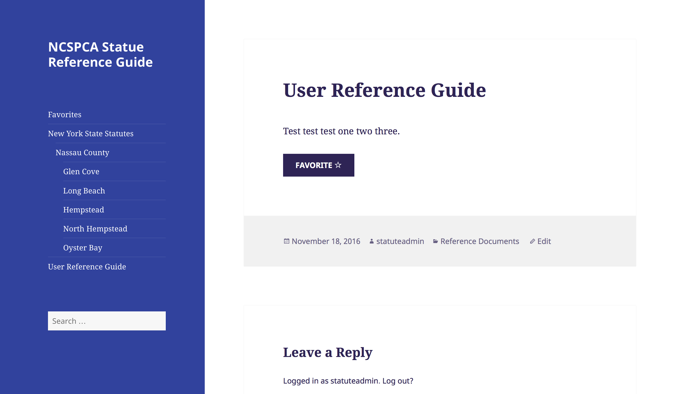
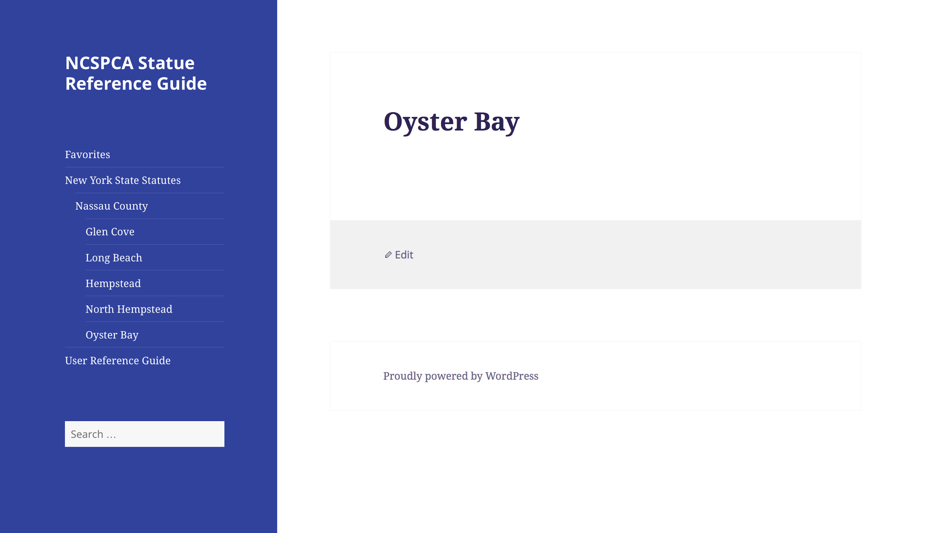
Notes:
Getting it up to full functionality--fixing broken links, populating content, and a comprehensive admin guide for easy hand off.

Slide 11
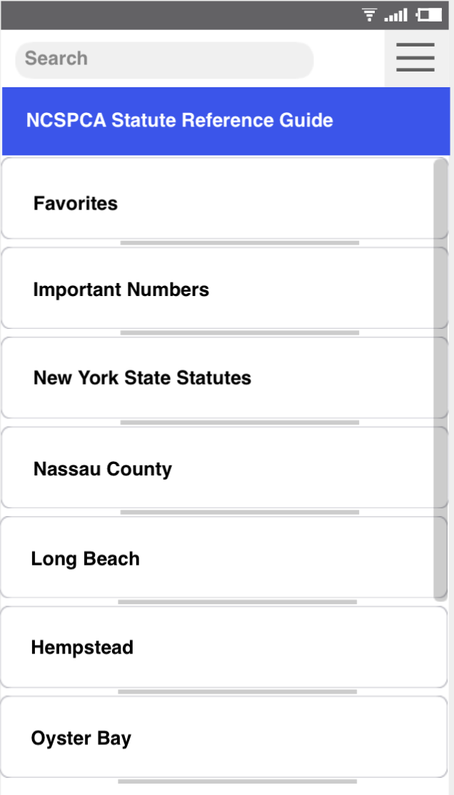
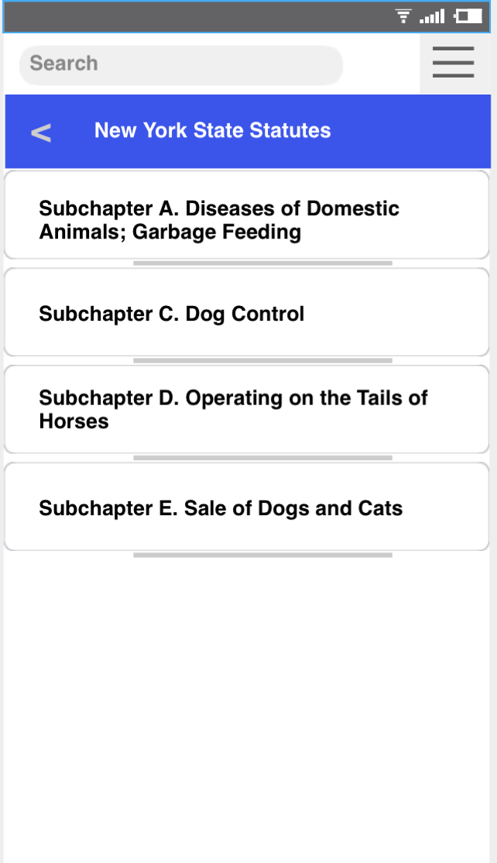
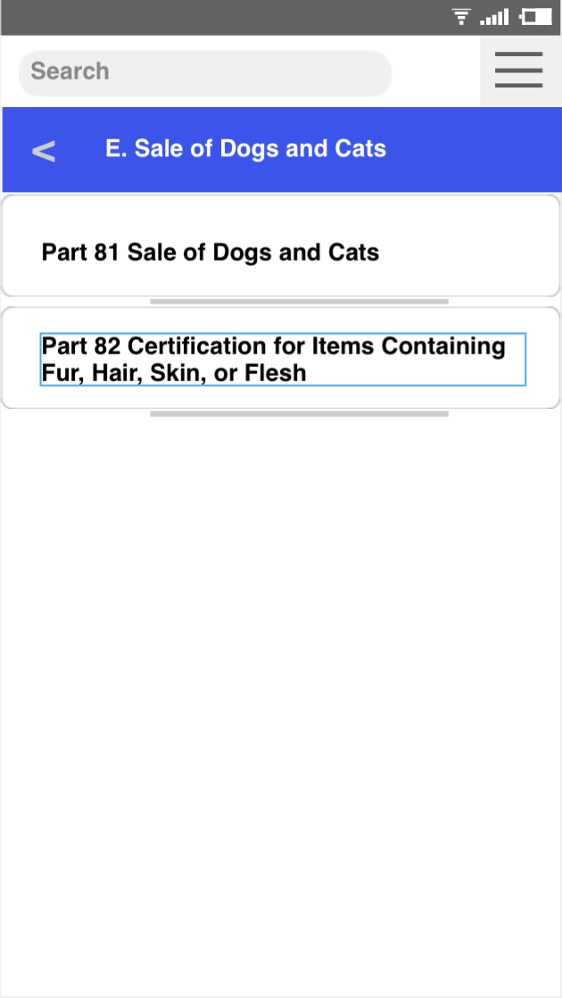
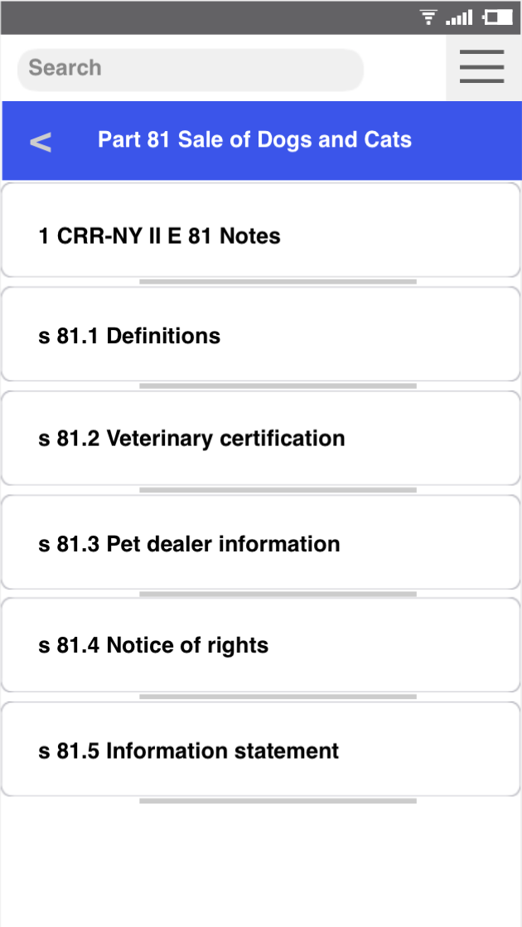
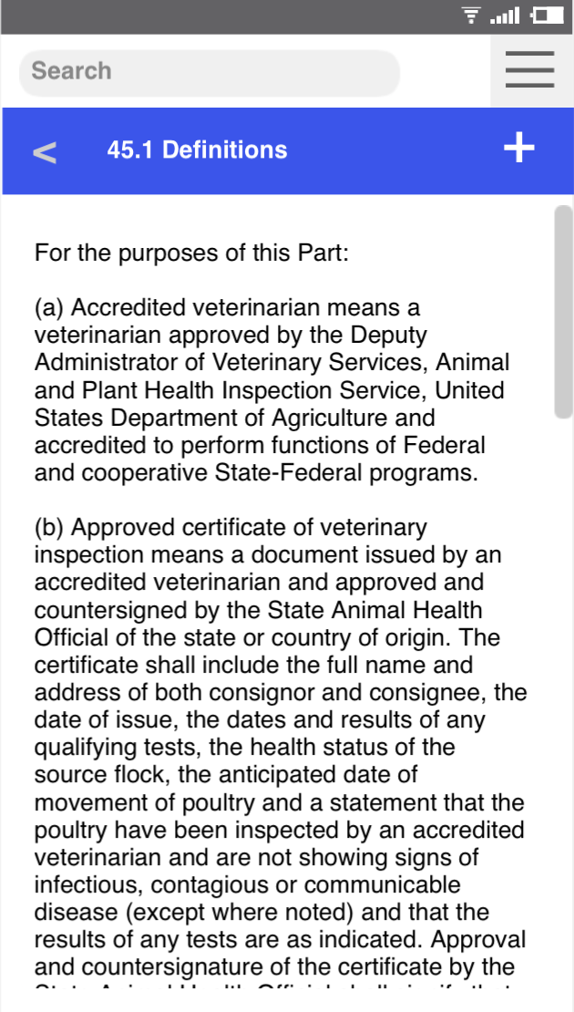
Mobile Wireframe
Notes:
-was difficult to navigate between pages --includes back button and button to add favorites

Slide 12
Automatic Statute Updates
Regular timed notifications for updates
Diff Check
Statute History
Example: http://ecode360.com/11768279

Slide 13
Diff Check
NPM Packages
Pull from online source
Parse and/or send get requests to repositories
Example: https://www.npmjs.com/package/html-to-json

Slide 14
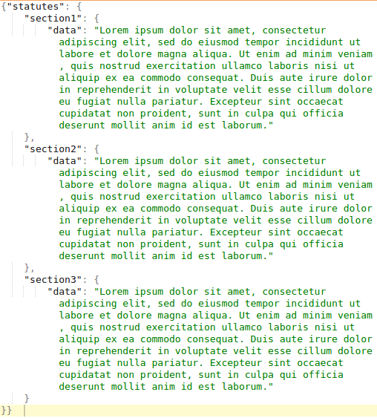
Diff Check Example
Notes:
Current data

Slide 15
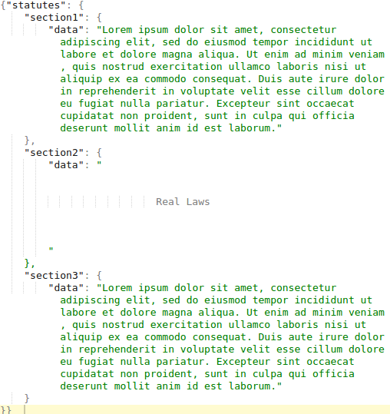
Diff Check Example
Notes:
Text from getmyanimalabusestatutes.com API

Slide 16
Diff Check Example
Notes:
New, updated data

Slide 17
Statute History
Write to timestamped JSON files
Store on server

Slide 18
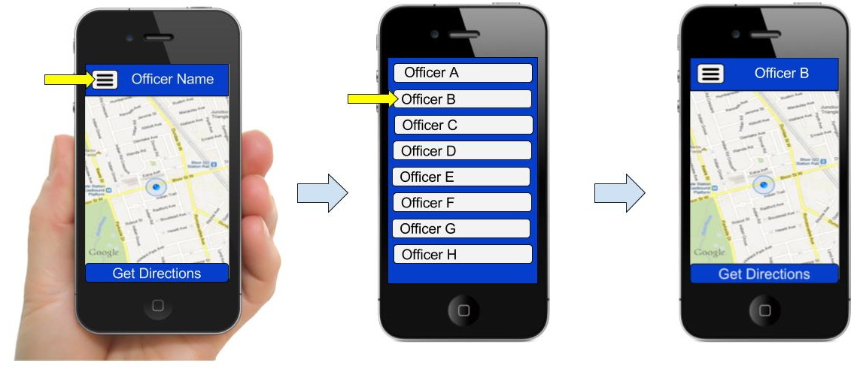
Officer Tracking - Map GUI

Slide 19
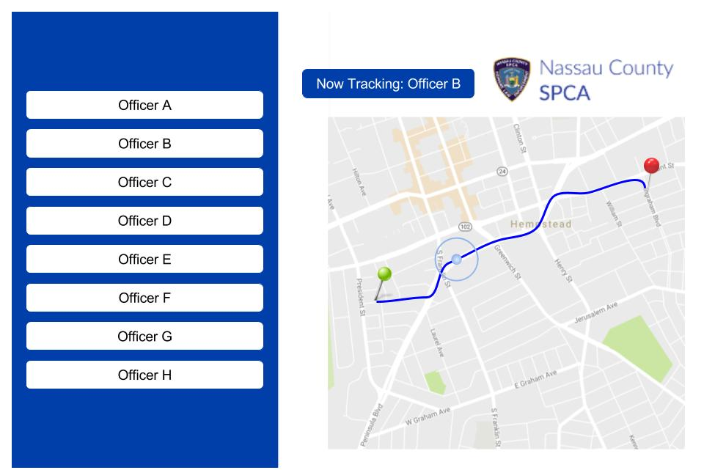
Officer Tracking - Map GUI

Slide 20

Officer Tracking - Codirector Side
Through the application, use GPS location services to track officers’ whereabouts
Send all locations back to co-director of NCSPCA
Allows our client to ensure the safety of officers and check their status

Slide 21
Officer Tracking - Officer Side
Must update application permissions to include access to location service
In Android:
Connect to Google Play Services
Call Locations API for lastKnownLocation
In iOS:
Create a locationManager object
Start a loop that updates user location
Access user location

Slide 22
THANKS!
Any questions?

