Slide 1
Asian games and Olympic games data analysis
CS685 Project Presentation
Group 10
Deepak Raj-21111024 deepakr21@iitk.ac.in
Dinkar Tewari-21111025 dinkart21@iitk.ac.in
Divyansh Bisht-21111027 dbisht21@iitk.ac.in
Rohit Kushwah-21111053 krohit21@iitk.ac.in
Vikas-21111067 vikas21@iitk.ac.in
Indian Institute of Technology Kanpur (IIT Kanpur)
November 20, 2021

Slide 2

Problem Statement
We aim to work on data of Olympic games and Asian games separately first. Then we wish to take their intersection and do a comparative analysis between the two. The format and type of events are almost similar in both the events, Yet, there are differences in medal-winning patterns in both these events for Asian countries. This work showcase extensive analysis on player data, country data, gender data, host country data, year-wise data, medal data, and sports data.

Slide 3

Methodology
First we have collected the entire dataset for Asian and Olympic games from various sources, then built a web scrapper which scrapped raw data into many files, and then after some manual modifications, we compiled them into one large dataset separately for Asian and Olympic games.
We have considered a total of 45 countries that participate in both events.
The years that we have taken into account will be after 1951 only, as Asian games started from 1951. So, Olympics data before 1951 must be discarded from the study as its intersection with the Asian games dataset provides a null set.

Slide 4
we have covered several questions which will be discussed in detail in this report later.
After performing analysis on the dataset, we generate output tables. To make it visually appealing, we have created various visualizations of this data using various graphs and plots
For making it easy to visualize data, we have even created a front-end web app using streamlit that creates an overview of all our analyses.

Slide 5
Dataset
After doing all manual modifications and combining the files, Finally we will have a total of 4 data tables.
Asian and Olympics medal table
This table contains the medal counts(Gold medal, Silver medal, Bronze medal, and Total medal) year-wise for each country.
This table has the following structure
Year | Host_City | Sport | Country | Gold | Silver | Bronze | Total

Slide 6
Asian and Olympic Player medal table
This table contains the complete player information of all the players and also the medal counts, year-wise.
This table has the following structure
Player_name | Gender | Country | Year | Sport | Event | Sport_Type | Gold | Silver | Bronze

Slide 7

Deployment of Code
We have designed a nice front-end to showcase our work, the front is designed using “streamlit” which is a python package.
The website can be accessed using the link: streamlit.io

Slide 8
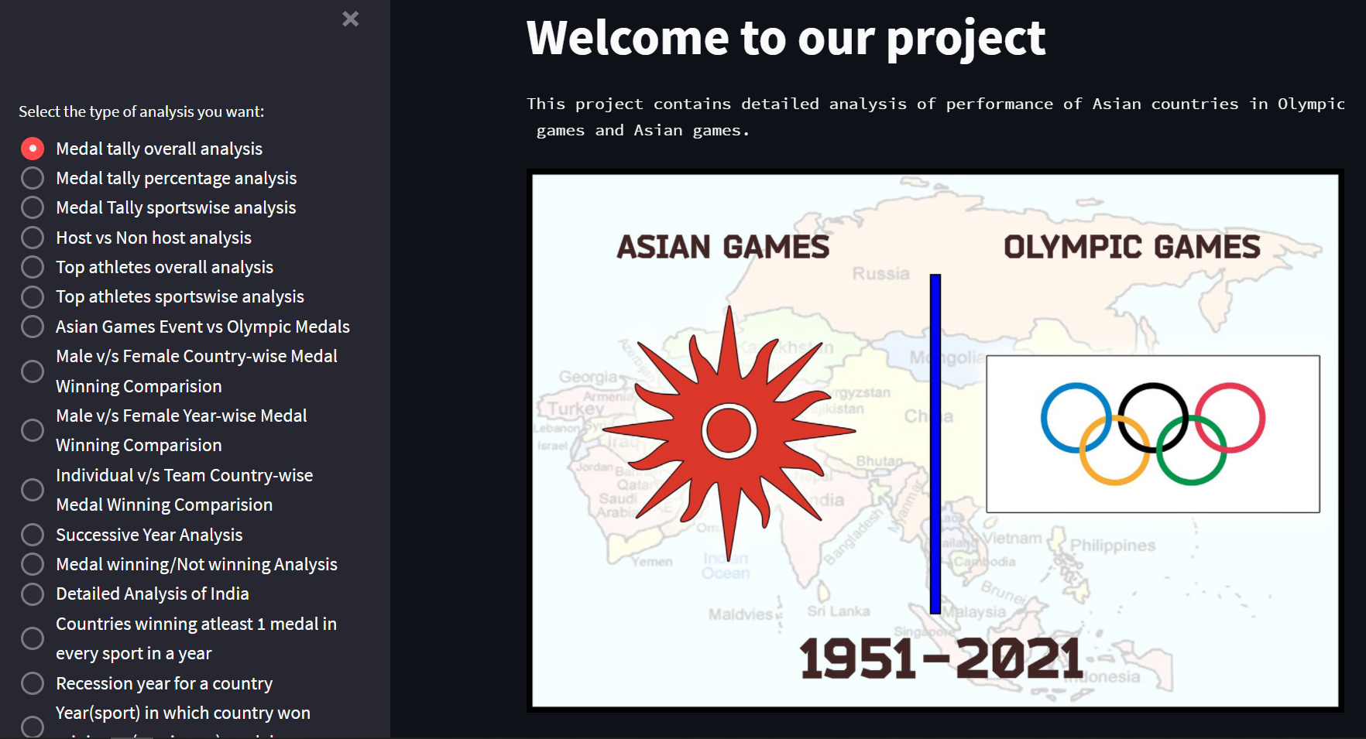
The Home page of our Website

Slide 9
Type of Analysis we have carried out
Medal Tally Overall Analysis
Medal Tally Percentage Analysis
Medal Tally Sports wise Analysis
Host vs Non-Host Analysis
Top Athletes Overall Analysis
Asian Games Event vs Olympics Medals
Gender Wise Analysis
Individual vs Team Sport Analysis
Detailed Analysis Of India
Recession Year Analysis

Slide 10
Results

Slide 11
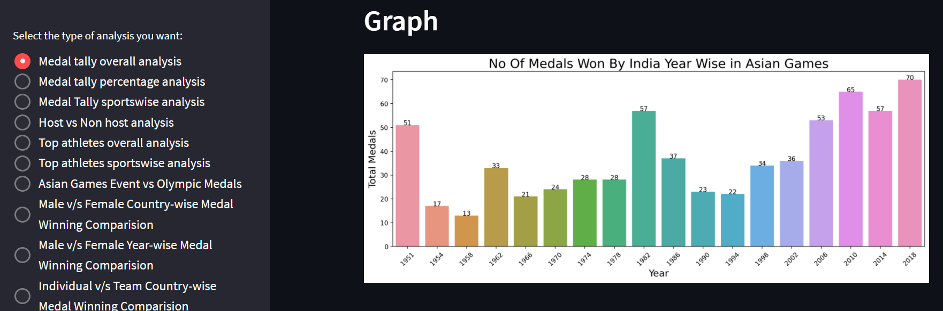
Performance of India in Asian Games :
Interpretation: In Asian Games, India has won 669 medals. The worst years for India were 1954, 1958, 1966, 1990, and 1994. The best years for India were 2010(65 medals) and 2018(70 medals). India has performed well in the last 3 Asian games.

Slide 12
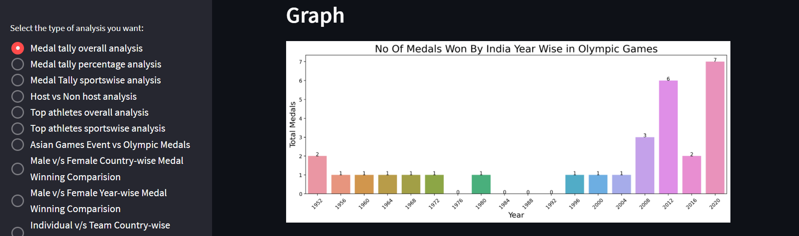
Performance of India in Olympics Games:
Interpretation: In the Olympic Games, India has won 29 medals. The worst years for India were 1976, 1984, 1988, and 1982 in which India did not win even a single medal. The best years for India were 2012(6 medals) and 2020(7 medals).

Slide 13
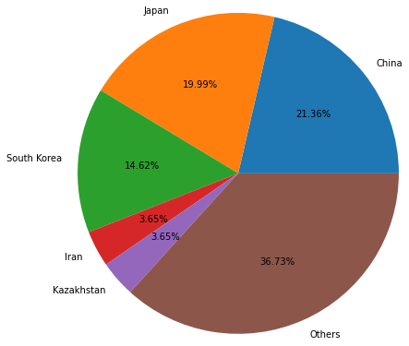
Countries performance in Asian Games:
Interpretation: as we can see India is not among the top medal sharers in Asian games, China with 21.36% medals is dominating.

Slide 14
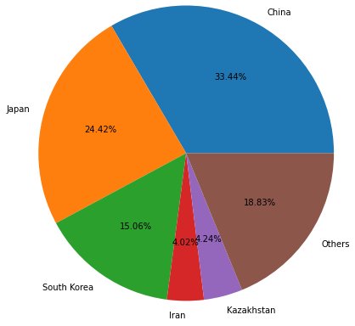
Countries performance in Olympics Games :
Interpretation: Top performer China has 33.44% of total medals won in Olympic won. A total of 72.92% of medals are won by just three countries - China, Japan, and South Korea. This infers that these three countries dominate Olympic Games among Asian countries.

Slide 15
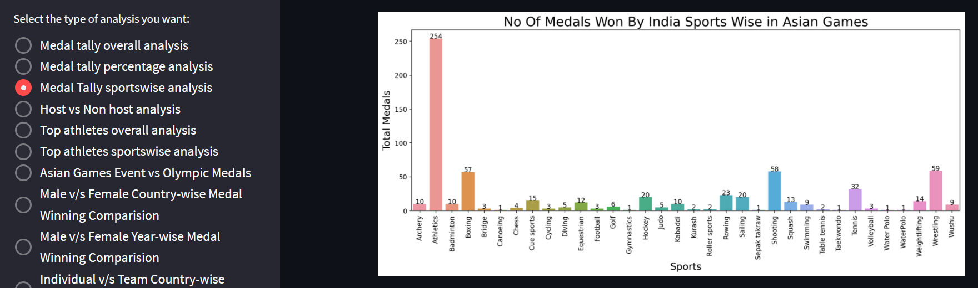
Sport-wise medals of India in Asian Games :
Interpretation:- The top sport for India is Athletics in Asian Games. Out of 669 medals, 254 medals are won by India in athletics alone. The other three best sports of India are Boxing, Shooting, and Wrestling. The sports India is very bad at are Canoeing, Gymnastics, Sepak takraw, Taekwondo, and Water polo.

Slide 16
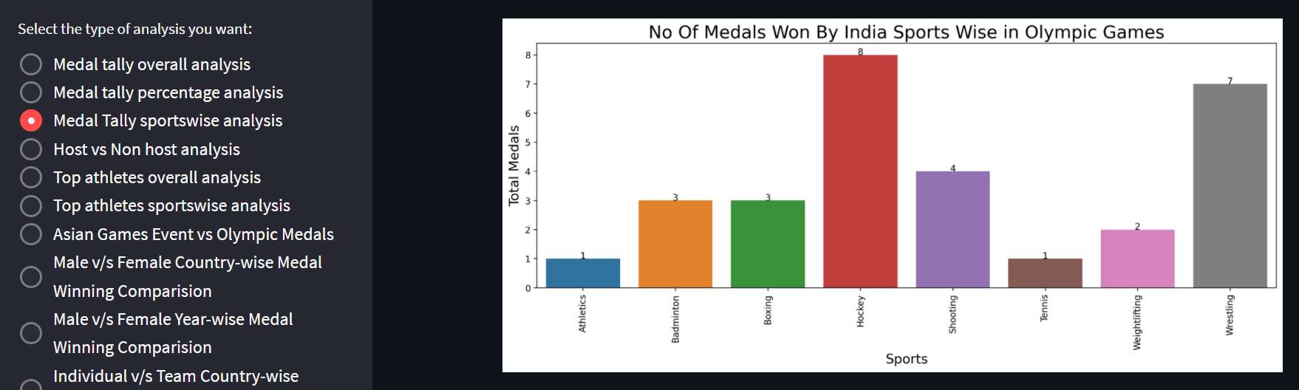
Sport-wise medals of India in Olympics Games :
Interpretation:- India has won medals in only eight sports in Olympics. The top sports for India are Hockey(7 medals), Shooting(4 medals), and Wrestling(7 medals). Project report 6 Although the best sport for India in Asian Games is athletics, India has performed very poorly in the same sport in Olympics.

Slide 17
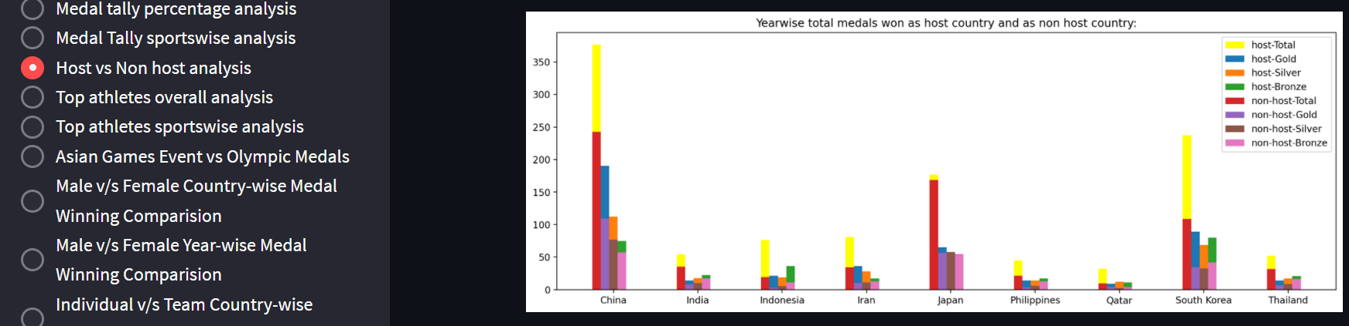
Medals Won as Host and Non Host Country in Asian Games :
Interpretation :- The total number of medals won by China, Indonesia, and South Korea is almost doubled when these countries played on home ground. From the above graph, we can infer that the number of total medals and gold medals are highly affected by playing as the host nation. Silver and Bronze are little affected but still, they are slightly more than medals when won as a non-host country. For Japan only, the performance as host nation and away nation is almost the same.

Slide 18
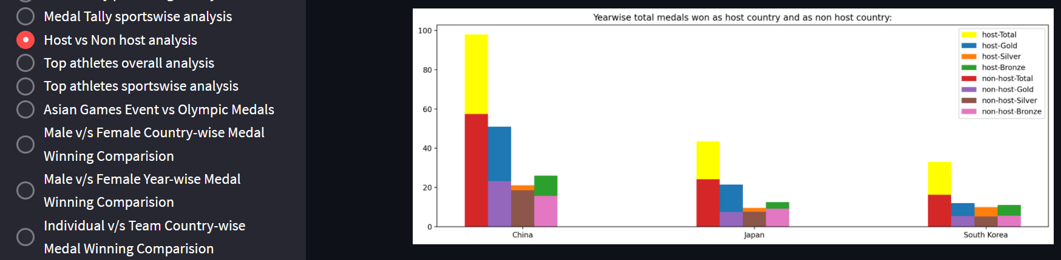
Medals Won as Host and Non Host Country in Olympic Games :
Interpretation :- we can infer from the graph that the number of total medals and gold medals are highly affected by playing as the host nation. Silver and Bronze are little affected but, they are still more than medals won as a non-host country.

Slide 19
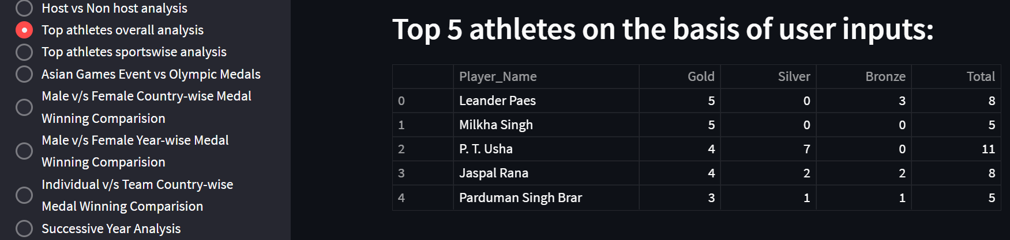
Top athletes for India in Asian Games :
Interpretation : Leander Paes is the most successful player for India in Asian games who plays tennis. He has won 5 gold medals and 3 bronze medals for India.
P.T. Usha holds the record of winning the maximum medals(11 medals) for India in the Asian Games.

Slide 20
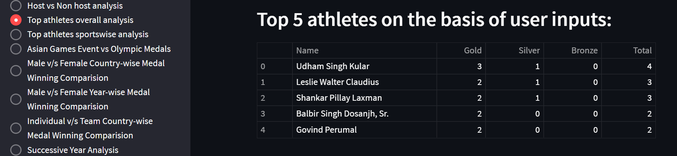
Top athletes for India in Olympics Games :
Interpretation : Udham Singh Kular was an Indian Hockey Player from Punjab. He shares the distinction of being the only Indian player to win four Olympic medals.

Slide 21
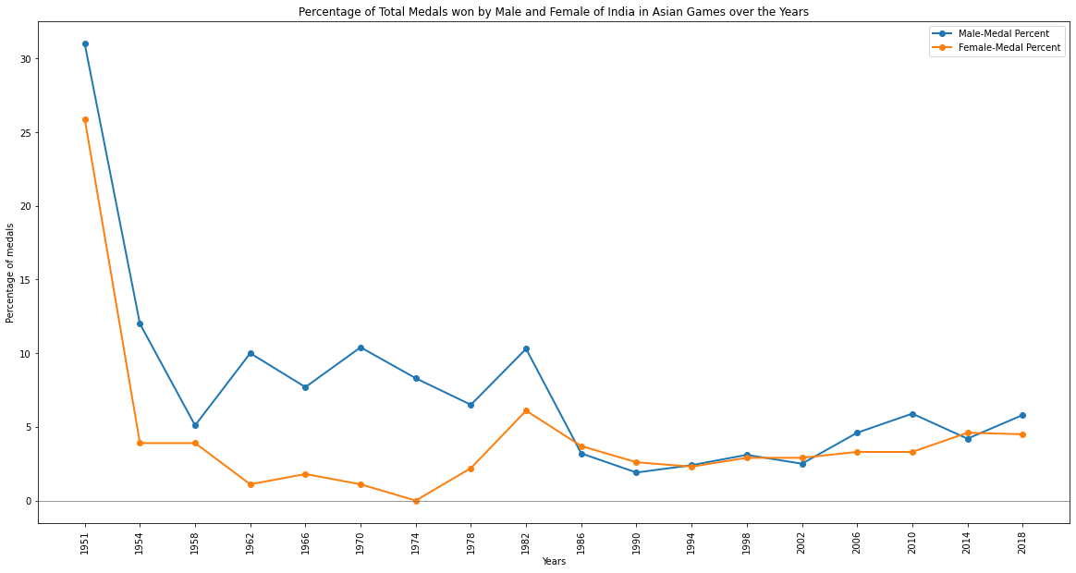
Male and Female athletes of India in Asian Games:
Interpretation : From 1951 to 1986, female athletes have won fewer medals than male athletes. But from 1990 onwards, female athletes have performed really well and even outperformed male athletes in some years like 1990, 2002.

Slide 22
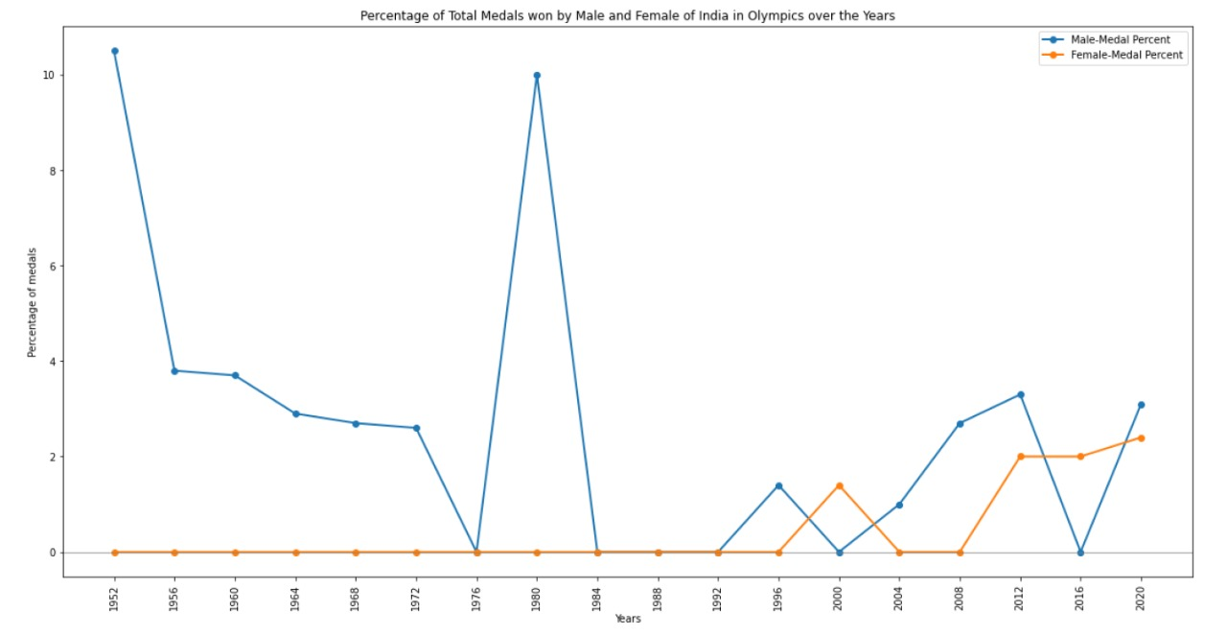
Male and Female athletes of India in Olympics Games:
Interpretation :- No female athlete has won any medal till 1996. The performance of female athletes has improved from the year 2000 in both the Asian and Olympics Games.

Slide 23
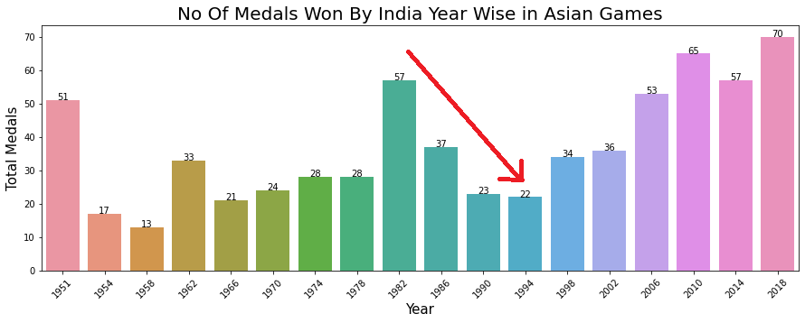
Recession period in Asian Games :
Interpretation: The recession period of India in Asian games is 1982 to 1994, India won 52 medals in 1982, 37 medals in 1986, 23 medals in 1990, and 22 medals in 1994.

Slide 24
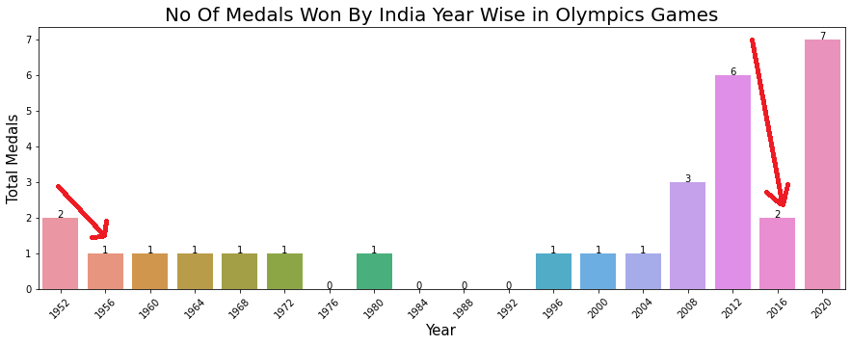
Recession period in Olympics games:
Interpretation: The recession period of India in the Olympics Games is from 1952 to 1956, India won 2 medals in 1952 and 1 medal in 1956.

Slide 25
Conclusion
Now we can conclude our Analysis with some interesting notes which we come across:
Top countries of Asian Games, like China, Japan, South Korea, are also top Asian countries in Olympics, that too in the same order.
Increasing the number of events in the Asian Games increases the chances of Asian countries’ medal-winning chances.
Countries where females performed better than males in Asian games, also performed better in Olympics. Same for males.
When a team starts performing poorly in Asian Games(Recession), their performance drops in Olympics as well. Same when a country's performance increases(Booming years), those years they do good in Olympics too. The period of recession and booming years is almost the same for both the Asian and Olympic Games.

Slide 26
The chances of winning a medal for a player in the Olympics increase when he starts winning medals in the Asian Games. E.g., Neeraj Chopra, Bajrang Punia are Indian athletes who first won medals in Asian games, then in Olympics. There are many such players. The Asian games winning players are more valuable for any country
Sports, where a country is good at Olympics, is also very good as Asian Games. But, some countries are good at some sports in Asian games but that doesn't make them good at the Olympics. E.g., India is good at Athletics in Asian games, but their performance at athletics in the Olympics is not so good.
These all facts indicate that Asian Games performance directly influences Olympic Games performance for any country. So, a country must give their best in Asian Games, to increase their chances of winning in the Olympics as well. Winning in the Olympics is the ultimate aim for any country, but Asian countries have the advantage to first do their best in Asian games, which will prepare them for the Olympics

Slide 27
Future Work
We plan to include player details like height, weight, and age so that we can incorporate these features to see their impact on the player’s performance.
We will even perform some predictive analytics that can predict the number of medals that a country might win based on its past performance in the Asian Games and Olympic Games.
We wish to expand this analysis even further on Winter Olympics and Winter Asian games
With all these improvements planned, we wish to sincerely look forward to improving this work to its full extent.

Slide 28
Thank You !!

