Slide 1

Cross Lingual IR for Chanakya Neeti
Deepak Raj(21111024)
Dinkar Tewari (21111025)
Vikas (21111067)
Divyansh Bisht(21111027)
Rohit Kushwah(21111053)

Slide 2
Problem Statement
The information or database need not necessarily be in one language. In other words, language should not limit the finding of information.
Chanakya Neeti is a very philosophical book that contains answers to almost all life problems.
The shlokas are present in different Indian languages with a slight difference in the meaning.
There are a lot of shlokas and which are really tough to understand.
Mechanism is required such that a user can search his query in his own mother tongue language and still get relevant shlokas and their meanings.

Slide 3

Idea
Main Goal: to develop a cross lingual search engine for Chanakya Neeti.
We propose a cross lingual search engine where user can search and retrieve results in his/her desired language.
The basics models implemented for scoring the documents are TF-IDF, BM25 and improved BM25.
All the models listed above are implemented from scratch.
Query expansion technique is applied by adding synonym terms to query words using ‘pyiwn’ package.
We convert query to Hindi language(intermediary lang), search it in Hindi corpora and then use the mapping between corpora to return outputs in desired language.

Slide 4
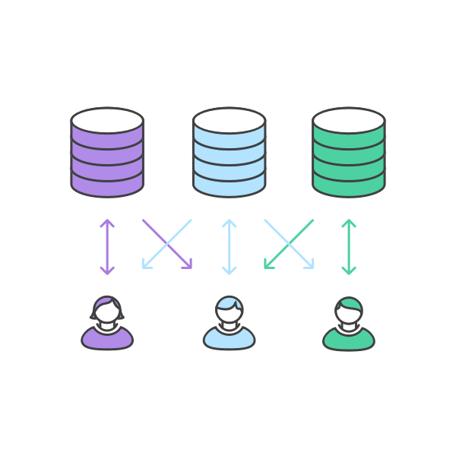
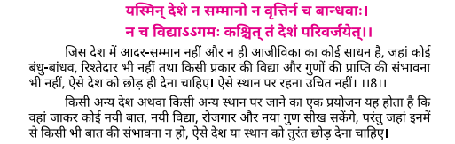
Data Structure
Each document in our corpus has three main features: shlokas, their actual meaning and their interpretation according to the author.
The format of the dataset in the corpora is shown in the figure below:

Slide 5
Methodology
Let’s discuss a detailed approach of our method.

Slide 6
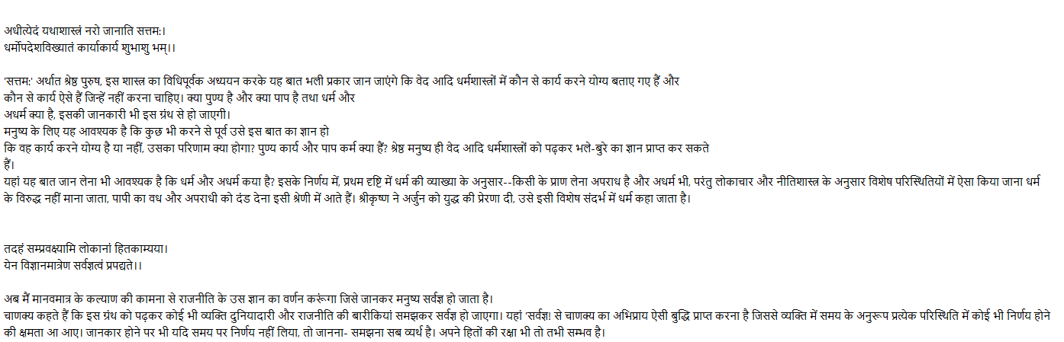

Data preparation
There is a single line gap between the shlokas and their meanings.
After shloka's meaning and before next shloka, there must be a gap of two lines.
Between shloka's actual meaning and their interpretation according to the author, there must be no line gap.
The interpretation will start from the immediate next line of shloka's meaning.

Slide 7
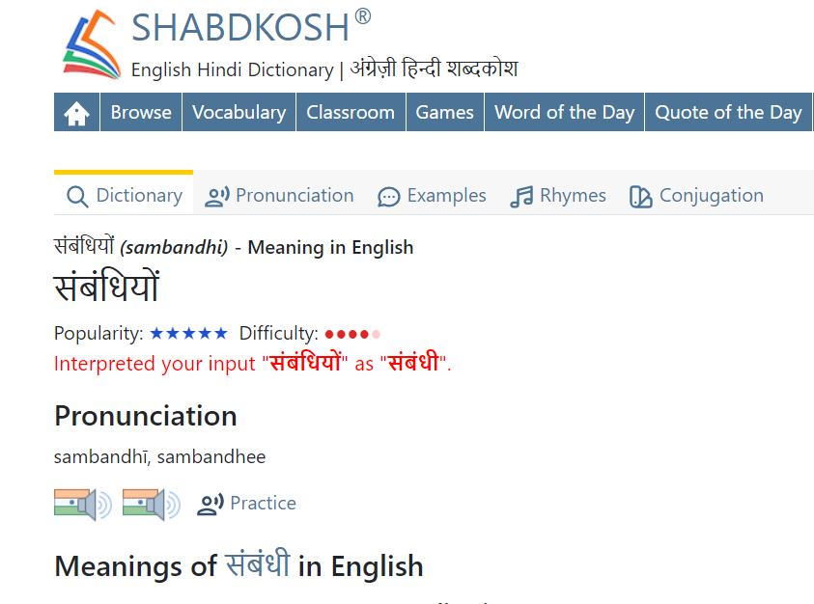
Data preprocessing
We performed various preprocessing steps such as tokenization, lemmatization, stop words removal and non-ASCII characters removal.
We scraped lemmatized word from website shabdkosh.com using libraries like request, beautifulsoup, selenium, etc.

Slide 8
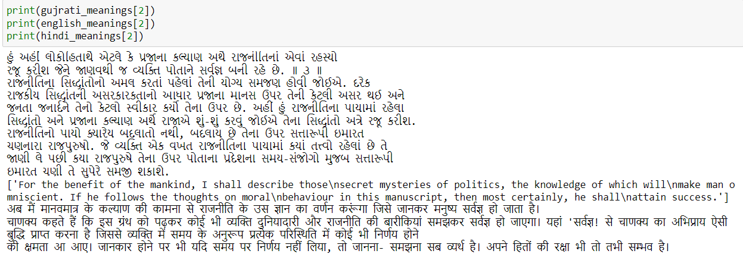
Corpora mapping for cross-lingual dynamics
Mapping between English, Hindi and Gujrati corpora is done manually.
All shlokas in all language are made to occur at the same indices.

Slide 9
Query Expansion
Query expansion was done in a way to generate synonyms and semantically similar words to the given query.
Web scraping was performed from the website mentioned previously to generate these words for hindi language.
If user input is English or Gujarati, then the query is first translated to Hindi.
Then the query expansion task is performed.
Then we will pass this expanded query to the scoring information retrieval models.

Slide 10
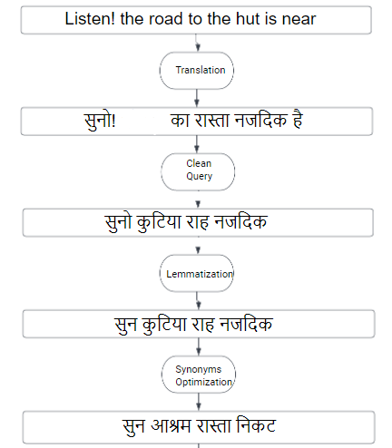
Query
Expansion
(cont’d)

Slide 11
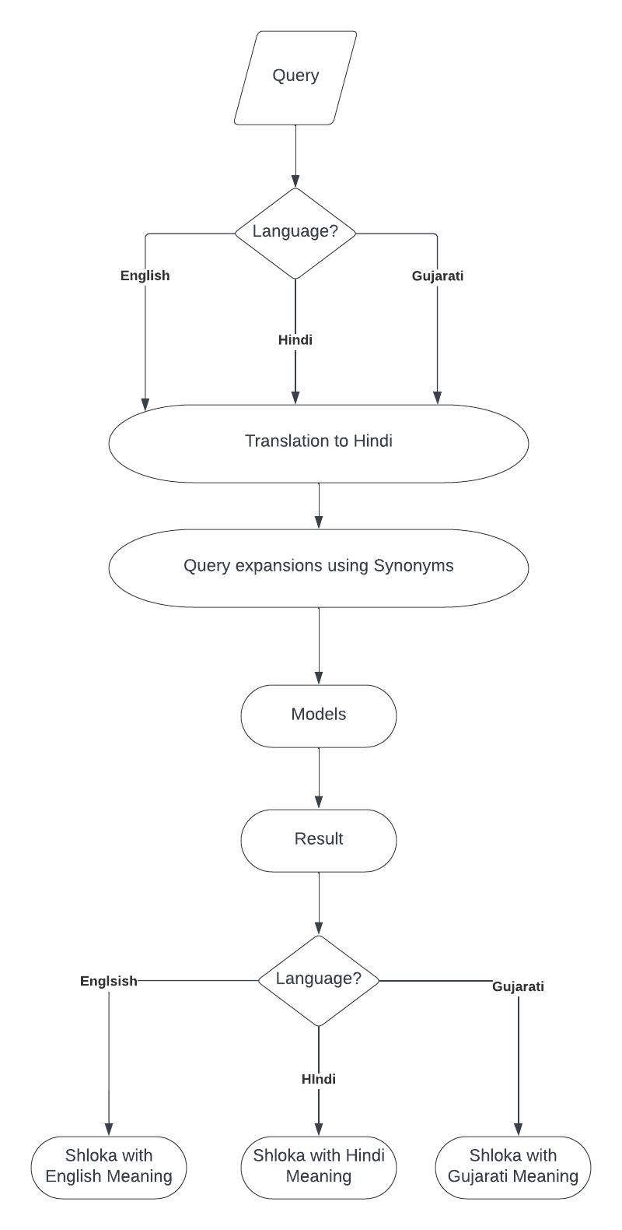
Flow Chart

Slide 12
Scoring Models used
We used TF-IDF and BM25 for our corpora as scoring models.
Both these models were implemented from scratch without the use of libraries.
On the basis of the scoring, the search engine will reciprocate top 5 documents according to its mathematical formulation.
The shloka and its meaning will be retrieved according to the user’s query in his/her desired language.
TF-IDF
BM25

Slide 13
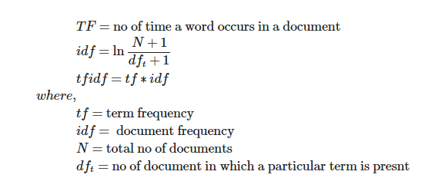
Scoring Models used(TF-IDF)
The formula used is as follows:

Slide 14
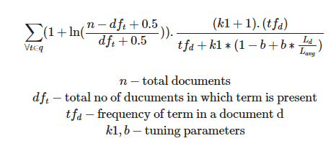
Scoring Models used(BM25)
The formula used is as follows:

Slide 15
USER INTERFACE
Let’s see the designed user interface for our given search engine.

Slide 16
FRONTEND (details)
The frontend web app was developed using streamlit to sum up the entire work.
The User Interface is very user friendly with plenty of features.
The user can choose the language in which he/she wishes to type the query.
The user can also choose the language in which he wishes to see the retrieved documents.
The link to the frontend web app is provided below:
https://share.streamlit.io/divyansh009/ir/main/main.py

Slide 17
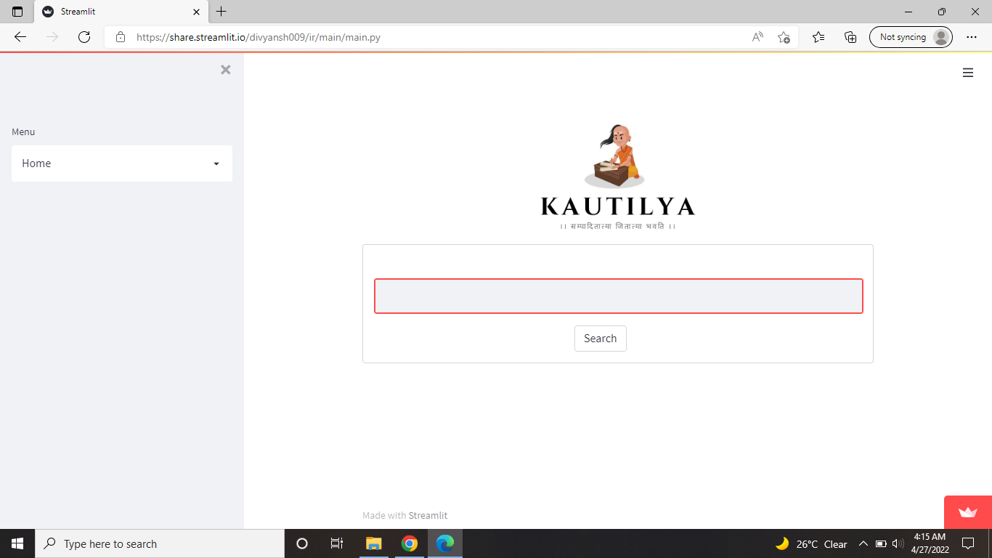
FRONTEND (design)
A glimpse of our front end web app is shown below:

Slide 18
Results
Let’s discuss the obtained results from the proposed method.

Slide 19
Experimental Results
We have evaluated each language query individually. We are testing our model on total of 10 queries in each language. For english queries, we are getting an accuracy of 40%, For Hindi queries, we are getting 95% accuracy, For Gujrati Queries, we are getting a total of 50% accuracy. So the average accuracy of our improved BM25 model is 61.66%.

Slide 20
Conclusion

Slide 21
Conclusion
The given project generates an effective cross-lingual search engine for Chanakya neeti in English, Hindi and Gujarati languages.
The TF-IDF and BM25 models perform very well in the retrieval task.
A frontend web app is successfully created as an end result of this project that is very user friendly.
The user can search the query in his desired language and also retrieve the documents in his desired language, even though the retrieved documents are originally of some other language.
The query expansion technique using synonyms and semantically similar words proves to be very effective in efficient searching of the documents.

Slide 22

Thank You.
Any questions?

