Slide 1
MAP REDUCER
1
BDA UNIT- I

Slide 2
WHAT IS MAP REDUCE
Map Reduce is a Programming Framework for data processing. It is also called the execution engine of Hadoop
Map Reduce accomplishes parallel processing by sending the processing logic to the storage. MapReduce task works in two phases by splitting the whole data into chunks
Map phase
Processes the data chunks in parallel Reduce phase
The data processed by all the Mappers are aggregated

Slide 3
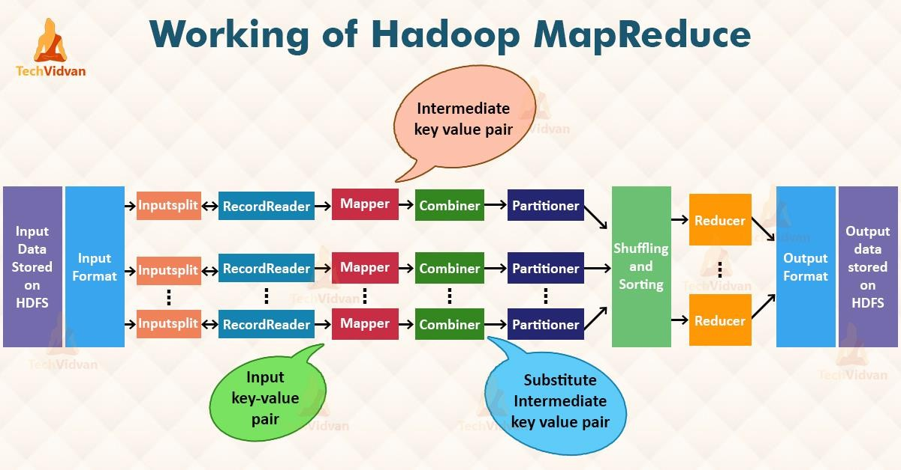

Slide 4
1. Input Files
The data that is to be processed by the MapReduce task is stored in input files.These input files are stored in the Hadoop Distributed File System.The file format is arbitrary, while the line-based log files and the binary format can also be used.
Input Format
It specifies the format for Map reduce input. It validates the Map reduce job input specification and splits the input data.
Input Split
It represents the data for processing by the individual mappers. It presents the byte-oriented view of the input.
Record Reader
It is responsible for converting the byte-oriented view of the input split into recored oriented view. It processes the record boundaries and present the mapper with <key, value> pairs
Mapper
It receives the input split in <key, value> form from Record Reader, processes them and generates a new form of
<kay,value> pairs which are different from the input <kay,value> pairs.These are called intermediate output.

Slide 5
Combiner
It is also called 'Mini-Reducer' since it performs local aggregation upon the Mapper's output.
It minimizes the data transfer between the Mapper and Reducer.
Partitioner
Partitioner exists only when we have multiple reducers.The partitions the key space of Mapper/Combiner output into several partitions.These no: of partitions would be equal to the no: of reducers.
Shuffling and Sorting
The intermediate outputs received from all the mapper/partitioner are shuffled and then sorted.
Reducer
The Reducer's input is always a sorted list of <key, value> pairs.The Reducer reduces/aggregates all the values sharing the same key into a smaller set of values.This output of the Reducer is the original output of the Map reduce process which would be stored in HDFS
Record Writer
It writes the output of the Mapreduce job (which is a list of <key, value> pairs into a file that can be stored in to a FileSystem.
Outputformat
It specifies the format into which the Mapreducer's output has be written into.

Slide 6
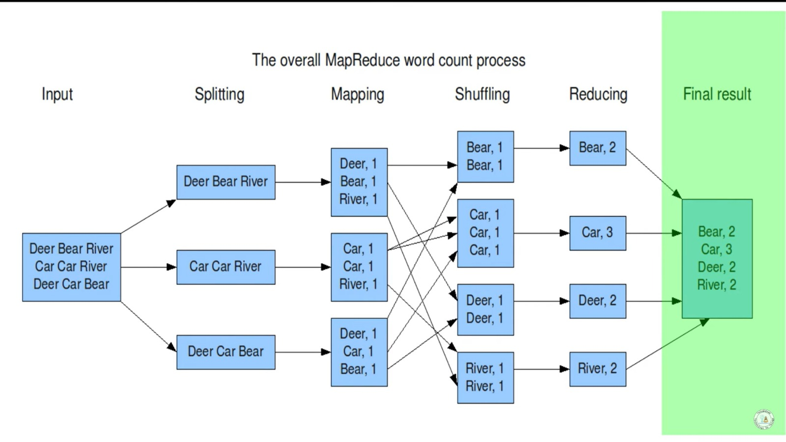

Slide 7
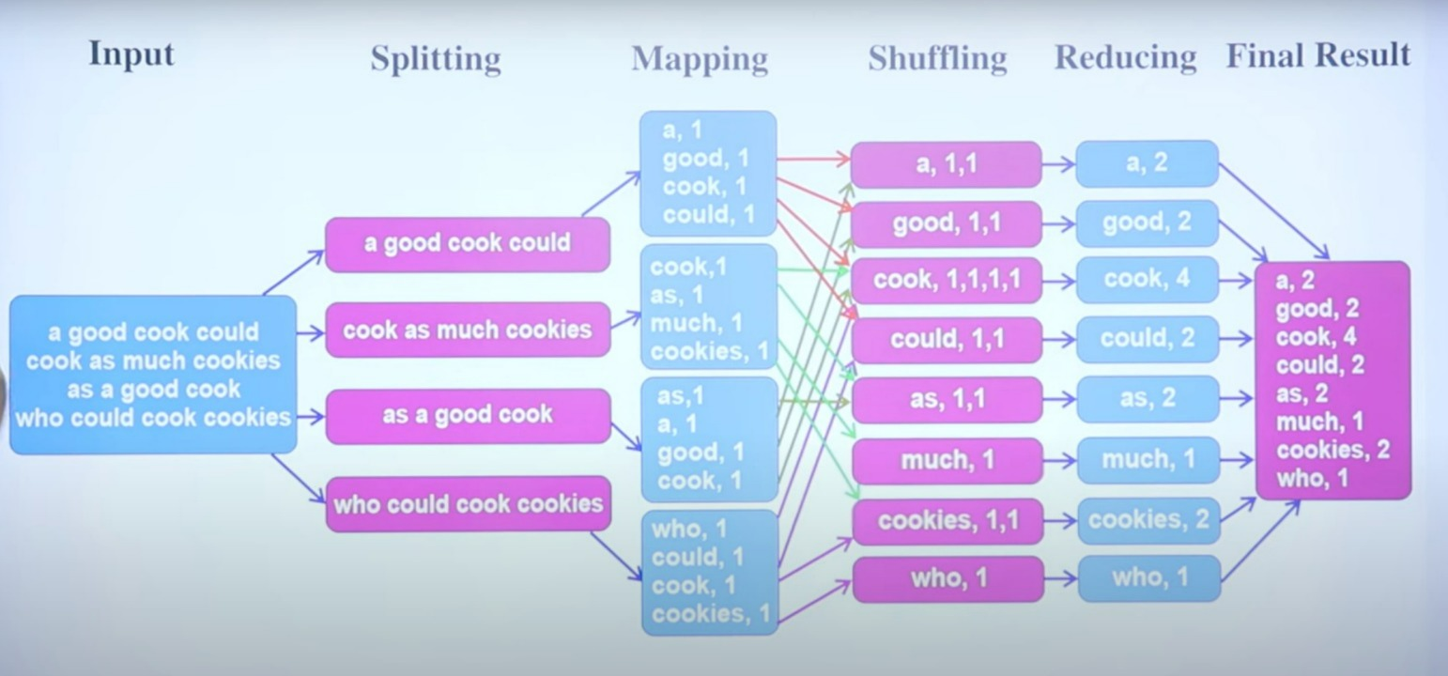

Slide 8
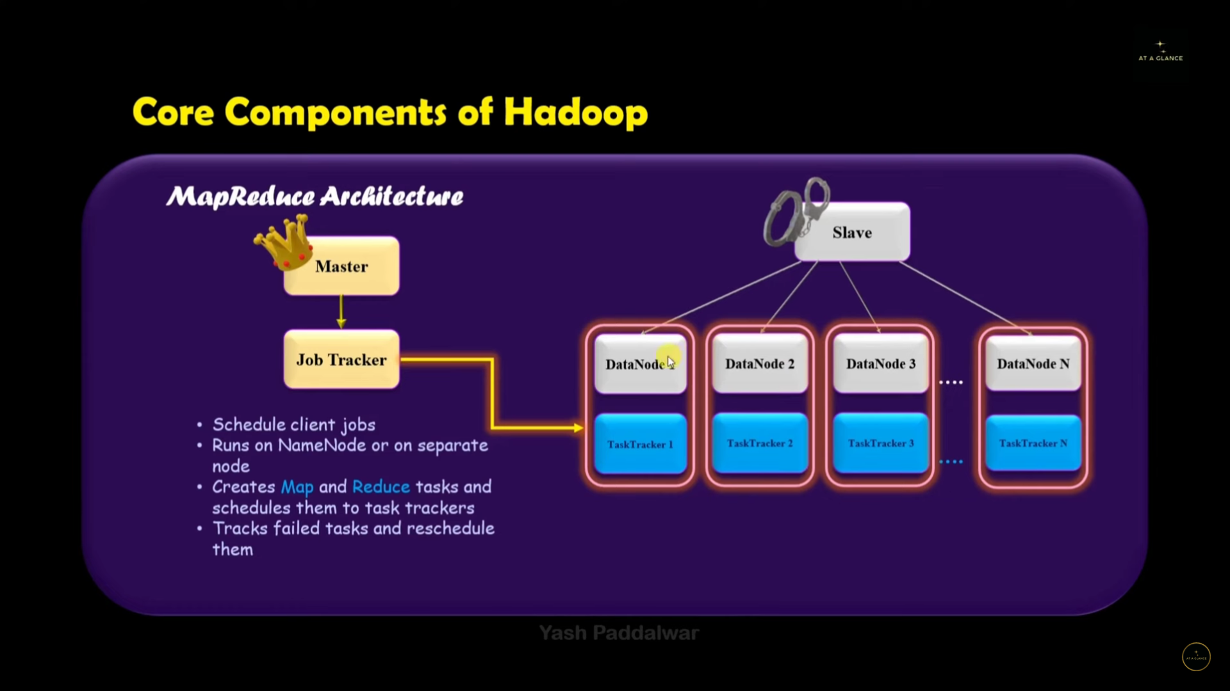

Slide 9

Weather Dataset from NCDC (National Climatic Data
Center )
Weather sensors collect data every hour at many locations across the globe and gather a large volume of log data, which is a good candidate for analysis with
MAPREDUCE
-
WEATHER D ATASET EXAMPLE
MapReduce because we want to process all the data, and the data is semi-structured and record-oriented.
The data is stored using a line-oriented ASCII format, in
which each line is a record.
There are tens of thousands of weather stations, so the whole dataset is made up of a large number of
relatively small files. It’s generally easier and more efficient to process a smaller number of relatively large files, so the data was preprocessed so that each year’s readings were concatenated into a single file.

Slide 10


MAPREDUCE
Datafiles are organized by date and weather station.There is a directory for each year from 1901 to 2001, each containing a gzipped file for each weather station with its readings for that year. For example, here are the first entries for 1990:
-
% ls raw/1990 | head
010010-99999-1990.gz
010014-99999-1990.gz
010015-99999-1990.gz
010016-99999-1990.gz
010017-99999-1990.gz
010030-99999-1990.gz
010040-99999-1990.gz
010080-99999-1990.gz
010100-99999-1990.gz
010150-99999-1990.gz
WEATHER D ATASET EXAMPLE

Slide 11
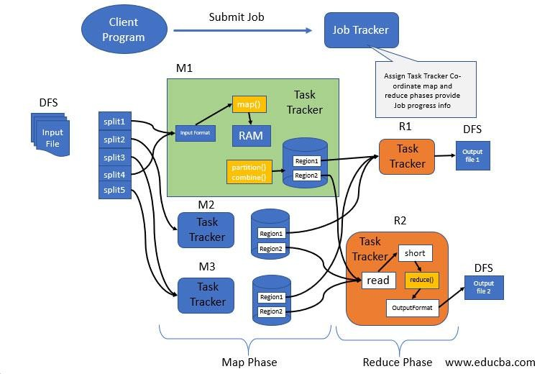
Map Reduce Architecture
Entities of MapReduce Architecture
Client :
The client submits the Map reduce job to the Job Tracker present in the Master of a Hadoop cluster
Job Tracker: The job tracker is a Java application whose
main class is JobTracker .The work of Job tracker is
Managing all the resources and all the jobs across the cluster
Schedule each map on the Task Tracker running on the same data node since there can be hundreds of data nodes available in the cluster.
Monitoring the progress of Task tracker
Task Tracker:
Tasktrackers run a simple loop that periodically sends heartbeat method calls to the jobtracker. Heartbeats tell the jobtracker that a tasktracker is alive, . As a part of the heartbeat, a tasktracker will indicate whether it is ready to run a new task, and if it is, the jobtracker will allocate it a task.
Hadoop Distributed File System (HDFS)
used for sharing job files between the other entities

Slide 12


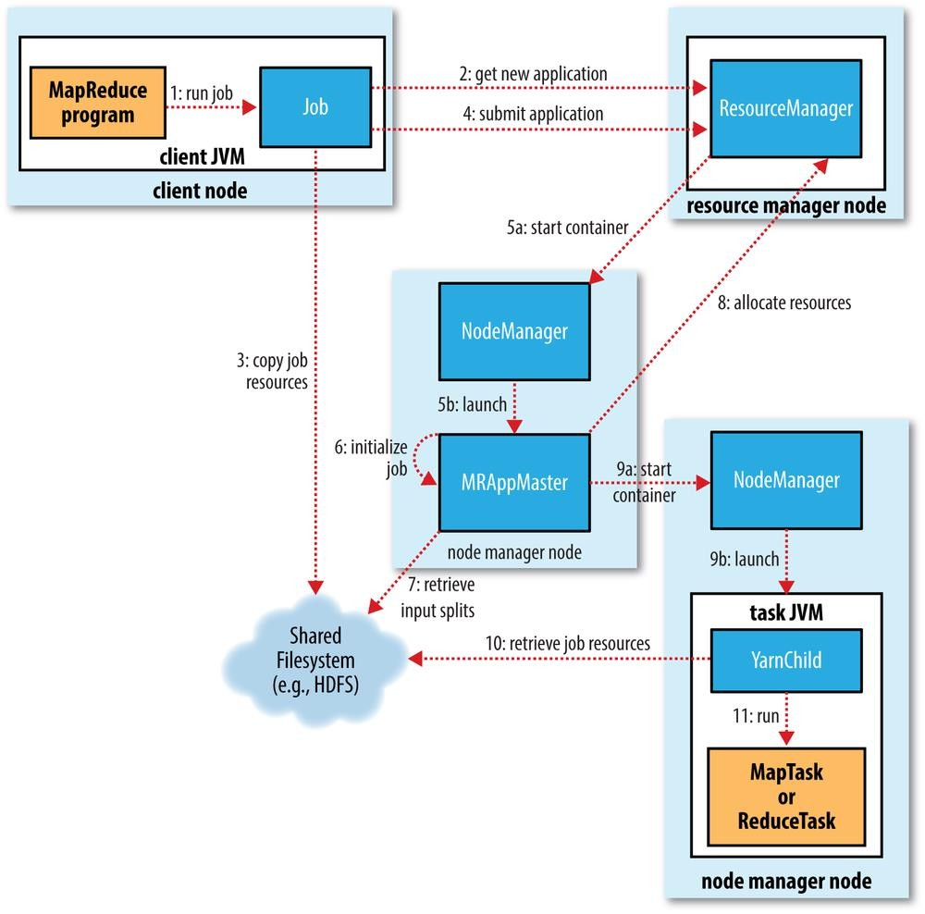
Anatomy of Map Reduce Job
Job Submission
Step1 : The runJob() method on JobClient creates a new JobClient instance and calls submitJob() on it
The job submission process implemented by JobClient’s submitJob() method does the following:
Step 2: a) Asks the jobtracker for a new job ID (by calling
getNewJobId() on JobTracker).
Checks the output specification of the job.
Throughs error to the MapReduce program if the directory does not exist or not specified
Computes the input splits for the job.
Throughs error to the MapReduce program if the file does not exist and
the split operation fails
Step 3:
Copies the resources needed to run the job, including the job JAR file, the configuration file, and the computed input splits, to the jobtracker’s filesystem in a directory named after the job ID.
Step 4:
Tells the jobtracker that the job is ready for execution (by calling submitJob() on JobTracker)

Slide 13
Anatomy of Map Reduce Job
Job Initialization
When the JobTracker receives a call to its submitJob() method, it puts it into an internal queue from where the job scheduler will pick it up and initialize it
Step5 : An object representing the current job to be run is created by encapsulating the tasks and their bookkeeping information for tracking their status and progress
Step 6: Input splits are retrieved from the shared file system. One map task will be created for each split and the no: of reducer tasks will be determined by the mapred.reduce.tasks property in the JobConf, which is set by the setNumReduce Tasks() method
Tasks are assigned with ids
c) Computes the input splits for the job.
Throughs error to the MapReduce program if the file does not exist and the split operation fails

Slide 14
Anatomy of Map Reduce Job
Task Assignment
When the TaskTracker informs the JobTracker that it is ready to receive the task by sending its heart beat, the JobTracker assigns it with a task if it
is intended for it (if there is a task scheduled to be run on the data residing in
the same data node where this Task tracker is residing)
Step7 : Task Tracker communicates to the Job Tracker using the heartbeat return value
Job Tracker executes the scheduling algorithm to know which job to assign to the Task Tracker.The default choice is the one with highest priority
Task Tracker can execute two map tasks and two reduce tasks simultaneously
The default scheduler fills empty map task slots before reduce task slots, so if the tasktracker has at least one empty map task slot, the jobtracker will select a map task; otherwise, it will select a reduce task.
For assigning the reduce task, no locality considerations are followed by the Job Tracker whereas for a map task the nearest Task Tracker is preferred. In the optimal case, the task is data-local, that is, running on the same node that the split resides on. Alternatively, the task may be rack-local: on the same rack, but not the same node, as the split
K H Vijaya Kumari, Asst.Professor, Dept of IT, CBIT,Hyderabad

Slide 15
Anatomy of Map Reduce Job
Task Execution
When the Job Tracker receives a call to its submit Job() method, it puts it into an internal queue from where the job scheduler will pick it up and initialize it
Step8 :
The Task tracker localizes the job JAR by copying it from the shared filesystem to the task tracker’s filesystem. It also copies any files needed from the distributed cache by the application to the local disk
It creates a local working directory for the task, and un-jars the contents of the JAR into this directory.
C) It creates an instance of TaskRunner to run the task.
Step 9: Task Runner launches a new Java Virtual Machine for each task
Step 10: Retrieves the Job resources from the shared file system, if any are
needed
Step 11: Respective JVMs will run the Map or Reduce Tasks assigned to them so as to prevent the user bugs from effecting the task tracker

Slide 16
Anatomy of Map Reduce Job
Progress and Status Update
A job and each of its tasks have a status, which includes such things as the state
of the job or task (e.g., running, successfully completed, failed)
All of the following operations constitute progress:
Reading an input record (in a mapper or reducer)
Writing an output record (in a mapper or reducer)
Setting the status description on a reporter (using Reporter’s setStatus() method)
Incrementing a counter (using Reporter’s incrCounter() method)
Calling Reporter’s progress() method
If a task reports progress, it sets a flag to indicate that the status change should be sent to the tasktracker.
The flag is checked in a separate thread every three seconds, and if set it notifies the tasktracker of the current task status.
Meanwhile, the tasktracker is sending heartbeats to the jobtracker every five
seconds
The status information received from different task trackers would be aggregated to form a global status report for the job which will be communicated to the JobClient.
Clients can also use JobClient’s getJob() method to obtain a RunningJob instance, which contains all of the status information for the job.

Slide 17
Anatomy of Map Reduce Job
Job Completion
When the jobtracker receives a notification that the last task for a job is complete, it changes the status for the job to “successful.”
Then, when the JobClient polls for status, it learns that the job has completed successfully, so it prints a message to tell the user and then returns from the runJob() method
The jobtracker also sends an HTTP job notification if it is configured to do so via the job.end.notifica tion.url property.
Last, the jobtracker cleans up its working state for the job and instructs
tasktrackers to do the same

Slide 18
FAILURES IN MAPREDUCE JOB EXECUTION
Due to the buggy nature of user code, process crash and machine failure problems are common to occur in the real-world scenario. One of the major benefits of using Hadoop is its ability to handle such failures and allow your job to complete.
The common failure scenarios during the Map Reduce job execution include
Task Failure
Task Tracker Failure
Job Tracker Failure

Slide 19
TASK FAILURE SCENARIOS
The Map or Reduce task returns a runtime exception.The JVM launched for the task execution encounters a bug and therefore exits.The Map or Reduce task is hanging
If the tasktracker does not receive a status update for a while, it marks the task as failed and notifies the same this to jobtracker .
When the jobtracker is notified of a task attempt that has failed (by the tasktracker’s heartbeat call), it will reschedule execution of thetask. The jobtracker will try to avoid rescheduling the task on a tasktracker where it has previously failed.
The maximum number of attempts to run a task is controlled by the mapred.map.max.attempts property for map tasks and mapred.reduce.max.attempts for reduce tasks.A task attempt may also be killed, which is different from it failing. A task attempt may be killed because it is a speculative duplicate Users may also kill or fail task attempts using the web UI or the command line

Slide 20
TASK TRACKER FAILURE
Scenarios
Task Tracker not responding
If a tasktracker fails by crashing, or running very slowly, it will stop sending heartbeats to the jobtracker.
When the jobtracker donot receive the heartbeat from a tasktracker for 10 minutes, (configured via the mapred.task tracker.expiry.interval property, in milliseconds) it removes it from its pool of tasktrackers to schedule tasks on.
The jobtracker arranges for map tasks that were run and completed successfully on that tasktracker to be rerun if they belong to incomplete jobs, since their intermediate output residing on the failed tasktracker’s local filesystem may not be accessible to the reduce task. Any tasks in progress are also rescheduled
Tasktracker is black listed
A tasktracker is blacklisted if the number of tasks that have failed on it is significantly higher than the average task failure rate on the cluster.
Blacklisted tasktrackers can be restarted to remove them from the jobtracker’s blacklist.

Slide 21
JOB TRACKER FAILURE
Failure of the jobtracker is the most serious failure mode. Currently, Hadoop has no mechanism for dealing with failure of the jobtracker—it is a single point of failure— so in this case the job fails.
This limitation is expected to be removed from the latest versions of hadoop by using
more number of jobtrackers.

Slide 22
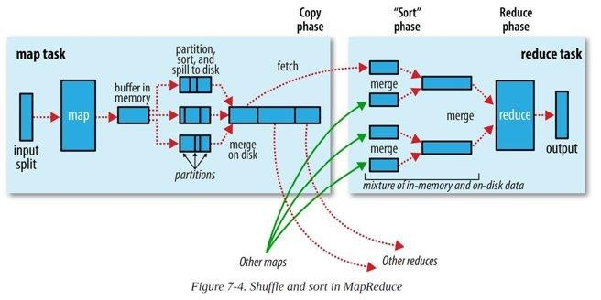

Slide 23
SHUFFLE AND SORT
The Map Side
The Map task will have a circular buffer whose size is 100 MB by default and can be changed by tuning the io.sort.mb property .The buffer's threshold size is defined by io.sort.spill.percent (by default 0.80)
Once the buffer reaches this threshold a background process spills the buffered data to disk. During this process the Map task keeps writing to the buffer. But if the buffer is filled then the map task will be halted until the completion of the spill.
Spills are written in round-robin fashion to the directories specified by
the mapred.local.dir property, in a job-specific subdirectory.
Before spilling the data to disk, the thread partitions the data into as many partitions as the reducers, unto which the data has to be sent to. For each partition the thread performs an in-memory sort by key operation. An optional combiner function would run upon this sorted partition

Slide 24
SHUFFLE AND SORT
The Map Side
Each time the buffer is full a new spill file is created, therefore by the end of a Map task there could be several number of spill files. Before finishing the task ,all these spill files will be merged into single partitioned and sorted output file the io.sort.factor(default 10) property defines the no: of streams that can be merged at once.
The final map output will be compressed before writing it to the
disk provided mapred.compress.map.output is set to true.
The output file’s partitions are made available to the reducers over HTTP. The number of worker threads used to serve the file partitions is controlled by the task tracker.http.threads property

Slide 25
SHUFFLE AND SORT
The Reduce Side
The output of any map task resides in the disk of it's local system
I.e where the map task was executed.
The jobtracker gets these location details of the Mapper outputs through the tasktracker heartbeats. It also maitains a mapping between the mapper outputs and the tasktrackers.
The reducer task need the mapper outputs for its perticular partition from several map tasks across the cluster. therefore a reducer thread periodically asks the jobtracker for the location of it's required Mapper outputs. The reducer keeps copying the mapper outputs as and when they are available. This phase of the reducer is called the copy phase.

Slide 26
SHUFFLE AND SORT

Slide 27
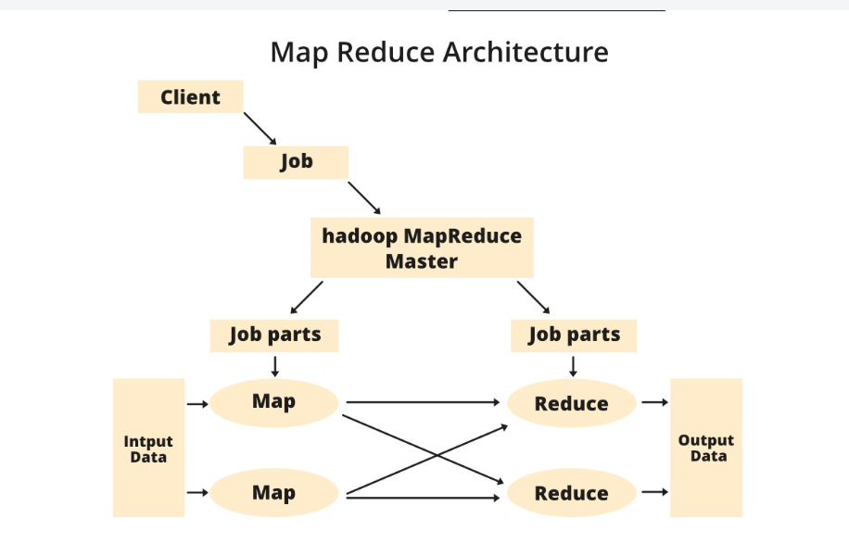

Slide 28
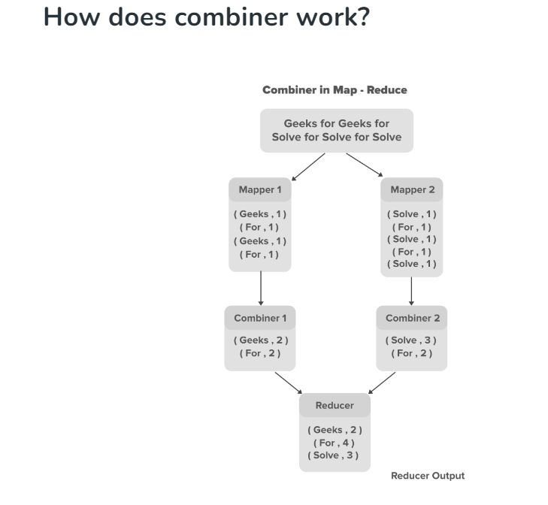

Slide 29
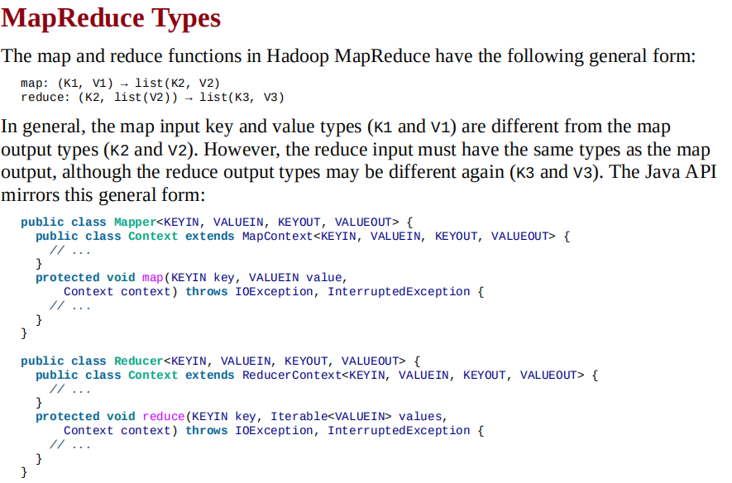

Slide 30
MAPREDUCE TYPES
The map and reduce functions in Hadoop MapReduce have the following general form:
map: (K1,V1) → list(K2,V2) reduce: (K2, list(V2)) → list(K3,V3)
If a combine function is used, then it is the same form as the reduce function (and is an implementation of Reducer), except its output types are the intermediate key and value types (K2 and V2), so they can feed the reduce function:
map: (K1,V1) → list(K2,V2) combine: (K2, list(V2)) → list(K2,V2) reduce: (K2, list(V2)) → list(K3,V3)
Often the combine and reduce functions are the same, in which case, K3 is the same as K2, and V3 is the same as V2.
The partition function operates on the intermediate key and value types (K2 and V2), and returns the partition index. In practice, the
partition is determined solely by the key (the value is ignored):
partition: (K2,V2) → integer

Slide 31
MAPREDUCE TYPES
public interface Mapper<K1, V1, K2, V2> extends JobConfigurable,
Closeable {
void map(K1 key, V1 value, OutputCollector<K2, V2> output,
Reporter reporter) throws IOException;
}
public interface Reducer<K2, V2, K3, V3> extends JobConfigurable, Closeable {
void reduce(K2 key, Iterator<V2> values, OutputCollector<K3, V3> output ,Reporter reporter) throws IOException; }

Slide 32
MAPREDUCE TYPES
The Output Collector is the generalized interface of the Map-Reduce framework to facilitate collection of data output either by the Mapper or the Reducer. These outputs are nothing but intermediate output of the job. Therefore, they must be parameterized with their types.
The Reporter facilitates the Map-Reduce application to report progress and update counters
and status information.

Slide 33
MAPREDUCE TYPES
Input types are set by the input format
a TextInputFormat generates keys of type LongWritable and values of type Text.
The other types are set explicitly by calling the methods on the JobConf. If not set explicitly, they will be set to the default types LongWritable and Text.
why can’t the types be determined from a combination of the mapper and the reducer?
In Java generics: type erasure means that the type information isn’t always present at runtime, so Hadoop has to be given it explicitly.
This also means that it’s possible to configure a MapReduce job with incompatible types, because the configuration isn’t checked at compile time.

Slide 34
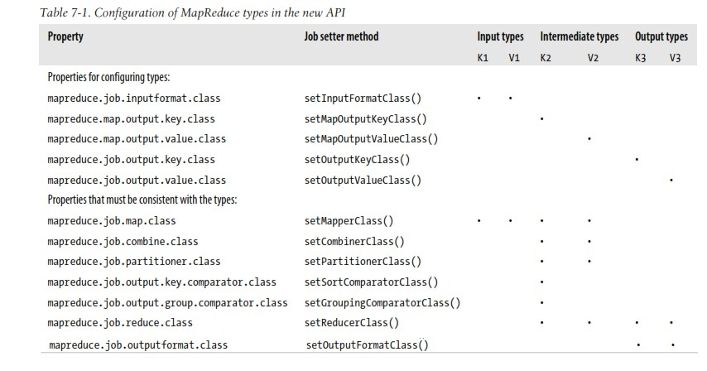

Slide 35
THE DEFAULT MAPREDUCE JOB
When you run MapReduce without setting a mapper or a reducer by setting only the input path and an output path.
We do get some output: one file named part-00000 in the output directory. Here’s what the first few lines look like :
0→0029029070999991901010106004+64333+023450FM-12+000599999V0202701N01591...
0→0035029070999991902010106004+64333+023450FM-12+000599999V0201401N01181...
135→0029029070999991901010113004+64333+023450FM-12+000599999V0202901N00821...
141→0035029070999991902010113004+64333+023450FM-12+000599999V0201401N01181...
270→0029029070999991901010120004+64333+023450FM-12+000599999V0209991C00001...
282→0035029070999991902010120004+64333+023450FM-12+000599999V0201401N01391...

Slide 36
THE DEFAULT MAPREDUCE JOB
The default Streaming job
% hadoop jar $HADOOP_INSTALL/contrib/streaming/hadoop-*-streaming.jar \ -input input/ncdc/sample.txt \ -output output \
-mapper /bin/cat
We need to supply the mapper code here as the default mapper do not work.The reason is that for the default mapper default input format is TextInputFormat, which generates LongWritable keys and Text values. But for the streaming output the keys and values are always text .The identity mapper cannot change LongWritable keys to Text keys, so it fails
For non-Java mappers the streaming simply presents the reducer with the values since the keys are only line offsets Final streaming command without any defaults:
% hadoop jar $HADOOP_INSTALL/contrib/streaming/hadoop-*-streaming.jar \ -input input/ncdc/sample.txt \ -output output \ - inputformat org.apache.hadoop.mapred.TextInputFormat \ -mapper /bin/cat \ -partitioner org.apache.hadoop.mapred.lib.HashPartitioner \ -numReduceTasks 1 \ -reducer org.apache.hadoop.mapred.lib.IdentityReducer \ - outputformat org.apache.hadoop.mapred.TextOutputForma

Slide 37
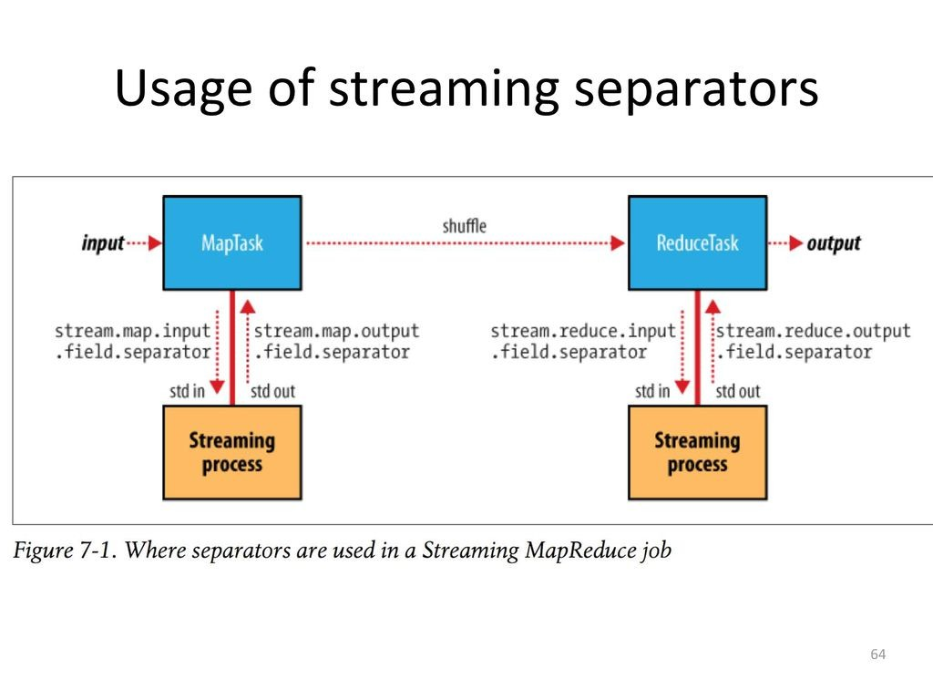
THE DEFAULT MAPREDUCE JOB
Key-Value separation in streaming
The streaming application separates the key value pairs provided in form of bytestream input. Default seprator is tabspace,which can be changed in case where the key and value include tabspace within them. Similarly the output of a reducer can we separated into key-value pairs by using a configurable separator. If there are more fields in each record the no: of fields to be considered as keys can be configured by using the following
Stream.num.map.output.key.fields stream.num.reduce.output.key.fields
if the output from a Streaming process was a,b,c (and the separator is a comma), and n is two, then the key would be parsed as a,b and the value as c.

Slide 38
TYPES AND FROMATS
Text Input
TextInputFormat is the default InputFormat. Each record is a line of input. The key, a LongWritable, is the byte offset within the file of the beginning of the line. The value is the contents of the line, excluding any line terminators (e.g., newline or carriage return),and is packaged as a Text object. So, a file containing the following text:
On the top of the Crumpetty Tree
The Quangle Wangle sat,
But his face you could not see,
On account of his Beaver Hat.
is divided into one split of four records. The records are interpreted as the following key_x0002_value pairs:
(0, On the top of the Crumpetty Tree)
(33, The Quangle Wangle sat,)
(57, But his face you could not see,)
(89, On account of his Beaver Hat.)

Slide 39
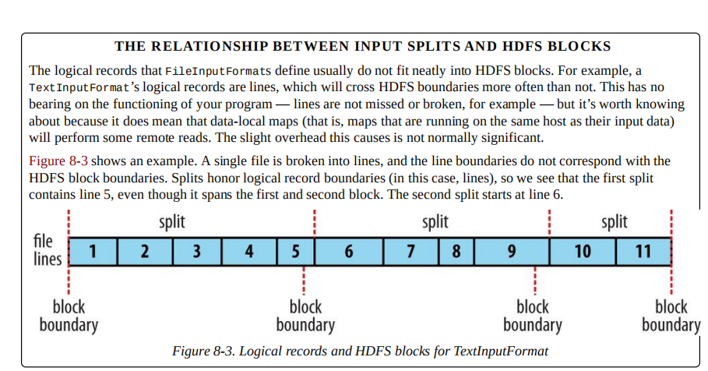

Slide 40
NLineInputFormat
With TextInputFormat and KeyValueTextInputFormat, each mapper receives a variable number of lines of input.
XML
Most XML parsers operate on whole XML documents, so if a large XML document ismade up of multiple input splits, it is a challenge to parse these individually. Of course,you can process the entire XML document in one mapper (if it is not too large) using the
technique in Processing a whole file as a record.
Hadoop comes with a class for this purpose called StreamXmlRecordReader (which is in the org.apache.hadoop.streaming.mapreduce package, although it can be used outside.
Binary Input
Hadoop MapReduce is not restricted to processing textual data. It has support for binary
formats, too.
SequenceFileInputFormat
Hadoop’s sequence file format stores sequences of binary key-value pairs. Sequence files are well suited as a format for MapReduce data because they are splittable (they have sync points so that readers can synchronize with record boundaries from an arbitrary point in the file, such as the start of a split), they support compression as a part of the format, and they can store arbitrary types using a variety of serialization frameworks.

Slide 41
SequenceFileAsTextInputFormat
SequenceFileAsTextInputFormat is a variant of SequenceFileInputFormat that converts the sequence file’s keys and values to Text objects. The conversion is performed by calling toString() on the keys and values. This format makes sequence files suitableinput for Streaming.
SequenceFileAsBinaryInputFormat
SequenceFileAsBinaryInputFormat is a variant of SequenceFileInputFormat that retrieves the sequence file’s keys and values as opaque binary objects. They are encapsulated as BytesWritable objects, and the application is free to interpret the underlying byte array as it pleases.
FixedLengthInputFormat
FixedLengthInputFormat is for reading fixed-width binary records from a file, when the
records are not separated by delimiters. The record size must be set via fixedlengthinputformat.record.length.
Multiple Inputs
Although the input to a MapReduce job may consist of multiple input files (constructed by
a combination of file globs, filters, and plain paths), all of the input is interpreted by a
single InputFormat and a single Mapper.

Slide 42
Database Input (and Output)
DBInputFormat is an input format for reading data from a relational database, using JDBC.

Slide 43
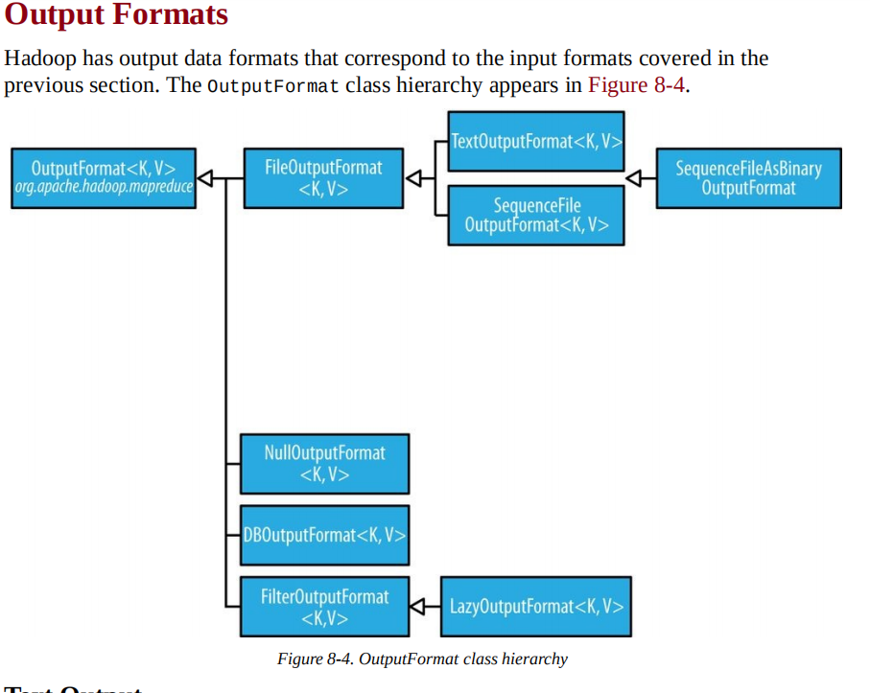

Slide 44
MAP REDUCE FEATURES
1. Counters
Counters are a useful channel for gathering statistics about the job: for quality control or for application-level statistics. They are also useful for problem diagnosis. If you are tempted to put a log message into your map or reduce task, it is often better to see whether you can use a counter instead to record that a particular condition occurred.
2. Built in Counters
Hadoop maintains some built-in counters for every job, and these report various metrics. For example, there are counters for the number of bytes and records processed, which allow you to confirm that the expected amount of input was consumed and the expected amount of output was produced.

Slide 45
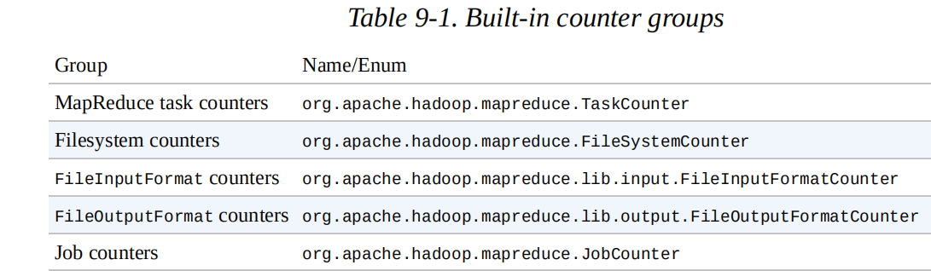
Each group either contains task counters (which are updated as a task progresses) or job counters (which are updated as a job progresses).

Slide 46
Task counters
Task counters gather information about tasks over the course of their execution, and the results are aggregated over all the tasks in a job. The MAP_INPUT_RECORDS counter, for example, counts the input records read by each map task and aggregates over all map tasks in a job, so that the final figure is the total number of input records for the whole job.

Slide 47
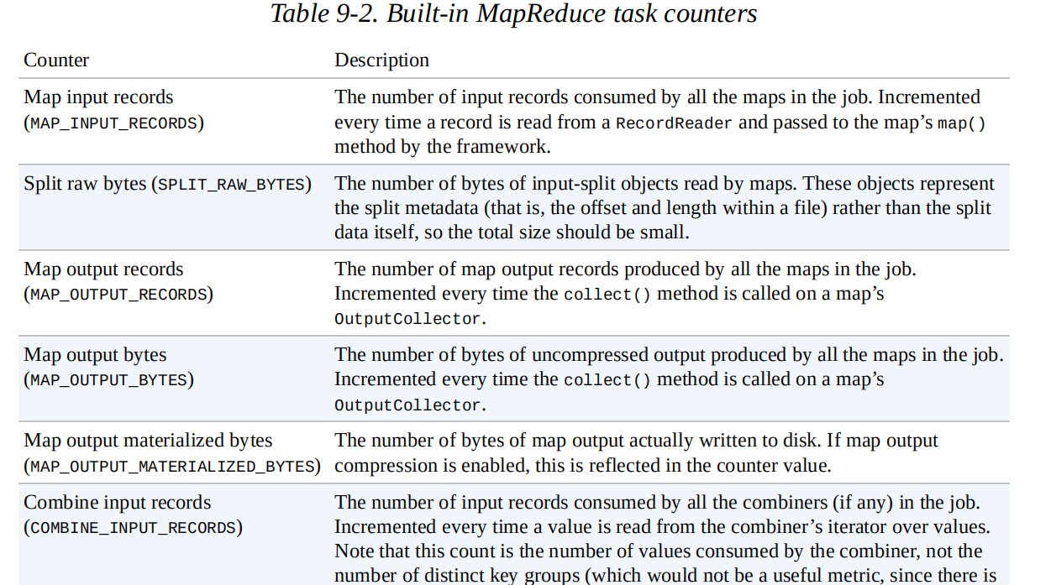

Slide 48
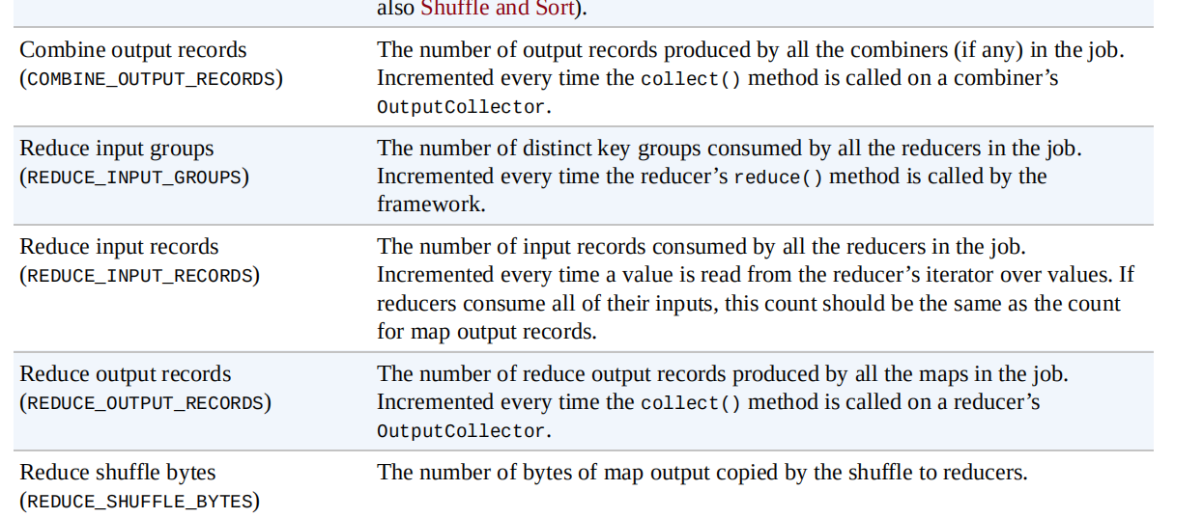

Slide 49
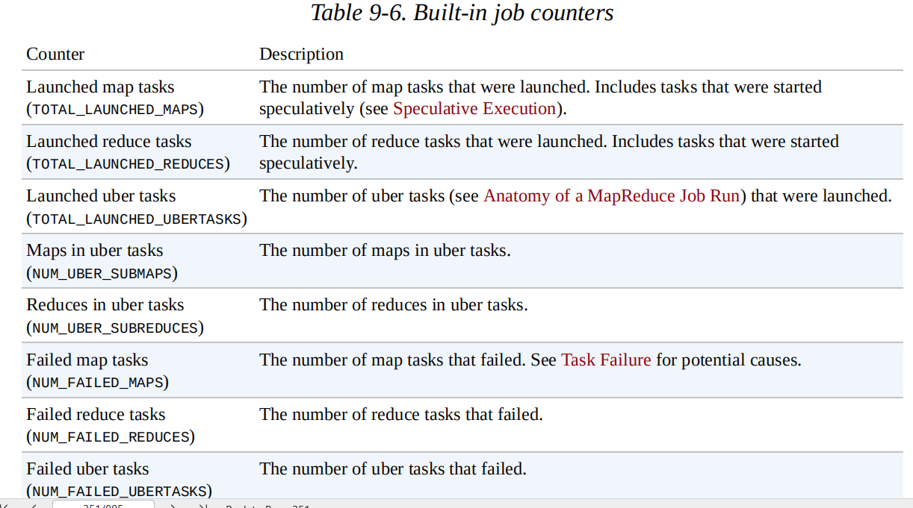
Job counters
Job counters are maintained by the application master, so they don’t need to be sent across the network, unlike all other counters, including user-defined ones. They measure job-level statistics, not values that change while a task is running.

Slide 50
User-Defined Java Counters
MapReduce allows user code to define a set of counters, which are then incremented as desired in the mapper or reducer. Counters are defined by a Java enum, which serves to group related counters.
A job may define an arbitrary number of enums, each with an arbitrary number of fields. The name of the enum is the group name, and the enum’s fields are the counter names. Counters are global: the MapReduce framework aggregates them across all maps and reduces to produce a grand total at the end of the job.
Dynamic counters
The code makes use of a dynamic counter — one that isn’t defined by a Java enum.Because a Java enum’s fields are defined at compile time, you can’t create new counters on the fly using enums.

Slide 51
Retrieving counters
In addition to using the web UI and the command line (using mapred job -counter), you can retrieve counter values using the Java API. You can do this while the job is running, although it is more usual to get counters at the end of a job run, when they are stable.
User-Defined Streaming Counters
A Streaming MapReduce program can increment counters by sending a specially formatted line to the standard error stream, which is co-opted as a control channel in this case.

Slide 52
Sorting
The ability to sort data is at the heart of MapReduce. Even if your application isn’t concerned with sorting per se, it may be able to use the sorting stage that MapReduce provides to organize its data.
Partial Sort
In The Default MapReduce Job, we saw that, by default, MapReduce will sort input records by their keys.
Suppose we run this program using 30 reducers:
% hadoop jar hadoop-examples.jar SortByTemperatureUsingHashPartitioner \
-D mapreduce.job.reduces=30 input/ncdc/all-seq output-hashsort
This command produces 30 output files, each of which is sorted. However, there is no
easy way to combine the files (by concatenation, for example, in the case of plain-text
files) to produce a globally sorted file.

Slide 53
Total Sort
How can you produce a globally sorted file using Hadoop? The naive answer is to use a single partition[But this is incredibly inefficient for large files, because one machine has to process all of the output, so you are throwing away the benefits of the parallel architecture that MapReduce provides.
Here’s how we run it:
% hadoop jar hadoop-examples.jar SortByTemperatureUsingTotalOrderPartitioner \-D mapreduce.job.reduces=30 input/ncdc/all-seq output-totalsort
The program produces 30 output partitions, each of which is internally sorted; in addition, for these partitions, all the keys in partition i are less than the keys in partition i + 1.

Slide 54
Secondary Sort
The MapReduce framework sorts the records by key before they reach the reducers. For any particular key, however, the values are not sorted. The order in which the values appear is not even stable from one run to the next, because they come from different map tasks, which may finish at different times from run to run.
To summarize, there is a recipe here to get the effect of sorting by value:
Make the key a composite of the natural key and the natural value.
The sort comparator should order by the composite key (i.e., the natural key and
natural value).
The partitioner and grouping comparator for the composite key should consider only the natural key for partitioning and grouping

Slide 55
JOINS
MapReduce can perform joins between large datasets, but writing the code to do joins from scratch is fairly involved. Rather than writing MapReduce programs, you might consider using a higher-level framework such as Pig, Hive, Cascading, Cruc, or Spark, in
which join operations are a core part of the implementation.

Slide 56
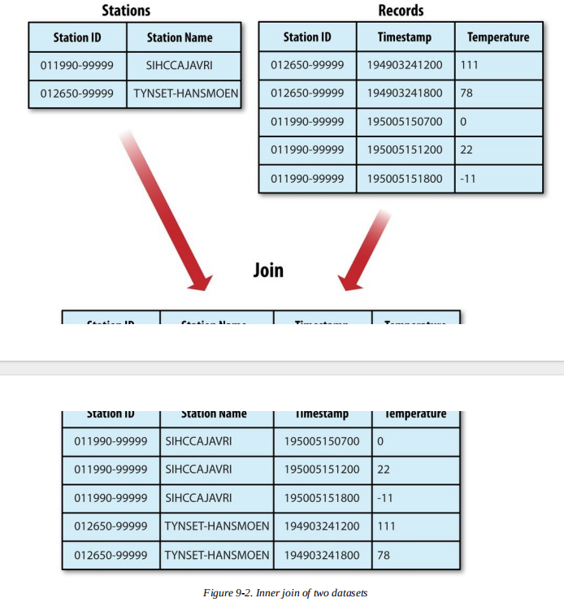

Slide 57
MAP SIDE JOINS
A map-side join between large inputs works by performing the join before the data reachesthe map function. For this to work, though, the inputs to each map must be partitioned and sorted in a particular way.
Each input dataset must be divided into the same number of partitions, and it must be sorted by the same key (the join key) in each source. All the records for a particular key must reside in the same partition. This may sound like a strict requirement (and it is), but it actually fits the description of the output of a MapReduce job.
A map-side join can be used to join the outputs of several jobs that had the same number of reducers, the same keys, and output files that are not splittable (by virtue of being smaller than an HDFS block or being gzip compressed, for example).

Slide 58
REDUCE SIDE JOINS
A reduce-side join is more general than a map-side join, in that the input datasets don’t have to be structured in any particular way, but it is less efficient because both datasets have to go through the MapReduce shuffle.
The basic idea is that the mapper tags each record with its source and uses the join key as the map output key, so that the records with the same key are brought together in the reducer. We use several ingredients to make this work in practice:
Multiple inputs
The input sources for the datasets generally have different formats, so it is very
convenient to use the MultipleInputs class (see Multiple Inputs) to separate the logic
for parsing and tagging each source.
Secondary sort
As described, the reducer will see the records from both sources that have the same key,
but they are not guaranteed to be in any particular order. However, to perform the join,
it is important to have the data from one source before that from the other.

Slide 59
