Slide 1
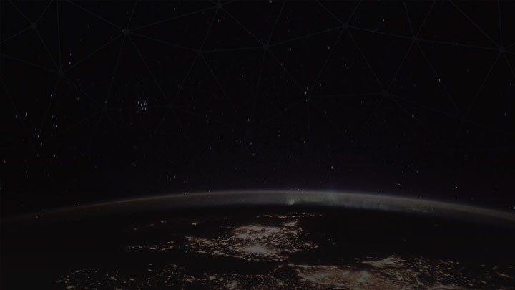

GraphQL
The introduction of a new way of dealing with data
Muhammad Sholahuddin
@saladinid
Front End Engineer at Pinjam.co.id

Slide 2


Muhammad
Sholahuddin
Front End Engineer at Pinjam.co.id
@saladinid

Slide 3

Agenda
> Opening
> What’s GraphQL?
> How does it work?
> Demo
> Q & A

Slide 4

REST
A.P.I
HTTP
Request
Web Service
Response
Facebook
JSON

Slide 5
let me tell you a story

Slide 6


Slide 7
NEED SOME REST
List of Jane’s friends
+ Their names
+ Their locations
GET /users/Jane/friends
[1, 2, 3]
GET /friends/{ID}
{name: “...”, locationID: 1}
GET /location/{ID}
{name: “Depok”}

Slide 8
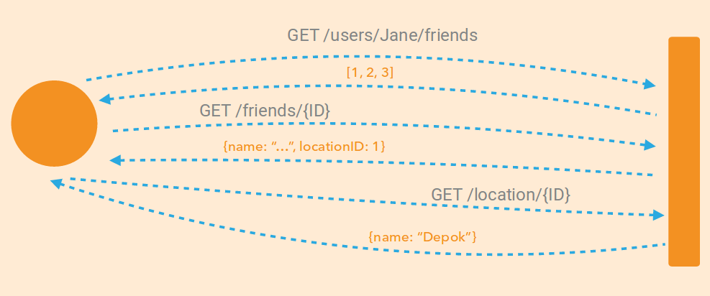
Multiple Round Trip (Multiple Calls)

Slide 9
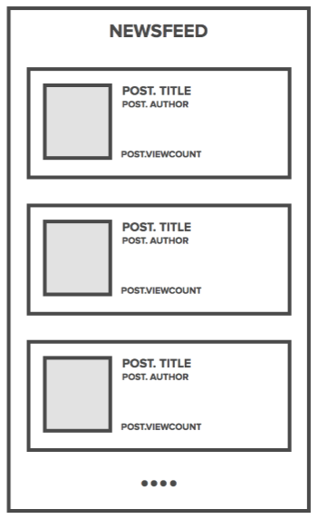
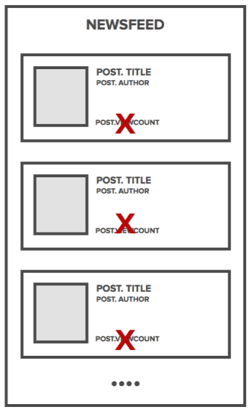
Data
Version
v1
v2

Slide 10
GraphQL

Slide 11
What is GraphQL?
GraphQL is a data query language and runtime designed and used at Facebook to request and deliver data to mobile and web apps
since 2012 (Open Source on 2015)
Source: http://graphql.org

Slide 12
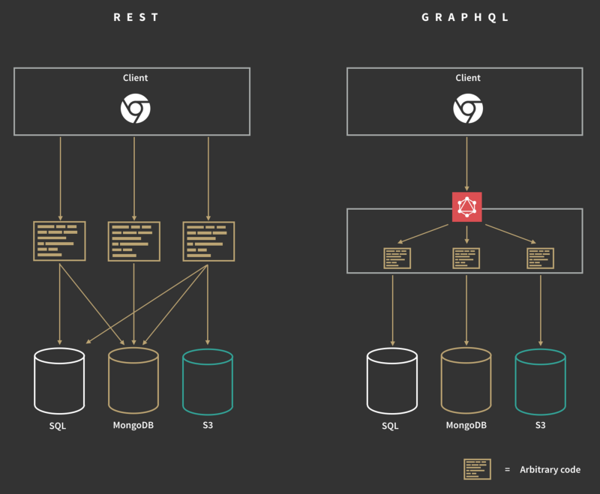
REST
GraphQL

Slide 13
Main Topics
> Queries and Mutations
> Schemas and Types
> Validation
> Execution
> Introspection

Slide 14
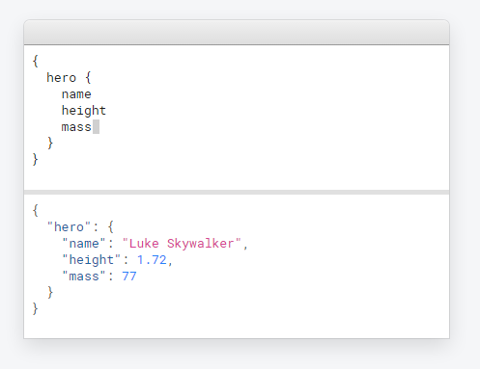
Queries & Mutations

Slide 15
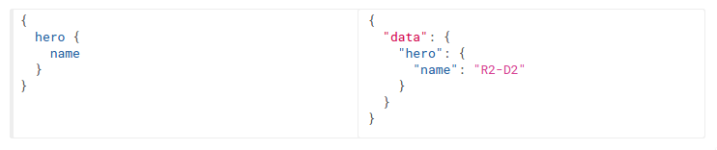
Queries
"Ask for what you need,
get exactly that"

Slide 16
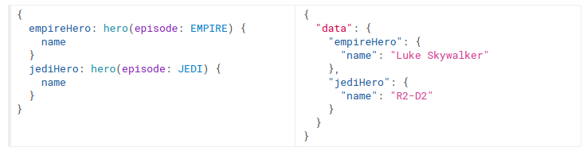
Queries
Aliases

Slide 17
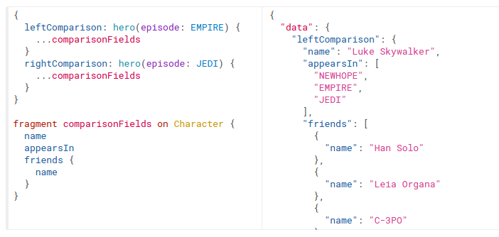
Queries
Fragments

Slide 18
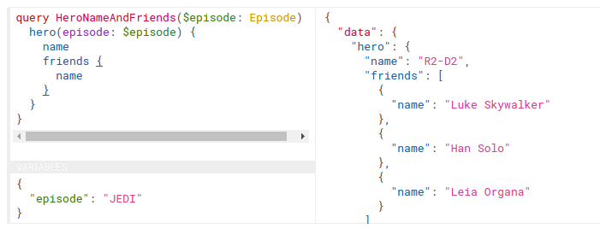
Queries
Variables

Slide 19
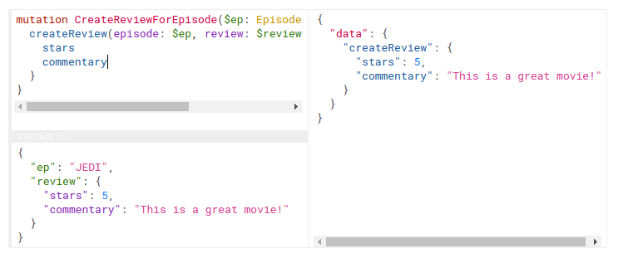
Mutations
Just like in queries, if the mutation field returns an object type, you can ask for nested fields.

Slide 20
Mutations
var MutationType = new GraphQLObjectType({
name: 'GraphQL Mutations',
description: 'These are the things we can change',
fields: () => ({
createArticle: {
type: ArticleType,
description: 'Create a new article',
args: {
article: { type: ArticleInputType }
},
resolve: (value, { article }) => {
return ArticleServices.createArticle(article);
}
}
}),
});
Create

Slide 21
Mutations
var MutationType = new GraphQLObjectType({
name: 'GraphQL Mutations',
description: 'These are the things we can change',
fields: () => ({
updateArticle: {
type: ArticleType,
description: 'Update an article article, and optionally any related articles.',
args: {
article: { type: ArticleAttributesInputType }
},
resolve: (root, { article }) => {
return ArticleServices.createOrUpdateArticle(article);
}
}
}),
});
Update

Slide 22
Mutations
var MutationType = new GraphQLObjectType({
name: 'GraphQL Mutations',
description: 'These are the things we can change',
fields: () => ({
deleteArticle: {
type: ArticleType,
description: 'Delete an article with id and return the article that was deleted.',
args: {
id: { type: new GraphQLNonNull(GraphQLInt) }
},
resolve: (value, { id }) => {
return ArticleServices.delete(id);
}
}
}),
});
Delete

Slide 23
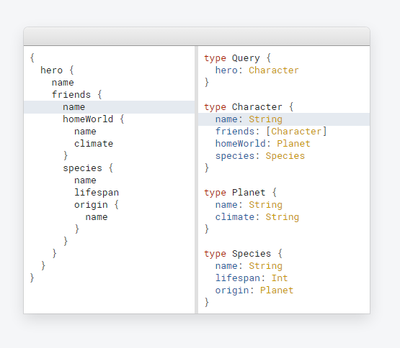
Schemas & Types

Slide 24
Schemas & Types
GraphQL type system to describes what data can be queried. Using any backend framework or programming language.

Slide 25
const PersonType = new GraphQLObjectType({
name: 'Person',
description: 'Somebody that you used to know',
fields: () => ({
id: globalIdField('Person'),
firstName: {
type: GraphQLString,
resolve: (person) => person.first_name,
},
lastName: {
type: GraphQLString,
resolve: (person) => person.last_name,
},
email: {
type: GraphQLString
},
username: {
type: GraphQLString
},
friends: {
type: new GraphQLList(PersonType),
resolve: person => personLoader.loadMany(person.friends),
},
}),
interfaces: [ nodeInterface ],
});

Slide 26
Best Practices
> Thinking in Graphs
> Serving over HTTP
> Authorization
> Pagination
> Caching

Slide 27
Best Practices
> Thinking in Graphs
> Serving over HTTP
> Authorization
> Pagination
> Caching

Slide 28
How does it works?

Slide 29
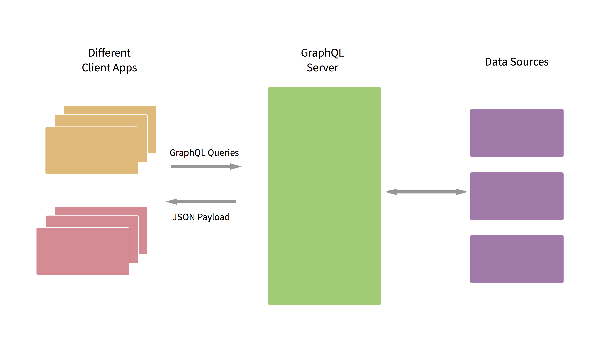
API / Data

Slide 31
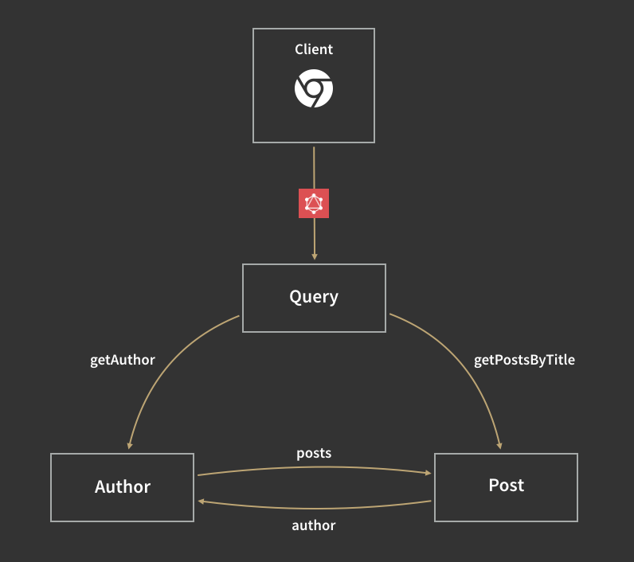
getPeople
getPersonById
person
People
Person
friends

Slide 32
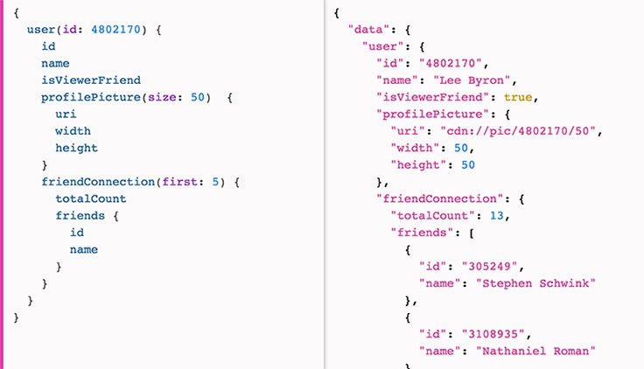

Slide 33
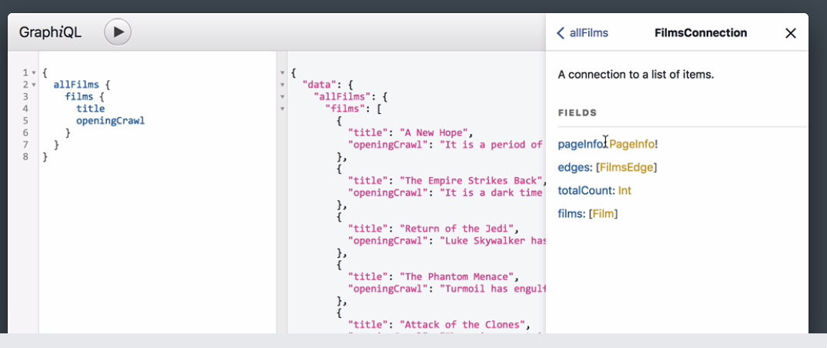
GraphiQL - Cool Tool

Slide 34


Who’s using GraphQL?

Slide 35
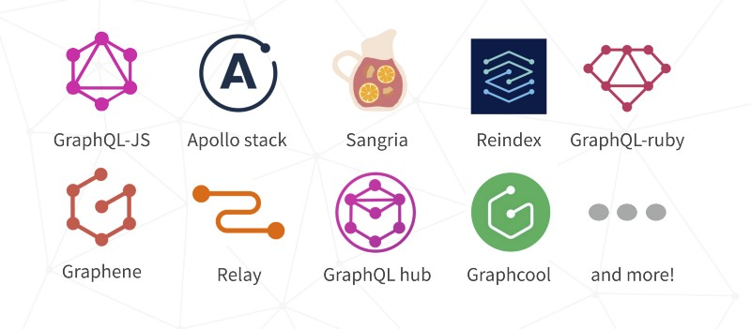
The growing GraphQL ecosystem

Slide 36
DEMO

Slide 37
GitHub
https://github.com/saladinid/techtalk-graphql

Slide 38
Conclusion
> GraphQL is query language
> GraphQL is not RESTful API killer
> GraphQL available for many Tech.
> Many supports
> For dynamic & high scalability App

Slide 39
Questions

Slide 40
LEARN MORE
▸ GraphQL Introduction
▸ Exploring GraphQL video
▸ Zero GraphQL video
▸ Fullstack React & GraphQL
▸ Your First GraphQL Server
▸ Intro To GraphQL

Slide 41
Thank You

