Slide 1

PIXAI: Political Image Cross Attention Inference
CSE 3200: Software Development Project II
A Multimodal Framework for Code-Mixed Bangla Political Meme Classification
Author: Tamjid Hasan Fahim (Roll: 2103052)
Supervisor: Utsha Das, Assistant Professor
Department of Computer Science & Engineering, RUET.

Slide 2
The problem: Challenges in Meme Classification
Semantic Gap in Multimodality
Linguistic Complexity
Visual Noise
Image and text analyzed in isolation miss implicit reasoning.
Bengali-English code-mixing ("Banglish") breaks traditional OCR systems
Compression artifacts, watermarks, non-standard fonts degrade feature extraction.

Slide 3
Motivation: Why It Matters
Technical Gap:
Existing models fail on low-resource, code-mixed languages
Simple concatenation-based fusion insufficient for nuanced reasoning
Traditional OCR inadequate for noisy meme text
Societal Impact:
Making computational models understand the social phenomena of political discourse.
Content moderation at scale for social media platforms
Understanding political narrative propagation

Slide 4
Objectives
Granular Multimodal Extraction: VLM-based transcription of code-mixed text with noise filtering
Robust Text Normalization: Comprehensive cleaning pipeline for internet text entropy
PIXAI Architecture Development: Novel cross-attention mechanism for visual-textual fusion.
Why not Unimodal?
Why not Early Fusion?
Why not Late Fusion?
Real-Time Deployment: Production-ready web API with asynchronous processing

Slide 5
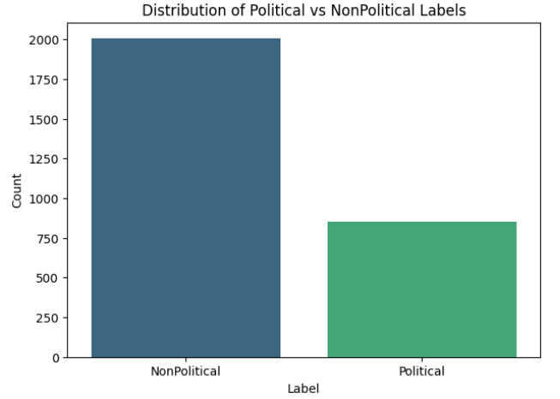
Dataset Overview
Meme Decode Dataset
Total Samples: 2,860 code-mixed Bengali memes
Training Set: 2,002 samples (70%)
Validation Set: 429 samples (15%)
Test Set: 429 samples (15%)
Class Distribution:
Non-Political: 2,007 samples
Political: 853 samples
Weighted loss (pos_weight = 2007/853 = 2.35) applied to handle imbalance instead of other techniques (i.e. data augmentation, resampling etc) to keep the normal distribution.

Slide 6
System Architecture Overview
Granular Multimodal Extraction: VLM-based transcription of code-mixed text with noise filtering
Robust Text Normalization: Comprehensive cleaning pipeline for internet text entropy
PIXAI Architecture Development: Novel cross-attention mechanism for visual-textual fusion
Real-Time Deployment: Production-ready web API with asynchronous processing

Slide 7
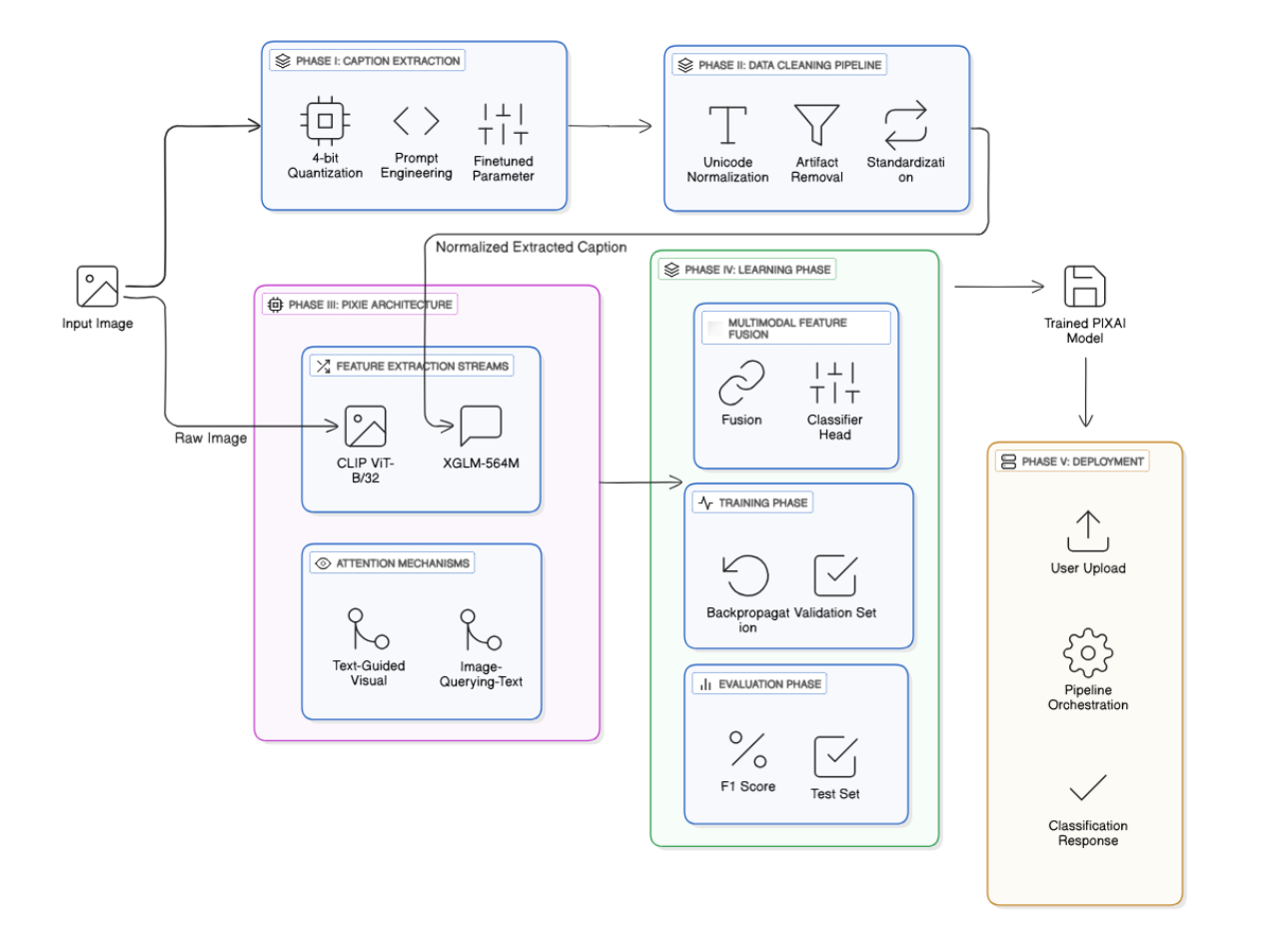

Slide 8
System Architecture - VLM Text Extraction
Traditional OCR (Tesseract):
Dumb pattern recognition. No semantic understanding
Fails on mixed scripts, stylized fonts
Cannot handle visual noise
Terrible accuracy for memes, more suitable for low-noise clear documents
Our VLM Approach (Qwen/Gemini):
Semantic understanding. Knows what it is extracting
Accuracy: >90% extraction quality
Context-aware correction of spelling errors
Handles code-mixed text naturally
Robust against stylized fonts and artifacts

Slide 9
System Architecture - Text Normalization Pipeline
Cleaning Internet Text Entropy
Noise keyword filtering (watermarks, social media handles)
Character mapping for stylized Unicode
URL, emoji, and punctuation removal via regex
NFKC Unicode normalization for Bengali script
Whitespace standardization
Result: Clean, standardized input for robust classification
Hasan, T., Bhattacharjee, A., Samin, K., Hasan, M., Basak, M., Rahman, M. S., & Shahriyar, R. (2020).
Not Low-Resource Anymore: Aligner Ensembling, Batch Filtering, and New Datasets for Bengali-English Machine Translation.
EMNLP 2020.

Slide 10
System Architecture - Dual Cross-Attention Mechanism
Visual Stream: CLIP (ViT-B/32) → 512D → 1024D projection (frozen). Works as static image feature extractor.
Textual Stream: XGLM-564M → 1024D contextual embeddings.
Attention Stream I - Image-Querying-Text: – Query: Visual Features – Key/Value: Textual Features – Function: This mechanism allows the model to identify which parts of the text are relevant to specific visual regions.
Attention Stream II - Text-Guided Visual Attention: – Query: Visual Features – Key: Textual Features – Value: Visual Features – Function: Here, the text acts as a filter (Key) to re-weight the visual features (Value). This effectively “highlights” visual regions that are semantically aligned with the text.
Classification: Concatenated features (4096) → FC layers (32) → Sigmoid(Output) → Label

Slide 11
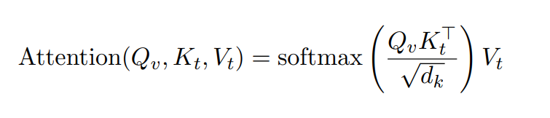
System Architecture - Dual Cross-Attention Mechanism (Cont’d)
Q (Query): what the model is looking for
K (Key): what the model can match against
V (Value): information to be aggregated
Dot product: measures similarity between queries and keys
Scaling: stabilizes gradients for large dimensions
Softmax: outputs a probability distribution that sums to 1.
Attention Weight: signifies significance, multiplied with V to get a wegiht sum.

Slide 12
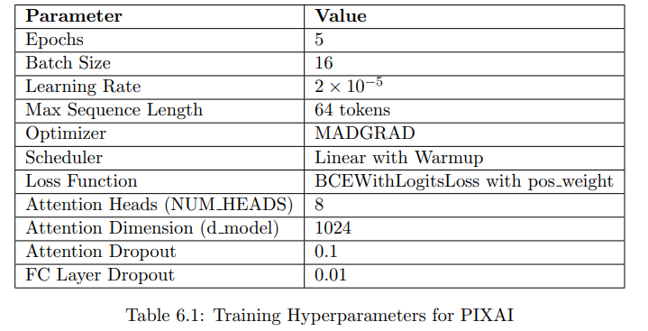
System Architecture - Training Hyperparameters

Slide 13
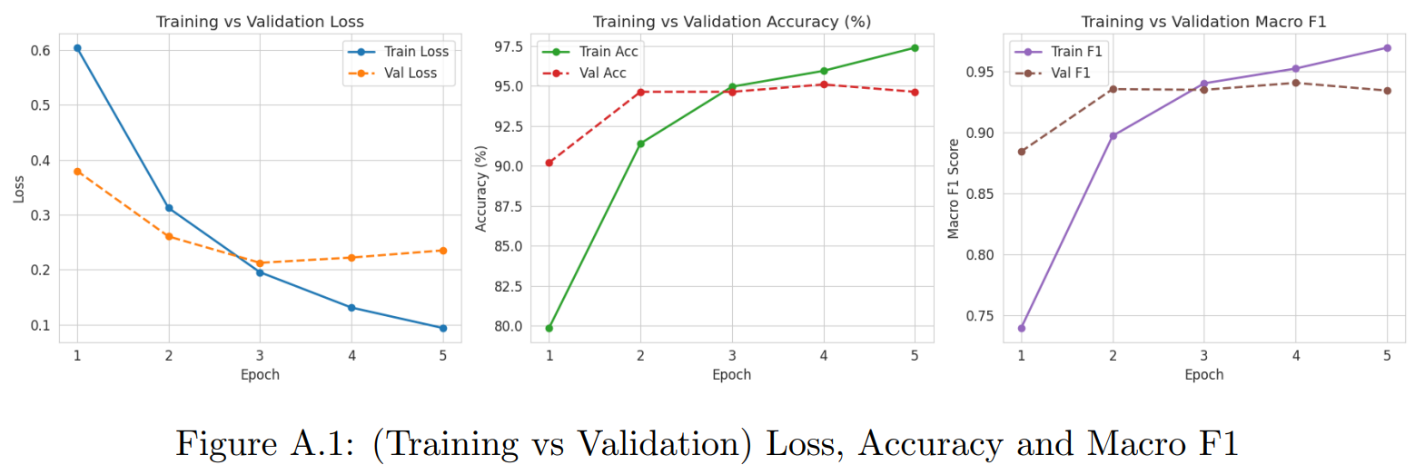
System Architecture - Training Hyperparameters (Cont’d)
Notably, Epoch 4 achieves the highest validation Macro F1-score, confirming it as the optimal checkpoint and justifying its selection for final testing and deployment.

Slide 14
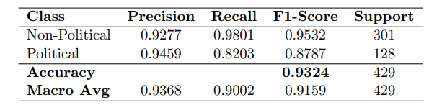
Result : Model Performance
Overall accuracy: 93.24% on a 429-sample test set. Macro F1-score: 0.9159 confirms robustness despite class imbalance.
Non-Political class:
Very high recall (98.01%)
Neutral content is rarely misclassified or over-flagged
Political class:
High precision (94.59%)
When flagged as political, predictions are usually correct
Lower recall (82.03%) reflects a precision-first design choice

Slide 15
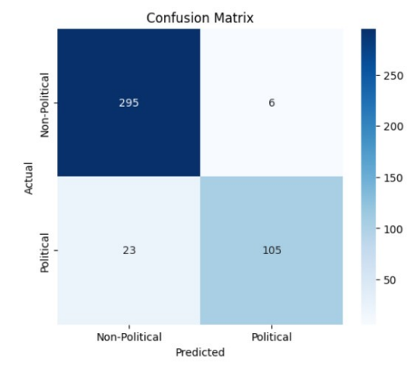
Result : Model Performance (Cont’d)
True Negatives: 295 (correctly identified non-political)
True Positives: 105 (correctly identified political)
False Positives: 6 (minimal over-censorship)
False Negatives: 23 (subtle satire detection challenge)
Trade-off: High precision prioritized for safe deployment

Slide 16
System Architecture - Deployment of the Trained Model
Production-Ready FastAPI Backend
Features:
Asynchronous request handling (async/await)
4-bit quantization for consumer GPU deployment
Singleton pattern for model loading (lifespan context)
Structured API contracts with Pydantic validation
Performance:
Inference Latency: 2.5-4 seconds per image
VRAM Usage: ~7GB with quantization
Concurrent request support

Slide 17
System Integration Workflow
End-to-End Pipeline:
User Upload: Drag-and-drop image via web interface
Text Extraction: VLM-based OCR
Normalization: Clean and standardize extracted text
Classification: Trained PIXAI model inference with CLIP for the uploaded image + XGLM for the normalized extracted text.
Response: JSON output with confidence scores and probabilities
All orchestrated through FastAPI controller

Slide 18
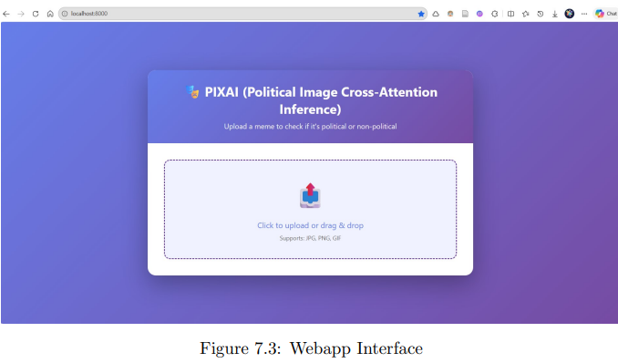
Deployed System Screenshots

Slide 19
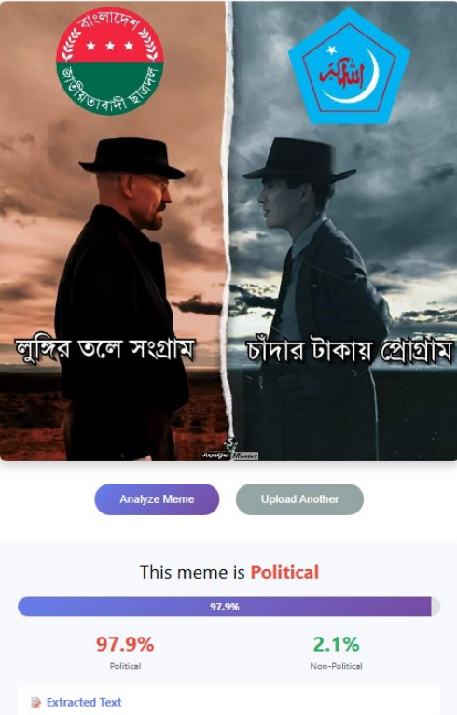
Correctly Classified
Political Meme

Slide 20
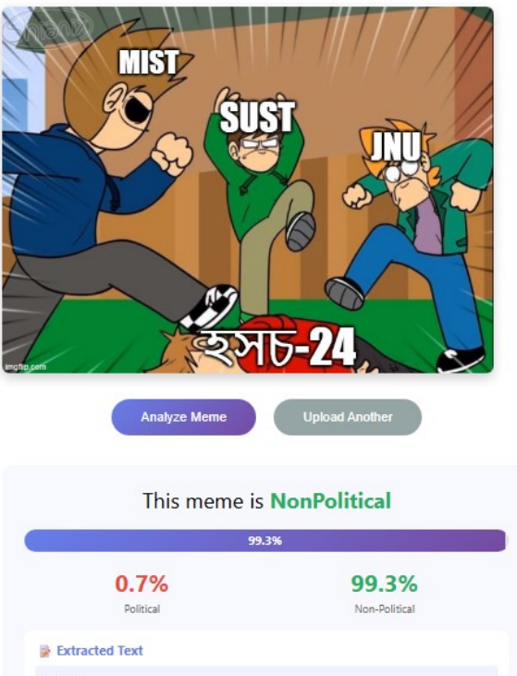
Correctly Classified
Non-Political Meme

Slide 21
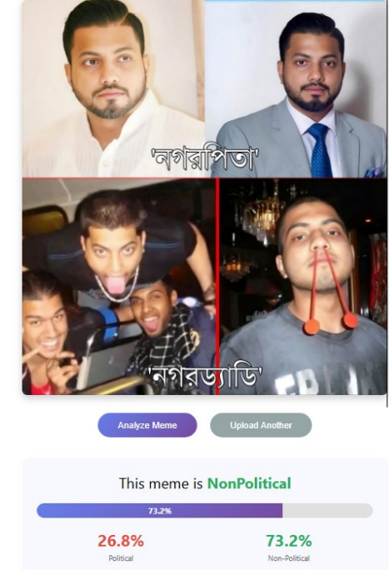
Misclassified
Political Meme
Evolving political narratives, new symbols and slang emerge constantly.
Subtle, implicit political cues embedded within context-dependent scenarios .
Sarcasm and irony obscure intent.
Static models lack adaptability.
Lowering the threshold for political class might help.

Slide 22
Key Contributions
First dedicated code-mixed political meme classifier for low-resource Bengali language.
Novel VLM-based extraction pipeline replacing traditional OCR
Dual cross-attention architecture for explicit multimodal reasoning
Production-ready deployment with asynchronous FastAPI backend
Established baseline: 93.24% accuracy, 0.9159 Macro F1

Slide 23
Limitations and Future Work
Static modeling in dynamic political landscape
Binary classification only (no satire/propaganda/sentiment detection)
2-4 second latency limits high-throughput scenarios
Explainable AI with attention map visualization for trustworthiness.

Slide 24
Conclusion
PIXAI successfully demonstrates:
Automated political meme classification for Bengali code-mixed content
VLM-based extraction overcomes traditional OCR limitations
Cross-attention fusion enables nuanced multimodal reasoning
Real-time deployment achieves 93.24% accuracy with high precision
Significance: First computational framework for low-resource political discourse analysis in Bengali digital spaces.

Slide 25
Thank You. Questions?

