Slide 1

PROJECT-CENTRIC LEARNING (PCL)
Real-Time Human Violence Detection Using ResNet3D-18 with Confidence-Gated Temporal Voting Mechanism
Review Presentation - 1
Presented by:
TEJAS R U (23BTRCL165)
SUJEET R K (23BTRCL081)
TANISHA V (23BTRCL086)
THANISH K C (23BTRCL089)
S UDAY GOWDA (23BTRSN065)
Computer Science Of Engineering Artificial Intelligence And Machine Learning
Under the Guidance of:
Dr. Senthil kumar
Associate Professor , CSE - AIML,
FET, JAIN(Deemed–to-be) UNIVERSITY

Slide 2
Contents
Abstract
Introduction
Problem Statement
Aim and Objectives
Comparative Analysis with Existing Models
Literature Survey
Methodology
Results & Advantages
Conclusion
Future scope
References

Slide 3
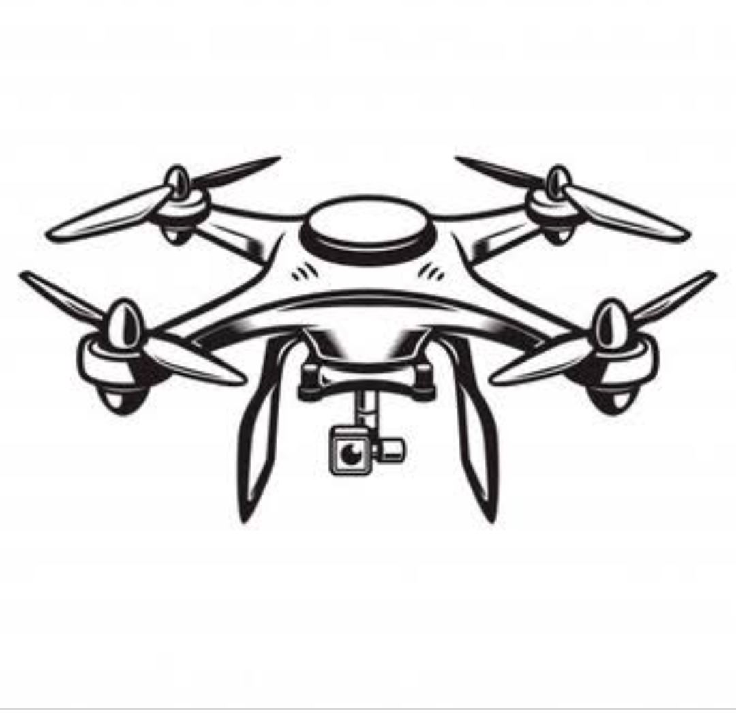
Abstract
The increasing use of surveillance systems demands automated real-time violence detection. Manual monitoring of video feeds is inefficient and prone to human error.
This work proposes a deep learning framework based on ResNet3D-18 for spatio--temporal video analysis using 16-frame clips for accurate violence recognition
A Confidence-Gated Temporal Voting Mechanism triggers a VIOLENT alert only when prediction confidence exceeds 85% across 5 consecutive frames
The proposed system achieves 97.95% accuracy and is deployed through a web-based interface supporting both CPU and GPU inference, ensuring practical real-time implementation

Slide 4
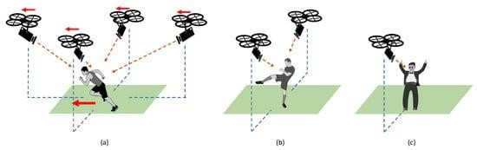
Introduction
.
Rapid expansion of surveillance infrastructure has increased daily video data
generation in public and private spaces.
CCTV systems are widely used in transportation hubs, educational institutions,
shopping centers, and residential areas for public safety.
Continuous manual monitoring is labor-intensive, inefficient, and prone to human
error.
Critical violent incidents may go unnoticed due to operator fatigue or delayed
response.
Advances in deep learning have improved action recognition and anomaly
detection in video analysis.
Traditional 2D image-based models focus only on spatial features and fail to
capture temporal motion patterns.

Slide 5
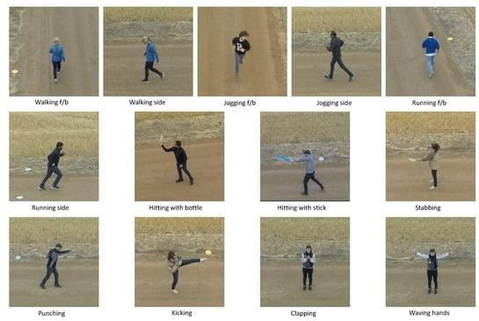
Violence detection is inherently a spatio-temporal problem, requiring simultaneous
modeling of appearance and motion.
3D Convolutional Neural Networks (e.g., ResNet3D-18) process consecutive frames
as volumetric data, enabling effective spatio-temporal feature extraction.
Existing systems often suffer from high false positives and unstable real-time
predictions

Slide 6
Problem Statement:
Scale of Surveillance: Billions of CCTV feeds → impossible for humans to monitor continuously
Human operators experience a significant decline in attention during prolonged monitoring, resulting in missed detection of critical events such as violent activities
Existing automated violence detection systems suffer from high false positive rates, often misclassifying non-violent actions (e.g., sports or playful interactions) as violence.
Most current approaches perform predictions on individual frames or short clips without incorporating temporal consistency, leading to unstable and unreliable outputs.
There is a need for a system that is accurate, stable, and computationally efficient, capable of real-time deployment on standard hardware.

Slide 7
Aim and Objectives
To design and implement a real-time human violence detection system using (ResNet3D-18) with improved detection stability for surveillance applications.
1.Spatio-Temporal Feature Extraction: Design a deep learning framework using ResNet3D-18 to capture both spatial and motion-based features from video sequences.
2. Video Clip Processing: Process short clips of 16 consecutive frames to effectively model temporal dynamics.
3. Detection Stability Enhancement: Implement a confidence-gated temporal voting mechanism to reduce false-positive alerts.
4. Sustained Alert Mechanism: Trigger violence alerts only when prediction confidence exceeds 0.85 across five consecutive evaluations.
5. Performance Evaluation: Assess system performance using standard classification metrics such as accuracy, precision, recall, and F1-score.
6. Real-Time Deployment: Enable practical implementation with support for both CPU and GPU-based inference.

Slide 8
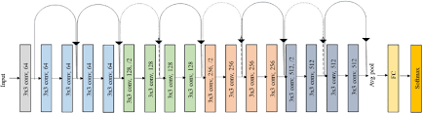
ResNet3D-18 Architecture:
ResNet3D-18 is a Convolutional Neural Network for video understanding.
Extends 2D ResNet by replacing 2D convolutions with 3D convolutions.
ResNet solves Vanishing gradients & Degradation problems by using:
Residual Connections
Processes video as volumetric input: 3 × 16 × 112 × 112 (RGB channels × frames × height × width)
It Extracts both spatial (appearance) and temporal (motion) features.
3D CNN: Processes video. Kernel shape: (time, height, width)

Slide 9
Existing Models:
YOLO-based Violence Detection Systems Widely used in modern surveillance for real-time detection due to speed and efficiency. These systems analyze live CCTV feeds and trigger alerts instantly.
CNN + LSTM-Based Systems Combine spatial (CNN) and temporal (LSTM) features to detect violent activities in video sequences. Common in research and IoT-based surveillance setups.
3D CNN Models (C3D, I3D, SlowFast) Advanced deep learning models that process video clips to capture motion and appearance, achieving high accuracy but requiring heavy computation.
Vi-SAFE (YOLO + Temporal Networks) Hybrid system combining object detection (YOLO) with temporal analysis for improved accuracy (~88%), but requires GPU-based infrastructure

Slide 10
Comparative Analysis with Existing Models:
Model | Main Problem | Our Improvement
C3D model | Too heavy → cannot run on normal computers | Runs on CPU with fewer parameters (~33M)
SlowFast model | Needs multiple GPUs → expensive and complex | Works on CPU or single GPU
I3D model | High accuracy but slow and resource-heavy | Fast + accurate, suitable for real-time use
YOLO-based detection | Detects frame-by-frame → misses motion, causes false alerts | Uses 16-frame video input → understands motion
CNN + LSTM | Slow due to two-step processing | Single-step model → faster prediction
Vi-SAFE | Requires GPU, no false-alert control | Runs on CPU + reduces false alerts using voting

Slide 11
Literature Survey
S.No | Title | Authors | Journal/Conference | Year | Key Focus | Key Findings
1 | A Survey of UAV Applications in Civilian Missions: Challenges and Future Trends | E. Yanmaz, I. Güvenç, Y. Mulgaonkar, R. Ohare, D. Schmale | Ad Hoc Networks | 2018 | Civilian applications of drones, including surveillance | Discusses challenges and future trends in UAV applications, emphasizing their potential in surveillance missions.
2 | Deep Learning for Real-Time Human Action Recognition with UAVs | P. Molchanov, S. Gupta, K. Kim, K. Pulli | Proceedings of the IEEE Conference on Computer Vision and Pattern Recognition Workshops | 2016 | Application of deep learning for UAV-based action recognition | Highlights the implementation and accuracy of deep learning models for real-time human action recognition using UAVs.
3 | Multi-Sensor Fusion for Robust UAV-Based Human Action Recognition | M. H. ElSayed, A. M. Ahmed, H. A. AboElFotoh | IEEE Sensors Journal | 2020 | Integration of multiple sensors for UAV-based action recognition | Demonstrates the benefits of sensor fusion techniques in enhancing the robustness of UAV-based human action recognition.

Slide 12
Literature Survey
S.No | Title | Authors | Journal/Conference | Year | Key Focus | Key Findings
4 | Real-Time Action Recognition in Surveillance Video Using Deep Learning | K. Simonyan, A. Zisserman | arXiv preprint arXiv:1409.1556 | 2014 | Deep learning framework for action recognition in surveillance videos | Proposes a deep learning framework for real-time action recognition, applicable to UAV-based surveillance systems.
5 | Unmanned Aerial Vehicles for Long-Term Public Safety Monitoring: A Review | G. F. Nunez, A. J. Perez, J. B. Nunez | IEEE Access | 2018 | Use of UAVs for public safety monitoring | Reviews technological advancements and operational challenges in using UAVs for long-term public safety monitoring.
6 | A Comprehensive Survey on Multi-Sensor Fusion for Video Surveillance | F. Castanedo | Sensors | 2013 | Multi-sensor fusion techniques for video surveillance | Provides an overview of multi-sensor fusion techniques, relevant for enhancing the accuracy of UAV-based human action recognition.

Slide 13
Methodology
The proposed framework is designed to perform real-time violence detection from live video streams. The system processes short video clips extracted from continuous input, enabling spatio-temporal feature learning for robust classification.
1. Video Stream Acquisition :
Capture live webcam or pre-recorded surveillance video streams.
Enable continuous real-time frame extraction for processing.
2. Frame Buffering :
Use a sliding window to collect 16 consecutive frames per clip.
Each clip is represented as: X ∈ RC×T×H×W
𝐶=3(RGB channels)
𝑇=16(temporal dimension)
𝐻=112, 𝑊=112(spatial dimensions)
3. Preprocessing :
Resize frames to 112 × 112 resolution.
Apply pixel normalization and tensor conversion for model input.
Mean and standard deviation normalization for training stability.

Slide 14
Cont….
4. Spatio-Temporal Feature Extraction:
Feed the 16-frame clip into ResNet3D-18 to extract motion and spatial features.
5. Classification : Final fully connected layer modified for binary output :
as Violent or nonviolent.
Dropout (0.5) → Linear (512 → 2).
Class probability computed using Softmax:
6. Confidence-Gated Temporal Voting :
Generate an alert only when prediction confidence ≥ 0.85 for five consecutive evaluations.
7. Real-Time Deployment
Maintain rolling buffer for uninterrupted inference.
Support both CPU and GPU execution via web-based interface.

Slide 15
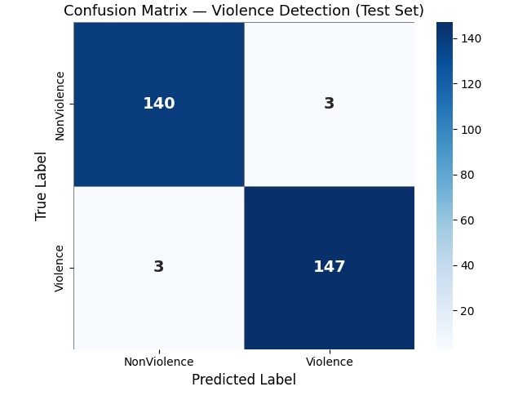
Experimental Results:
TEST SET EVALUATION RESULTS:
Accuracy : 97.95%
Precision : 98.00%
Recall : 98.00%
F1 Score : 98.00%
Confusion Matrix:
TP Violent → Violent : 147
TN NonViolent. → NonViolent. : 140
FP NonViolent. → Violent : 3
FN Violent → NonViolent. : 3
Confusion Matrix Visualization
Displays true vs predicted labels.
Helps analyze:
False positives
False negatives
Class-wise performance

Slide 16
Advantages
High Accuracy with Minimal Data: Achieves 97.95% accuracy using transfer learning from Kinetics-400 pretrained weights, trained on only ~293 balanced samples
Reduced False Alarms: Uses a confidence-based temporal voting system (5 frames, 85% threshold) to filter out momentary errors, making predictions more stable and reliable than single-frame methods.
Easy-to-Use Web Interface: Built with a browser-based interface, enabling users to run detection without any coding or technical setup.
Lightweight and Portable:
Requires only a single model file (.pth) and standard libraries. Runs consistently across Windows, Linux, and macOS with no hardware dependency.

Slide 17
Conclusion
A real-time human violence detection framework based on ResNet3D-18 was
developed for spatio-temporal video analysis.
The model effectively captures motion and appearance features from 16-frame
video clips.
The proposed confidence-gated temporal voting mechanism significantly
reduces false positives and improves detection stability.
The system achieved 97.95% accuracy with strong precision and
recall performance.
Real-time deployment with CPU and GPU support demonstrates practical
applicability in surveillance environments.

Slide 18
Future Scope:
Multimodal Fusion — Audio + Video: Integrate audio analysis (screams, impact sounds, breaking glass) alongside video using a gated fusion module
Multi-Camera Centralized Dashboard: Build a unified monitoring dashboard aggregating real-time alerts from multiple camera feeds simultaneously
Auto Sending Alerts: When violence is detected, the system should automatically send an SMS or email to security staff or police
Making It Smarter Over Time: The model can be retrained regularly with new video data from the actual deployment location — making it more accurate

Slide 19
References
“Fabrication of Drone.” SlideShare, 30 Apr. 2019, www.slideshare.net/Rajnishkumar468/fabrication-of-drone. Accessed 31 May 2024.
Kotecha, Ketan, et al. “Background Invariant Faster Motion Modeling for Drone Action Recognition.” Drones, vol. 5, no. 3, 31 Aug. 2021, p. 87, https://doi.org/10.3390/drones5030087.
Perera, Asanka G., et al. “Drone-Action: An Outdoor Recorded Drone Video Dataset for Action Recognition.” Drones, vol. 3, no. 4, 28 Nov. 2019, p. 82, https://doi.org/10.3390/drones3040082.
Ramachandran, Anitha, and Arun Kumar Sangaiah. “A Review on Object Detection in Unmanned Aerial Vehicle Surveillance.” International Journal of Cognitive Computing in Engineering, vol. 2, 1 June 2021, pp. 215–228, www.sciencedirect.com/science/article/pii/S2666307421000267#bib0011, https://doi.org/10.1016/j.ijcce.2021.11.005.
Srivastava, Anugrah, et al. “Recognizing Human Violent Action Using Drone Surveillance within Real-Time Proximity.” Journal of Real-Time Image Processing, vol. 18, no. 5, 12 Sept. 2021, pp. 1851–1863, https://doi.org/10.1007/s11554-021-01171-2.
Accessed 1 Feb. 2022.
https://ieeexplore.ieee.org/abstract/document/10459026
https://ieeexplore.ieee.org/abstract/document/9006834
Singh, Pawan Kumar, et al. “Progress of Human Action Recognition Research in the Last Ten Years: A Comprehensive Survey.” Archives of Computational Methods in Engineering, 30 Nov. 2021, https://doi.org/10.1007/s11831-021-09681-9.

Slide 20
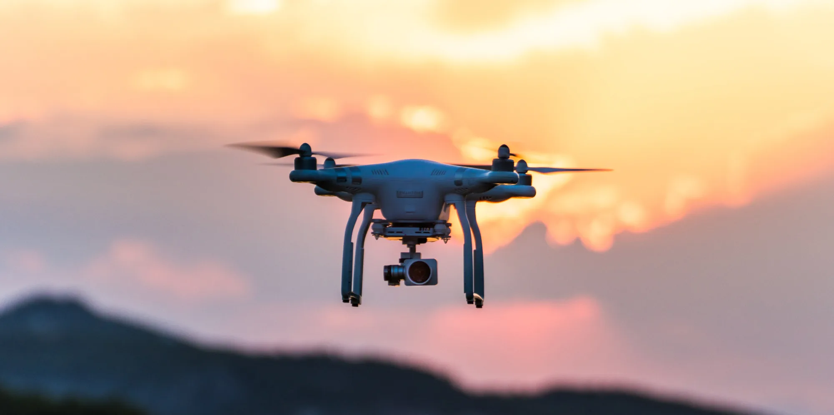
Thank You

