Slide 1
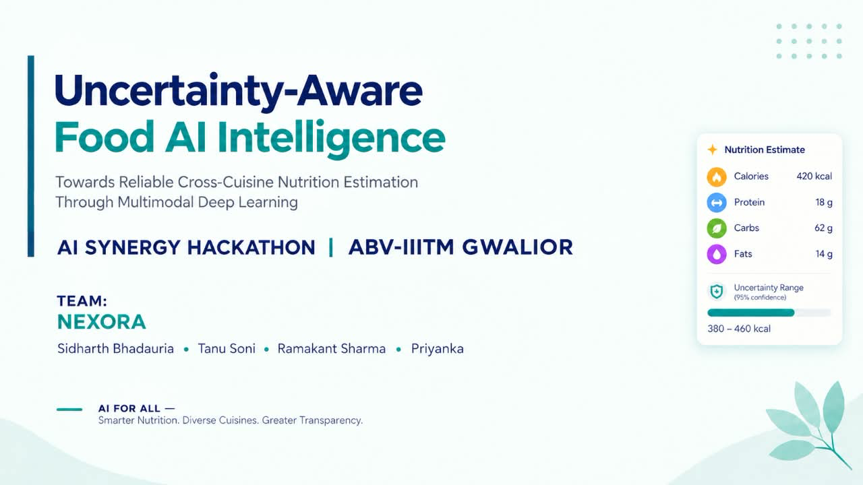

Slide 2
Understanding the Topic
02
Four ideas that define the Cortix approach
01
Nutrition estimation
02
Multimodal inputs
Predict approximate calories, protein, carbohydrates and fat from a meal photo.
Combine the image with available clues such as dish name, ingredients or portion details.
03
Uncertainty-aware
04
Cross-cuisine
Show a range or ask a clarifying question when the image does not provide enough evidence.
Evaluate on Indian, East Asian and Western meals—not only familiar training examples.
In one line: estimate the meal, combine clues, test across cuisines, and be transparent about uncertainty.

Slide 3
Case Understanding
03
A food photo shows visible clues, but hides key nutrition details
Hidden ingredients
Unclear portion size
Cuisine variation
Oil, ghee, dressings and sauces may not be visible in the image.
Small and large servings can look similar from one camera angle.
Models may struggle when a dish differs from their training examples.
PHOTO EVIDENCE
Visible food
Missing context
Risk
shape • colour • dish cues
oil • weight • ingredients
a precise-looking but unreliable number

Slide 4
Final Problem Statement
04
Food photos hide key details, making cross-cuisine nutrition estimates uncertain.
01
02
03
Show a range
Test new cuisines
Ask when needed
Return an estimated interval when appropriate—not only one number.
Measure how performance changes across different food styles.
Request portion size or added-oil details only when they may change the estimate.
Estimate
Check
Improve
Initial prediction
Assess uncertainty
Ask or show a range
Key design choice: estimate → quantify uncertainty → decide whether to report, qualify or request more input.
Success means better transparency—not a promise of perfect accuracy.

Slide 5
Proposed Solution
05
Three connected modules turn a photo into a responsible estimate
01 Food understanding
02 Nutrition estimate
03 Confidence check
Photo + available dish or ingredient details
Approximate calories, protein, carbs and fat
Decide whether to show, qualify or refine result
Enough evidence
More context needed
Show estimate + range
Ask about size or oil

Slide 6
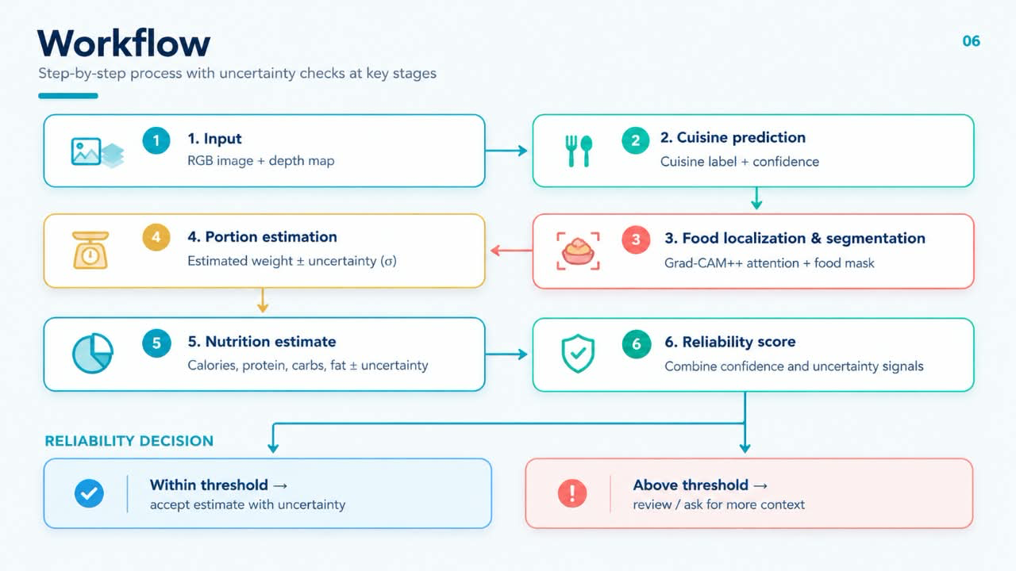

Slide 7
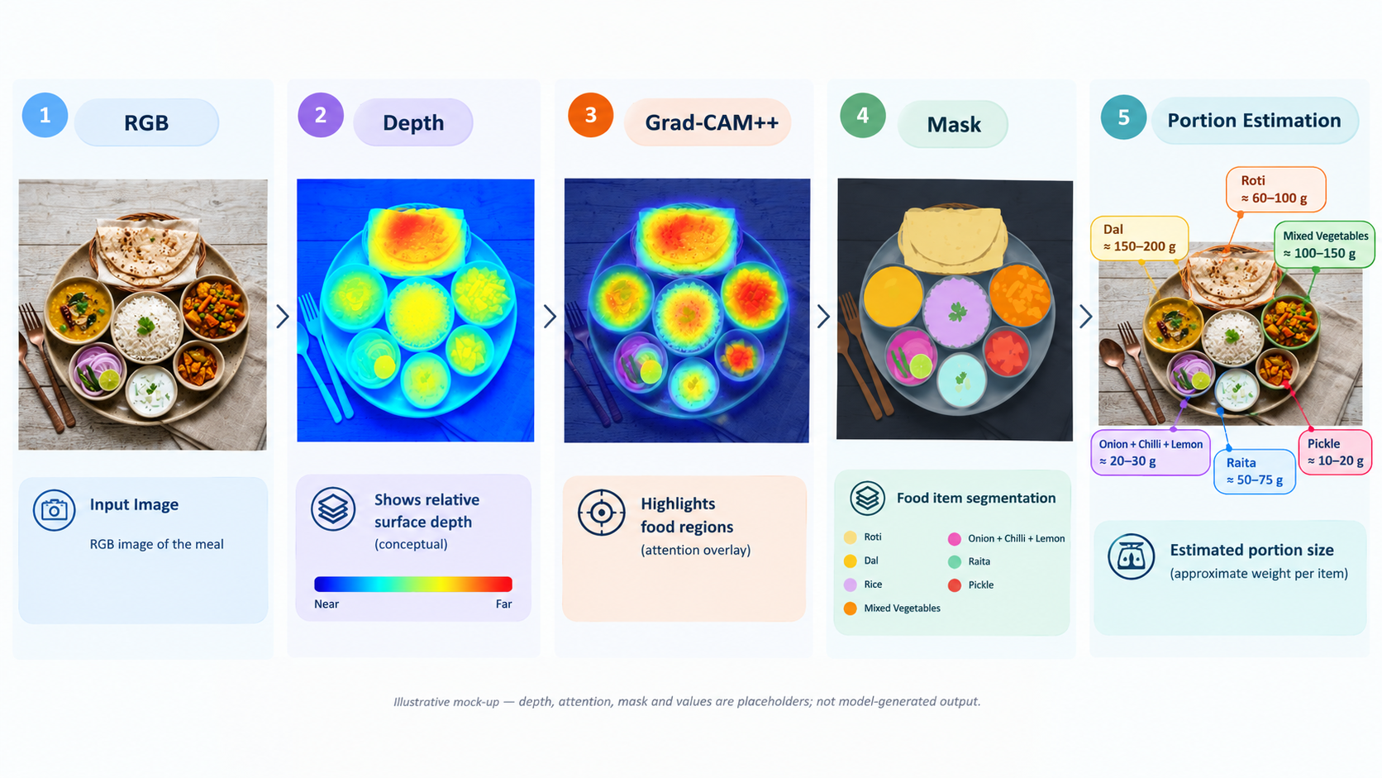
Example: Indian Thali Analysis
07
Illustrative example of how a food image could be processed by Cortix
Meal: roti, rice, dal, mixed vegetables, pickle and raita

Slide 8
Feasibility & Implementation Plan
08
Start with a small prototype, then add and test features in stages
1
Collect data
Food images + nutrition labels
PROTOTYPE MILESTONES
2
Establish references
Use nutrition tables to check values
Working photo-upload flow
3
Build prototype
Nutrient estimate output
Photo upload + nutrition result
Uncertainty / clarification logic
4
Add uncertainty
Cross-cuisine test log
Ranges + portion/oil questions
5
Test across cuisines
Record strengths and failure cases
Keep every result traceable to its data and assumptions.

Slide 9
How We Will Evaluate It
09
Evaluation criteria planned for the prototype
Nutrition error
Compare predicted and reference values
Test set
Run model
Known meals + reference values
Predict nutrients + range
Range quality
Check how often truth falls in the range
Cuisine performance
Compare outcomes by food style
Report results only after testing—no accuracy claims in advance.

Slide 10
Risks & Limitations
10
A useful support tool, but not a perfect measurement
POTENTIAL BENEFITS
CURRENT LIMITATIONS
Faster meal logging
Oil and ingredients may be hidden
Useful approximate nutrition estimates
Portion size can be difficult to infer
Clearer warning when confidence is low
Unfamiliar dishes need more testing

Slide 11
Development Roadmap
11
A staged path from baseline model to robust cross-cuisine testing
01
02
03
04
Baseline
Uncertainty
Clarification
Validation
Build photo-based nutrition estimate
Add ranges to communicate confidence
Ask about portion size or added oil
Test across cuisines and document errors
Deliverable: a working prototype with transparent outputs and documented evaluation.

Slide 12


