Slide 1


An Embedding Approach to Anomaly Detection
Renjun Hu¹, Charu Aggarwal², Shuai Ma¹, and Jinpeng Huai¹
¹SKLSDE Lab, Beihang University, China
²IBM T. J. Watson Research Center, USA

Slide 2



Motivation
Anomaly detection
Identification of patterns in data that do not conform to expected behaviors [Chandola et al. 2009]
Useful in a wide variety of applications
In networks, anomaly detection has broader meanings
Application-specific significance
Possibility to improve the performance of network-centric mining tasks such as community detection and classification
V. Chandola, A. Banerjee, and V. Kumar. Anomaly detection: A survey. ACM Comput. Surv. 41(3), 2009.

Slide 3

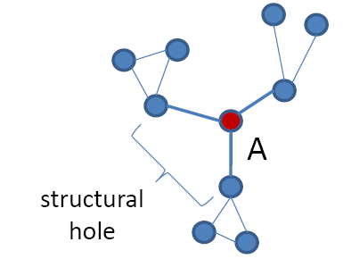
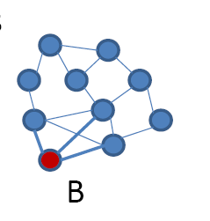
Motivation
Structural hole theory [Burt 1992, 2004]
Theory of social capital
A structural hole is a gap between two nodes who have complementary sources to information
Prof. Ronald S. Burt
How to detect social brokers?
A formal quantitative definition is needed in the first place!
u
v
Node A (social broker) is more likely to get novel information than B, even though they have the same number of links.
Burt, Ronald S. (1992). Structural holes: the social structure of competition. Harvard University Press.
Burt, Ronald S. (2004). Structural Holes and Good Ideas. American Journal of Sociology 110 (2): 349–399.

Slide 4
Motivation
Structural inconsistencies
Nodes that connect to a number of diverse influential communities
Detect social brokers quantitatively
Anomalousness from homophily [McPherson et al. 2001]
Linked nodes have similar properties
Fundamental to a wide variety of algorithms in network science
E.g., community detection, collective classification, link prediction, influence analysis
Violated by structural inconsistencies
M. McPherson, L. Simth-lovin and J. Cook. Birds of a feather: Homophily in social networks. Annual review of sociology, Vol. 27: 415-444, 2001.

Slide 5
Motivation
Structural inconsistencies
Nodes that connect to a number of diverse influential communities
Detect social brokers quantitatively
The presence of structural inconsistencies may:
have a substantial impact on network structure
E.g., all nodes tend to form one large cluster
prevent effective applications of network mining algorithms
E.g., hard for community detection algorithms to achieve meaningful clusters

Slide 6
Outline
Anomaly detection model
Graph embedding
A quantitative measure of anomaly
Algorithm optimization techniques
Evaluation

Slide 7
Why graph embedding?
Structural inconsistencies
connect to a number of diverse influential communities
Evaluate the diversity or similarity of nodes. How?
B
C
To node B, node A is more similar than C, even though they have the same (global) distance from B.
A
Graph embedding
Associate each node with a multidimensional vector
Preserve local linkage structure (instead of global structure)
Each dimension corresponds to a community in the network

Slide 8
Why graph embedding?
Structural inconsistencies
connect to a number of diverse influential communities
An alternative option: doing community detection followed by anomaly detection
Do not distinguish anomalies from normal nodes
The presence of anomalies has certain impacts on the results of community detection
Community detection is a heavy task.
Fail to detect structural inconsistencies!

Slide 9
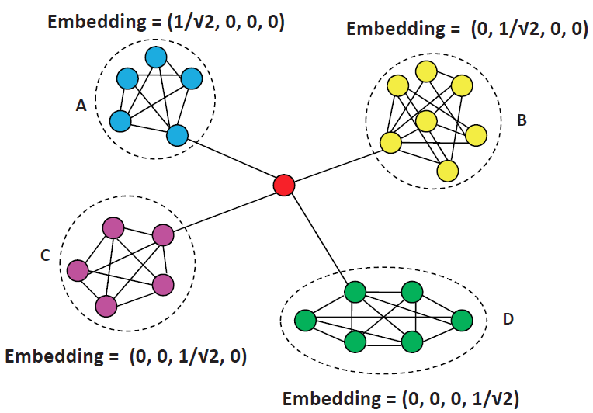
Graph embedding
Given an undirected graph G=(V, E), associate each node i with a d-dimensional vector X_{i}
V = {1,2,…,n}
d : number of communities
X_{i} : correlation between node i and the d communities
A reasonable selection of d suffices for anomaly detection. Not necessary to use the number of real-life communities.

Slide 10
Graph embedding
Given an undirected graph G=(V, E), associate each node i with a d-dimensional vector X_{i}
Goal: preserve local linkage structure
Connected nodes should have similar values of X_{i}
Disconnected nodes should have diverse values of X_{i}
Computation: minimizing objective function O
n: number of nodes in G, m: number of edges in G
α : balancing factor that regulates the importance of the two components in O
The embedding ensures that 0≤‖X_{i} - X_{j}‖²≤1

Slide 11
A quantitative measure
Inspired by structural inconsistencies and structural holes (social brokers)
Connect to a number of diverse influential communities
Bridge across complementary sources
NB(i): how node i connects to communities
AScore(i): the anomalousness of node i
Detect anomalies by AScore(i) > thre

Slide 12
Example
Optimality of embedding, i.e., minimum value of O
Small values within groups because of missing edges
No values across groups
Certain values for the red node (no better embedding)
Anomalousness of nodes
AScore(red) = 4 (equal values in dimensions of NB(red))
AScore(i) ≈ 1 for others (NB(i) only has a dominating dimension)
The red node is detected as an anomaly!

Slide 13
Outline
Anomaly detection model
Algorithm optimization techniques
Sampling
Graph partitioning based initialization
Dimension reduction
Evaluation

Slide 14
Issues in the model
Objective function O is a sum over O(n²) terms
Forbidden in large social networks
Optimizing O uses a gradient descent method
Critically dependent on a good initialization
Dimensionality of embedding (i.e., d) could be large
E.g., 8,353 for YouTube and 6,288,363 for Orkut [Yang & Leskovec 2012]
J. Yang and J. Leskovec. Defining and evaluation network communities based on ground-truth. In ICDM, 2012.

Slide 15
Sampling
Objective function O is a sum over O(n²) terms
Observation: balancing factor α is close to 0
Very inefficient
Possible to approximately represent O by sampling
Sampled objective function O
|E_{s}| = |E| = m

Slide 16
Graph partitioning based initialization
Optimizing O uses a gradient descent method
Critically dependent on a good initialization
A good initialization means small value of O
Densely connected nodes have similar values of X_{i}
Nodes across groups have diverse values of X_{i}
Incorporating graph partitioning (METIS) for initialization
P_{i} : partition number of node i

Slide 17
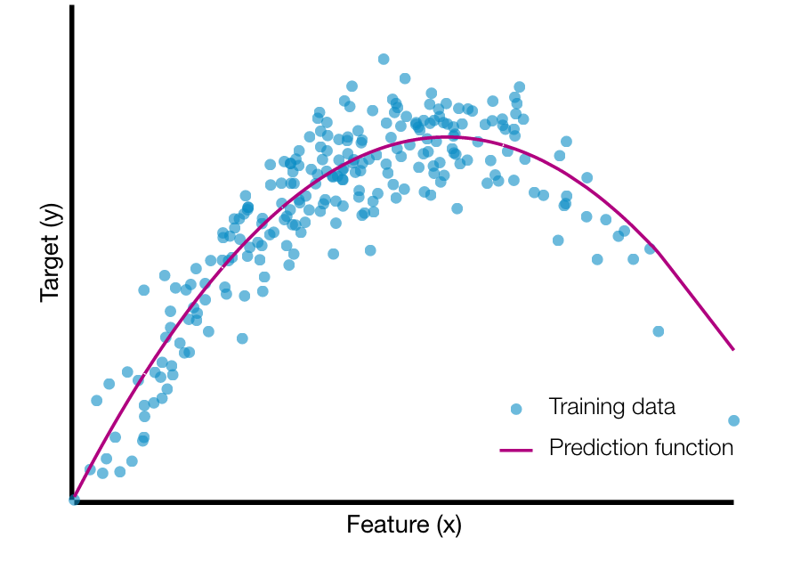
Dimension reduction
Dimensionality of embedding (i.e., d) can be large
The complete d-dimensions are unnecessary
Nodes typically connect to a limited number of communities
A limited number of communities suffice to ascertain anomalies
(Gordon) Hughes Effect
Data approximation (k+β reduction)
only maintain (k+β)-dimensions for embedding of each node
k : the maximum number of communities to connect
β : tolerate mistakes when determining the k communities
k << d & β << d, e.g., 10 & 2 for a network with n = 10⁶

Slide 18
Impacts of optimization techniques
 | Space | Efficiency | Effectiveness
Sampling | / | Prev.: O(n²∙d) | Remain effective (from experiments)
 |  | After: O(m∙d)
Graph partitioning | / | Prev.: 0 | Provide a good initialization
 |  | After: O(n+m+d∙log(d))
k+β reduction | Prev.: O(n∙d) | Prev.: O(t∙m∙d) t : # of iterations | Slightly improve effectiveness
 | After: O(n∙(k+β)) | After: O(t∙m∙(k+β))

Slide 19
Outline
Anomaly detection model
Algorithm optimizations
Evaluation

Slide 20
Experimental settings
Datasets
Dataset | # of nodes | # of edges | Descriptions
Amazon | 334,863 | 925,872 | Product co-purchasing
DBLP | 1,150,852 | 5,098,175 | Co-authorship
Synthetic | 10⁵ - 4x10⁶ | m = n^{1.15} | LFR-benchmark graph
Anomaly injection on Synthetic data for ground-truth of anomalies
Algorithms
Embed(d) : embedding of d-dimensions
Embed(k+β) : embedding with k+β reduction
Oddball : based on violation of power-laws of egonet-based features
MDS(d) : similar to Embed(d), except using multi-dimensional scaling for embedding (preserve global structure)
Parameters: d = n/500, k = avgDeg, β = k/4
Implementation: C++, Core i5 3.10GHz, 16GB of memory

Slide 21
Case study on DBLP
Different people with the same name
Wei Wang
84 people named Wei Wang [DBLP, May 10 2016]
University of Waterloo (Canada), Fudan University (China), University of California, San Diego (USA), etc.
People with many collaborators in diverse institutes
Dr. Ajith Abraham
Director of intelligence research labs which has members from more than 100 countries
Work in a multi-disciplinary environment involving machine intelligence, cyber security, sensor networks and data mining
Teach in 23 universities all over the world

Slide 22
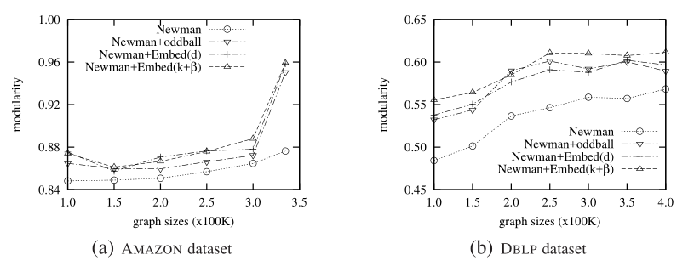
Quality study: modularity
Modularity measures the strength of division of a network into communities
Using modularity to evaluate the improvement of the effectiveness of community detection
 | oddball | Embed(d) | Embed(k+β)
Amazon | 2.1% | 2.8% | 3.0%
DBLP | 4.2% | 4.1% | 5.6%
Table 1: Improvement of modularity

Slide 23
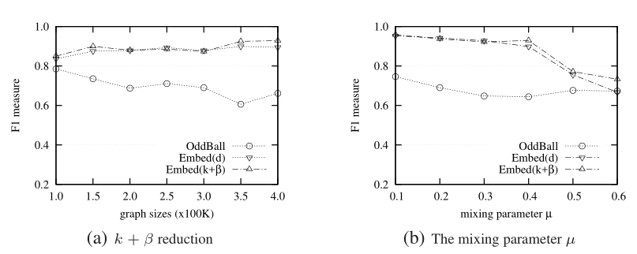
Quality study: F₁ measure
On Synthetic data with ground-truth of anomalies
Mixing parameter μ: fraction of inter-group edges (i.e., μ ↑, strength of community structure ↓)
 | oddball | Embed(d) | Embed(k+β)
Varying graph sizes | 70% | 88% | 89%
Varying μ | 68% | 86% | 88%
Table 2: F₁ score of anomalies

Slide 24
Impacts on quality: d & embedding
Synthetic data, n = 400K, n/500 = 800
 | MDS(d) | Embed(d)
d = 200 | 11.3% | 89.4%
d = 400 | 13.6% | 90.6%
d = 600 | 12.7% | 89.8%
d = 800 | 7.9% | 85.5%
d = 1000 | 11.3% | 88.8%
Average | 11.3% | 88.8%
Table 3: MDS(d) vs. Embed(d) using F₁ measure
Multi-dimensional scaling fails to effectively detect anomalies
Our approach works well as long as d falls into a reasonable range

Slide 25
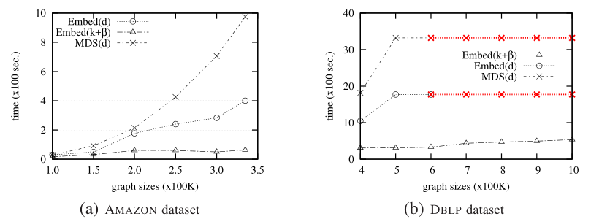
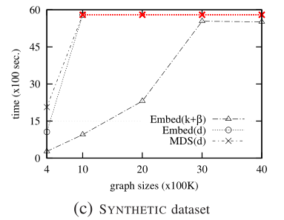
Efficiency study
x : out of memory exception
 | E(k+β)/E(d) | E(k+β)/MDS(d)
Amazon | 35.3% | 25.0%
DBLP | 23.4% | 13.1%
Synthetic | 25.6% | 13.2%
Table 4: running time comparison

Slide 26
Summary
Structural inconsistencies
Nodes that connect to a number of diverse influential communities
A formal quantitative definition of social brokers
An embedding approach
Preserve local linkage structure of networks
A quantitative measure Ascore inspired by structural inconsistencies and structural holes
Three algorithm optimization techniques
Quality and efficiency results
Modularity increases 2.9%, 4.9% and 6.9% on Amazon, DBLP and Synthetic data
F1 measure is 88% on Synthetic data
Running time increases reasonably w.r.t graph sizes

Slide 27
Thanks! Q & A

