Slide 1



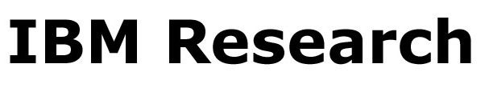
Scaling up Link Prediction with Ensembles
Liang Duan¹, Charu Aggarwal², Shuai Ma¹, Renjun Hu¹, Jinpeng Huai¹
¹SKLSDE Lab, Beihang University, China
²IBM T. J. Watson Research Center, USA

Slide 2


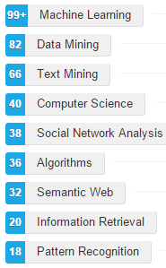





Motivation
Link prediction
predicting the formation of future links in a dynamic network
Applications
recommender systems, examples:
collaborators
friends
movies
Lily
Alice
Hank
Martin
Various applications in large networks!

Slide 3

Motivation
The O(n²) problem in link prediction
Assume a node pair could be done in a single machine cycle.
A network with n nodes contains O(n²) possible links.
Analysis of required time:
Network Sizes | 1 GHz | 3 GHz | 10 GHz
10⁶ nodes | 1000 sec. | 333 sec. | 100 sec.
10⁷ nodes | 27.8 hrs | 9.3 hrs | 2.78 hrs
10⁸ nodes | > 100 days | > 35 days | > 10 days
10⁹ nodes | > 10000 days | > 3500 days | > 1000 days
It is challenging to search the entire space in large networks!
Most existing methods only search over a subset of possible links rather than the entire network.

Slide 4
Outline
Latent Factor Model for Link Prediction
Structural Bagging Methods
Experimental Study
Summary

Slide 5
Latent Factor Model for Link Prediction
Network G(N, A) and weight matrix W
G: an undirected graph
N: node set of G containing n nodes
A: edge set of G containing m edges
W: an n$×$n matrix containing the weights of the edges in A
Nonnegative Matrix factorization (NMF)
F_{i} is an r-dimensional latent factor with the i-th node.
determine F by
using multiplicative update rule:
Link prediction
positive entries in FF^{T} are viewed as predictions of 0-entries in W

Slide 6
Latent Factor Model for Link Prediction
Example 1: Given a network with 5 nodes and r = 3, predict links on this network.
1
2
1
2
1
3
5
3
4
2
W
F
F^{T}
1
2
1
2
1
3
5
3
4
2
FF^{T}

Slide 7
Latent Factor Model for Link Prediction
Efficient top-k prediction searching is necessary
FF^{T} contains n² entries
F is often nonnegative and sparse
Top-(ε, k) prediction problem is to return k predicted links
the k-th best value of FF^{T} for a link (i, j) is at most ε less than the k-th best value of FF^{T} over any link (h, l) in the network.
A tolerance of ε helps in speeding up the search process

Slide 8
Top-(ε, k) Prediction Searching Method
A solution for top-(ε, k) prediction problem
Execute the following nested loop for each column of S:
f_{p} (f_{p}’): the number of rows in the p-th column of S that S_{ip} > (0)
for each i = 1 to f_{p} do
for each j = i + 1 to f_{p}’ do
if S_{ip} ∙ S_{jp} < ε / r then break inner loop;
else increase the score of node-pair (R_{ip}, R_{jp}) by an amount of S_{ip} ∙ S_{jp} ;
end for
end for
S: sorting the columns of F in a descending order
R: node identifiers of F arranged according to the sorted order of S
outer loop
S_{ip} <
underestimation is at most ε
inner loop
S_{ip} ∙ S_{jp} < ε / r

Slide 9
Top-(ε, k) Prediction Searching Method
Example: Continue with example 1, assume ε = 1.
F
S
R
Column 1: f₁ = 1, f₁’ = 4, S₁₁*S₂₁ = 0.35, S₁₁*S₃₁ = 0.35,
Column 2: f₂ = 3, f₂’ = 4, S₁₂*S₂₂ = 0.88, S₁₂*S₃₂ = 0.77, S₁₂*S₄₂ = 0.33, S₂₂*S₃₂ = 0.56
Column 3: f₃ = 3, f₃’ = 4, S₁₃*S₂₃ = 0.63, S₁₃*S₃₃ = 0.63, S₂₃*S₃₃ = 0.49
A large portion of search space is pruned!

Slide 10
Outline
Latent Factor Model for Link Prediction
Structural Bagging Methods
Experimental Study
Summary

Slide 11
Structural Bagging Methods
Problems in latent factor models
the complexity is O(nr²)
r usually increases with the network size
bad performance (efficiency & accuracy) on large sparse networks
Structural bagging methods
Ensemble 1
Data
Ensemble 2
Result
Ensemble x
decompose the link prediction problem into smaller sub-problems
aggregate results of multiple ensembles to a robust result
ensemble-enabled method
Efficiency advantages
smaller sizes of the matrices in NMF
smaller the number r of latent factors

Slide 12
Random Node Bagging
Steps:
f : fraction of the number of nodes to be selected
1.
2.
3.
Bound of random node bagging
The expected times of each node pair included in μ / f² ensembles is at least μ.

Slide 13
Edge & Biased Edge Bagging
Random node bagging samples less relevant regions.
Edge bagging
Steps:
1.
Steps 2 and 3 are same to the random node bagging.
Edge bagging tends to include high degree nodes.
Biased edge bagging
Difference with edge bagging:

Slide 14

Using Link Prediction Characteristics
Bagging should be designed in particular for link prediction.
Observation
Most of all new links span within short distances (closing triangles)
Combine link prediction characteristics
a node should be always sampled together with all its neighbors.
Example:
The edge (c, d) is a triangle-closing edge.
When the node a is selected, its neighbors b, c, d and e are also put into the same ensemble.
b
c
a
e
d
Figure 1: Triangle-closing model.

Slide 15

Ensemble Enabled Top-k Predictions
Framework for ensemble-enabled top-k prediction
a network G(N, A) and parameters μ and f
repeat μ / f² times do
1: N_{s} ← ensemble generated by one of node, edge and biased edge bagging;
2: Compute F_{s} by factorizing W_{s} using NMF;
3: Obtain Γ ’ using top-(ε, k) method on F_{s};
4: Г ← top-k largest value node pairs in Γ ’$∪$ Г;
maximum value
return Г

Slide 16
Outline
Latent Factor Model for Link Prediction
Structural Bagging Methods
Experimental Study
Summary

Slide 17
Experimental Settings
Datasets:
Datasets | Descriptions | # of nodes | # of edges
YouTube | friendship | 3,223,589 | 9,375,374
Flickr | friendship | 2,302,925 | 33,140,017
Wikipedia | hyperlink | 1,870,709 | 39,953,145
Twitter | follower | 41,652,230 | 1,468,365,182
Friendster | friendship | 68,349,466 | 2,586,147,869
Algorithms:
AA | the popular neighborhood based method Adamic/Adar
BIGCLAM | a probabilistic generative model based on community affiliations
NMF | our latent factor model for link prediction
NMF(Node) | NMF with random node bagging
NMF(Edge) | NMF with edge bagging
NMF(Biased) | NMF with biased edge bagging
Implementation:
All algorithms were written in C/C++ with no parallelization
2 Intel Xeon 2.4GHz CPUs and 64GB of Memory

Slide 18
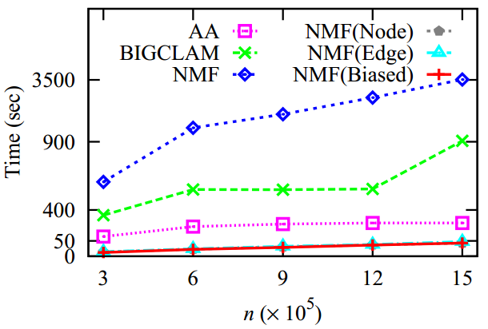
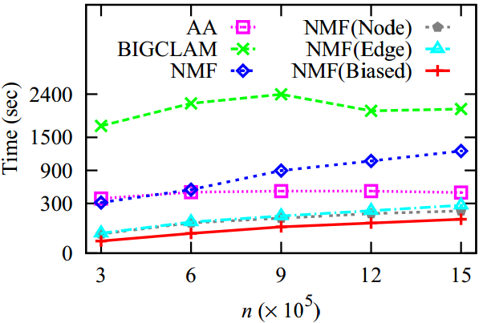
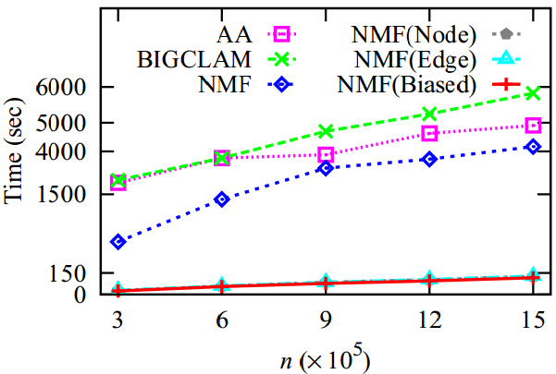
Efficiency Test
Efficiency comparison: with respect to the network sizes.
(a) YouTube
(b) Flickr
(c) Wikipedia

Slide 19
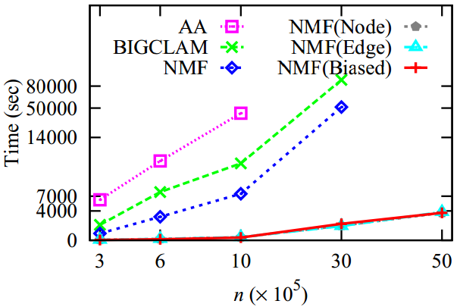
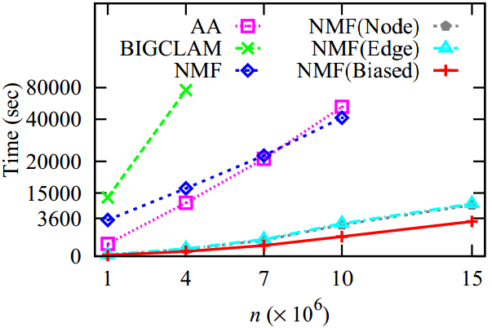
Efficiency Test
Efficiency comparison: with respect to the network sizes.
(d) Twitter
(e) Friendster
Dataset | NMF | AA | BIGCLAM
Twitter | 20x | 107x | 43x
Friendster | 31x | 21x | 175x
Table 2: The speedup of NMF(Biased) compared with other methods.

Slide 20
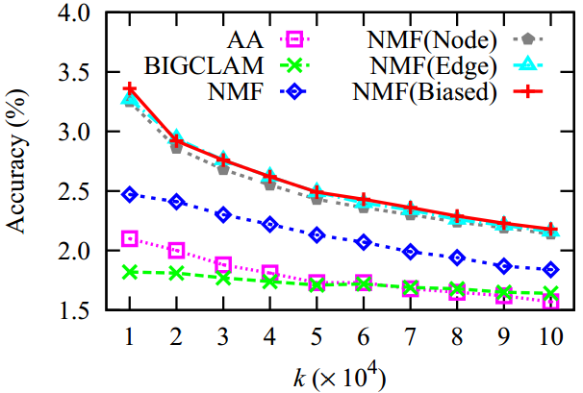
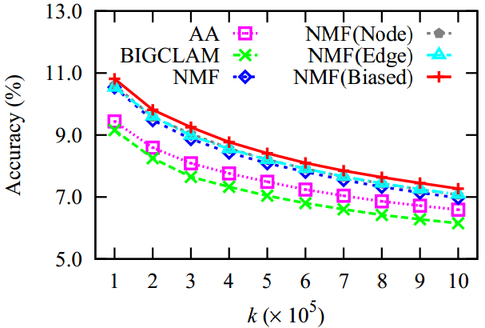
Effectiveness Test
The effectiveness of a top-k link prediction method x is evaluated with the following measure:
Accuracy comparison: with respect to the number k of predicted links.
(a) YouTube
(b) Flickr

Slide 21
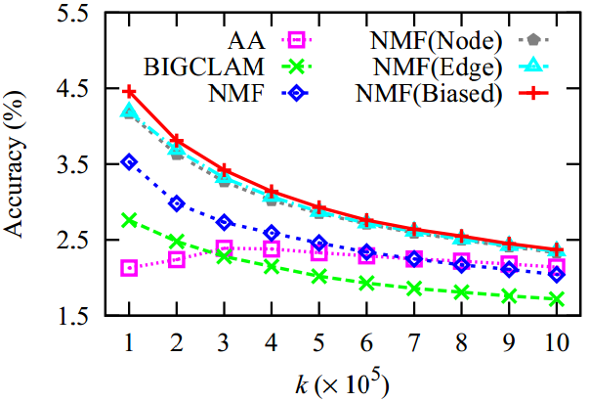
Effectiveness Test
Accuracy comparison: with respect to the number k of predicted links.
(c) Wikipedia
Dataset | NMF | AA | BIGCLAM
YouTube | 18% | 39% | 33%
Flickr | 4% | 10% | 18%
Wikipedia | 16% | 11% | 38%
Table 2: The accuracy improved by NMF(Biased) compared with other methods.
Both efficiency and accuracy are improved!

Slide 22
Outline
Latent Factor Model for Link Prediction
Structural Bagging Methods
Experimental Study
Summary

Slide 23
Summary
Conclusions
an ensemble-enabled approach for top-k link prediction;
scale to large networks with over 15 million nodes and 1 billion edges;
both accuracy and efficiency improved.
Accuracy and efficiency improved by NMF(Biased) compared with NMF:
Dataset | Accuracy | Dataset | Speedup
YouTube | 18% | Twitter | 20x
Flickr | 4%
 |  | Friendster | 31x
Wikipedia | 16%
Future work
distributed approaches scalable on networks with billions of nodes;
personalized recommendation using our approach.

Slide 24
Thanks!
Q & A

Slide 25
Experimental Settings
Training and ground truth data
Datasets | Date | # of nodes | # of edges
YouTube | 2006-12-09 ― 2007-02-22 | 1,503,841 | 3,691,893
 | 2007-02-23 ― 2007-07-22 | 1,503,841 | 806,213
Flickr | 2006-11-01 ― 2006-11-30 | 1,580,291 | 13,341,698
 | 2006-12-01 ― 2007-05-17 | 1,580,291 | 3,942,599
Wikipedia | 2001-02-19 ― 2006-10-31 | 1,682,759 | 28,100,011
 | 2006-11-01 ― 2007-04-05 | 1,682,759 | 5,856,896
The data in the first time slot is the training data and the remaining is the ground truth data.
The latest five month part is treated as its ground truth.
Twitter and Friendster do not have timestamps and are only used for the scalability test.

Slide 26
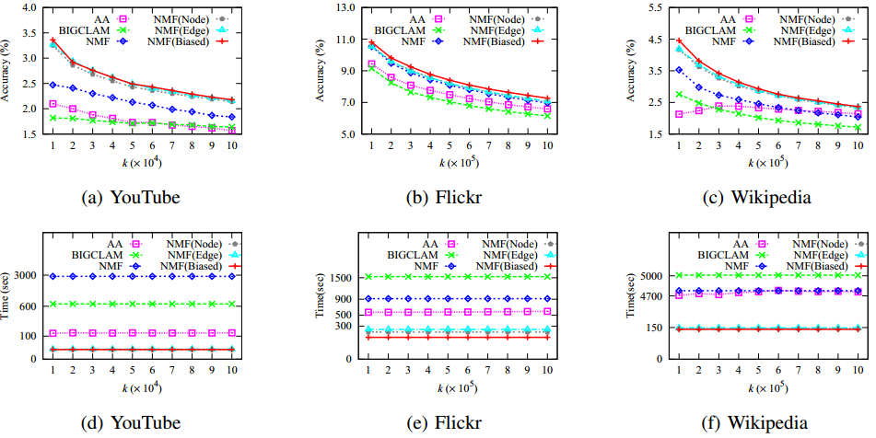
Experimental Results
Accuracy and efficiency comparison: with respect to the number k of predicted links

Slide 27
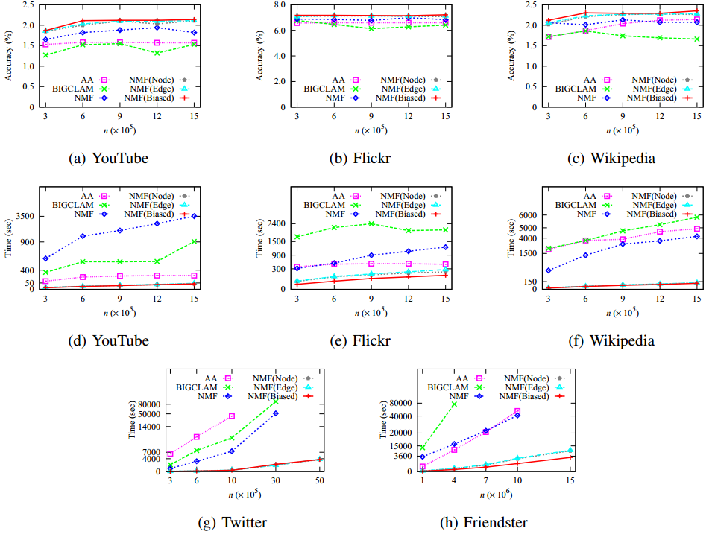
Experimental Results
Accuracy and efficiency comparison: with respect to the network sizes

Slide 28
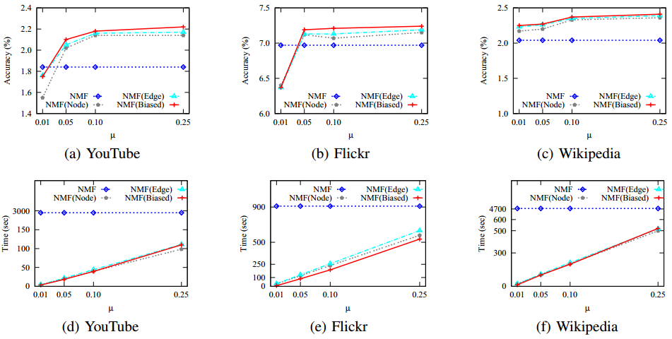
Experimental Results
Accuracy and efficiency comparison: with respect to the expected appearing times μ

Slide 29
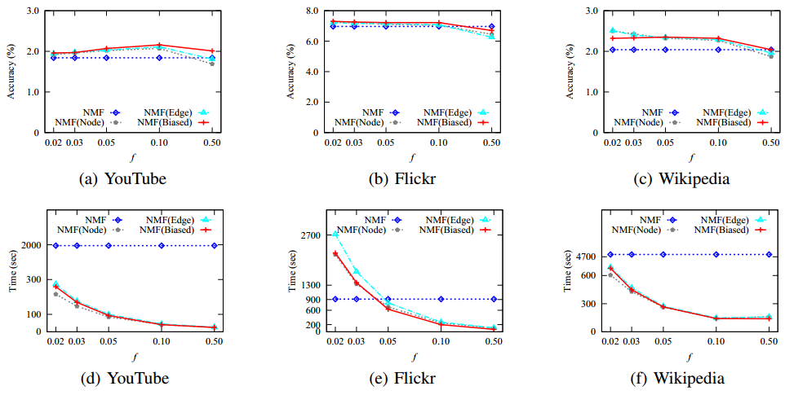
Experimental Results
Accuracy and efficiency comparison: with respect to the fraction f

Slide 30
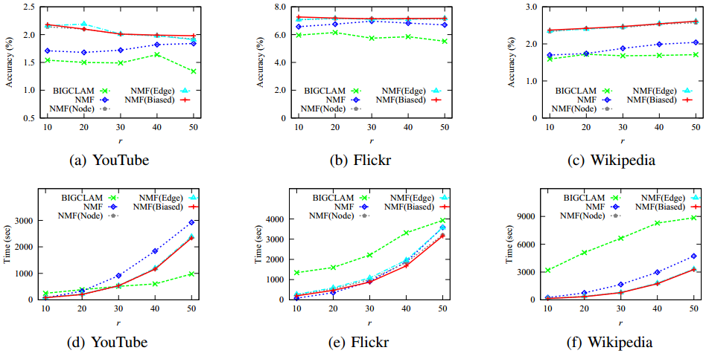
Experimental Results
Accuracy and efficiency comparison: with respect to the number r of latent factors

Slide 31
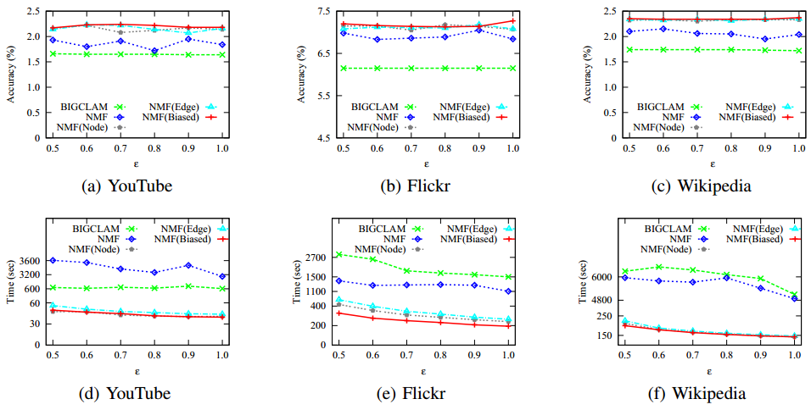
Experimental Results
Accuracy and efficiency comparison: with respect to the tolerance ε of top-(ε, k)

