Slide 1
ADVISOR PULSE
Where does this client stand?
AI-powered investor intelligence & action-prioritization layer for advisors — detect, explain, prioritize, prepare, act.
Demo book: 220 clients · 16 need review · Critical 1 · High 15
Team: [Name 1] · [Name 2] · [Name 3] · [Name 4] | Globathon 2026 FinTech
Advisor Pulse · Globathon 2026 · DEMO data · Citations on-slide

Slide 2
The problem: data exists — attention doesn't scale
• Holdings, goals, past advice, and notes live in different systems.
• Advisors can know their top ~20 clients deeply — the other ~200 rarely get proactive review.
• Hypothesis: the gap is not another chart — it is continuous, explainable prioritization of whom to contact next.
• Cerulli (2026): 64% of surveyed RIAs say AI reduced admin work; firms use AI to expand capacity, not replace advice.
Sources: Globathon problem framing; Cerulli Associates press release, 9 Sep 2026 (AI capacity survey, n=68 RIAs). Client-book 20/200 = illustrative.
Advisor Pulse · Globathon 2026 · DEMO data · Citations on-slide

Slide 3
Why CRM + portfolio tools still leave a gap
Store & engage
Analyze & construct
Still missing
CRM (e.g. Salesforce FSC)
Household 360, tasks, AI meeting prep
Morningstar / Aladdin Wealth
Research, risk, proposals, rebalancing
Cross-context attention loop
Goal path vs actual + explainable why-now + long-tail queue
Sources: salesforce.com/financial-services/wealth-management-software; morningstar Advisor Workstation; blackrock.com/aladdin (Aladdin Wealth). Fair comparison — not capability denial.
Advisor Pulse · Globathon 2026 · DEMO data · Citations on-slide

Slide 4
Advisor Pulse — the attention layer
Detect
Explain
Prioritize
Prepare
Act
Learn
→ Unified client context: holdings + goals + advice + notes (+ optional cash-flow signals)
→ Expectation-vs-actual with evidence-linked driver analysis (qualified, not fabricated)
→ Transparent multi-factor priority (Critical / High / Monitor / On Track) — configurable thresholds
→ Meeting briefs & review suggestions — human approval required; no autonomous trading
Advisor Pulse · Globathon 2026 · DEMO data · Citations on-slide

Slide 5
How the intelligence works
1. Txn + portfolio sources
4. Attention model
2. Validate
5. Evidence-linked summary
3. Goal & portfolio analytics
6. Advisor approves
Security boundary: no sensitive investor data to external LLMs without approved DPA. Demo uses deterministic templates. SEBI IA Reg. 15(14): IA remains responsible for AI tools.
Advisor Pulse · Globathon 2026 · DEMO data · Citations on-slide

Slide 6
Where the value lies: 20 vs 200
Known clients (illustrative top 20)
Long tail (illustrative ~200)
Meeting prep briefs
Changes since last review
Goal progress + evidence
Conversation-ready context
Supports depth — does not replace relationship.
Proactive detection of material deviations
Demo: 200 long-tail · 16 total need review
Configurable thresholds reduce alert fatigue
Data-quality ≠ financial distress
Greatest incremental value: scaling quality attention.
Illustrative book sizes. Industry context: Institutional Investor summarizing Cerulli — senior advisors ~160 clients; 29% manage >200. Not a measured productivity claim for Advisor Pulse.
Advisor Pulse · Globathon 2026 · DEMO data · Citations on-slide

Slide 7
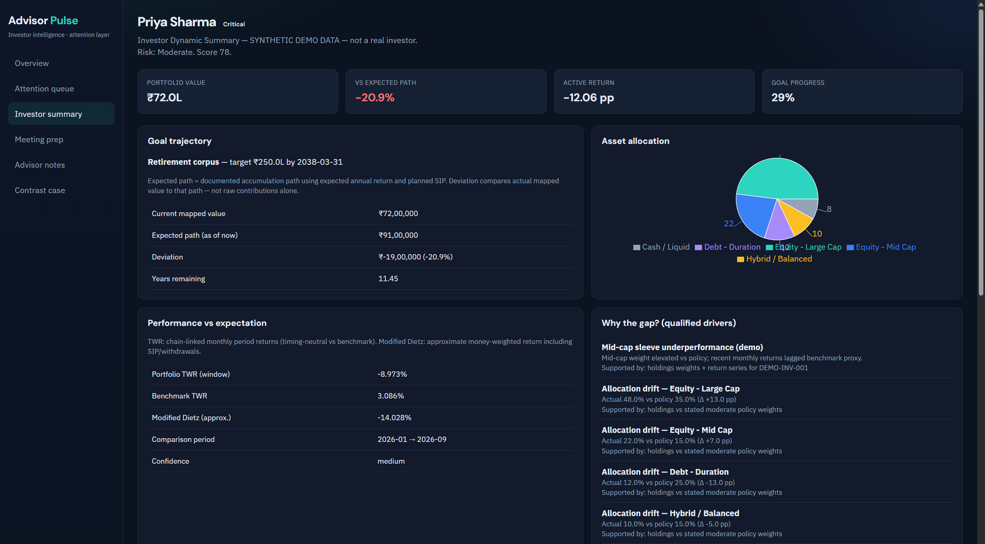
Investor Dynamic Summary — Priya Sharma (DEMO)
Computed demo metrics
Priority: Critical (score 78.0)
Portfolio ≈ ₹72.0L
Vs expected path: -20.9%
Active return: -12.06 pp
Goal: Retirement corpus
Confidence: medium
SYNTHETIC DEMO — not a real client.
Advisor Pulse · Globathon 2026 · DEMO data · Citations on-slide

Slide 8
Live demo walkthrough
1. DETECT — Priya behind expected path by -20.9%
2. EXPLAIN — Mid-cap overweight + active TWR lag vs benchmark (qualified drivers)
3. PRIORITIZE — Surfaces as Critical in book of 220
4. PREPARE — Meeting brief with open questions & overdue follow-ups
5. ACT — Advisor review suggestions only (rebalance discussion, close follow-up)
6. CONTRAST — Arjun Mehta: AUM dip from planned withdrawal → NOT escalated
Advisor Pulse · Globathon 2026 · DEMO data · Citations on-slide

Slide 9
Privacy, trust & human oversight
• RBAC, encryption in transit/at rest, audit trails — production architecture (prototype is local demo)
• Data minimization & purpose limitation (DPDP Act 2023 design considerations)
• SEBI IA Reg. 15(14): IA solely responsible for AI tools & client data integrity; disclose AI use (18(9))
• No investor PII to external models without approved processing arrangement — demo uses templates
• Meeting transcripts: mocked local path in prototype; production = on-prem ASR + consent
• Prompt-injection resistant summaries: numbers only from structured analytics
• Honest limit: NOT claimed compliant, certified, or regulator-approved
Sources: SEBI IA Regulations PDF; SEBI IA Master Circular PDF; MeitY DPDP Act 2023 PDF. Design considerations ≠ compliance certification.
Advisor Pulse · Globathon 2026 · DEMO data · Citations on-slide

Slide 10
Competitive positioning
Capability Salesforce FSC/Agentforce Morningstar AWS Aladdin Wealth Advisor Pulse
CRM / household 360 Y P P Integrates
Deep risk / stress NV P Y Not claimed
Goal path vs expected P P P Core
Explainable gap drivers NV P P Core (qualified)
Transparent priority factors NV NV P (alerts) Core
Evidence-bound NL briefs Y NV NV Y (structured→text)
Long-tail attention workflow P NV P Primary job-to-be-done
Differentiation: combination + explainable attention loop — not 'another dashboard'.
Y=evidenced · P=partial · NV=not verified in sources examined. See research/competitor_matrix.md.
Advisor Pulse · Globathon 2026 · DEMO data · Citations on-slide

Slide 11
Implementation & validation roadmap
Built today
Needs integration
Pilot metrics (plan)
• React + FastAPI prototype
• Synthetic DEMO book (220)
• TWR + Modified Dietz
• Transparent prioritization
• Meeting briefs + notes
• Deterministic summaries
• Tests + research pack
• Live custodian / PMS feeds
• CRM task push
• On-prem ASR
• Approved LLM under DPA
• Full Brinson attribution
• Production security review
• Review prep time
• % alerts advisor-validated
• Missed events (retro)
• False-positive rate
• % summaries with cited facts
No invented pilot results.
Round 2 Globathon rule: problem-specific logic must be built during the 12-hour finale; this repo is Round 1 ideation + reference architecture.
Advisor Pulse · Globathon 2026 · DEMO data · Citations on-slide

Slide 12
Where does this client stand?
Advisor Pulse helps advisors spend less time searching for signals —
and more time acting on the right ones.
Detect → Explain → Prioritize → Prepare → Act → Learn
Team placeholders · Globathon 2026 · React web prototype
Advisor Pulse · Globathon 2026 · DEMO data · Citations on-slide

Slide 13
Appendix — Finale pitch cut (2–4 slides)
Official Round 2 pitch requires a short PPT (2–4 slides). Suggested cut:
1) Title + promise (Slide 1)
2) Solution workflow + differentiation (Slide 4)
3) Demo metrics / Priya story (Slides 7–8 compressed)
4) Trust + ask (Slide 9 + close)
Also required at finale: working prototype, source code, run instructions, live demo + Q&A.
Reuse rule: problem-specific features must be developed during the coding round.
Advisor Pulse · Globathon 2026 · DEMO data · Citations on-slide

