Slide 1
ADVISOR PULSE
Where does this client stand?
AI-powered investor intelligence & action-prioritization layer —
Detect → Explain → Prioritize → Prepare → Act → Learn
220
16
1 / 15
20 + 200
DEMO clients
Need review
Critical / High
Visible + long-tail
Globathon 2026 FinTech · Advisor Dynamic Summary · Team: [Name 1] · [Name 2] · [Name 3] · [Name 4]
Metrics computed from SYNTHETIC DEMO book (live_api). Not real investors. Not investment advice.
Advisor Pulse · Globathon 2026 · DEMO / SYNTHETIC data · Citations on-slide

Slide 2
The problem: data exists — attention doesn't scale
Fragmented context
Holdings, goals, past advice, and notes live in different systems — so “where does this client stand?” takes too long to answer.
Capacity cliff
Advisors know their top ~20 deeply; the other ~200 rarely get proactive, evidence-backed review.
Wrong product gap
Hypothesis: the gap is not another chart — it is continuous, explainable prioritization of whom to contact next.
Industry signal
Cerulli (2026): 64% of surveyed RIAs say AI reduced admin work; firms use AI to expand capacity, not replace advice.
Sources: Globathon problem framing; Cerulli Associates press release, 9 Sep 2026 (AI capacity survey, n=68 RIAs). 20/200 book split = illustrative for demo storytelling.
Advisor Pulse · Globathon 2026 · DEMO / SYNTHETIC data · Citations on-slide

Slide 3
Why CRM + portfolio tools still leave a gap
Store & engage
Analyze & construct
Still missing
CRM (e.g. Salesforce FSC /
Agentforce Wealth)
Household 360, tasks,
AI meeting prep & briefs
Morningstar Advisor Workstation
· BlackRock Aladdin Wealth
Research, risk, proposals,
rebalancing, stress tests
Cross-context attention loop
Goal path vs actual +
explainable why-now +
long-tail review queue
Sources: salesforce.com/financial-services/wealth-management-software; morningstar.com Advisor Workstation; blackrock.com/aladdin (Aladdin Wealth). Fair comparison — not capability denial.
Advisor Pulse · Globathon 2026 · DEMO / SYNTHETIC data · Citations on-slide

Slide 4
Advisor Pulse — the attention layer
Detect
Explain
Prioritize
Prepare
Act
Learn
Detect — Unified client context: holdings + goals + advice history + notes (+ optional cash-flow signals)
Explain — Expectation-vs-actual with evidence-linked, qualified drivers (not fabricated narratives)
Prioritize — Transparent multi-factor score → Critical / High / Monitor / On Track (configurable)
Prepare — Meeting briefs & open questions grounded in structured facts
Act — Advisor-review suggestions only; human approval; no autonomous trading
Learn — Capture outcomes & notes so the next review starts smarter
Advisor Pulse · Globathon 2026 · DEMO / SYNTHETIC data · Citations on-slide

Slide 5
How the intelligence works
1. Ingest
2. Validate
3. Analytics
Txn CSV (cash-flow) +
SYNTHETIC portfolio
universe (labeled)
Schema checks,
freshness, missing-
data warnings
Goal path, TWR,
Modified Dietz,
allocation drift
4. Attention
5. Summarize
6. Human gate
Transparent factors +
thresholds → book
priority queue
Structured facts →
deterministic brief
(LLM optional, off)
Advisor reviews &
approves actions;
audit trail ready
Honest data split: supplied CSV = transactions only. Portfolio/goal analytics use labeled SYNTHETIC DEMO data. SEBI IA Reg. 15(14): IA remains responsible for AI tools & client data.
Advisor Pulse · Globathon 2026 · DEMO / SYNTHETIC data · Citations on-slide

Slide 6
Where the value lies: 20 vs 200
Known clients (illustrative top 20)
Long tail (illustrative ~200)
• Meeting prep briefs in minutes, not hours
• Changes since last review, surfaced
• Goal progress + evidence-linked drivers
• Conversation-ready open questions
Supports depth — does not replace the
relationship or professional judgment.
• Demo book: 200 long-tail clients
• 16 total need review now
• Proactive detection of material deviations
• Configurable thresholds cut alert fatigue
• Data-quality ≠ financial distress
Greatest incremental value: scaling quality
attention across clients outside daily focus.
Illustrative book sizes. Context: Institutional Investor summarizing Cerulli — senior advisors ~160 clients; 29% manage >200. Not a measured productivity claim for Advisor Pulse.
Advisor Pulse · Globathon 2026 · DEMO / SYNTHETIC data · Citations on-slide

Slide 7
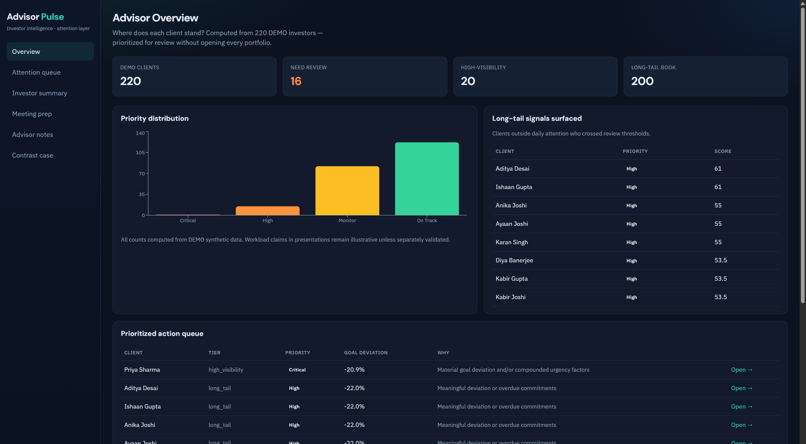
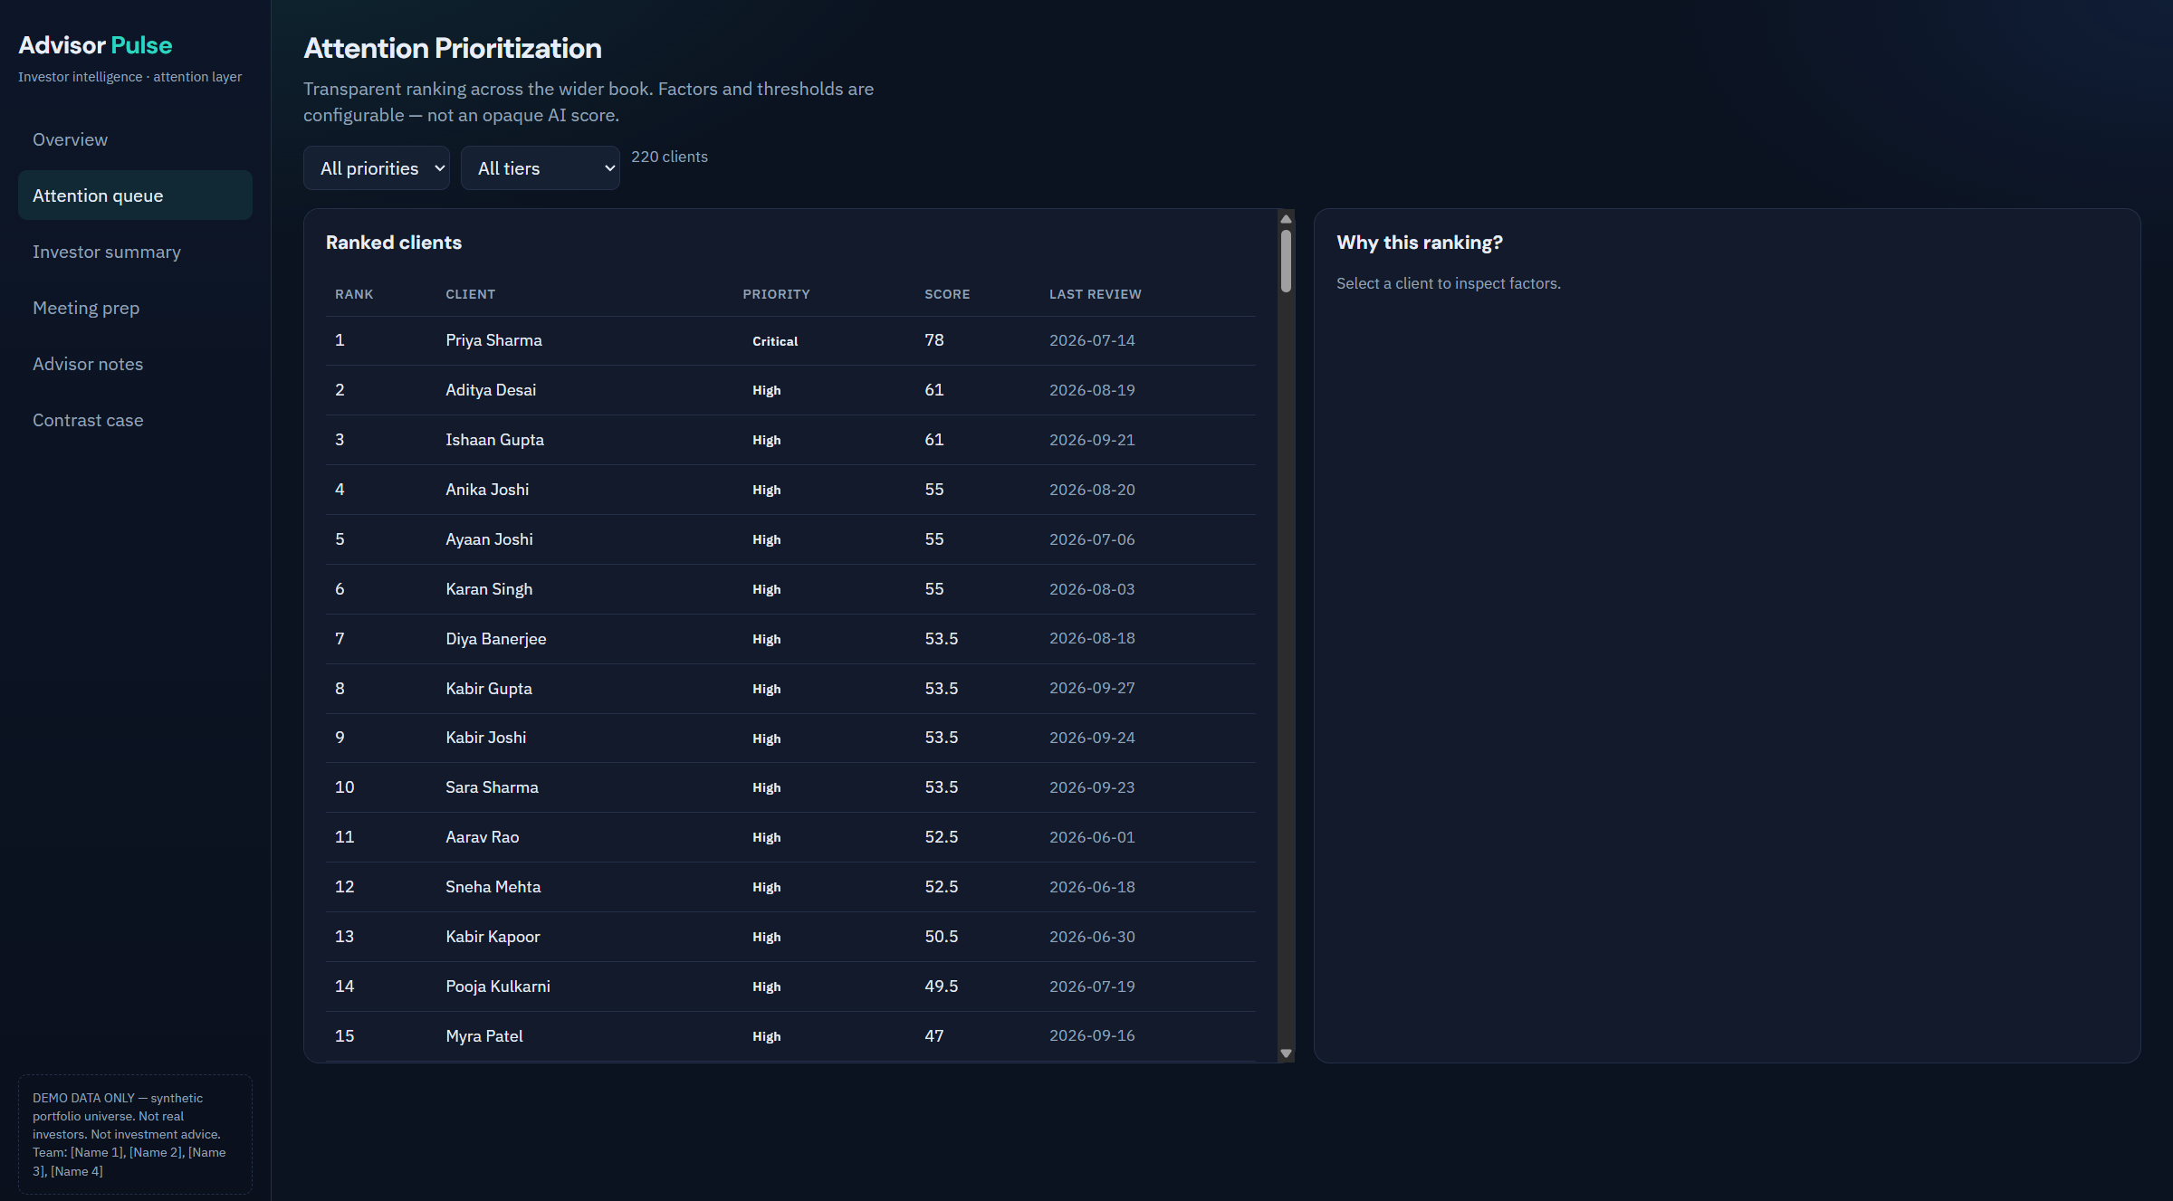
Product walkthrough — live prototype screens
REAL PROTOTYPE screens (React @ :5173) · Labels: DEMO / SYNTHETIC · Not mockups unless marked CONCEPT
Advisor Pulse · Globathon 2026 · DEMO / SYNTHETIC data · Citations on-slide

Slide 8
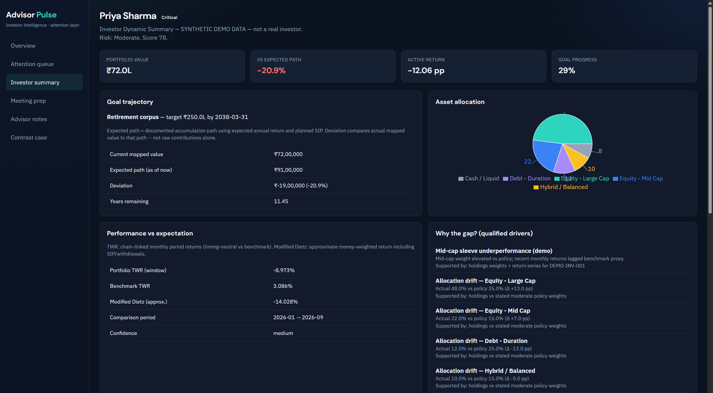
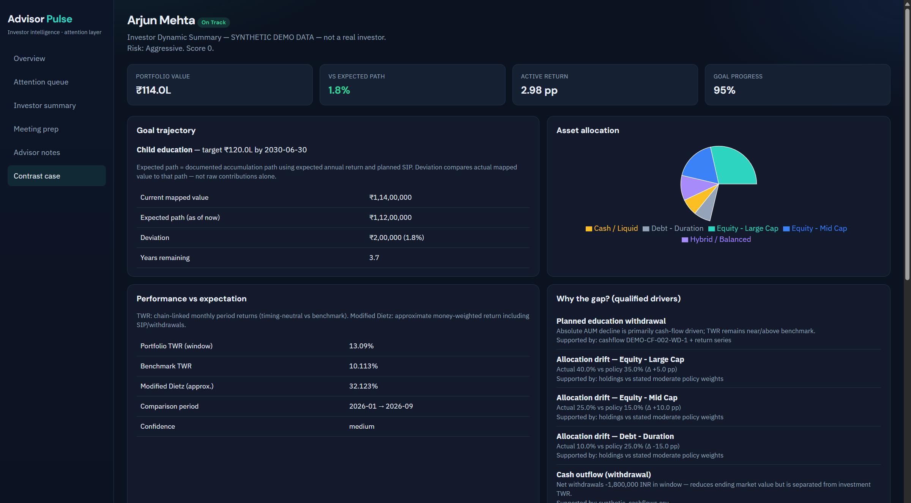
Demo: Priya (escalate) vs Arjun (do not escalate)
Priya Sharma · Critical · score 78.0
Path -20.9% · Active -12.06 pp · ₹72.0L
Arjun Mehta · On Track · score 0.0
Path +1.8% · Planned withdrawal explains AUM dip — NOT escalated
Advisor Pulse · Globathon 2026 · DEMO / SYNTHETIC data · Citations on-slide

Slide 9
Privacy, trust & human oversight
Human-in-the-loop
Outputs are advisor-review suggestions — never autonomous trade instructions.
SEBI IA Reg. 15(14)
IA solely responsible for AI tools, client-data integrity, and advice based on AI output; disclose AI use (Reg. 18(9)).
DPDP Act 2023
Design considerations: free/specific/informed consent, purpose limitation, Data Fiduciary security duties. Not claimed compliance.
Data boundary
Demo: no investor PII to external models — deterministic templates. Production: approved DPA or on-prem only.
Transcripts
Prototype: mocked local path. Production: consent + on-prem ASR + retention limits.
Evidence discipline
Summary numbers copied only from structured analytics; confidence + missing-data warnings shown.
Honest limit
Prototype is NOT SEBI-compliant, DPDP-certified, or production-secure.
Sources: SEBI IA Regulations PDF (Reg. 15(14)); SEBI IA Master Circular (AI disclosure / 18(9)); MeitY DPDP Act 2023 PDF. Design considerations ≠ certification.
Advisor Pulse · Globathon 2026 · DEMO / SYNTHETIC data · Citations on-slide

Slide 10
Competitive positioning
Capability
Salesforce
FSC/Agentforce
Morningstar
AWS
Aladdin
Wealth
Advisor
Pulse
CRM / household 360
Y
P
P
Integrates
Deep risk / stress
NV
P
Y
Not claimed
Goal path vs expected
P
P
P
Core
Explainable gap drivers
NV
P
P
Core*
Transparent priority
NV
NV
P
Core
Evidence-bound briefs
Y
NV
NV
Y
Long-tail attention loop
P
NV
P
Primary JTBD
Y=evidenced · P=partial · NV=not verified in sources examined. *Qualified drivers. Differentiation = combination + explainable attention loop. See research/ppt/competitor_matrix.md.
Advisor Pulse · Globathon 2026 · DEMO / SYNTHETIC data · Citations on-slide

Slide 11
Validation & roadmap
Built today
Needs integration
Pilot metrics (plan)
• React + FastAPI prototype
• SYNTHETIC DEMO book (220)
• TWR + Modified Dietz
• Transparent prioritization
• Meeting briefs + notes
• Deterministic summaries
• Tests + research + this deck
• Live custodian / PMS feeds
• CRM task push / SSO
• On-prem ASR (consent)
• Approved LLM under DPA
• Fuller Brinson attribution
• Production security review
• Firm-specific thresholds
• Review prep time saved
• % alerts advisor-validated
• Missed events (retro)
• False-positive rate
• % claims with cited facts
No invented pilot results.
Globathon Round 2 rule: problem-specific logic must be built during the 12-hour finale; this repo is Round 1 ideation evidence + reference architecture.
Advisor Pulse · Globathon 2026 · DEMO / SYNTHETIC data · Citations on-slide

Slide 12
Where does this client stand?
Advisor Pulse helps advisors spend less time searching for signals —
and more time acting on the right ones.
Detect → Explain → Prioritize → Prepare → Act → Learn
Globathon 2026 · React web prototype · SYNTHETIC DEMO data
Team: [Name 1] · [Name 2] · [Name 3] · [Name 4]
Advisor Pulse · Globathon 2026 · DEMO / SYNTHETIC data · Citations on-slide

Slide 13
Appendix — Finale pitch cut (2–4 slides)
Official Round 2 live pitch PPT is short (2–4 slides). Suggested cut from this deck:
1) Title + promise + live KPIs → Slide 1
2) Solution workflow + differentiation → Slide 4 (+ one line from 3)
3) Demo: Priya escalate / Arjun suppress → Slide 8
4) Trust + ask / close → Slides 9 + 12
Also required at finale: working prototype, source code, run instructions,
live demo + Q&A.
Reuse rule (official): problem-specific features & business logic must be
developed during the coding round — treat this build as ideation evidence.
Source: https://globathon.globatech.net/rulebook (examined 17 Oct 2026). Homepage final round listed Saturday 15 Nov 2026.
Advisor Pulse · Globathon 2026 · DEMO / SYNTHETIC data · Citations on-slide

Slide 14
Appendix — Principal sources
1. https://globathon.globatech.net/ — Globatech homepage (timeline)
2. https://globathon.globatech.net/rulebook — Official Quest Log / rulebook
3. Cerulli: Advisor Headcount Set to Grow as AI Expands Capacity (9 Sep 2026)
4. Institutional Investor / Cerulli — advisor client-load capacity summary
5. Salesforce Financial Services — Wealth / Agentforce product pages
6. Morningstar Advisor Workstation product pages
7. BlackRock Aladdin Wealth product pages
8. SEBI IA Regulations PDF — Reg. 15(14) AI responsibility
9. SEBI IA Master Circular PDF — AI disclosure guidance (Reg. 18(9))
10. MeitY — Digital Personal Data Protection Act, 2023 PDF
Full citations & assumption labels: research/ppt/fintech_research.md
Capability matrix: research/ppt/competitor_matrix.md
Advisor Pulse · Globathon 2026 · DEMO / SYNTHETIC data · Citations on-slide

