Slide 1
Develop HTML page named as “newpaper.html” having variety of HTML semantic elements with background colors, text-colors & size for figure, table, aside, section, article, header, footer… etc.

Slide 2
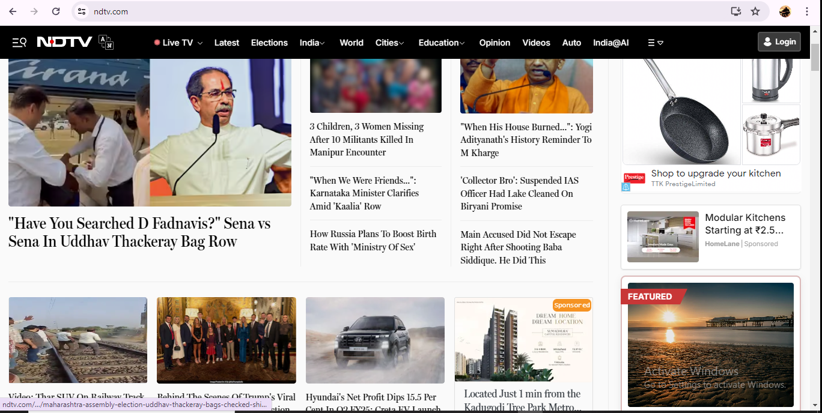


Slide 3
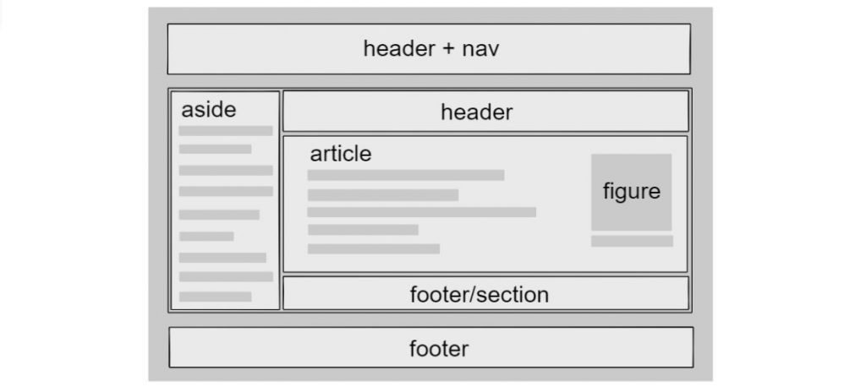

Slide 4

Footer

Slide 5
Semantic Elements
HTML tags that convey the semantics/meaning of the content contained within them.
<header>: Represents introductory content or navigation, typically at the top of a page or section.
<footer>: Contains footer information, often including copyright details, contact information, or related links.

Slide 6
Semantics Elements
<header>
<footer>
<article>
<section>
<main>
<nav>
<aside>
<figure>
<figcaption>
<details>
<summary>
<time>
<progress>
<meter>
<output>
<address>

Slide 7
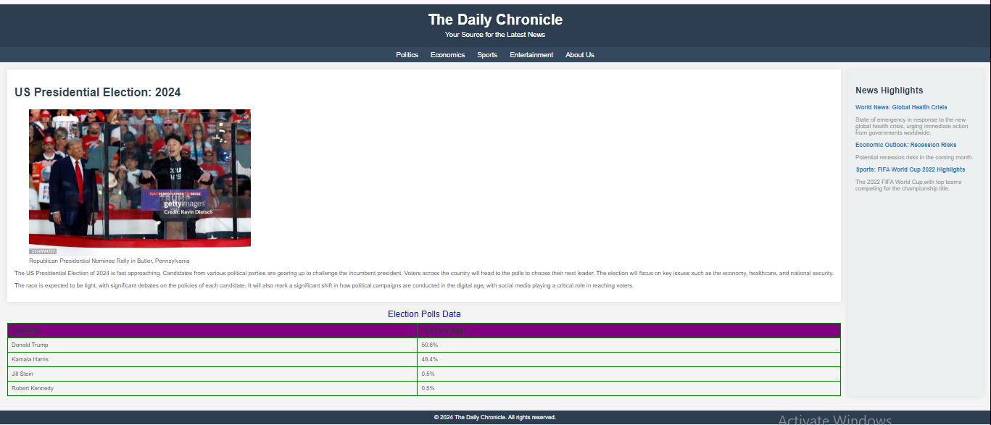

Slide 8
Header
header {
background-color: #2c3e50;
color: white;
padding: 20px;
text-align: center;
}
<header>
<h1></h1>
<p></p>
</header>

Slide 9
Navigation
nav {
background-color: #34495e;
color: white;
padding: 10px;
text-align: center;
}
<nav>
<a href=“#">Politics</a>
<a href=“#">Economics</a>
<a href=“#">Sports</a>
<a href=“#">Entertainment</a>
<a href="#">About Us</a>
</nav>

Slide 10
nav a {
color: white;
margin: 0 15px;
text-decoration: none;
font-size: 1.2em;
}
nav a:hover {
text-decoration: underline;
color: #ecf0f1;
}
<nav>
<a href=“#">Politics</a>
<a href=“#">Economics</a>
<a href=“#">Sports</a>
<a href=“#">Entertainment</a>
<a href="#">About Us</a>
</nav>

Slide 11
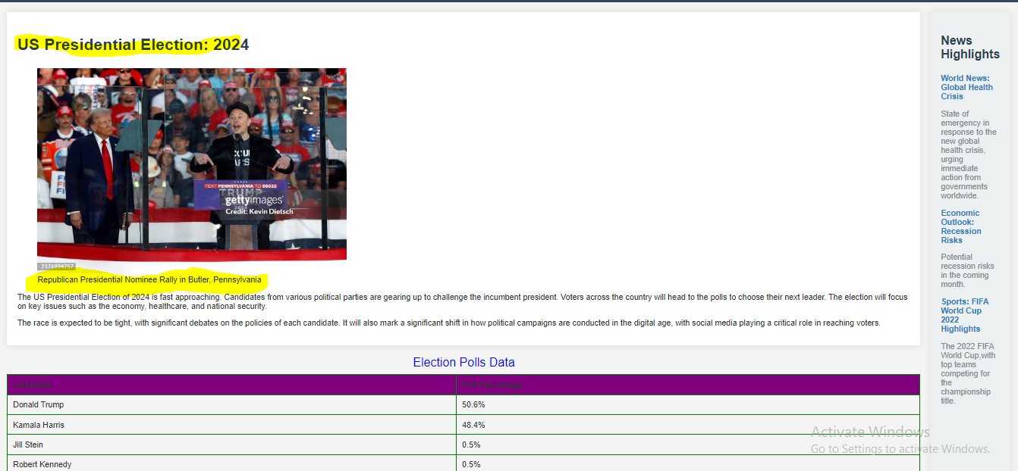
<main></main>
<section>
<article></article>
</section>
<aside>
</aside>

Slide 12
CSS
main {
display: flex;
padding: 20px;
justify-content: space-between;
gap: 20px;
}

Slide 13
<section></section>
<article>
<h2></h2>
<figure>
<img src="" alt="">
<figcaption> Ficap</figcaption>
</figure>
</article>

Slide 14
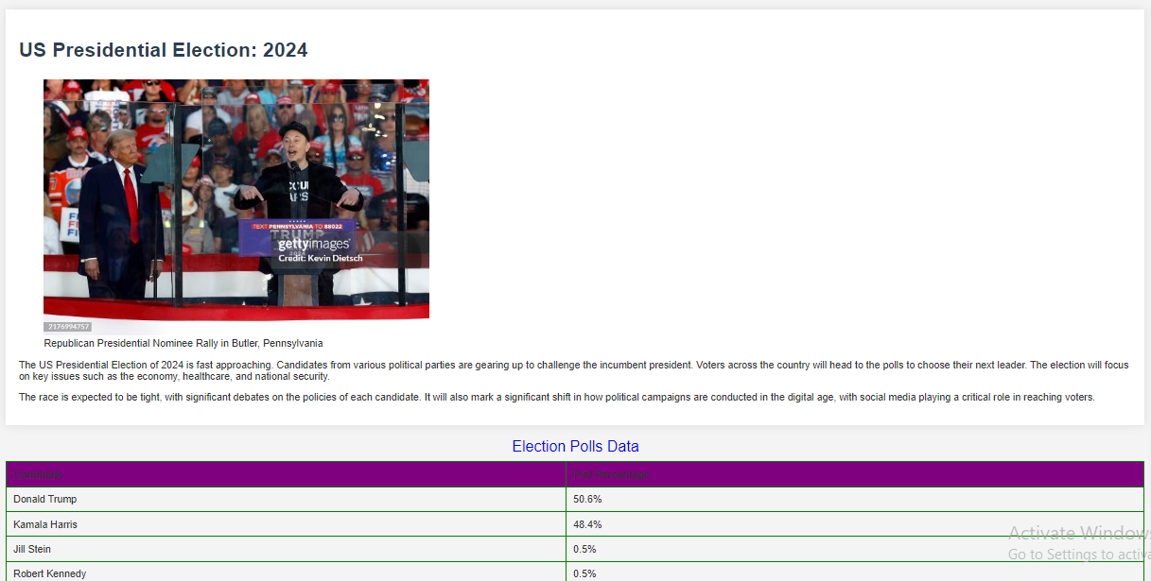
article {
flex: 1;
background-color: white;
padding: 20px;
box-shadow: 0 0 15px rgba(0, 0, 0, 0.1);
}
article img {
max-width: 100%;
height: auto;
}
article h2 {
font-size: 2em;
color: #2c3e50;
}

Slide 15
Table (<table> </table>) <caption>Election Polls Data</caption>
<thead>
<tr>
<th>Candidate</th>
<th>Poll Percentage</th>
</tr>
</thead>
<tbody>
<tr>
<td>Donald Trump</td>
<td>50.6%</td>
</tr>
<tr>
<td>Kamala Harris</td>
<td>48.4%</td>
</tr>
</tbody>

Slide 16
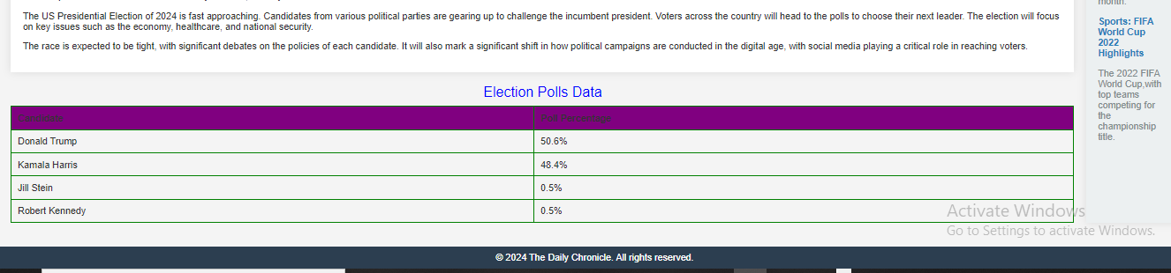
table {
width: 100%;
border-collapse: collapse;
margin-top: 20px;
}
table caption {
font-size: 1.5em;
margin-bottom: 10px;
color:blue;
}
th, td {
padding: 10px;
border: 1px solid green;
text-align: left;
}
th {
background-color: purple;
}

Slide 17
<aside>
<h3>News Highlights</h3>
<ul>
<li>
<a href="https://www.bbc.com/news/world-65843343" target="_blank">
<strong>World News: Global Health Crisis</strong>
</a>
<p>State of emergency in response to the new global health crisis, urging immediate action from governments worldwide.</p>
</li>
</ul>
</aside>

Slide 18
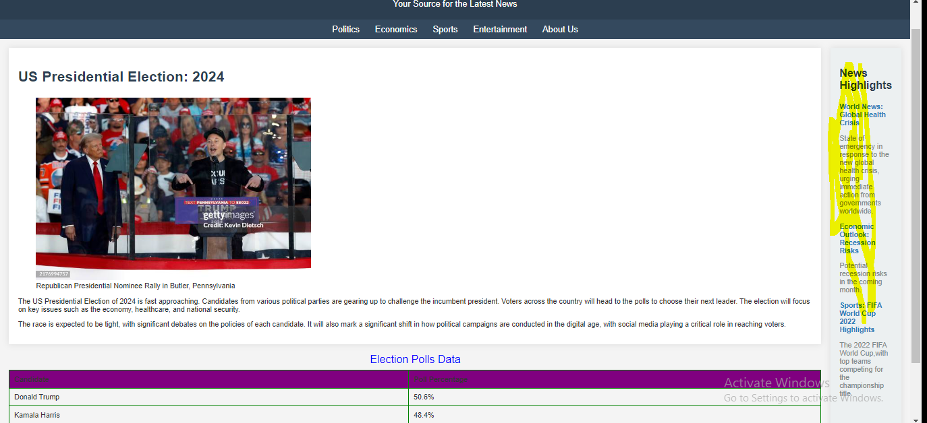
Aside
<aside>
<h3>News Highlights</h3>
<ul>
<li>
<a href="https://www.bbc.com/news/world-65843343" >
<strong>World News: Global Health Crisis</strong>
</a>
<p>State of emergency in response to the new global health crisis, urging immediate action from governments worldwide.</p>
</li>
</ul>
</aside>

Slide 19
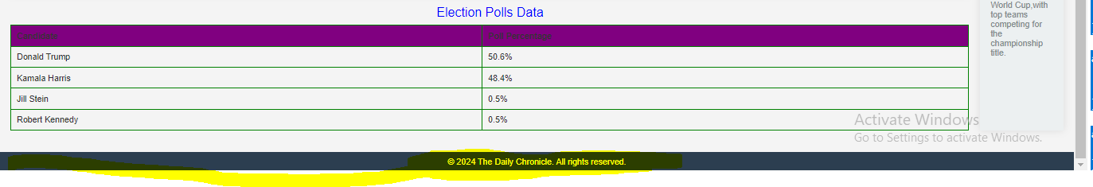
Footer:
<footer>
<p>&copy; 2024 The Daily Chronicle. All rights reserved.</p>
</footer>

Slide 20
CSS
footer {
background-color: #2c3e50;
color: white;
padding: 10px;
text-align: center;
margin-top: 20px;
}
footer p {
margin: 0;
}

