Slide 1

Project Title - Seasonal Agriculture Performance Analysis
Student Name : Trayam Roy
College Name : Techno International New Town
AICTE STU ID : STU69286094440e21764253844

Slide 2

PROBLEM STATEMENT
Agricultural activities are influenced by seasonal variations in environmental conditions, farming practices, resource availability and market conditions. As a result, agricultural performance may differ from one season to another. However, raw agricultural data does not clearly explain how agricultural performance changes across seasons or what patterns can be observed in different seasonal conditions. The problem is to analyze the given agricultural dataset and investigate seasonal differences in agricultural performance by identifying meaningful patterns, trends, relationships and variations within the available data.

Slide 3
Project Description
This project analyses 4,000 farm-level agricultural records containing 28 variables
related to seasons, locations, crops, environmental conditions, farming practices, production, resources and financial performance.
The analysis was performed using Python and included:
Understanding the structure and quality of the dataset
Handling missing values and duplicate records
Descriptive and statistical analysis
Univariate and bivariate analysis
Multivariate analysis
Correlation analysis
Seasonal and crop-wise comparisons
ROI and water-efficiency analysis
Pesticide usage vs disease/pest risk analysis
State-wise yield comparison
The final objective was to identify meaningful patterns and convert them into practical recommendations for agricultural planning.

Slide 4

WHO ARE THE END USERS?
The insights from this analysis can be useful for:
Farmers
Choosing suitable crops and seasons
Managing water and other inputs
Understanding profitability
Agricultural Planners
Comparing seasonal performance
Planning crop allocation and resources
Government & Policy Makers
Identifying areas where support or subsidies may be required
Supporting evidence-based agricultural policies
Agricultural Researchers
Studying relationships between environmental conditions and crop performance
Agribusinesses
Understanding crop profitability, resource requirements and seasonal trends

Slide 5

Technology Used
Python Used as the main programming language for data analysis.
Pandas Used for loading, cleaning, transforming and grouping the agricultural dataset.
NumPy Used for numerical calculations and statistical operations.
Matplotlib Used for creating analytical charts and visualizations.
Seaborn Used for statistical visualizations such as heatmaps, scatter plots, bar charts and pair plots.
Google Colab Used as the working environment to perform and document the complete analysis.

Slide 6
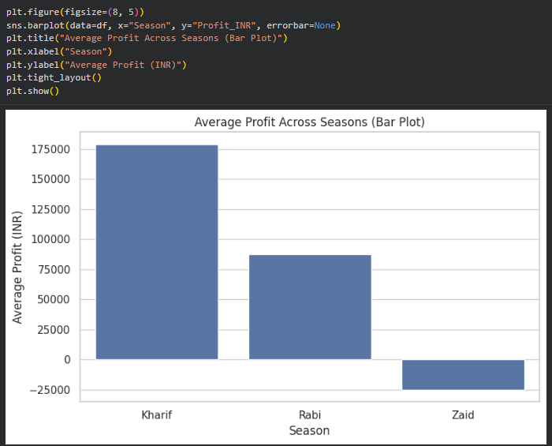
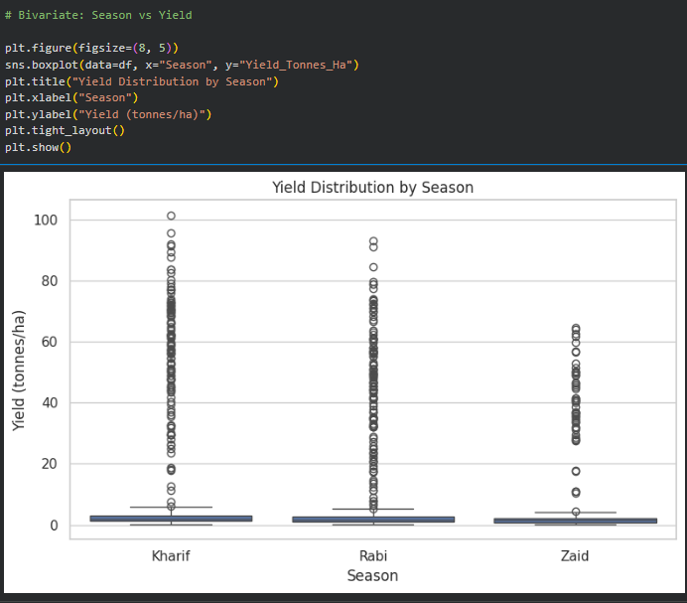
RESULTS
Seasonal Yield & Profitability
This boxplot compares the distribution of yield in the three seasons. We can see that Kharif has the highest average yield, while Zaid has the lowest average yield. The boxplot also shows considerable variation and outliers within each season.
This chart compares the profit.
Kharif clearly performs the best financially, while Zaid has a negative average profit.
So, the seasonal difference is not only in production but also in economic performance.

Slide 7
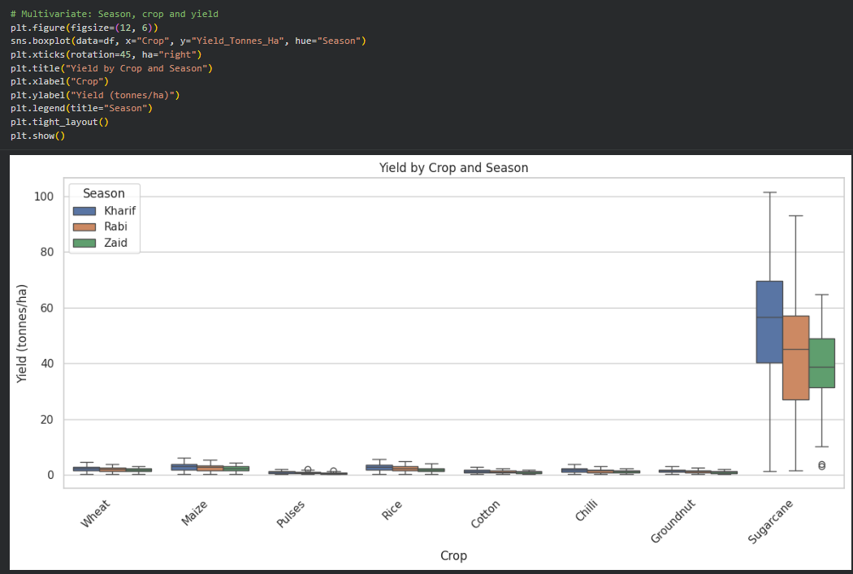
RESULTS
Crop Performance Across Seasons
Crop performance varies across seasons. • The plot compares yield distribution across crops and seasons. • Sugarcane shows the highest yield range among the crops. • Chilli also shows comparatively strong performance. • The results indicate that both crop selection and season influence yield.

Slide 8
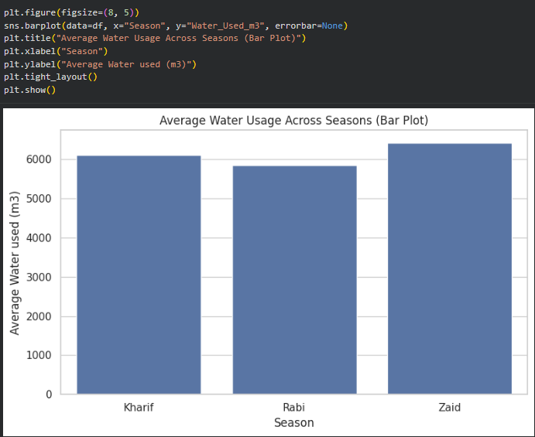
RESULTS
Water Usage Across Seasons
This plot compares the average amount of water used in each season. Zaid has the highest average water usage, even though its average yield is the lowest. This makes Zaid particularly important from a resource-management point of view.
Zaid recorded the highest average water usage: 6,419.89 m³. Zaid also recorded the lowest average yield: 4.64 tonnes/ha. High water usage does not necessarily mean high agricultural performance

Slide 9
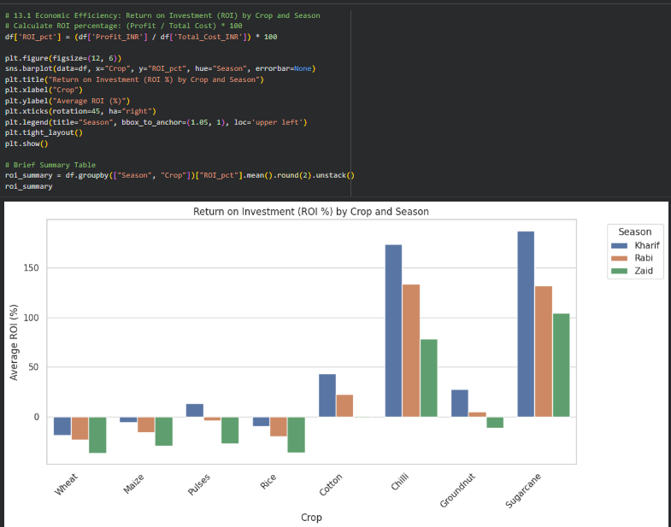
RESULTS
Economic Efficiency – ROI Analysis
Content:
ROI was calculated using:
ROI = (Profit / Total Cost) × 100
Sugarcane and Chilli show the strongest ROI performance in the dataset.
Wheat, Rice and Maize show negative ROI across the analysed seasons.
The results show a substantial difference in economic efficiency between crops.
Crop selection can therefore have a major influence on farm profitability.

Slide 10
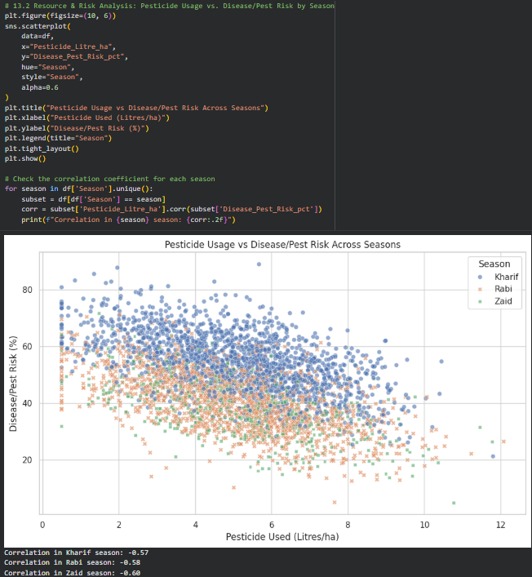
RESULTS
Pesticide Usage and Disease/Pest Risk
Content:
A moderate negative relationship was observed between pesticide usage and reported disease/pest risk.
Correlation values were approximately:
Kharif: −0.57
Rabi: −0.58
Zaid: −0.60
Higher pesticide usage was associated with lower reported pest/disease risk in the dataset.
However, correlation does not prove causation.
Other factors may also influence disease and pest risk.

Slide 11
Future scope
This analysis can be extended further by:
Adding multi-year agricultural data to study long-term seasonal trends.
Including historical market price data to study price fluctuations.
Adding detailed soil and weather information.
Studying the effect of irrigation methods on water efficiency.
Comparing input costs and subsidies across regions.
Developing predictive models for crop yield or profitability in a future project.
Creating an interactive dashboard for farmers and planners.
Adding more detailed geographical and crop-level analysis.
Future Goal
The analysis can eventually be developed into a more complete decision-support system for crop, season and resource planning.

Slide 12
GitHub Link
https://github.com/heyytrayamm/Seasonal-Agriculture-Performance-Analysis.git

Slide 13
VOIS Course completion certificate - Course name- Data Visualization

Slide 14
Thank you
.
.

