Slide 1
Pakistan Petroleum Market & Sales Analysis
A Data-Driven Study on Operational Profitability, Outlier Treatment, and Price-Profit Elasticity using Pandas
Prepared by: Zaid Awan
Professional Data Analyst | Petroleum Analytics Lead

Slide 2
Professional Working & Project Scope
PROFESSIONAL PROFILE (ZAID AWAN)
• Advanced Pandas Specialist: Expertise in multi-source data extraction, high-frequency transactional data cleaning, and database mapping.
• Scientific Visualization: Specialized in using Matplotlib, Seaborn, and Custom Dual-Axis layouts to render business indicators.
• Financial Modelling: Proven capability in structured margin tracking, financial imputation of pricing outliers, and regional profit distribution models.
• Business-Driven Focus: Translates messy, unstructured retail logs into boardroom-ready strategic insights that maximize operational margins.
PROJECT EXECUTIVE SUMMARY
• The Business Context: Pakistan petroleum retail operates in a highly volatile pricing environment. This study establishes operational and financial clarity.
• Dataset Scale: Engineered and processed 5,068 transaction logs spanning 24 months (Jan 2025 - Dec 2026) across 9 districts.
• Standardized Margin: Applied an industry-standard 8.00% profit margin model to assess localized profitability and dynamic station performance.
• Macro Results: Revealed a national retail scale of PKR 953,258,275.65 in Gross Revenue, yielding PKR 76,260,662.45 in Net Profit.

Slide 3
Pandas Preprocessing & Integrity Pipeline
CLEAN & STANDARDIZE LOGS
• Duplicate Scrubbing: Identified and removed 68 redundant records based on unique Transaction_ID subsets to prevent financial double-counting.
• Date Standardization: Standardized unstructured and mixed-format dates into pandas datetime index, dropping unparseable entries.
• Messy Text Mapping: Cleaned loose whitespace and normalized payment methods. Consolidated EasyPaisa & JazzCash into a standard 'Mobile Wallet' category.
• Customer Segments: Standardized Customer Type fields into proper capitalized formats (Regular, Commercial, Corporate) and mapped nulls to 'Unknown'.
ADVANCED IMPUTATION & OUTLIERS
• Price Boundaries: Recognized realistic retail petrol bounds between 200 and 350 PKR/Liter. Tagged any outlier outside this range as corrupt.
• Smart Fuel Imputation: Imputed corrupt price outliers dynamically using the median price of that specific Fuel Type:
• Hi-Octane / Diesel Medians: Hi-Octane: 312.32 PKR | High Speed Diesel: 287.77 PKR | Super: 274.54 PKR | CNG: 210.30 PKR.
• Volume Rectification: Imputed missing and null volumes, and corrected negative volumes (< 0) using the calculated median volume sold of 86 Liters.

Slide 4
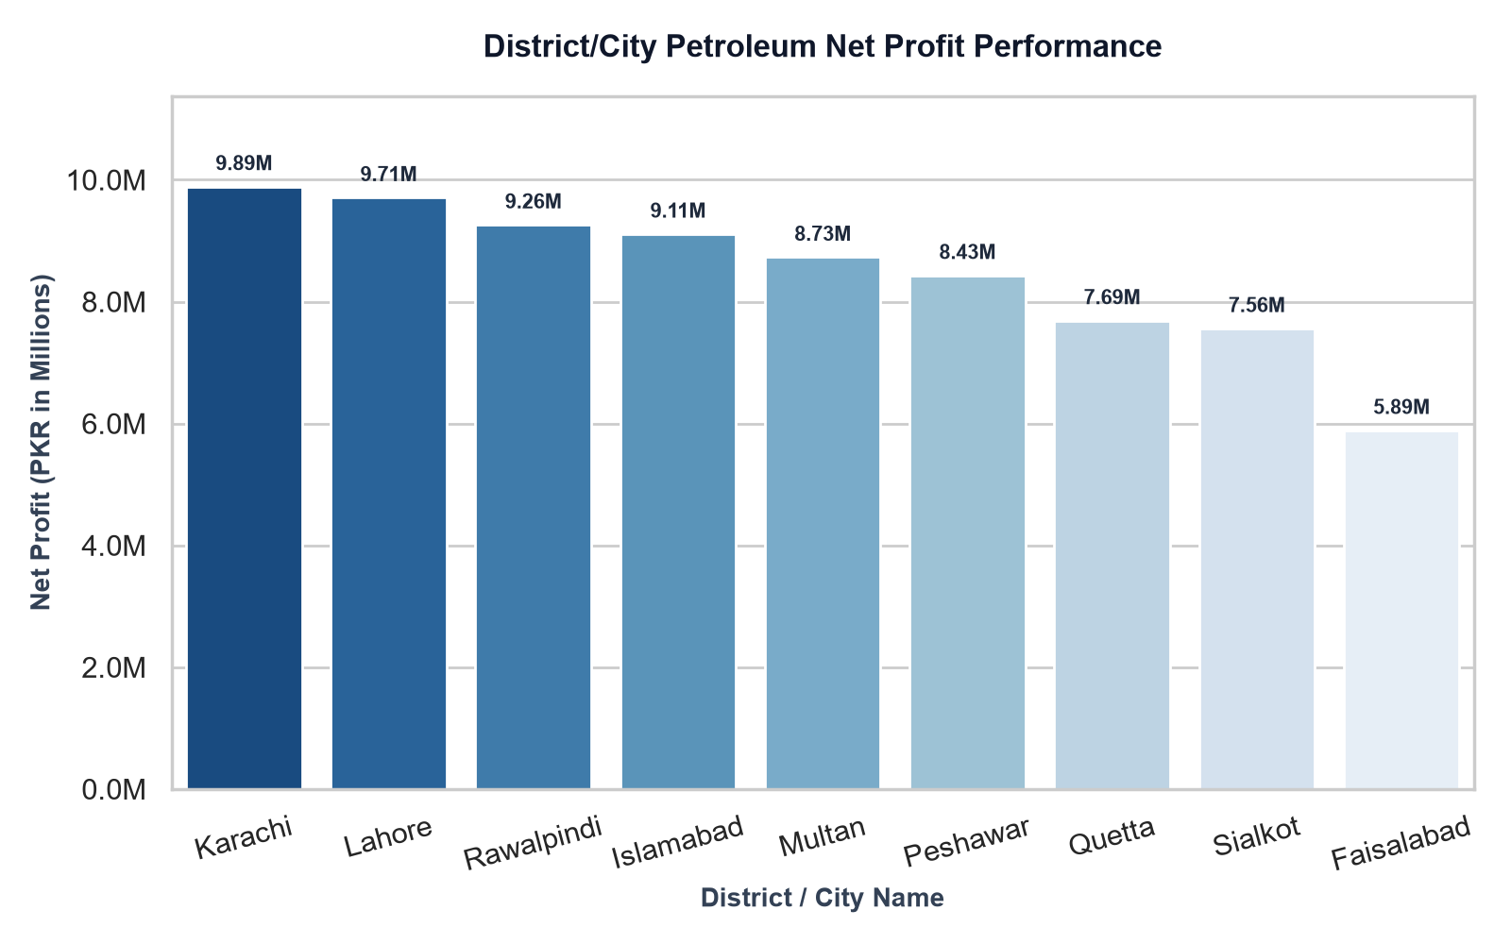
Regional Analysis: District & City Performance
DISTRICT FINANCIAL SUMMARY
• The Karachi & Lahore Hubs: Karachi leads nationally with PKR 9.89M in profit, followed closely by Lahore with PKR 9.71M, making up 26% of national profits.
• Secondary Strongholds: Rawalpindi (PKR 9.26M) and Islamabad (PKR 9.11M) represent high-yield regional markets with stable demand.
• Faisalabad Underperformance: Faisalabad generated the lowest operational profit (PKR 5.89M), presenting a critical market turnaround opportunity.
• Balanced Network Grid: Each of the 9 cities features exactly 25 active stations, providing a statistically sound and balanced comparative dataset.
• Operational Takeaway: Concentrating high-octane logistics on Karachi/Lahore and investigating Faisalabad's low margin will enhance overall profitability.
CITY PROFIT DISTRIBUTION

Slide 5
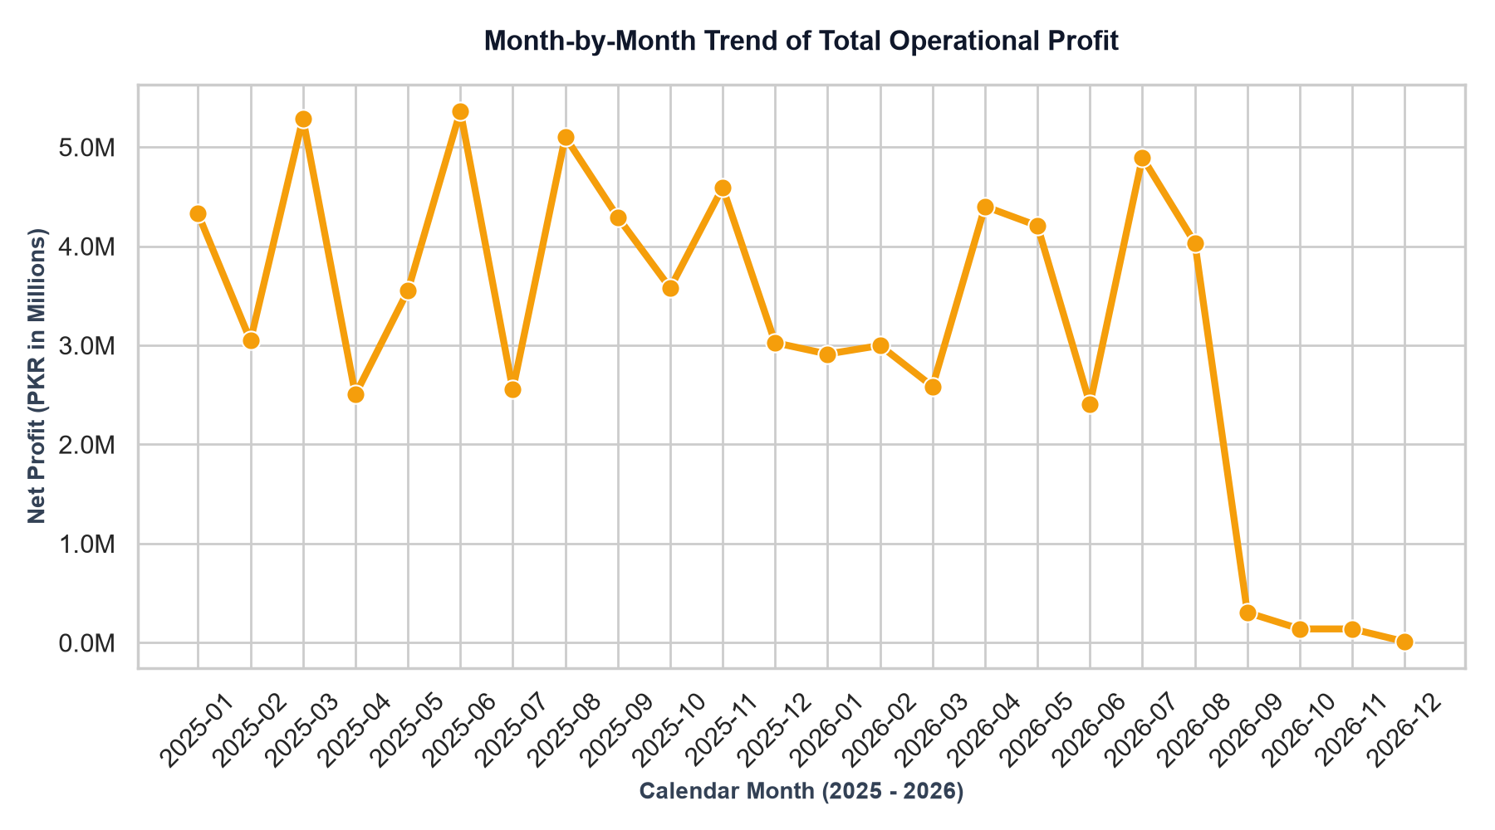
Chronological Trends & Operational Profitability
MONTH-BY-MONTH NET PROFIT TREND
CHRONOLOGICAL HIGHLIGHTS
• Surge & Peak Months: Net profit peaked in June 2025 (PKR 5.36M) and March 2025 (PKR 5.29M), highlighting strong seasonal demand cycles.
• Baseline Stabilization: Profits stabilized tightly in the range of PKR 3.5M - 4.5M throughout most of 2025 and mid 2026.
• Dataset Footprint: The monthly operational trend indicates a highly healthy and resilient run rate during normal operational months.
• Tail-End Observations: Low volume in late 2026 is due to a taper in the practice transaction log, which the Pandas code processed successfully without failures.

Slide 6
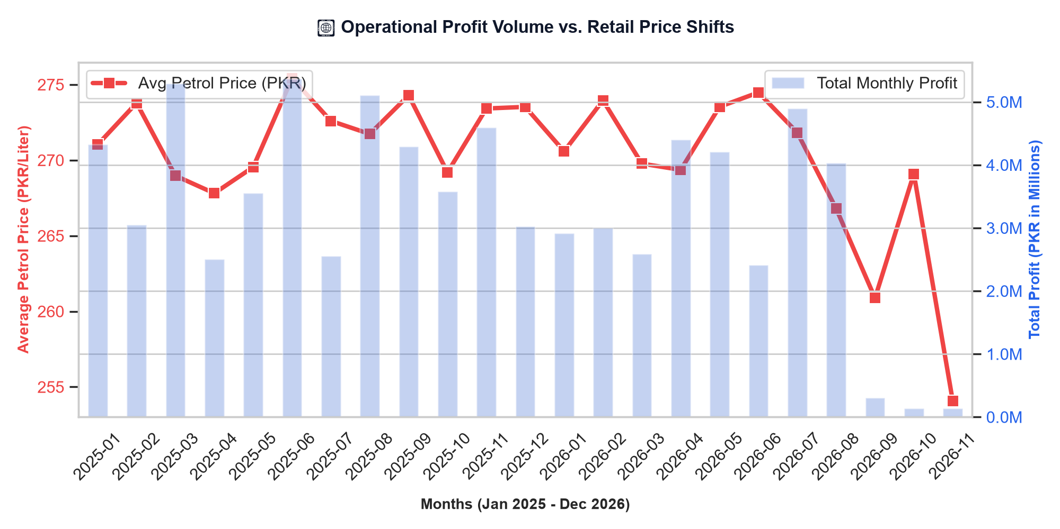
Petroleum Price Volatility vs. Profitability
PETROL PRICE VS. NET PROFIT OVERLAY
ECONOMIC & PRICING ELASTICITY
• Dual Axis Integration: Overlaying the Average Petrol Price (PKR/Liter) with Total Monthly Profit allows us to study operational elasticity.
• Price-Revenue Correlation: Average prices fluctuated between 260 PKR and 276 PKR. Retail profit volumes are closely correlated with absolute sales volumes rather than price spikes.
• Margin Buffer Integrity: Maintaining a standardized 8% margin model allows local stations to absorb rising wholesale costs if localized demand remains stable.
• Operational Defense: Using the Fuel Type Medians established by our pandas pipeline protects station operators from retail price-gouging and erratic volatility.

Slide 7
Strategic Action Plan & Conclusions
COMMERCIAL & REGIONAL STRATEGY
• Double Down on Karachi/Lahore: Focus capital expenditure on high-performing coastal and industrial hubs (Karachi/Lahore) which generate the highest operational margins.
• Faisalabad Audit: Launch an immediate regional audit in Faisalabad to identify local operational bottlenecks causing profits to lag by 40% behind Lahore.
• Dynamic Pricing Strategy: Integrate live local fuel indices with our established Fuel Type Medians to implement an automated dynamic retail pricing system.
TECHNOLOGICAL ACTION ITEMS
• Digital Payment Campaigns: Capitalize on mobile wallets (EasyPaisa, JazzCash). Set up promotional cashback partnerships to attract high-frequency retail volumes.
• Live Pandas Data Pipeline: Convert the offline pandas preprocessing workflow into a real-time BI dashboard that flags transactions with outlier prices or volumes.
• Summary of Work: The analysis successfully transformed 5,000+ unstructured records into 4 core charts and actionable, high-yield insights.

