Slide 1

Chapter 1
Introduction, History of molecular Evolution
Welcome to the 2011 class
Chau-Ti Ting
ctting@ntu.edu.tw
Unless noted, the course materials are licensed under Creative Commons Attribution-NonCommercial-ShareAlike 3.0 Taiwan (CC BY-NC-SA 3.0)

Slide 2

Course description:
This course is to introduce the fundamentals and methodology on research of molecular evolution. The topics include evolutionary changes and patterns of sequences and methods for phylogenetic analyses. Topics on recent advances of molecular evolution studies will be offered at the end, on phylogenomics, horizontal gene transfer, and genome evolution. Students are highly recommended to take evolution, genetics or equivalent subjects before taking this course. There are three laboratory practices for students being familiar with data retrieving and analyses. Several homework assignments will be distributed during the semester, which require substantial extra work time after the class.

Slide 3
Lecture Wednesday 10:20~12:10, Life Science 419
Instructors Chau-Ti Ting (丁照棣)
E-mail: ctting_at_ntu.edu.tw
Phone: 3366 2522
Jer-Ming Hu (胡哲明)
E-mail: jmhu_at_ntu.edu.tw
Phone: 3366 2472

Slide 4
Course website: http://ceiba.ntu.edu.tw/1002molevo
Official language: English
Prerequisite: Biology; Evolutionary Biology; Genetics or equivalent preferred
Office hour: Wed 12:00-13:00, or with appointments

Slide 5
Laboratory practice
We will have computers available to use on the class, but you are welcome to bring your own laptop computer. In the later case, you should download the corresponding softwares before the class. You are welcome to use your own data for the homework assignments.

Slide 6
TA
Grading
Midterm exam 25%
Final exam 30%
Homework 35%
Classroom performance 10%

Slide 7
Textbook
There is no required textbook for this class. Most of the lectures are based on selected chapters from the following books.

Slide 8
Suggested reading
Graur, D. and W.-H. Li. 2000. Fundamentals of Molecular Evolution. 2nd ed., Sinauer Assoc., Sunderland, MA, USA.
Hall, B. G. 2011. Phylogenetic trees made easy: a how-to manual, 4th ed. Sinauer Assoc., Inc., Sunderland, MA, USA.
Li, W.-H. 1997. Molecular evolution. Sinauer Associates, Sunderland, MA, USA.
Lynch, M. 2007. The origins of genome architecture. Sinauer Associates, Sunderland, MA, USA.

Slide 9
Fundamentals of Molecular Evolution
by Dan Graur and Wen-Hsiung Li, 2nd Edition (1999, Sinauer)
http://www.sinauer.com/detail.php?id=2666

Slide 10
Hall, B. G. 2011. Phylogenetic trees made easy: a how-to manual, 4th ed. Sinauer Assoc., Inc., Sunderland, MA, USA.
http://www.sinauer.com/detail.php?id=6069

Slide 11
Li, W.-H. 1997. Molecular evolution. Sinauer Associates, Sunderland, MA, USA.
http://books.google.com.tw/books/about/Molecular_evolution.html?id=2mPGQgAACAAJ&redir_esc=y

Slide 12
Lynch, M. 2007. The origins of genome architecture. Sinauer Associates, Sunderland, MA, USA.
http://www.sinauer.com/detail.php?id=4843

Slide 13
Molecular Evolution and Phylogenetics
by Masatoshi Nei, Sudhir Kumar
Oxford University Press (2000)
http://www.oup.com/us/catalog/general/subject/LifeSciences/EvolutionaryBiology/?view=usa&ci=9780195135855
Molecular Evolution : A Phylogenetic Approach
by Roderic D. M. Page, Edward C. Holmes
Blackwell Science Inc. (1998)
http://as.wiley.com/WileyCDA/WileyTitle/productCd-0865428891.html
Integrated Molecular Evolution by Scott O. Rogers (Jul 27, 2011)
http://www.crcpress.com/product/isbn/9781439819951;jsessionid=43hickpiklcWh5SL-z17dQ**

Slide 14
More reference book
Bioinformatics and Molecular Evolution by Paul Higgs and Teresa Attwood (Wiley-Blackwell, 2005)
*Computational Molecular Evolution by Ziheng Yang (Oxford University Press, 2006)
*Inferring Phylogenies (Paperback) by Joseph Felsenstein (Sinauer, 2003)
*Statistical Methods in Molecular Evolution by Rasmus Nielsen (Springer, 2005)
The Phylogenetic Handbook: A Practical Approach to DNA and Protein Phylogeny Ed. by Marco Salemi and Anne-Mieke Vandamme (Cambridge University Press, 2003)

Slide 15
Journals
Cladistics (http://www.blackwell-synergy.com/toc/cla/21/3;jsessionid=bfrbfx_Qdkn8)
BMC Evol Biol (http://www.biomedcentral.com/bmcevolbiol/)
Evolution (http://www.blackwell-synergy.com/loi/EVO)
Evol Dev (http://www.blackwell-synergy.com/loi/ede)
Evol Bioinformatics (http://la-press.com/journal.php?journal_id=17&issue_id=103)
Genome Biology (http://genomebiology.com/home/)
J Evol Biol (http://www.blackwellpublishing.com/jeb_enhanced/)
J Mol Evol (http://www.springer.com/life+sci/cell+biology/journal/239)
Mol Biol Evol (http://mbe.oxfordjournals.org/)
Mol Ecol (http://www.blackwell-synergy.com/loi/MEC)
Mol Phyl Evol (http://www.sciencedirect.com/science/journal/10557903)
Syst Biol (http://www.informaworld.com/smpp/title~db=bisc~content=….ueslist)
Trends in Ecology & Evolution (http://www.sciencedirect.com/science/…)

Slide 16
Related courses and workshops
NTU campus
Mathematical Molecular Evolution (221 U4730)
Molecular Evolution Laboratory (B44 U1630)
Population Genetics (B44 U1570)
Seminar in Molecular Evolution (B41 M0310)
Summer course on molecular phylogeny
Workshop on Computational Molecular Evolution (http://homepage.ntu.edu.tw/~ctting/CMB.html)
Elsewhere
Summer Institute in Statistical Genetics (http://www.biostat.washington.edu/node/1020)
Workshop on Molecular Evolution (http://workshop.molecularevolution.org/mbl/)

Slide 17

Molecular Evolution
The evolution of macromolecules
The rates and patterns of changes in the genetic material and its encoded products during evolutionary time
The mechanisms responsible for such changes
Molecular phylogeny
The reconstruction of the evolutionary history of genes and organisms
Source: M. Prakash
2007. Encyclopaedia of Gene Evolution Vol. 2, Molecular Genetics, p. 42. Discovery Publishing House. India.

Slide 18
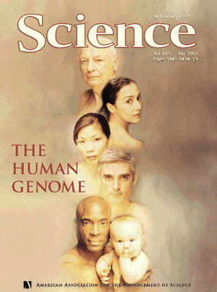

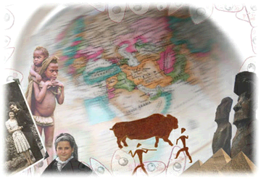
Carolina Biological Supply Company
Source: Carolina Biological Supply Company
http://www.geneticorigins.org/
Science /AAAS
Source: 2001. Science. Vol. 291. Issue 5507.
http://www.sciencemag.org/content/291/5507.cover-expansion
Notes:
Science/AAAS http://www.sciencemag.org/site/help/about/copyright.xhtml
The materials on this Website are protected by United States copyright law except that no copyright is claimed in any work of the US government. Users may download material from this site (one machine-readable copy and one print copy per page) for personal, noncommercial use only.
Carolina Terms of Use http://www.carolina.com/category/customer+service/terms+of+use.do
User Conduct
Our websites are intended for educational and entertainment purposes, primarily for the use and enjoyment of teachers, educators, students, parents and families. You agree to use this website only for such purposes.

Slide 19
1904
Nuttall conducted precipitin tests of serum proteins to infer the phylogenetic relationship among various groups of animals.
Source: M. Prakash
2007. Encyclopaedia of Gene Evolution Vol. 2, Molecular Genetics, p. 42. Discovery Publishing House. India.
George H. F. Nuttall
1904. Blood immunity and blood relationship. University press. Cambridge, England.
http://www.biodiversitylibrary.org/title/8418#page/7/mode/1up

Slide 20
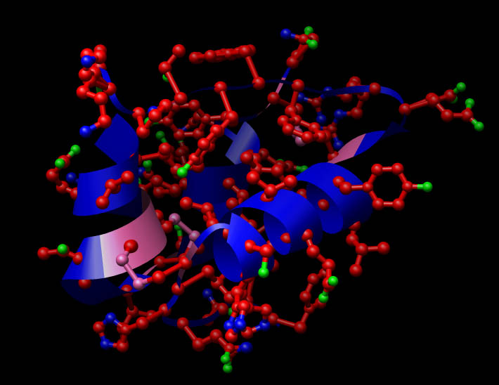


1952
Sanger and colleagues complete first protein sequence – insulin
Sanger, F. 1952. The arrangement of amino acids in proteins. Advances in Protein Chemistry. 7: p.1-66.
http://www.sciencedirect.com/science/article/pii/S0065323308600170
Wikipedia Commons

Slide 21
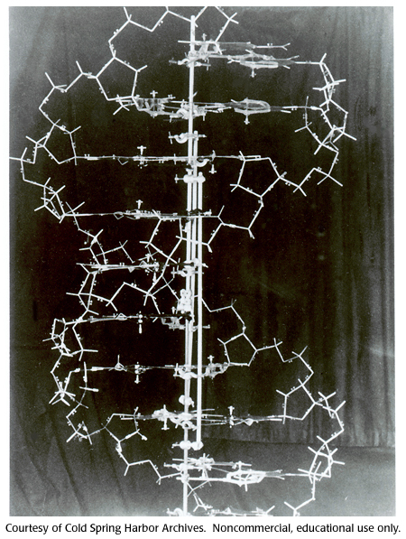

1953
Watson and Crick in 1953. Cold Spring Harbor Laboratory

Slide 22
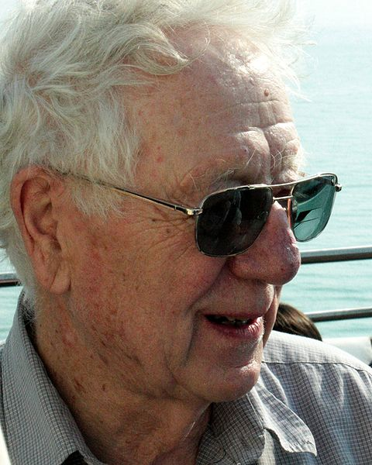

1955
Smithies uses starch-gel electrophoresis to identify protein polymorphisms
John C. Avise
http://www.ncbi.nlm.nih.gov/pmc/articles/PMC1215845/
Wikipedia Mapos

Slide 23

1963
Margoliash determines amino acid sequences for cytochrome c in several taxa and generates the first phylogenetic tree for a specific gene product.
John C. Avise
http://www.ncbi.nlm.nih.gov/pmc/articles/PMC221244/

Slide 24
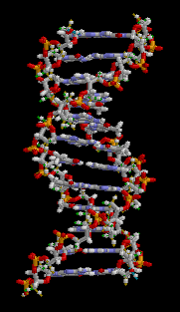

1965
Zuckerkandl and Pauling
“molecular clock” hypothesis.
http://en.wikipedia.org/wiki/History_of_molecular_evolution

Slide 25
1966
Harris, Lewontin and Hubby
electrophoresis and histochemical enzyme stains
examined level of genetic variability in natural populations.
http://en.wikipedia.org/wiki/Richard_Lewontin
http://www.ncbi.nlm.nih.gov/pmc/articles/PMC1211186/?tool=pmcentrez
http://www.jstor.org/stable/75451
National Taiwan University Chau-Ti Ting

Slide 26
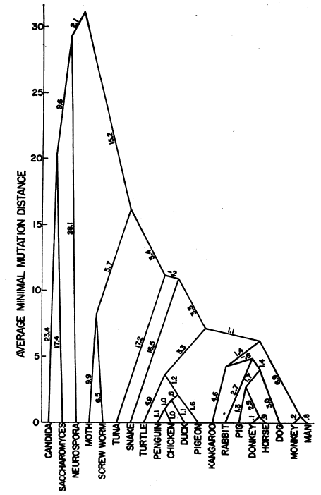
1967
Fitch and Margoliash
“Construction of phylogenetic trees” published in Science.
Walter M. Fitch and Emanuel Margoliash
1967. Construction of phylogenetic trees. Science Vol. 155: p. 279-284
Source: Walter M. Fitch and Emanuel Margoliash
1967. Construction of phylogenetic trees. Science Vol. 155: p. 279-284 http://www.sciencemag.org/content/155/3760/279.full.pdf

Slide 27
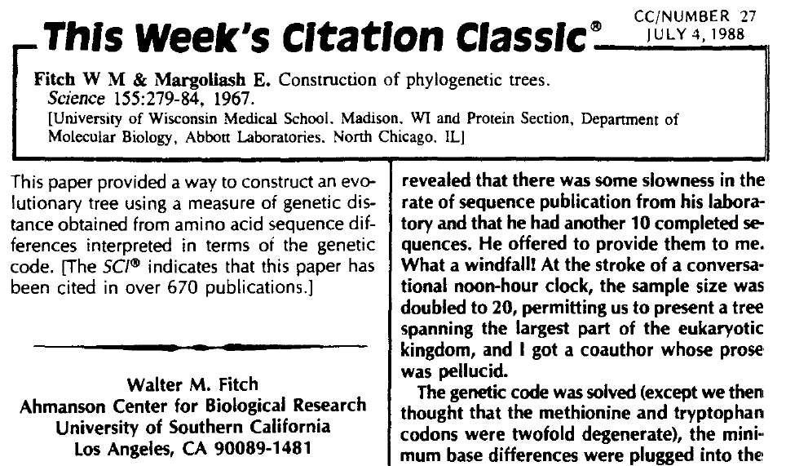
Source: Walter M. Fitch. 1988. Citation Classic. No. 27.
http://garfield.library.upenn.edu/classics.html
http://garfield.library.upenn.edu/classics1988/A1988N888200001.pdf

Slide 28
1968
Kimura proposes that the majority of molecular changes in evolution are due to random drift of neutral or nearly neutral mutations.
http://en.wikipedia.org/wiki/Motoo_Kimura#cite_note-Kimura68-1
http://www.nature.com/nature/journal/v217/n5129/abs/217624a0.html
Source: John C. Avise
1994. Molecular Markers, Natural History and Evolution, p. 42. Chapman & Hall. New York, USA.
1969
King and Jukes
“Non-Darwinian evolution”
Also proposed neutral theory .
http://en.wikipedia.org/wiki/Non-Darwinian_Evolution
http://www.sciencemag.org/content/164/3881/788.citation

Slide 29

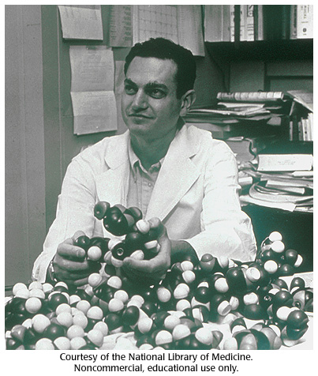
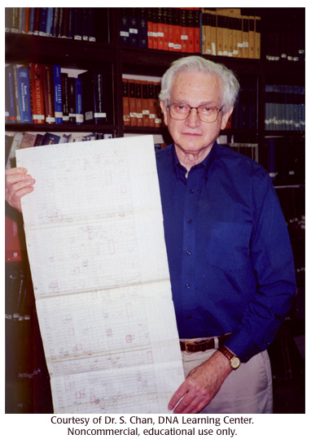
Marshall Nirenberg, a young biochemist at the National Institute of Arthritic and Metabolic Diseases, discovered the first "triplet"—a sequence of three bases of DNA that codes for one of the twenty amino acids that serve as the building blocks of proteins. Subsequently, within five years, the entire genetic code was deciphered.
Source: Genome News Network
http://www.genomenewsnetwork.org/resources/timeline/1961_Nirenberg.php
Cold Spring Harbor Laboratory
Cold Spring Harbor Laboratory

Slide 30
1972
Nei’s genetic distance has greatly facilitated the study of evolutionary relationships among populations or closely related species.
http://en.wikipedia.org/wiki/Masatoshi_Nei
http://www.jstor.org/stable/2459777
Source: M. Prakash
2007. Encyclopaedia of Gene Evolution Vol. 2, Molecular Genetics, p. 47. Discovery Publishing House. India.

Slide 31
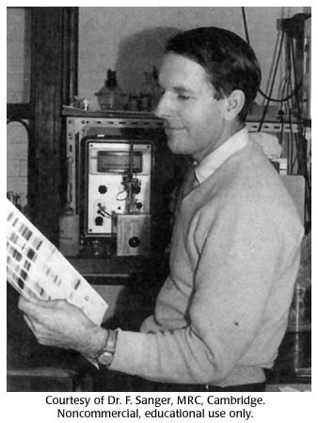
1977
Molecular biologists by the 1970s had deciphered the genetic code and could spell out the sequence of amino acids in proteins. But inability to easily read off the precise nucleotide sequences of DNA forestalled further advances in molecular genetics and all prospects of genetic engineering. Walter Gilbert (with graduate student Allan M. Maxam) and Frederick Sanger, in 1977, working separately in the United States and England, developed new techniques for rapid DNA sequencing.
Source: Genome News Network
Cold Spring Harbor Laboratory

Slide 32
1981
Palmer and colleagues begin an important series papers utilizing cpDNA for phylogenetic reconstructions in plants
Source: John C. Avise
1994. Molecular Markers, Natural History and Evolution, p. 42. Chapman & Hall. New York, USA.
1984
Sibley and Ahlquist
DNA-DNA hybridization
primate evolution study.
http://en.wikipedia.org/wiki/DNA-DNA_hybridization
http://www.springerlink.com/content/g3020651ml536640/

Slide 33
Carolina Biological Supply Company
Source: Carolina Biological Supply Company
http://www.geneticorigins.org/
Science /AAAS
Source: 2001. Science. Vol. 291. Issue 5507.
http://www.sciencemag.org/content/291/5507.cover-expansion
Notes:
Science/AAAS http://www.sciencemag.org/site/help/about/copyright.xhtml
The materials on this Website are protected by United States copyright law except that no copyright is claimed in any work of the US government. Users may download material from this site (one machine-readable copy and one print copy per page) for personal, noncommercial use only.
Carolina Terms of Use http://www.carolina.com/category/customer+service/terms+of+use.do
User Conduct
Our websites are intended for educational and entertainment purposes, primarily for the use and enjoyment of teachers, educators, students, parents and families. You agree to use this website only for such purposes.

Slide 34
Homework Assignment I
1) Write a paragraph about yourself (including name, background, and contact information) and your research interests.
2) What do you expect to learn from taking this course?
Please send your homework as a pdf document online by Feb. 28th

Slide 35
Copyright Declaration
Work | Licensing | Author/Source | Page
P17. “The rates and patterns of changes in the genetic material and its encoded products during evolutionary time” |  | M. Prakash 2007. Encyclopaedia of Gene Evolution Vol. 2, Molecular Genetics, p. 42. Discovery Publishing House. India. http://books.google.com.tw/books?id=OoG4_y2Q9AEC&printsec=frontcover&hl=zh-TW#v=onepage&q&f=false 2012/02/21 visited It is used subject to the fair use doctrine of: Taiwan Copyright Act Articles 52 & 65 | P17
P17. “The mechanisms responsible for such changes” |  | M. Prakash 2007. Encyclopaedia of Gene Evolution Vol. 2, Molecular Genetics, p. 42. Discovery Publishing House. India. http://books.google.com.tw/books?id=OoG4_y2Q9AEC&printsec=frontcover&hl=zh-TW#v=onepage&q&f=false 2012/02/21 visited It is used subject to the fair use doctrine of: Taiwan Copyright Act Articles 52 & 65 | P17
P17. “The reconstruction of the evolutionary history of genes and organisms ” |  | M. Prakash 2007. Encyclopaedia of Gene Evolution Vol. 2, Molecular Genetics, p. 42. Discovery Publishing House. India. http://books.google.com.tw/books?id=OoG4_y2Q9AEC&printsec=frontcover&hl=zh-TW#v=onepage&q&f=false 2012/02/21 visited It is used subject to the fair use doctrine of: Taiwan Copyright Act Articles 52 & 65 | P17
 |  | Science /AAAS 2001. Science. Vol. 291. Issue 5507. http://www.sciencemag.org/content/291/5507.cover-expansion It is used subject to the fair use doctrine of: Taiwan Copyright Act Articles 52 & 65 Science /AAAS Copyright Statement | P18, 33
 |  | Carolina Biological Supply Company http://www.geneticorigins.org/ 2012/02/21 visited It is used subject to the fair use doctrine of: Taiwan Copyright Act Articles 52 & 65 Carolina Biological Supply Company Terms of Use | P18, 33

Slide 36
Work | Licensing | Author/Source | Page
P19. “Nuttall conducted precipitin tests of serum proteins to infer the phylogenetic relationship among various groups of animals.” |  | M. Prakash 2007. Encyclopaedia of Gene Evolution Vol. 2, Molecular Genetics, p. 43. Discovery Publishing House. India. http://books.google.com.tw/books?id=OoG4_y2Q9AEC&printsec=frontcover&hl=zh-TW#v=onepage&q&f=false It is used subject to the fair use doctrine of: Taiwan Copyright Act Articles 52 & 65 | P19
 |  | Wikipedia Commons http://commons.wikimedia.org/wiki/File:Insulin.jpg 2012/02/21 visited | P20
 |  | Watson and Crick in 1953.Cold Spring Harbor Laboratory http://www.dnalc.org/view/16430-Gallery-19-DNA-model-1953.html 2012/02/21 visited | P21
P22. “Smithies uses starch-gel electrophoresis to identify protein polymorphisms.” |  | John C. Avise 1994. Molecular Markers, Natural History and Evolution, p. 42. Chapman & Hall. New York, USA. http://books.google.com.tw/books?id=aWSbZf-dRbEC&printsec=frontcover&hl=zh-TW#v=onepage&q&f=false It is used subject to the fair use doctrine of: Taiwan Copyright Act Articles 52 & 65 | P22
 |  | Wikipedia Mapos http://en.wikipedia.org/wiki/File:Oliver-smithies.jpg 2012/02/22 visited | P22
P23. “Margoliash determines amino acid sequences for cytochrome c in several taxa and generates the first phylogenetic tree for a specific gene product.” |  | John C. Avise 1994. Molecular Markers, Natural History and Evolution, p. 42. Chapman & Hall. New York, USA. http://books.google.com.tw/books?id=aWSbZf-dRbEC&printsec=frontcover&hl=zh-TW#v=onepage&q&f=false It is used subject to the fair use doctrine of: Taiwan Copyright Act Articles 52 & 65 | P23
 |  | Open Clip Art Library Anonymous http://openclipart.org/detail/108235/view-tree-by-anonymous 2012/02/21 visited | P23, 30

Slide 37
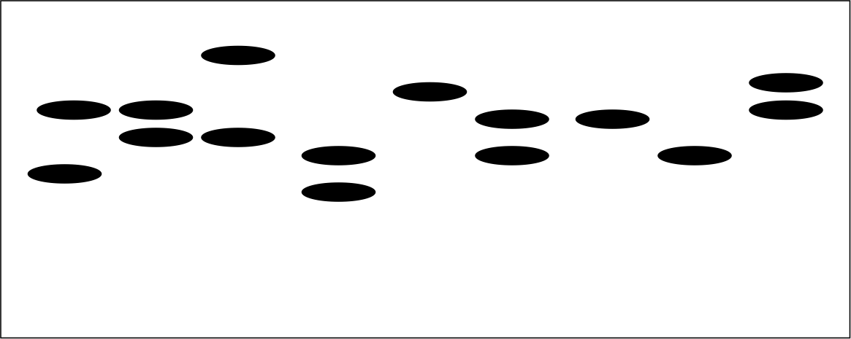
Work | Licensing | Author/Source | Page
 |  | Wikipedia brian0918™ http://en.wikipedia.org/wiki/File:ADN_animation.gif 2012/02/21 visited | P24
 |  | Open Clip Art Library fzap http://openclipart.org/detail/16605/clock-sportstudio-design-by-fzap 2012/02/21 visited | P24
 |  | National Taiwan University Chau-Ti Ting | P25
 |  | Walter M. Fitch and Emanuel Margoliash. 1967. Construction of phylogenetic trees. Science Vol. 155: p.282 http://www.sciencemag.org/content/155/3760/279.extract?sid=fe0a324a-4d85-453e-b77a-8a69782df245 2012/02/21 visited It is used subject to the fair use doctrine of: Taiwan Copyright Act Articles 52 & 65 Science /AAAS Copyright Statement | P26
 |  | Walter M. Fitch 1988. Citation Classic. No. 27. http://garfield.library.upenn.edu/classics.html http://garfield.library.upenn.edu/classics1988/A1988N888200001.pdf 2012/02/21 visited It is used subject to the fair use doctrine of: Taiwan Copyright Act Articles 52 & 65 The "Code of Best Practices in Fair Use for OpenCourseWare 2009 (http://www.centerforsocialmedia.org/sites/default/files/10-305-OCW-Oct29.pdf)" by A Committee of Practitioners of OpenCourseWare in the U.S. The contents are based on Section 107 of the 1976 U.S. Copyright Act | P27

Slide 38
Work | Licensing | Author/Source | Page
P28. “Kimura proposes that the majority of molecular changes in evolution are due to random drift of neutral or nearly neutral mutations.” |  | John C. Avise 1994. Molecular Markers, Natural History and Evolution, p. 42. Chapman & Hall. New York, USA. http://books.google.com.tw/books?id=aWSbZf-dRbEC&printsec=frontcover&hl=zh-TW#v=onepage&q&f=false 2012/02/21 visited It is used subject to the fair use doctrine of: Taiwan Copyright Act Articles 52 & 65 | P28
P29. “Marshall Nirenberg, a young biochemist at the National Institute of Arthritic and Metabolic Diseases… Subsequently, within five years, the entire genetic code was deciphered” |  | Genome News Network http://www.genomenewsnetwork.org/resources/timeline/1961_Nirenberg.php 2012/02/21 visited It is used subject to the fair use doctrine of: Taiwan Copyright Act Articles 52 & 65 | P29
 |  | Cold Spring Harbor Laboratory http://www.dnalc.org/view/16497-Gallery-22-Marshall-Nirenberg-1960.html 2012/02/21 visited | P29
 |  | Cold Spring Harbor Laboratory http://www.dnalc.org/view/16498-Gallery-22-Marshall-Nirenberg-1999.html 2012/02/21 visited | P29
P30. “Nei’s genetic distance has greatly facilitated the study of evolutionary relationships among populations or closely related species.” |  | M. Prakash 2007. Encyclopaedia of Gene Evolution Vol. 2, Molecular Genetics, p. 47. Discovery Publishing House. India. http://books.google.com.tw/books?id=OoG4_y2Q9AEC&printsec=frontcover&hl=zh-TW#v=onepage&q&f=false 2012/02/21 visited It is used subject to the fair use doctrine of: Taiwan Copyright Act Articles 52 & 65 | P30
P31. “Molecular biologists by the 1970s had deciphered… developed new techniques for rapid DNA sequencing.” |  | Genome News Network http://www.genomenewsnetwork.org/resources/timeline/1977_Gilbert.php 2012/02/21 visited It is used subject to the fair use doctrine of: Taiwan Copyright Act Articles 52 & 65 | P31

Slide 39
Work | Licensing | Author/Source | Page
 |  | Cold Spring Harbor Laboratory http://www.dnalc.org/view/16520-Gallery-23-Fred-Sanger-late-1950-s.html 2012/02/21 visited | P31
P32. “Palmer and colleagues begin an important series papers utilizing cpDNA for phylogenetic reconstructions in plants” |  | John C. Avise 1994. Molecular Markers, Natural History and Evolution, p. 42. Chapman & Hall. New York, USA. http://books.google.com.tw/books?id=aWSbZf-dRbEC&printsec=frontcover&hl=zh-TW#v=onepage&q&f=false 2012/02/21 visited It is used subject to the fair use doctrine of: Taiwan Copyright Act Articles 52 & 65 | P32

