Slide 1
pH limit range
ORR
Voltage limit range (vs SHE)
Voltage limit range (vs RHE)
Stable region
HER

Slide 2
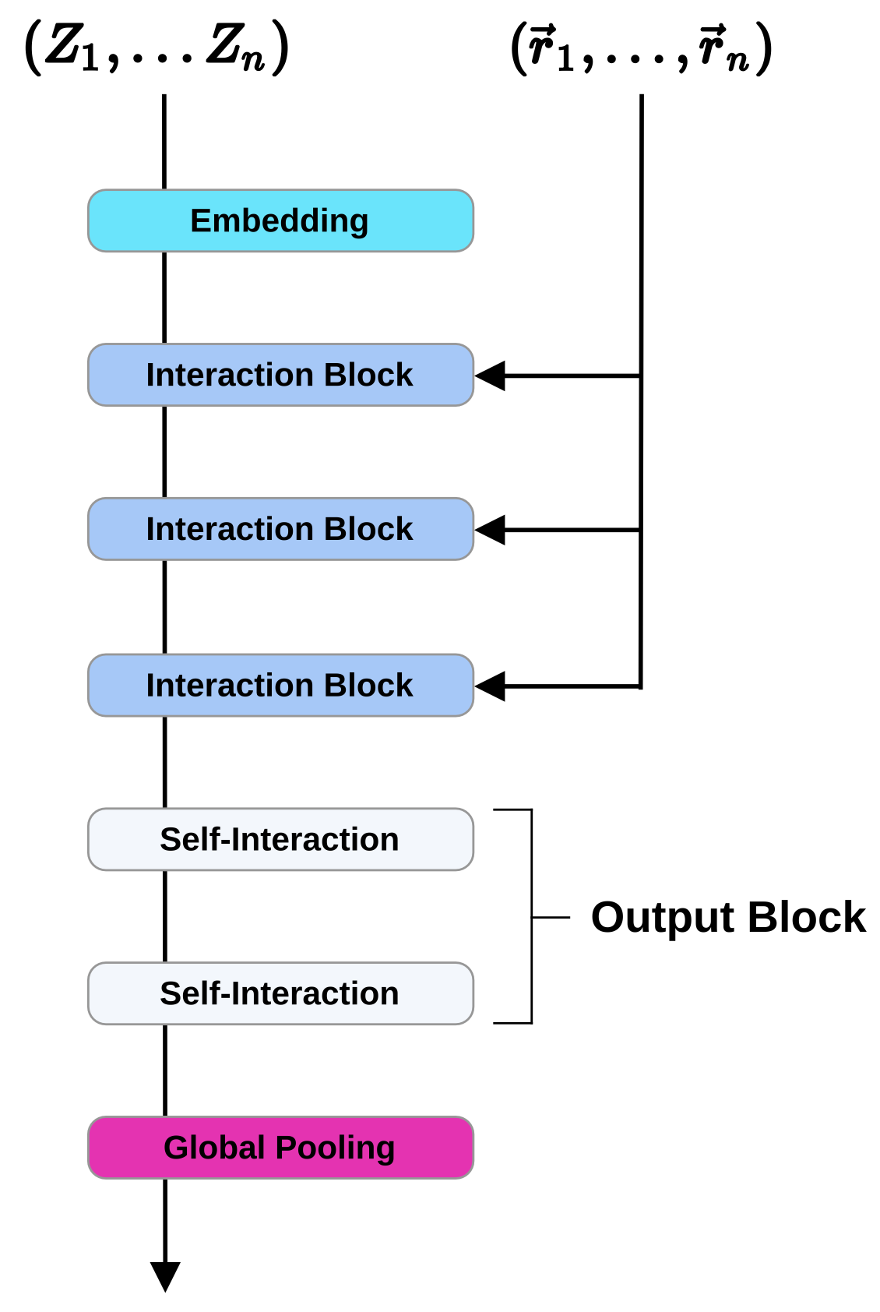

Slide 3
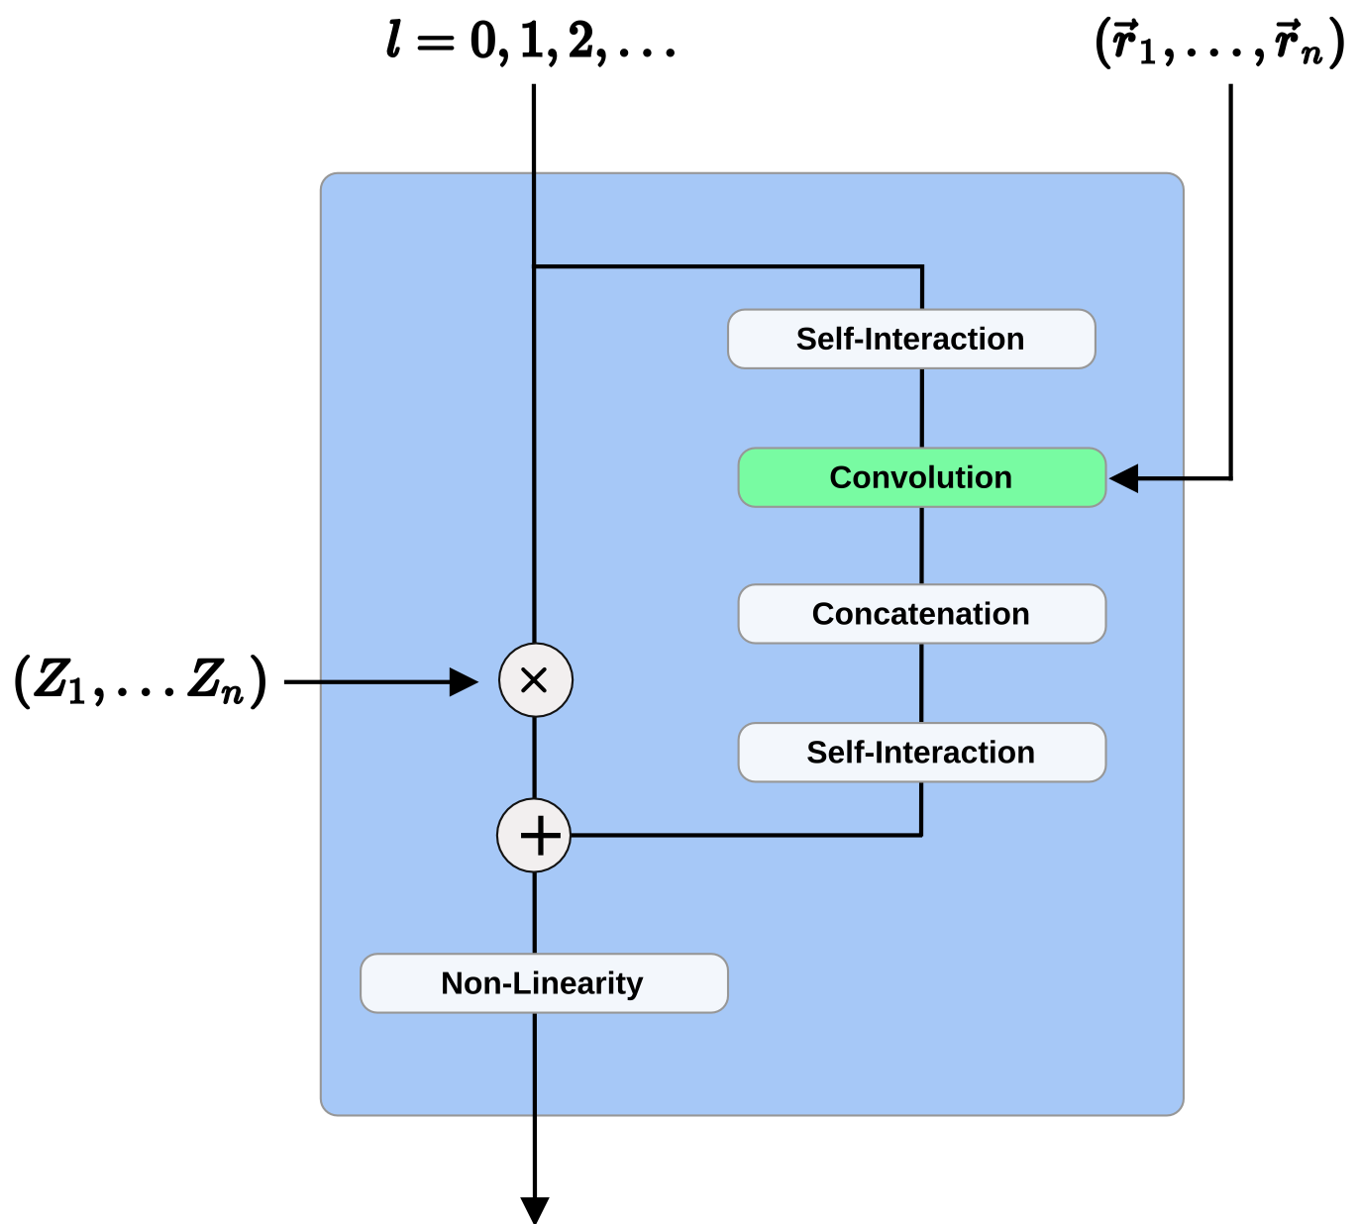
Convolutional Layer
InteractionBlock

Slide 4
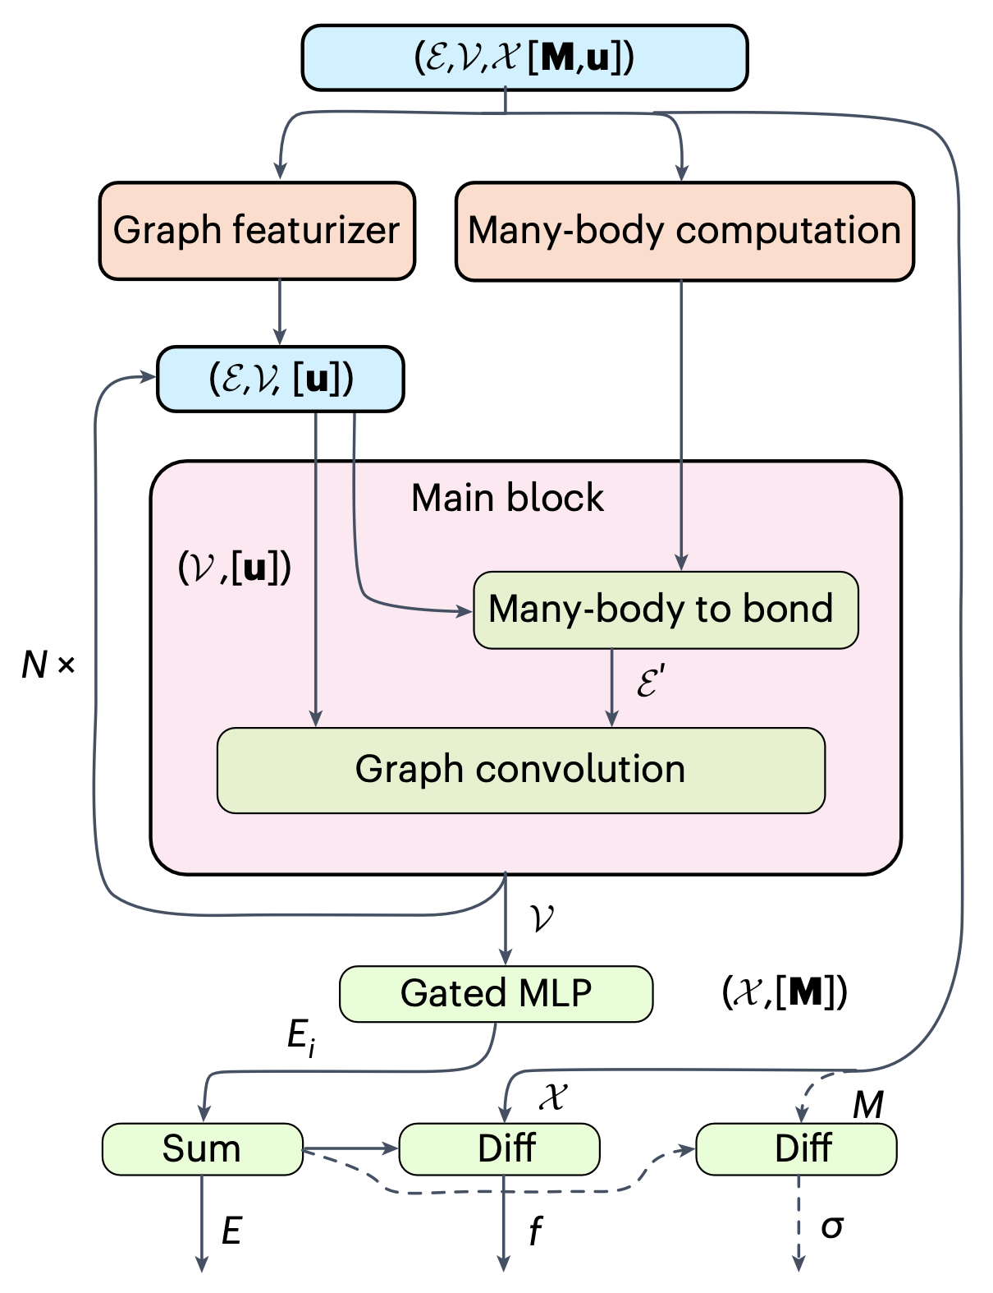

Slide 5
