Slide 1
KDD CUP 2015

Slide 2
Problem
The competition participants need to predict whether a user will drop a course within next 10 days based on his or her prior activities.
If a user leaves no records for course in the log during the next 10 days, we define it as dropout from course.

Slide 3
User Logs
problem – Interaction with the course’s quiz;
video - Interaction with the course’s video;
access – Interaction with other course objects (rather than videos or quizzes);
wiki – Interaction with the course wiki;
discussion – Interaction with the course forum.
navigate - Navigation through the course;
page_close – Leaving the course’s web page.

Slide 4
Data Statistics
Start Time: 2013-10-27
End Time: 2014-08-01
Duration: 10 months

Slide 5
Data Statistics

Slide 6
Data Statistics

Slide 7
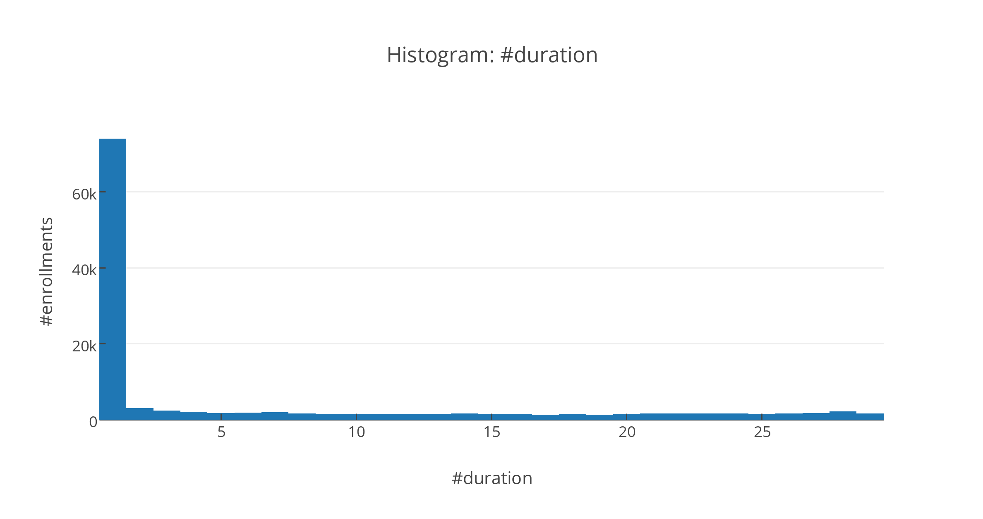
Data Statistics

Slide 8

2013-10-27
2014-08-01

Slide 9
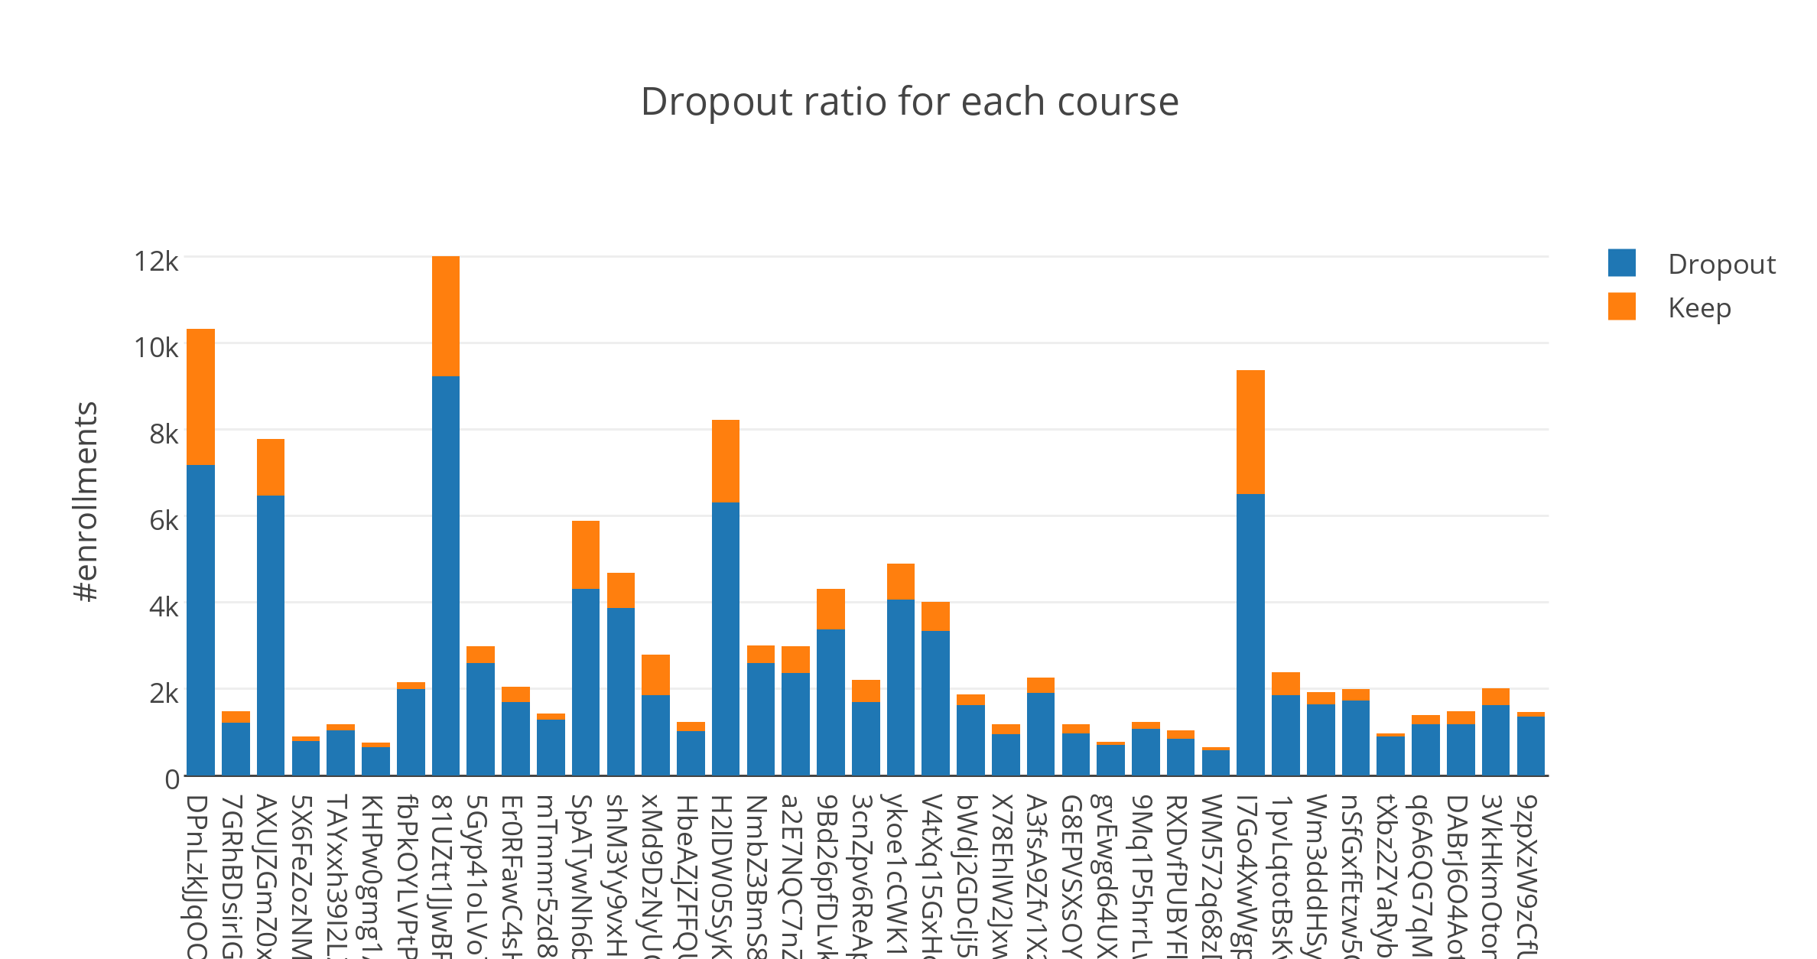
Dropout vs Keep per Course

Slide 10
Features #1: summary features
Duration (days) of enrolment: from the start of the first event to the last one
Number of (cumulated) events of enrolment: the count of event observed in the log
Number of videos: the count of observed video event in the log
Number of problem: the count of observed problem event in the log
Number of wiki: the count of observed wiki event in the log
Number of navigate: the count of observed navigate event in the log
Number of access: the count of observed access event in the log
Number of discussion: the count of observed discussion event in the log
Number of page_close: the count of the page_close event in the log

Slide 11
Features #1
Active days of enrolment: the total number of days that the user access the course
Active days per week: the average active days every week
For the last 3 months from 05-13-2014 - End (12 week)
Active days in week [1-12]: the active days in the #-th week

Slide 12
Features #2: sessions
Number sessions: the number of sessions included in the enrolment logs
The time gap between sessions is 30 minutes
Avg requests per session: #video, #problem, #access, #navigate, #discussion
Avg video per session
Avg problem per session
Avg access per session
Avg navigate per session
Avg discussion per session

Slide 13
Features #3: behaviour time-pattern
Daytime vs Nighttime
Daytime: 07:00 - 19:00
Nighttime: others
Weekday vs Weekend

Slide 14
Features #4: temporal features
Summary features in last {1, 2} week
Session features in last {1, 2} week
The number request happens in time slots:
0am-6am
6am-9am
8am-12am
12am-18pm
17pm-20pm
19pm-24pm
The count/mean/variance hour of requests

Slide 15
Features #5: lagging
Lag: the time gap (in unit day) between active days
Min/Max/Mean/Std lags
Number of lags > 3 days
Number of lags > 1 week
Number of lags > 2 weeks

Slide 16
Features #6: module level features
The lag (in unit of day) between the release time of the accessed module and the access date
The median days of the lags for 1st/last access
The 25% and 75% percentage days of lags for 1st/last access

Slide 17
Features #7: stay time
The stay time for every active days
max/min/mean/variance stay time

Slide 18
Models
Logistic Regression
Gradient Boosting Tree (xgboost)
Random Forest
Deep learning

Slide 19
Improvement Directions
The correlations between users who enrol the same course
similarities between users
the preference regarding to the courses’ module
Feature selections/normalise/scaling
t-SNE dimension reduction (would benefit the logistic regression/neural network classifier)
Different perspective of this problem
ranking/recommendation problem
pair-wise (positive vs negative enrolment) model (address the imbalance problem)

Slide 20
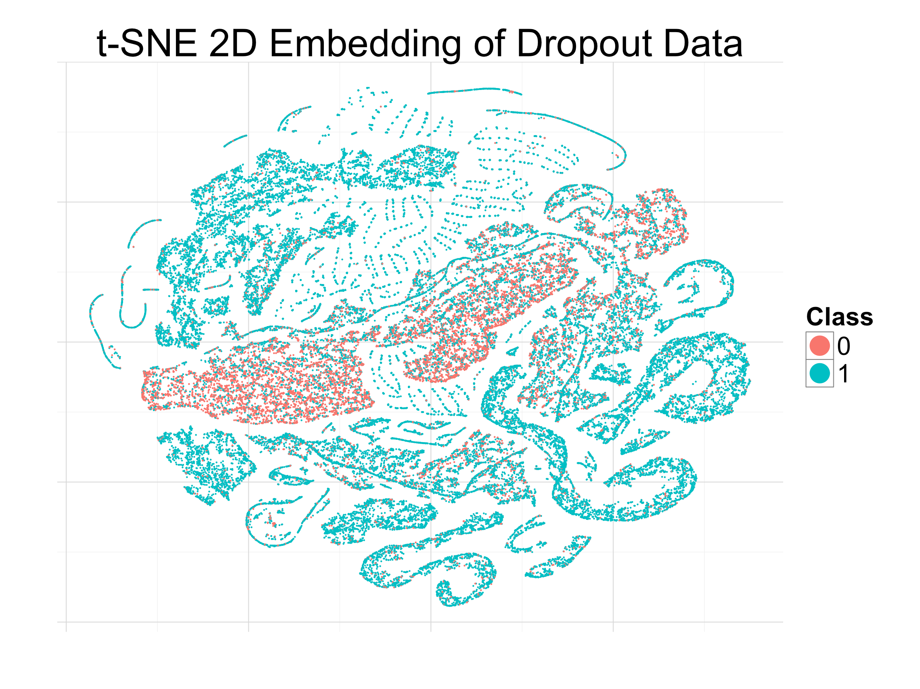

Slide 21
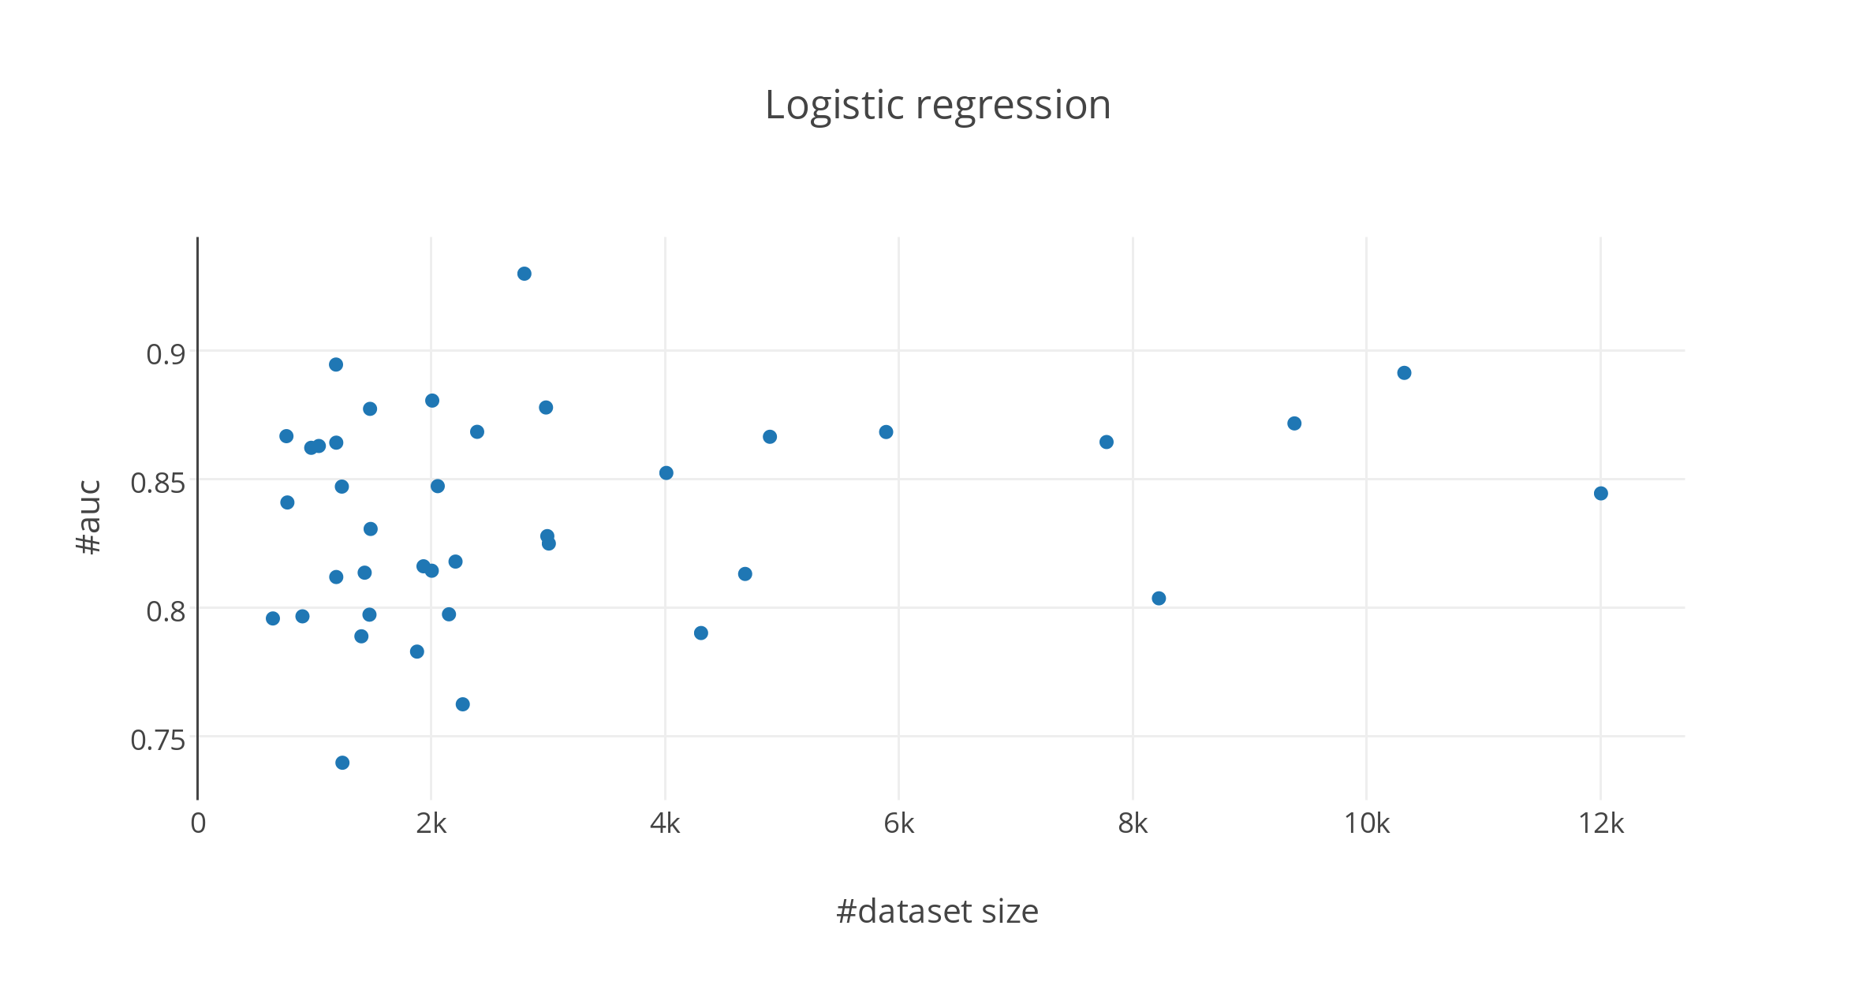
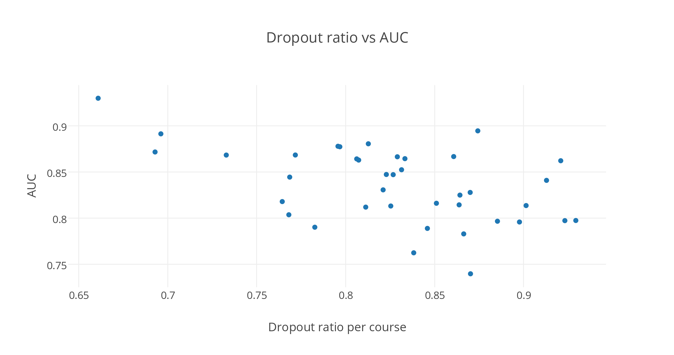
Course-independent Model

Slide 22
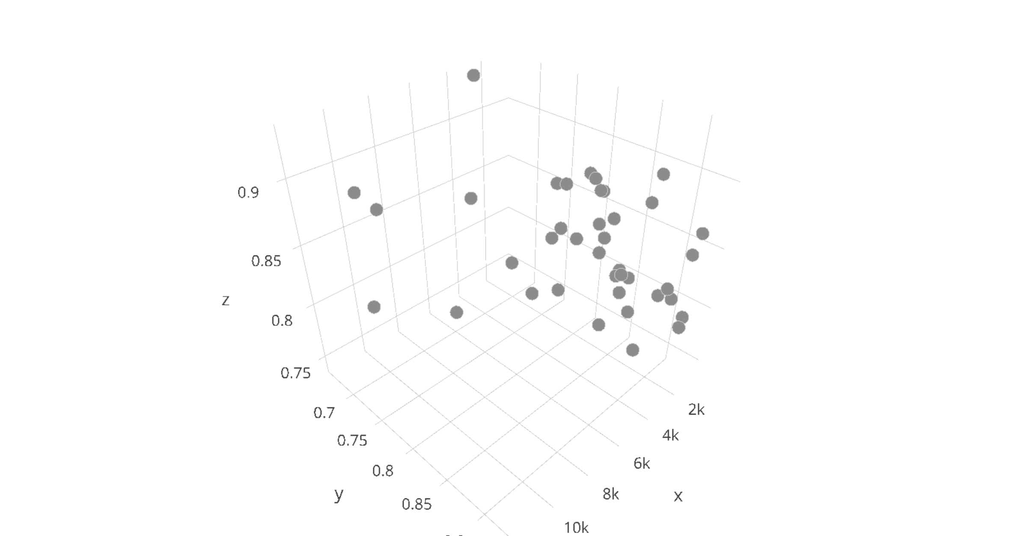
https://plot.ly/~numb3r3/181

