Slide 1
KDD CUP 2015

Slide 2
Problem
The competition participants need to predict whether a user will drop a course within next 10 days based on his or her prior activities.
If a user leaves no records for course in the log during the next 10 days, we define it as dropout from course.

Slide 3
User Logs
problem – Interaction with the course’s quiz;
video - Interaction with the course’s video;
access – Interaction with other course objects (rather than videos or quizzes);
wiki – Interaction with the course wiki;
discussion – Interaction with the course forum.
navigate - Navigation through the course;
page_close – Leaving the course’s web page.

Slide 4
Data Statistics
Start Time: 2013-10-27
End Time: 2014-08-01
Duration: 10 months

Slide 5
Data Statistics

Slide 6
Data Statistics

Slide 7
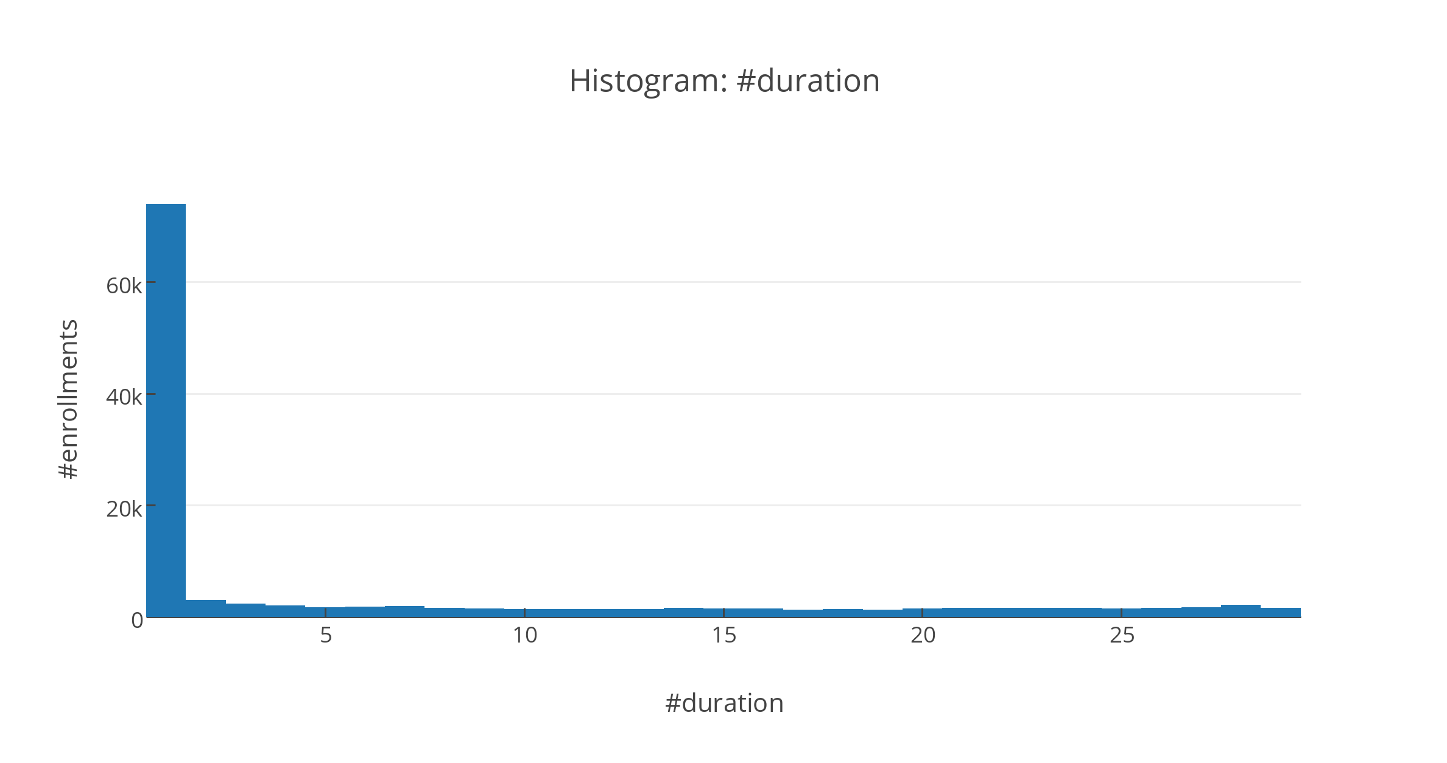
Data Statistics

Slide 8

2013-10-27
2014-08-01

Slide 9
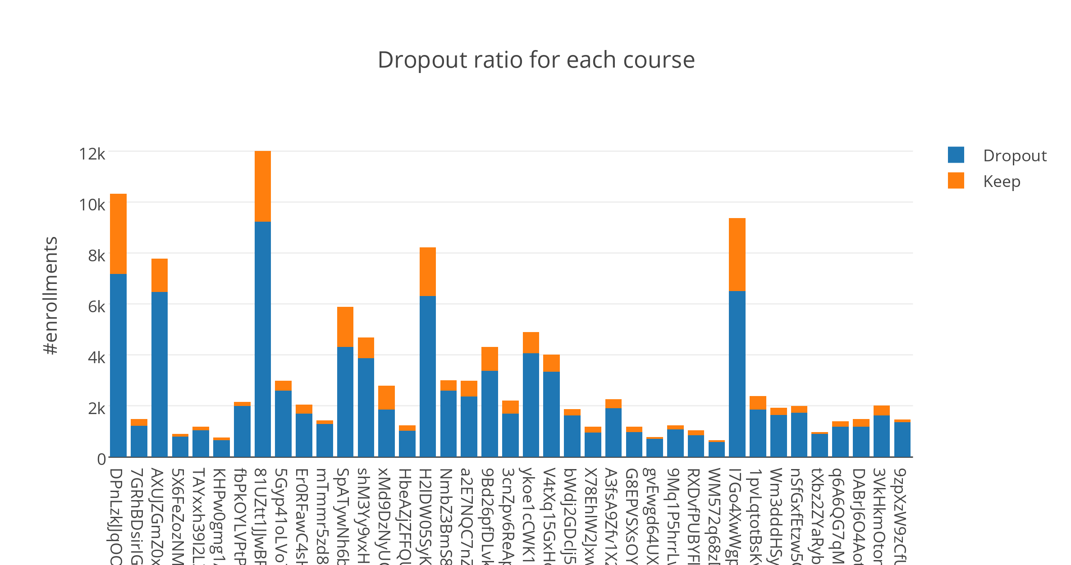
Dropout vs Keep per Course

Slide 10
Models
Logistic Regression
Gradient Boosting Tree (xboost)
Deep learning (TODO)

Slide 11
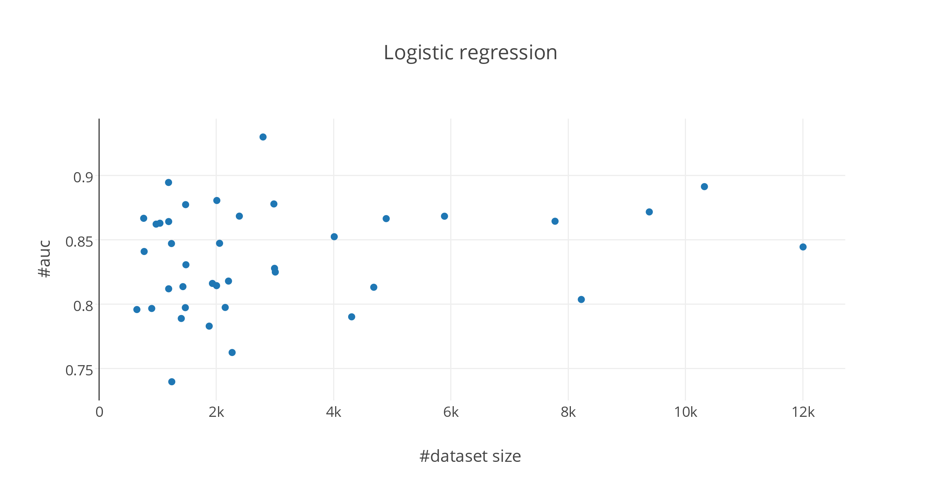
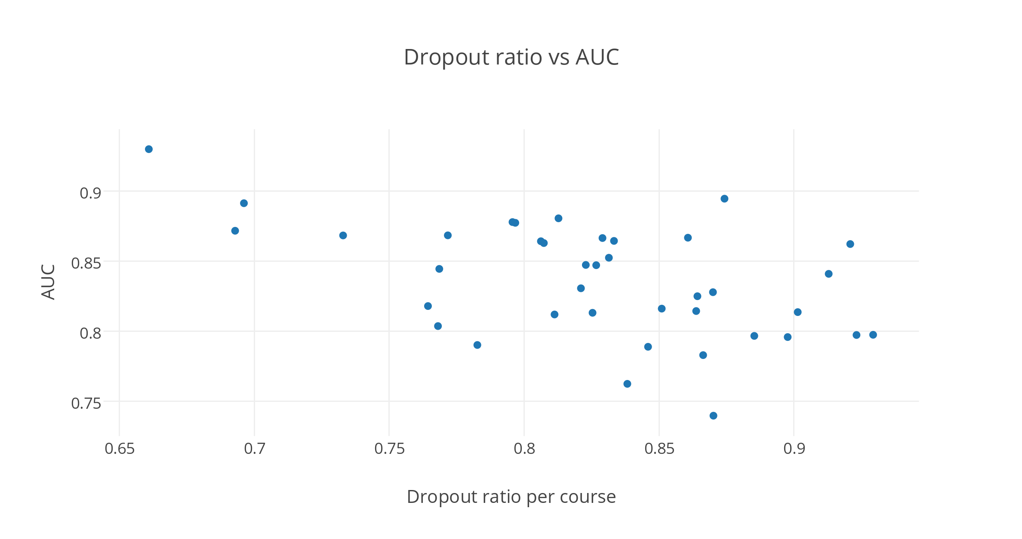
Course-independent Model

Slide 12
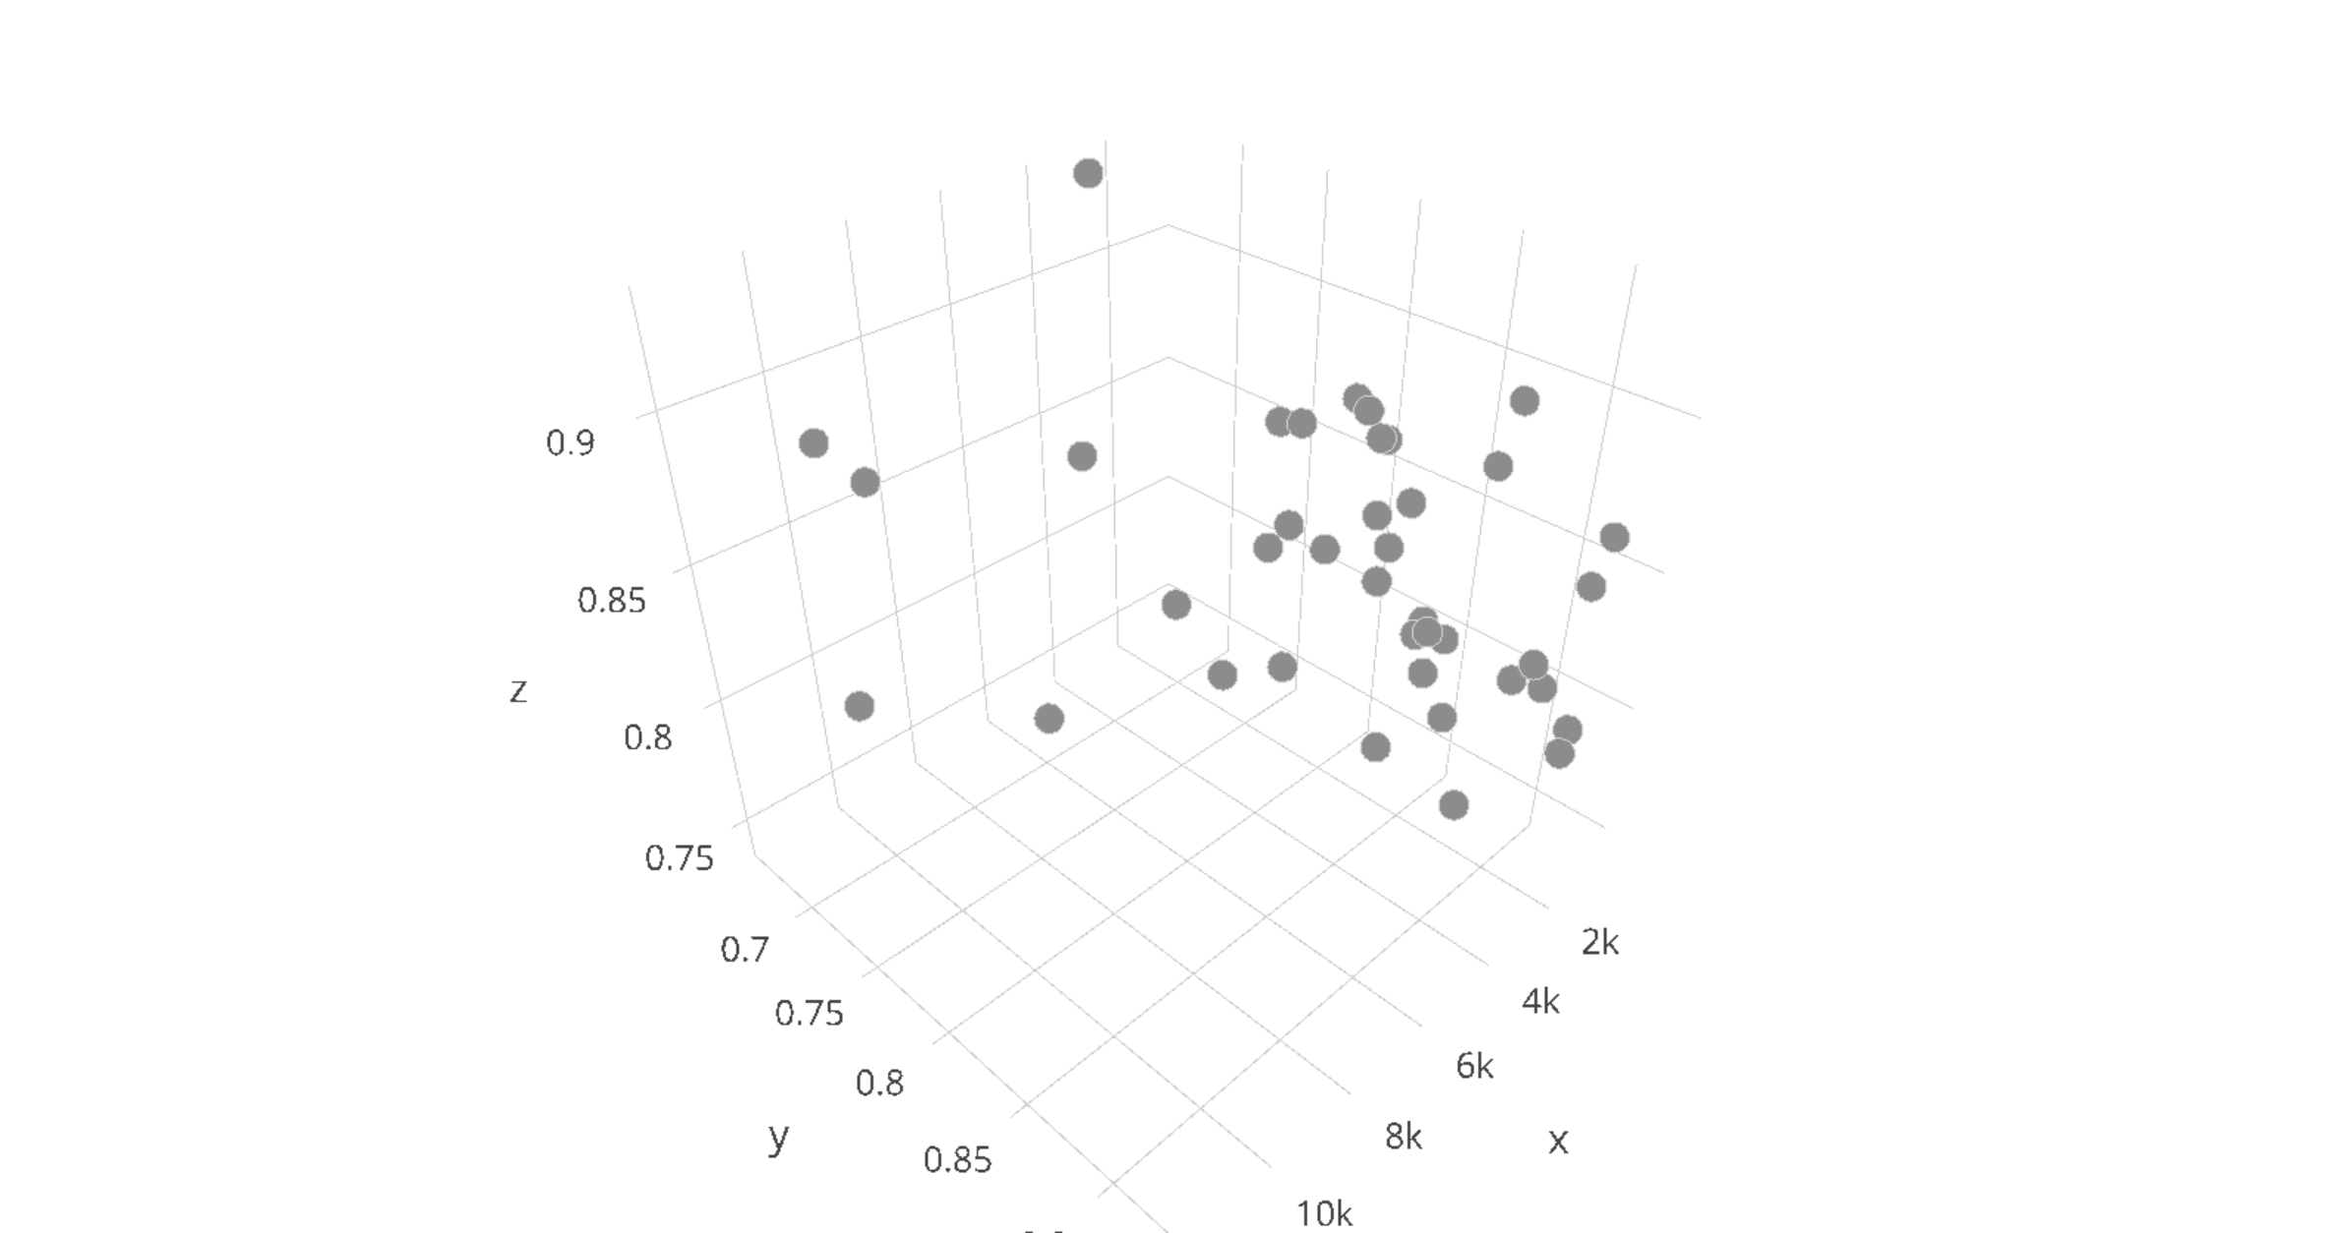
https://plot.ly/~numb3r3/181

