Slide 1
Landmark Detection for Cephalometric X-Ray Images
Ray Zhang, Nik Sun, William Pan
Professor: Vicente Ordóñez-Román
Department of Computer Science, Rice University

Slide 2
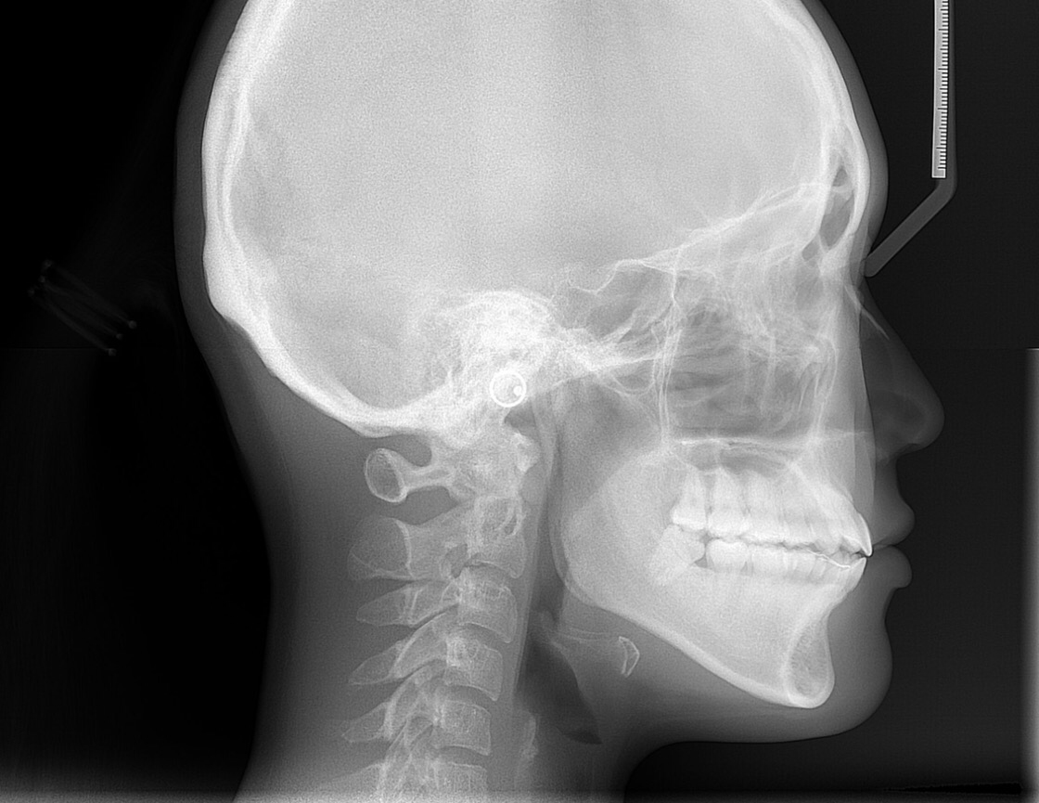
What is Cephalometric
Cephalometric analysis is a diagnostic tool used in dentistry and orthodontics to assess the relationships between the bones, teeth, and soft tissues of the face and jaws. It involves taking measurements and analyzing X-ray images of the head and neck, which can help dentists and orthodontists diagnose and treat malocclusions (improper bites) and other dental and facial irregularities. Cephalometric analysis can provide information on the position, size, and shape of the teeth, jaws, and other facial structures, which can be used to plan and monitor orthodontic treatment.

Slide 3
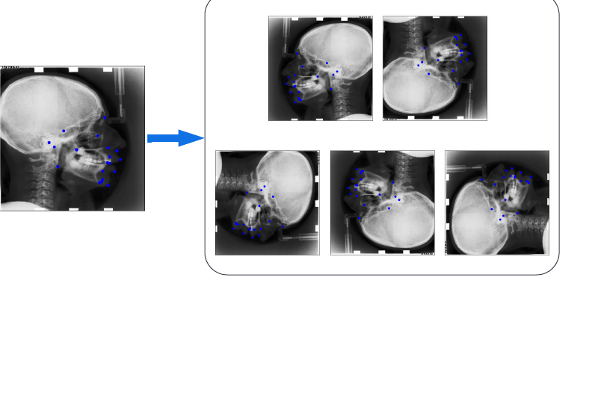
Dataset
The dataset comes form 2015 International Symposium on Biomedical Imaging (ISBI) Grand Challenge and comprises
150 training image
150 validation image
100 testing image
We preprocessed the data as follows:
Resize all image to 224x224
Apply five augmentation to the training set: horizontal and vertical flips, 3 different rotations

Slide 4
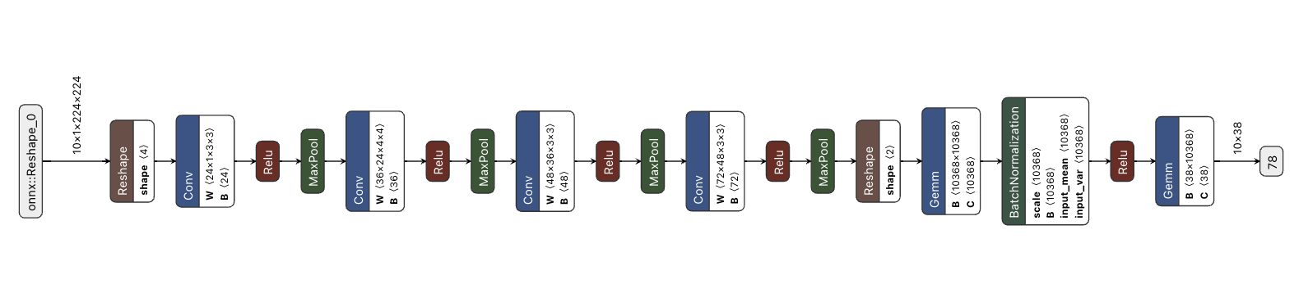
Model - CNN and a deeper CNN variant
3-4 stacks of convolutional, ReLU, and pooling layers followed by fully connected layers

Slide 5
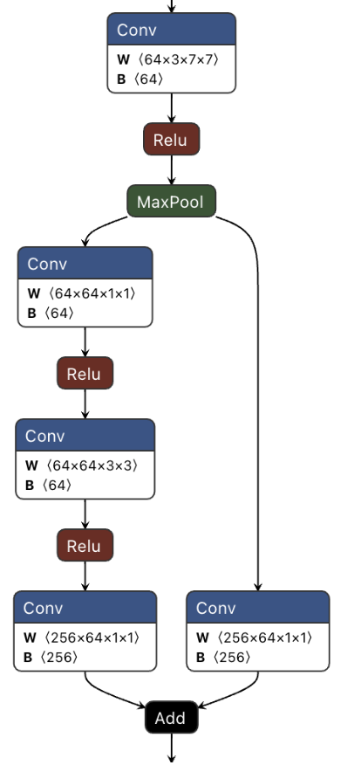
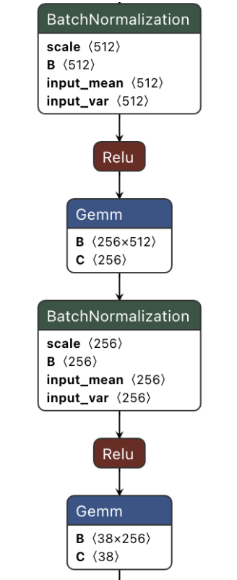
Model - ResNet50
ResNet Architecture:
50 layers, including convolutional, batch normalization, ReLU, and fully connected layers
cannot take an input channel equal to 1 for grayscale images, we prepare a separate dataloader for this model and set the channel to be 3

Slide 6
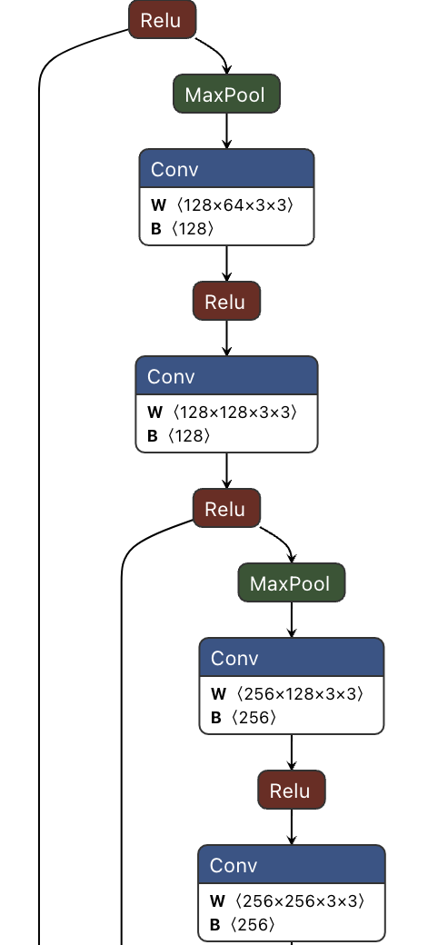
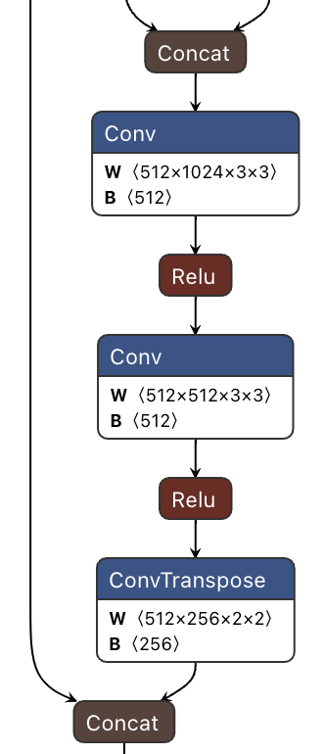
Model - U-Net
Encoder:
4 sets of double convolution blocks
ReLU activation
Max Pooling
Decoder:
4 sets of up-convolution blocks
ReLU activation
Adaptive Average Pooling (Global)
Skip Connections:
help the network better localize and preserve high-resolution features
Input: 1 or 3 channel image
Output: 38 coordinates (19*2)

Slide 7
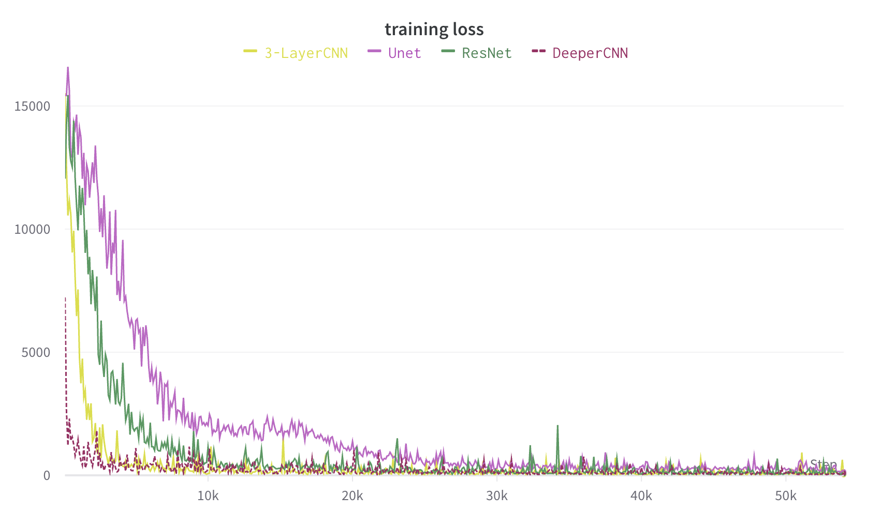
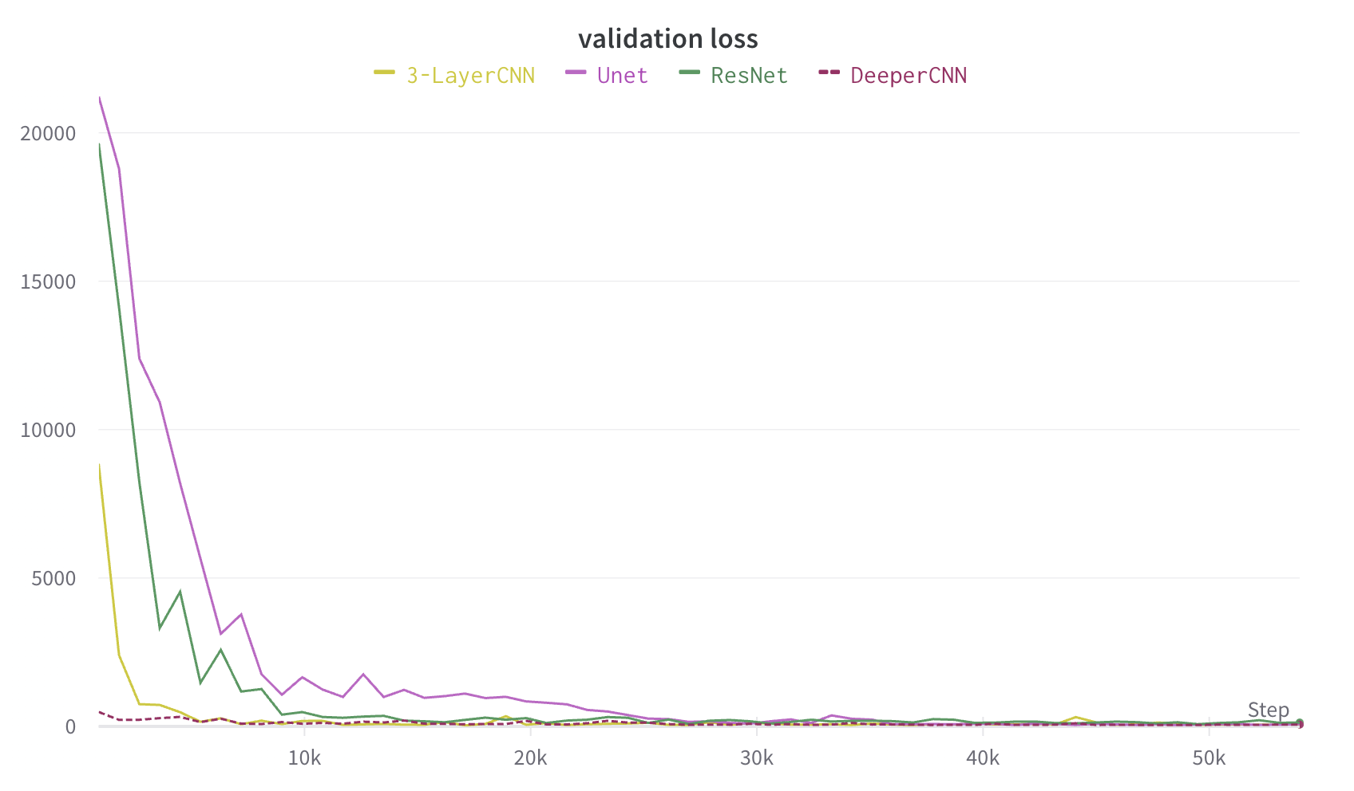
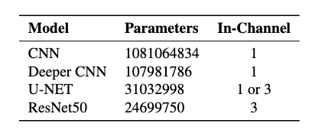
Model Performance
Hyperparameters: batch_size =10, learning_rate = 1e-3,
SGD/Adam optimizer, MSE loss
U-NET converges slower; CNN and Deeper CNN start with lower loss
The evaluation results of our models can be found at https://wandb.ai/646_project/646_project?workspace=user-zp15

Slide 8
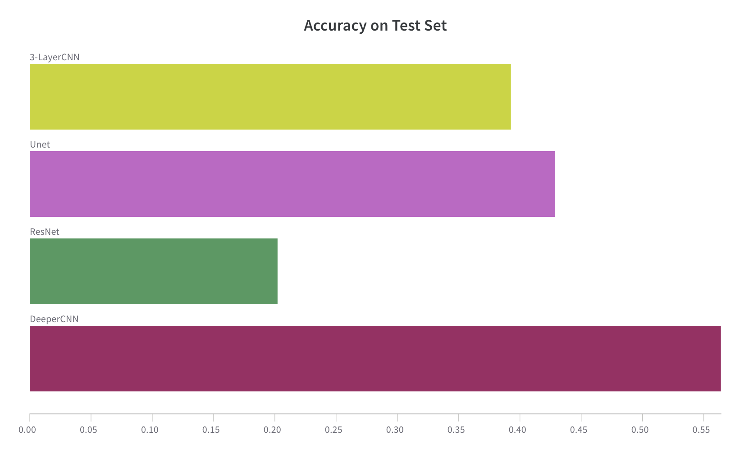
Model Performance
Evaluate the performance of models based on their prediction accuracy on the testing set:
Simple CNN model with more layers has the best performance
ResNet50: whether include pre-trained model does not improve
Accuracy: threshold = 10
The evaluation results of our models can be found at https://wandb.ai/646_project/646_project?workspace=user-zp15

Slide 9
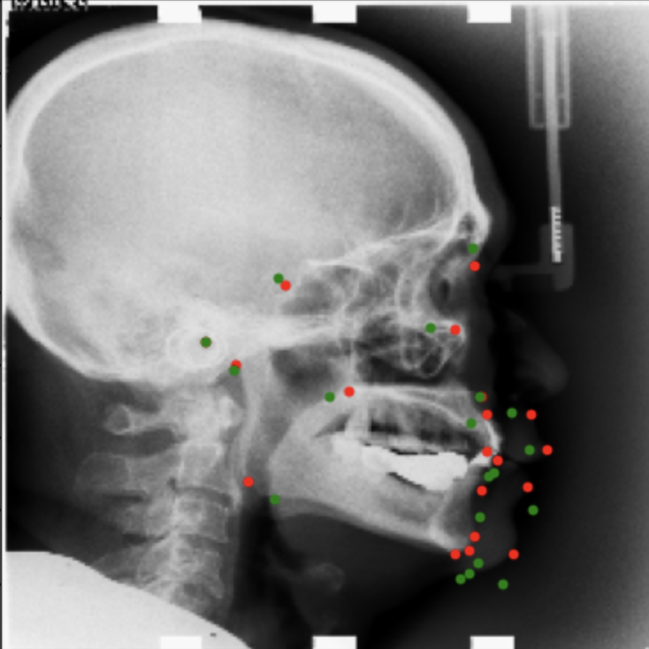
Sample Prediction
Red: ground truth landmarks
Green: predicted points using U-Net model

