Slide 1





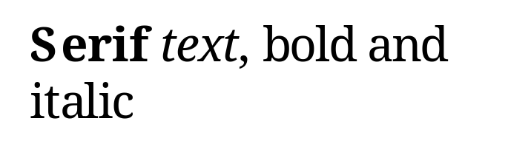
EMF exported by PowerPoint

Slide 2





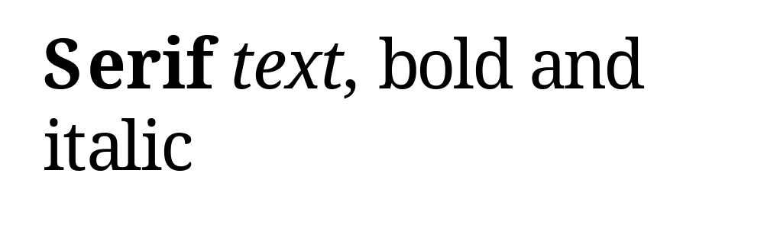
WMF exported by PowerPoint

Slide 3
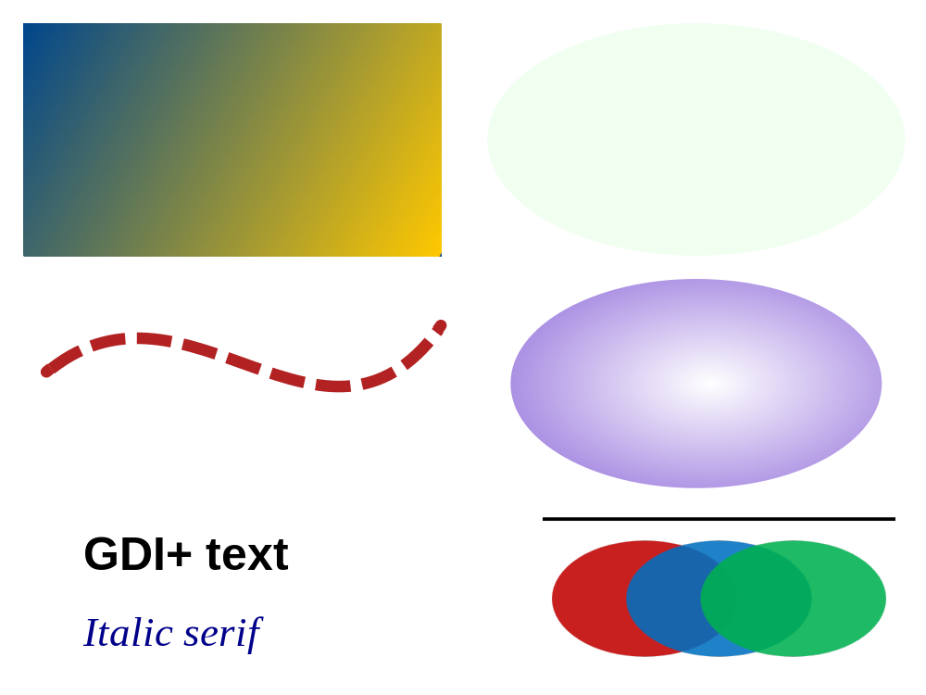
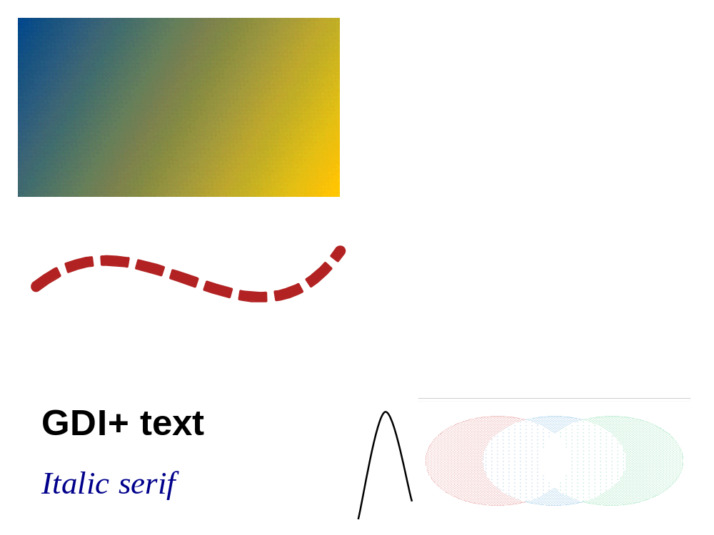
Recorded with GDI+: dual and GDI only

