Slide 1






$$x=\frac{−b±\sqrt{b^{2}−4ac}}{2a}$$
$$\sum_{i=1}^{n}{i}=\frac{n\left(n+1\right)}{2}$$
$$\int_{0}^{∞}{e^{−x^{2}}dx}=\frac{\sqrt{π}}{2}$$
$$A=\left[\begin{matrix}a & b \\ c & d\end{matrix}\right]$$
$$\lim_{x→0}{\frac{\sin{x}}{x}}=1$$
$$\overline{x}=\left(\frac{1}{n}\sum_{k=1}^{n}{x_{k}}\right),\vec{v}={\left(a+b\right)}^{n}$$
Energy $E=mc^{2}$ is mass times the speed of light squared.

Slide 2




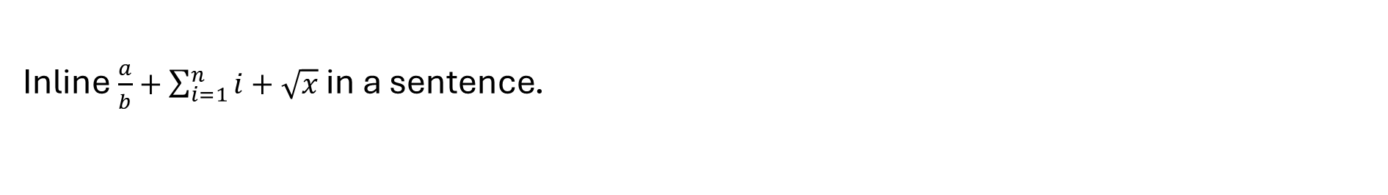

$$\frac{1}{1+\frac{1}{x}}=a/b+c/d$$
$$\sqrt[3]{x+1}+x_{i}^{2}−{}_{n}^{k}C$$
$$\prod_{i=1}^{n}{a_{i}}=\oint_{C}{fdz}+\iint{gdA}$$
$$\left(a | b\right)+\left\{x\right\}+\left\langle ψ\right\rangle +\left|x\right|+\left\lfloor y\right\rfloor$$
$$M=\left(\begin{matrix}1 & 0 & 0 \\ 0 & 1 & 0 \\ 0 & 0 & 1\end{matrix}\right)$$
$$\begin{aligned}x+y=2 \\ x−y=0\end{aligned}$$
$$\hat{a}+\tilde{b}+\dot{c}+\vec{AB}+\underset{n}{\underbrace{x+y+z}}+\underline{w}$$
$$\overset{t}{max}\cos{θ}+\log{n}=\boxed{E=mc^{2}}+k$$
Inline $\frac{a}{b}+\sum_{i=1}^{n}{i}+\sqrt{x}$ in a sentence.

Slide 3












$$1/2+{x^{2}}/y+{\frac{a}{b}}/c$$
$$\int{x}+\int_{0}^{1}{x}$$
$$\sum_{i=1}^{n}{x}+\sum{x}$$
$$\int_{0}{x}+y$$
$$\hat{x}+\tilde{y}+\overline{x}+\check{x}$$
$$\vec{x}+\breve{x}+\ddot{y}+\overline{ab}$$
$$\left(a | \frac{1}{2} | c\right)$$
$$\boxed{x}+\boxed{\frac{a}{b}}$$
$$\overbrace{a+b+c+d}+e$$
$$\frac{1}{1+\frac{1}{1+\frac{1}{x}}}$$
$$\lim_{n→∞}{x}+\sin{x}$$
$$x^{\frac{a}{b}}+y_{\frac{1}{2}}$$
Inline $\int_{0}^{1}{xdx}+\frac{a}{b}+x^{\frac{a}{b}}$ in a sentence.

Slide 4

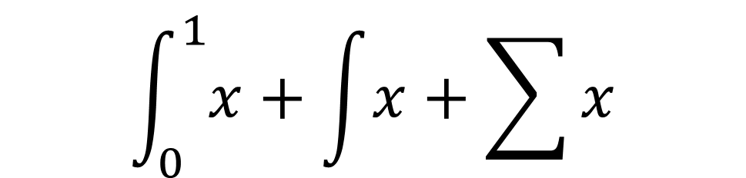


$$\int_{0}^{1}{x}+\int{x}+\sum{x}$$
$$\sum_{i=1}^{n}{x}+\left(\frac{1}{2}\right)$$
$$x_{i=1}+y^{a+b}$$
$$abcdefgh$$
Text $\int_{0}^{1}{x}+\sum_{i=1}^{n}{x}$ end

Slide 5


$$\begin{aligned}x&=1 \\ x+y&=12\end{aligned}$$
$$\begin{aligned}x&=1&y&=2 \\ a+b&=3&c&=45\end{aligned}$$
$$ℝℕ+ℒ+𝔤+x+y$$
$$α+Γ+Γ+Γ+x$$

