Slide 1
Radar and filled radar

Slide 2
Stock charts

Slide 3
Contour

Slide 4
Trendline and error bars

Slide 5
Data table and bubbles

Slide 6
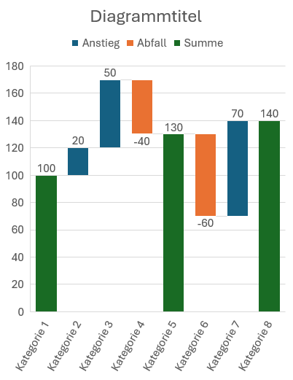
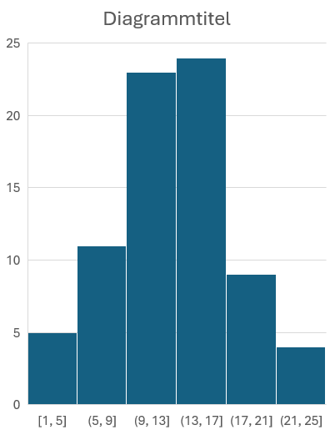
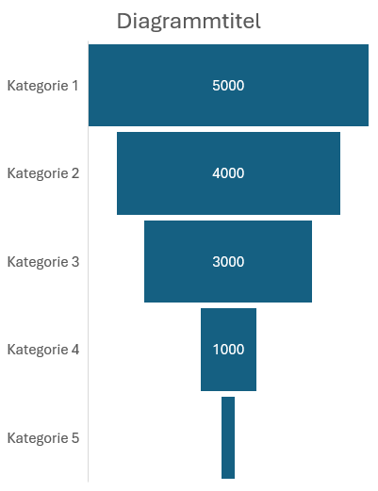
Waterfall, funnel and histogram

Slide 7
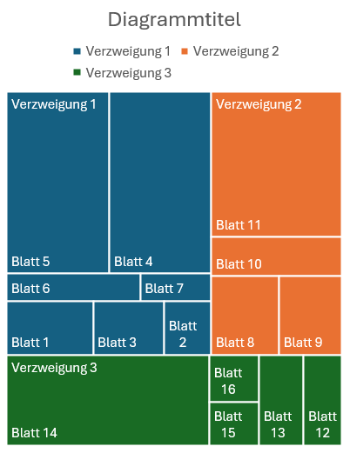
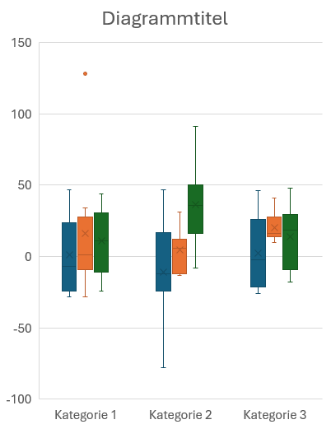
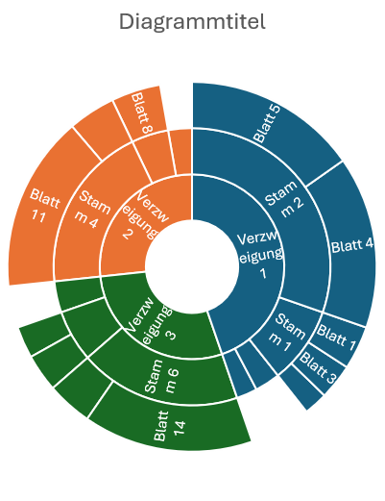
Treemap, sunburst and box and whisker

Slide 8
Shapes on a chart

