Slide 1
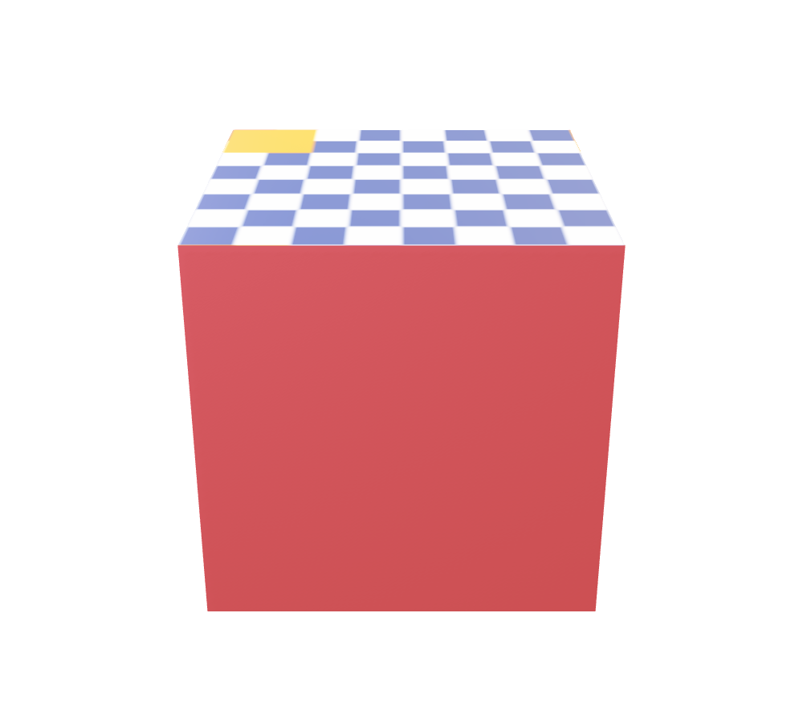
Turntable: node rotation, materials, texture

Slide 2
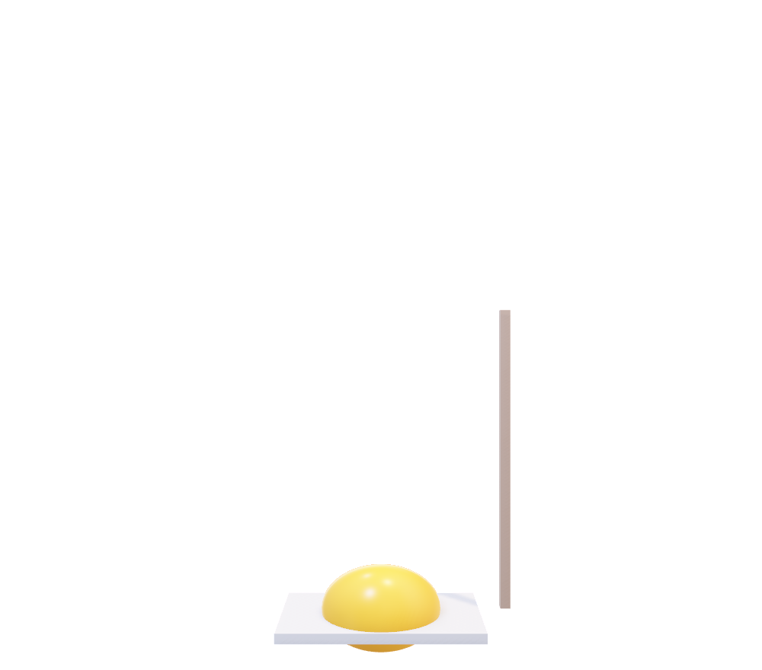
Bounce: cubic spline translation, scale

Slide 3

Arm: skin

Slide 4
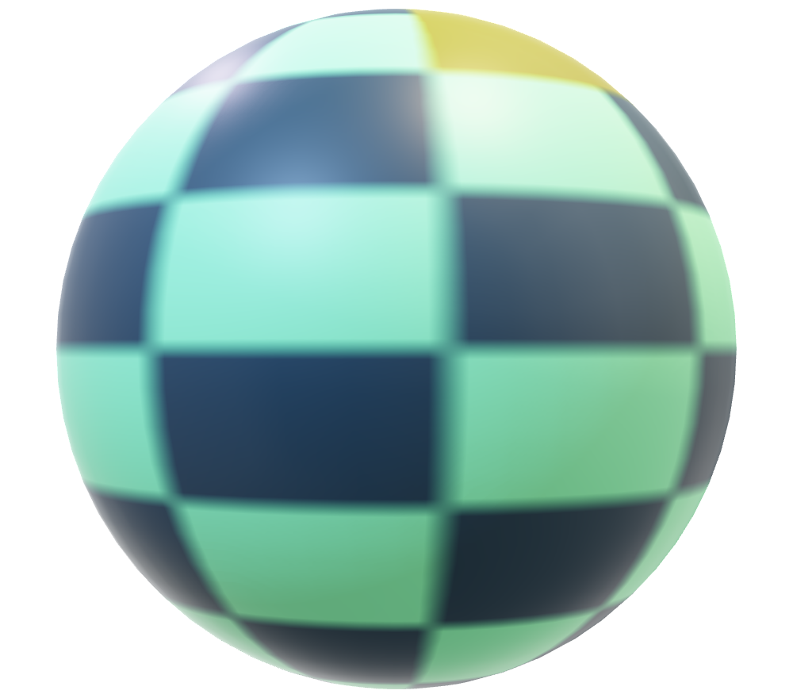
Blob: morph targets

Slide 5
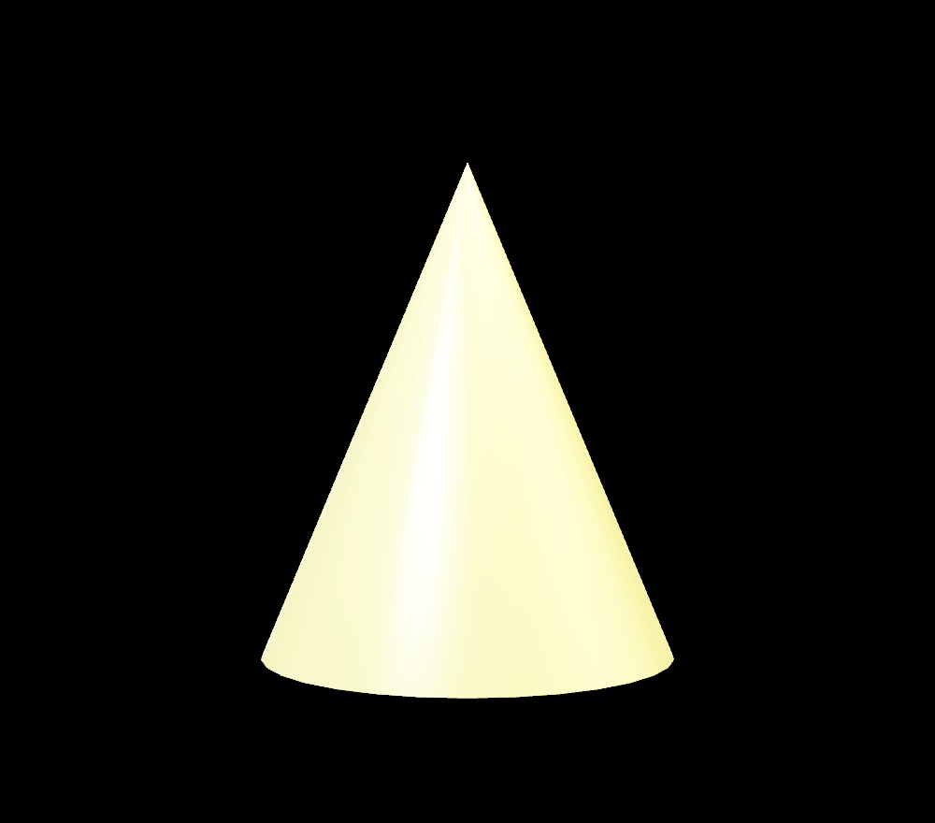
Scenes: the second animation

