Slide 1
Agenda
Trust negotiation frameworks
  Introduction
  TrustBuilder
  Trust-X
Laboratory assignment #2
  IPSec review
  IPSec connections and configuration requirements
  Assignment description

Slide 2
Trust Negotiation Frameworks
Introduction

Slide 3
Trust Establishment
Trust establishment between strangers in open system.
  The client and server are not in the same security domain.
  Access control decision is attribute based instead of identity based.
    Examples: citizenship, clearance, job classification, group memberships, licenses, etc.
    The client’s role within his home organization.
Trust Management – coined by Matt Blaze

Slide 4
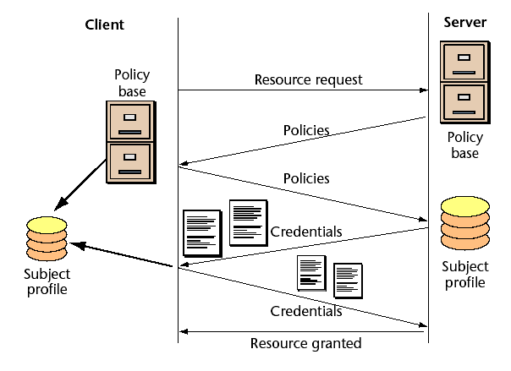
Trust negotiation

Slide 5
Trust Negotiation
TN=“Approach to access control and authentication that enables resource requesters and providers in open systems to establish trust based on attributes other than identity.”*
Goals
  Establish trust
  Maintain privacy of attributes
Process
  Iteratively exchange digital credentials between two negotiating participants.
  Begin by exchanging less sensitive credentials
  Build trust gradually in order to exchange more sensitive credentials
* Adaptive Trust Negotiation and Access Control, Tatyana Ryutov, et.al.

Slide 6

Example/Scenario
Electronic business transactions
Parties in transaction don’t know each other
Attacks can be launched to the transaction (negotiation) infrastructure
Trust is required for transaction
  For buyers:
    Trust that sellers will provide services
    No disclosure of private buyer info
  For Sellers:
    Trust that buyers will pay for services
    Meet conditions for buying certain goods (age)

Slide 7
Example/Scenario
In an electronic business transaction, participants interact beyond their local security domain.
Traditionally, pre-registration required
Without a pre-existing relationship trust must be established
Access control policies to control:
  Granting of resources
  Revealing sensitive user information

Slide 8
Digital Credentials
Digital Credentials
  Are the vehicle for carrying attribute information reliably
  Contain attributes of the credential owner asserted by the issuer
    Issuer is a certification authority
  Must be unforgeable
  Must be verifiable
  Digitally signed using PKI
    X.509 V3 standard for public-key certificate

Slide 9
Credential disclosure
Credential disclosure policy (CDP)
  Conditions under which a party releases resources
  Credentials it contains may be sensitive information and should be treated as protected resources
  The CDP itself could be a protected object

Slide 10
Requirements
Language requirements
  Well-defined semantics
  Monotonicity
  Credential combination (and, or)
  Authentication
    E.g., a subject may have multiple identities/credentials
  Constraints on property values
  Intercredential constraints
    e.g., compare values of different credentials of a subject
  Sensitive policy protection – no inference should be allowed
  Unified formalism and use of interoperable language (XML)

Slide 11
Requirements
System requirement
  Credential ownership (challenge response)
  Credential validity
  Credential chain discovery
  Privacy protection mechanisms
  Support for alternative negotiation strategies
    E.g., maximizing protection or considering first the computation efforts
  Fast negotiation strategies

Slide 12
Some existing systems
Keynote trust management system
Trust Establishment at Haifa Research lab
  Trust Policy Language
TrustBuilder
Unipro
Role-based trust management framework
Trust-X

Slide 13
Adaptive Trust Negotiation and Access Control
Tatyana Ryutov, et.al.

Slide 14

Introduction
Proposed framework: Adaptive Trust Negotiation and Access Control (ATNAC)
  Combination of two systems into an access control architecture for electronic business services
    TrustBuilder: Determines how sensitive information is disclosed
    GAA-API: For adaptive access control

Slide 15
GAA-API : Generic Authorization and Access-control API
Middleware API
Fine-grained access control
Application level intrusion detection and response
Can interact with Intrusion Detection Systems (IDS) to adapt network threat conditions
It does not support trust negotiation

Slide 16
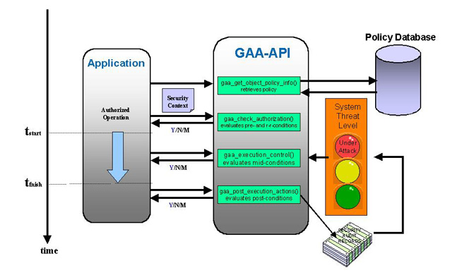
GAA-API

Slide 17
TrustBuilder
Trust negotiation system developed by BYU and UIUC
Vulnerable to DoS attacks.
  Large number of TN sessions sent to server
  Having the server evaluate a very complex policy
  Having the server evaluate invalid or irrelevant credentials
Attacks aimed at collecting sensitive information

Slide 18
ATNAC
Combines an access control and a TN system to avoid the problems that each has on its own.
Supports fine-grained adaptive policies
  Protection based on perceived suspicion level
  Uses feedback from IDS systems
Reduces computational overhead
  Associates less restrictive policies with lower suspicion levels.

Slide 19
ATNAC (2)
GAA-API
  Access control policies for resources, services and operations
  Policies are expressed in EACL format
TrustBuilder
  Enforces sensitive security policies
  Uses X.509v3 digital certificates
  Uses TPL policies
EACL: Enhanced Access Control List
TPL: Trust Policy Language

Slide 20
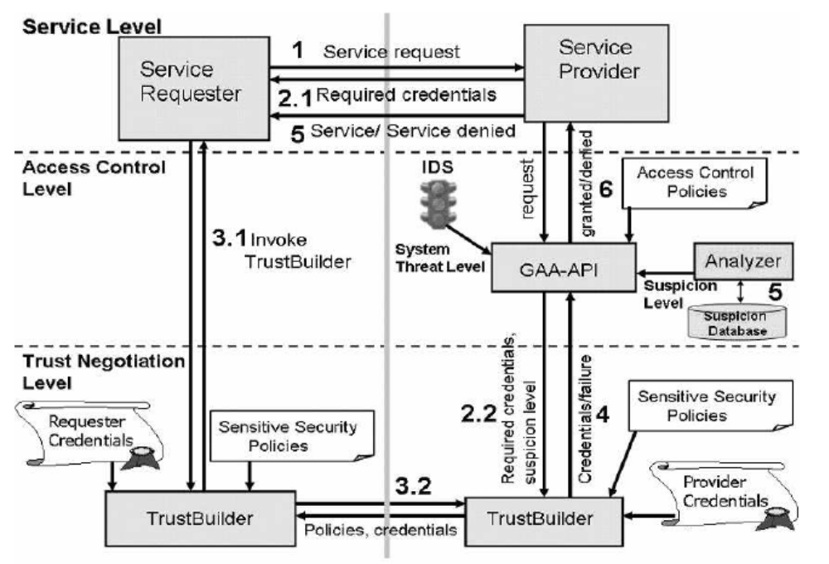
ATNAC Framework
Notes:
In the GAA-API/TrustBuilder integration, a typical session involving trust negotiation proceeds as follows:
The service requester sends a request to the service provider (1). The request is forwarded to the GAA-API. The API first evaluates the access control policies that govern access to the requested service. The policies specify which credentials are necessary to satisfy the request. The set of required credentials depend on the sensitivity of the request, the service or operation, a system threat level, and the suspicion level (SL) for a particular requester.
The GAA-API uses the credentials to evaluate the policy and either grant or deny the request (6). If the required credentials are not available, or the system threat level is high, the API submits the request for required credentials to the client (2.1). At the same time, the Analyzer calculates the suspicion level for the particular requestor/connection. Next, the GAA-API passes the suspicion level and a set of required credentials to TrustBuilder (2.2).
The requester receives a response requiring further proof (2.1), and initiates trust negotiation (3.1) with the TrustBuilder server. The TrustBuilder server and client then engage in a negotiation to obtain the requested client credentials (3.2). During the negotiation, the TrustBuilder server selects credential release policies with the help of the current suspicion level. If the TrustBuilder server's policy is satisfied and all the client's credentials are verified successfully, the negotiation succeeds, and the verified credentials are passed to the GAA-API (4).
Feedback from TrustBuilder is also used to adjust the current suspicion level. The Analyzer checks the session history in order to identify active attacks or potential threats and calculates the suspicion level for each requester. The Analyzer stores this information in the Suspicion Database using the IP address or username as the index key (5). Increasing the suspicion level tightens the access control and sensitive security policies. The updated suspicion level is used by the GAA-API to process future requests from the same requester. The GAA-API uses TN results
(4) to evaluate the access control policy and either grants or denies the requested service (6).

Slide 21

Suspicion Level
Indicates how likely it is that the requester is acting improperly.
A separate SL is maintained for each requester of a service.
Has three components:
  S_{DOS} : Indicates probability of a DoS attack from the requester
  S_{IL} : For sensitive information leakage attempts
  S_{o} : Indicates other suspicious behavior
SL is increased as suspicious events occur and decreased as “positive” events occur.

Slide 22
ATNAC operation
The Analyzer identifies requesters that generate unusually high numbers of similar requests and increment S_{DoS}
In a trust negotiation process, credentials sent by client must match credentials requested by the system otherwise S_{DoS} set to 1.
If either S_{DoS}, S_{IL} or S_{o} > 0.9, the system will block the requester at the firewall
If S_{IL} > threshold. Trust Builder will impose stricter sensitive credential release policies.
As S_{IL} increases, GAA-API uses tighter access control policies
Notes:
Many other counteractions depending on suspicion levels

Slide 23
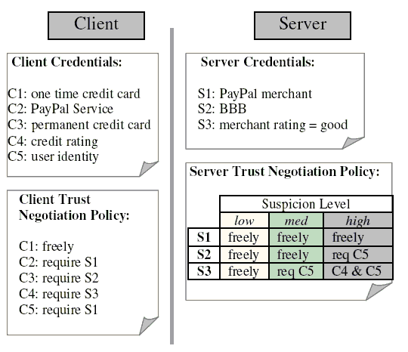
ATNAC operation - example

Slide 24
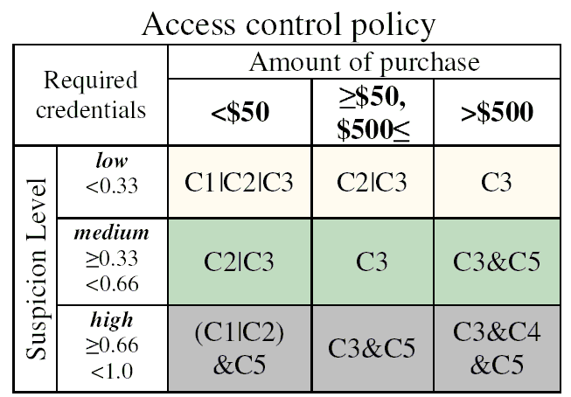
ATNAC operation - example

Slide 25
Summary
ATNAC = framework for protecting sensitive resources in e-commerce
Trust negotiation useful for access control and authentication.
ATNAC dynamically adjusts security policies based on suspicion level
System protects against DoS attacks on the service provider
Guards against sensitive information leaks.

Slide 26
Trust-X: A Peer-to-Peer Framework for Trust Establishment
Elisa Bertino, et.al.

Slide 27
Introduction
Trust establishment via trust negotiation
  Exchange of digital credentials
Credential exchange has to be protected
  Policies for credential disclosure
Claim: Current approaches to trust negotiation don’t provide a comprehensive solution that takes into account all phases of the negotiation process
Notes:
Credentials contain sensitive info
Policies specify which credentials must be received before the requested credential can be revealed

Slide 28


Trust Negotiation model
Resource request
Server
Client
Policy Base
Policy Base
Policies
Policies
Subject Profile
Subject Profile
Credentials
Credentials
Resource granted

Slide 29
Trust-X
XML-based system
Designed for a peer-to-peer environment
  Both parties are equally responsible for negotiation management.
  Either party can act as a requester or a controller of a resource
X-TNL: XML based language for specifying certificates and policies

Slide 30
Trust-X (2)
Certificates: They are of two types
  Credentials: States personal characteristics of its owner and is certified by a CA
  Declarations: collect personal information about its owner that does not need to be certified
Trust tickets (X-TNL)
  Used to speed up negotiations for a resource when access was granted in a previous negotiation
Support for policy pre-conditions
Negotiation conducted in phases

Slide 31
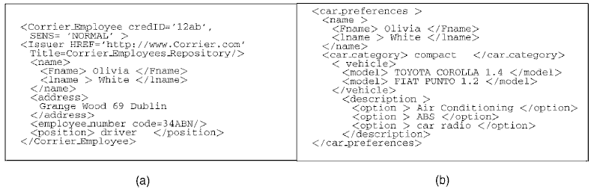
Trust-X (3)
a) Credential b) Declaration

Slide 32

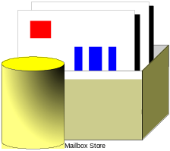


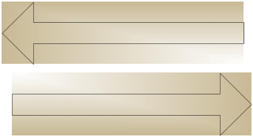



The basic Trust-X system
Alice
Bob
Policy Database
X Profile
Policy Database
X Profile
Compliance
Checker
Compliance
Checker
Tree
Manager
Tree
Manager
Notes:
The system is composed of a
Policy Base, storing disclosure policies,
the X-Profile associated with the party,
a Tree Manager, storing the state of the negotiation, and a
Compliance Checker, to test policy satisfaction and determine request replies.
Client e Server sono dotati di un’architettura per mantenere sotto controllo il processo di negoziazione in Trust-X che è cosi composta:
il Policy DataBase dove risiedono le politiche di rilascio
Un X-Profile che contiene i certificati che ha a disposizione l’entità
Un Tree Manager dove viene memorizzato lo stato della negoziazione
Un Compliance Checker che determina sia la soddisfacibilità delle politiche di rilascio che le richieste verso al controparte attra.
Il compito principale di tali moduli è di supportare la negoziazione tramite lo scambio di politiche e eventualmente di credenziali e risorse sensibili.

Slide 33
Message exchange in a Trust-X negotiation
Alice
Bob
Preliminary
Information
exchange
Request
Service request
INTRODUCTORY
PHASE
Disclosure policies
Bilateral
disclosure
of policies
Disclosure policies
POLICY EXCHANGE
Match disclosure
policies
Credential and/or Declaration
Actual credential
disclosure
Credential and/or Declaration
CREDENTIAL
DISCLOSURE
RESOURCE
DISCLOSURE
Service granted
Notes:
Once a trust sequence has been determined the credential exchange phase is actually executed.
Each time a credential is received, the local compliance checker module checks local policy satisfaction and verifies at runtime the validity and ownership of the remote credentials.

Slide 34
Disclosure Policies
“They state the conditions under which a resource can be released during a negotiation”
Prerequisites – associated to a policy, it’s a set of alternative disclosure policies that must be satisfied before the disclosure of the policy they refer to.

Slide 35
Modeling negotiation: logic formalism
Disclosure policies are expressed in terms of logical expressions which
can specify either simple or composite conditions against certificates.
P() credential type
C set of conditions
P(C)
TERM
Policy expressed as
R←P₁(c), P₂(c)
Resource which
the policy refers to
Requested
certificates
Slide from: http://www.ccs.neu.edu/home/ahchan/wsl/symposium/bertino.ppt
Notes:
Una slide per l’albero

Slide 36
Example
Consider a Rental Car service.
The service is free for the employees of Corrier company.
Moreover, the Company already knows Corrier employees and has a digital copy of their driving licenses. Thus, it only asks the employees for the company badge and a valid copy of the ID card, to double check the ownership of the badge.
By contrast, rental service is available on payment for unknown requesters, who have to submit first a digital copy of their driving license and then a valid credit card.
These requirements can be formalized as follows:

Slide 37
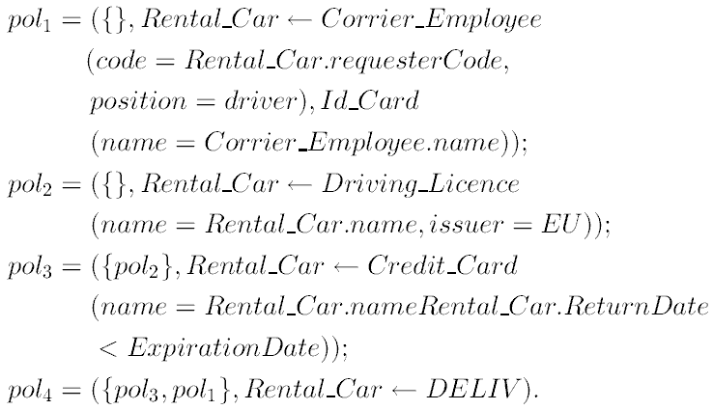
Example (2)
Notes:
Policy pol2 requires the driving license of the requester
and is a precondition to proceed on the rental process.
Intuitively, there is no reason to ask for a credit card if
the requester cannot drive a car. Thus, pol3 can be
disclosed whether policy pol2 specified in its precondition
set is satisfied. The resource is thus deliverable (pol4)
when either policy pol3 or pol1 are satisfied.

Slide 38
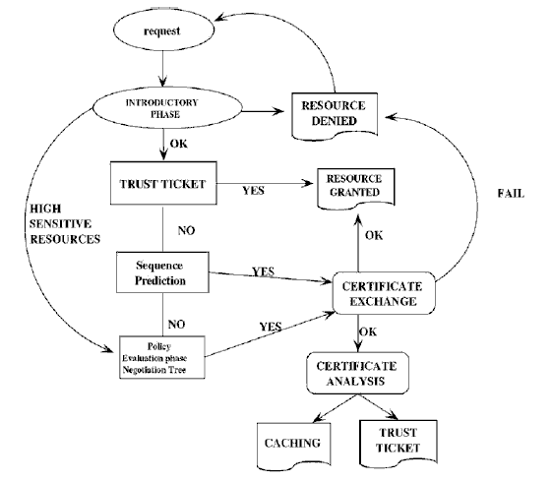
Trust-X negotiation

Slide 39


Slide 40
Security Lab – Assignment #2
Carlos Caicedo
Department of Information Science and Telecommunications
University of Pittsburgh

Slide 41
IPSec
Set of protocols/mechanisms
  Encrypts and authenticates all traffic at the IP level
    Protects all messages sent along a path
    Intermediate host with IPSec mechanism (firewall, gateway) is called a security gateway
  Use on LANs, WANs, public, and private networks
Application independent (Transparent to user)
  Web browsing, telnet, ftp…
Provides at the IP level
  Access control
  Connectionless integrity
  Data origin authentication
  Rejection of replayed packets
  Data confidentiality
  Limited traffic analysis confidentiality

Slide 42

Cases where IPSec can be used
Internet/
Intranet
End-to-end security between two hosts
SG
Internet/
Intranet
SG
End-to-end security between two security gateways

Slide 43
Cases where IPSec can be used (2)
SG
Internet
SG
Intranet
Intranet
End-to-end security between two hosts + two gateways
Internet
SG
Intranet
End-to-end security between two hosts during dial-up

Slide 44
IPSec Protocols
Authentication header (AH) protocol
  Message integrity
  Origin authentication
  Anti-replay services
Encapsulating security payload (ESP) protocol
  Confidentiality
  Message integrity
  Origin authentication
  Anti-replay services
Internet Key Exchange (ISAKMP/IKE)
  Exchanging keys between entities that need to communicate over the Internet
  What authentication methods to use, how long to use the keys, etc.

Slide 45
Security Association (SA)
Unidirectional relationship between peers (a sender and a receiver)
Specifies the security services provided to the traffic carried on the SA
  Security enhancements to a channel along a path
Identified by three parameters:
  IP Destination Address
  Security Protocol Identifier
    Specifies whether AH or ESP is being used
  Security Parameters Index (SPI)
    Specifies the security parameters associated with the SA

Slide 46
Security Association Databases
IPSec needs to know the SAs that exist in order to provide security services
Security Policy Database (SPD)
  IPSec uses SPD to handle messages
  For each IP packet, it decides whether an IPSec service is provided, bypassed, or if the packet is to be discarded
Security Association Database (SAD)
  Keeps track of the sequence number
  AH information (keys, algorithms, lifetimes)
  ESP information (keys, algorithms, lifetimes, etc.)
  Lifetime of the SA
  Protocol mode
  MTU

Slide 47
IPSec Modes
Two modes
  Transport mode
    Encapsulates IP packet data area
    IP Header is not protected
      Protection is provided for the upper layers
      Usually used in host-to-host communications
  Tunnel mode
    Encapsulates entire IP packet in an IPSec envelope
      Helps against traffic analysis
      The original IP packet is untouched in the Internet

Slide 48
Authentication Header (AH)
Next header
  Identifies what protocol header follows
Payload length
  Indicates the number of 32-bit words in the authentication header
Security Parameters Index
  Specifies to the receiver the algorithms, type of keys, and lifetime of the keys used
Sequence number
  Counter that increases with each IP packet sent from the same host to the same destination and SA
Authentication Data
Next Header
Payload length
Security Parameters
Index
Sequence
Number
Authentication Data

Slide 49
Transport Mode AH
Internet/
Intranet
Original IP
Header
TCP
Header
Payload Data
Without IPSec
Original IP
Header
Auth
Header
TCP
Header
Payload Data
Authenticate
IP Payload
Next
Header
Payload
Length
SPI
Seq.
No.
MAC

Slide 50
Tunnel Mode AH
Internet
SG
Intranet
Original IP
Header
TCP
Header
Payload Data
Without IPSec
New IP
Header
Auth
Header
Original IP
Header
TCP
Header
Payload Data
Authenticate
Entire IP Packet
Next
Header
Payload
Length
SPI
Seq.
No.
MAC

Slide 51
ESP – Encapsulating Security Payload
Creates a new header in addition to the IP header
Creates a new trailer
Encrypts the payload data
Authenticates the security association
Prevents replay
Security Parameters
Index (SPI) – 32 bits
Sequence Number
32 bits
Payload Data
Padding/ Next Header
Authentication Data

Slide 52
Details of ESP
Security Parameters Index (SPI)
  Specifies to the receiver the algorithms, type of keys, and lifetime of the keys used
Sequence number
  Counter that increases with each IP packet sent from the same host to the same destination and SA
Payload
  Application data carried in the TCP segment
Padding
  0 to 255 bytes of data to enable encryption algorithms to operate properly
  To mislead sniffers from estimating the amount of data transmitted
Authentication Data
  MAC created over the packet

Slide 53
Transport mode ESP
Original IP
Header
TCP
Header
Payload Data
Without IPSec
Original IP
Header
ESP
Header
TCP
Header
Payload Data
ESP
Trailer
ESP
Auth
Encrypted
Authenticated

Slide 54
Tunnel mode ESP
Original IP
Header
TCP
Header
Payload Data
Without IPSec
New IP
Header
ESP
Header
Original IP
Header
TCP
Header
Payload Data
ESP
Trailer
ESP
Auth
Encrypted
Authenticated

Slide 55
IPSec Connections
Something triggers the connection
If no VPN connection exists:
  IPsec will use ISAKMP/IKE Phase 1 to build a secure management connection.
  Management connection is used so that the two peers can communicate with each other securely and can build secure data connections.
Using the secure management connection, the two IPsec peers will negotiate the security parameters that are used to build the secure data connections (Phase 2)

Slide 56
IPSec Connections
Once the data connections are built, the IPsec devices can use them to share user data securely
Management and data connections have a lifetime associated with them.
  keying information is regenerated to provide for better security

Slide 57
IPSec configuration
Determine the traffic that should be protected
How will the management connection be protected?
  Device authentication method
  Which encryption algorithm and HMAC function should be used?
  Which Diffie-Hellman key group should be used?
  What is the lifetime of the connection?

Slide 58
IPSec configuration (2)
How will the data connections be protected?
  Which security protocol is used: AH and/or ESP?
  For ESP, what encryption algorithm and/or HMAC function is used?
  For AH, what HMAC function is used?
  For AH and ESP, what mode will they operate in: tunnel or transport?
  What are the lifetimes of the data connections?

Slide 59
Protecting the management connection (ISAKMP/IKE Phase 1)
Done through the definition of a transform (also called a policy )
A transform might contain:
  The encryption algorithm to use: DES, 3DES, or AES.
  The HMAC function to use: MD5 or SHA-1.
  The type of device authentication: pre-shared keys, RSA encrypted nonces, or RSA signatures (certificates).
  The Diffie-Hellman key group: Cisco only supports 1, 2, 5, and 7
    Group 1— 768-bit
    Group 2— 1,024-bit
    Group 5— 1,536-bit
  The lifetime of the management connection.

Slide 60
Protecting the data connection (ISAKMP/IKE Phase 2)
Information on the transform
The security protocol: AH and/or ESP
The connection mode for the security protocols: tunnel or transport
For ESP, encryption information: no encryption algorithm, DES, 3DES, AES-128, AES-192, or AES-256
The packet authentication and verification HMAC function: MD5 or SHA-1 (with ESP, this is optional)
Crypto map

Slide 61


Assignment Description
Establish a VPN tunnel using IPSec to protect the traffic flowing between two corporate LANs
LAN 1
Internet
LAN 2

